Slide 1



Study of Strangeness Production in Underlying Event at 7 TeV
Tomas Hreus, Pascal Vanlaer

Slide 2
Overview
V0 correction: refined pT cuts
TrackJet pT-correction
Closure tests: P6D6T, P6Z1, P8 tunes
Systematic from V0 correction
Rates

Slide 3
Event Selection (Recap)
Trigger:
HLT_MinBiasPixel_SingleTrack
BSC
Primary vertex:
single vertex (offlinePrimaryVertices)
valid vertex (not fake, diff from beam spot)
dZ(vtx, beamspot) < 10cm
Number of tracks > 4 (ndof > 4)
Leading Track-jet:
- anti-kt alg. (R = 0.5)
Tracks: - dst to vtx: dz < 0.5cm, dxy < 0.1cm: no V0s
- hits >= 8
- pT > 0.5 GeV
- |eta|<2.5
7 TeV data from 2010:
/MinimumBias/Commissioning10-Jun14thReReco_v1/RECO
Runs: 132440-137436 + JSON file (CMSSW_3_6_3)
MC Samples:
Pythia6-D6T (50M)
/MinBias_TuneD6T_7TeV-pythia6/Summer10-START36_V10_SP10-v1/GEN-SIM-RECODEBUG
Pythia6-Z1 (10M)
/MinBias_TuneZ1_7TeV-pythia6/Summer10-START36_V10_TP-v1/GEN-SIM-RECODEBUG
Pythia8 (10M)
/MinBias_7TeV-pythia8/Summer10-START36_V10_SP10-v1/GEN-SIM-RECODEBUG

Slide 4
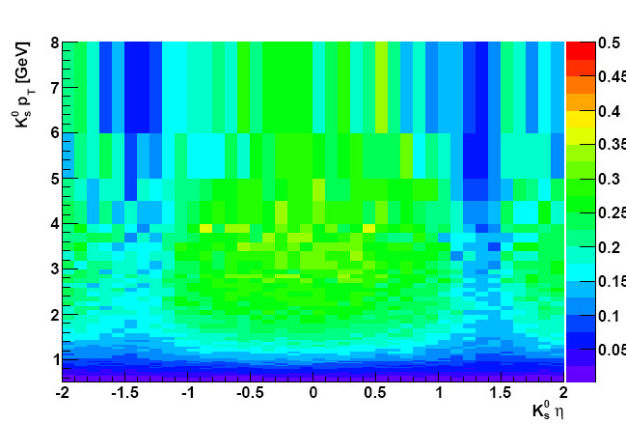
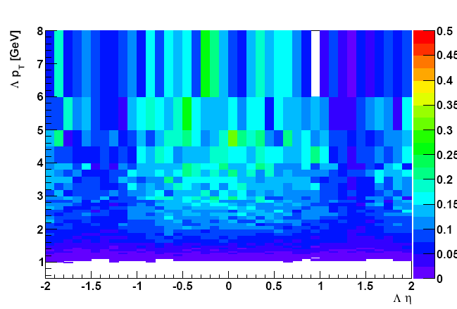
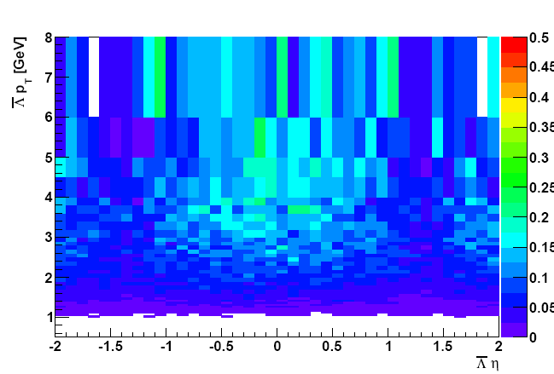
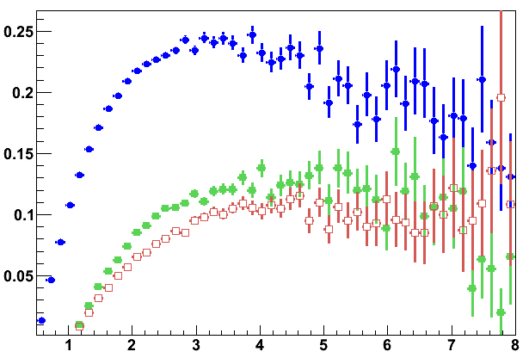
V0 Correction
V0 Correction = 1 / ( acceptance x efficiency )
- computed using Pythia6 D6T tune (highest stats)
K0s
La
Al
correction map extended from 4 to 8 GeV
K0s pT cut raised from 0.5 to 0.6 GeV
La/Al pT cut raised from 1.0 to 1.5 GeV
V0 correction now < 20
V0 pT [GeV]
Notes:
Uncertainty! Pt cut such that closure test works, maybe at lower pt, there is additional dependence that we’d need to count in
d6t

Slide 5
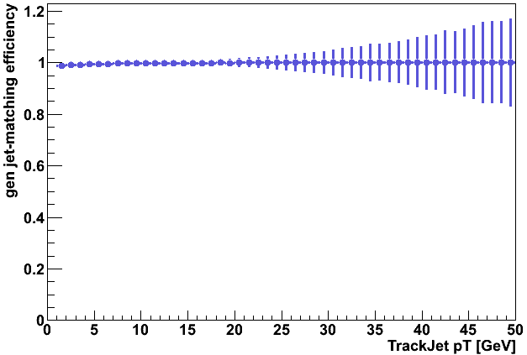
TrackJet-Pt Correction (I)
Reconstructed GenChargedJet
- stable charged particles with pT > 0.5 GeV and |eta| < 2.5
- unstable particles explicitly removed from clustering
- anti-kt algorithm (R = 0.5)
- match closest gen jet in R(ΔηΔφ) < 0.3 to reco trackjet
Matching performance
jets matched in 98%
Reco-Gen match
Notes:
Remove reco-leadinggen match, after conclusion: open questions: discussion all issues of correcting to gen primary rates

Slide 6
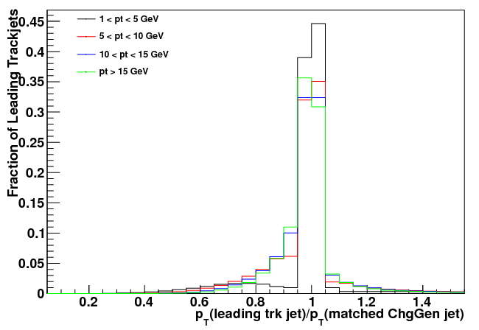
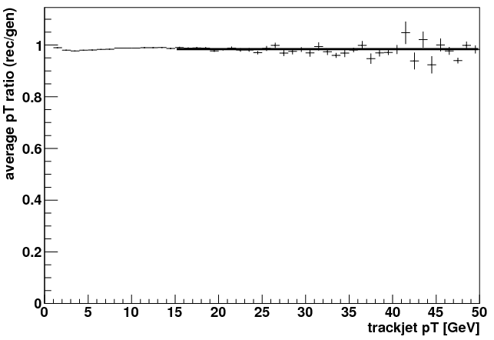
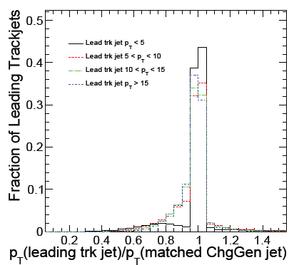
TrackJet-Pt Correction (II)
pT ratio
pT correction
For pt > 15 GeV:
0.98 +/- 0.001
Ratio consistent with UE analysis
Using constant correction for pT > 15 GeV
UE analysis (QCD‐10‐010)

Slide 7
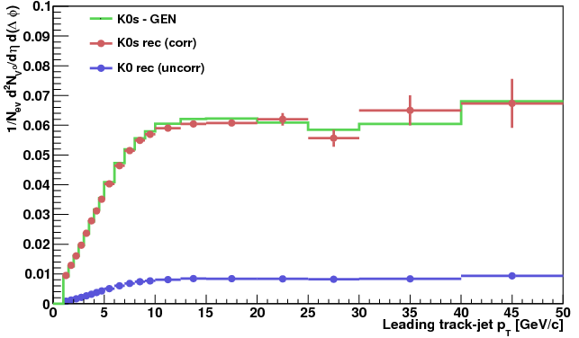
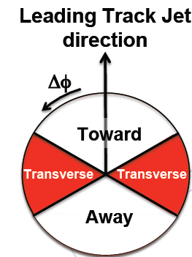
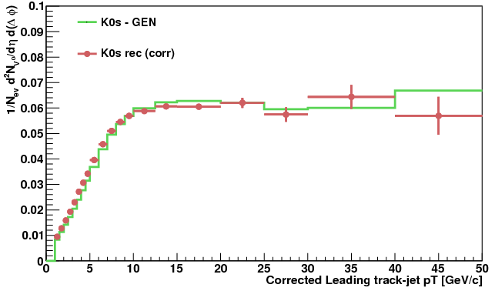
Closure Test K0s: Pythia6-D6T
In transverse region wrt reco trackjet
Rates from D6T
V0 correction taken from D6T
Gen rates: transverse region wrt reco trackjet
test V0 correction
trackjet
K0s
In transverse region wrt leading gen trackjet
Gen rates: activity in the transverse region wrt gen leading trackjet
Reco jet is pt corrected
Bias small from jet-matching eff
We will not correct up to leading gen-jet level
Including jet-pt scale correction
K0s
Notes:
legend
GEN – transverse region wrt reco trackjet
Wrt leading gen jet
Bottom: the matching inefficiency does not give a bias-but it’s not an observable
Xcheck to see the effect of the rec/gen jet-matching and jet-pt scale correction
-xcheck of bias from jet-matching
- Strong correlation btw observable and …

Slide 8
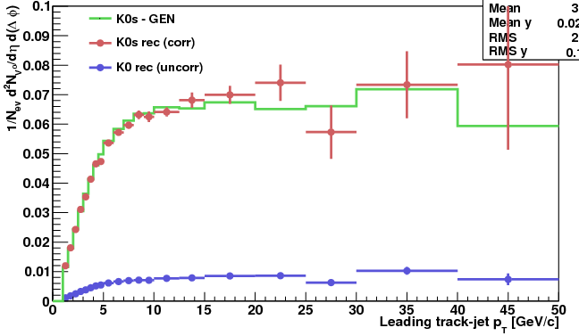
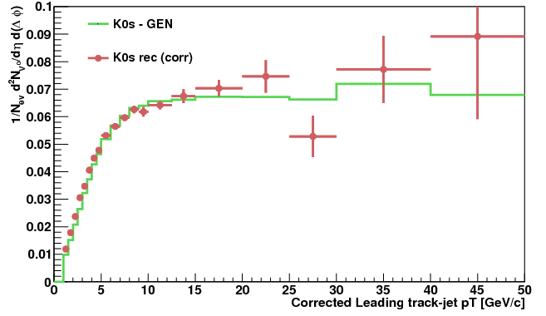
K0s Closure Test: Pythia6-TuneZ1
In transverse region wrt reco trackjet
Rates from TuneZ1
V0 correction taken from D6T
K0s
In transverse region wrt leading gen trackjet
Including jet-pt scale correction
K0s

Slide 9
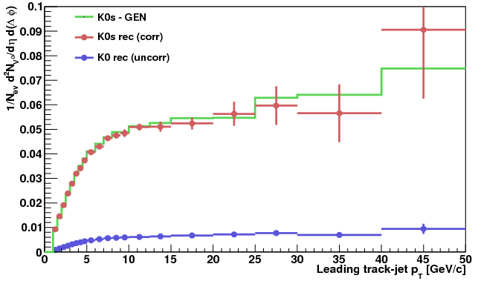
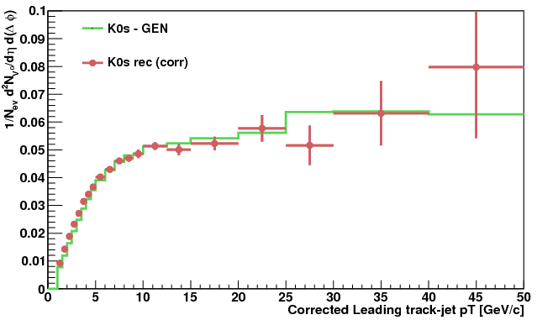
K0s Closure Test: Pythia8
In transverse region wrt reco trackjet
Rates from Pythia8
V0 correction taken from D6T
K0s
In transverse region wrt leading gen trackjet
Including jet-pt scale correction
K0s

Slide 10
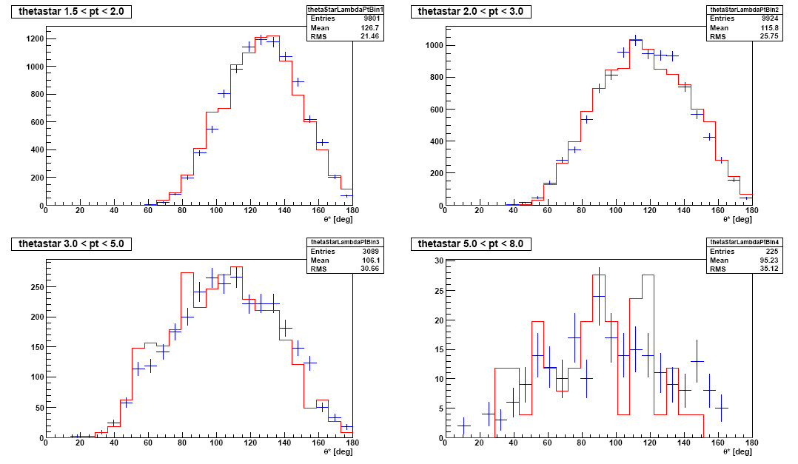
Polarization: Lambda
1.5 < pT < 2.0 GeV
2.0 < pT < 3.0 GeV
5.0 < pT < 8.0 GeV
3.0 < pT < 5.0 GeV
using Pythia6-D6T
data/mc matches well: polarization in MC describes the data → our acceptance can be used
Notes:
→ our acceptance can be used for data
Rec lambda
At low pt we observe cases where pion is forward, proton backward
Spin conservation + weak decay couplings
Mc describes polarization accurately, that means our acc is OK
Pythia d6t

Slide 11
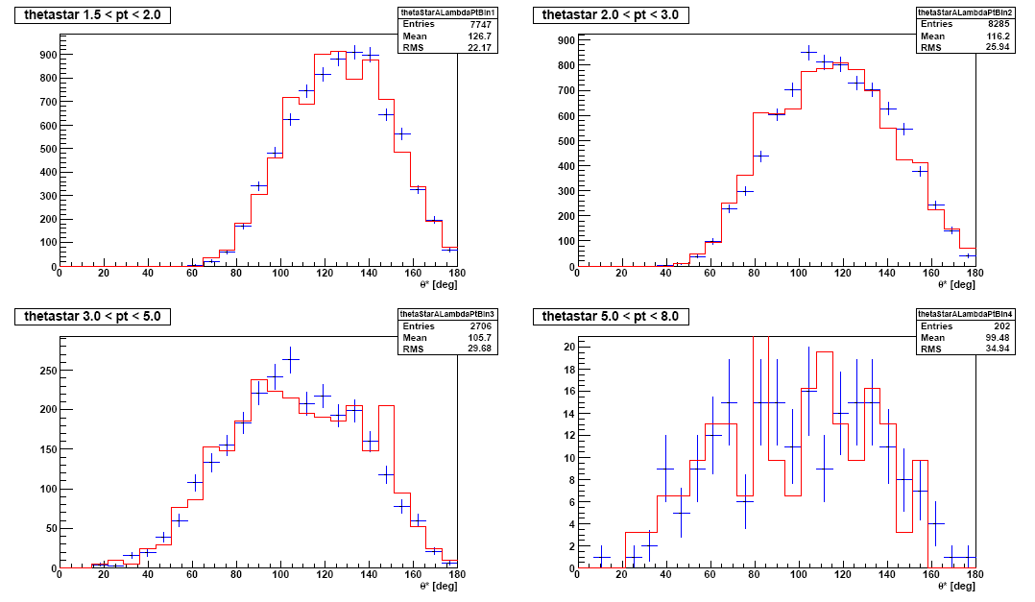
Polarization: AntiLambda
1.5 < pT < 2.0 GeV
2.0 < pT < 3.0 GeV
3.0 < pT < 5.0 GeV
5.0 < pT < 8.0 GeV
using Pythia6-D6T
Data/MC well matched

Slide 12
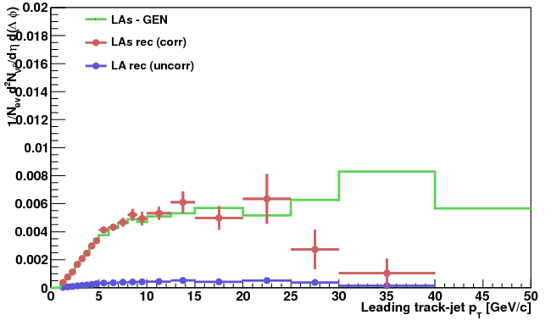
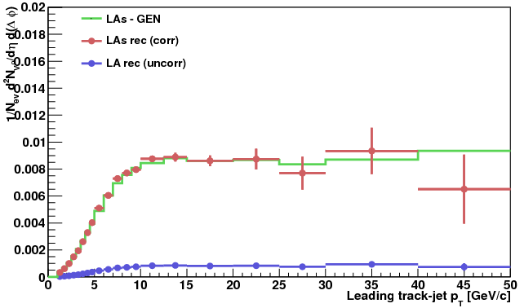
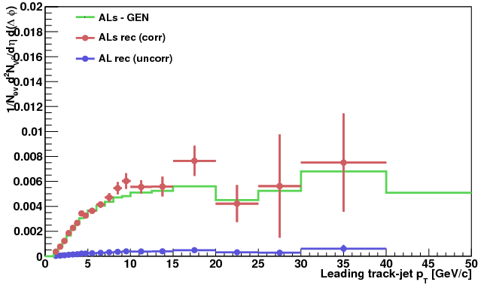
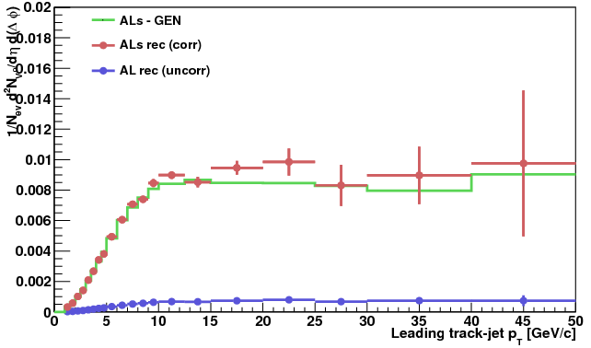
Lambda Closure Test
V0 correction from D6T ; gen rates wrt reco trackjet
Pythia6-TuneZ1
Pythia6-D6T
La
La
Pythia6-TuneZ1
Pythia6-D6T
Al
Al

Slide 13
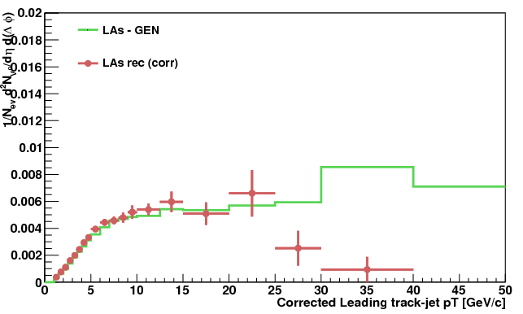
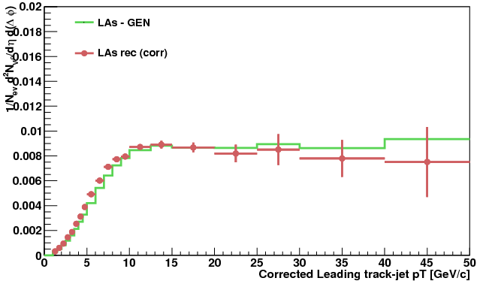
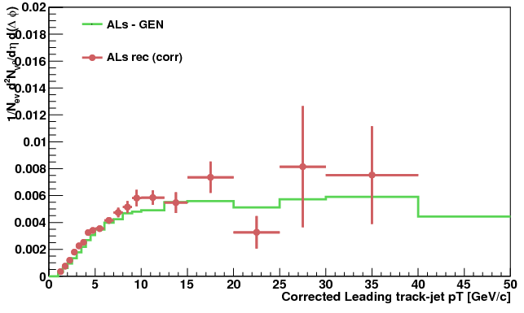
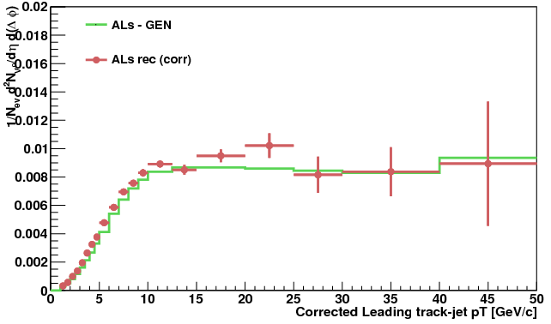
Lambda Closure Test
V0 correction from D6T ; jet-pt scale correction included (gen rates wrt gen jet)
Pythia6-TuneZ1
Pythia6-D6T
La
La
Pythia6-TuneZ1
Pythia6-D6T
Al
Al

Slide 14
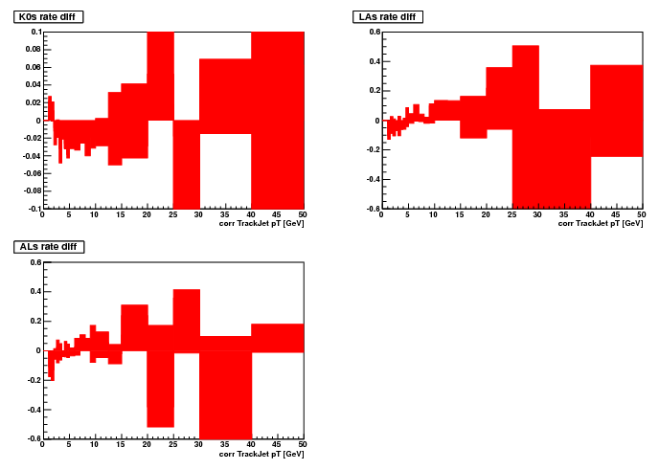
V0 Correction Systematics
K0s: 2%
La: 10%
syst estimated from MC as a difference in rates of D6T, Z1 and P8, obtained using V0 corrections from D6T
Al: 20%
still to be applied
Notes:
To get lifetimes right, need correction as f of flight distance (we don’t apply here)
Tunes – to evaluate sys
Bias – additional

Slide 15
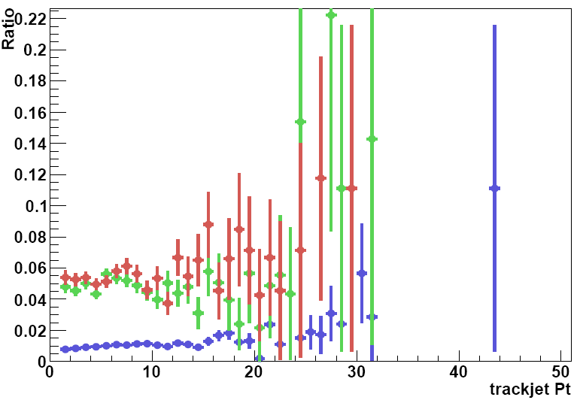
V0 Background
K0s
La
Al
Background estimated from reconstructed V0s not matched to GEN level
Subtracted from rates:
K0s 1%
Lambda/Antilambda 5%
Notes:
To get lifetimes right, need correction as f of flight distance (we don’t apply here)
Tunes – to evaluate sys
Bias – additional

Slide 16
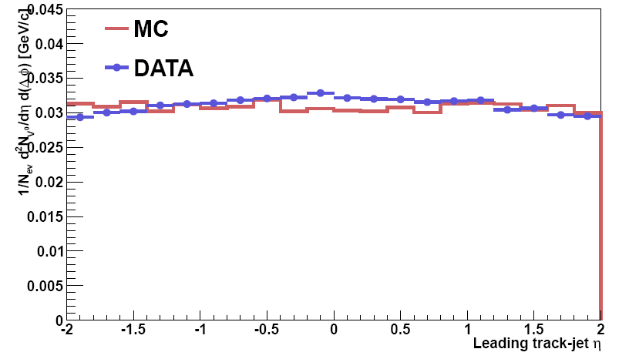
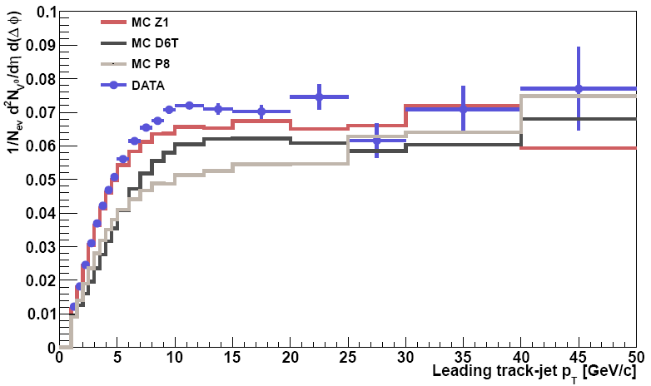
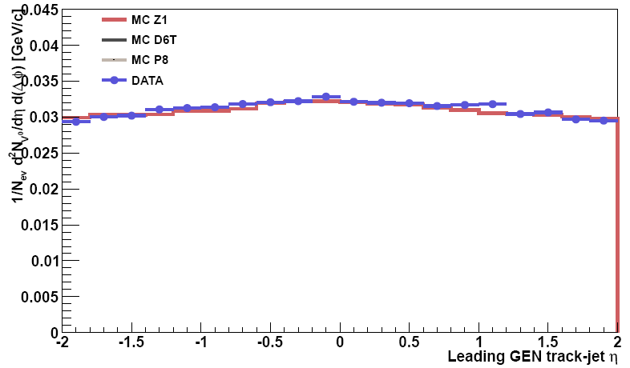
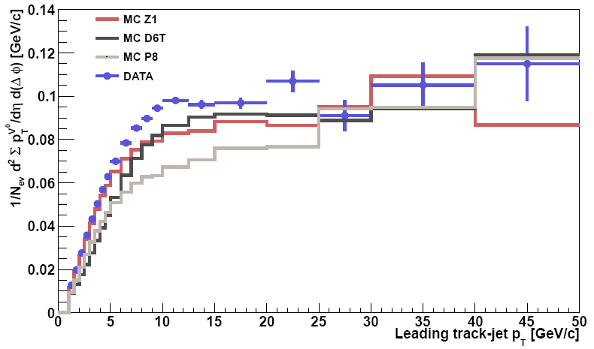
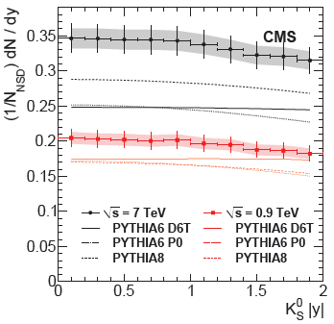
K0s Rates & pT Sum
Incl. Strang. Prod. (QCD‐10‐007)
background subtracted
Show excess in rates
Warning: inclusive analysis estimates rates down to pT = 0

Slide 17
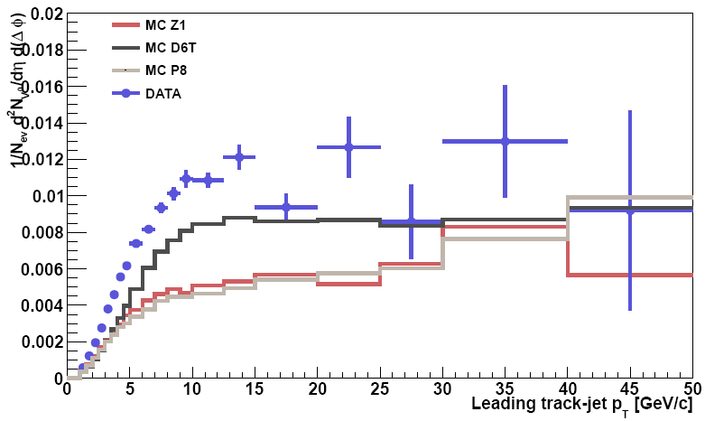
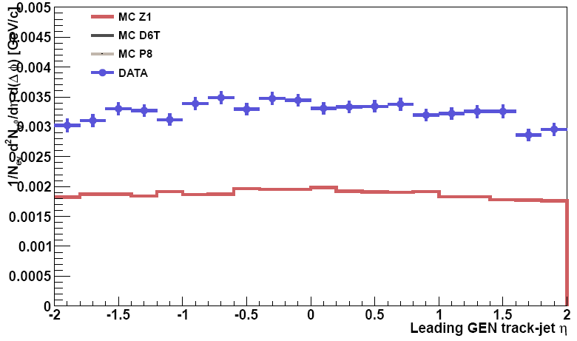
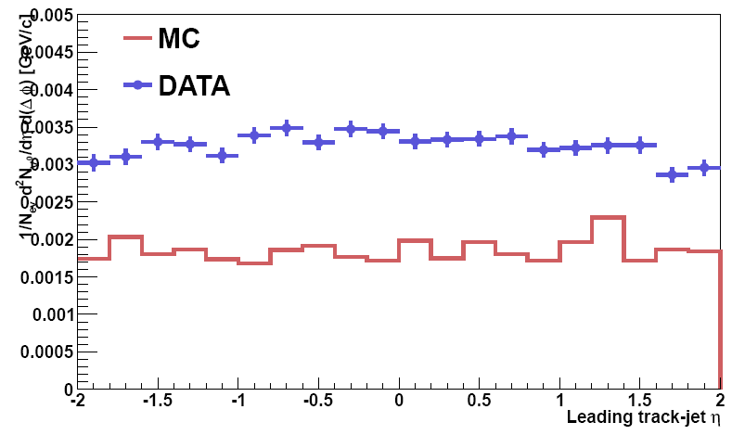
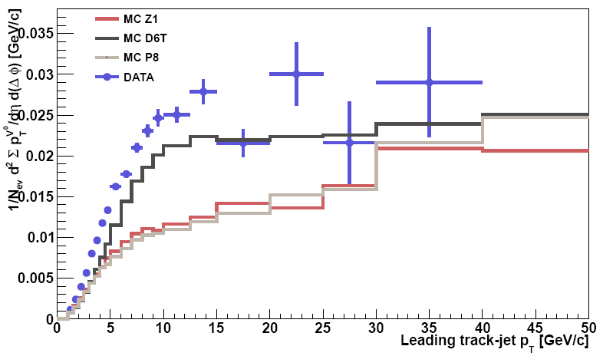
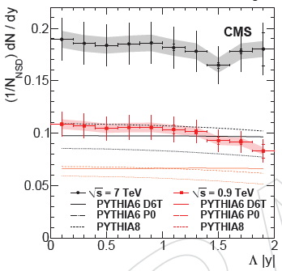
Lambda Rates & pT Sum
Incl. Strang. Prod. (QCD‐10‐007)

Slide 18
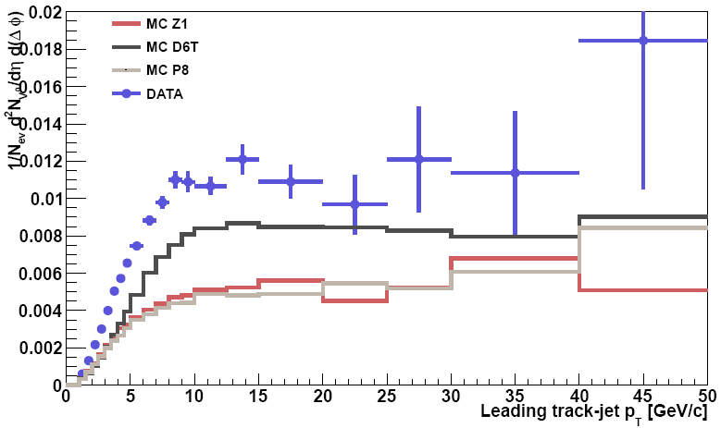
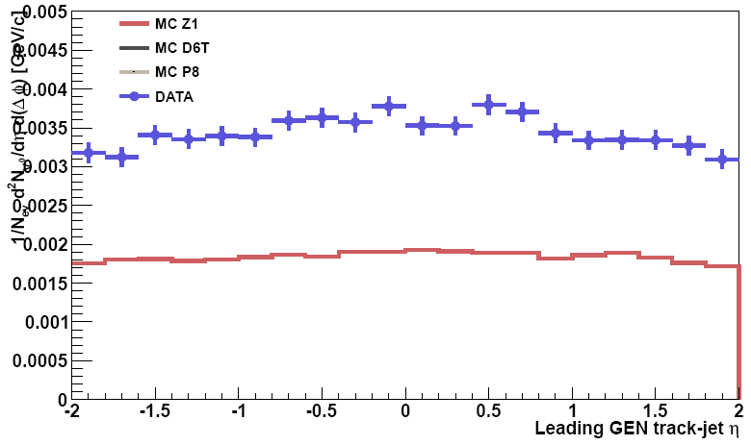
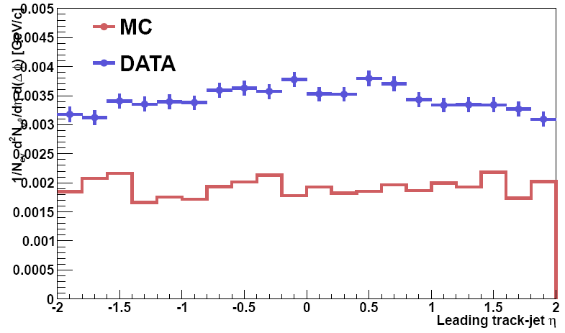
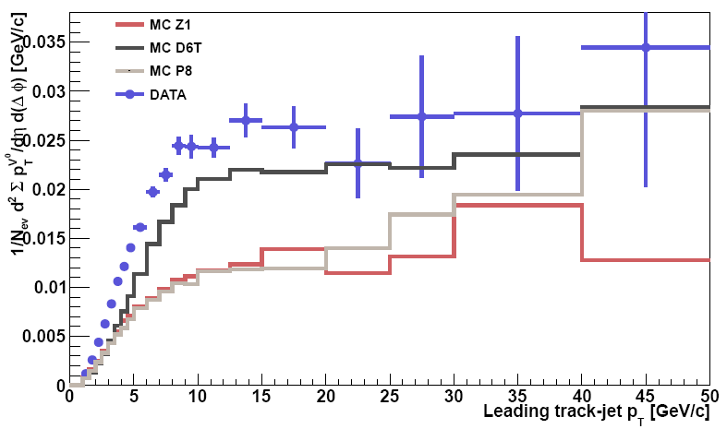
AntiLambda Rates & pT Sum

Slide 19
Conclusion & Plans
- presented measurements that we think should be published
- in process of writing the note
To do:
- Finalize systematics from other sources (trigger, …)
Notes:
Leading jet convention (choice of the leading jet)

Slide 20
Backup

Slide 21
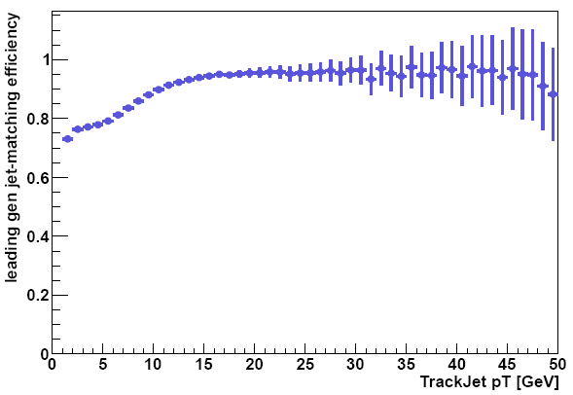
Leading-Jet Convention
Correcting to GEN primary rates:
Matching of the leading reconstructed trackjet to leading generated trackjet drops at lower pT

