Slide 1



Study of Strangeness Production in Underlying Event at 7 TeV
Tomas Hreus, Pascal Vanlaer
Overview:
K0s correction stability tests
Jet-pt correction
closure test

Slide 2
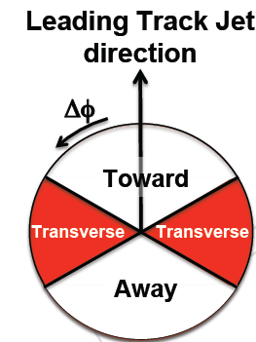
Event Selection
Using 7 TeV data from 2010
/MinimumBias/Commissioning10-Jun14thReReco_v1/RECO
/MinBias_TuneD6T_7TeV-pythia6/Summer10-START36_V10_SP10-v1/GEN-SIM-RECODEBUG
Runs: 132440-137436 + JSON file (CMSSW_3_6_3)
Trigger:
HLT_MinBiasPixel_SingleTrack
BSC
Primary vertex:
single vertex (offlinePrimaryVertices)
valid vertex (not fake, different from beam spot)
dZ(vtx, beamspot) < 10cm
Number of tracks > 4 (ndof > 4)
Leading Track-jet:
- anti-kt alg. (R = 0.5)
Tracks: - dst to vtx: dz < 0.5cm, dxy < 0.1cm: no V0s
- hits >= 8
- pT > 0.5 GeV
- |eta|<2.5
0º
60º
120º
Notes:
Impact parameter cut, v0 tracks are not included – check in parameter file, collection for trackjet, say GeneralTrackCollection

Slide 3
V0 Selection
Tracks:
|η| < 2.5
pT > 0.3 GeV
Nhits >= 3
χ² / ndf < 5
secondary vertex:
Distance of closest approach of both tracks < 1cm
χ² / ndf < 7
d_{T} > 8 σ(d_{T}) ; σ accounts for beam spot and sec. vertex errors
V0:
|η| < 2.0
0.5 < pT_K0s; 1.0 < pT_Λ, Λbar
Transverse flight distance > 1 cm
0º
60º
120º

Slide 4
Kinematic Fit
Kinematic fit = iterative minimization of the χ² function with kinematic constraints, using covariance of track parameters
3 constraints applied:
vertexing (daughter tracks come from the same point)
pointing (V0 points to the primary vertex)
fixed V0 mass to V0 PDG value
Result of the fit:
fitted daughter track parameters (pt, θ, φ)
χ² (probability)
Fit done separately for K0s, Lambda and Antilambda hypotheses:
χ² prob(K0s) vs χ² prob(Λ) vs χ² prob(Λbar)
The mass hypothesis with the highest χ² probability dictates the V0 identification.
Fits with all probabilities < 5% are rejected.

Slide 5
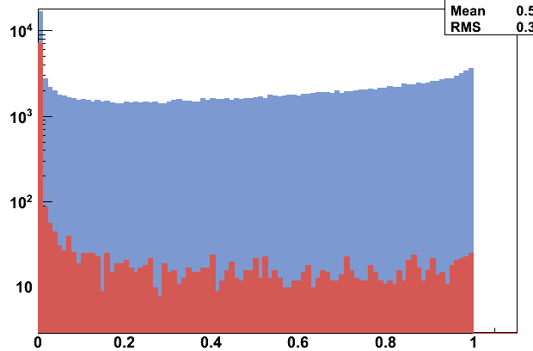
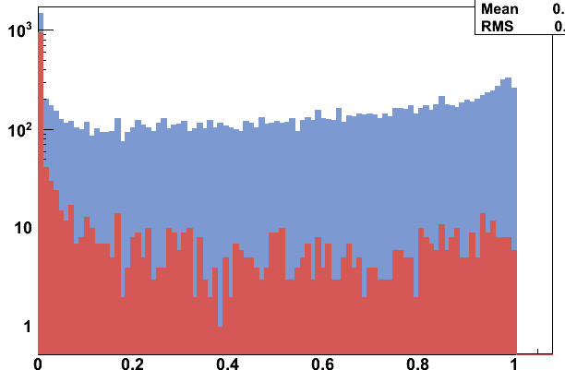
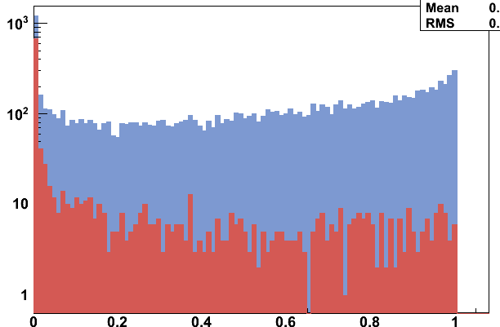
Kinematic Fit: Remaining Background
matched to primary V0
not matched to primary V0
Primary-matched within
R(ΔηΔφ) < 0.1 and δpT/pT< 0.1
Background to V0 sample estimated from MC:
Background for K0s ~1%
Background for Λ ~4%
Background for Λbar ~6%
K0s
χ² prob
Λ
background type | K0s | Λ/Λbar
ambiguous identification | 40% | 20%
photon conversion | 1% | 20%
nuclear interactions | 1% | 1%
to be understood | 50% | 50%
Λbar
χ² prob
χ² prob
Notes:
50% to be understood, distinguish

Slide 6
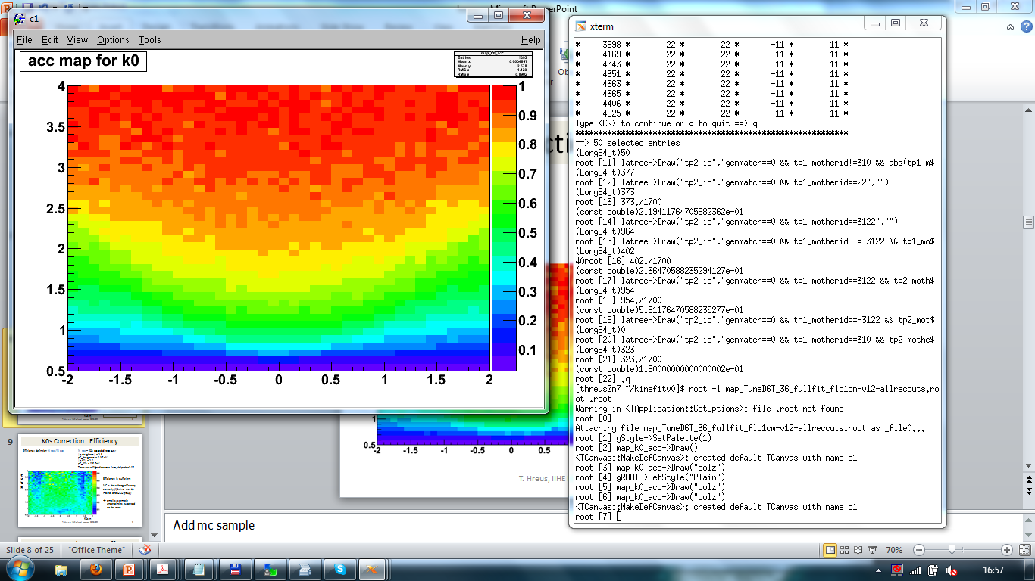
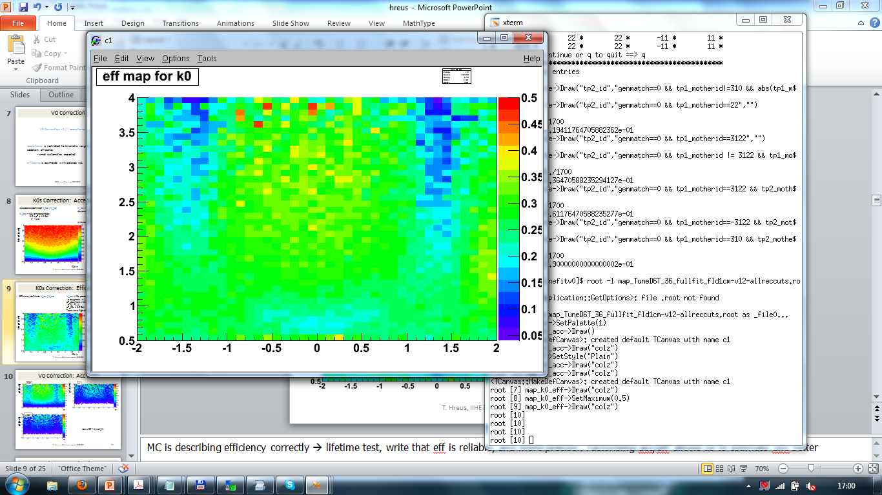
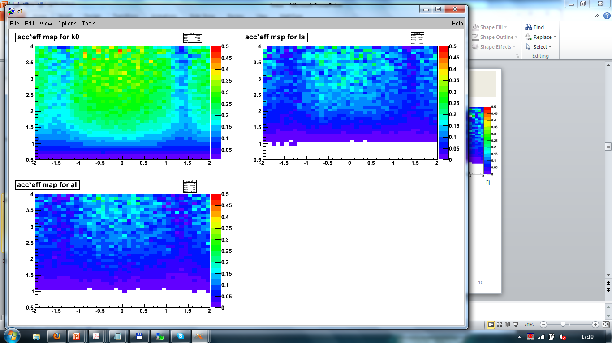
V0 Correction
V0 Correction = 1 / ( acceptance x efficiency )
acceptance is restricted to kinematic range of sufficient V0 selection efficiency
- small systematics expected
efficiency is estimated with detailed MC
K0s pT [GeV]
K0s η
K0s η
K0s η
acceptance
efficiency
acc x eff
Lambda decay:
need angular distribution of decay proton
Acc*eff may depend on Lambda polarization (we would measure the lambda polarization)
never measured!

Slide 7
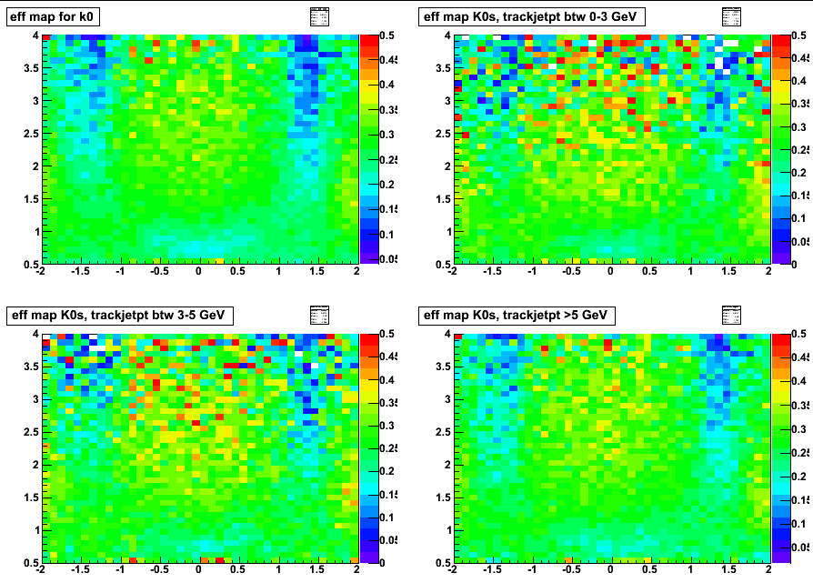
K0s Efficiency: Stability (1)
check the stability as a function of trackjet pt:
bin 1: 0 < 3 GeV
bin 2: 3 - 5 GeV
bin 3: > 5 GeV
pT [GeV]
η
pT [GeV]
η
η

Slide 8
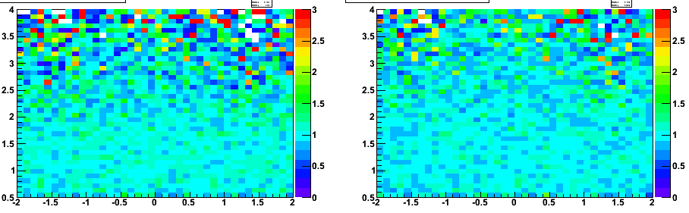
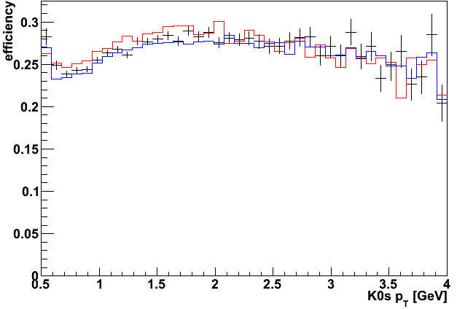
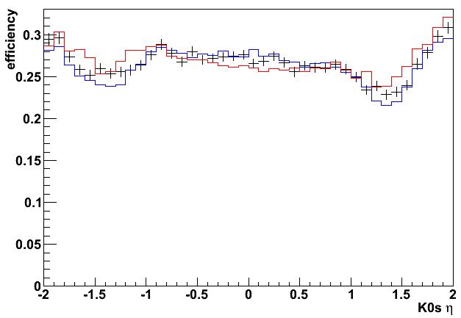
K0s Efficiency: Stability (2)
Bin 1: 0 < 3 GeV Bin 2: 3 - 5 GeV Bin 3: > 5 GeV
Low pt bin / mid pt bin
High pt bin / mid pt bin
max per-bin difference: ~10%
- syst unc. from the V0 correction will be deduced from difference in these maps
-- Mid trackjet pt (3-5 GeV)
-- Low trackjet pt (0-3 GeV)
-- High trackjet pt( > 5 GeV)

Slide 9
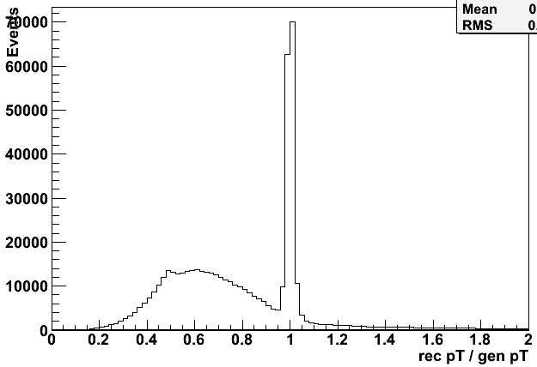
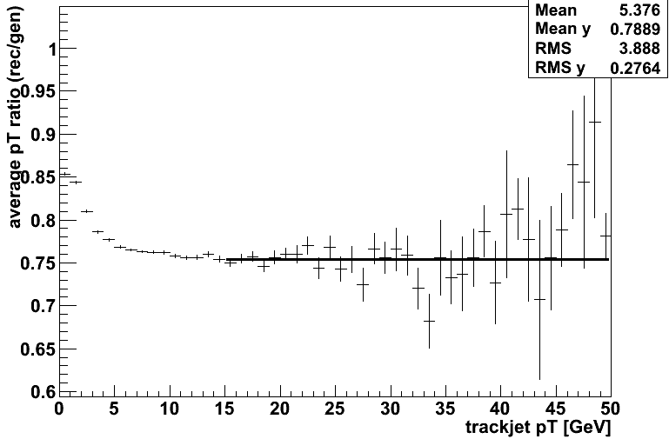
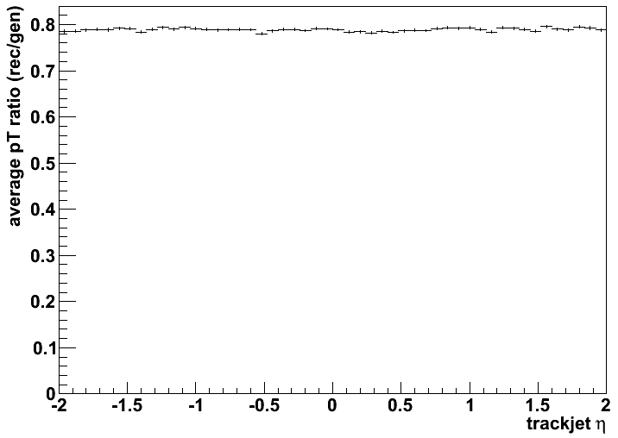
TrackJet-Pt Correction
Reconstructed GenChargedJet
- select all stable charged generated particles with pT > 0.5 GeV and |eta| < 3.0
- run anti-kt algorithm (R = 0.5) on this ChargedGen selection
- match closest gen jet in R(ΔηΔφ) < 0.5 to reco trackjet
For pt > 15 GeV:
0.754 +/- 0.002
pT ratio
- trackjet-pt average correction in bins of trackjet pt only
no dependence on trackjet eta
Notes:
Take the average correction, -> seems consistent with track-finding efficiency (80%) + out-of-cone effect
Lowpt= 1 track, perfectly aligned, see track finding efficiency
Correction as f of jet multiplicity

Slide 10
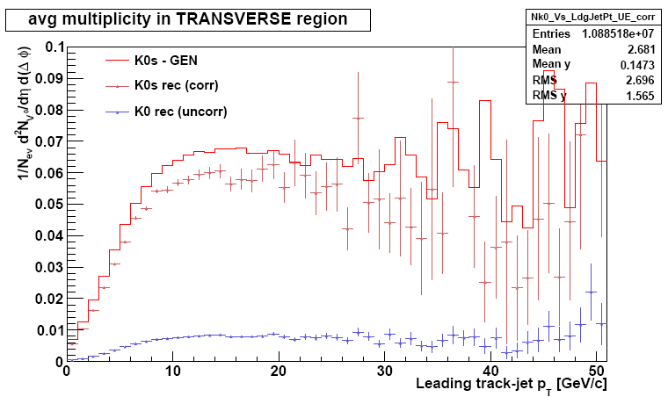
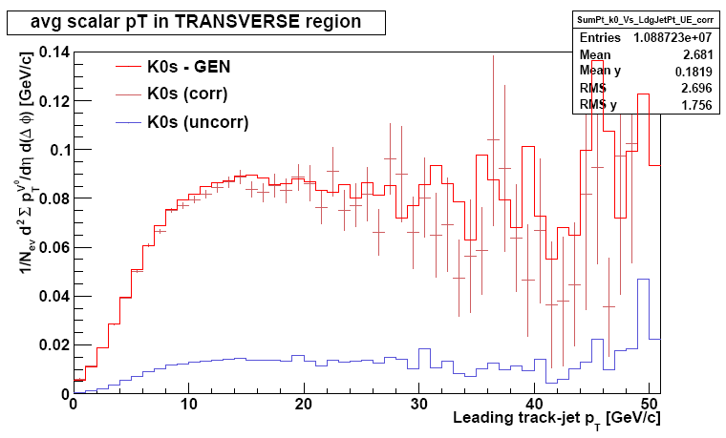
Closure Test (MC)
compare TRUE MC distribution to
corrected reconstructed level (acceptance, efficiency, background subtracted)
statistical errors only
sign of additional source of syst
Notes:
To get lifetimes right, need correction as f of flight distance (we don’t apply here)
Tunes – to evaluate sys
Bias – additional

Slide 11
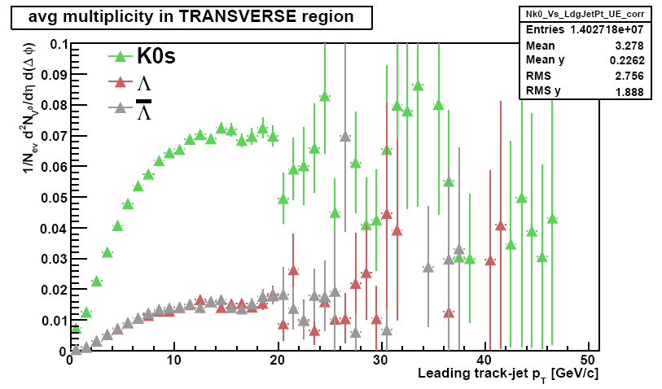
Rates
V0 correction and jet-pt correction applied
corrected for background (bin-by-bin basis)

Slide 12
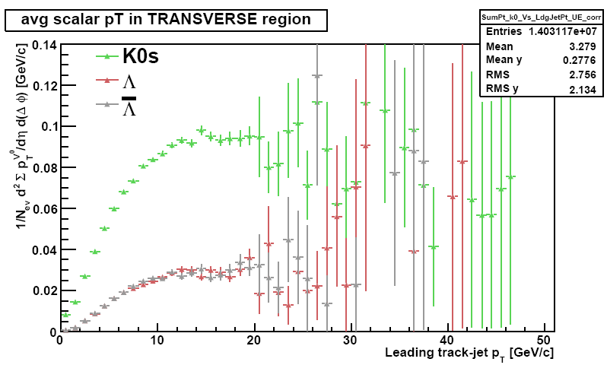
Scalar pT Sum

Slide 13
Conclusion & Plans
shown rates corrected for background
stability tests of the K0s correction: will be used for systematic uncertainty estimation
trackjet-pt correction based on the generated charged jet
closure test: need to understand the missing part
Plans
- evaluate systematic uncertainties
V0 selection efficiency
V0 acceptance (different PYTHIA tunes)
trigger and event selection
write PAS/paper
Notes:
Trig eff small for low multiplicity, check MC without trigger, look at rates, then compare rates with trigger

Slide 14
Backup

Slide 15
K0s Correction: Acceptance
Acceptance definition: N_acc / N_gen
N_gen = K0s generated inside:
0.5 < pT < 4.0 GeV
|η| < 2.0
N_acc = fraction of N_gen which passed the acceptance cuts:
pT_daughters > 0.3 GeV
|η_daughters| < 2.5
gen transv. flight dist. > 1 cm
(simulated isotropic decay of gen K0s)
Efficiency definition: N_rec / N_acc
N_rec = K0s passed all reco cuts:
|η daughters| < 2.5
pT_daughters > 0.3 GeV
|η K0| < 2.0
pT_K0s > 0.5 GeV
Transverse flight distance > 1 cm, chi2prob > 0.05
Notes:
Add mc sample

Slide 16
V0 Correction: Acc x Eff
K0s
Λ
pT [GeV]
pT [GeV]
η
η
Λbar
pT [GeV]
Acc x Eff = 1/weight
η

Slide 17
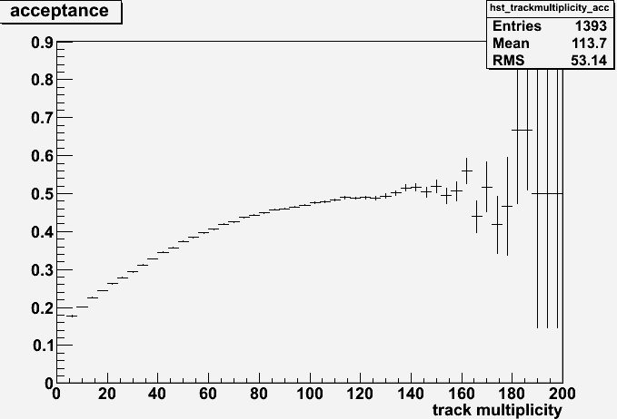
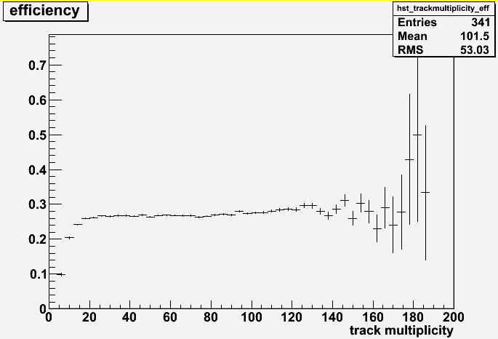
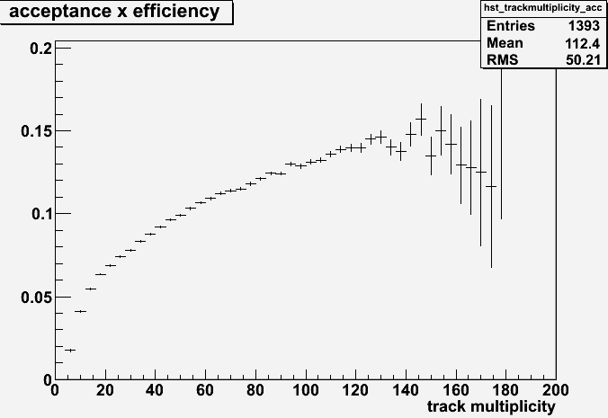
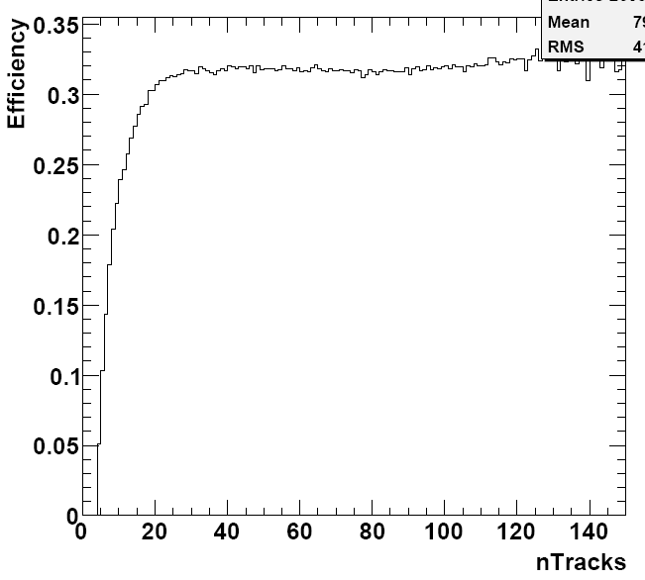
Acc/Eff vs Track Multiplicity
From the Strange Particle Production analysis (QCD-10-007)
kindly provided by Kevin Stenson
Notes:
Another sys effect (eff vs track multiplicity)

