Slide 1
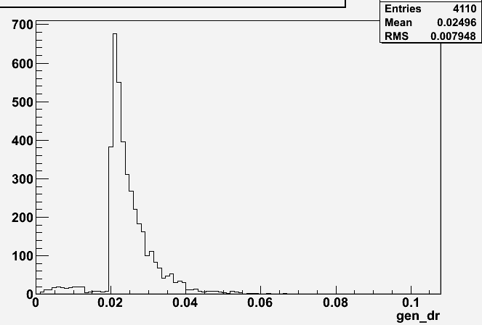
K0s gen issue
Problem with unmatched K0s solved.
The deltaR cut for keeping the closest gen particle of any ID around selected K0s is 0.3.
Now, looking at the DeltaR distribution (below) for those gen K0s found around “gen-unmatched” K0s, there is a significant contribution above dR of 0.02.
0.02 is precisely the dR cut for the present gen-matching requirement, so all this issue means is that dR of 0.02 is simply too tight and we still see closest gen K0s at dR of 0.04 and above.
When I look at the gen particles within dR < 0.02 from rec K0s (to match the gen-matching requirement), only ~10% of total K0s background shows that gen K0s is still around.
- Now I will put back the dR for gen-matching to 0.1, as written in the analysis note.

Slide 2
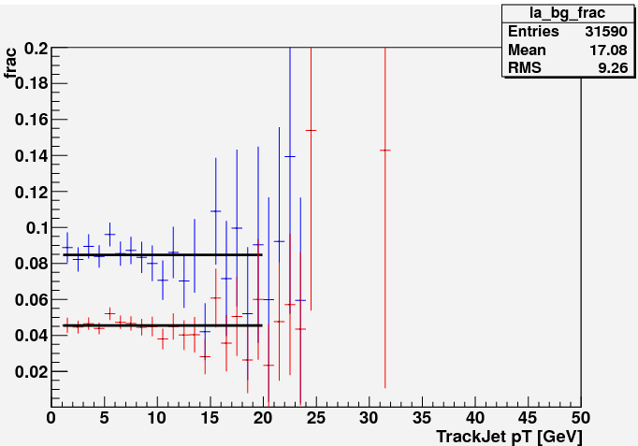
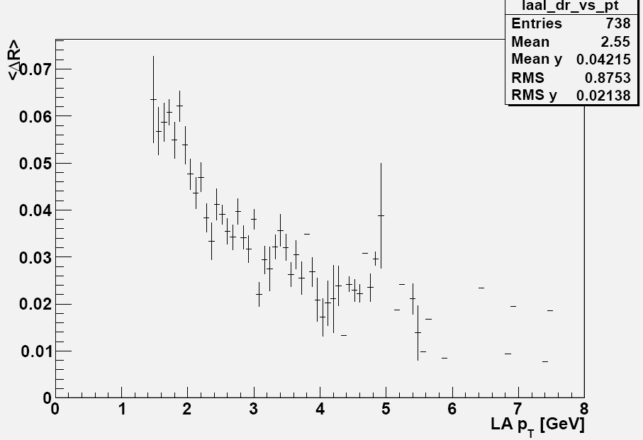
Lambda Background using GEN-matching
Identified Lambdas
5% non-matched Lambdas
Reweighting bg contribution by QCD-10-007 numbers:
cascades identified at gen level (xsi, omega, sigma)
  deltaR < 0.3
  Default contribution to bkg = 50%
  Weight = 2.67
K0s identified at gen-level
  Default contribution to bg = 20%
  Weight = 1.39
Weighted
Non-weighted
Mean distance of gen cascade:
deltaR < 0.02
deltaPt < 0.1

Slide 3
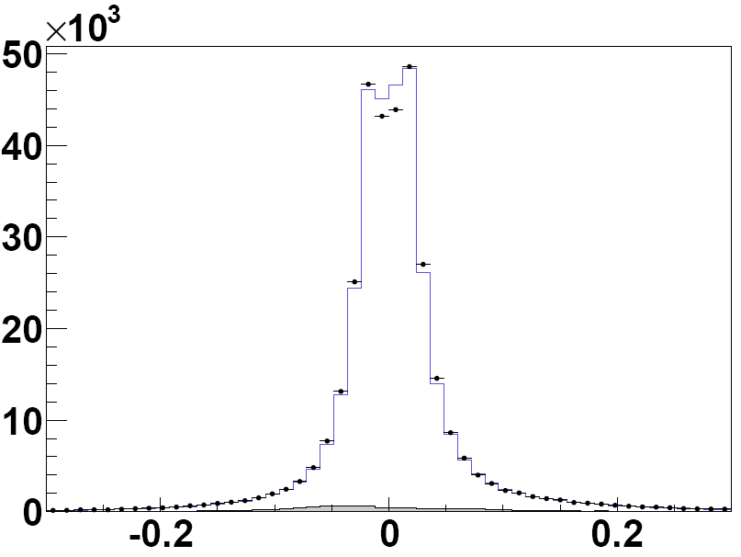
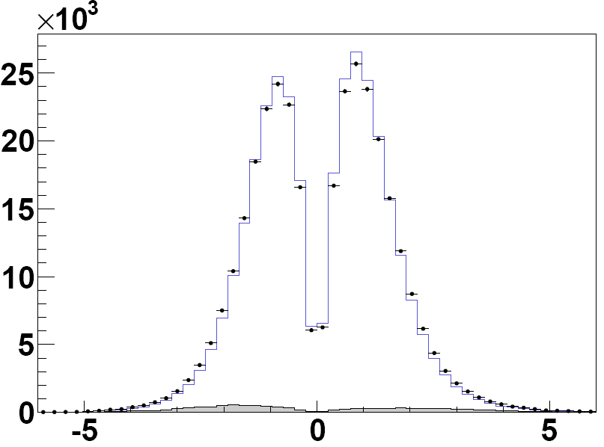
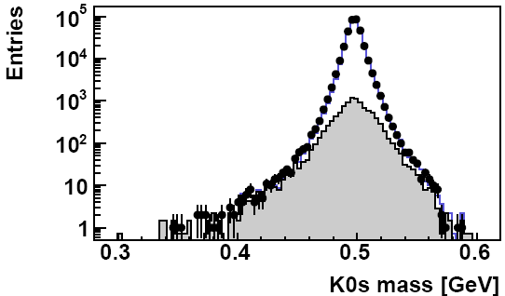
Mass & Pulls (K0s)
Pointing pulls before the full fit: absolute distance to PV (left), pull (right)
3D distance [cm]
Pointing pull
Mass distribution before the full fit

Slide 4
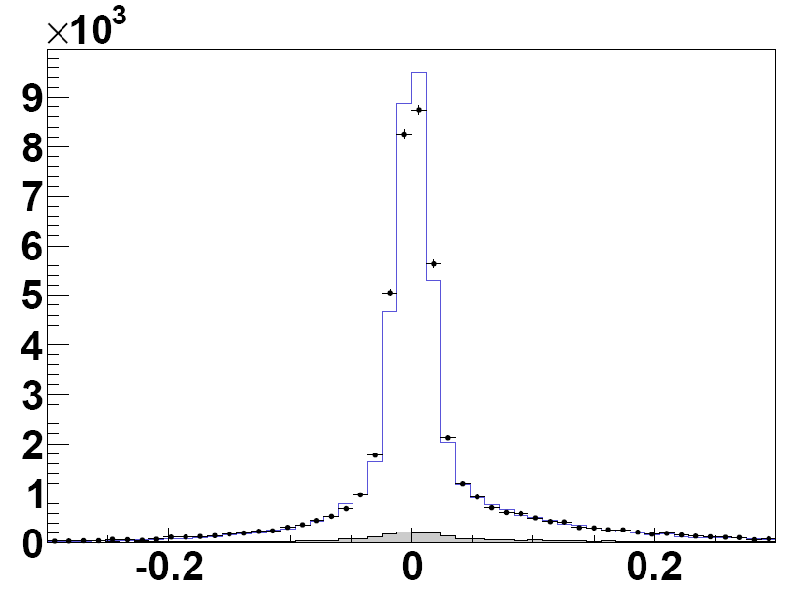
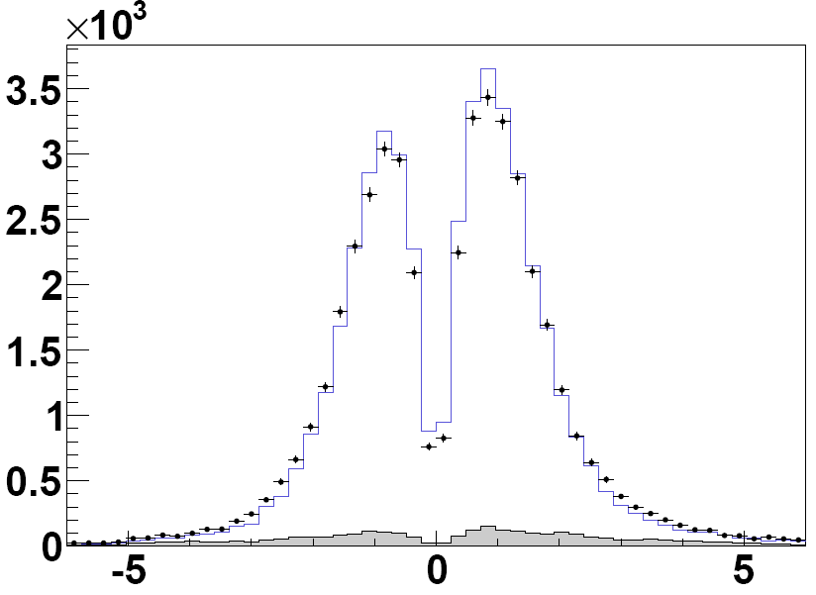
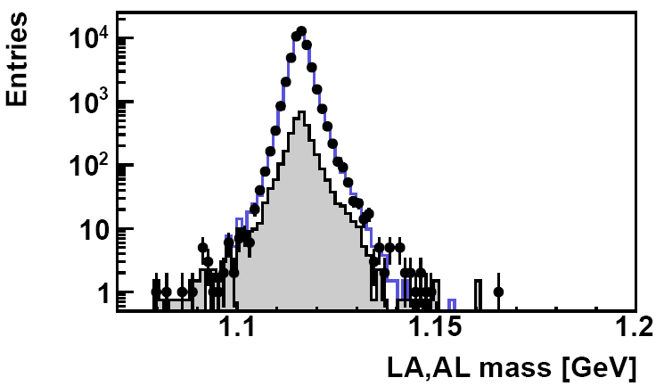
Mass & Pulls (LA+AL)
Pointing pulls before the full fit: absolute distance to PV (left), pull (right)
3D distance [cm]
Pointing pull
Mass distribution before the full fit

Slide 5
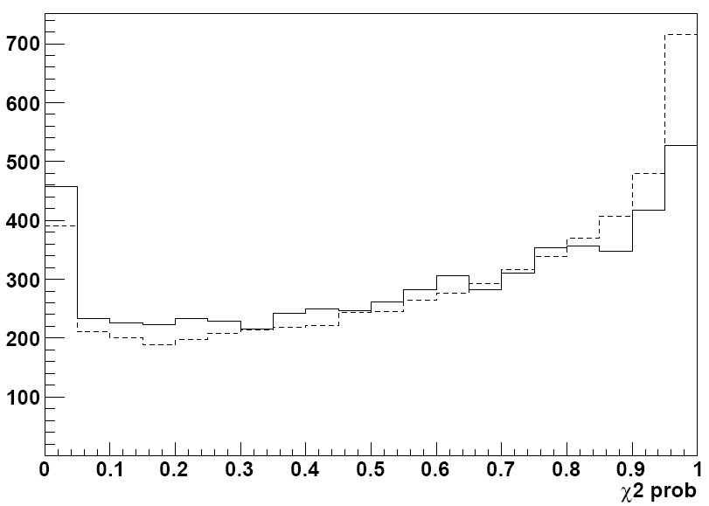
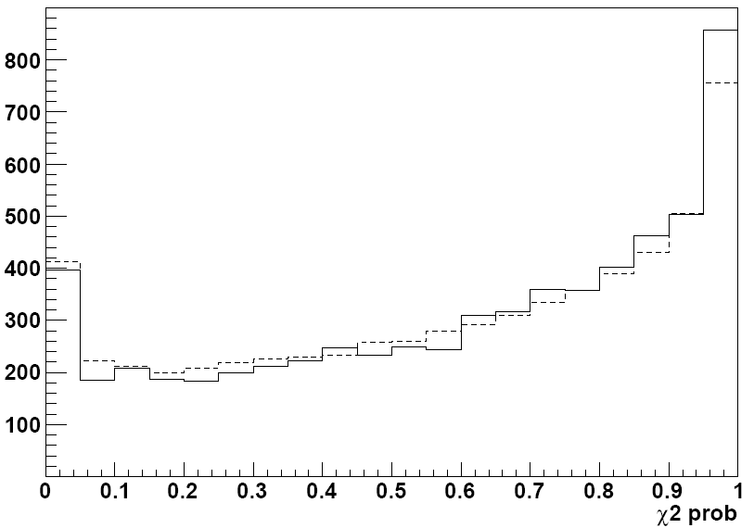
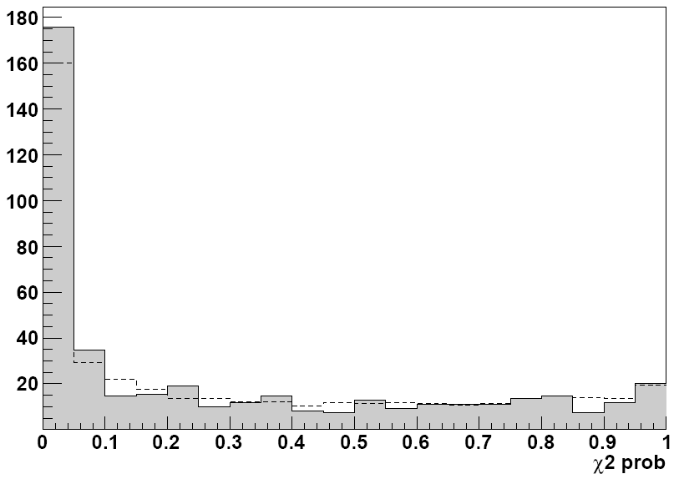
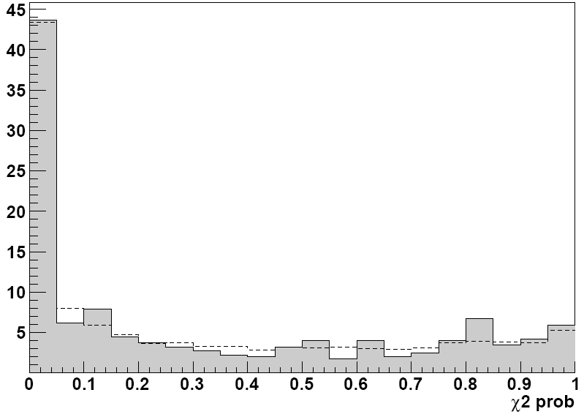
Background from DATA – chi2prob distributions
Signal component
1 < Trackjetpt < 2 GeV
Signal component
10 < Trackjetpt < 15 GeV
Background component
10 < Trackjetpt < 15 GeV
Background component
1 < Trackjetpt < 2 GeV
Identified Lambdas+Antilambda
Dotted line = shape averaged over trackjet pt range
Shapes vary between trackjetpt bins

Slide 6
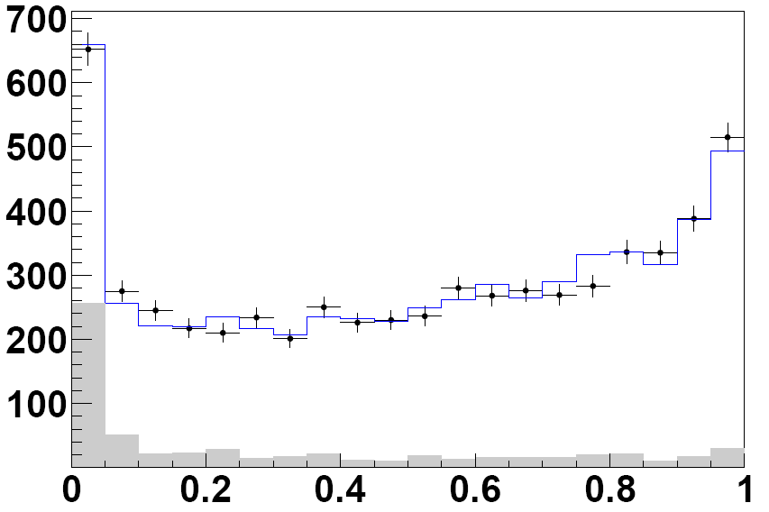
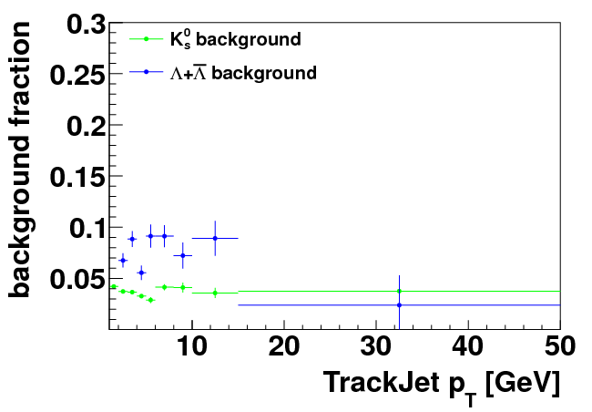
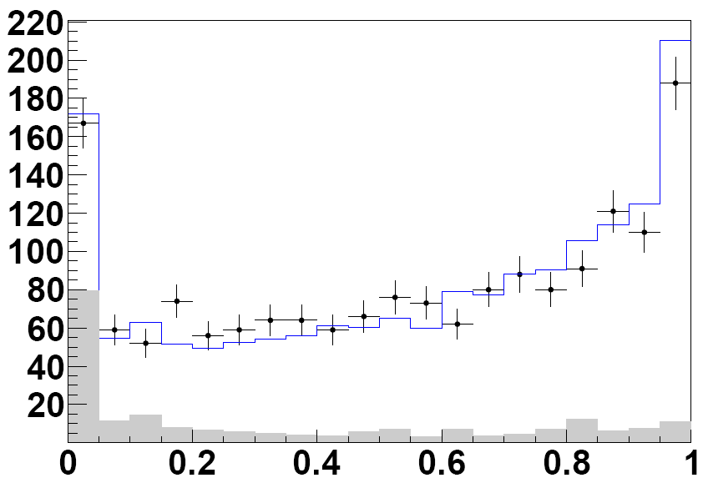
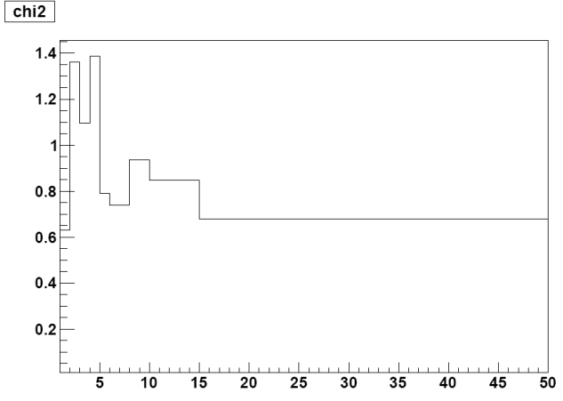
Background from DATA – shape fit
Identified V0s
Here signal+BG MC shape fit in trackjet pt bins, between chi2prob of 0.0 and 1.0
Fitted lambda
1 < Trackjetpt < 2 GeV
chi2prob
Fitted lambda
10 < Trackjetpt < 15 GeV
baryons
chi2prob

Slide 7
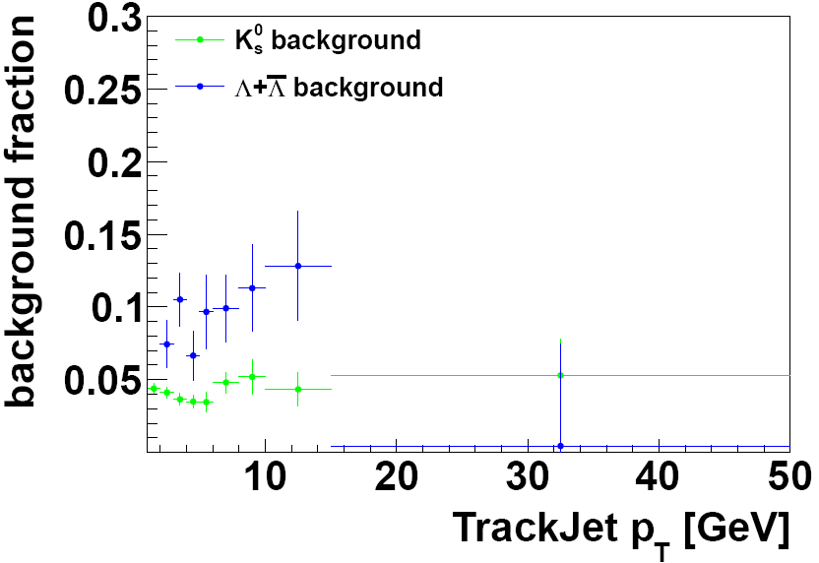
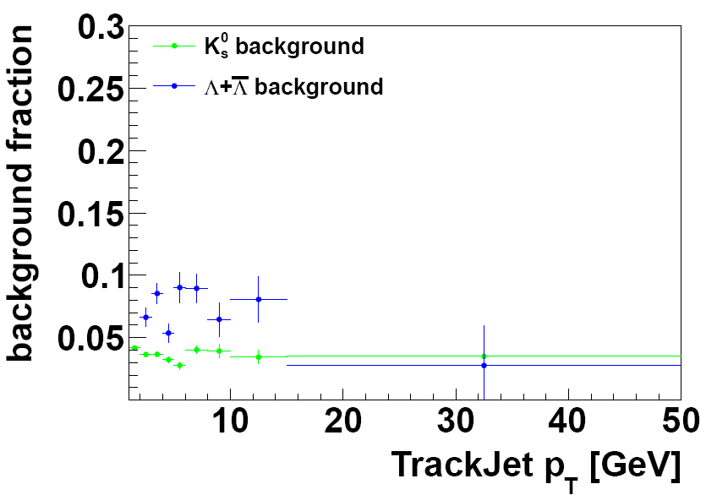
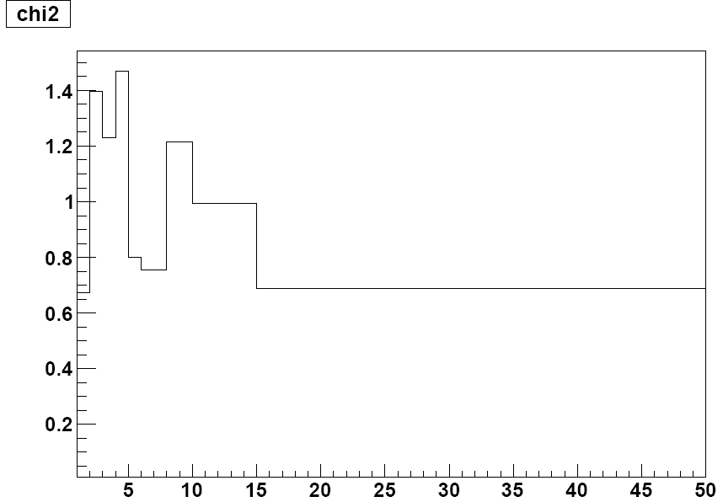
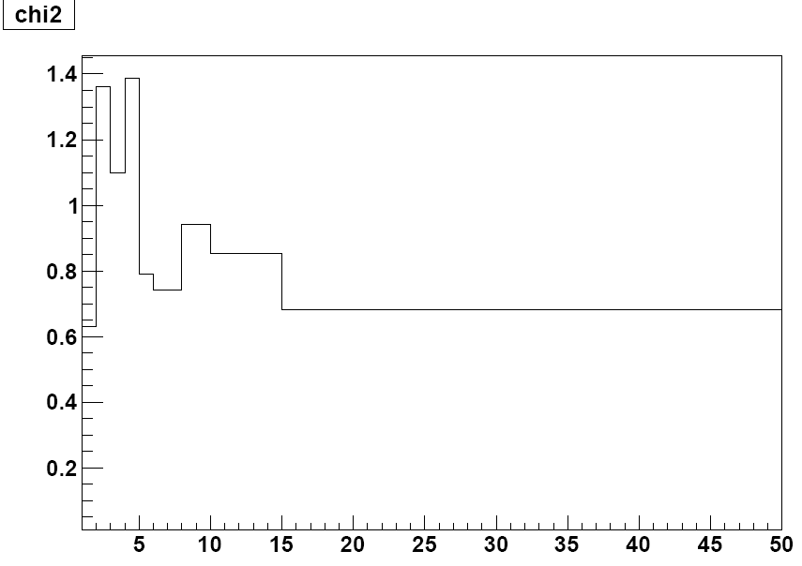
Background from DATA – shape fit (2)
Identified V0s
Here signal+BG MC shape fit in trackjet pt bins, between chi2prob of 0.3 and 1.0:
Here signal+BG MC shape fit in trackjet pt bins, between chi2prob of 0.0 and 0.3:
baryons
baryons

Slide 8
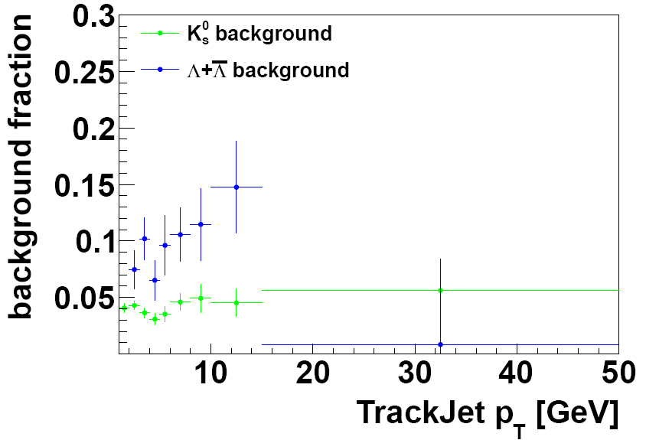
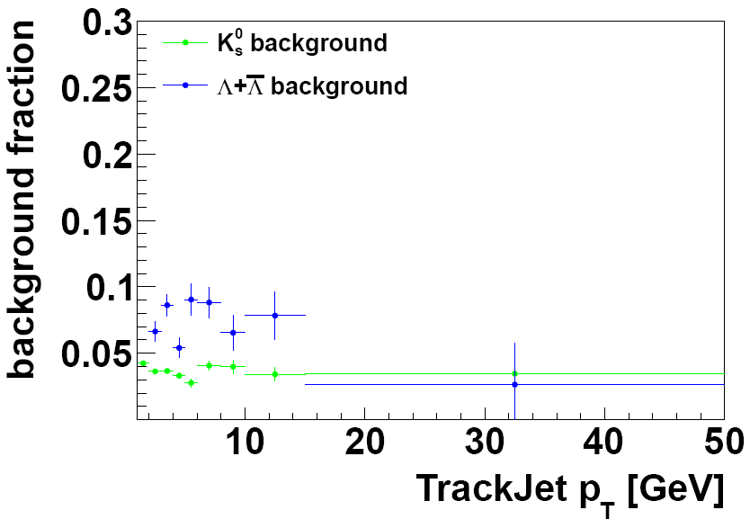

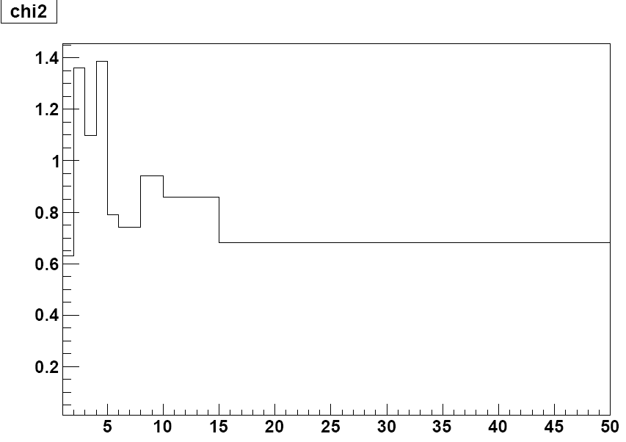
Background from DATA – shape fit (3)
Identified V0s
Here signal+BG MC shape fit in trackjet pt bins, between chi2prob of 0.5 and 1.0:
Here signal+BG MC shape fit in trackjet pt bins, between chi2prob of 0.0 and 0.5:
baryons
baryons

