Slide 1



Study of Strangeness Production in Underlying Event at 7 TeV
Tomas Hreus, Pascal Vanlaer

Slide 2
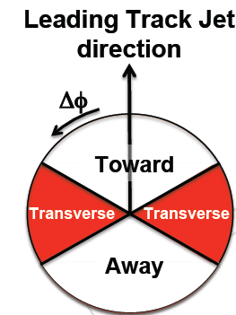
Data Sample and Selection
Data Sample:
/MinimumBias/Commissioning10-Jun14thReReco_v1/RECO
Runs: 132440-137436
+ JSON file
(CMSSW_3_6_1_patch4)
Event & Track-Jet Selection:
- meant to be identical to UE QCD-10-010 analysis
Trigger:
HLT_MinBiasPixel_SingleTrack
BSC
Primary vertex:
single single vertex (offlinePrimaryVertices)
valid vertex (not fake, different from beam spot)
dZ(vtx, beamspot) < 10cm
ndof > 4
Leading Track-jet:
tracks with pT > 0.5 GeV, |eta|<2.5
V0 Selection (K0s, Λ, Λbar):
|η daughters| < 2.5
|η V0| < 2.0
pT_K0s > 0.5 GeV ; pT_Λ, Λbar > 1.0 GeV
Transverse flight distance > 1 cm
+ kinematic fit
0º
60º
120º

Slide 3
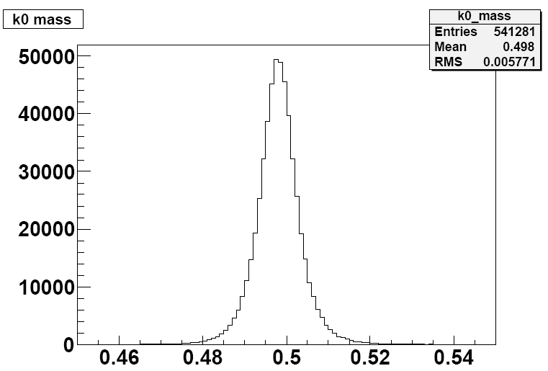
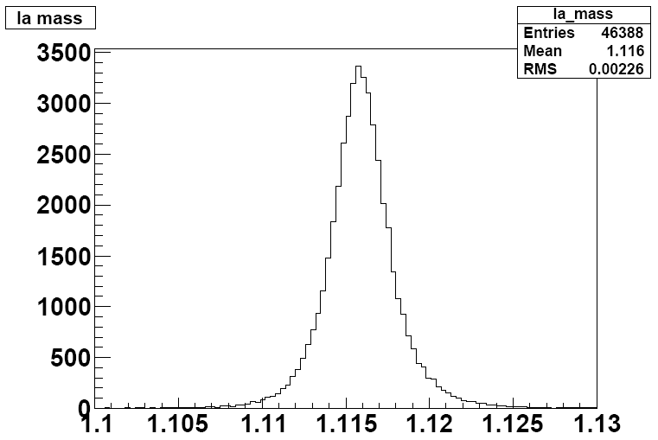
Kinematic Fit: Principle
Talks on the fit presented at tracking PDG/POG
and Alignment meetings
V0s selected based on the chi2 probability of the kinematic fit.
Kinematic fit: minimization of the χ² function with kinematic constraints:
3 constraints:
vertexing (daughter tracks cross secondary vertex)
fixed V0 mass to V0 PDG value
pointing (V0 point to primary vertex)
Fitting 9 measured parameters: ρ = q / pt, θ, φ of two daughter tracks, sec. vertex (x,y,z), considering full 9x9 covariance matrix of measured parameters
https://indico.cern.ch/getFile.py/access?contribId=3&sessionId=2&resId=0&materialId=slides&confId=82610
https://indico.cern.ch/getFile.py/access?contribId=4&sessionId=2&resId=0&materialId=slides&confId=82616
https://indico.cern.ch/getFile.py/access?contribId=15&sessionId=1&resId=0&materialId=slides&confId=120130
K0s mass
Λ mass
K0s mass [GeV]
Λ mass [GeV]

Slide 4
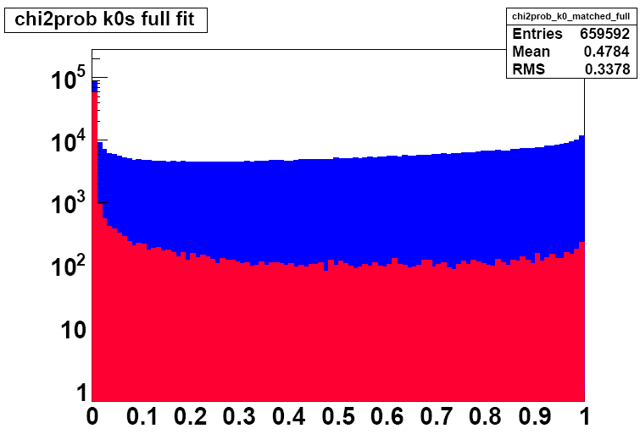
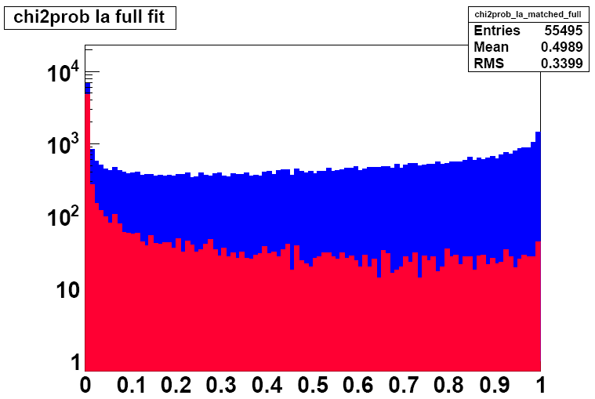
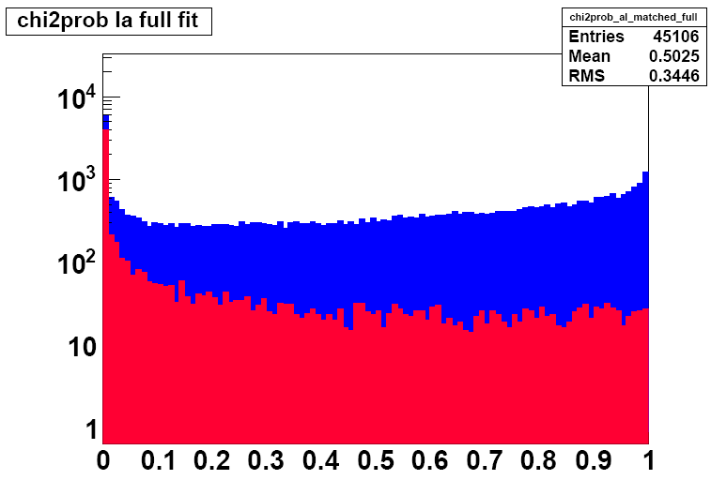
Kinematic Fit: Chi2 Probability & Background
matched to primary
not matched to primary
Cut: χ² probability > 0.05
Background to V0 sample estimated from MC:
Background for K0s = 2.23 +- 0.02%
Background for Λ = 6.64 +- 0.12%
Background for Λbar = 7.45 +- 0.14%
Primary-matched within R(ΔηΔφ) < 0.04
K0s
χ² prob
Λ
Λbar
χ² prob
χ² prob

Slide 5
V0 Correction
V0 Correction = 1 / ( acceptance x efficiency )
acceptance is restricted to kinematic range of sufficient V0 selection efficiency
- small systematics expected
efficiency is estimated with detailed MC
MC Sample:
/MinBias_TuneD6T_7TeV-pythia6/Summer10-START36_V10_SP10-v1/GEN-SIM-RECODEBUG
(CMSSW_3_6_2)

Slide 6
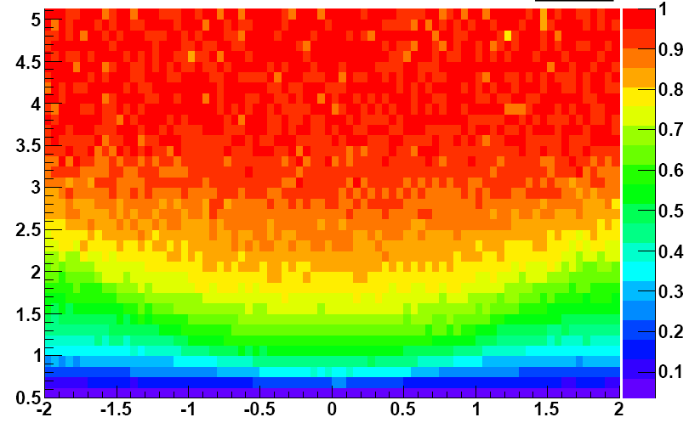
K0s Correction: Acceptance
Acceptance definition: N_acc / N_gen
N_gen = K0s generated inside:
pT > 0.5 GeV
|η| < 2.0
N_acc = fraction of N_gen which passed the acceptance cuts:
pT_daughters > 0.3 GeV
|η_daughters| < 2.5
gen transv. flight dist. > 1 cm
K0s pT [GeV]
K0s η

Slide 7
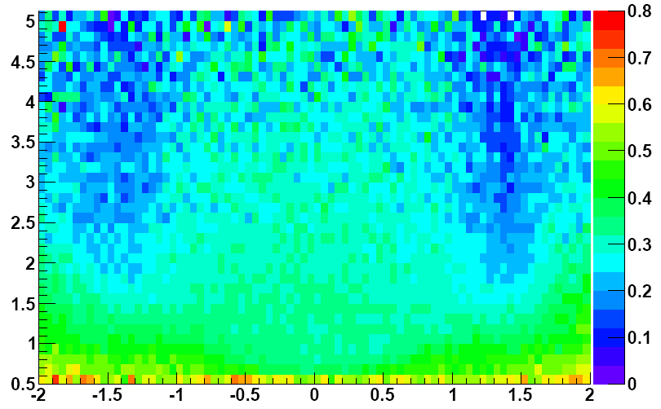
K0s Correction: Efficiency
Efficiency definition: N_rec / N_acc
N_rec = K0s passed all reco cuts:
|η daughters| < 2.5
pT_daughters > 0.3 GeV
|η K0| < 2.0
pT_K0s > 0.5 GeV
Transverse flight distance > 1 cm
Efficiency is relatively high
MC is describing efficiency correctly → lifetime test
https://indico.cern.ch/getFile.py/access?contribId=0&resId=0&materialId=slides&confId=115969
(QCD meeting)
→ small systematic uncertainties expected on the rates.
K0s pT [GeV]
K0s η

Slide 8
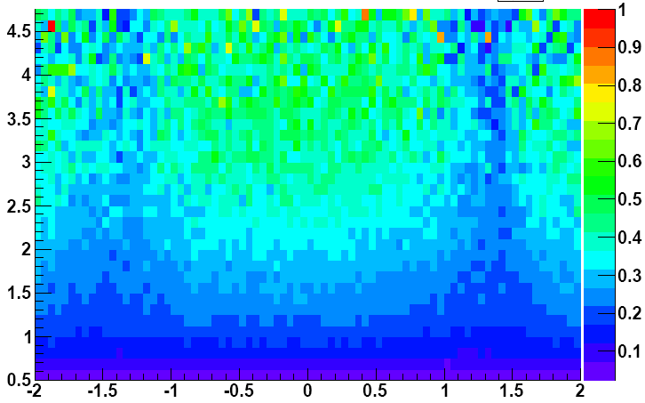
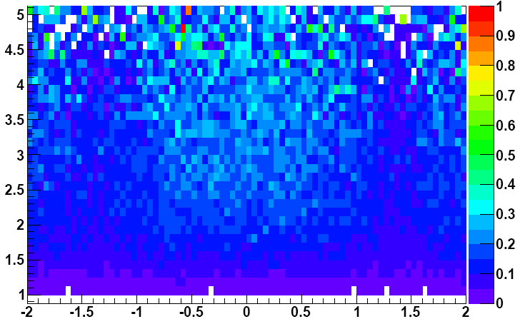
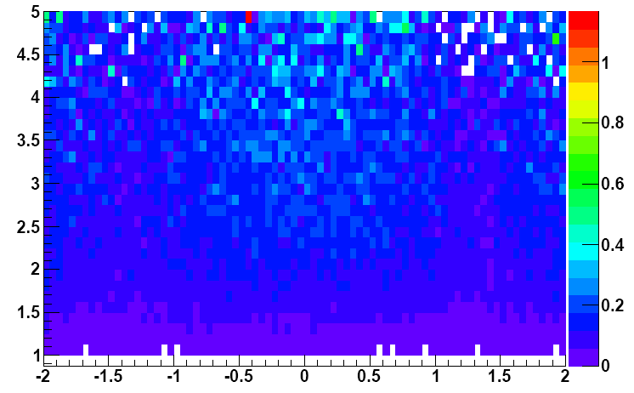
V0 Correction: Acc x Eff
K0s
Λ
pT [GeV]
pT [GeV]
η
η
Λbar
pT [GeV]
Acc x Eff = 1/weight
η

Slide 9
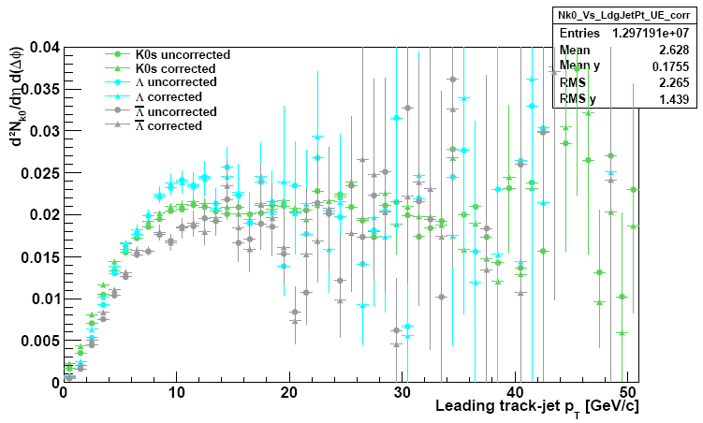
Cross-check: uncorr./corrected rates
Shapes normalised to 1
Observed trend is not a feature of the correction

Slide 10
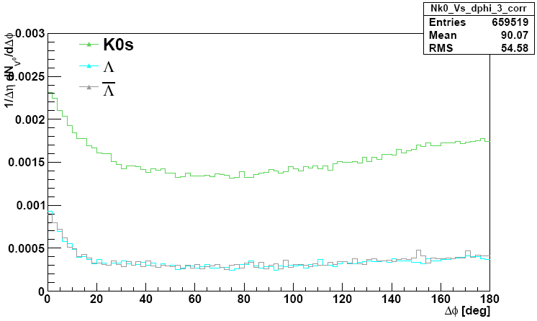
1/Δη dN/dΔφ

Slide 11
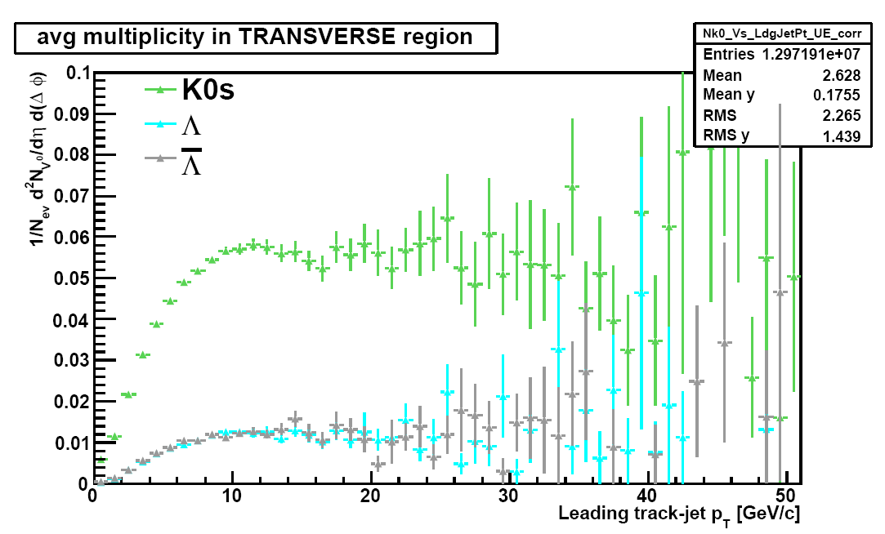
Rates

Slide 12
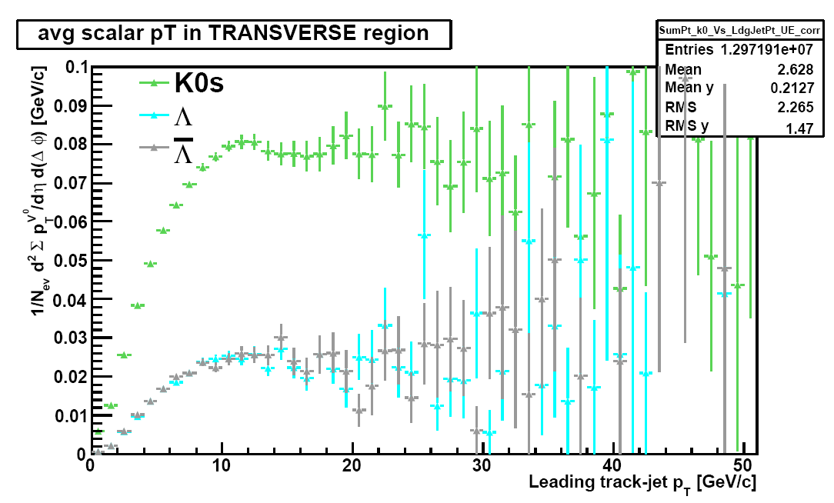
Scalar pT Sum

Slide 13
Conclusion & Plans
very first look on the rates of the strange particles (K0s, Λ, Λbar) in the underlying event
using kinematic fit to select relatively clean V0 sample
Similar trend with track-jet pT as for primary charged particles
Plans
produce rates corrected for background
evaluate systematic uncertainties
  V0 selection efficiency
  V0 acceptance (different PYTHIA tunes)
  background subtraction
  trigger and event selection

Slide 14
Backup Slides

Slide 15
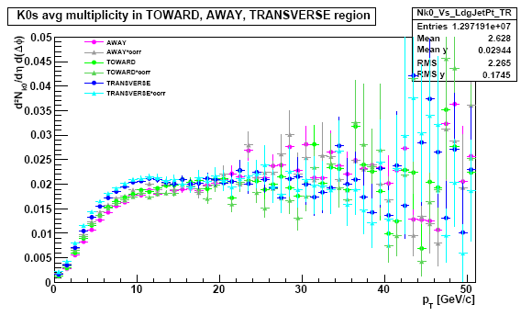
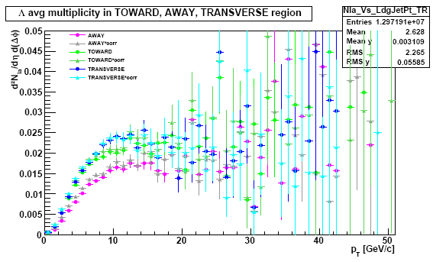
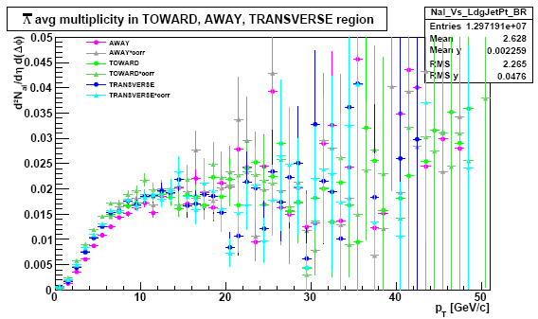
Cross-check: uncorr./corrected rates
Leading-jet
Leading-jet
Shapes normalised to 1
Observed trend is not a feature of the correction
Leading-jet

Slide 16
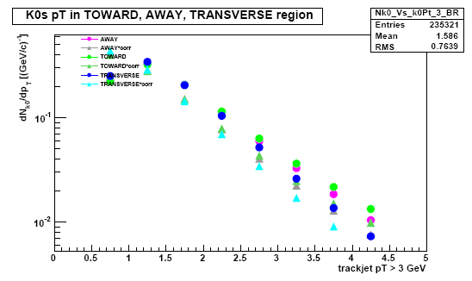
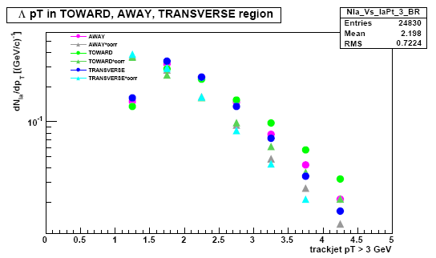
pT Spectra (shape comparison)

Slide 17
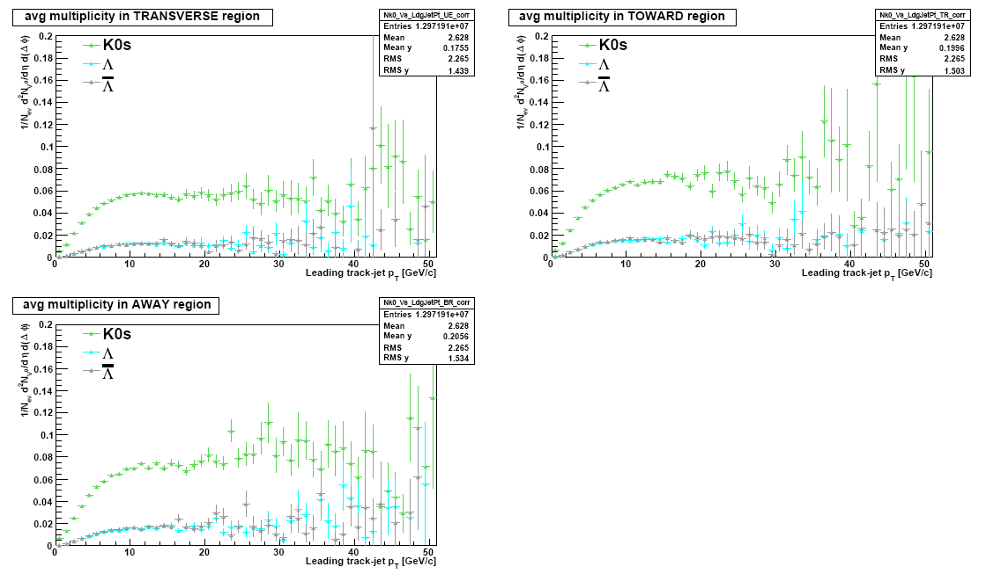
Rates
More V0 activity in the toward region

Slide 18
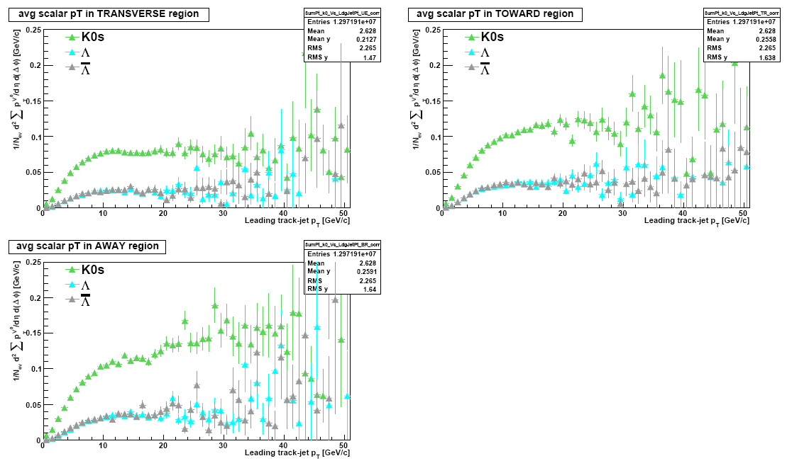
Scalar pT Sum

