Slide 1


Inner Tracking & Vertex Detectors
Frank Hartmann
Slides borrowed/stolen from many many people (including myself) ☺
Caveat: This is not a lecture about tracking; this is about how to design detectors to be good at the job!

Slide 2
You will learn today
A reminder that a silicon sensor is simply an array of diodes - see detailed silicon sensor lecture yesterday
  Today with a bit different spin
Designing and operating a Tracker is a bit more complicated than placing sensors one after the other
Different Tracking Detectors as examples!
  Historic and future
    NA11, DELPHI, CDF, CMS; future CMS

Slide 3
A simple array of diodes
A REPETITION WITH A SLIGHTLY DIFFERENT SPIN

Slide 4
Historical aspects – Why use silicon?
Since 50ies large crystals for energy measurements
Need for fast and precise position measurements
  80ies charm quark tagging
  Late 80ies LEP experiments, vertex tracker
  90ies in hadron machines FERMILAB
  Today in all LHC experiments
Where are silicon sensors better suited than gas detectors?
Fast ~O(10ns); Precise O(5µm); very good energy resolution ~O(eV)
Take home
Silicon detectors gives momentum & vertexing,
which gives
b tagging
lifetimes
mixing background suppression
…… and a lot of great physics!
  Why wasn’t silicon used earlier?
    Needed micro-lithography technology ⇒ cost
    Small signal size (need low noise amplifiers)
    Needed read-out electronics miniaturization
      (transistors, ICs)

Slide 5
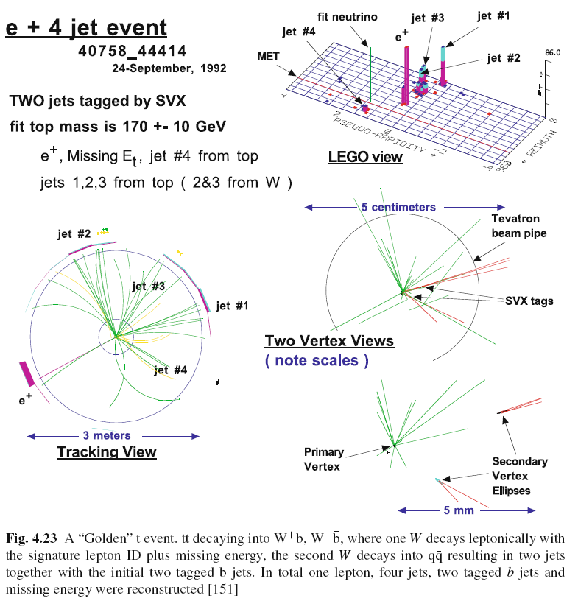
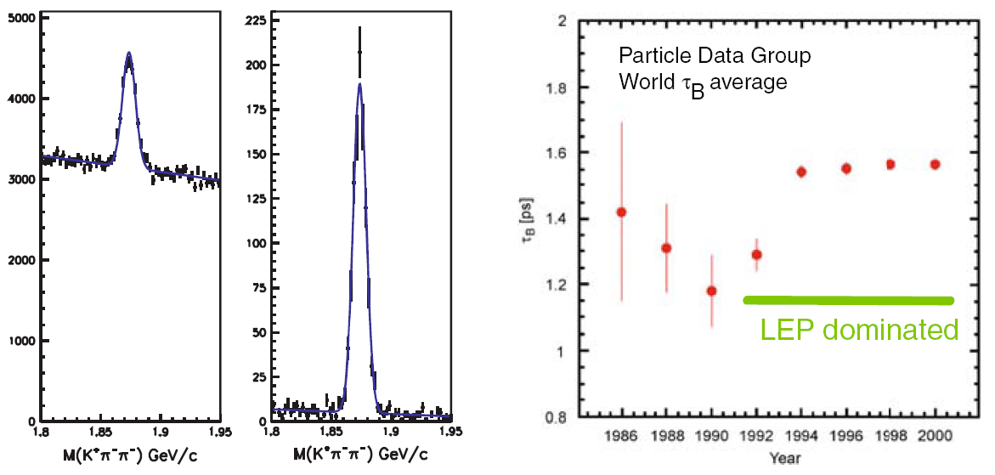
Historical aspects II – Why use silicon?
In the post era of the Z and W discovery, after the observation of Jets at UA1 and UA2 at CERN, John Ellis visioned at a HEP conference at Lake Tahoe, California in 1983 “To proceed with high energy particle physics, one has to tag the flavour of the quarks!”
CDF; top quark discovery
LEP
Background reduction

Slide 6
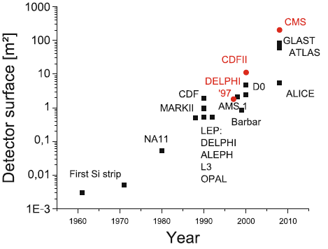
Evolution of Semiconductor detectors
scaling, scaling, scaling
HL-LHC CMS
Forward calorimeter???
HL-LHC
ATLAS/CMS
Tracker
FERMI
50ties
Early strips
NA11
LEP & Tevatron
LHC
Beyond
Notes:
Scaling system up and Scaling electronics down was the main challenge in the past!
Miniaturization!

Slide 7
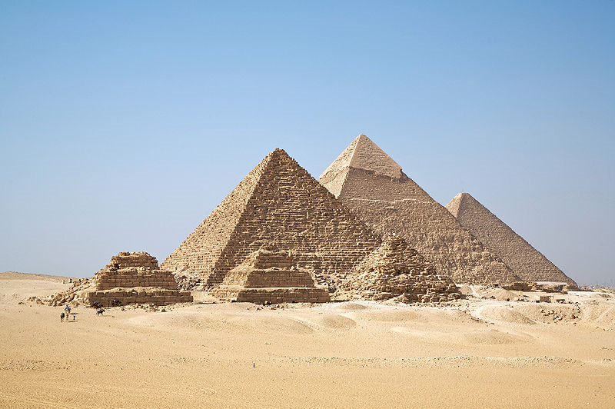
The truth - Why Really Use Silicon
We benefit from the huge technological advances in the IT industry
  Pattern and structuring is industry standard
Even if the infrastructure is expensive, the basic ingredients are ridiculously cheap and exist in abundance
Air
The usefulness and success of silicon technology can be explained in a handful of keywords:
• existence in abundance
• energy band gap
• possibility to change gap properties by defined adding of certain impurity atoms
(dopants)
• the existence of a natural oxide
Sand

Slide 8
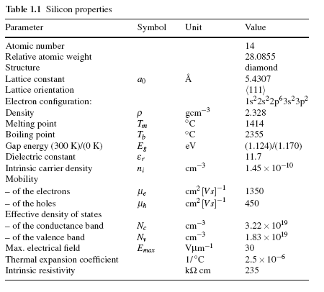
Silicon properties – the numbers are simply right
And detector relevant:
Dense: the average energy loss and high ionized particle number with 390eV/μm ∼ 108 (electron–hole pairs)/μm is effectively high due to the high density of silicon.
  No charge amplification needed
very good intrinsic energy resolution: for every 3.6 eV released by a particle crossing the medium, one electron–hole pair is produced. (30 eV to ionize a gas molecule)
Very fast O(10ns)
Mechanical stability
  Self supporting

Slide 9
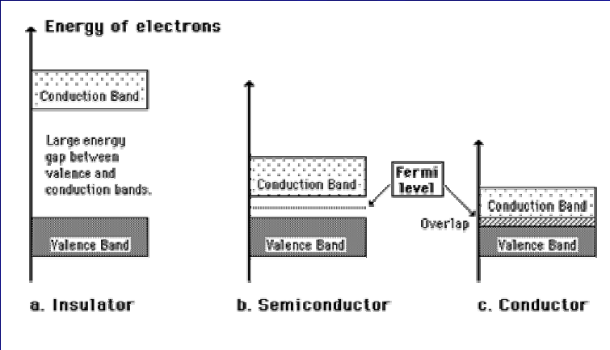
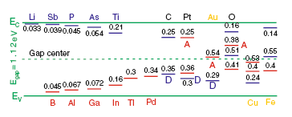
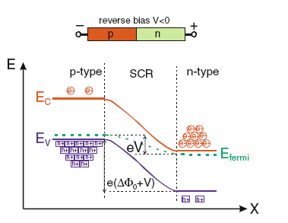
How do Silicon sensors work?
(Remember details last lecture)
Conductive, when electrons are here
Band gap
Conductive, when electrons are missing here (holes)
New energy levels
Dope
Take home: ➔ Dedicated material tuning possible!
Reverse bias
Reverse bias diode = no free charge carriers
Electrical field helps to „drain/collect“ the created charges (e-h)

Slide 10

BUT

Slide 11
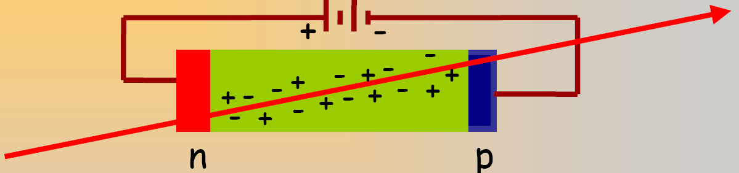
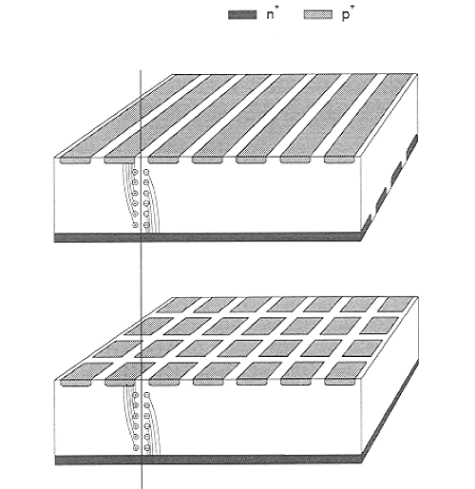
From Diode to Strip or Pixel Sensor
One diode
Produce more diodes!
Better: produce more diodes on a single substrate
  = Create a pattern on the substrate
  Reverse bias the pattern individually
Reminder:
Doping – Reverse Bias
strip
pixel/pad

Slide 12
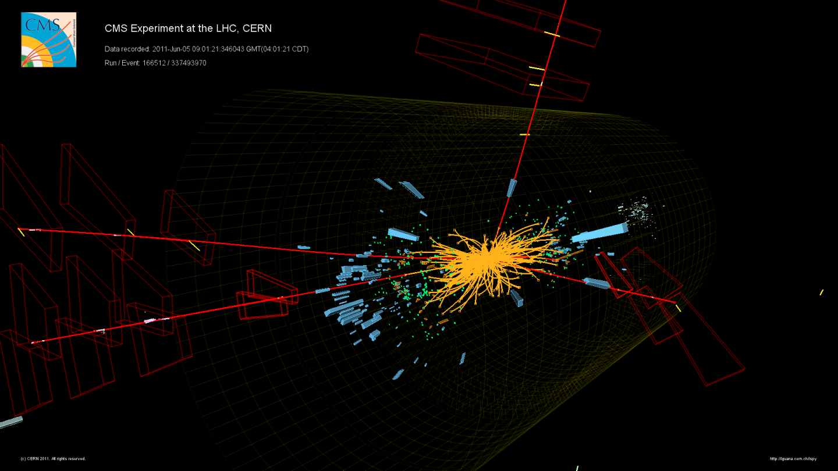
OK, let’s mount these arrays of diodes one after to other to get space points
How does it work in a FULL detector?

Slide 13
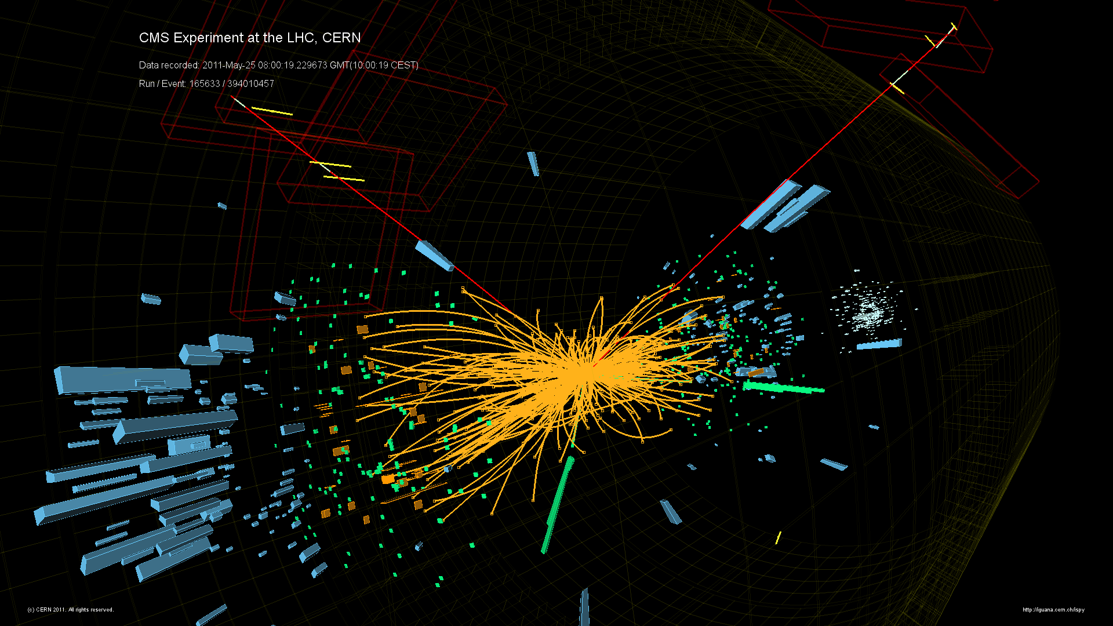
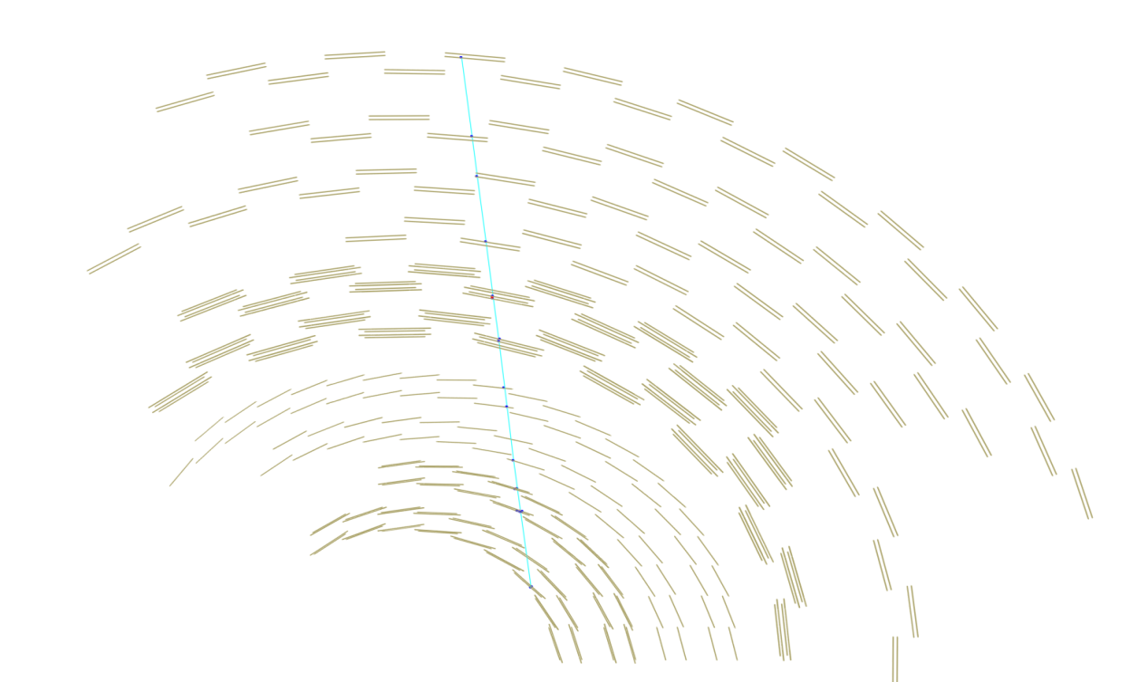
What is the task of these detectors?
(5) With even better resolution and lower occupancy (pixels)
- identify origin (vertex)
(2) Magnetic field bends the tracks
Momentum & energy
(3) With good 3D resolution and low occupancy
– isolate tracks in this mess
→ Pattern recognition
Measure track POINTs where charged particles traverses
Reconstruct tracks (interpolate points)
(4) In conjunction with calorimeter identify particle (see first lecture)

Slide 14

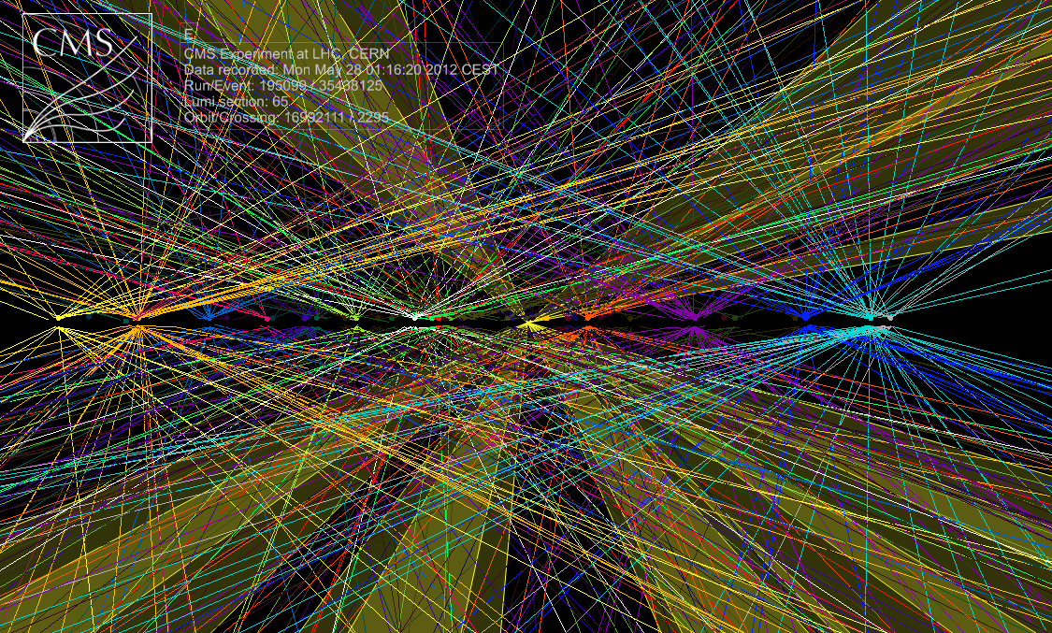
Role and Challenges (I)
Measure the trajectory of the particle
  Several points (hits) along the track
  Fit a curve (helix or straight line)
    Determine momentum from the curvature in the magnetic field
    Track is mandatory for the particle flow algorithm and used for jet and MET reconstruction
      Remember an ECAL event without a track is a photon
Challenge at LHC
  High occupancy, radiation dose and data rates
  At LHC design luminosity (times 10 for HL-LHC)
    >20 interactions = 1000 tracks per pp crossing every 25 ns
Need large channel granularity to keep occupancy at acceptable level (percentage and below)
  Large numbers of electronic channels increase material and heat load
    Sensors, Power, cooling
  Minimize material to minimize multiple scattering of charged (and neutral) particle before the calorimeter and to avoid photon conversion

Slide 15
Role of the Tracker (II) - Vertexing
Extrapolate track back to the point of origin
  Reconstruct
    Primary vertices (one among many)
      Distinguish primary vertices and identify the vertex associated with the interesting hard interaction
    Secondary vertices
      Identify tracks from tau-leptons, b- and c-quarks by lifetime tagging
        They decay inside the beam pipe
      Identify photon conversion and nuclear interactions
Just this one
Take home: This is the task of the pixel detector

Slide 16
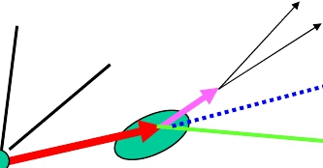
Example: Measurement of B Meson Lifetime
• Look for B vertex and measure decay length - distance between
primary and secondary vertices
• Most of decays of B mesons happen within 1-2 mm of interaction
point (cτ ~ 0.5 mm, stretched by relativistic time dilation)
• Need vertex detectors with excellent position resolution ~ 10 μm
Decay Length = lifetime
K
π
ν
D0
∝
B
Primary Vertex
Secondary Vertex

Slide 17
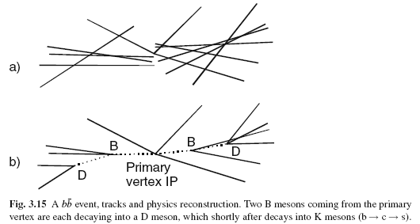
Ok, how does it work?
What we get, when “simply correctly” interpolate and extrapolate the space points to tracks!
Can you see the two B mesons?
A bit computational brainpower later

Slide 18
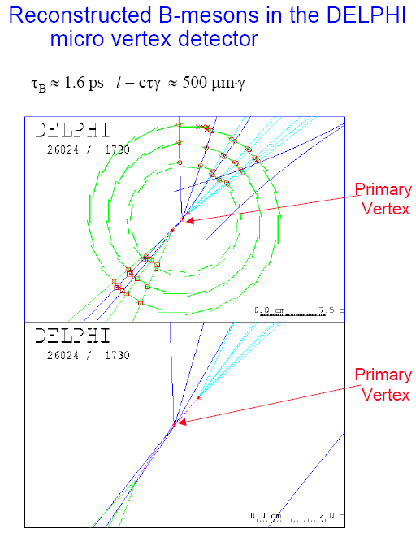
Do we need such a high resolution?
Identification of
b-quark event
~1 mm
=
~1ps
=
τ_{b}
Notes:
Inside the beam pipe

Slide 19
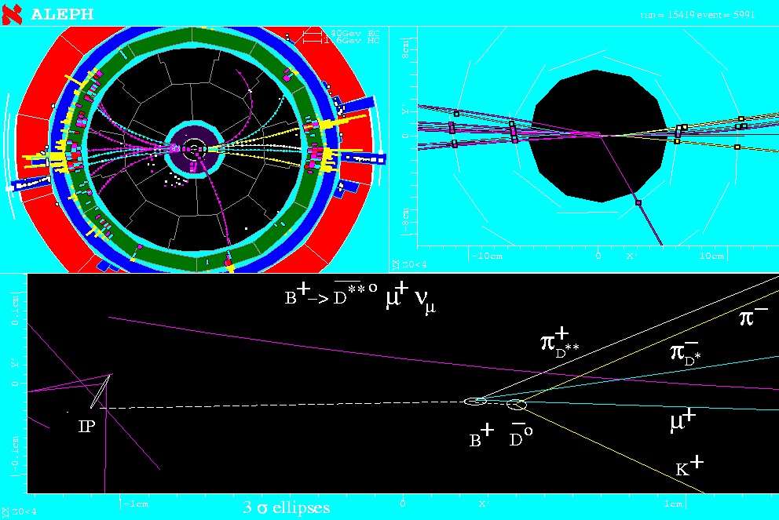
Increase in precision
=Beam crossing point
0
x
1cm

Slide 20
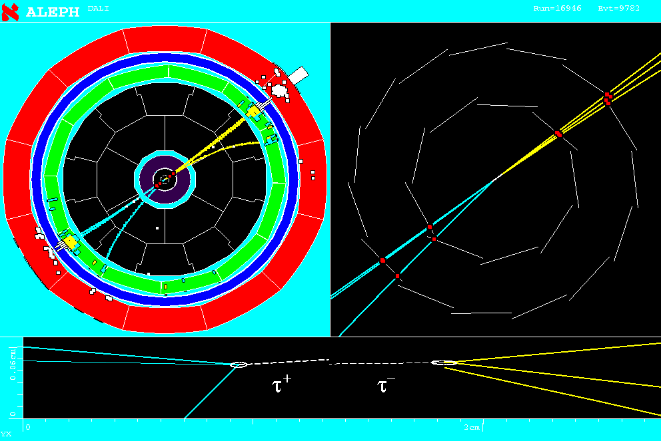
Mean Lifetime of tau τ=290 x 10⁻¹⁵ sec !! --> cτ = 87 μm !?

Slide 21
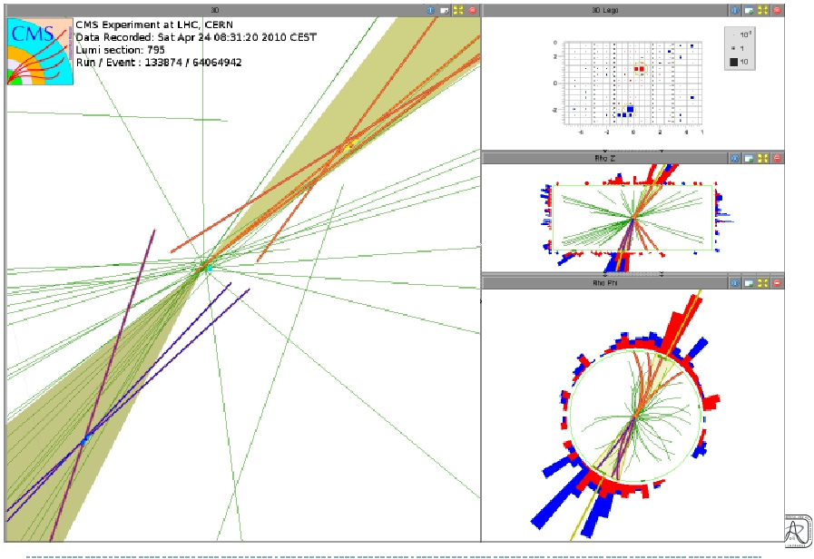
CMS double B jet CANDIDATE
Stating the obvious:
These second vertices are inside the beam pipe.
There are NO detector elements
Precision outside has to be good enough to extrapolate down here

Slide 22
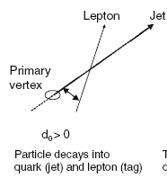
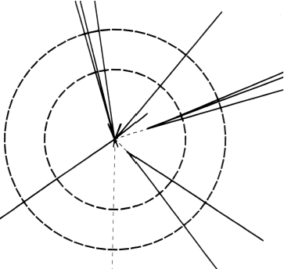
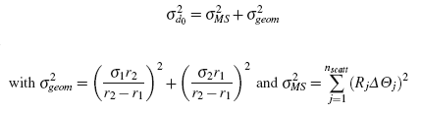
How to design to achieve the former?
Impact Parameter Resolution
Tag b-quark - secondary vertex
Impact parameter d₀
For two layers: Error propagated to interaction point
R₁
R₂
r₁ small
r₂ large
small σ_{n} = High intrinsic point resolution
Low mass
Take home

Slide 23
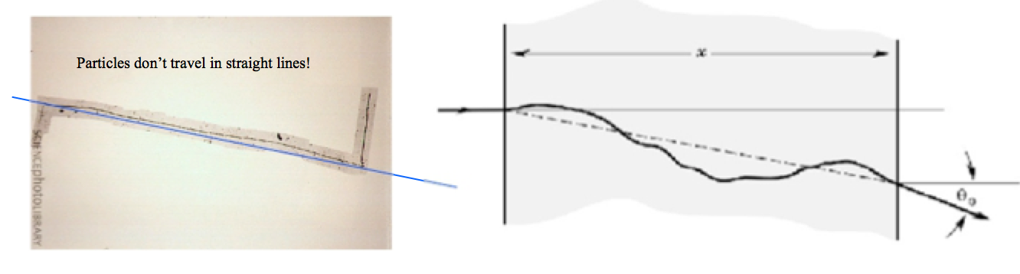
There is no straight line!
Particles moving through the detector material suffer innumerable EM collisions which alter the trajectory in a random fashion (stochastic process)
Coulomb scattering on nuclei
  Charged particles only
Ergo, you want to have a massless tracker

Slide 24
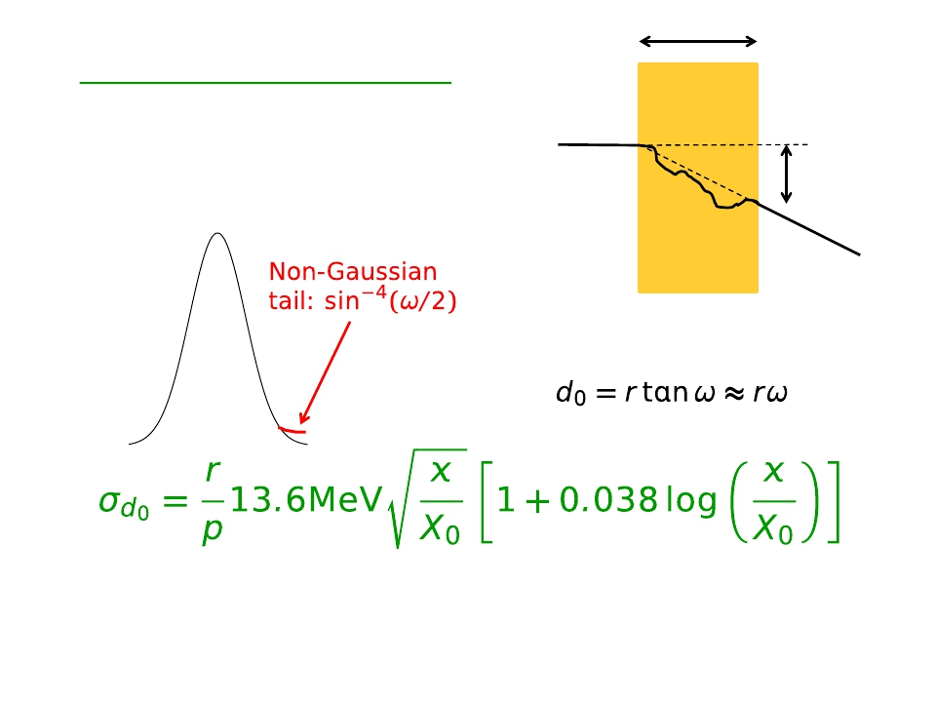
Multiple Scattering
x
plane
Distribution of ω is nearly
Gaussian (central 98%)
K. Nakamura et al. (PDG), J. Phys. G 37, 075021 (2010)
d₀=r tanω
Particle incident on a thin layer, fraction x/X0 of a radiation length is bent by angle ω
ω
MS
Higher momentum, p → less scattering
Best precision with
  small radius, r,
  and minimum thickness x
Take home
Notes:
This is BAD
x – traversed thickness,
X₀ – material radiation length

Slide 25
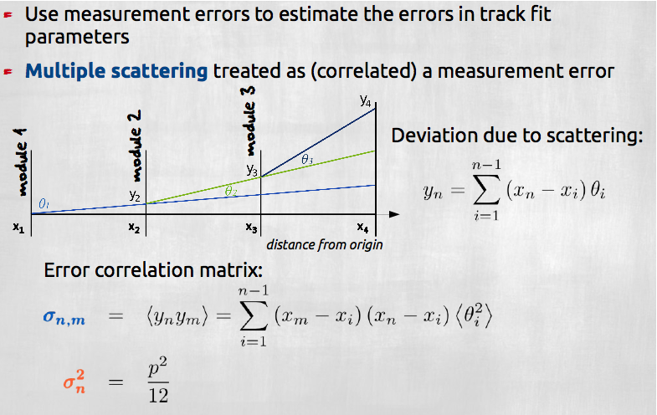
Tracking has to take it into account!

Slide 26
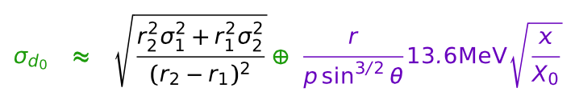
Leaving 90º incident angle
Transverse Impact Parameter resolution all together Geometry and Material
Tracks with θ ≠ 90 º
σ_{d0} depends
on geometry
on material,
decreases with p_{T}
Take home:
track
Sensor
This particle sees much more material
track

Slide 27
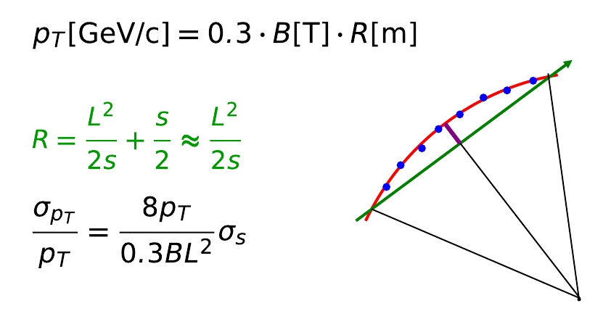
You want especially good point resolution σ _{n}
here
Measuring momentum
Circular motion transverse to uniform B field:
Measure sagitta s, from track arc → curvature, R
Assume path length 1 m; B=2T
p_{T} = 1GeV s = 7.4 cm R = 1.67m
p_{T} = 10GeV s = 0.74 cm R = 16.7m
p_{T} = 1TeV … ....
s
L/2
Relative momentum uncertainty is proportional to p_{T} times
Sagitta uncertainty, σs. Also want strong B field and long path length, L
Take home:
σ_{S} clearly defined by individual point resolutions and multiple scattering

Slide 28
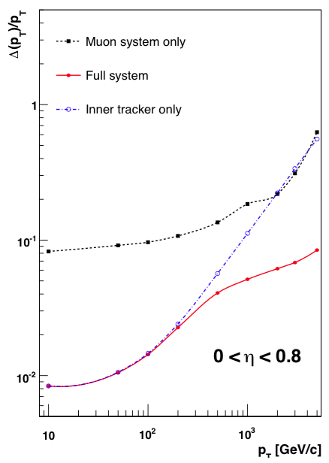
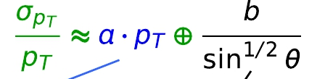
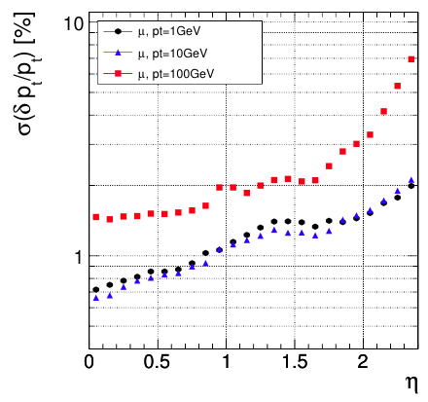
Momentum resolution (CMS)
2008 JINST 3 S08004 CMS Experiment
Expected relative pT resolution
for muons vs |η| and pT.
b = material term
Zoom – next slide
&
B-field wrong orientation
(More material) →
Notes:
In truth the energy information for low/middle energetic electrons come from the tracker!!!

Slide 29
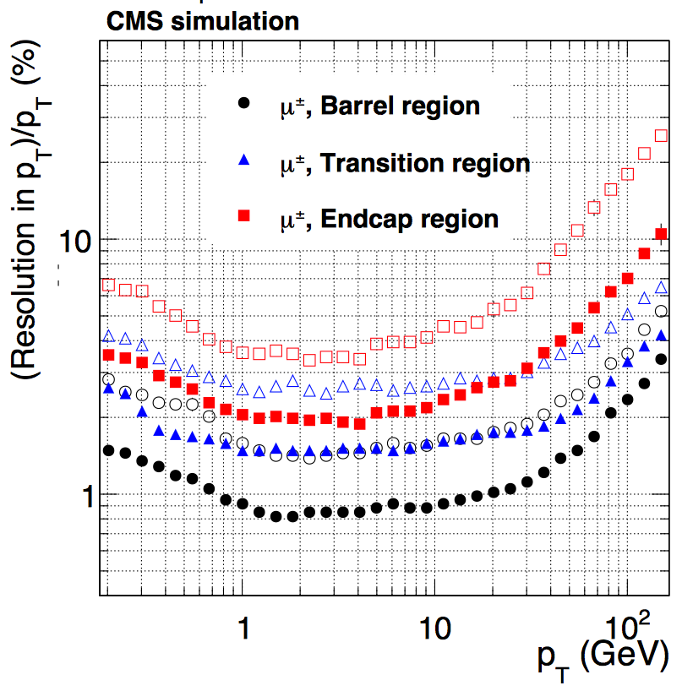
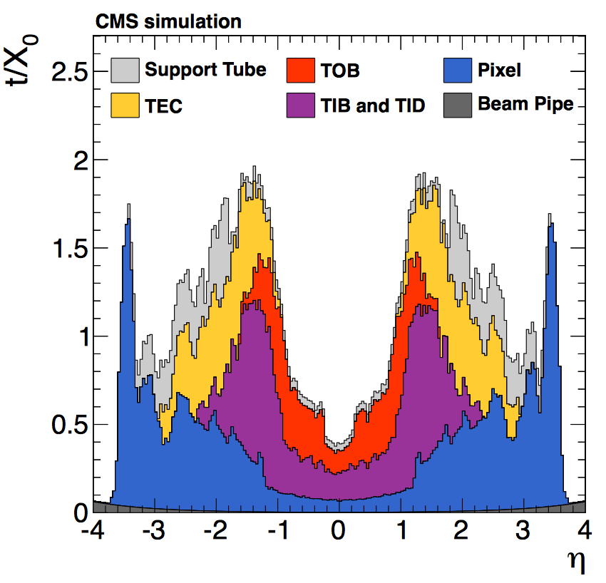
Track Intrinsic Parameters - CMS
Hit (point) Resolution
Alignment
High momentum
Straight tracks
Point resolution!
Sagitta resolution
Track parameter
resolutions
Multiple Scattering
  Mass is bad
Low momentum:
Multiple scattering

Slide 30
Again: Why Silicon Sensors for Trackers?
➢ Main features of silicon detectors:
• Fine granularity → very accurate position resolution
• Small amount of energy for signal quanta→ large signal
• Thin → close to interaction point
• Low mass → minimize multiple scattering
➢ True two dimensional detectors, like Silicon Pixel, are much robust in
high particle density environment
In most of the modern High Energy Physics experiment the
detector closest to the interaction point is based on silicon
pixel devices.
Small σ
Small r₁
Small

Slide 31
A bit of history
Pre-LEP
  Tracking with Gas Detectors – no vertexing
LEP
  Gas Detectors = tracking
  Silicon Strips = vertexing + seeding
    Without vertexing = no decent b-lifetime
TEVATRON:
  Gas Detectors = tracking
  Silicon Strips = tracking (seeding) + vertexing
    Without vertexing = no top quark
LHC
  Silicon Strips = tracking
  Silicon Pixel= vertexing and tracking (seeding)
HL-LHC
  Silicon Strips = tracking
  Silicon Strixels = tracking + vertexing on ~mm precision
  Silicon Pixels = tracking + vertexing (seeding)
Pattern recognition better with finer granularity
Often – one has an inside-out + an outside-in tracking algo

Slide 32
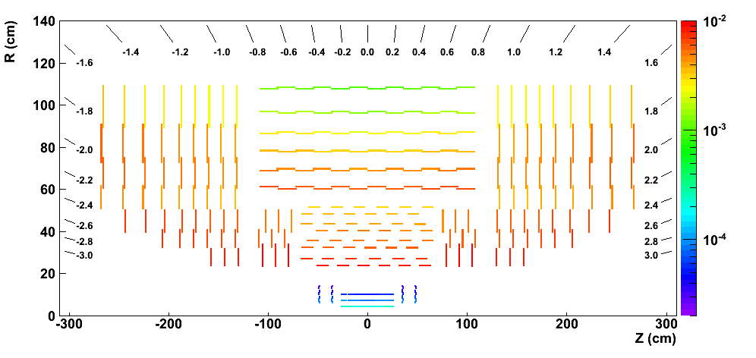
+ Reality & Detector occupancy
Example: pileup of 9 interactions.
~2%
Take home
This is DESIGN
~0,02%
➔ Track seeding here
Pixel detector occupancy is at least one order of magnitude smaller than strips. Occupancy depends on
  distance from collision point and
  channel size (pitch and length)
- single pixel area = 100μm×150μm = 1.5×10⁻²mm²
- typical strip area = 10cm×100μm = 10mm²
Notes:
Plots/maps from the Tracking paper

Slide 33
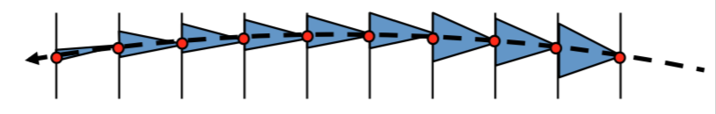
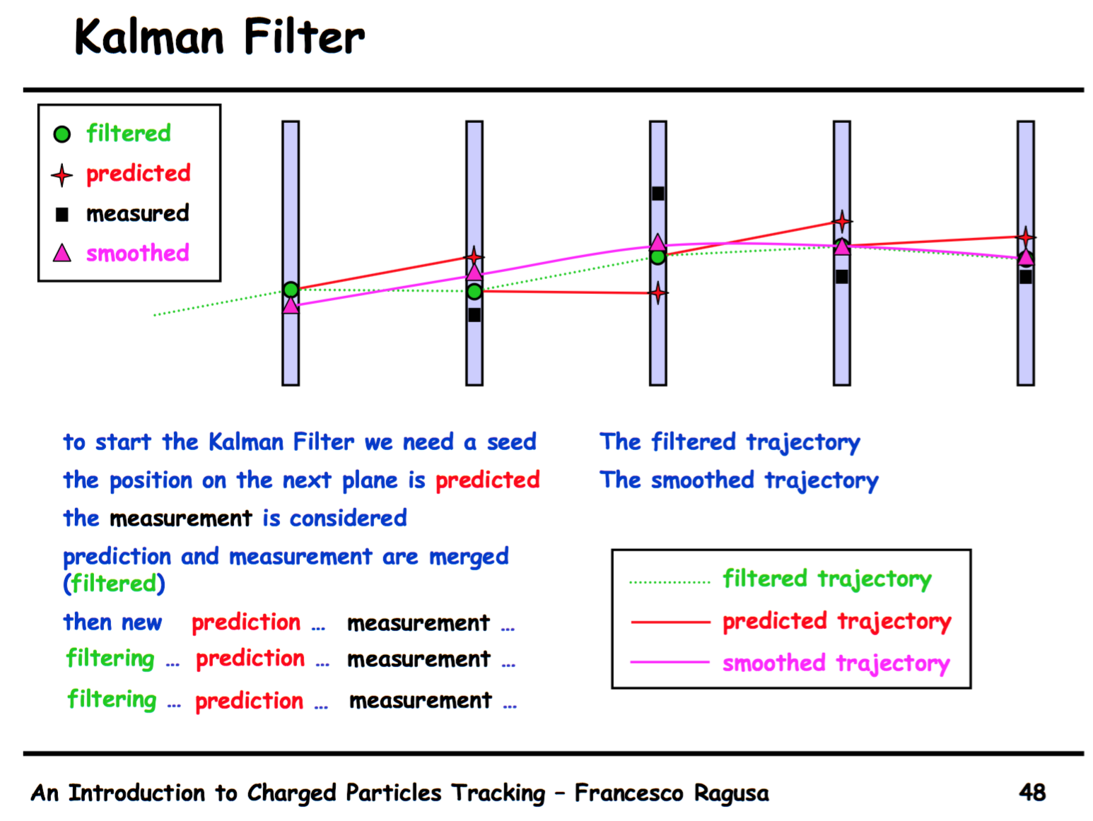
Tracking is basically A ROAD SEARCH
Often more than one possible road at the track points
Kalman filters improves parameters with each hit
Again: You want
No deviating tracks – no MS
  Algorithm compensates
Good granularity & low occupancy
  Only one track in the search window
  Low combinatorics
Track start at low radii
Large lever arm
Good point resolution
Any info/constraint helps:
  Vertex
  Info from other detectors
‘Borrowed’ from Francesco Ragusa

Slide 34
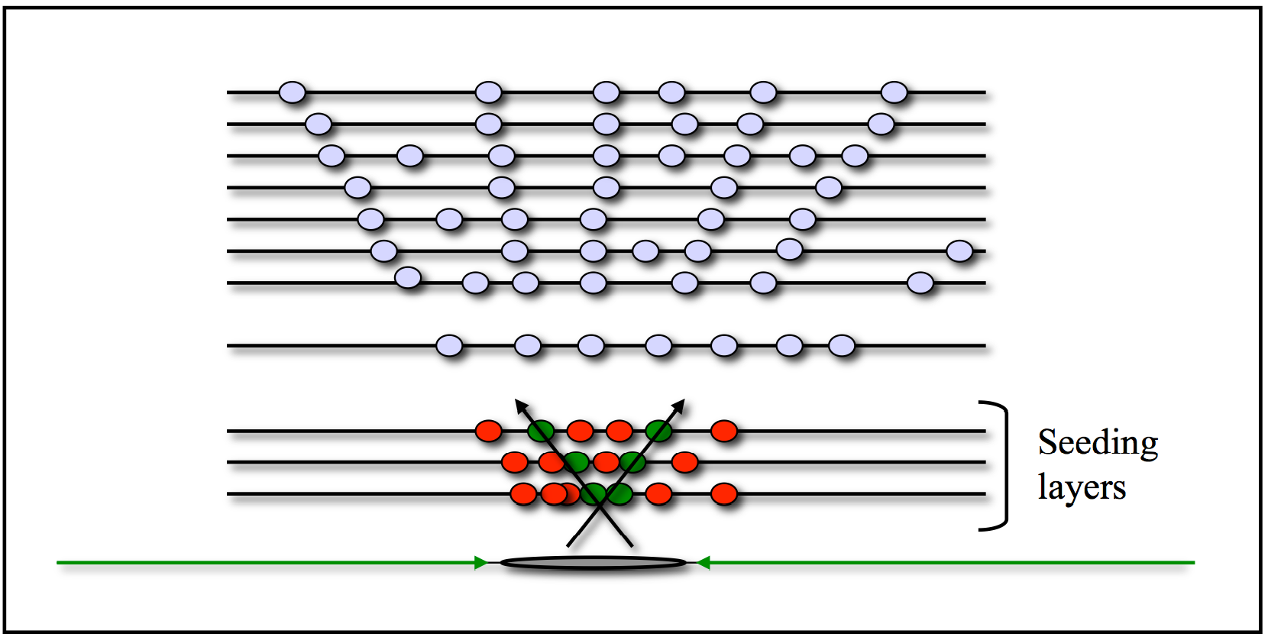
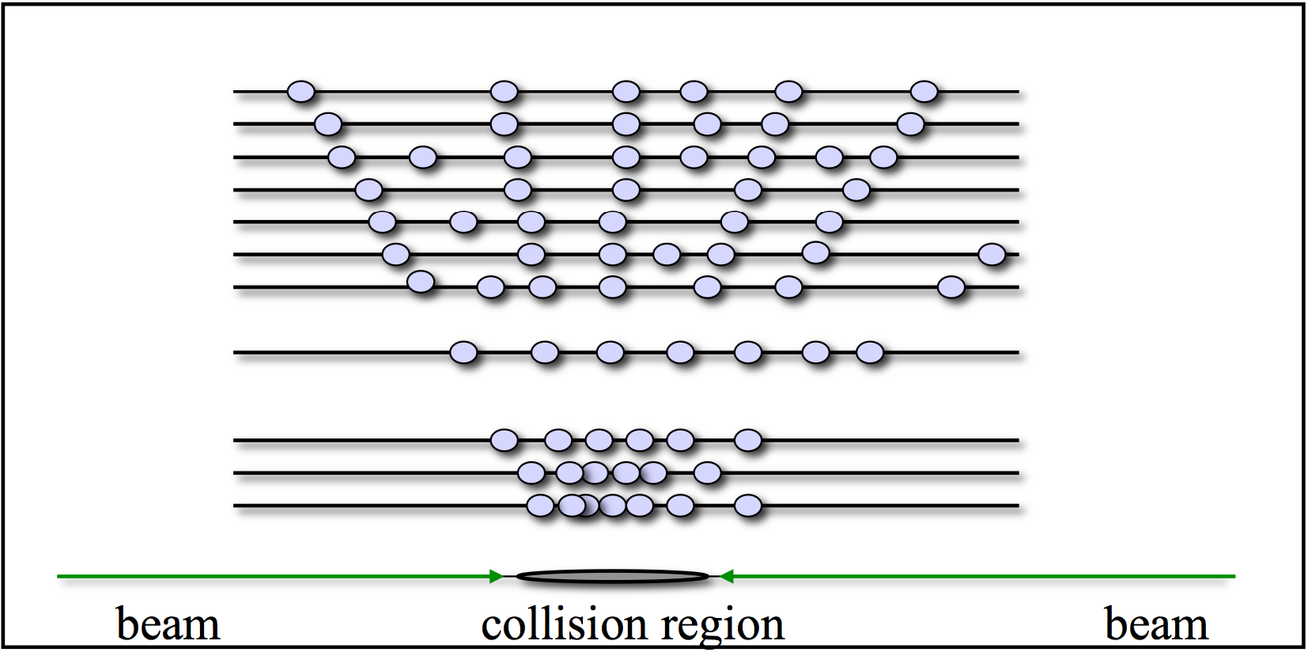
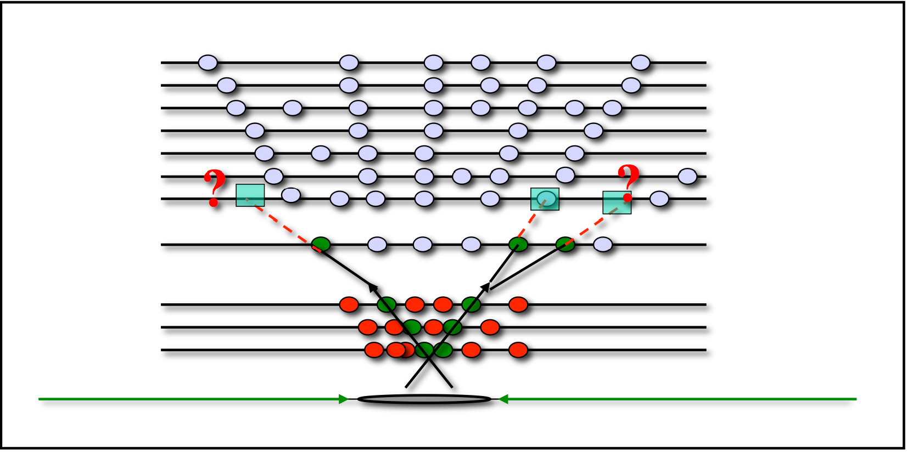
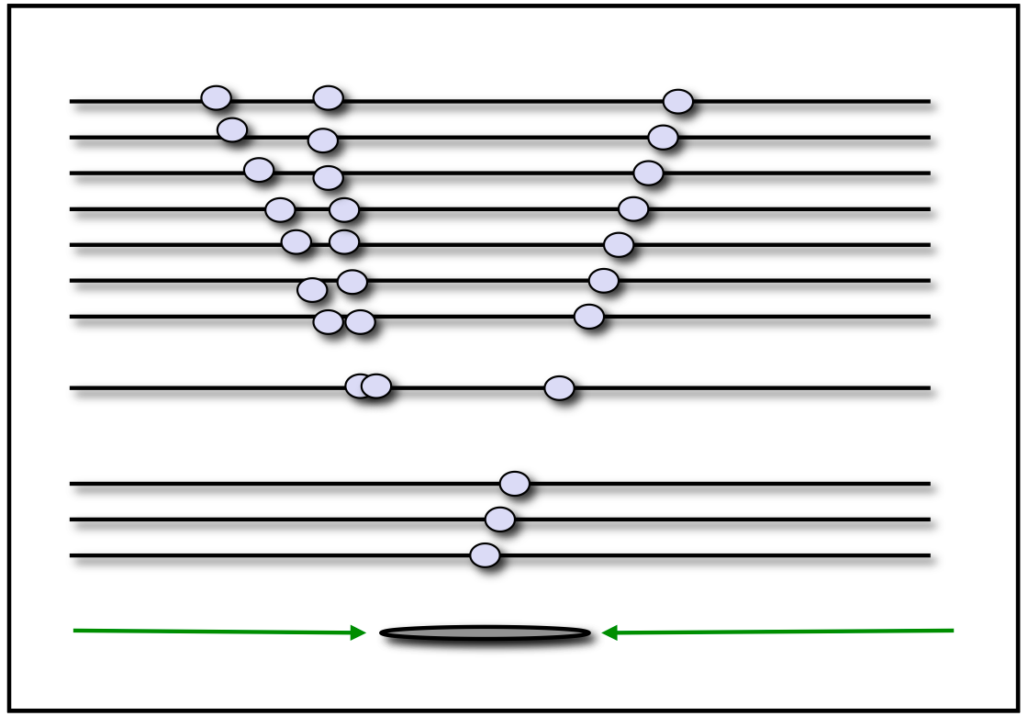
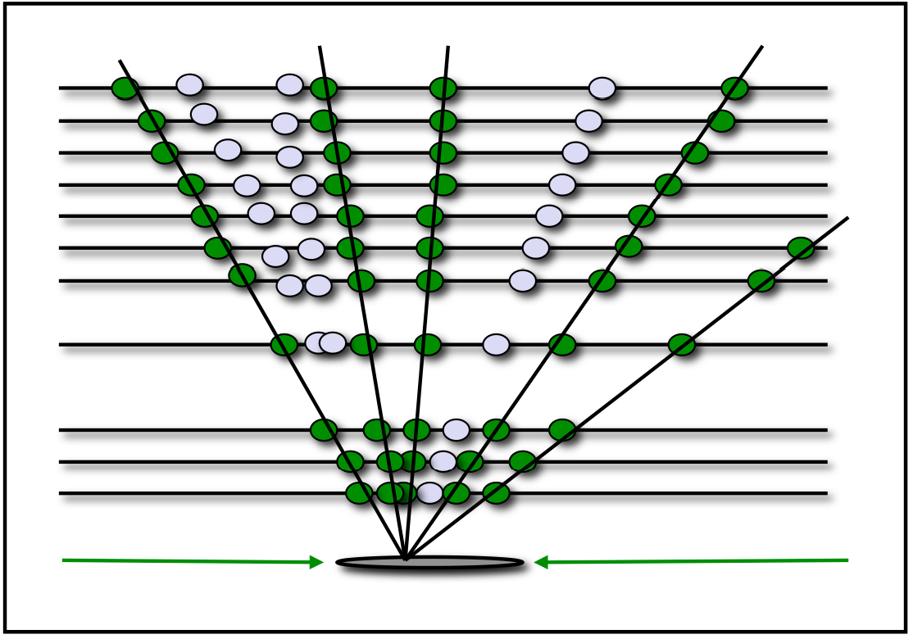
Tracking – https://cms.web.cern.ch/org/tracking-pog
Seeds
Strips
Hits (clusters)
Slide from CMS Tracking Training Days
Start
Pixel
Combinatorics!?!?!
Granularity is key
Track building
Unassigned hits
Serveral iterations
Track fitting and selection
Combinatorics!?!?!
Granularity is key
Notes:
Not addressed explicitly the track fitting, the track selection and the track quality assignment (only high purity track hits are removed for the next iteration). It is a detail

Slide 35
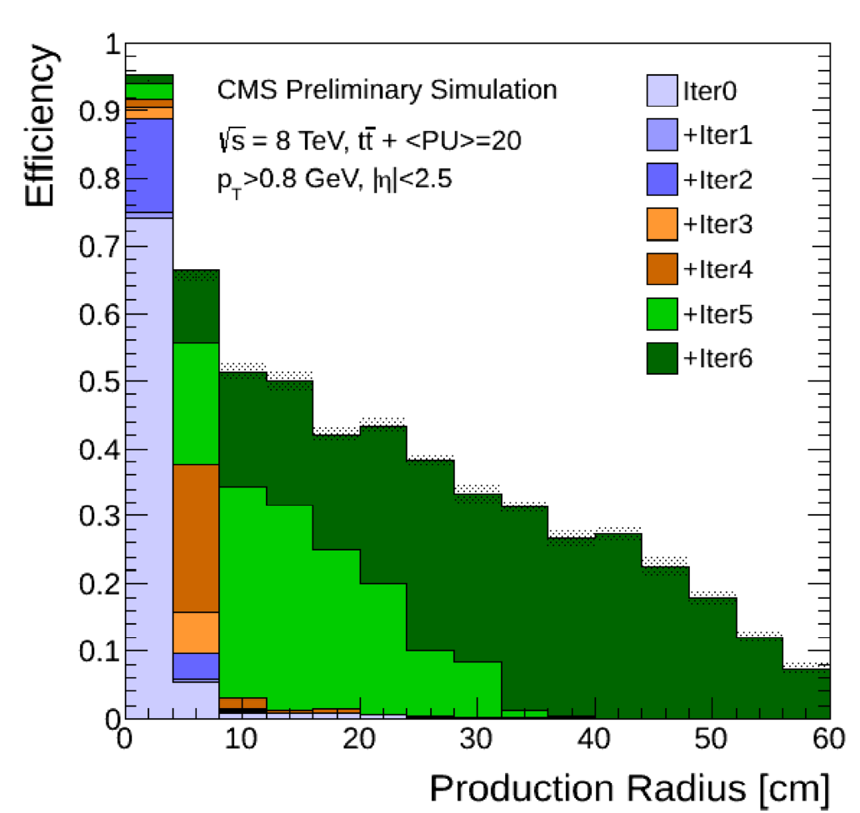
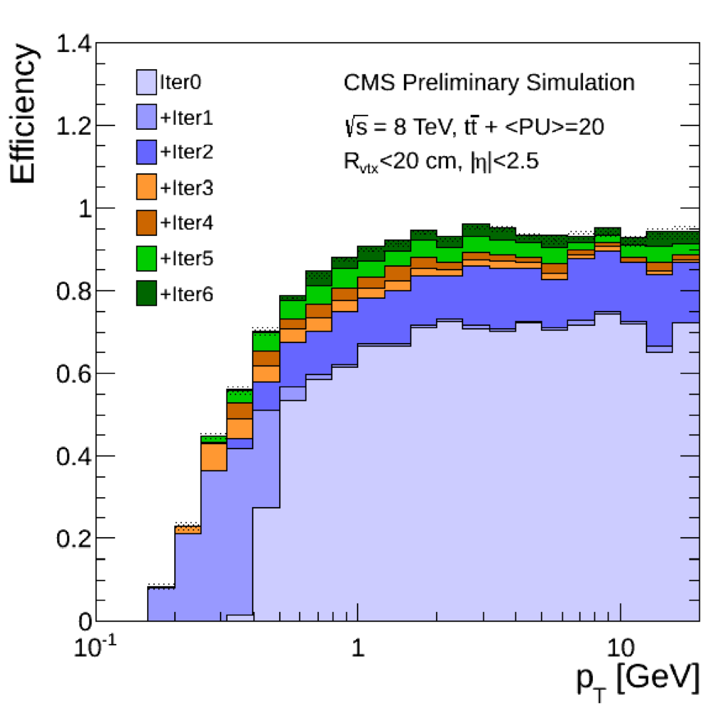
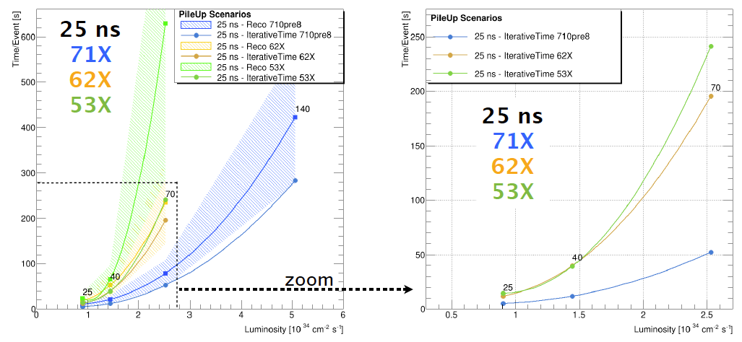
Iterative tracking features
Iterations beyond the
first one improve the
Acceptance either in
Pt or in displacement
And recover detector
Full hermeticity
Only 2 pixel hits …
displaced tracks
0: pixel triplets
1: low pt pixel triplets
2: pixel pairs. Recover gaps in pixel
3: displaced tracks with pixel triplets
4: mixed pixel/strip triplets
5: TIB/TEC
6: TOB/TEC
Situation gets more complicated with higher pile-up.
Lots of progress in software to counteract done and still necessary to be done!
Slide from CMS Tracking Training Days
Bla Bla computing power
Works with PU
PLOT
Notes:
Plots from here: https://indico.cern.ch/event/316061/contribution/3/material/slides/3.pdf.
Name of iterations are defined in a backup slide
Violet area- tracks passing through cracks, therefore producing only 2 hits in pixels
Later iterations cover wider phase space
Ideally profiting of the reduced hit multiplicity
…but it is not so easy
➔ tighter requirements to build those tracks

Slide 36
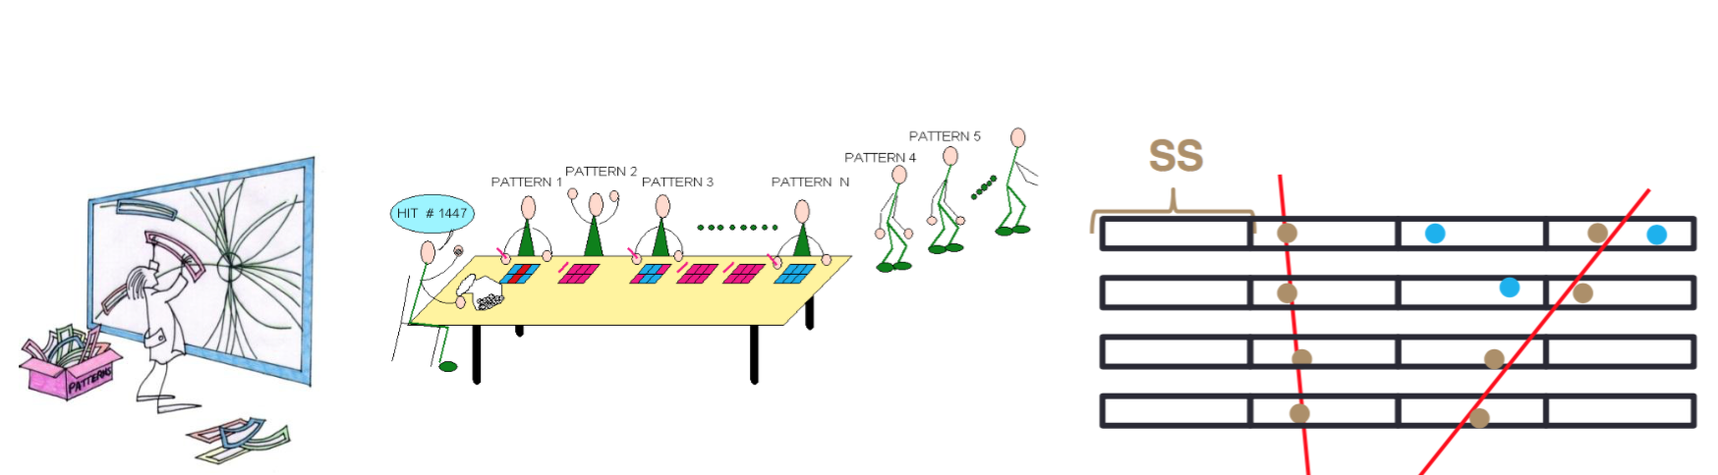
Or can we do tracking like this?
Look-up tables
  Associated Memories
  Number of patterns can easily ‘unmanageable’
Yes, we can
  This is what do in hardware for very fast response
    But it is a bit crude
    One needs to make a track-fit later
  Done at Level-2 trigger at CDF
  Will be done for ATLAS Track Trigger
  Is an option for the CMS Phase II trigger
    5μs / 12.8μs total trigger latency

Slide 37
And the EVIL mass …
How to avoid Multiple Scattering – It’s not the Silicon

Slide 38
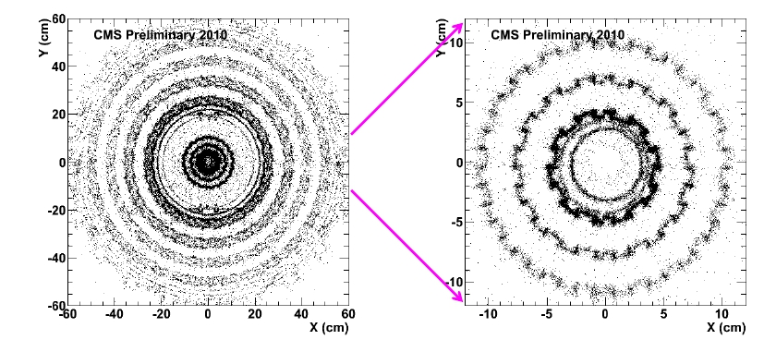
Photon conversions
CMS-­PAS-­TRK-­10-­003
Conversions, γ →
e+e , example from CMS
Two oppositely charged tracks
Consistent with coming from the same point
Consistent with fit to a common vertex, imposing zero mass
Slide from CMS Tracking Training Days
Have a guess!

Slide 39
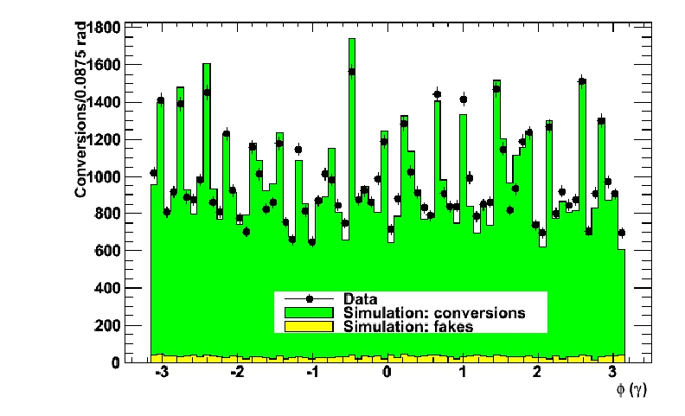
CMS conversions in pixel barrel
Φ distribution for conversions with |z|< 26cm, R< 19cm
→ Compare pixel barrel structure in data and simulation
Spikes due to cooling pipes

Slide 40
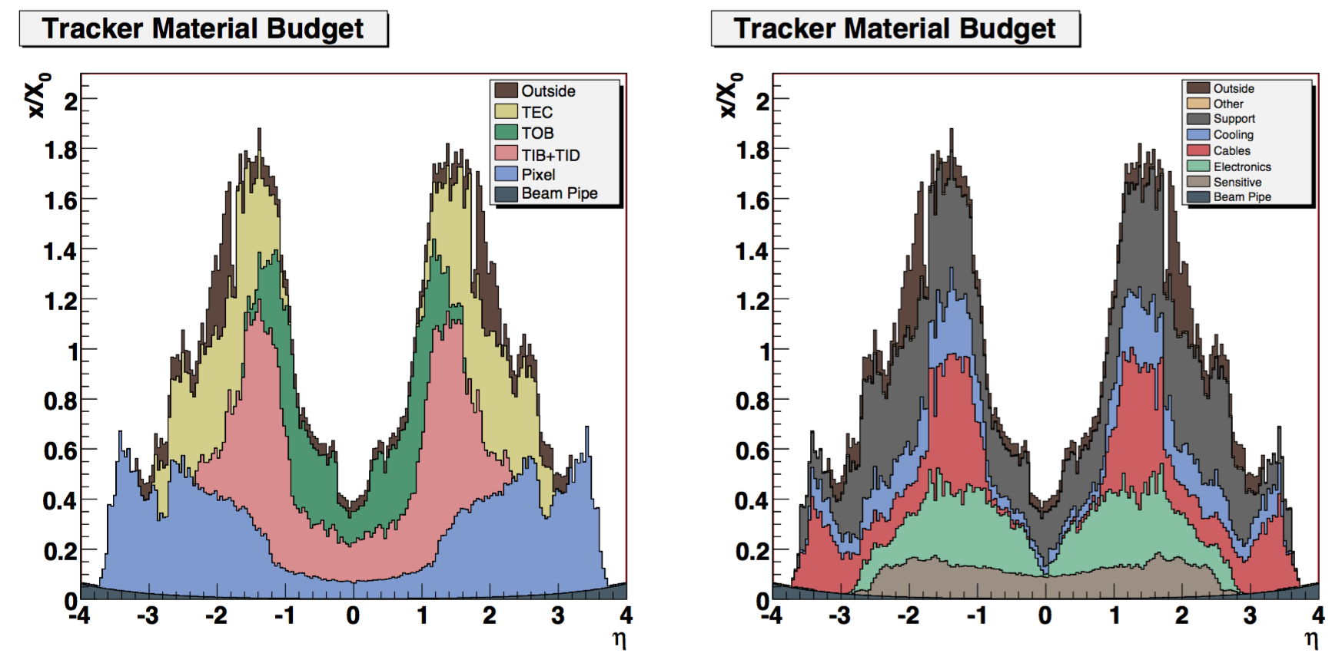
Tracker material (CMS TODAY)
Large material is considered the major drawback of the tracker. Nevertheless we should take into account that this large amount of material is instrumented.
➔Learn this lesson for the upgrade
Plot from JINST paper, actual numbers are even a bit higher

Slide 41
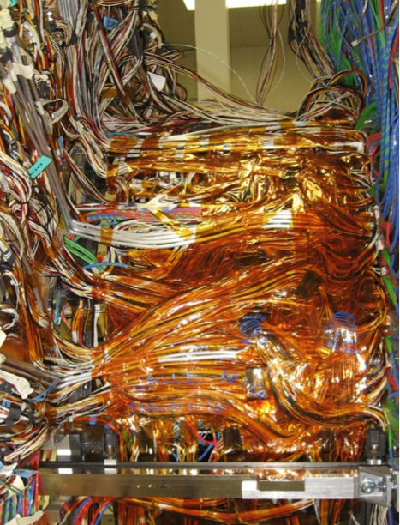
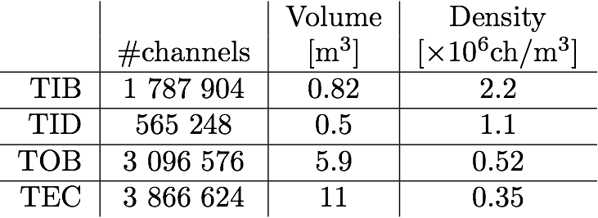
Services: why they are heavy?
TIB/TID is challenging in terms of number of channels over volume density.
A very large number of service connections to be constrained in a very tight room:
- ordered layout difficult;
- tough handworked job.
Slide from CMS Tracking Training Days

Slide 42
Last words on mass …
Earlier, I said: “It’s not the Silicon”
  This is true for a large detector as the LHC one.
  For an electron – positron detector even the mass of silicon is too much (services and mechanics are forbidden anyhow)
    Sensors should be thinned
    But not too thin to have enough signal (signal~thickness)
  Also remember the higher the momentum the less multiple scattering
    So what are you interested in??

Slide 43
More things to think about
Alignment
Overlaps to allow alignment determination in the first place
Hermeticity

Slide 44
Tracker Alignment
Consider a five-layer tracker
borrowed from F. Meier
To take home: CMS demonstrated, that initial perfect alignment is not crucial and can be determined later with tracks (but need collisions & cosmics)

Slide 45
Tracker Alignment
A track goes through, leaving hits

Slide 46
Tracker Alignment
All you really see are the hits, actually

Slide 47
Tracker Alignment
How do you fix this?
Now, if your tracker is misaligned, the hits positions really look like this

Slide 48
Tracker Alignment
How do you fix this?
If you assume the module positions are “ideal”, you see this

Slide 49
Tracker Alignment
How do you fix this?
So your track really looks like this

Slide 50
Tracker Alignment
How do you fix this?
To “align”, we keep track of the “residuals” between the hits and the
projected track positions (shown as ) for many tracks, then adjust
the positions of the actual detectors to minimize the residuals across the
whole tracker.

Slide 51
Real Life implementations in the CMS Tracker
2D (3D) information
Hermeticity
Lorentz angle compensation
Data treatment

Slide 52


Hermeticy
Tracker Inner Barrel
R
z=0
z
Slide from CMS Tracking Training Days
System is designed to be hermetic with respect to the interaction point
Being hermetic to other tracks would imply MORE material for tracks from the main interaction point
R
z
Tracker Endcap Disk

Slide 53


Double Sided (DS) module - 2D
DS modules are two modules literally glued back-to-back!
DS modules eventually provide 2D hit information; in CMSSW tracking both the single 1D rechits are used (fitting) and the matched rechits (building, HLT) are used
100 mrad
Slide from CMS Tracking Training Days

Slide 54

Overlap modules is necessary to guarantee hermeticity and to align the detector
Mechanical challenging
Silicon detector
×
overlap region
~5mm
×
Here TIB Single Sided modules

Slide 55



Tracker Inner Barrel (TIB) - TODAY
16 half cylinder shells, 135 to 216 modules. Front-back asymmetric, charge asymmetric since modules are tilted 9deg to compensate for Lorentz shift (different approach with respect to pixel detector)
+
-
9deg
ext
y
~70cm
int
x
ext
Slide from CMS Tracking Training Days
int
z=0
z

Slide 56
Pixel local reconstruction
Zero suppression performed on the readout chip discarding pixels below 3200e⁻ equivalent signal. Pixel clusters are formed from adjacent pixels. (threshold will be 1600e⁻ for pixel phase I)
Fast hit position reconstruction (track seeding and pattern recognition) consists in a slightly elaborated charge-based center-of-weight algorithm in both dimensions corrected for Lorentz shift.
More sophisticated template-based hit reconstruction is used for fitting. In the template-based reconstruction, the observed cluster charge distribution is compared to expected cluster charge shapes (templates) to estimate the hit position ⬅ Pixel simulation tool.
  Also helps a lot to accommodate all changes due to radiation effects
    Changes in electrical field; Lorentz angle
Too many channels:
Pixel sends only pulse height info and pixel address for pixels being hit

Slide 57

Strip Local Reco
Front End Driver (FED):
subtraction of pedestal (level when no particle signal is present)
subtraction of common mode (event-by-event chip-wide collective fluctuation)
zero suppression: strip is retained if signal >5noise or if strip and one neighbours have a signal>2noise.
  Channels passing zero suppression are known as digis.
Later digis to cluster
  Position = center of charge
From APVs
  Signal on top of pedestal and noise
From FEDs
  Pedestal is subtracted and signal is kept if above the noise
From offline reconstruction
  Tighter cuts are applied on clusters on strips
  Signal amplitude is corrected for gain calibration
Notes:
ATIQ UR RAMAN FROM NCP

Slide 58




OFFLINE DPG – https://cms.web.cern.ch/org/tracker-dpg
DPG Task#1:
Ultimate hit position
correction
Lorentz Angle
Hit resolution < pitch/√12
+
Alignment
Alignment with Cosmics 2009 http://arxiv.org/abs/0910.2505
Tracker Performance 2010 http://arxiv.org/abs/1007.1988
Alignment with Tracks 2014 http://arxiv.org/abs/1403.2286

Slide 59
Z – resolution pixels 100x150μm² analog information – interpolation possible
Small angle:
Worst resolution
  single pixel
Best resolution
  ‘couple’ of pixels
Large angle
multiple scattering
Charge distributed on too many pixels some stay below hit threshold
Pixel has pre-simulated TEMPLATES knowing the most probable hit scheme
  Angle; Lorentz angle
Single pixels
Change barrel to forward config. Here
Hits smeared
Multiple scattering
Optimum –
‘couple’ of pixels hit

Slide 60




Offline & Ops: Evolution of sensor parameters
Radiation changes:
  Electric field
  Defects
  Doping
pixel
To be compensated and corrected for (OFFLINE)
Lorentz Angle
Leakage currents
Depletion voltage
expectation

Slide 61
The real World II
The Problem Piles Up ..
The experimental reason for radiation …

Slide 62

Challenge: overlapping events – pile-up
Multi Jet Event at 7 TeV
L=10²⁹ yes …. But ➔ L=10³⁴

Slide 63

And more pile-up
Not the end of the story; mind also the computing power you need to analyze this
Notes:
Computing power

Slide 64


Even more PU
Precision allows
secondary vertex
identification
2012

Slide 65
Even more PU
Raw SE_{T}~2 TeV
14 jets with E_{T}>40
Estimated PU~50

Slide 66


The ultimate Pile-Up, so far
~10cm
ECAL hits HCAL hits
~10cm
78 reconstructed vertices
in a special run in 2012
Charged tracks
78 reconstructed vertices
in a special run in 2012

Slide 67



Tracking and Vertexing – CMS Today
Very high efficiency
Superb vertex resolution
The more tracks or better the more momentum parameters the better the vertex resolution
Tracker aligned to ∼5µm (pixel ~2µm)
Takes e.g. bow of sensors into account

Slide 68
And all combined
excellent resolution
Δp/p~2% @ 100GeV
Y resonances

Slide 69




Examples
Hey, check it out - an early super detector
CMS
CDF
DELPHI
NA11
Oh, NA11
LEP
DELPHI

Slide 70



Even a Bit Earlier

Slide 71

First Strip Sensor
NUCLEAR INSTRUMENTS AND METHODS 97 (1971) 465-469;
STRIPED SEMICONDUCTOR DETECTORS FOR DIGITAL POSITION ENCODING
E.L. HAASE, M.A. FAWZI*, D.P. SAYLOR and E. VELTEN
Institut für Experimentelle Kernphysik der Universität und des Kernforschungszentrums Karlsruhe, Germany
The counters are large area ion-implanted detectors with a common aluminium contact and a front contact consisting of five or twelve gold strips separated by 0.2 mm.
Today, I simply try to continue the good old tradition.
Notes:
When I was still in diapers
I could not resist to show this!

Slide 72

First Silicon Strip Detector in HEP
The NA11 silicon detector 1983
Experiments NA11/NA32 at CERN
Goal: Measure lifetime and mass of the charm mesons D⁰, D⁻, D⁺, D⁺_{s}, D⁻_{s}
Surface 24 cm² (2” wafer)
1200 strip, 20 µm pitch
Ever 3rd/6th strip connected.
Precision 4,5 µm !
8 silicon detectors
(2 in front, 6 behind the
Target)
Ratio detector surface
to nearby electronics
surface 1:300 !
NIM205 (1983) 99

Slide 73

First Silicon Strip Detector in HEP
Event from NA11
Computer reconstruction of
a decay of D⁻ ➔K⁺π⁻π⁻
Flight path length (cτγ)
used to deduce the lifetime
of the particle.
In later experiments these dislocated
vertices are used to identify - tag - heavy quarks.
Very Precise – Very Close

Slide 74
DELPHI

Slide 75


Si Detectors in Collider Experiments
The DELPHI Vertex Detector
Sensor surface ~1,5 m²
888 Silicon sensors
Length ~1 m
Diameter ~ 20 cm
4 sensors daisy-chained

Slide 76

DELPHI - Forward part
Great Fun!

Slide 77

LEP: DELPHI
1994
1997
3 double sided layers Rφ, Rz
Extra forward strip sensors
Extra forward pixel
1997
Even with the large size still clear bifurcation:
  Silicon gives Vertexing
  Gas gives Tracking
Notes:
10E0
Unique piece of Art and Beauty

Slide 78

I believe the most complex boutique like detector – ever built
First time forward tracking established
Notes:
I can never remember all the details – otherwise I would have studied biology

Slide 79



Working with Neural networks at the end
A bb(bar) event:
After reconstruction:
Sophisticated reconstruction
algorithms necessary!

Slide 80
CDF @ Tevatron
Silicon detector at a Hadron Collider – ARE YOU MAD?????

Slide 81

From Nicola Bacchetta

Slide 82


Collider Detector at Fermilab CDF
L00 – as close as possible to the beam
  ON the beam pipe
7 double sided sensor layers – 10m²
  Lowest mass possible
Tracking up to eta=2 with barrel configuration only
Tracking in Level-2 trigger

Slide 83

The CDF Vertex Detector
One barrel (out of 3) of the CDF vertex detector SVX II
Notes:
Every seen such a beauty?

Slide 84

CDF – Intermediate Silicon Layers
Layer 6 & 7
Mind there is a gas drift chamber further out
I think one can say – first stand-alone tracking with silicon
Bifurcation
Silicon gives Vertexing & Tracking
Gas gives Tracking

Slide 85


No top quark discovery without the vertex detector
A “Golden” Top Event
tt(bar) ➔ W⁺b, W⁻b(bar)
One W decays leptonically showing one lepton plus missing energy
Second W decays into qq(bar) producing two jets
Signature: one lepton, four jets of which two tagged b jets and missing energy
In 1994 the evidence of the top quark was published!
Phys. Rev. D50 (1994) 2966

Slide 86
CMS
Most of the CMS strategies already discussed → Enjoy the photos

Slide 87

  Silicon PIXEL
  Sensor technology: n+ implant in n bulk
  100X150 μm² pixel
  Operation: −10°C
40 MHz clock, Buffer data for 3.2μs for L1 accept
At r = 4.4cm
  60 MHz/cm² at peak LHC luminosity (L=1x10³⁴ cm)⁻²s⁻¹
  Radiation tolerance: 3x10¹⁴ neq/cm²/yr
  Occupancy: 10⁻⁴
18M forward and
48M barrel pixels
Tracking
3 space points to |η|=2.5
Seeds most tracking > 95% efficiency
Vertexing

Slide 88

Half disc of Forward Pixels
Forward Pixel: 672 plaquettes installed

Slide 89

Pixel Test Insertion into Tracker
70

Slide 90

Pixel Barrel plus Endcaps
Barrel Module
FPIX at CERN

Slide 91


And it is flexible – Long shutdown 1
Removed, repaired and re-inserted
  in 2009
Removed, repaired and re-inserted
  during 2013/2014

Slide 92

BPIX insertion
12.2014

Slide 93

FPIX
Installation
12.2015

Slide 94


Silicon Strip Tracker
Changing from barrel to endcap because of material
Best
resolution
Blue: double sided
Red: single sided
Sensor Technology p-in-n
Design occupancy 1-2% - resolve & isolate tracks
  Outer cell size ~20cm x 100-200μm
  Inner cell side ~10cm x 80μm
  Pixel 100x150 μm²
  Operation -15C
  Signal / noise ~20 (above 10 after radiation)
  Radiation tolerance ~1.5x10¹⁴ neq/cm²
bent track

Slide 95
CF plates:
Factory→Brussels
Kapton:
Factory→Aachen, Bari
FE-APV:
Factory → IC,RAL
Control ASICS:
Factory → Company (QA)
CF cutting
Factory
CF cutting
Factory
Sensors:
Hybrids:
Pitch adapter:
Frames:
Brussels, Pisa,
Islamabad
Factories
Factory-Strasbourg
Factories→ Brussels
Thank You Belgium
CERN
Louvain
Strasbourg
Firenze
Sensor QAC
Pisa
Perugia
Wien
Karlsruhe
Thank You Belgium
Module
assembly
FNAL
UCSB
Perugia
Bari
Wien
Lyon
Brussels
Bonding
& testing
FNAL
UCSB
Padova
Pisa
Torino
Bari
Firenze
Wien
Zurich
Strasbourg
Karlsruhe
Aachen
HH
Integration
into
mechanics
ROD INTEGRATION
TIB
-
TID INTEGRATION
Louvain
PETALS INTEGRATION
Aachen
FNAL
UCSB
Florence
Pisa
Torino
Brussels
Lyon
Hamburg
Strasbourg
Karlsruhe
Thank You Belgium
Sub-assemblies
TOB assembly
TIB/TID assembly
TEC assembly
TEC assembly
CERN
Pisa
Aachen
Lyon@CERN
TK ASSEMBLY
Move to Pit and Insert
CERN TIF

Slide 96


Intermediate Structures: Petals
400 Different Pieces Makes one Petal, a Fairly Complicated Object:
We needed 288 in total!
Notes:
ICB problem, thermal grease, back plane bonding, enforcement// ONE less mercedes per bin
31 LEP detectors had to be reworked ☺
DAQ petals due to missing thermal grease and backplane contact

Slide 97


Slide 98


Slide 99


Some cables

Slide 100


Slide 101

Optical Fibres Dressed onto the +End of the Tracker
90

Slide 102

Multiservice Cables Dressed
90

Slide 103

Tracker on the Way Down
6.5 tons
100 MCHF
2000 man years
100 m deep shaft below
Not insured ;-)
On one hook!
Several frightened physicists, including me!

Slide 104

FLY IN

Slide 105

Insertion of the CMS Tracker into the Heart of CMS

Slide 106

DONE, TRACKER IS IN (Sunday 15.12.07 01.30)
95

Slide 107
The CMS Upgrade
THE GREAT FUN for the next 10 years
1 slide only

Slide 108

Requirements for the Tracker Upgrade
Radiation tolerance
  3000 fb⁻¹ for Outer Tracker – Maintain possibility of replacing inner parts of the Pixel detector
Increased granularity
  Maintain occupancy ~1%, with 140 <PU>
Improved two-track separation
  Small pixels…
Reduced material in the tracking volume
  As good as we can
Robust pattern recognition
  Seeding capabilities in Outer Tracker
DAQ compatible with higher L1 rate and longer latency
  500 kHz ÷ 1 MHz, 12.5 μs
Contribution to Level-1 trigger
  p_{T} modules in Outer Tracker
    Intelligent tracker
Extended tracking acceptance
  Up to about η=4 – concerns mostly the pixel detector
See lecture Yesterday
See earlier sections of this talk

Slide 109

The CMS HL-LHC Tracker
I lied – it’s two slides ☺
Outer Tracker - 6(5) layers(disks) - 2 sensor modules for trigger purpose
220 m² silicon sensors ≃ 200 µm active or physical thickness - 15500 modules - 50M strips - 220M macro-pixels - 90/100 µm pitch - 2.5/5 cm strips - 1.5 mm macro-pixels in inner layers
To reduce mass
DCDC powering
CO2
Double sensor modules to enable triggering
Barrel → endcap
1.5 mm strips – pattern recognition
Tilted = no. of modules = mass
Occupancy:
Outer ~%
Inner 0.01%
EE
Low radius
Small pixel sizes
Pixel detector - 4 layers at 3/7/11/16 cm with coverage up to η = 3.8 with 10 disks
4 m² silicon sensors ≤ 150 µm physical thickness - 50x50 to 25x100 µm² pixels optimization for performance

Slide 110
Summary, or how to have a perfect tracker
No mass – no power – no cooling
High channel granularity
Many, many layers
High redundancy
Ultra-high point precision
All 3D – pattern recognition
How to space layers
  Smallest inner radius; highest outer radius
  Highest resolution at low, middle and high radius
Obviously, all points are highly contradicting

Slide 111
THE END
Thanks a lot for the invitation
It was a real pleasure!
And mind – AN ELECTRON
in the electromagnetic calorimeter without a track in the tracker
IS A PHOTON!

Slide 112
Tracker Useful Bibliography
Technical Design Reports:
  Tracker TDR http://cds.cern.ch/record/368412/files/Tracker_TDR.pdf
  Addendum TDR http://cds.cern.ch/record/490194/files/cer-2244540.pdf
  TDR pixel phase I https://cdsweb.cern.ch/record/1481838/files/CMS-TDR-011.pdf
Papers
  SiStrip Tracker Commissioning and Tests at TIF http://arxiv.org/abs/0901.4316
  SiStrip Tracker Alignment at TIF http://arxiv.org/abs/0904.1220
  Track Reconstruction at TIF http://arxiv.org/abs/0902.1860
  Pixel Detector Commissioning with Cosmic Rays http://arxiv.org/abs/0911.5434
  SiStrip Detector Commissioning with Cosmic Rays http://arxiv.org/abs/0911.4996
  Alignment with Cosmics 2009 http://arxiv.org/abs/0910.2505
  Tracker Performance 2010 http://arxiv.org/abs/1007.1988
  Alignment with Tracks 2014 http://arxiv.org/abs/1403.2286
  Track Reconstruction 2014 http://arxiv.org/abs/1405.6569
Physics Analysis Summaries
  Momentum Scale http://cds.cern.ch/record/1279137/files/TRK-10-004-pas.pdf
  Material Budget Studies http://cds.cern.ch/record/1279138/files/TRK-10-003-pas.pdf
  Tracking Efficiency http://cds.cern.ch/record/1279139/files/TRK-10-002-pas.pdf
  Tracking and Vertexing http://cds.cern.ch/record/1258204/files/TRK-10-001-pas.pdf, https://cds.cern.ch/record/1279383/files/TRK-10-005-pas.pdf
CMS Notes
  SiStrip Tracker Commissioning CMS NOTE – 2009/021
CMS Detector at JINST
  http://iopscience.iop.org/1748-0221/3/08/S08004
Semiconductor Detectors - Basics
  G.Lutz, Semiconductor Radiation Detectors, Springer, Berlin (1999)
  H. Spieler, Semiconductor Detector Systems, 2005, ISBN-10: 0198527845 | ISBN-13: 978-0198527848
  F. Hartmann; Evolution of Silicon Sensor Technology in Particle Physics ; Springer Series: Springer Tracts in Modern Physics , Vol. 231
  Advances in Tracking Detectors; Annu. Rev. Nucl. Part. Sci. 2011. 61:197–221; 10.1146/annurev-nucl-102010-130052

Slide 113
How to space layer?
Local spacing
Equal spacing
What is better?
Good seeding ☺
  computing ☺
Linking problem ☹
MS very critical ☹
High combinatorics ☹
No linking problem
  good sagitta ☺
MS can be smoothed better ☺
This can be discussed for hours. Actually it is being discussed for years!
Extreme case:
  Very close spacing
    increases just point precision
    No real track anymore
Frankly:
  What looks, by eye, better to connect the dots?

Slide 114
The CMS HL-LHC Tracker
I lied – it’s two slides ☺
Outer Tracker - 6(5) layers(disks) - 2 sensor modules for trigger purpose
220 m² silicon sensors ≃ 200 µm active or physical thickness - 15500 modules - 50M strips - 220M macro-pixels - 90/100 µm pitch - 2.5/5 cm strips - 1.5 mm macro-pixels in inner layers
EE
Pixel detector - 4 layers at 3/7/11/16 cm with coverage up to η = 3.8 with 10 disks
4 m² silicon sensors ≤ 150 µm physical thickness - 50x50 to 25x100 µm² pixels optimization for performance

Slide 115

Pitch/sqrt(12)

Slide 116
Welcome to the real world (1)
A perfect cylindrical or disk-like sensitive layer (as often the tracker is described to simplify) would be marvellous; in the reality layers and disks are a complicated mosaic of rectangular or wedge shaped detectors.
Overlaps within the same layer/disk are needed to ensure hermetic measurement surfaces. Each layer and disk is designed to be hermetic with respect to straight tracks from the origin. To have overlaps modules has to be either tilted (pixel forward, tib barrel) or placed staggered in r, z, phi...
Consequences on the tracking software:
== some parts are strictly correlated to the geometry: in particular, where to look for next hit in propagation (navigation)? You cannot afford querying all modules. You need to navigate hierarchically modules according to criteria that are inevitably very dependent on the geometry.
== tough transition to new/different geometries, like the ones of the phase-II tracker (but we have time).

Slide 117
Pixel local reconstruction
Zero suppression performed on the readout chip discarding pixels below 3200e⁻ equivalent signal. Pixel clusters are formed from adjacent pixels, including both side-by-side and corner-by-corner combination. Each cluster must have a minimum charge of 4000 electrons equivalent.
Fast hit position reconstruction (track seeding and pattern recognition) consists in a slightly elaborated charge-based center-of-weight algorithm in both dimensions corrected for the expected Lorentz shift.
More sophisticated template-based hit reconstruction is used for fitting. In the template-based reconstruction, the observed cluster charge distribution is compared to expected cluster charge shapes (templates) to estimate the hit position. Templates are generated using a detailed pixel sensor simulation (Pixelav) to accurately take into account effects induced by the accumulated radiation that may result in biases up to 50microns. Templates depend on track parameters.

Slide 118
Strip Local Reco
FED:
subtraction of pedestal (level when no particle signal is present)
subtraction of common mode (event-by-event chip-wide collective fluctuation)
zero suppression: strip is retained if signal >5noise or if strip and one neighbours have a signal>2noise. Channels passing zero suppression are known as digis.
Clusters are formed by digis.
Cluster seed: strip with signal>3noise; further strips are added if signal>2noise; cluster is kept if total charge (signal) is >5 times the cluster noise (the sum in quadrature of the noise of all strips in the cluster).
The cluster position is determined by charge-weighted average of strip positions corrected by Lorentz shift (10 to 20 microns in TIB and TOB respectively).

Slide 119
Welcome to the real world (1)
A perfect cylindrical or disk-like sensitive layer (as often the tracker is described to simplify) would be marvellous; in the reality layers and disks are a complicated mosaic of rectangular or wedge shaped detectors.
Overlaps within the same layer/disk are needed to ensure hermetic measurement surfaces. Each layer and disk is designed to be hermetic with respect to straight tracks from the origin. To have overlaps modules has to be either tilted (pixel forward, tib barrel) or placed staggered in r, z, phi...
Consequences on the tracking software:
== some parts are strictly correlated to the geometry: in particular, where to look for next hit in propagation (navigation)? You cannot afford querying all modules. You need to navigate hierarchically modules according to criteria that are inevitably very dependent on the geometry.
== tough transition to new/different geometries, like the ones of the phase-II tracker (but we have time).

Slide 120
Iterative tracking features
Iterations beyond the
first one improve the
Acceptance either in
Pt or in displacement
And recover detector
Full hermeticity
Only 2 pixel hits …
displaced tracks
0: pixel triplets
1: low pt pixel triplets
2: pixel pairs. Recover gaps in pixel
3: displaced tracks with pixel triplets
4: mixed pixel/strip triplets
5: TIB/TEC
6: TOB/TEC
Situation gets more complicated with higher pile-up.
Lots of progress in software to counteract done and still necessary to be done!
Bla Bla computing power
Works with PU
PLOT
Notes:
Plots from here: https://indico.cern.ch/event/316061/contribution/3/material/slides/3.pdf.
Name of iterations are defined in a backup slide
Violet area- tracks passing through cracks, therefore producing only 2 hits in pixels
Later iterations cover wider phase space
Ideally profiting of the reduced hit multiplicity
…but it is not so easy
➔ tighter requirements to build those tracks

Slide 121




Silicon Strips & Pixel
Principle similar to silicon strip sensors
Segmentation: Pixel(-diodes) instead of Strip(-diodes)
  Electronic on top of sensor to reach all pixels
strips
strips: just ONE coordinate,
Pixel: two coordinates 2D
pixel
Ultrasonic wire
“bonding”
Sensor
“bump” bonding
channels: ~10⁸ - 10⁹
Notes:
CMS Streifen 206m² 10 Mio Kanäle / CMS Pixel 2m²: 44Mio Kanäle

Slide 122


Modules
Strips
Pixels
PLL – Sync
Ops Team:
Configure
every
module
Multiplexer
Amplifier
& shaper
Full analogue information
Strips - synchronous ergo full info
Pixel – asynchronous – zero suppression
Notes:
Full info – also zero

Slide 123



Opto hybrids
Opto hybrid
FED in USC

Slide 124

Many of These Structured Devices form a Tracking Detector
We measure
  Momentum (with magnetic field)
  Tracks
  Decay points
    Life time
    Flavour tagging
A collision
Resolution in the order of some µm
A cosmic

