Slide 1
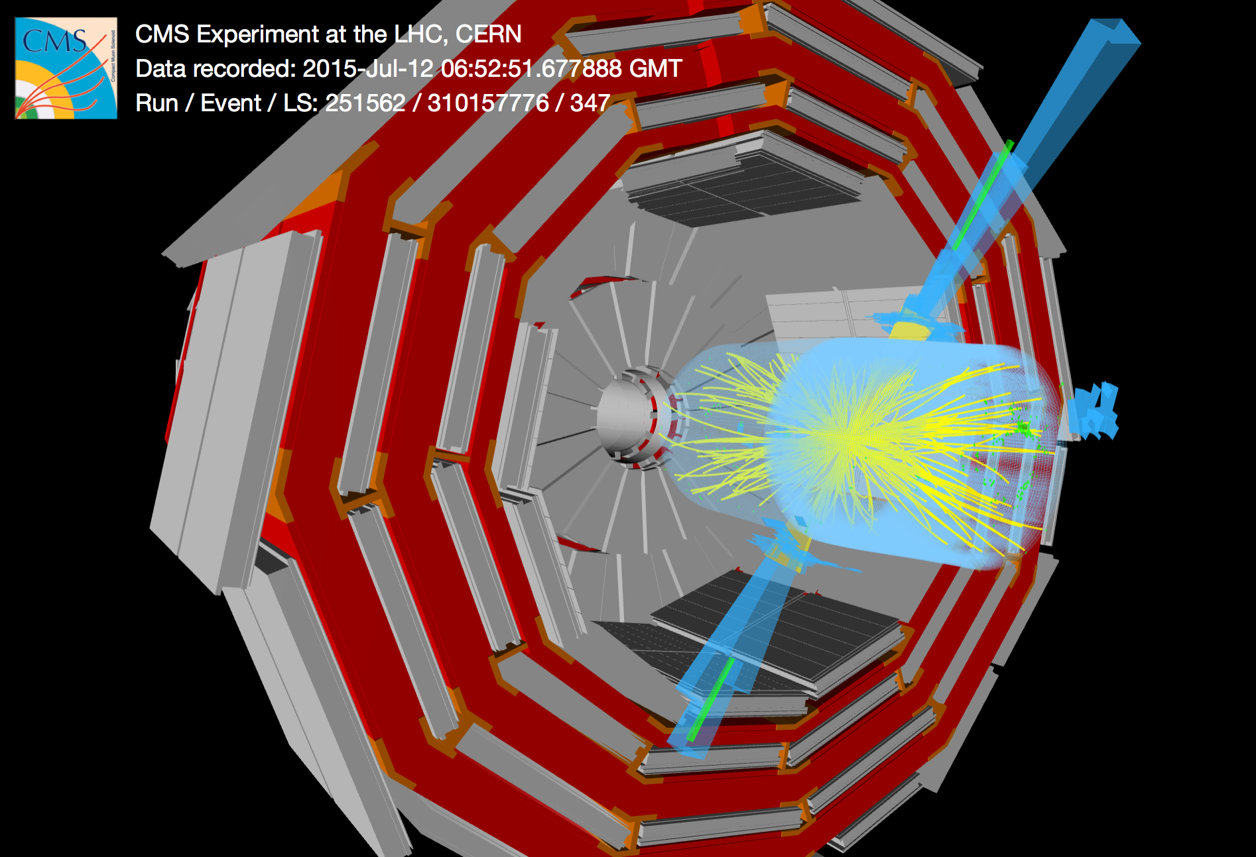
Status of the CMS experiment
Jorgen D’Hondt (Vrije Universiteit Brussel)
on behalf of the CMS Collaboration
di-jet event with m(jj) of 5.4 TeV

Slide 2
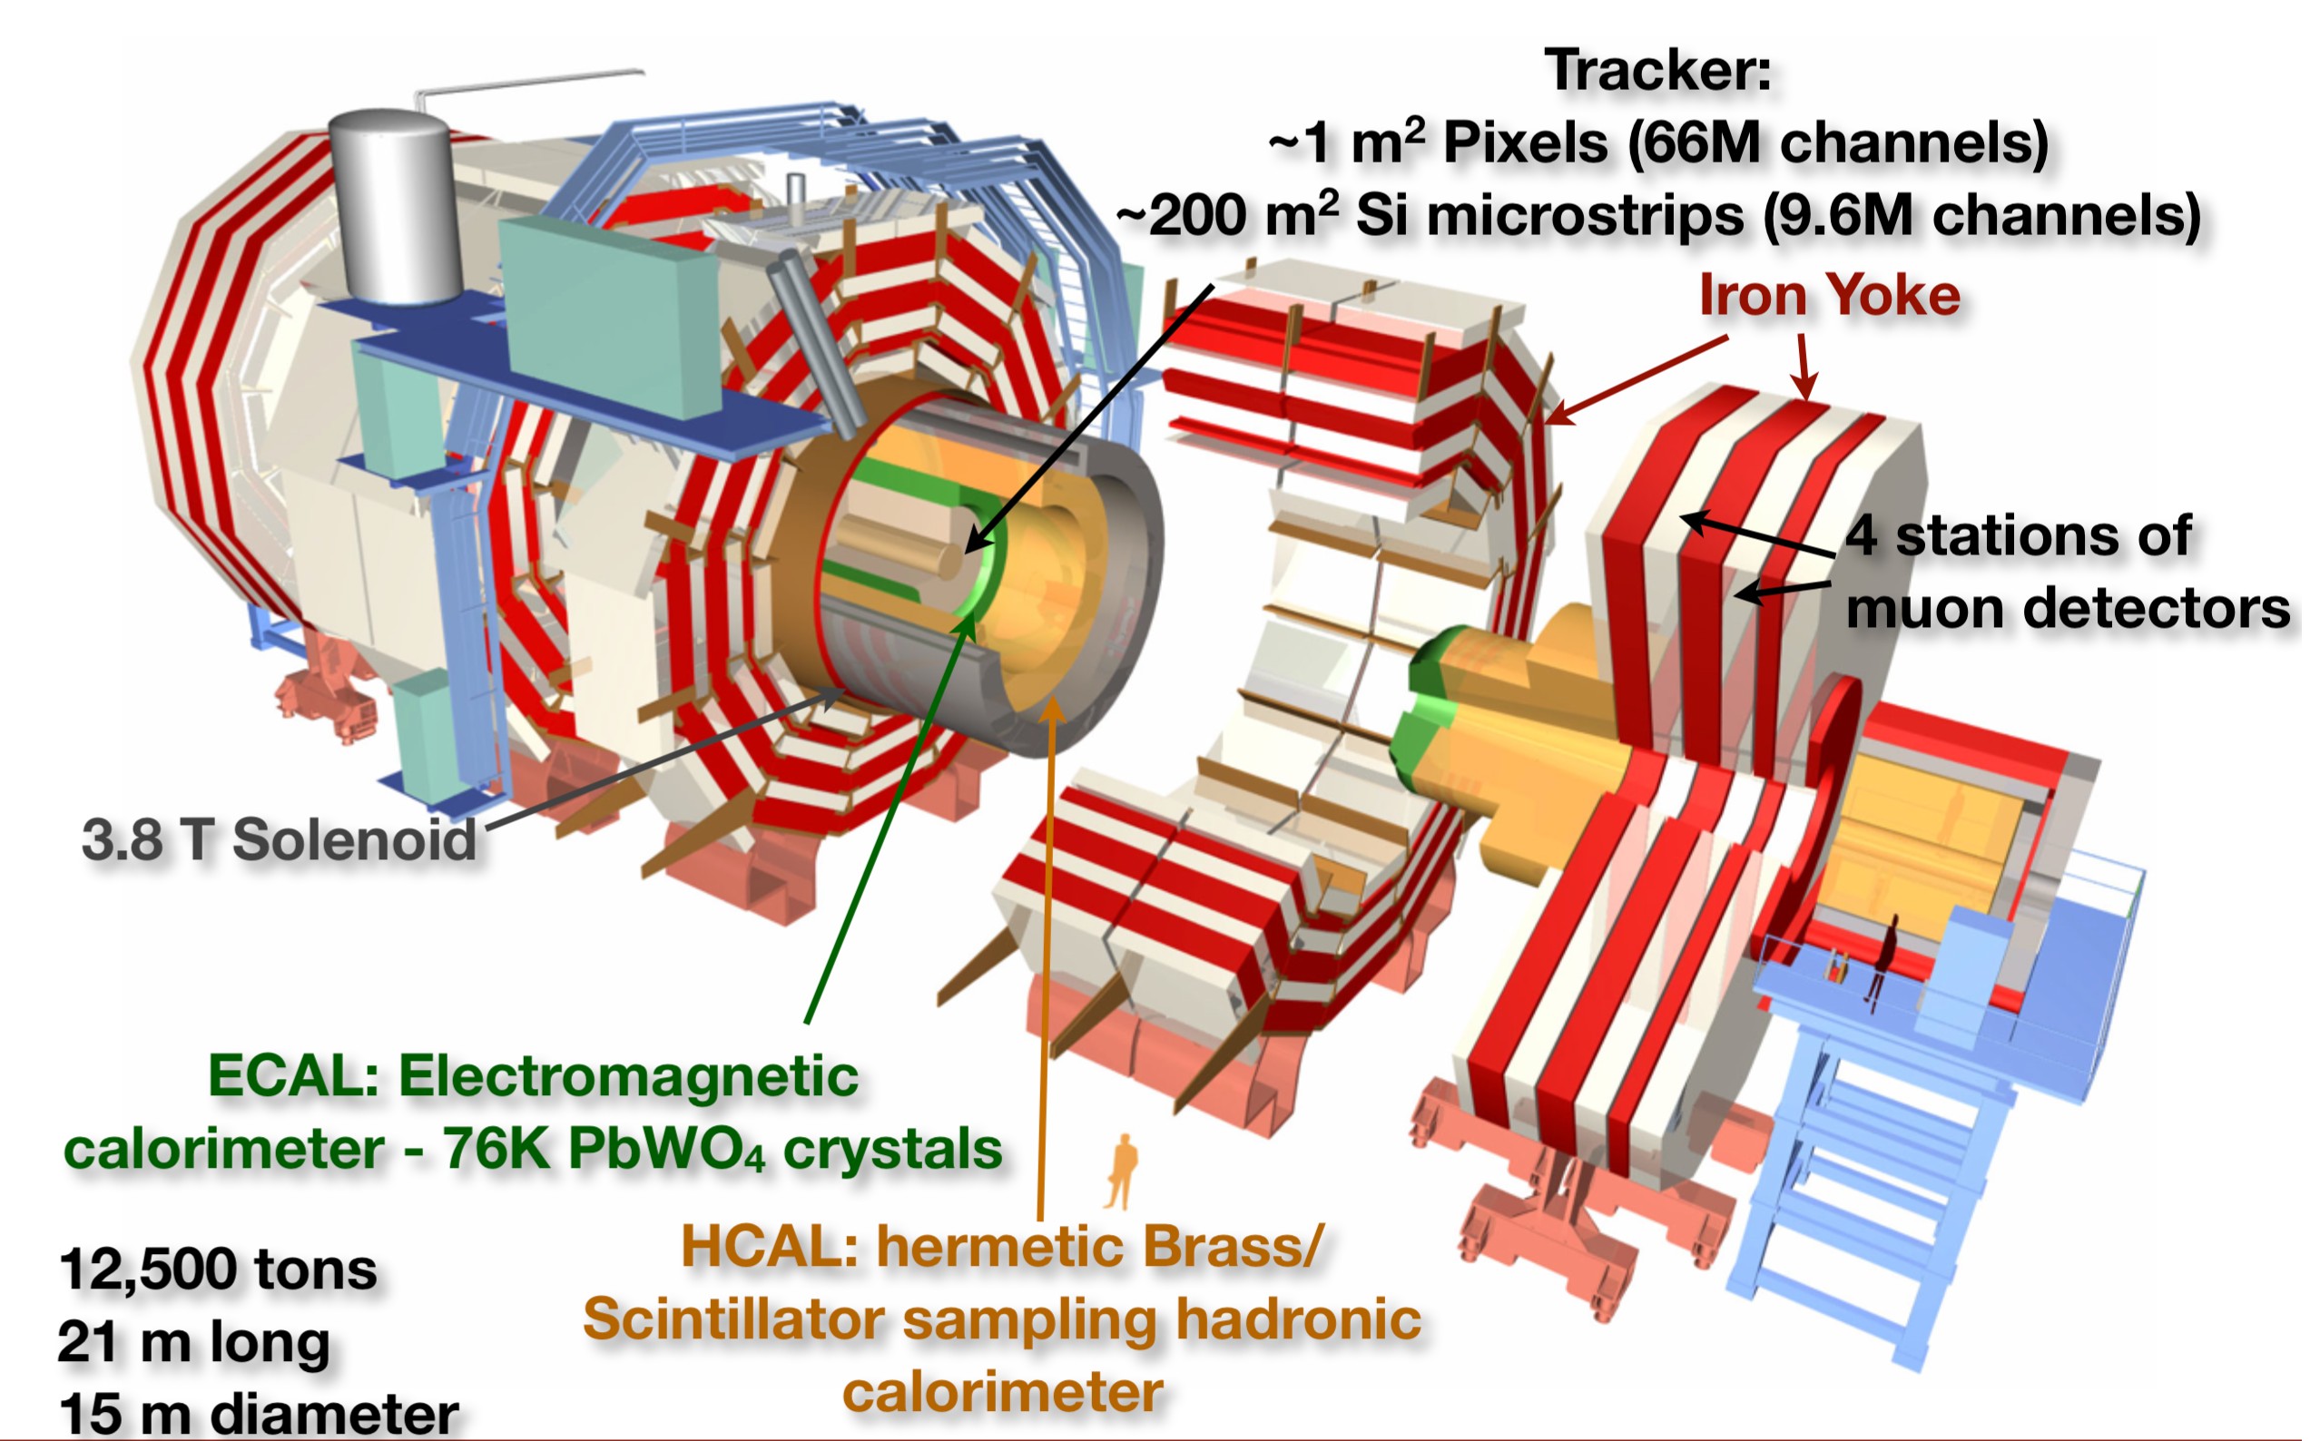

The CMS experiment @ LHC

Slide 3
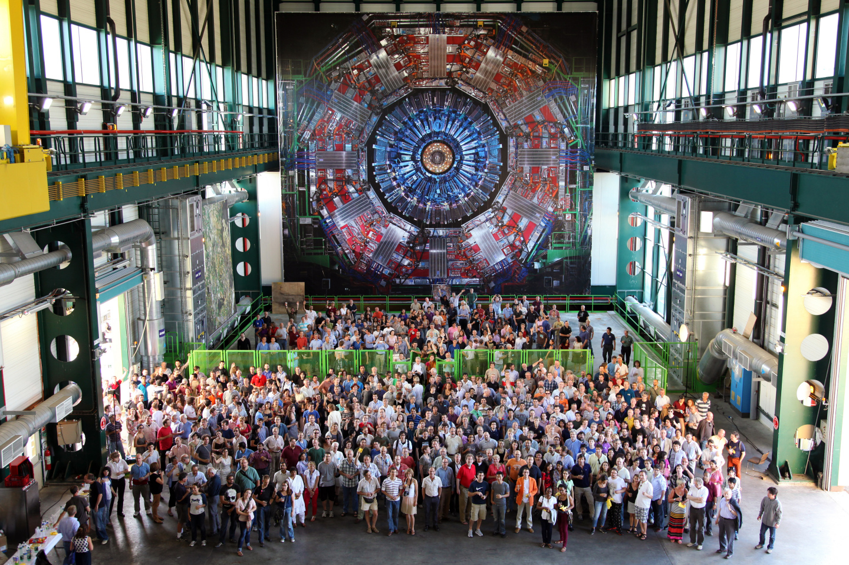
The CMS Collaboration
The US in CMS are ~30% of the total CMS members.
more than 200 institutions from 43 countries
Applications from in total 10 new institutions in 2015 from Russia, Ecuador, Hungary, China, Belgium, Korea

Slide 4
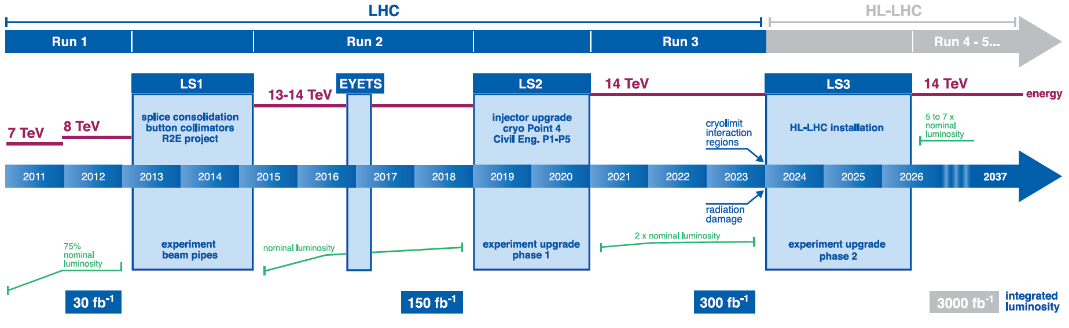
Timeline
Phase-1 CMS Upgrades
Phase-2 CMS Upgrades
Early Run-2
results
Run-1
highlights
CMS is active on many fronts
Long Shutdown 1 (LS1) activities

Slide 5
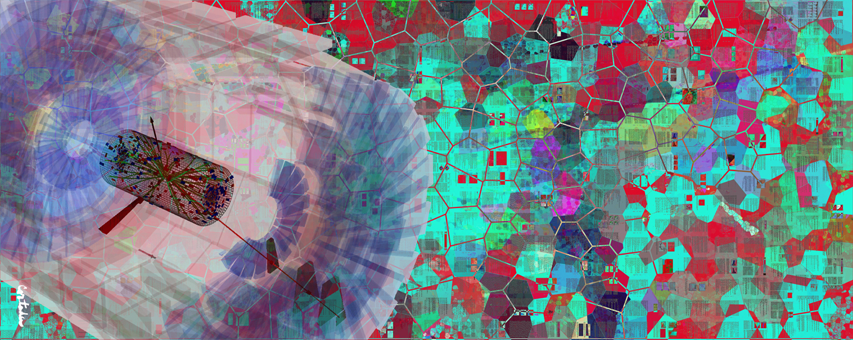
CMS-PHO-PUBLIC-2013-005-1
Run-1 results at 7 and 8 TeV
Xavier Cortada (with the participation of physicist Pete Markowitz), "In search of the Higgs boson: H -> WW", digital art, 2013.

Slide 6
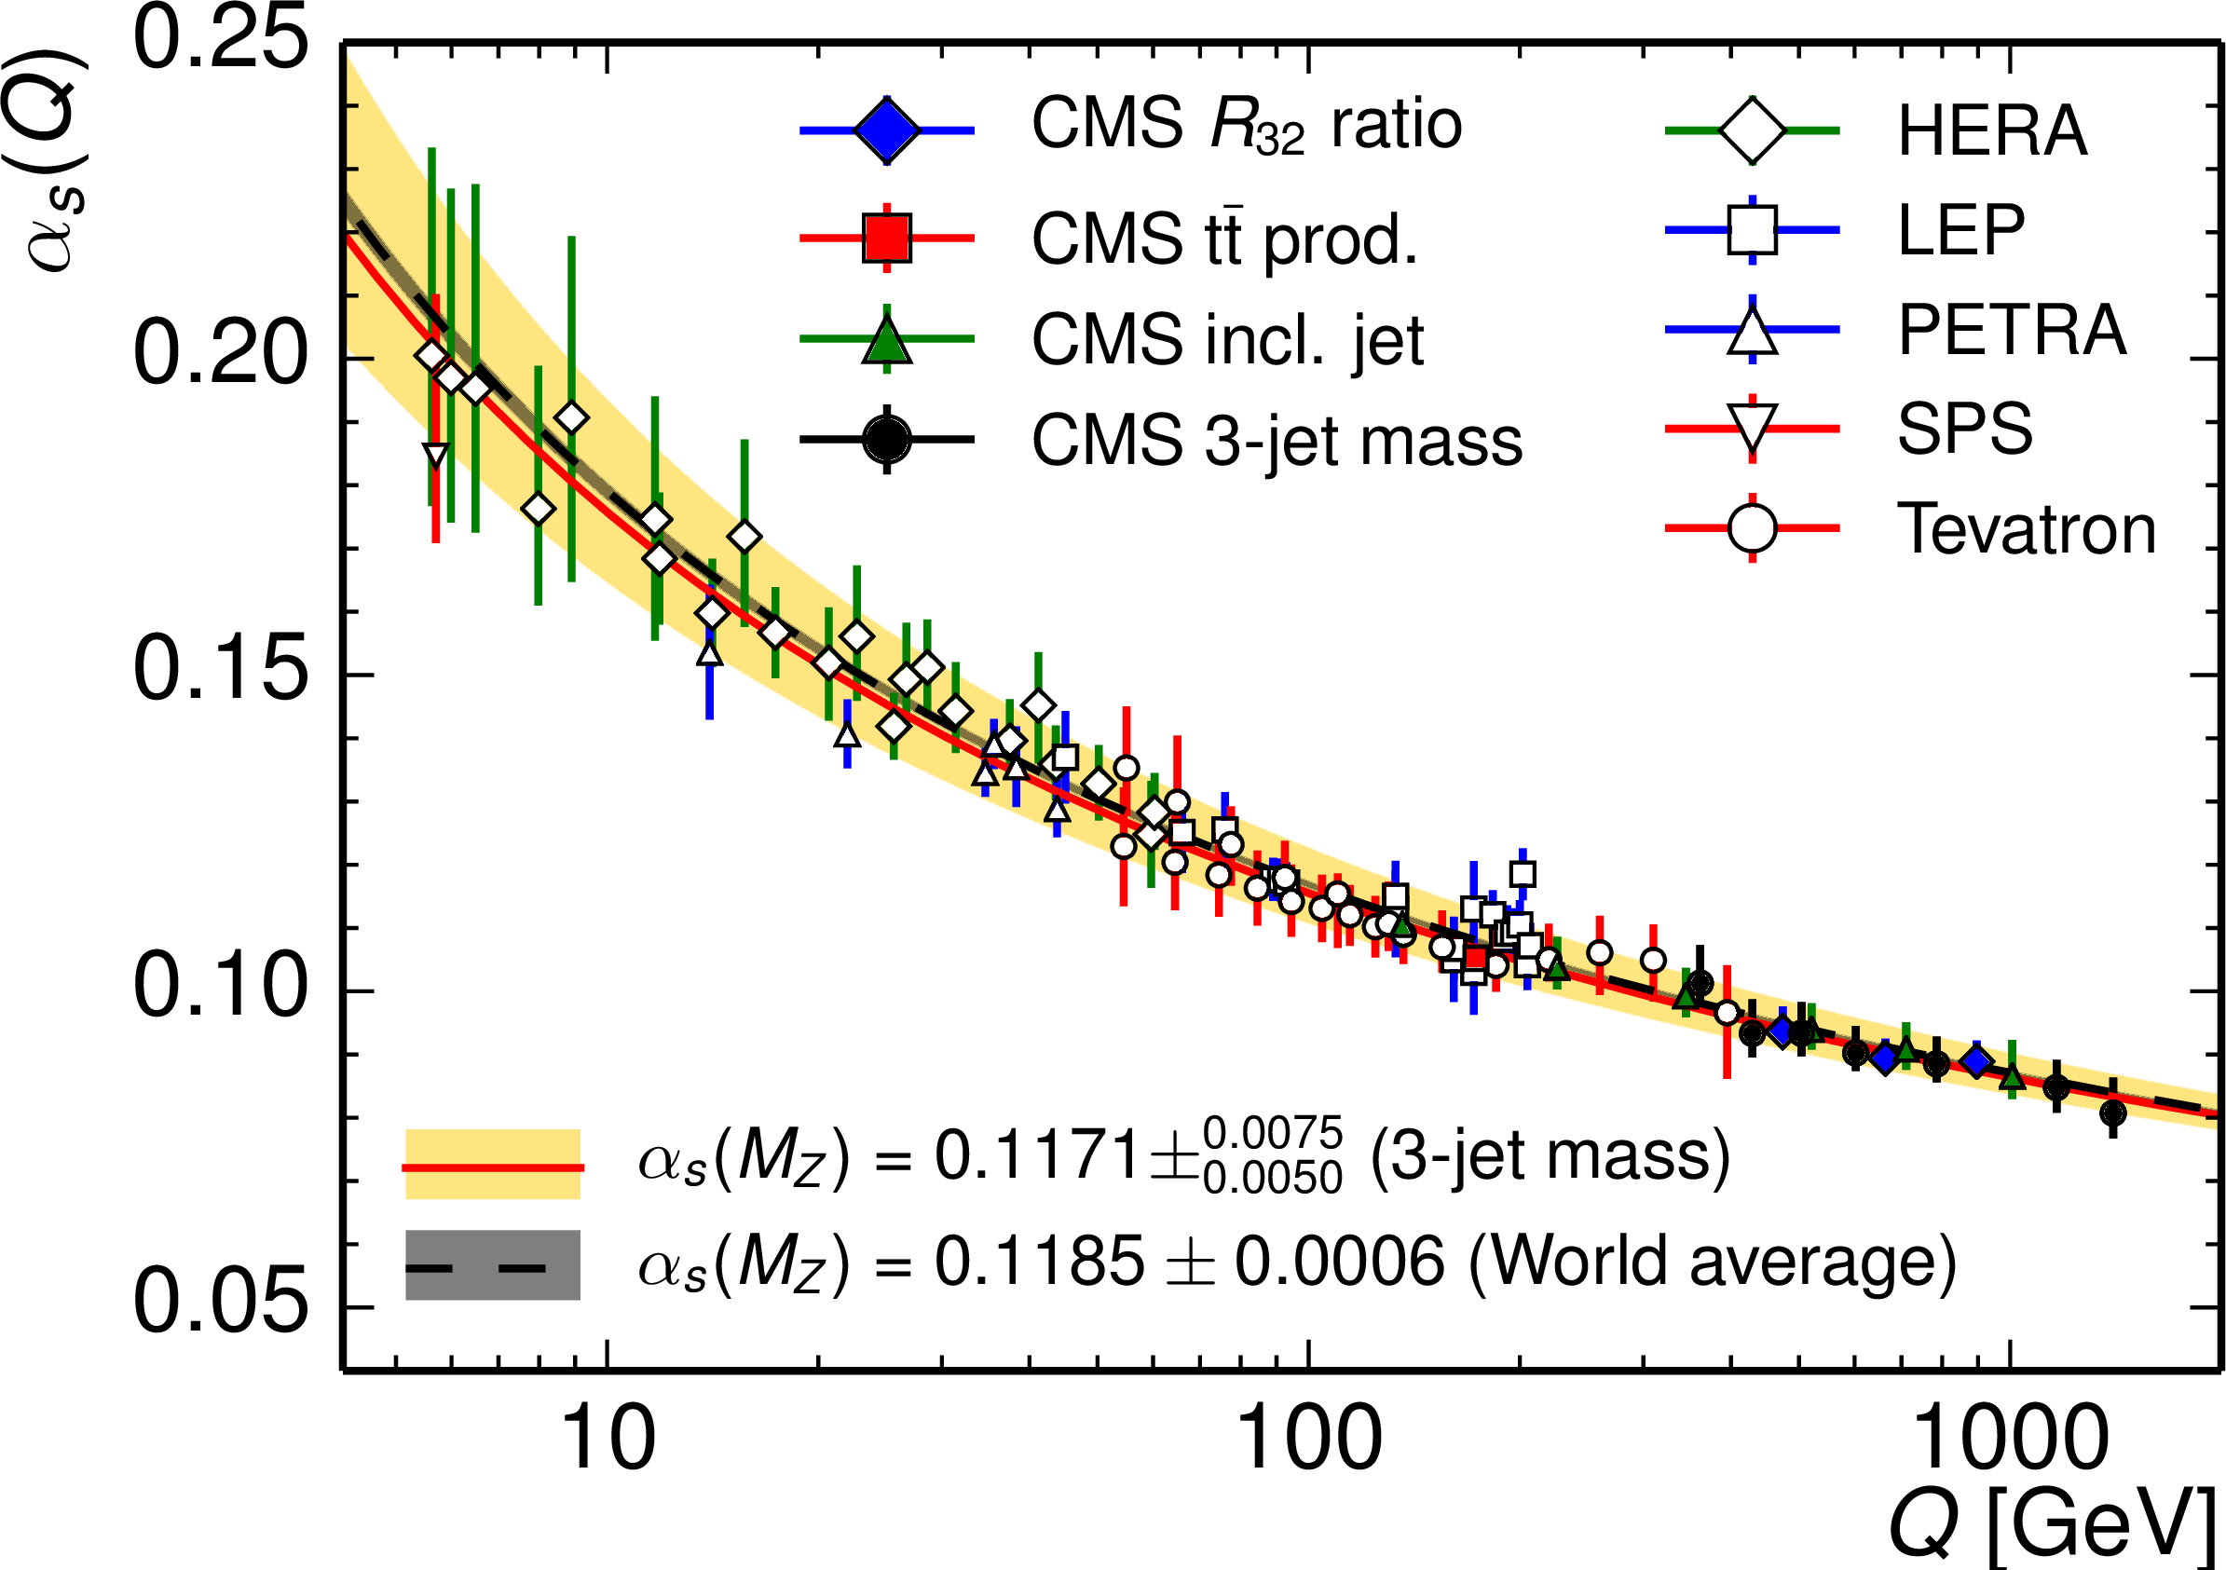
The LHC is a QCD machine
Eur. Phys. J. C 75 (2015) 186
renormalisation & factorisation

Slide 7
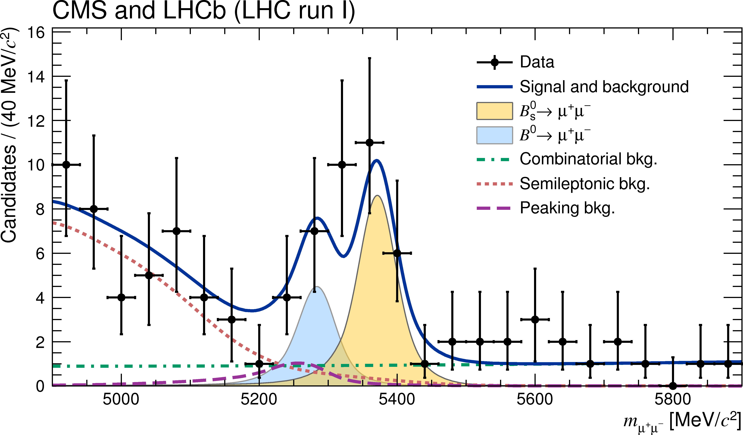
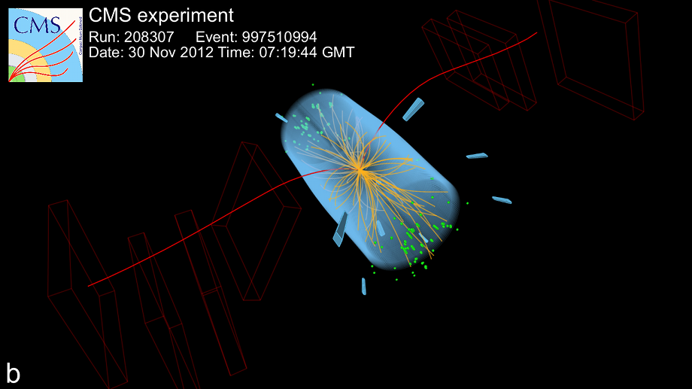
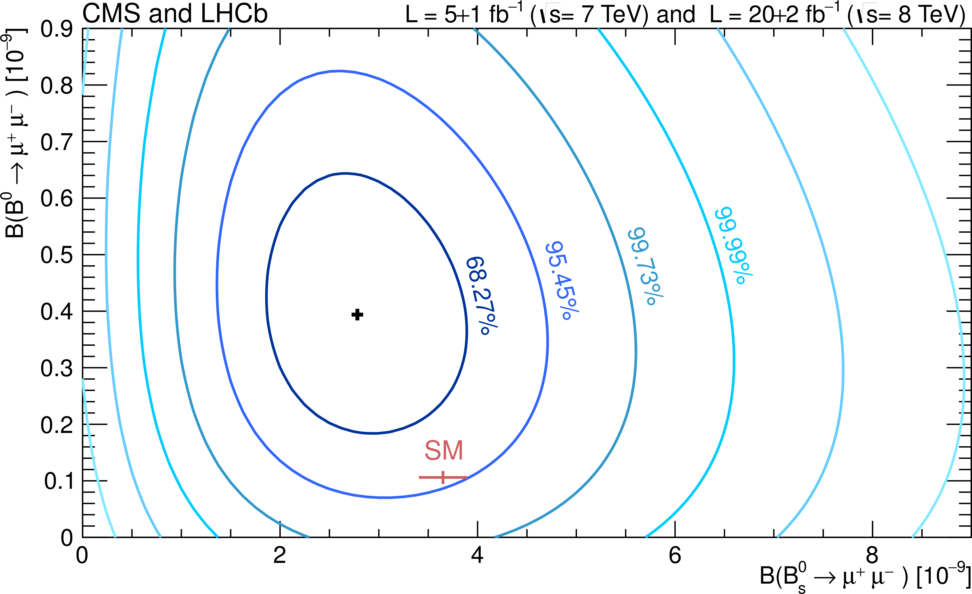
… a B-physics machine
After 3 decades of experiments:
CMS & LHCb, Nature (2015) 14474

Slide 8
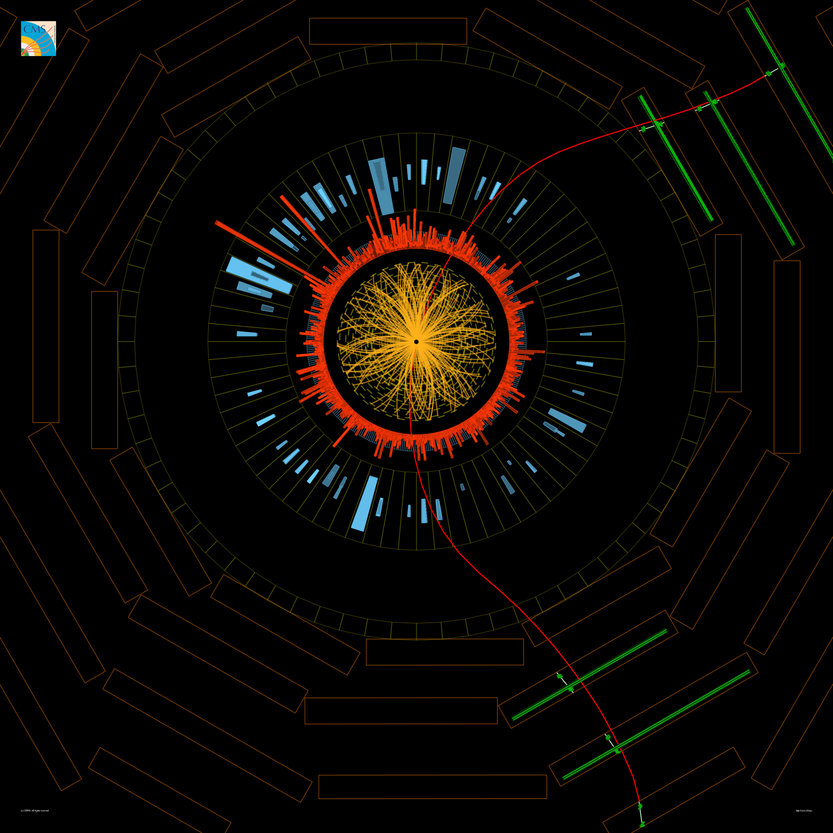
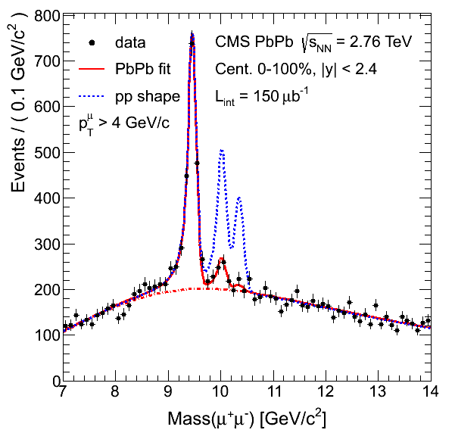
… a Heavy Ion machine
Understanding the properties of the quark-gluon plasma.
CMS observes melting of Upsilon (Y) particles in heavy-ion collisions.
PbPb collision
Y → μμ
PRL 109 (2012) 222301

Slide 9
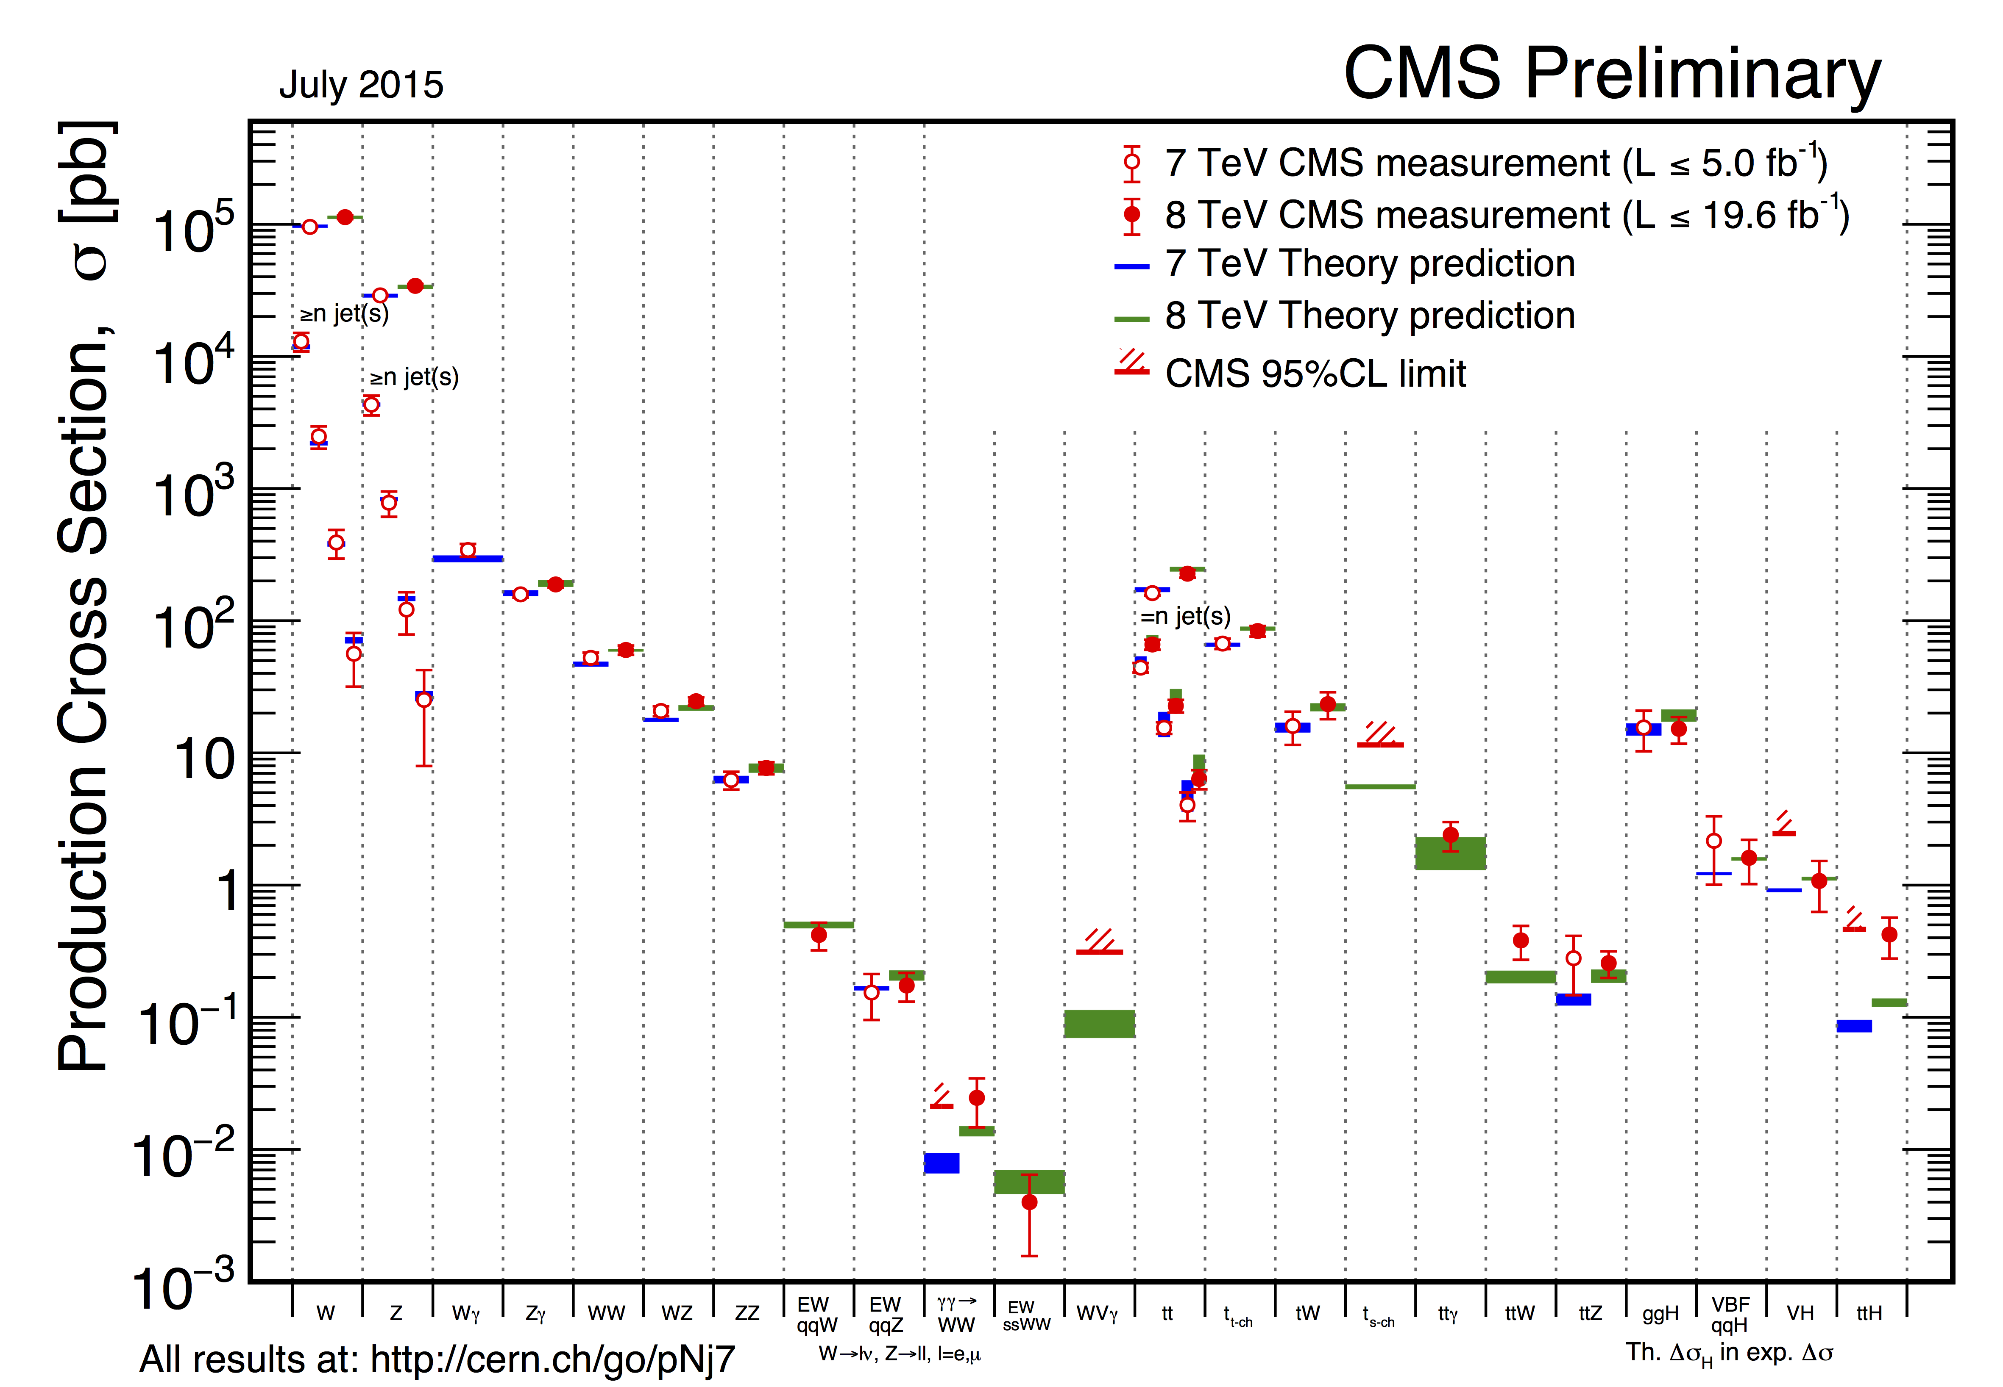
… a W/Z/top machine
measured cross-sections over 7 orders of magnitude

Slide 10
… and a Higgs particle machine
measured cross-sections over 7 orders of magnitude

Slide 11
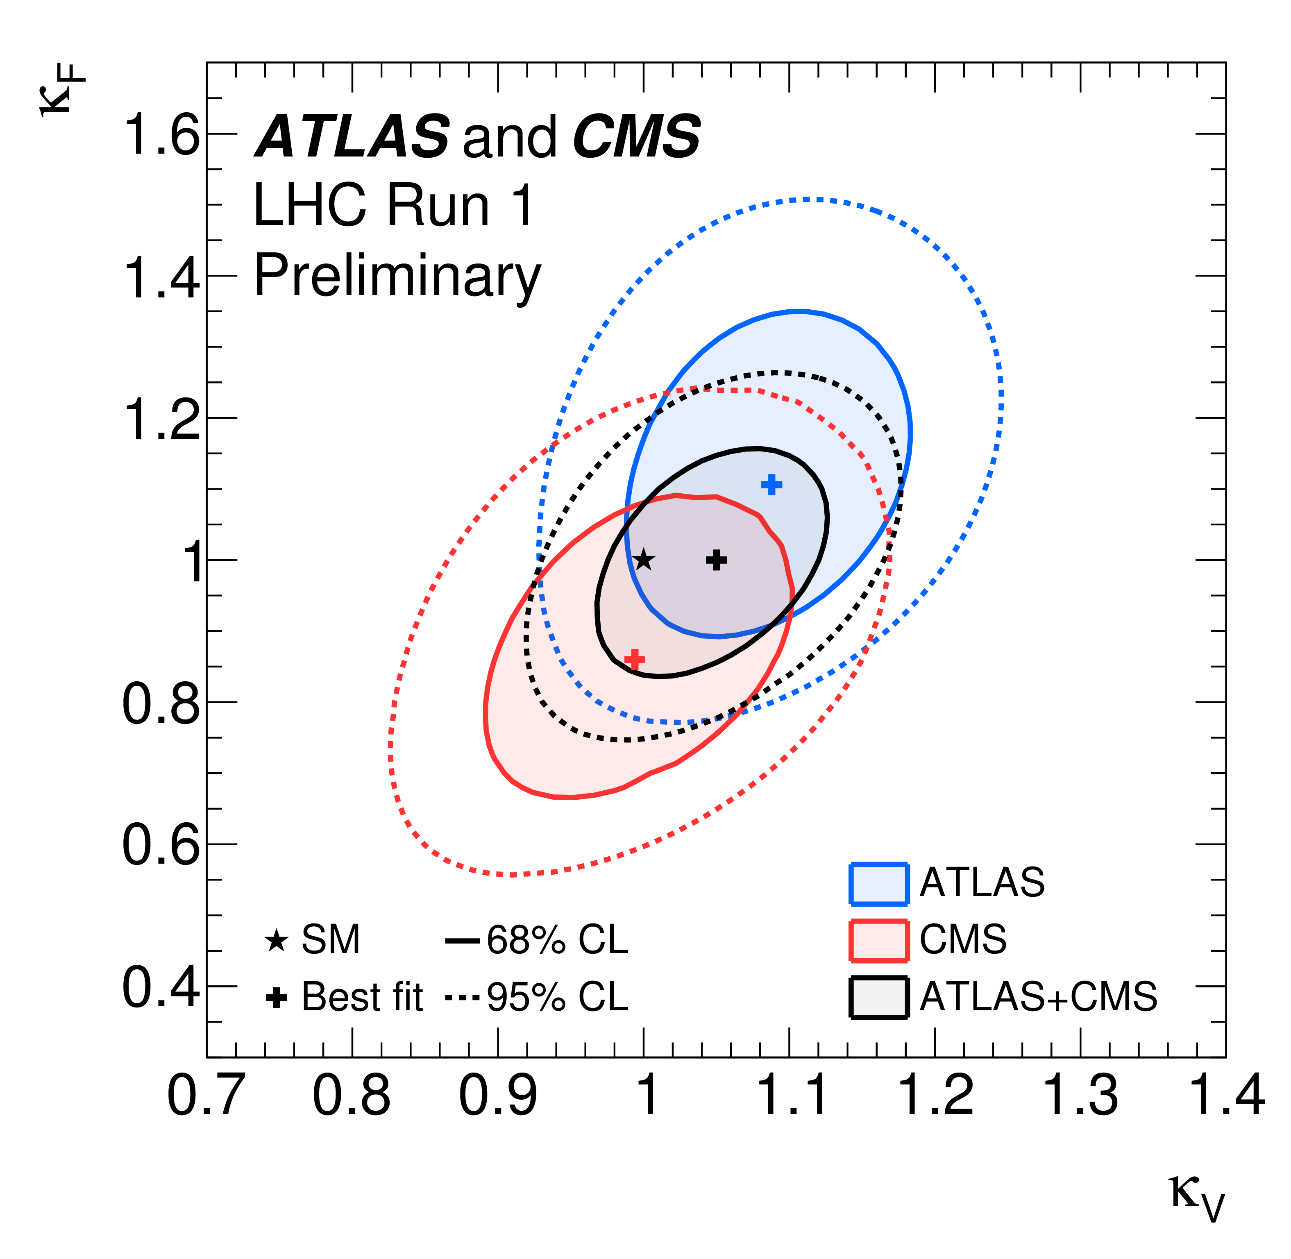
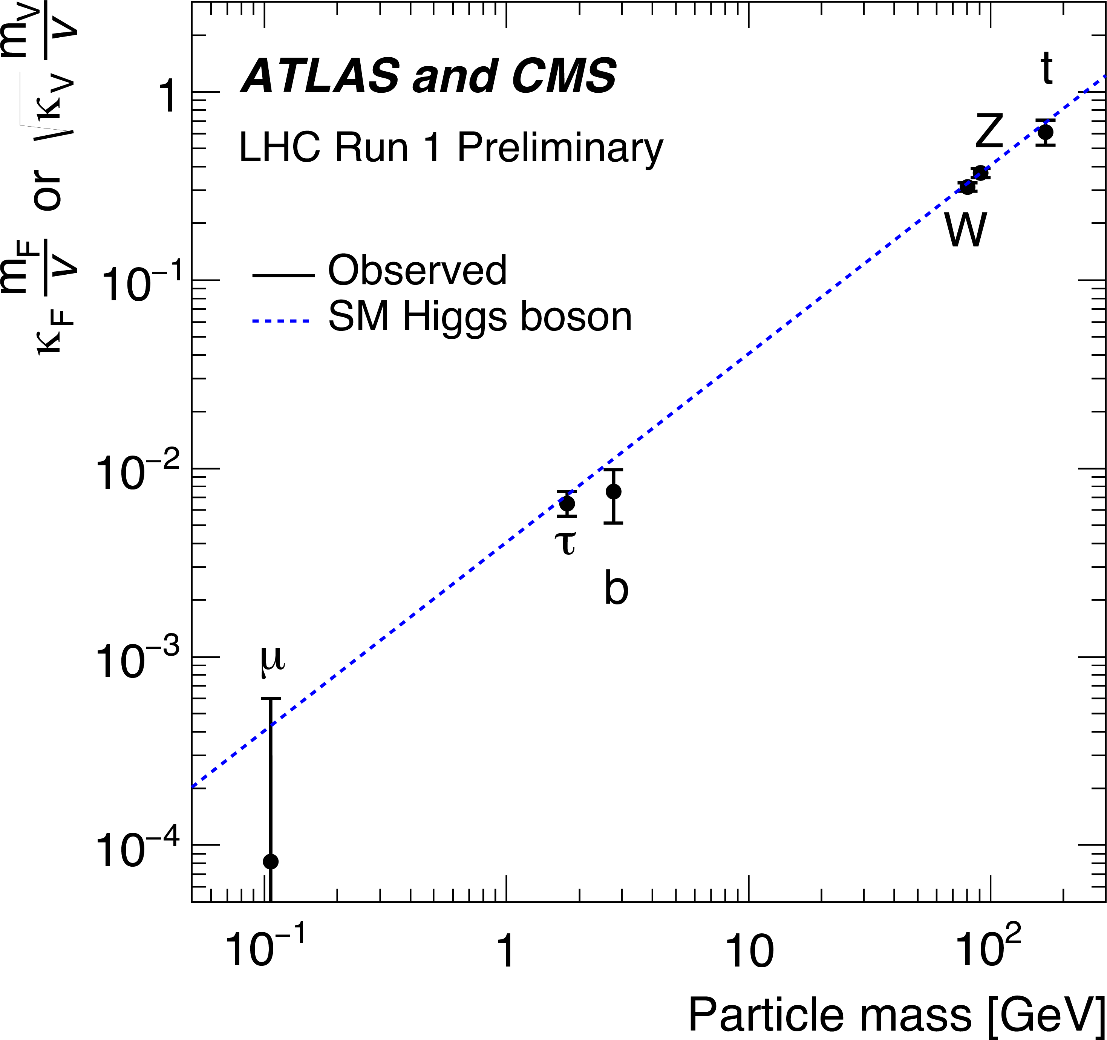
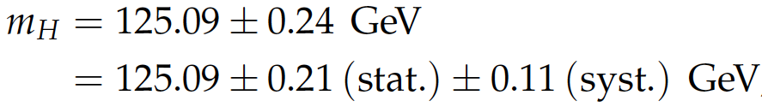
… and a Higgs particle machine
ATLAS/CMS combination: SM like couplings within the current precision
The combined signal yield relative to the SM expectation is:
ATLAS-CONF-2015-044; CMS-PAS-HIG-15-002
ATLAS/CMS combination of the mass :
PRL 114 (2015) 191803

Slide 12
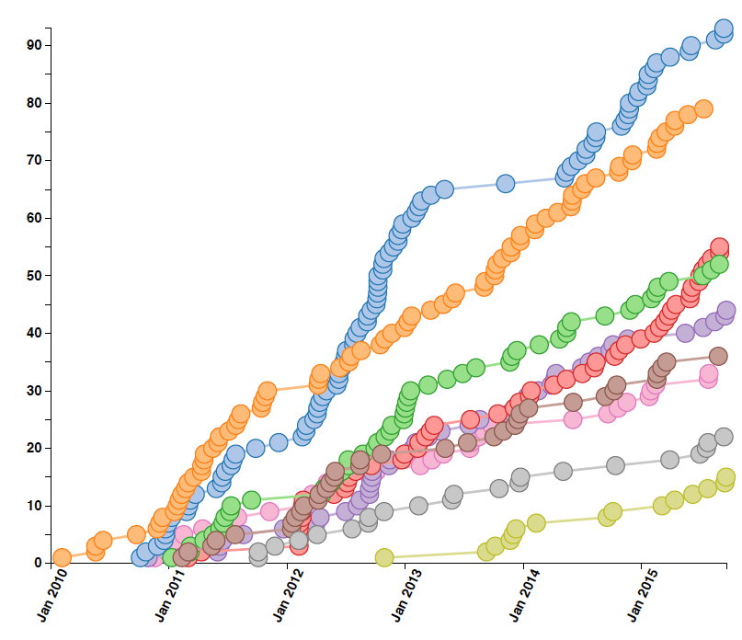
… more CMS Publications
exotica
428 physics papers submitted
+ 14 performance papers
+ 24 papers based on cosmic rays
+ many more in the pipeline
Standard Model
Higgs
Supersymmetry
Top quark physics
Heavy Ion physics
B physics
Forward physics
Beyond 2 Generations

Slide 13
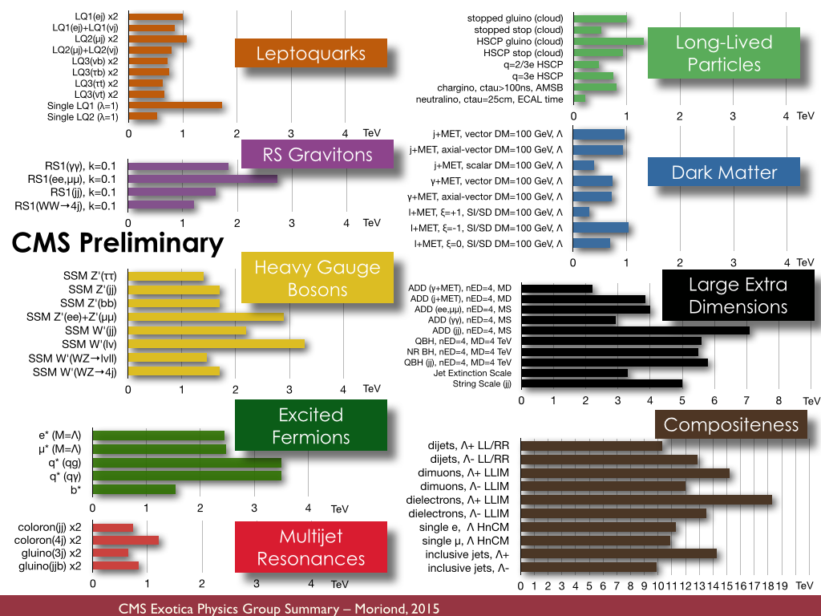
Searches for new physics

Slide 14
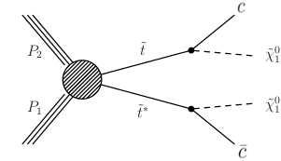
Will the LHC become a SUSY machine?
The signal can hide in a >100 dimensional parameter space
here only one (simplified model) example

Slide 15
Key challenge for Run-2
we need to turn each stone in the search for supersymmetry
1 TeV

Slide 16
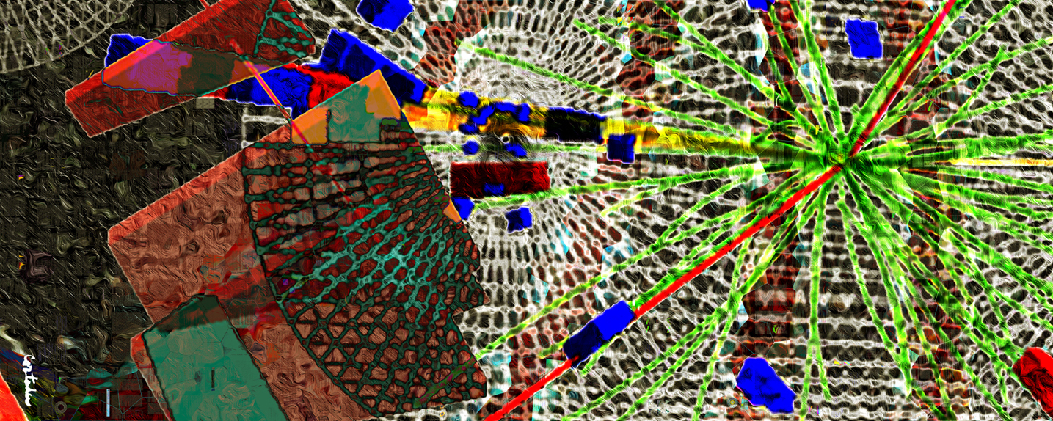
CMS-PHO-PUBLIC-2013-006-1
Towards Run-2: Long-shutdown 1
Xavier Cortada (with the participation of physicist Pete Markowitz), "In search of the Higgs boson: H -> gamma gamma", digital art, 2013.

Slide 17

LS1 program
Installation of new detector systems and extension of existing ones. Repair and maintenance after 3 years of Run-1 operation, and consolidation for the long-term future. CMS closed for physics on March 29th.
Preparations for the new “Stage-1” trigger system
New DAQ system
Extra CSC chambers
Extra RPC chambers
HF μTCA back-end electronics
Tracker cold (-10/15ºC)
New dry-gas injection system
New distributed analysis tools (CRAB3)
Data federation deployed (AAA)
Upgraded beam monitors
New Pixel Luminosity Telescope
New reconstruction software & miniAOD format & pile-up mitigation

Slide 18
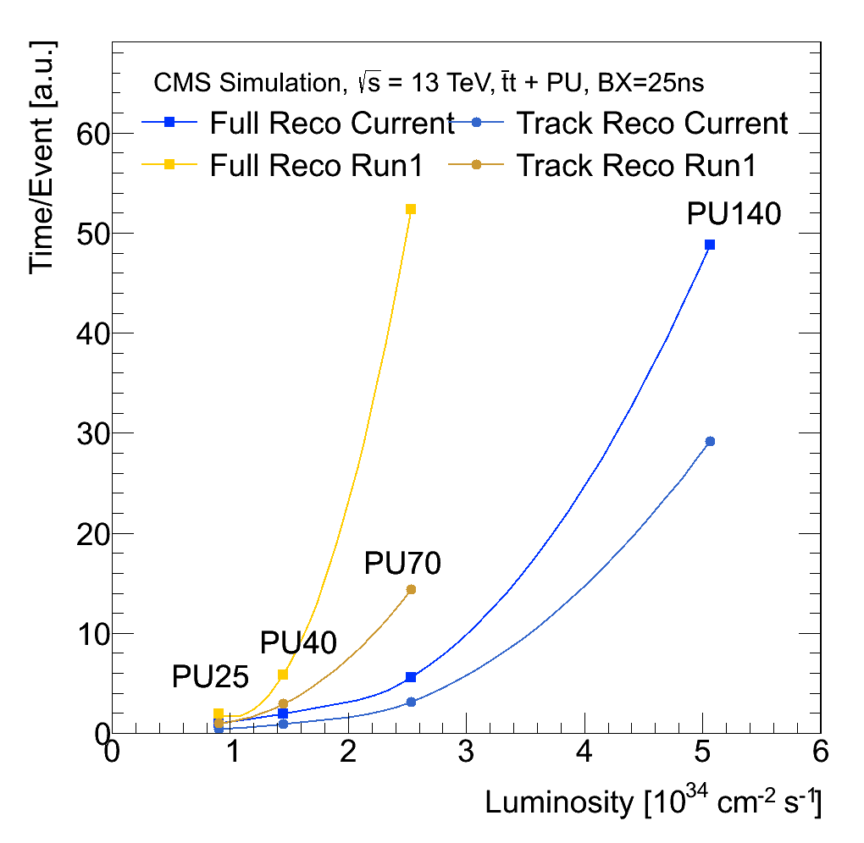
Computing & Offline evolution
Increased pile-up imposes important challenges to our computing and software parts
CMS achieved major improvements in the efficiency reconstruction code
also deployment of multi-threaded algorithms
These challenges are also essential towards the HL-LHC settings

Slide 19
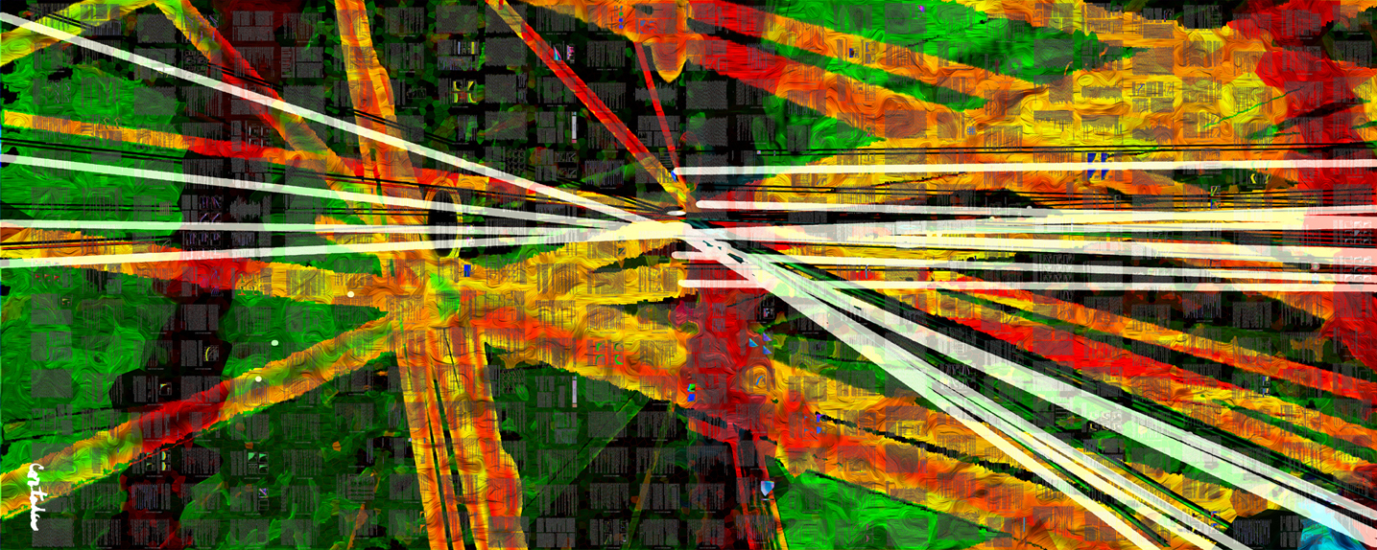
CMS-PHO-PUBLIC-2013-007-1
Run-2 at 13 TeV
General reference: http://cms-results.web.cern.ch/cms-results/public-results/publications/
Xavier Cortada (with the participation of physicist Pete Markowitz), "In search of the Higgs boson: H -> bottom bottom", digital art, 2013.

Slide 20
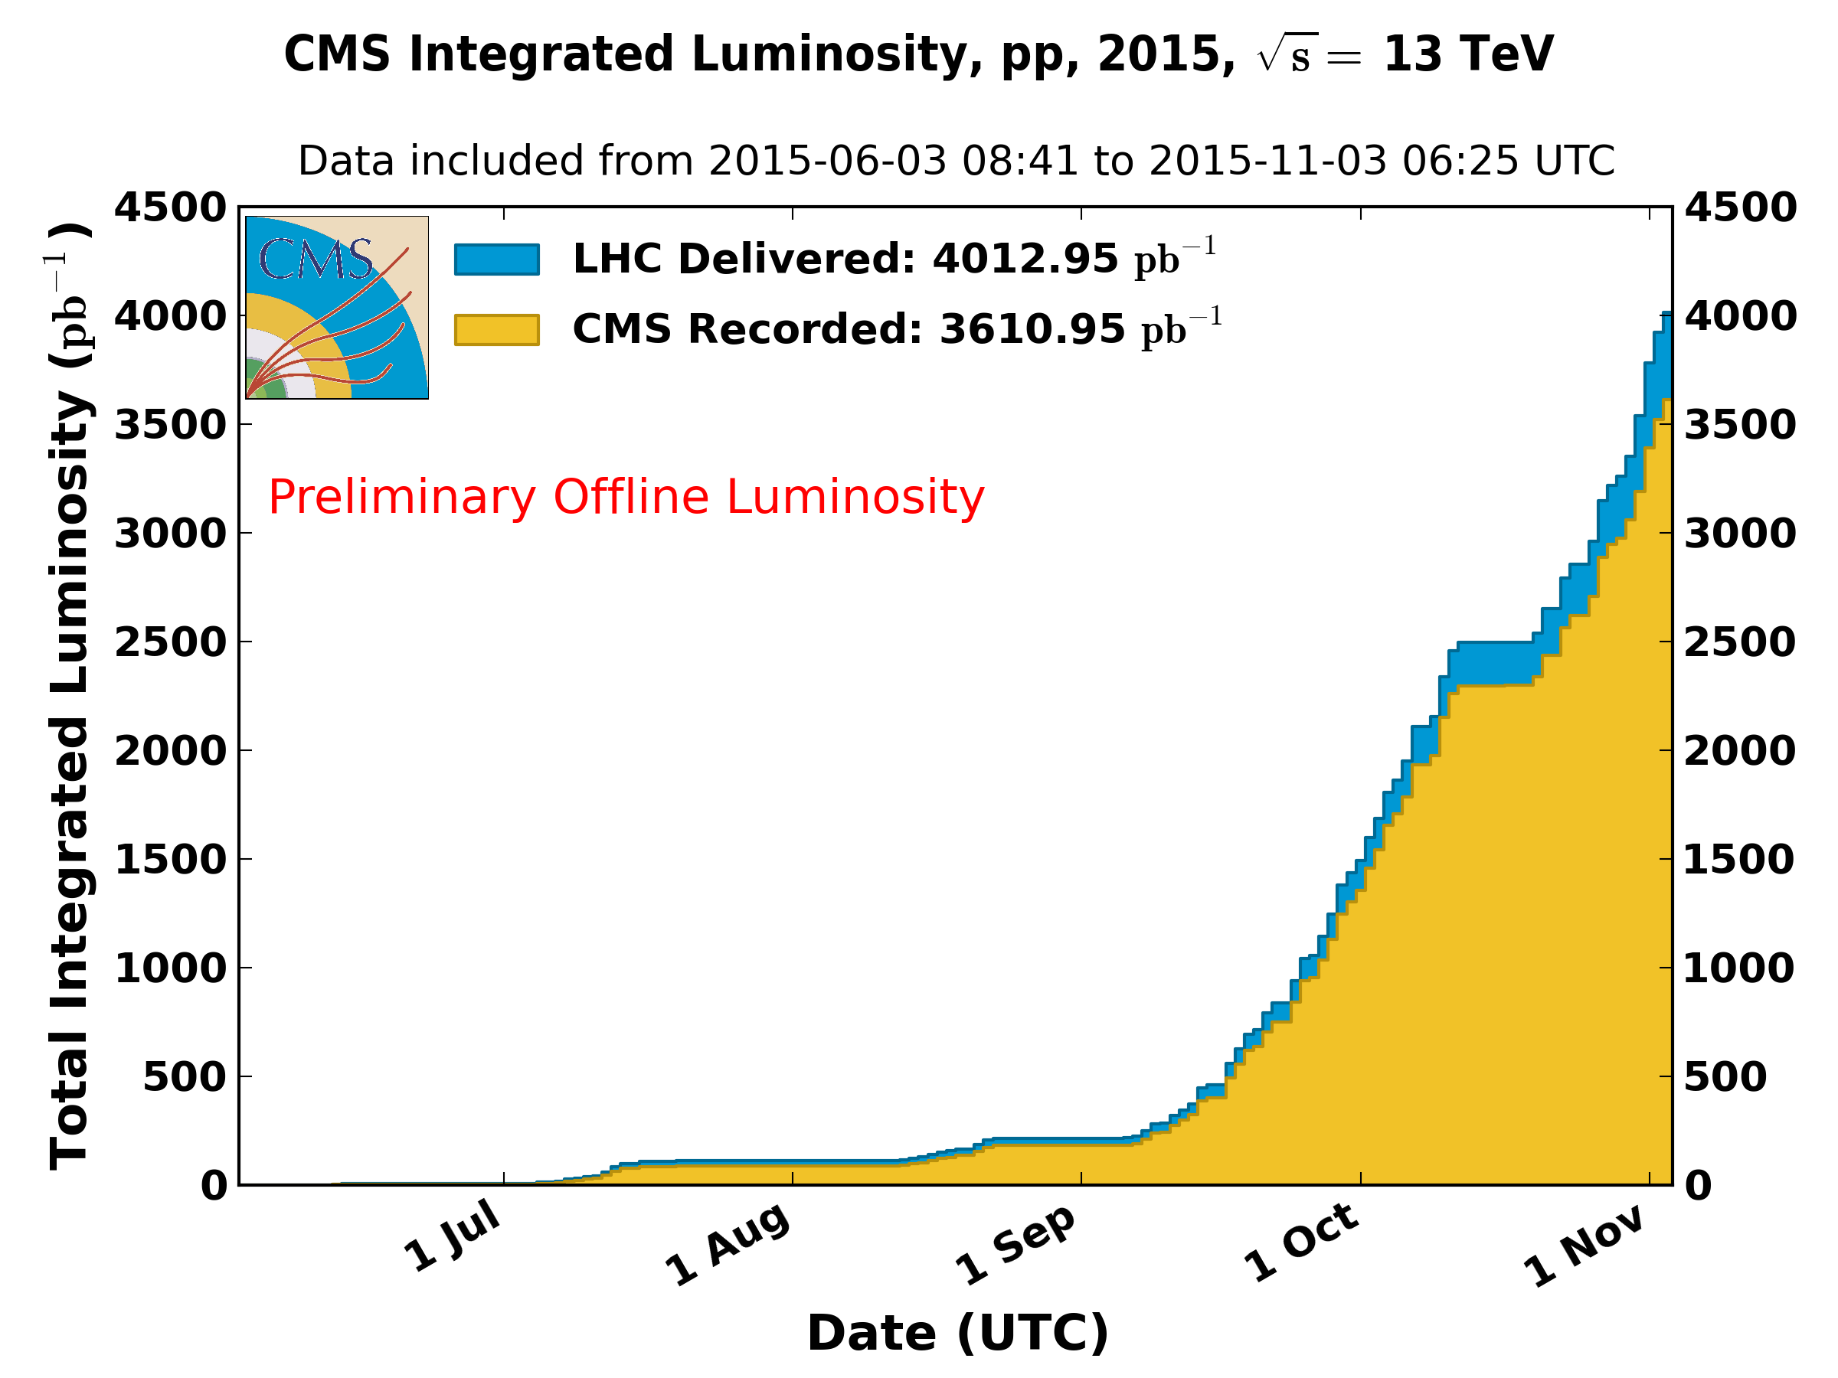
Data collected by CMS
https://twiki.cern.ch/twiki/bin/view/CMSPublic/LumiPublicResults
TOTAL in 2015: 4.1 fb^{–1} / 3.7 fb^{–1} (delivered/recorded)
B = 3.8T: 3.1 fb^{–1} / 2.9 fb^{–1} (93%)
B ≠ 3.8T: 1.0 fb^{–1} / 0.8 fb^{–1} (80%)

Slide 21
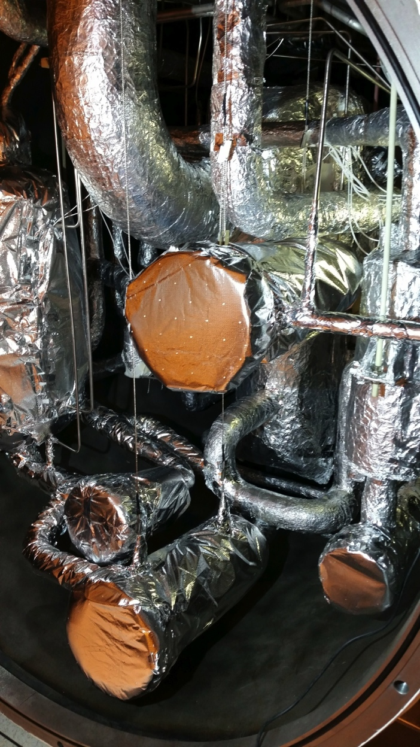
Cryogenic system for CMS magnet
The restart of the CMS magnet after LS1 was more complicated than anticipated due to problems with the cryogenic system in providing liquid Helium.
These problems are consistent with clogging effects due to contaminants in the “Cold box” that provides liquid Helium.
Currently the magnet can be operated, but the continuous up-time is still limited by the performance of the cryogenic system requiring more frequent maintenance than usual.
A comprehensive program to re-establish its nominal performance is being organized for the end-of-the-year technical stop.

Slide 22
Performance of the experiment
(fraction)

Slide 23
Di-muon mass spectrum
Collected with various di-muon triggers, from inclusive di-muons triggers at high p_{T} and low-mass non-resonant di-muon triggers, to specialized triggers.
CERN-CMS-DP-2015-018

Slide 24
Di-muon mass spectrum
Collected with various di-muon triggers, from inclusive di-muons triggers at high p_{T} and low-mass non-resonant di-muon triggers, to specialized triggers.
next page:
zoom
CERN-CMS-DP-2015-018

Slide 25
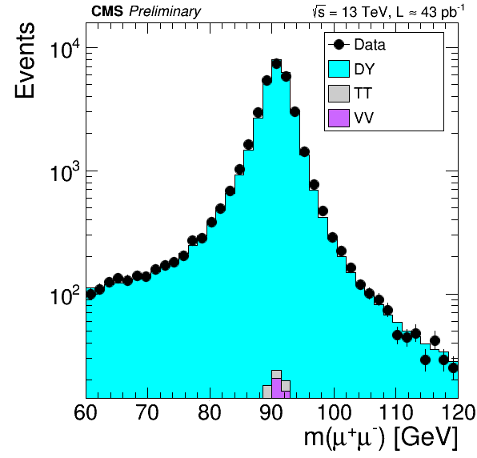
Di-muon mass spectrum
Very good agreement of our simulation with the collision data.
CERN-CMS-DP-2015-015

Slide 26
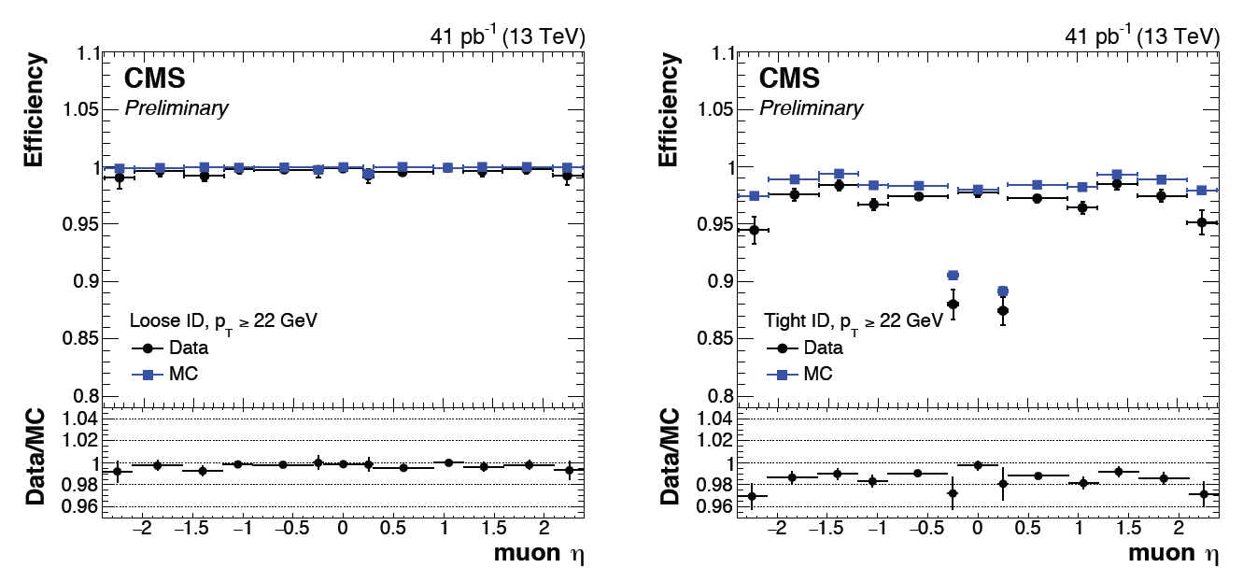
Muon reconstruction
Using Tag-and-Probe methods on Z events
→ using certified data & MadGraph_aMC@NLO Drell-Yan+jets samples
CMS DP-2015/047

Slide 27
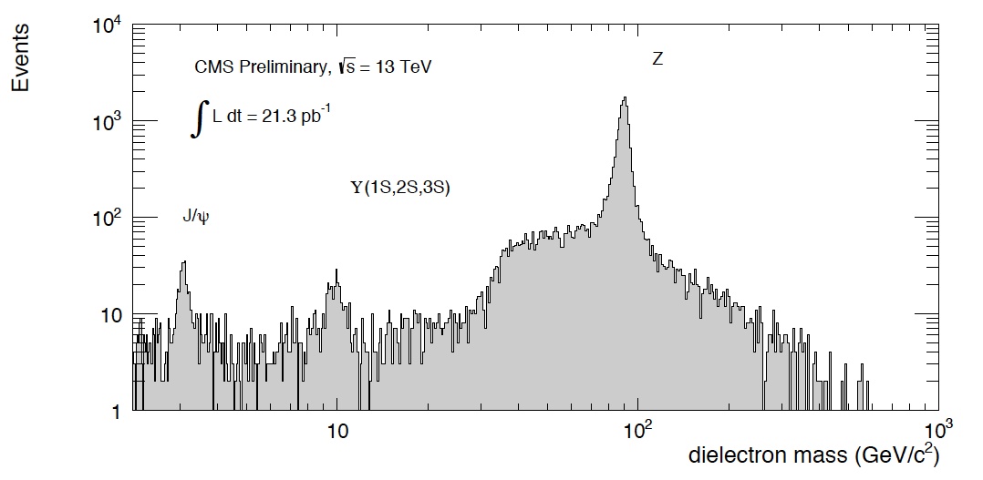
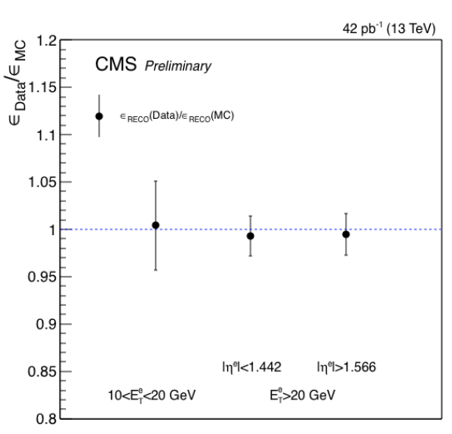
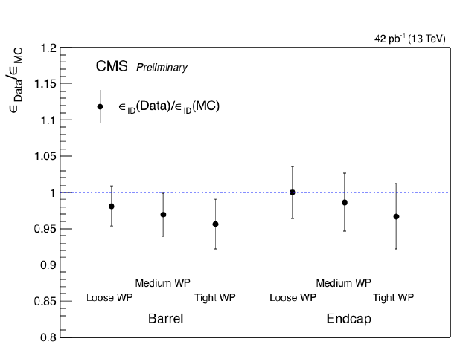
Electron reconstruction
Using Tag-and-Probe methods on Z events
reconstruction efficiency
identification efficiency
CMS DP-2015/013

Slide 28
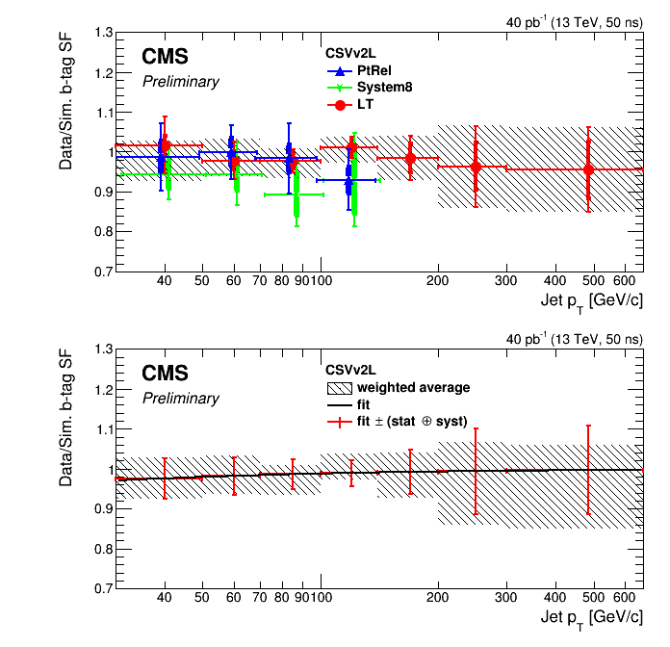
B-tagging performance
Data driven estimation of the tagging performance
using certified data & multi-jet events
Individual and combined measurements of the ratio of b-tagging efficiencies of data to that in simulation.
The grey hatched areas represent the combined measurement which is parameterized as a function of jet p_{T}.
CMS DP-2015/045

Slide 29
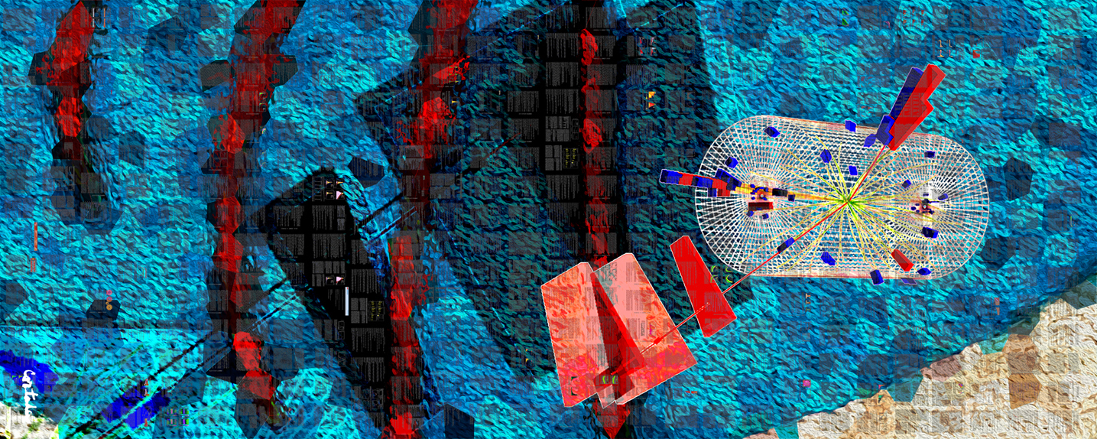
CMS-PHO-PUBLIC-2013-008-1
Spectacular events at 13 TeV
Xavier Cortada (with the participation of physicist Pete Markowitz), "In search of the Higgs boson: H -> tau tau", digital art, 2013.

Slide 30
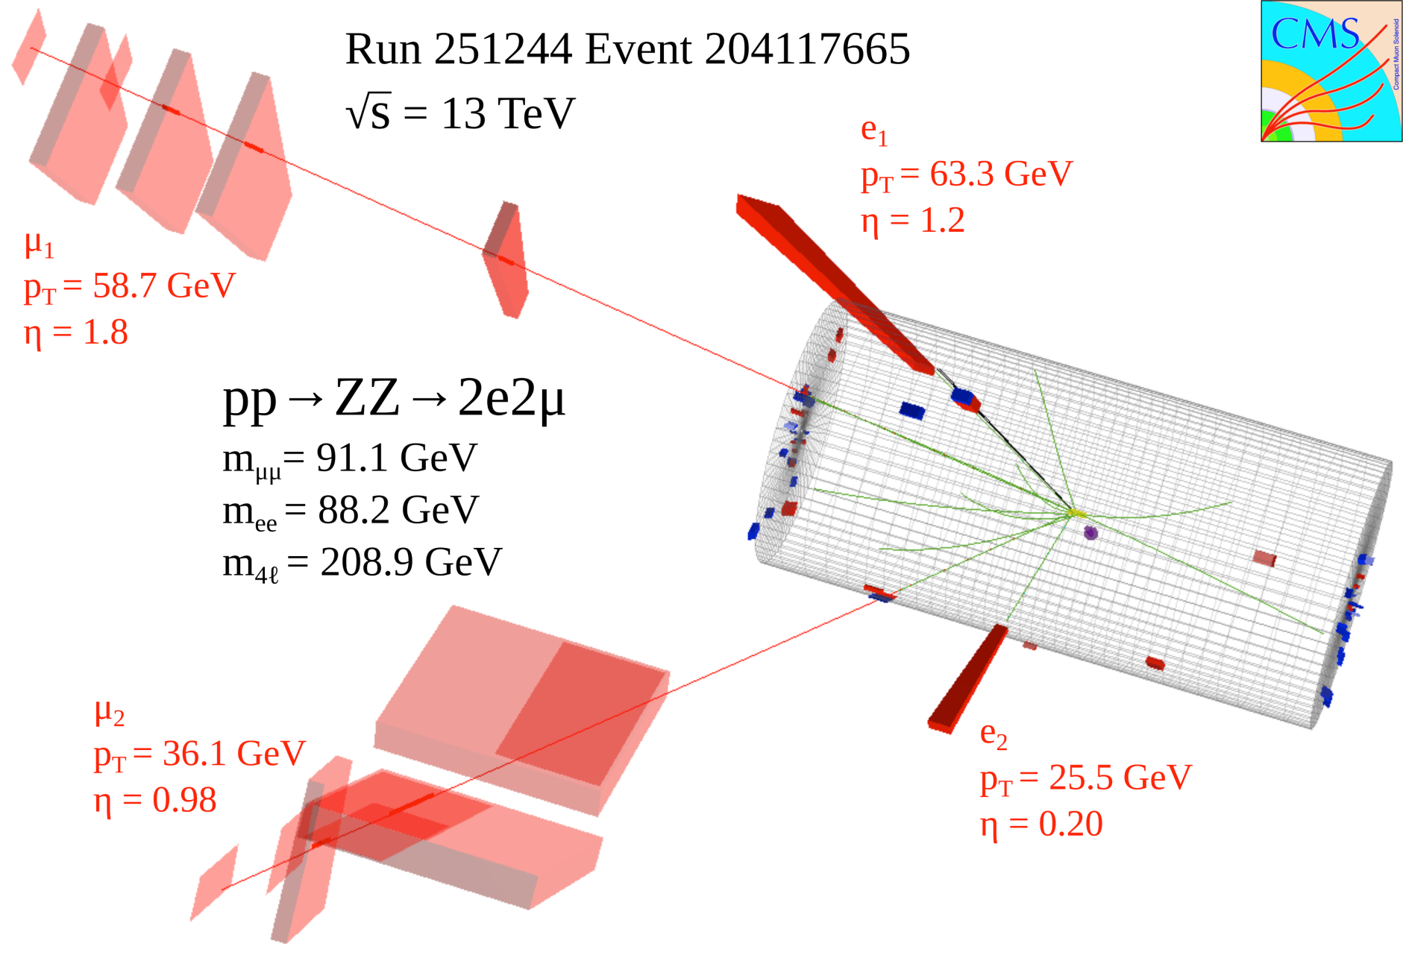
A very nice 4-lepton event
CERN-CMS-DP-2015-016

Slide 31
A very nice 4-lepton event: Higgs?
CERN-CMS-DP-2015-016

Slide 32
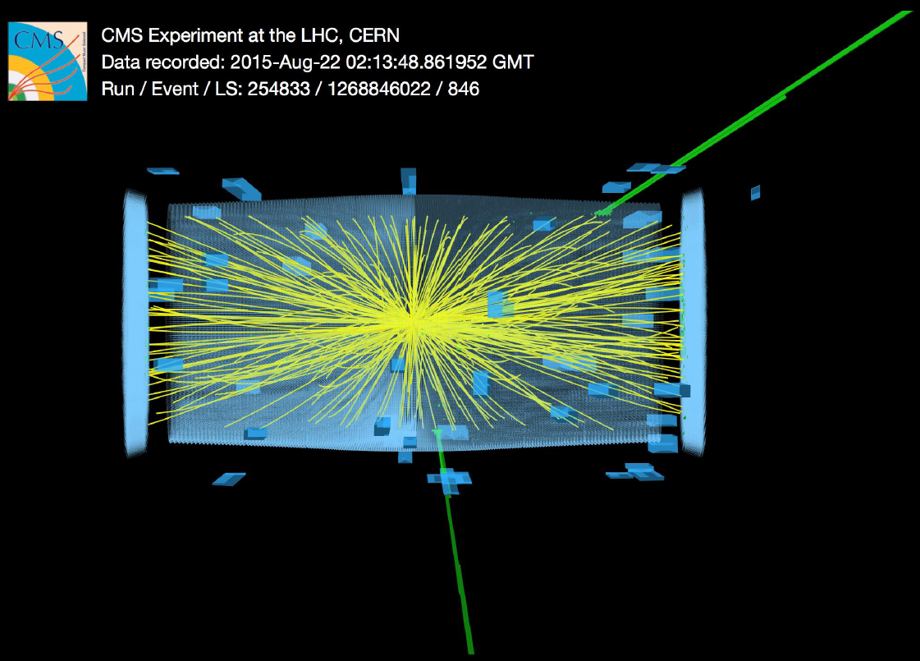
Initial searches for new physics
e⁺e⁻ final state
M(e⁺e⁻) = 2.9 TeV
CERN-CMS-DP-2015-039

Slide 33
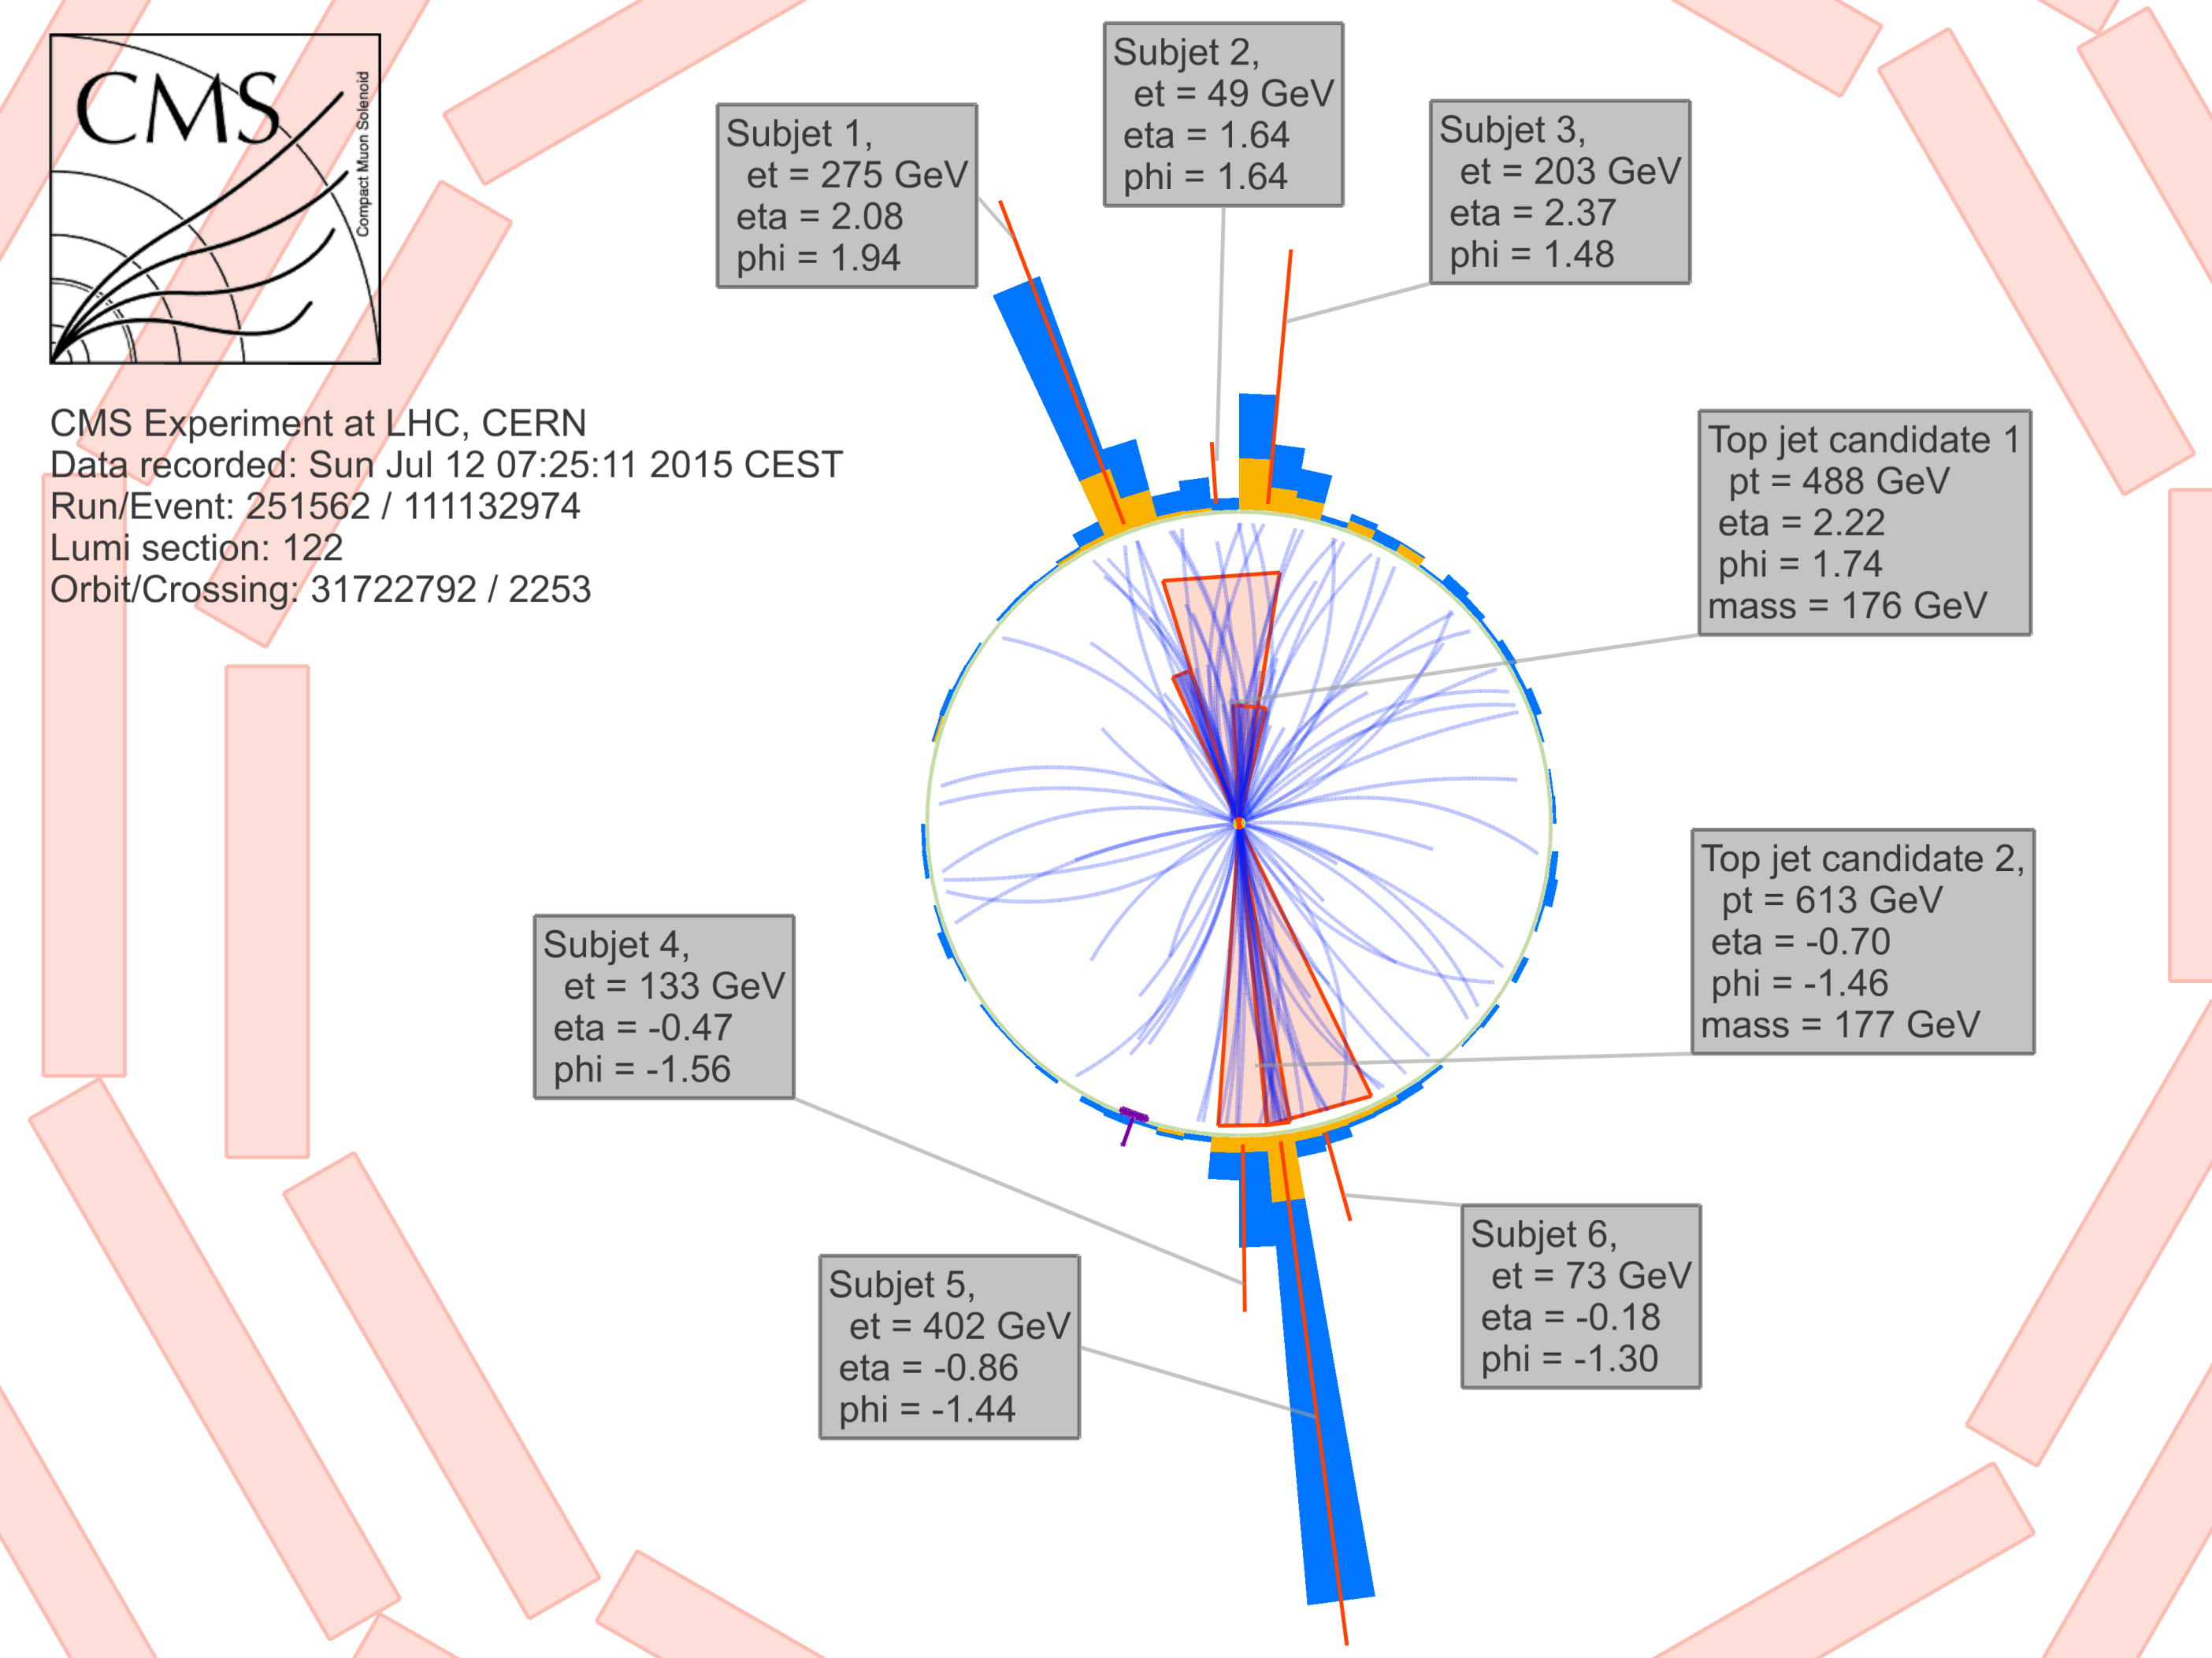
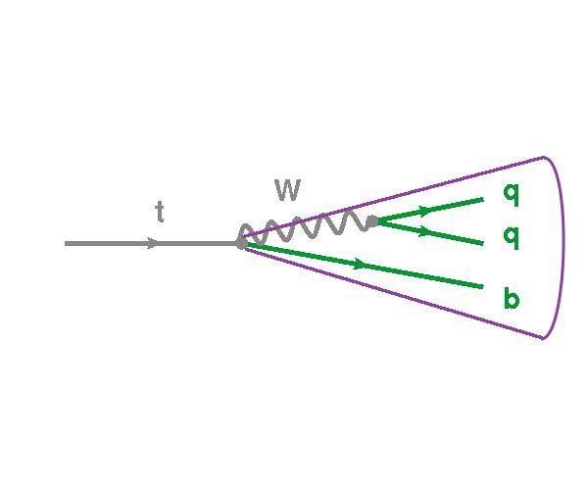
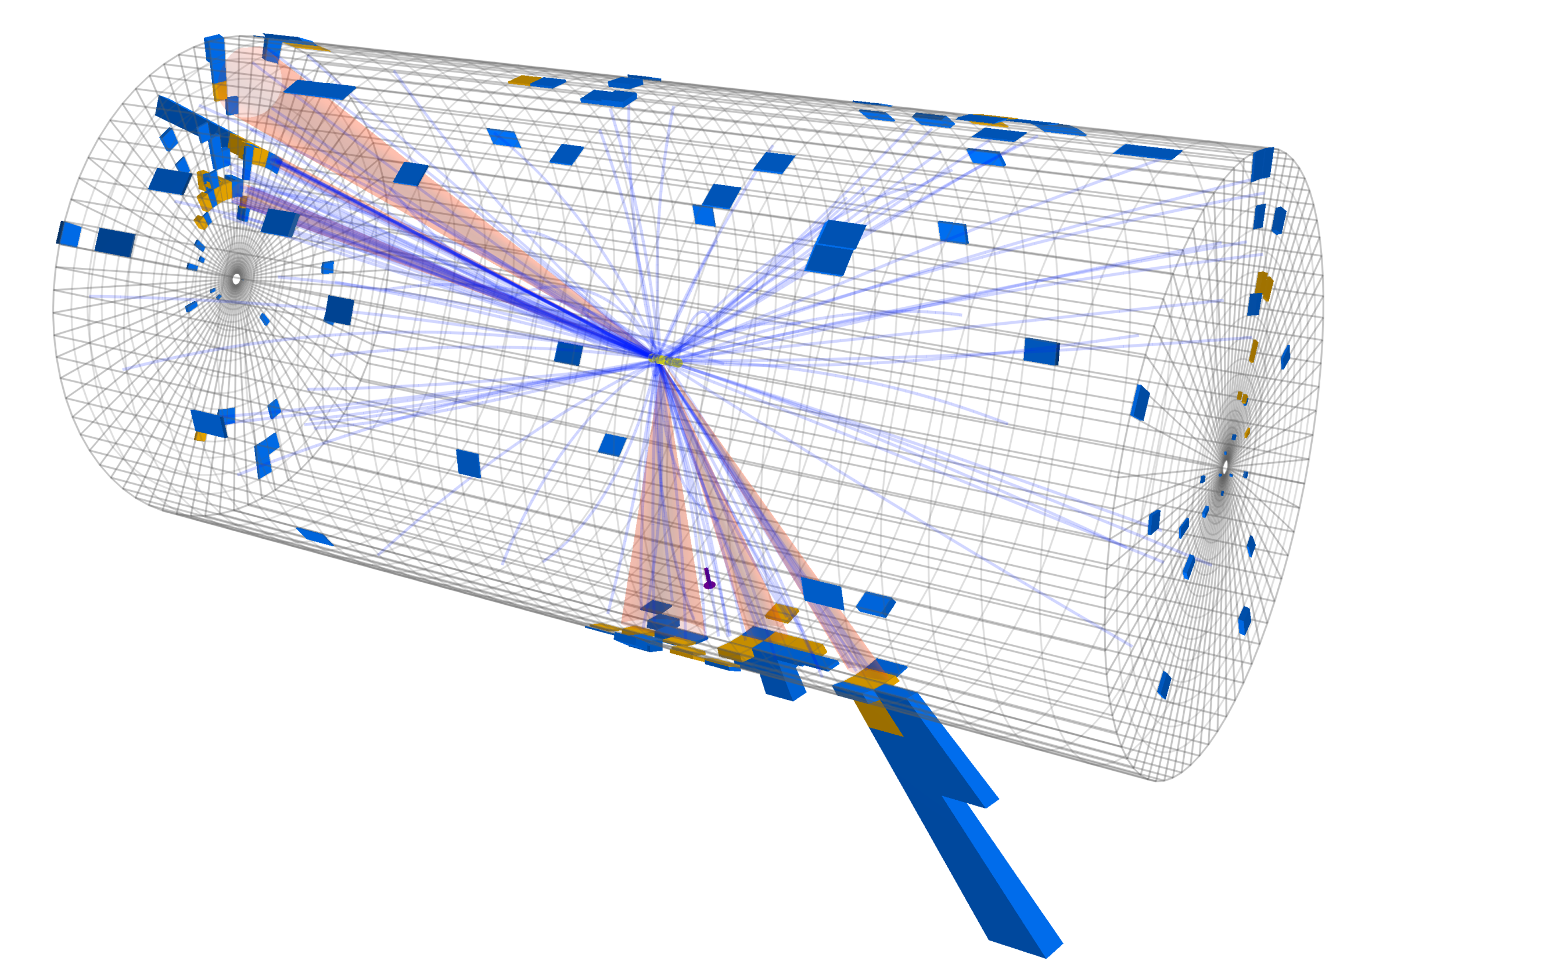
Initial searches for new physics
CERN-CMS-DP-2015-020
Two top-tagged objects
M(top-tagged 1) = 176 GeV
M(top-tagged 2) = 177 GeV
M(top-antitop) = 2.5 TeV

Slide 34
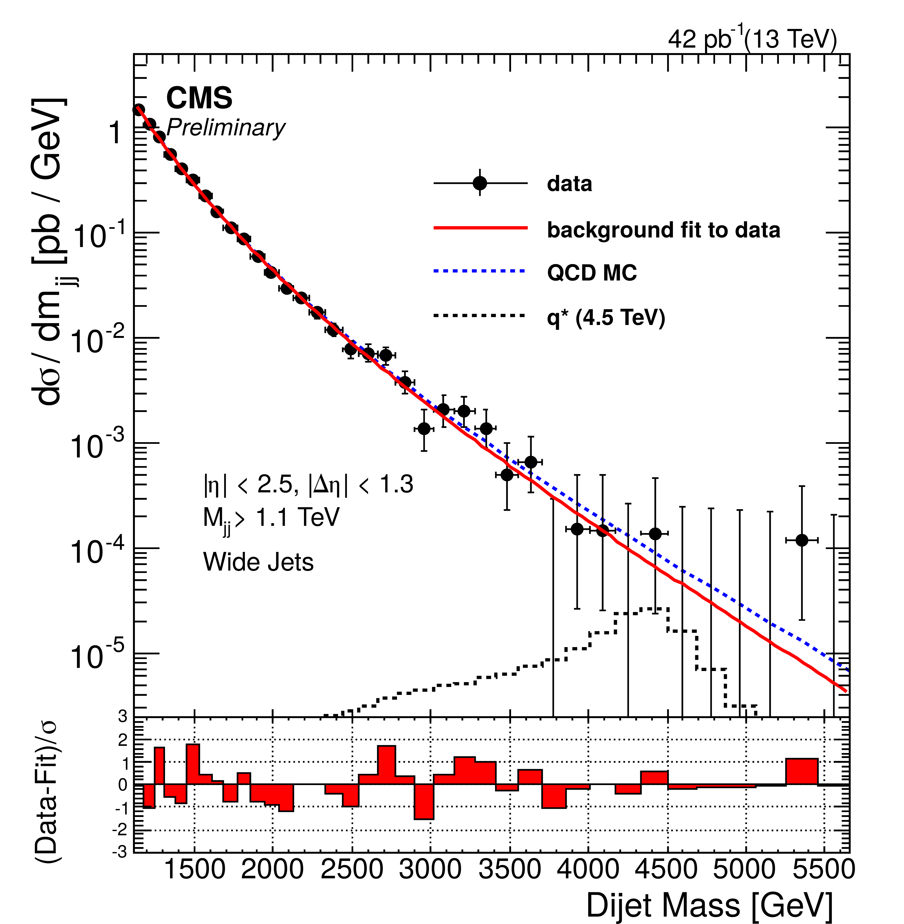
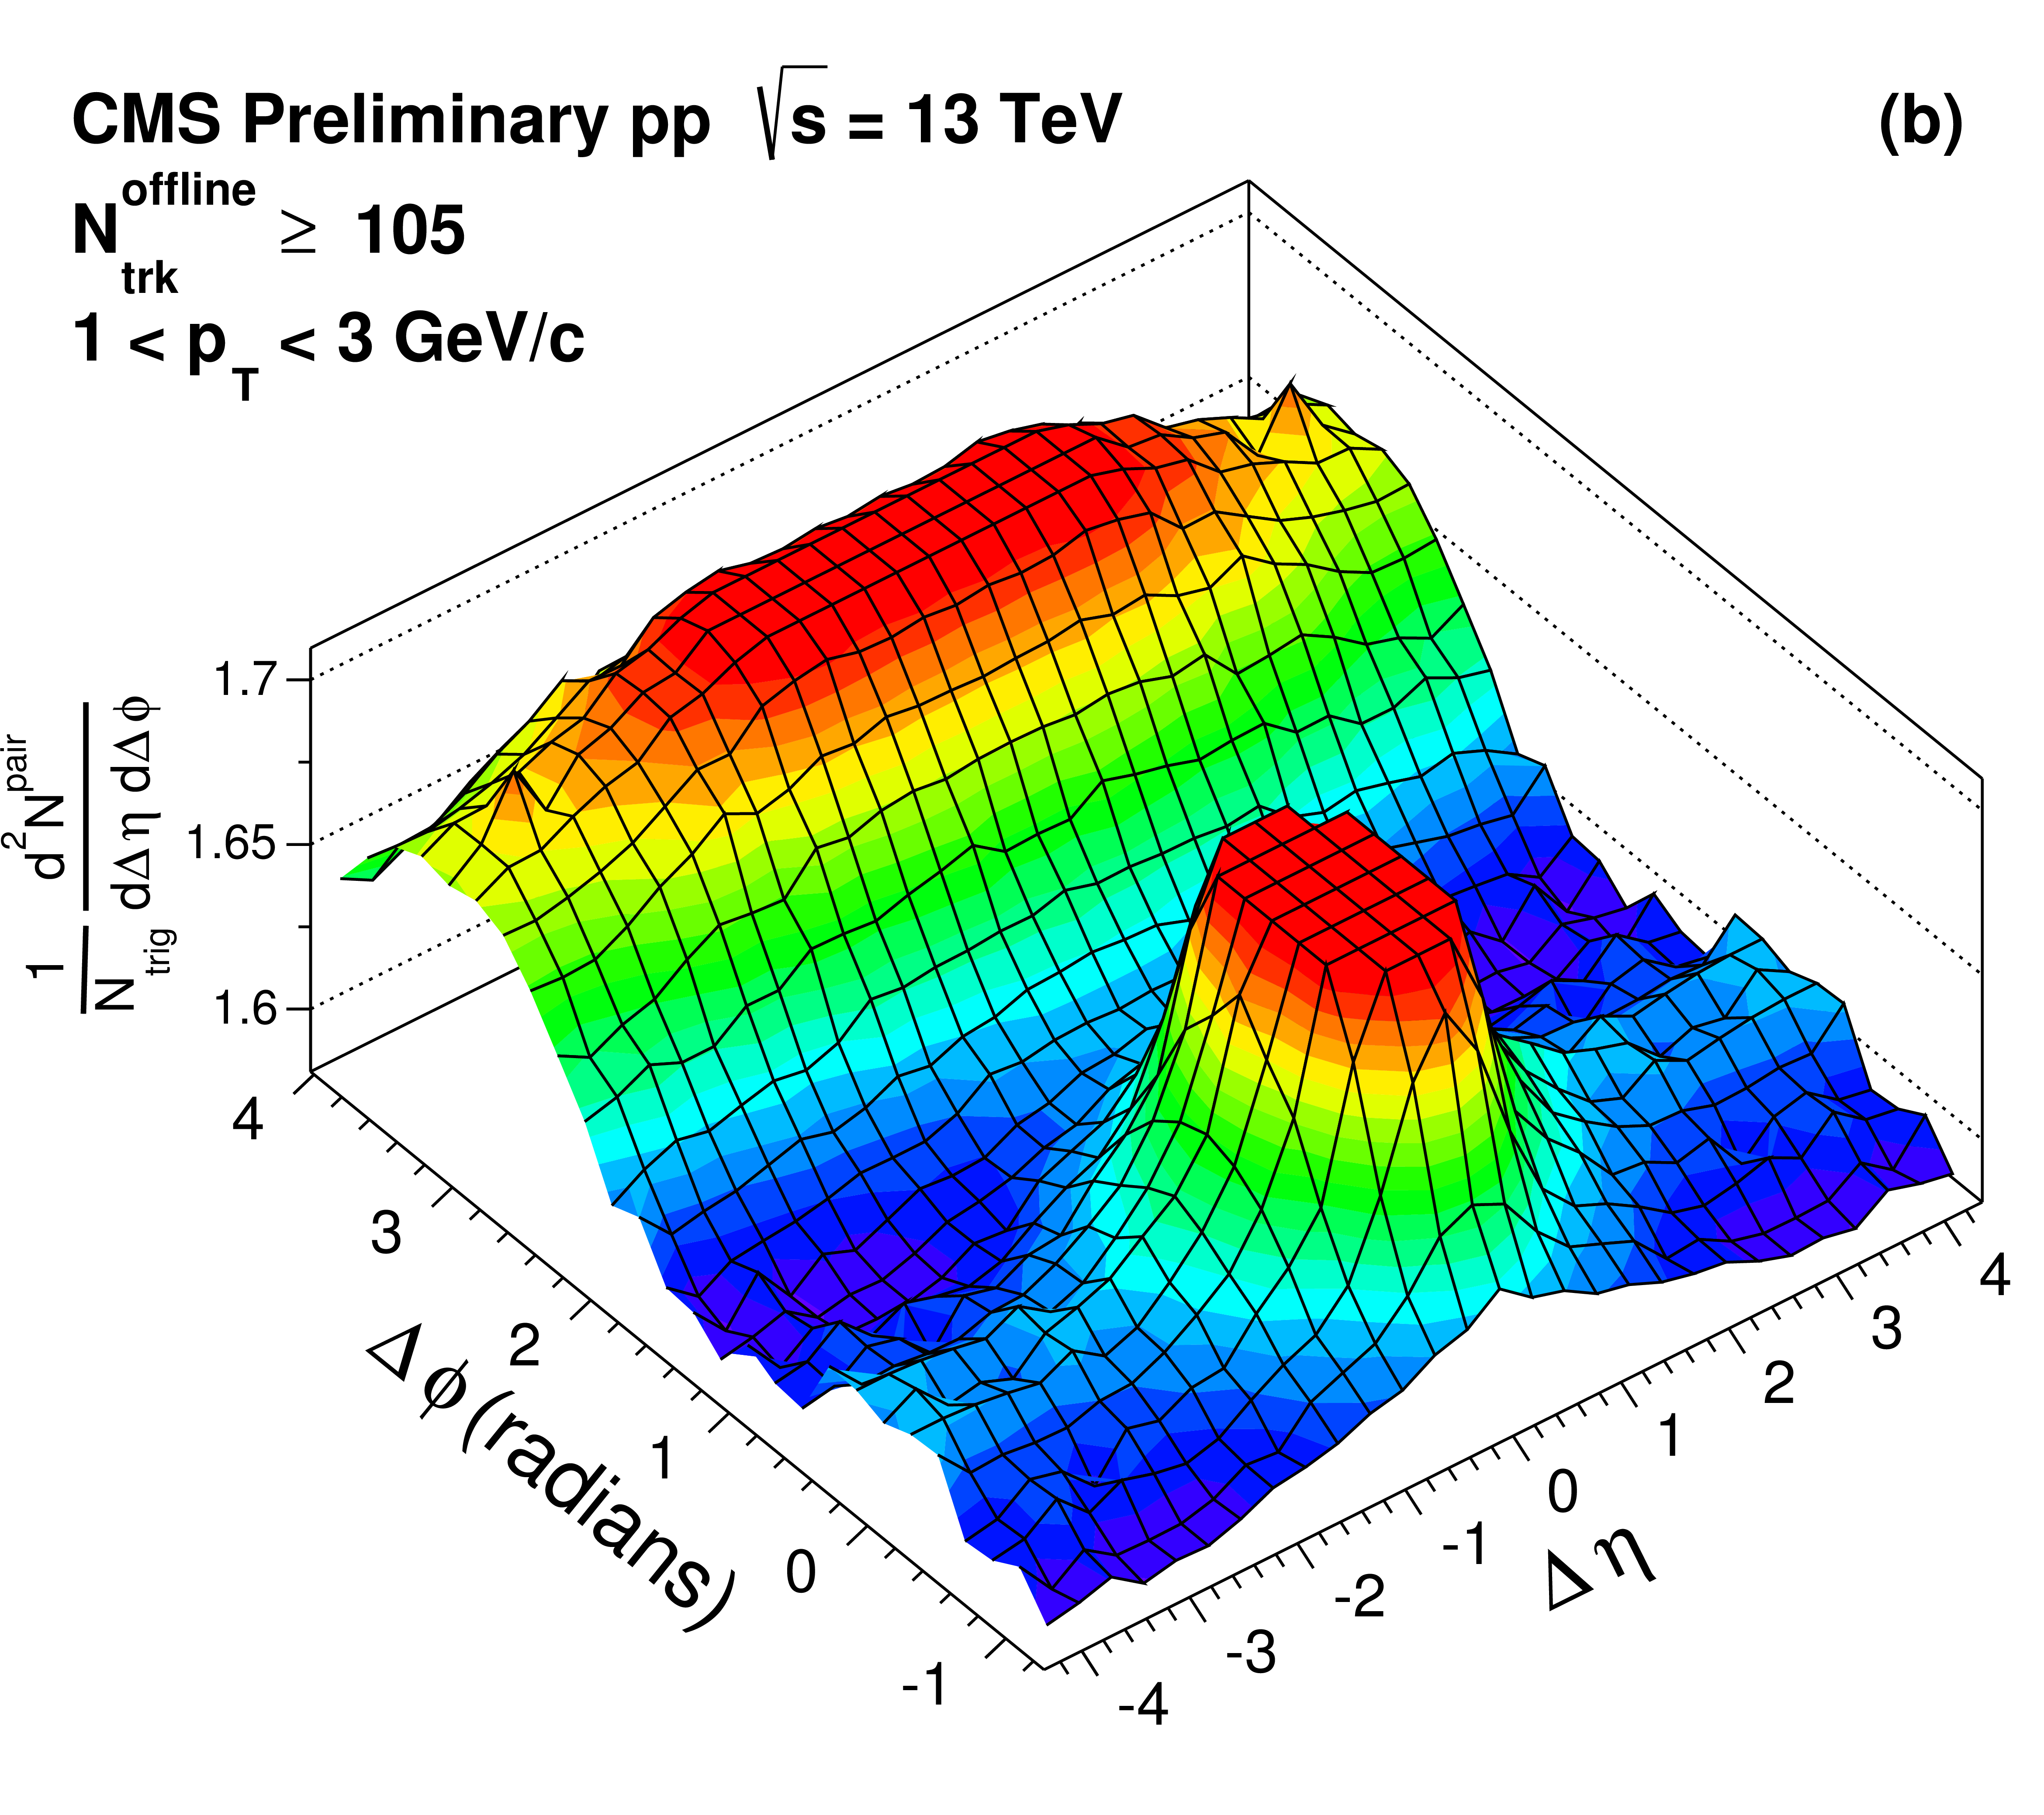
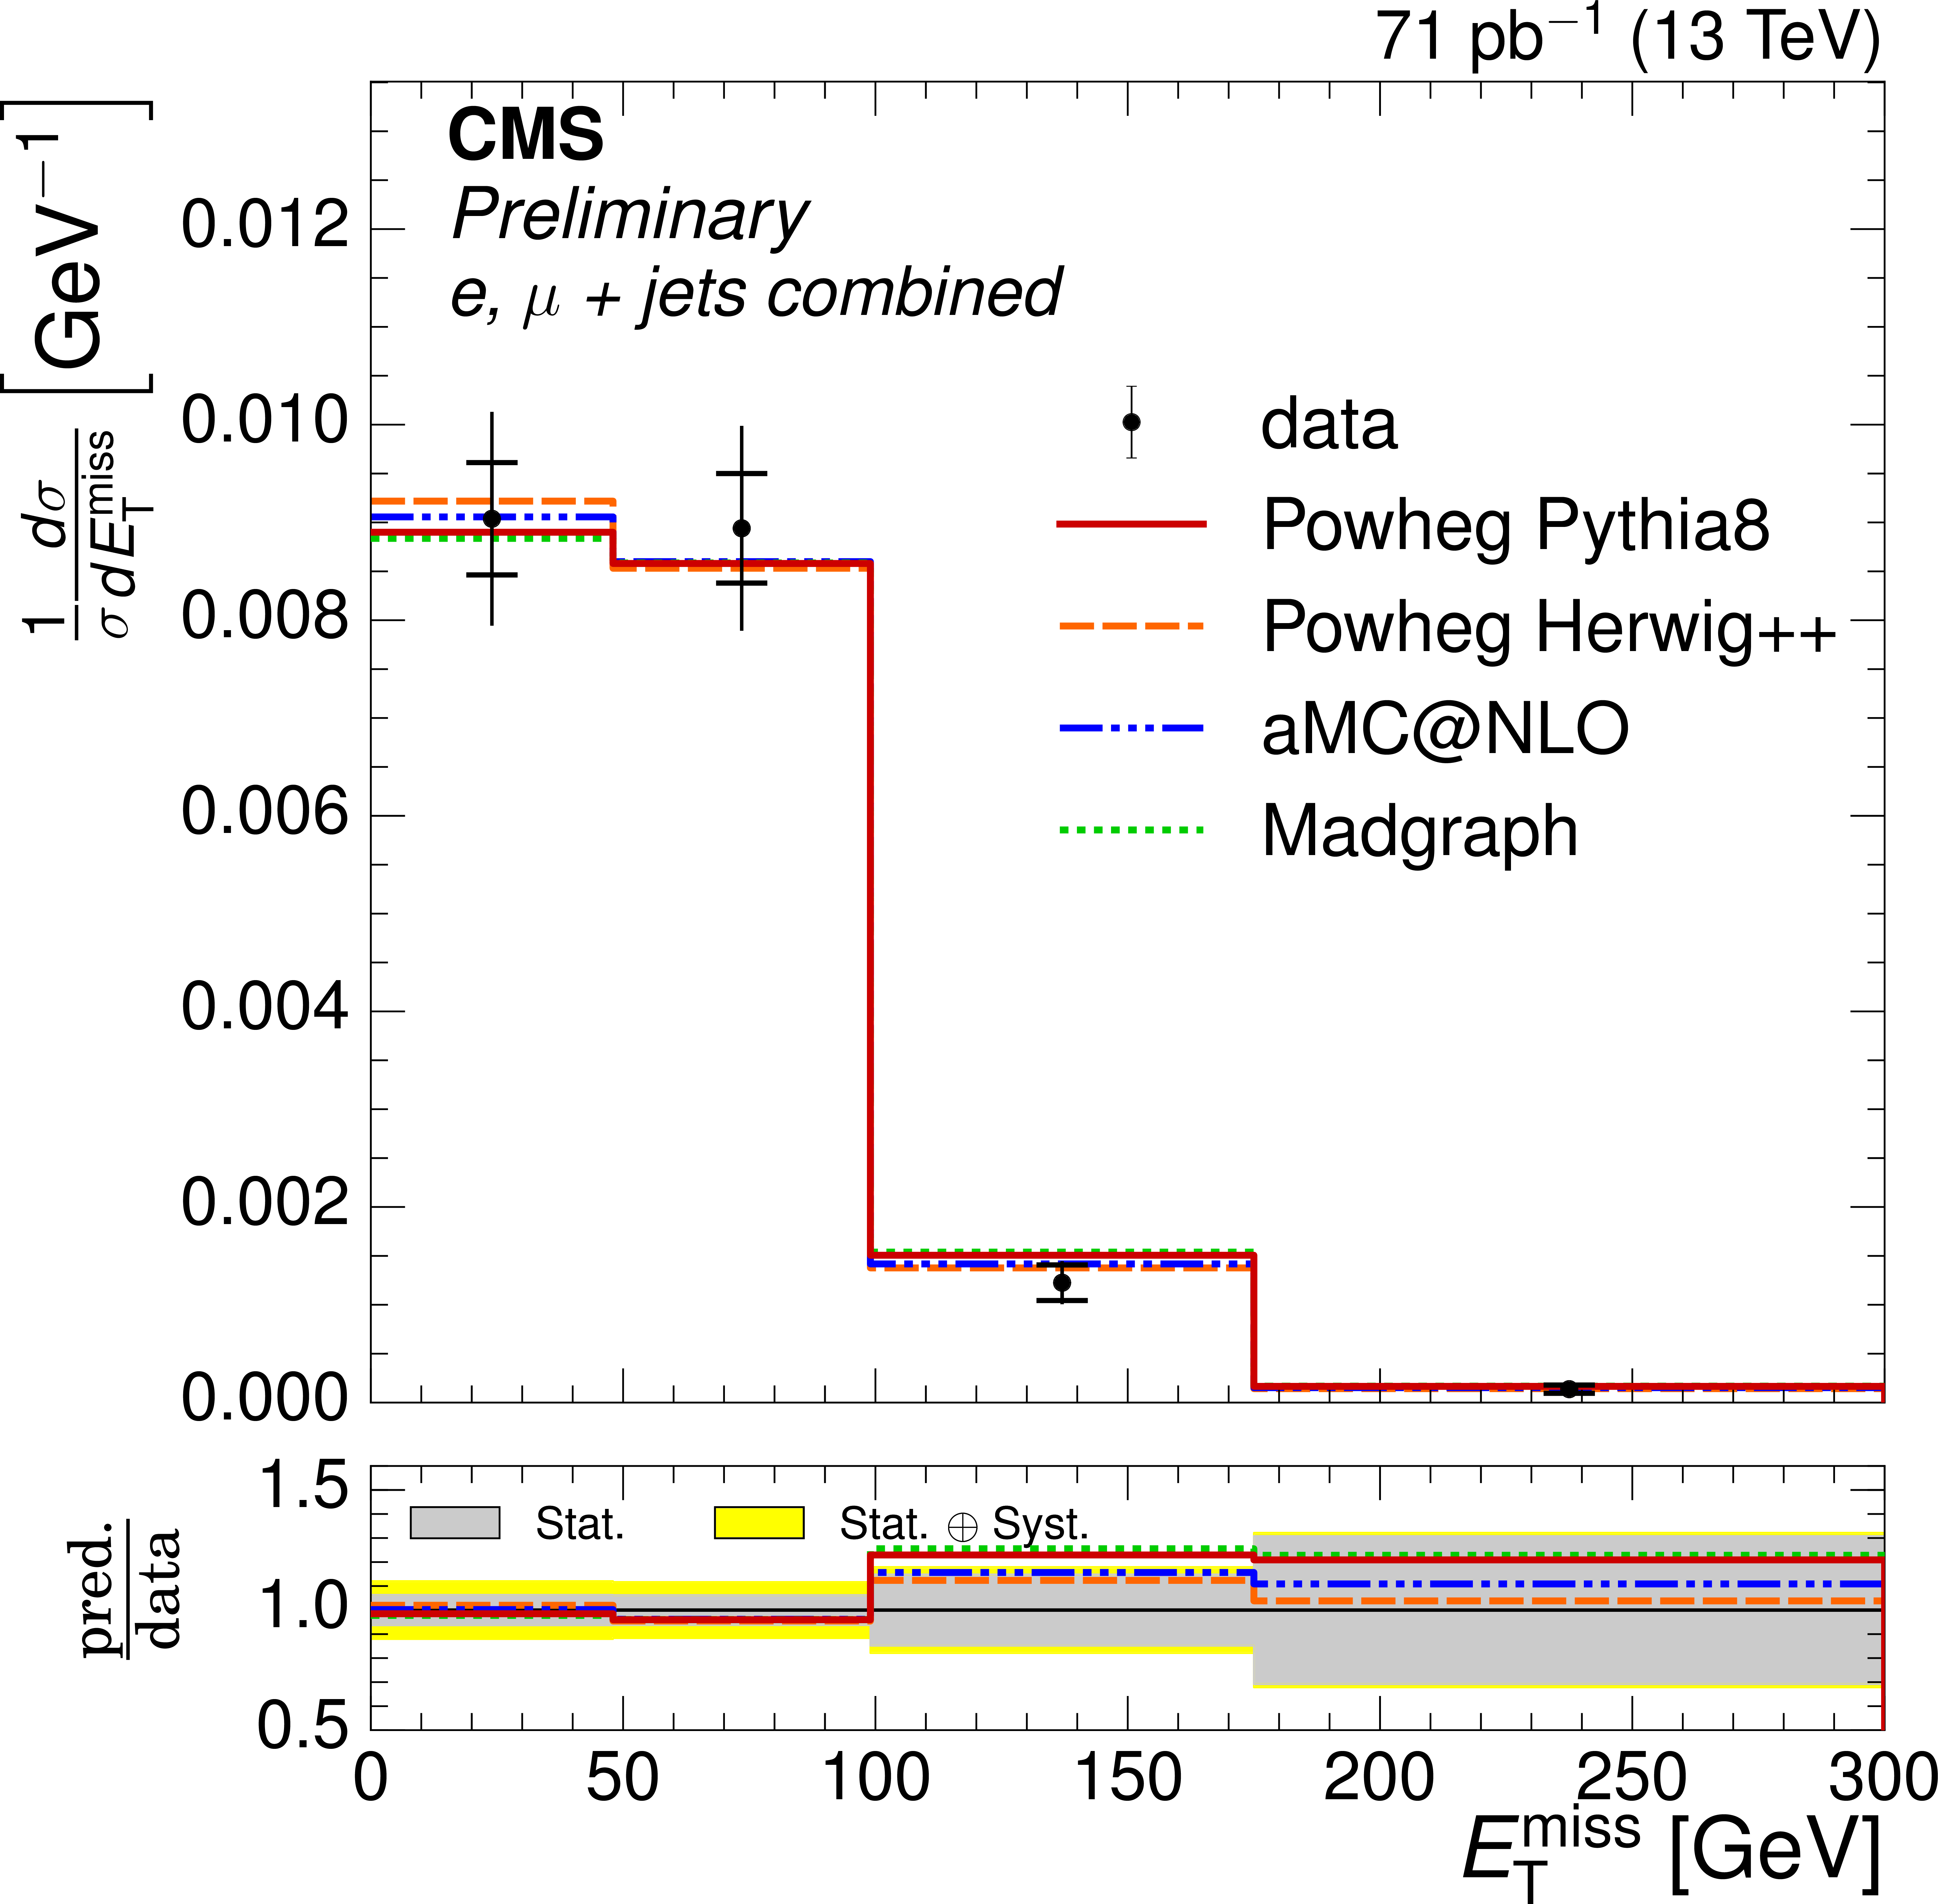
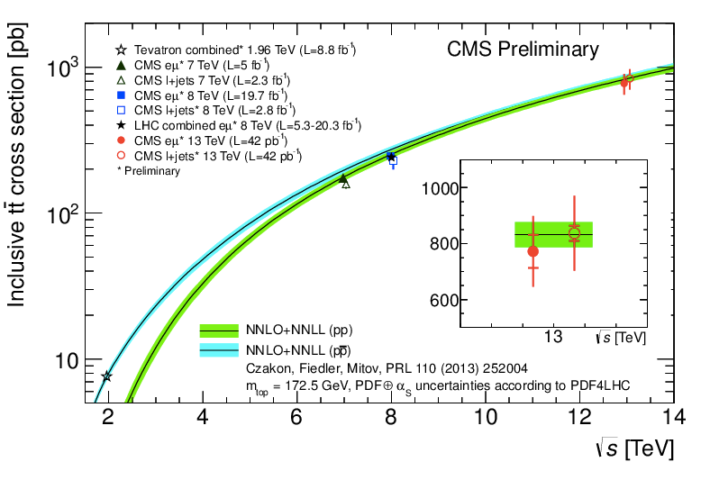
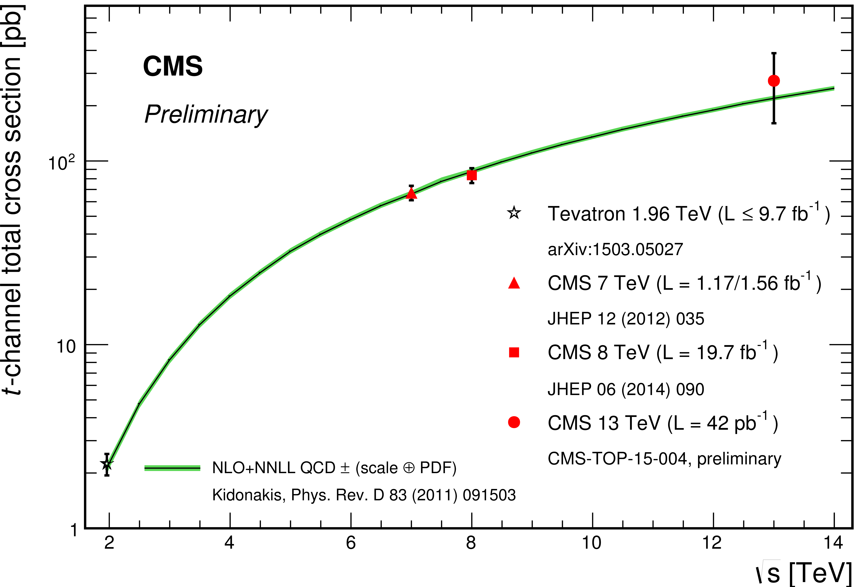
More physics in talk of G. Dissertori

Slide 35
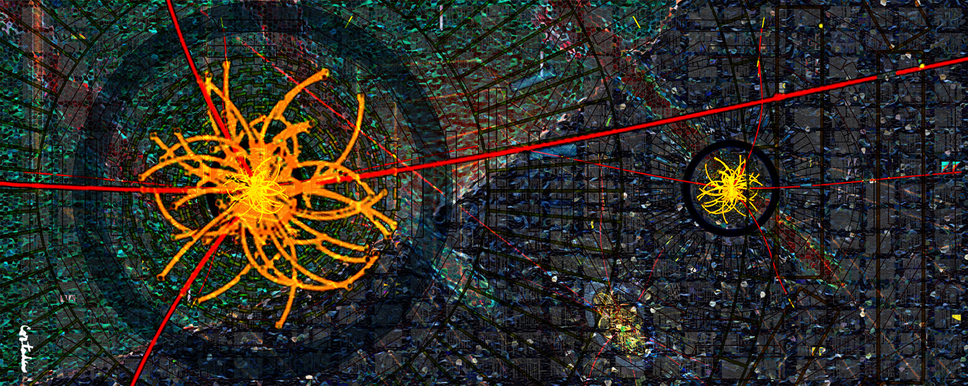
CMS-PHO-PUBLIC-2013-009-1
Upgrades: Towards improved detectors
Xavier Cortada (with the participation of physicist Pete Markowitz), "In search of the Higgs boson: H -> ZZ", digital art, 2013.

Slide 36
Timeline
Phase-1 CMS Upgrades
Phase-2 CMS Upgrades
Early Run-2
results
Run-1
highlights
CMS is active on many fronts
Long Shutdown 1 (LS1) activities

Slide 37
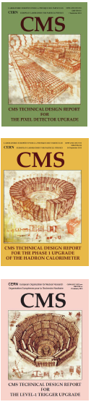
Overview of Phase-1 upgrades
Since the initial construction of CMS the pile-up will increase to twice the design and new technology opportunities appeared.
Upgrades are ongoing for three areas:
New Pixel Tracker: a barrel part with 4 layers and 3 forward disks, as well as a new readout chip
  → installation E-YETS 2016-2017
Level-1 Trigger: to cope with the higher rate the calorimeter and muon L1 trigger system is being upgraded as well as the global trigger
  → installation and commissioning in 2014-2016
Hadron Calorimeter: new electronics to be installed for the HF to allow timing based background rejection and new SiPM’s for the barrel and endcap (HB/HE) readout
  installation HF electronics YETS 2015-2016
  HCAL installation during LS2
The US has a major role in all these upgrades

Slide 38
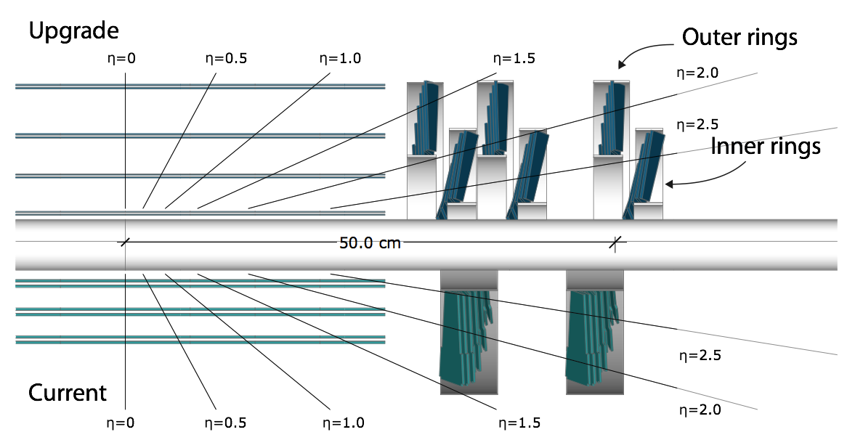
Pixel Phase-1 upgrade
More layers will be added in the barrel and endcap regions (most inner barrel layer with a radius of 3cm): will reduce fake rate and improve track resolution and efficiency
New readout chip to operate at 50 pile-up and 100kHz, and tolerate rates up to 100 pile-up events
8 pilot modules are installed on forward blades for Run-2
US

Slide 39
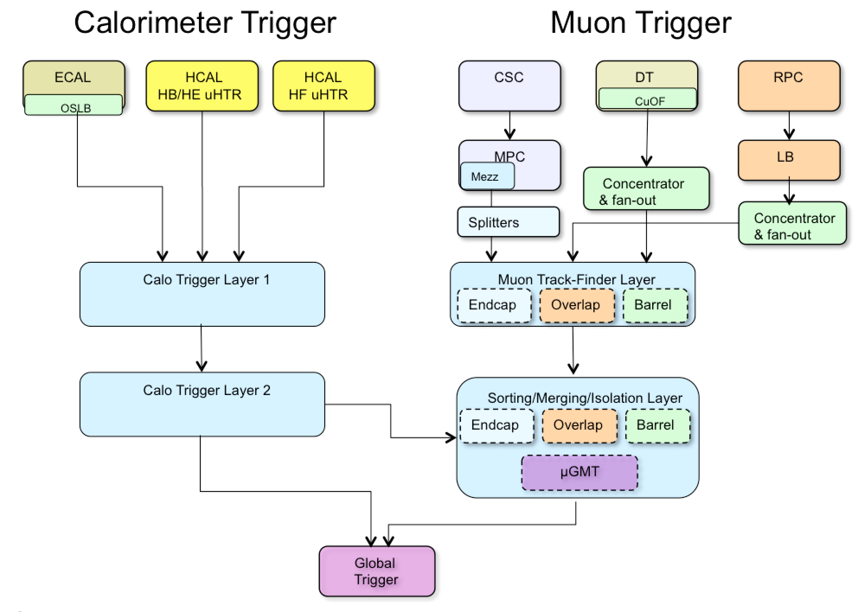
L1 trigger Phase-1 upgrade
Need to maintain the trigger performance of Run-1 towards Run-2&3
Move to high-performance FPGA’s and common use of the μTCA architecture
Deployed from “legacy” to “upgrade” trigger system in two stages
A two-layered calorimeter trigger with tower-level precision (i.e. improved tau and electron triggers, and pile-up subtraction)
Combining all muon subsystems in a Muon Trigger with track-finding options (i.e. more robust and improved p_{T} measurement)

Slide 40
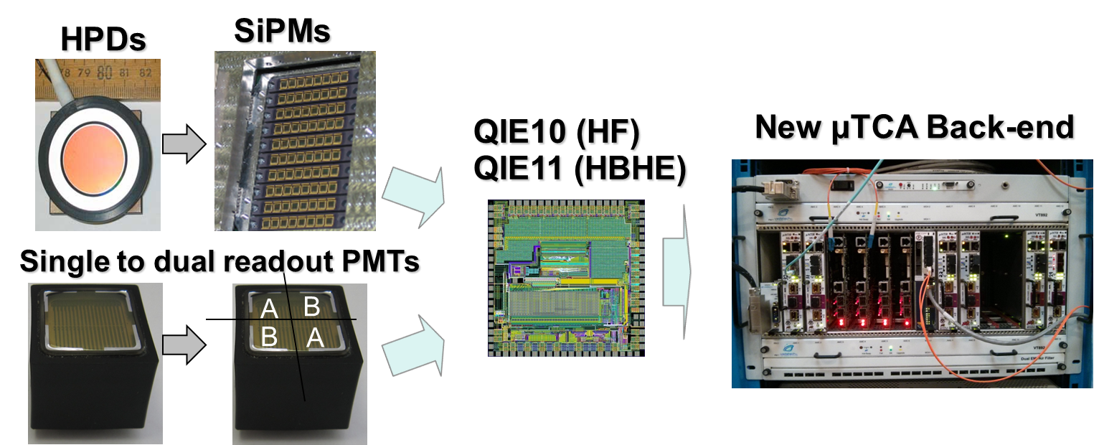
HCAL Phase-1 upgrade
New photodetectors to deal with radiation and anomalous signals: for HB/HE from HPD → SiPM, for HF from single-anode PMT → dual-anode PMT’s
New Front-End and Back-End electronics
HB/HE
HF

Slide 41
HCAL Phase-1 upgrade
New photodetectors to deal with radiation and anomalous signals: for HB/HE from HPD → SiPM, for HF from single-anode PMT → dual-anode PMT’s
New Front-End and Back-End electronics
HB/HE
HF
delivered (installation YETS 2015-2016)

Slide 42
HCAL Phase-1 upgrade
New photodetectors to deal with radiation and anomalous signals: for HB/HE from HPD → SiPM, for HF from single-anode PMT → dual-anode PMT’s
New Front-End and Back-End electronics
prototypes in test-beams
(installation LS2)
HB/HE
HF
delivered (installation YETS 2015-2016)

Slide 43
CMS-PHO-PUBLIC-2013-009-1
Upgrades: Towards HL-LHC
Xavier Cortada (with the participation of physicist Pete Markowitz), "In search of the Higgs boson: H -> ZZ", digital art, 2013.

Slide 44
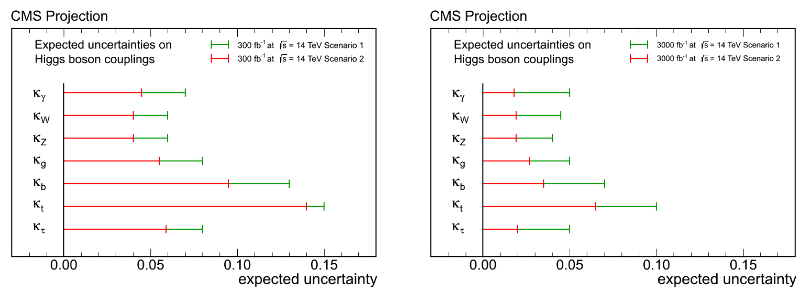
More luminosity at HL-LHC
From full LHC dataset to full HL-LHC dataset a factor of >2 improvement in Higgs boson SM coupling precision (scaled from current measurements and assuming same detector performances with the full 300-3000/fb).
300/fb
3000/fb
Two scenarios: (1) where systematic uncertainties do not scale with more integrated luminosity, and (2) where they do scale down with a factor of 2

Slide 45
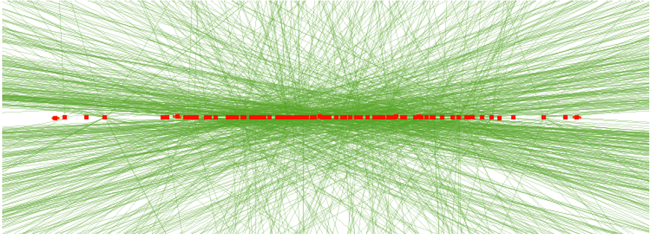
HL-LHC: more luminosity
“Baseline” peak luminosity 5 x 10³⁴ cm⁻² s⁻¹ (now ~1 x 10³⁴ cm⁻² s⁻¹ ) → 140 PU
“Ultimate” peak luminosity 7.5 x 10³⁴ cm⁻² s⁻¹ (i.e. 200 PU) potentially increasing integrated luminosity by 30%
Top quark pair event with 140 PU events
CMS Phase-II (i.e. HL-LHC) upgrade goals
Maintain Phase-I detector performance, at 140 PU (baseline)
Enable operation at 200 PU (ultimate), with moderate performance degradation
Radiation tolerance 3000 fb⁻¹ margin up to 4000 fb⁻¹

Slide 46
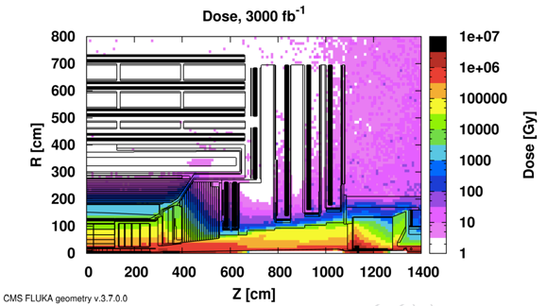
More luminosity, i.e. more radiation

Slide 47
More luminosity, i.e. more radiation

Slide 48
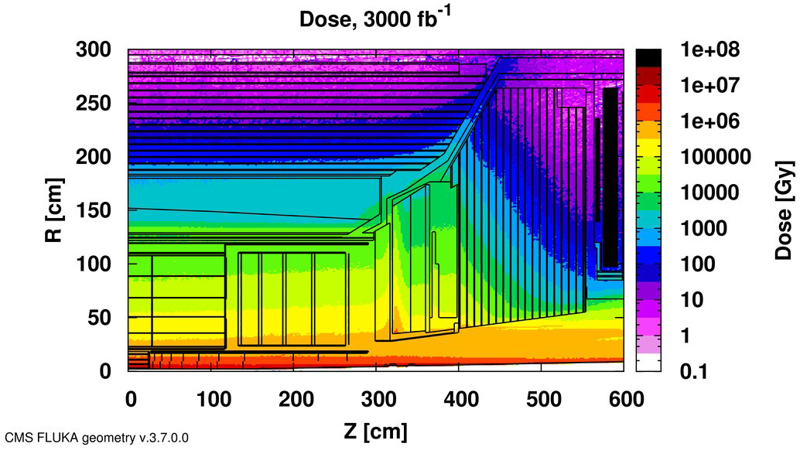
More luminosity, i.e. more radiation

Slide 49
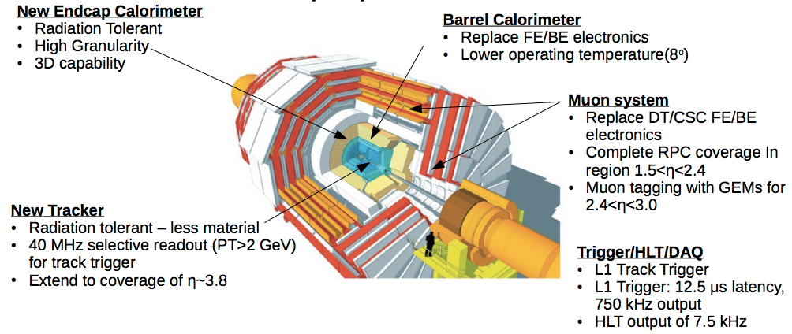

Upgrades for the CMS experiment
These upgrades come with scientific/technical challenges and the CMS Collaboration is prepared to face them
Technical Proposal: CERN-LHCC-2015-010, https://cds.cern.ch/record/2020886

Slide 50



Tracker Upgrade: Outer Tracker
2S modules
90 μm pitch & 5 cm length
PS modules
100 μm pitch & 2.5 cm length
100 μm x 1.5 mm macropixels

Slide 51


Tracker Upgrade: Inner (Pixel) Tracker
Covers up to |η|=4

Slide 52

Barrel Calorimeter Upgrade
Adapt to the trigger requirements & reduce radiation induced noise
New electronics to meet the trigger latency of 12.5 μs and L1 rate of 750 kHz
Adjust operating temperature (8ºC) to limit the noise in the APD’s to 200 MeV

Slide 53

Forward Calorimeter Upgrade
3D shower measurement in a new High-Granularity Calorimeter (HGC) with high timing precision, will mitigate pile-up effects
1.5 < |η| < 3.0
Operates at -30ºC
CO₂ cooling
ECAL section (EE): Tungsten/Silicon
Depth of 25X₀, 1.5λ (28 layers)
HCAL section (FH): Brass/Silicon
Depth of 3.5λ (12 layers)
Backing HCAL section (BH): Brass/Scintillator
Depth of 5λ (12 layers)
Total depth of 10λ
scintillator
silicon

Slide 54

Forward Calorimeter Upgrade
New Back Hadron calorimeter with scintillating tiles
Similar to current HE but more radiation tolerant and higher granularity
→ x2 in ϕ and x1.3 in η
Finger tile design with a shorter light path

Slide 55
Upgrades for the CMS experiment
R&D is well defined and in progress
Technical Design Reports (TDRs) to be delivered in 2017
Based on our successes and experiences, the CMS Collaboration is gearing up for its Phase-2 construction as well as its research program towards HL-LHC.

Slide 56
Upgrades for the CMS experiment
R&D is well defined and in progress
Technical Design Reports (TDRs) to be delivered in 2017
Based on our successes and experiences, the CMS Collaboration is gearing up for its Phase-2 construction as well as its research program towards HL-LHC.

Slide 57



LS2: installation of GEM detectors
Triple-GEM in 1.5<|η|<2.2 region
Improve L1 and HLT muon p_{T} resolution to reduce/maintain the global muon trigger rate
Ensure 100% trigger efficiency in Run-3

Slide 58
Status of the CMS experiment
    Excellent detector performance during Run-1
    >400 journal papers, including a major discovery
    Successful program during LS1 (2013-2014)
    Well prepared for 13 TeV collisions
    First 13 TeV results appear
    En-route for another long list of new physics insights
    Preparing for our future research at the HL-LHC

Slide 59

Many challenges ahead!
    >4000 CMS members with excellent skills to face them

Slide 60
Back-up

Slide 61
The CMS Management

Slide 62

The Particle Physics Puzzle

