Slide 1
Top Quark Physics in Belgium
Period 2003-2009
as part of the CMS collaboration
5 key staff members: Prof. J.D’Hondt (VUB), Prof. C.Vander Velde (ULB),
Prof. V.Lemaitre (UCL), Dr. E.Daubie (UMons), Prof. M.Grunewald (UGent)
in total 14 PhD students & 8 post-docs
convenorship of Top Quark physics in CMS (Prof. J.D’Hondt), subgroup convenorship
for Single-top physics (Dr. A.Giammanco)
two times winner of the annual CMS Thesis Award (Dr. S.Lowette & Dr. J.Heyninck)
in total ~25 notes/papers (~400 pages of research results) & ~25 conference talks
connection to phenomenology of top quark physics in Belgium (Prof. F.Maltoni)
involvement in different areas, examples: commissioning activities for top quark
physics, calibration of jets, calibration of b-tagging algorithms, commissioning of
particle flow and other methods for top quark physics, diverse measurements (cross
section, mass, Vtb, angular distributions), search for new physics in the top quark
sector (fourth generation, resonances, charged Higgs, …)
organizers of the 3rd International Top Quark Workshop (Bruges, May-June 2010)

Slide 2
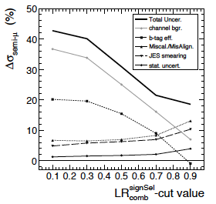
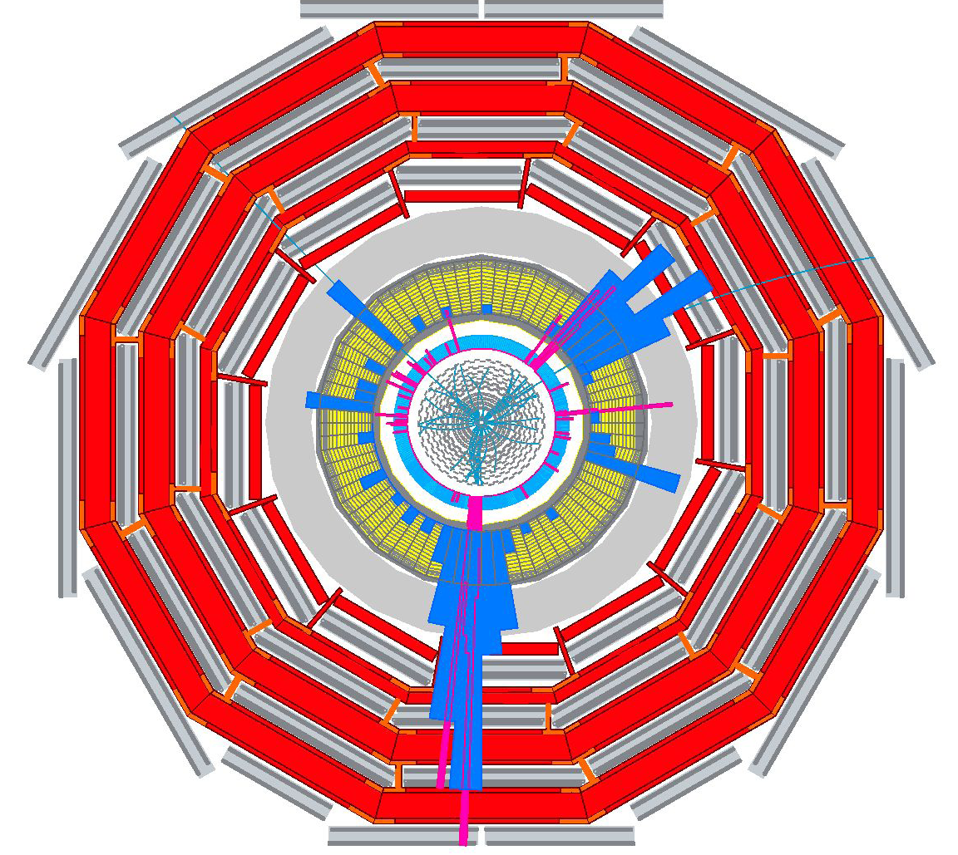
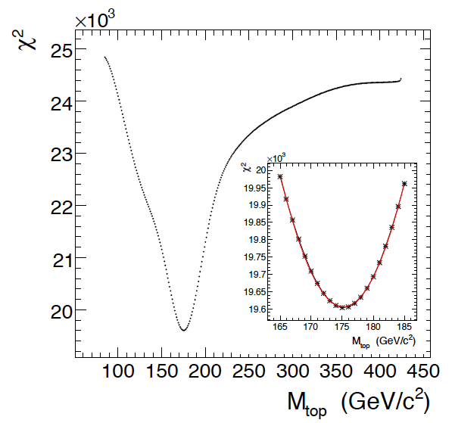
Top Quark Physics in Belgium
Period 2003-2009
Some examples
top quark pairs
Reducing the total uncertainty on the cross section with creative cuts
1fb⁻¹
1fb⁻¹
Measuring the top quark mass with advanced likelihood techniques
Simulated top pair event at CMS

Slide 3
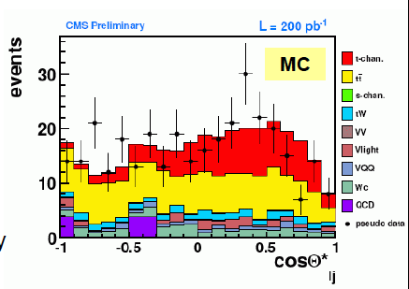
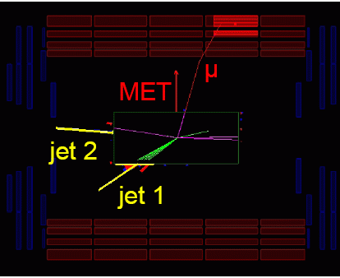
Top Quark Physics in Belgium
Period 2003-2009
Some examples
single-top
Extracting the single-top components via the angular distribution of the top quark decay, to measure |V_{tb}|
Simulated single top event at CMS

Slide 4
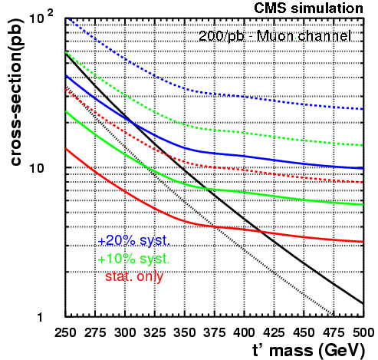
⁽‘⁾
‘
Top Quark Physics in Belgium
Period 2003-2009
‘
⁽‘⁾
Some examples
New physics in the
top quark sector
expected limits for
t’ particles with 200pb⁻¹
T prime signal
Standard Model

Slide 5
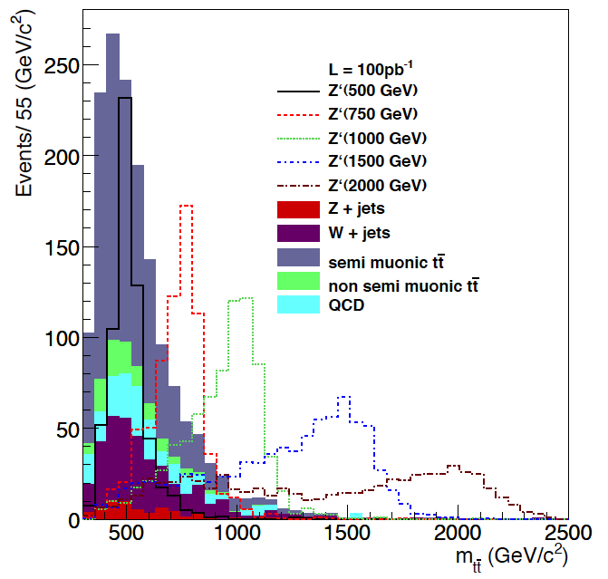
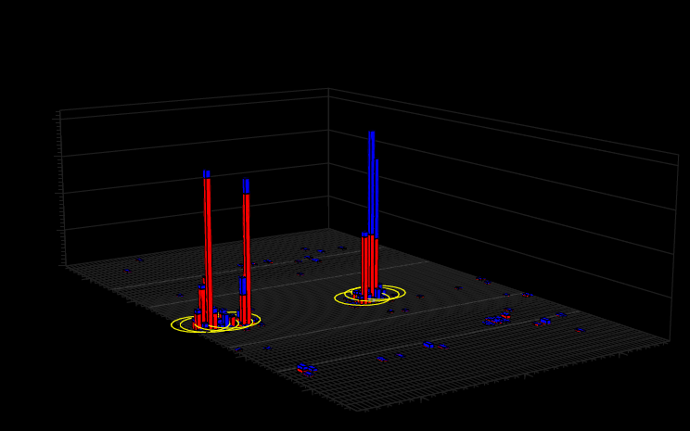
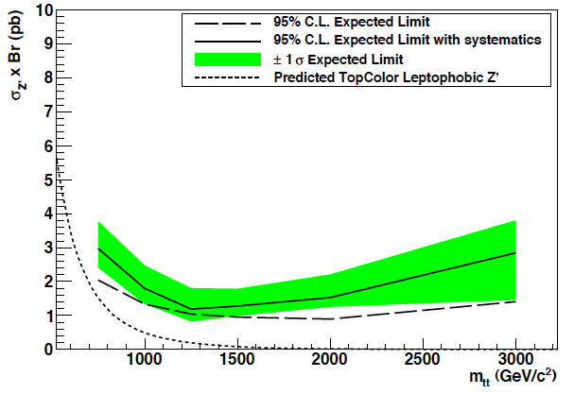
X
Top Quark Physics in Belgium
Period 2003-2009
Some examples
New physics in the
top quark sector
Standard Model
possible resonances
boosted top quarks
E_{T}
expected exclusion limits for resonances X→tt with 100pb⁻¹
η
φ
Simulated Z’→tt event at CMS

Slide 6
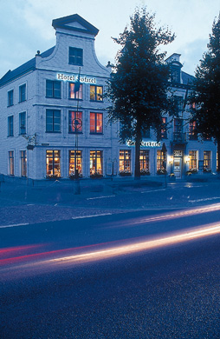
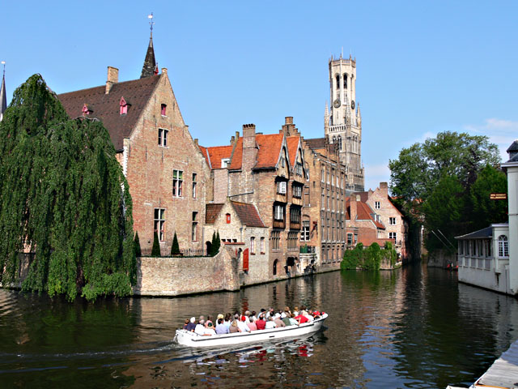
3rd International Workshop
on Top Quark Physics
theory & experiment
about 130 participants
Top Quark Physics in Belgium
Outreach
TOP2010 Conference
30th of May – 5th of June 2010
Brugge, Belgium
CP3 - IIHE
TOP2010 Conference
30th of May – 5th of June 2010
Brugge, Belgium
CP3 - IIHE
www.top2010.be

