Slide 1
Visit DSF @CERN
(Bond lab & QART lab)
Responsible Alan Honma
CERN 186-R-G16
http://bondlab-qa.web.cern.ch/bondlab-qa/
19 April 2015 , Jorgen and Wim

Slide 2
Bonding machine
Preferred type : Delvotec G5, Hesse&Knipps Bondjet 800 series
Cost ~ 150 … 200k Euro
Maintenance contract around 5k /y Euro
Clean room :
They work in a class 100000 clean room
Temperature stable within 1C ( otherwise bounding parameters change)
Humidity not asked , was 46% @ 21 C
Personnel :
One trained person to change parameters, adapt bounding programs, knows the habits of the machine → after setting up, the workload should not be high
Need to be available during the whole project
Doesn't need to do the production
Operator
Careful person, and should initiate the bonding for each module
Machine works thereafter automatic, alignment with pattern recognition
Per person max 6 hours / day (excluding regular breaks)

Slide 3
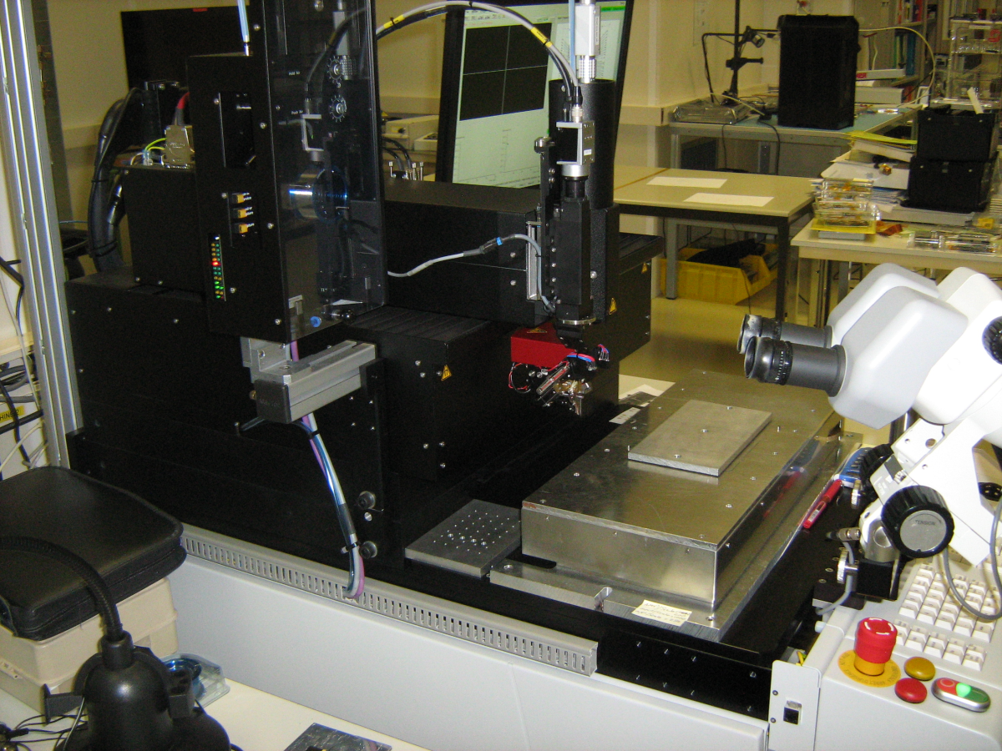
Bonding machine
Important note: different from Gantry in the past is that this bonding machine is one instrument and not a collection of pieces that one has to integrate yourself

Slide 4
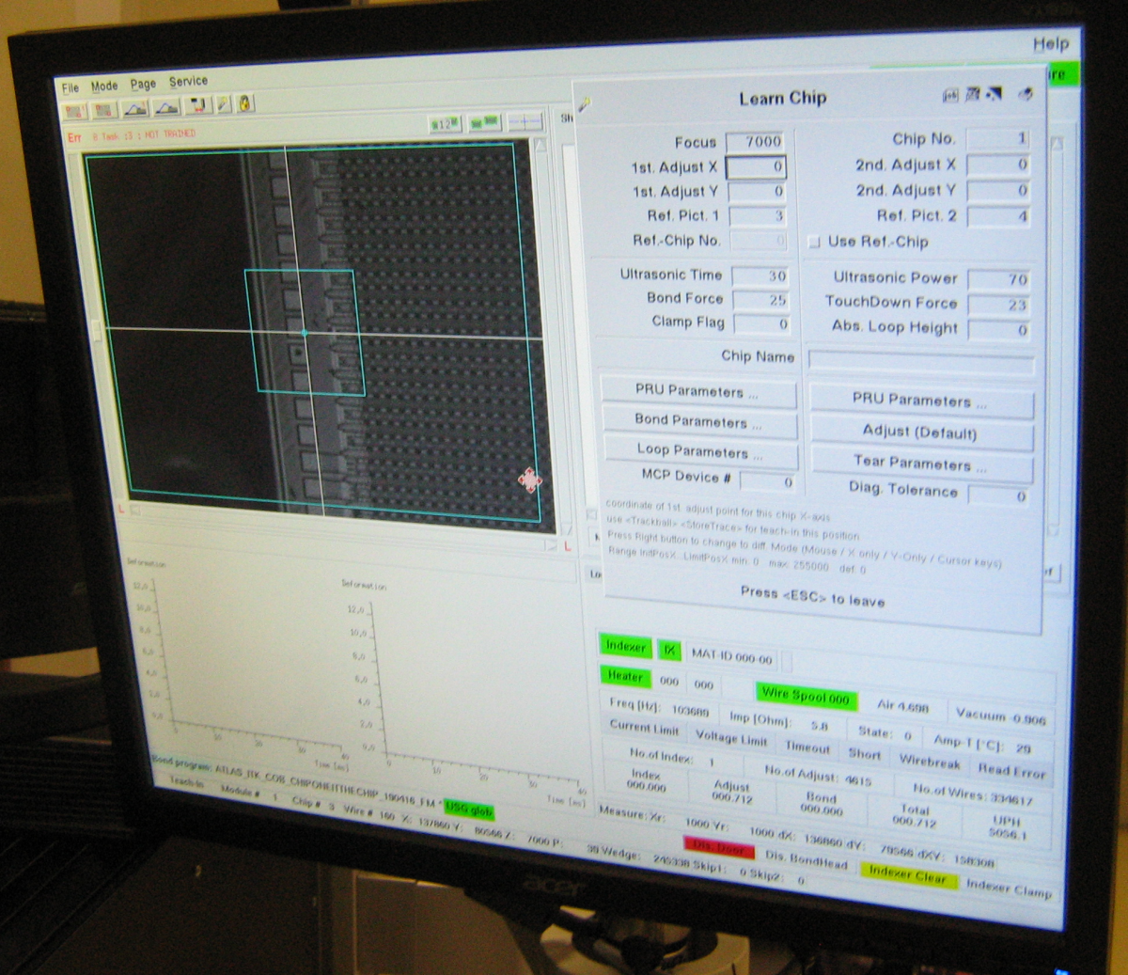
Program , control interface

Slide 5
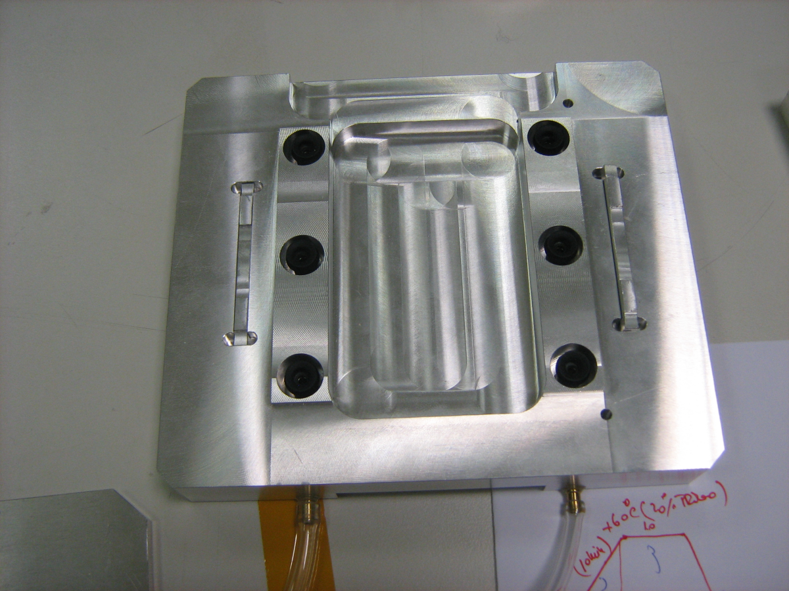
Bonding jig

Slide 6
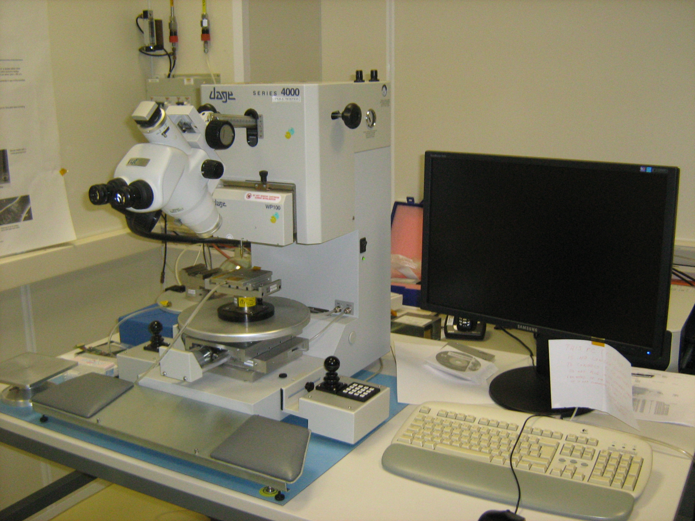
Pull tester
Not much discussed about it
Manual operation
Price ~ 40k Euro
Fits on one table

Slide 7
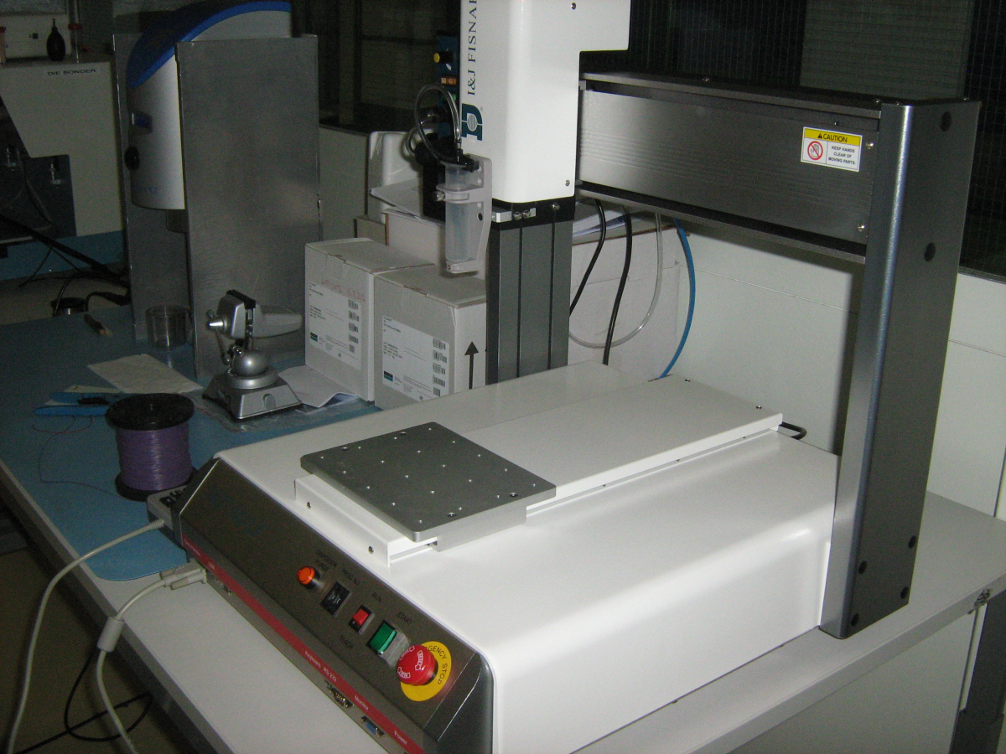
Encapsulation ( dispenser)
Cost ~10 k Euro
Programmed via a simple interface
Fits on one table

Slide 8
Other equipment needed
It might be needed to verify the alignment of the assembled modules with an independent instrument. The Aachen developed setup with Stereo microscope (measuring both sides of the module) might be an option. Specifications on for example the magnification for optical inspection to be discussed with the Aachen people. This is merely an option today, not a fixed procedure.
Total cost for bonding equipment ~ 200k Euro

Slide 9
Module assembly
Still in development phase
Need different jigs for different actions
Need also more ( ~5 ) of the same jigs to get a throughput of 20 modules/ week
Aim is to have relative cheap jigs but for a few points need high precision
Drawing will be made by CERN, but jigs are to be made elsewhere
Need different jigs for different module types (looks like several assembly sites are being prepared to PS modules and few for 2S modules)
All actions are manual (no robots)
Need microscope to check horizontal alignment sensors
Need verification vertical alignment , not yet clear how . Aachen system

Slide 10
Module assembly
Glue for assembly (mainly gluing the bridge to the sensors):
Current chosen glue cures at room temperature in 24 h
Very liquid, during first test caused high leakage current (up to 20 microAmp)
Consider to glue at higher temperature 65C… but aware of difficulty/safety
How ?
Extra requirements for the jigs ( CT Al different from CT Si and bridge material )
Heat source in the clean room that should be temperature stable (hence should have the option to separate some parts of the clean room from others)
Clearly this is under development and discussion…
There might be some additional jigs for the glue itself in order to have a uniform glue dispensing process. Not sure it this would be done manually or via a machine… the glue is always in one straight line, hence this would be a very simple glue dispensing machine.

Slide 11
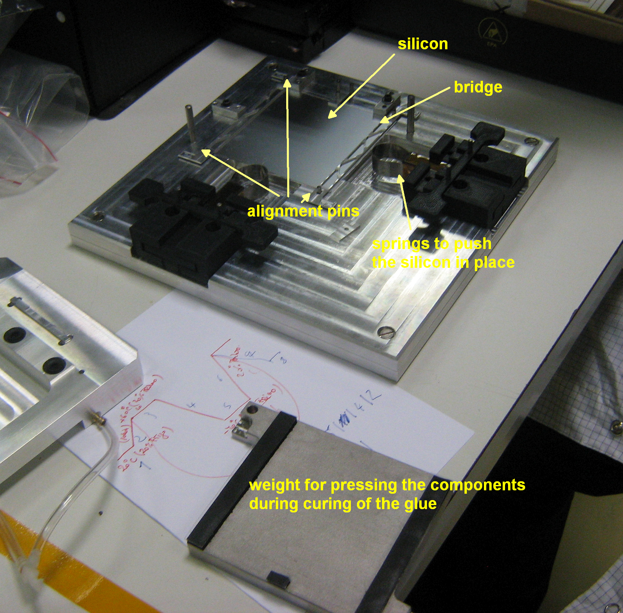
(sensor) glueing jig

Slide 12
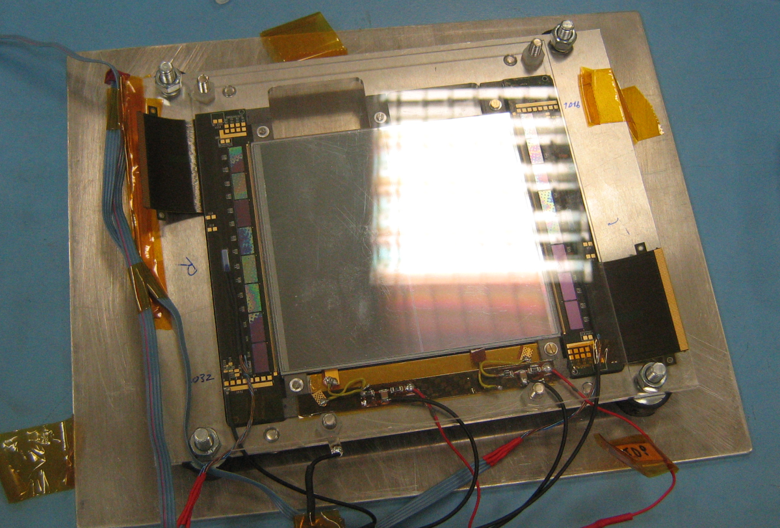
Module with transport plate
To be used for testing and transport, fixed via cooling contacts and to be removed when bonding the module… should be verified if this works when doing cooling tests
For after the bonding. No reasonable design for the transport plate was found to make it compatible with bonding.

Slide 13
Area needed
For work related to bonding , could fit in an area ~ 5 x 5 m2
Need three tables: bonding machine, pull tester, encapsulation
But need also additional tables to place modules that are not yet finished, are curing or for inspection
Module assembly
Several manual operations in parallel, hence need several assembly tables (about 4 assembly tables)
Storage for Modules in, out , cupboards, tables
Storage for modules under work.
Looks like the IIHE allocated room will certainly be large enough to receive components, assemble modules and the full bonding process. There should be enough space for the testing of the modules as well. Would require a large class 100000 clean room with options to separate parts of the clean room (eg. flexible “soft” walls).

