Slide 1
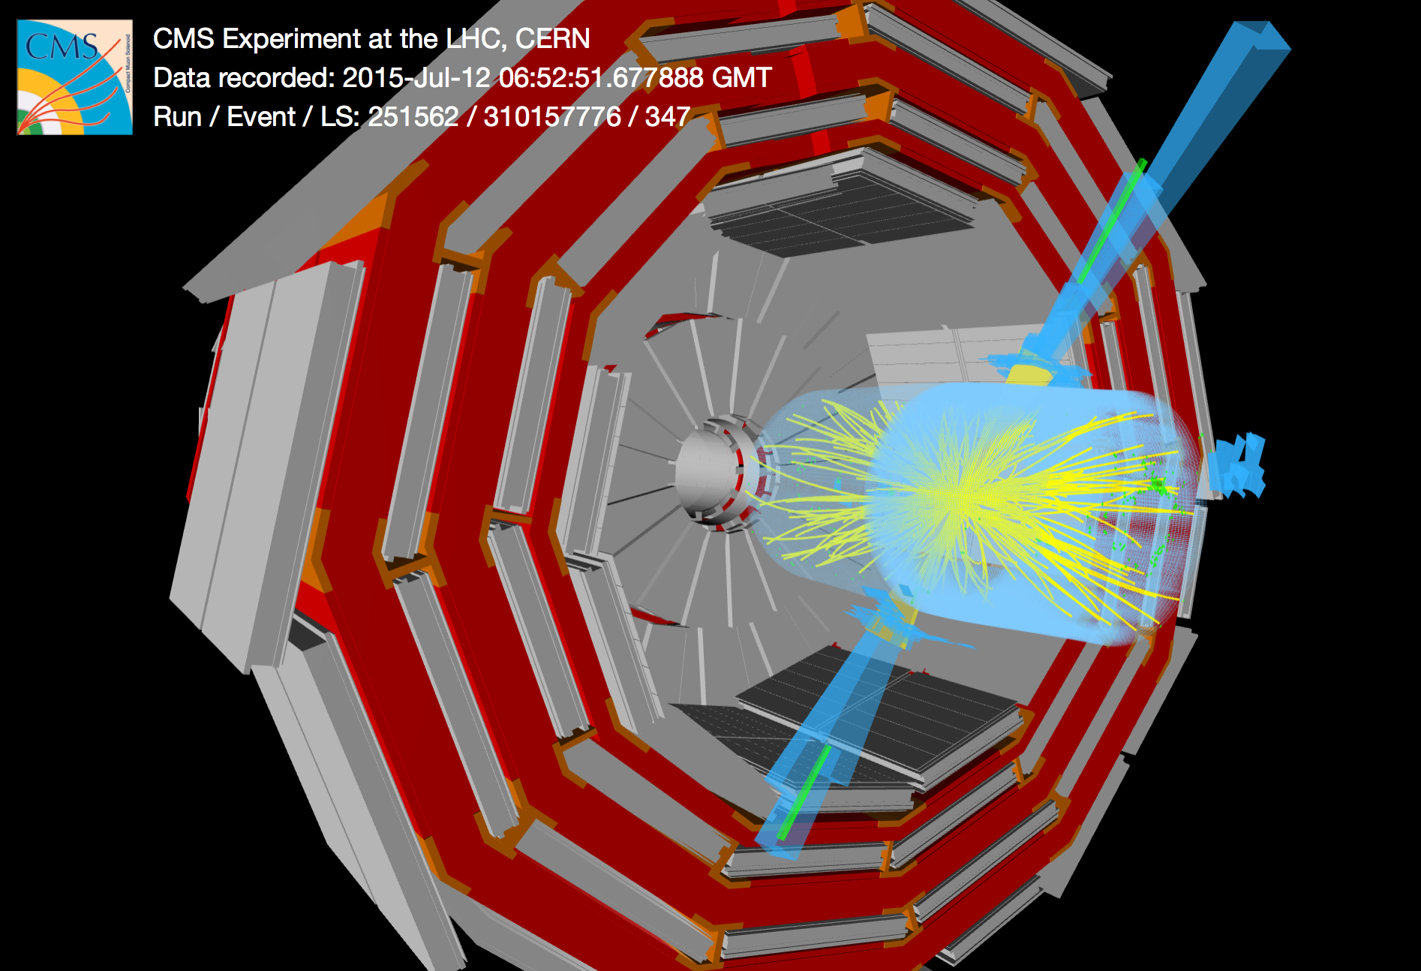
Status of the CMS experiment
Jorgen D’Hondt (Vrije Universiteit Brussel)
on behalf of the CMS Collaboration
di-jet event with m(jj) of 5.4 TeV

Slide 2
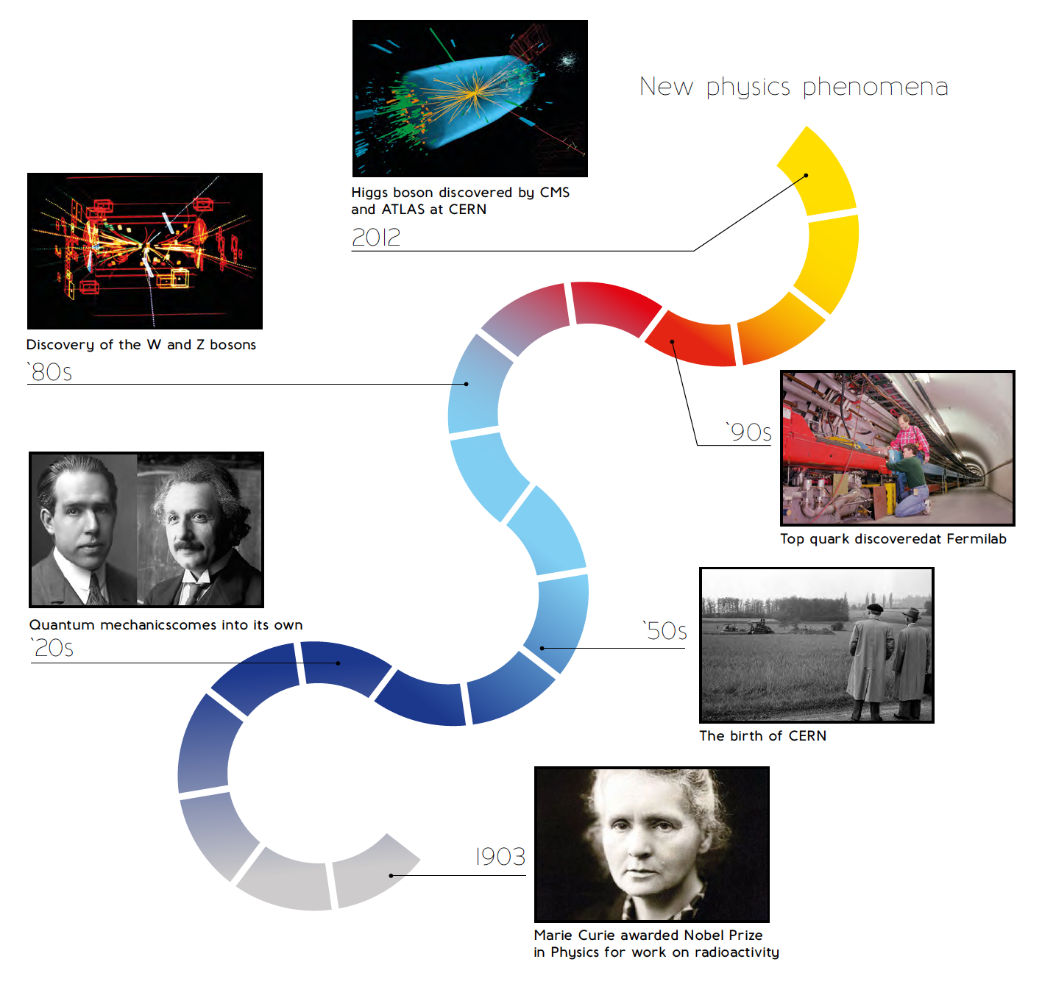

Particle Physics

Slide 3
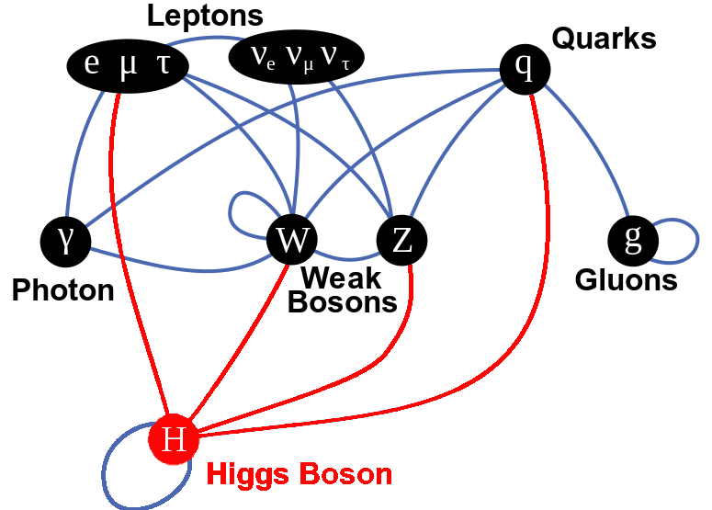
Particle Physics: the Standard Model

Slide 4
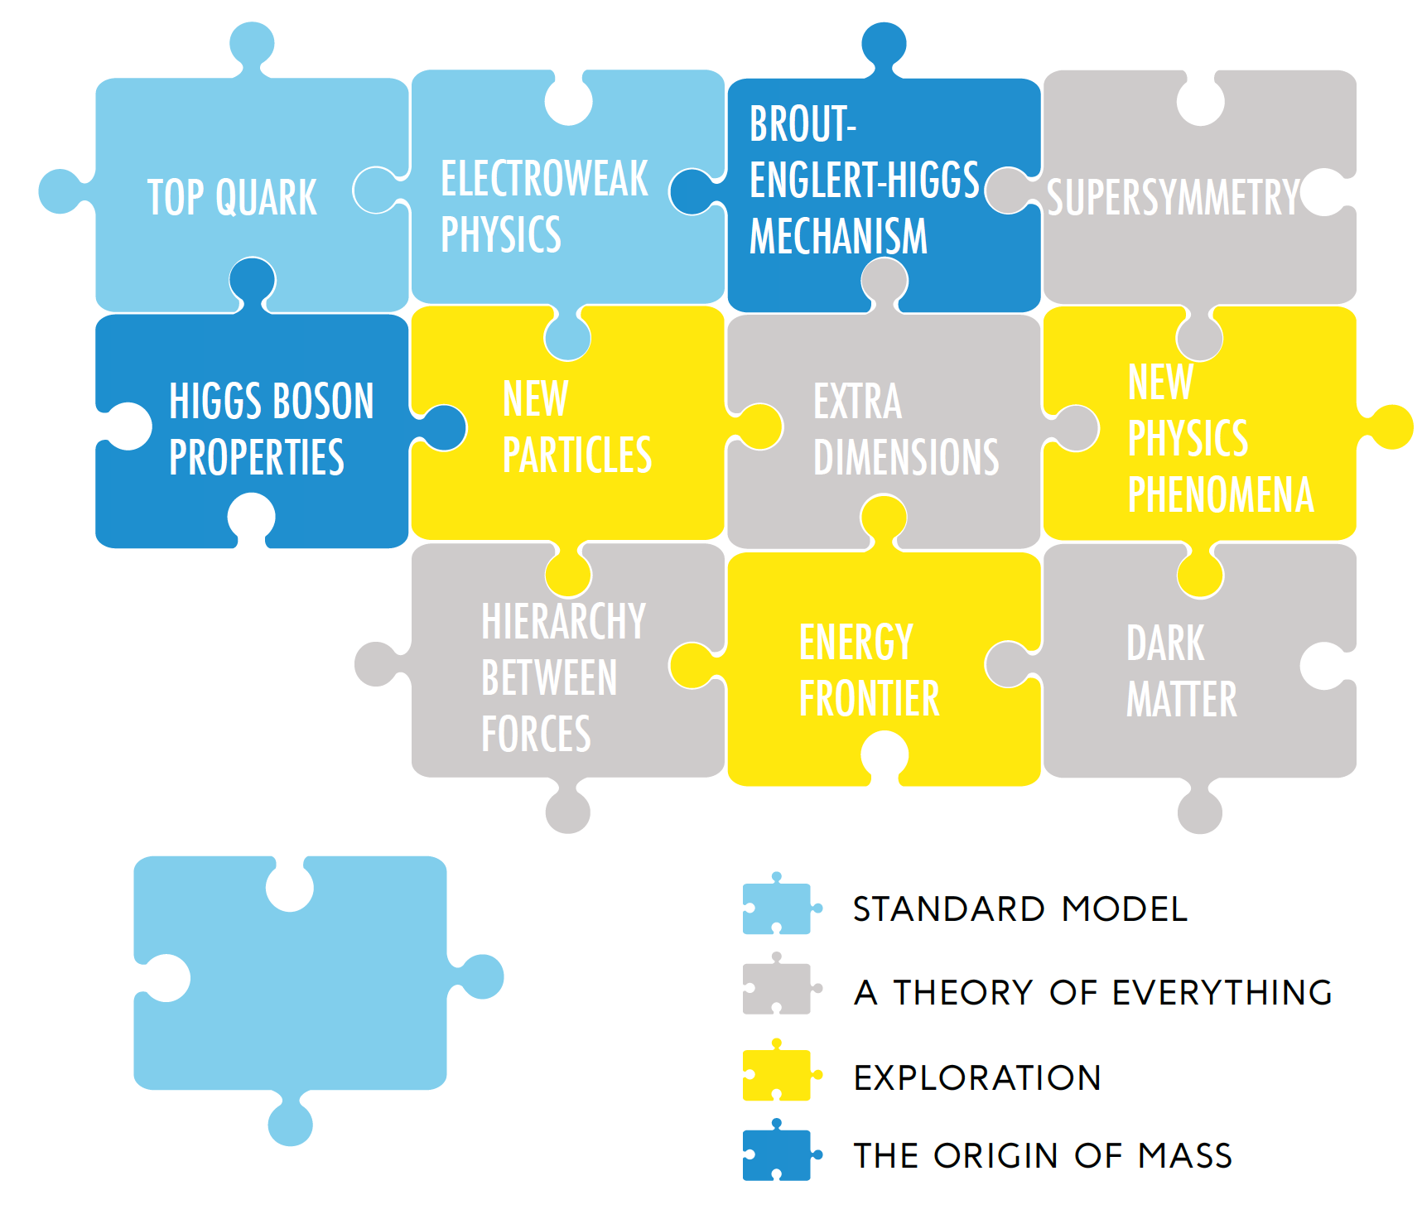
… and beyond

Slide 5
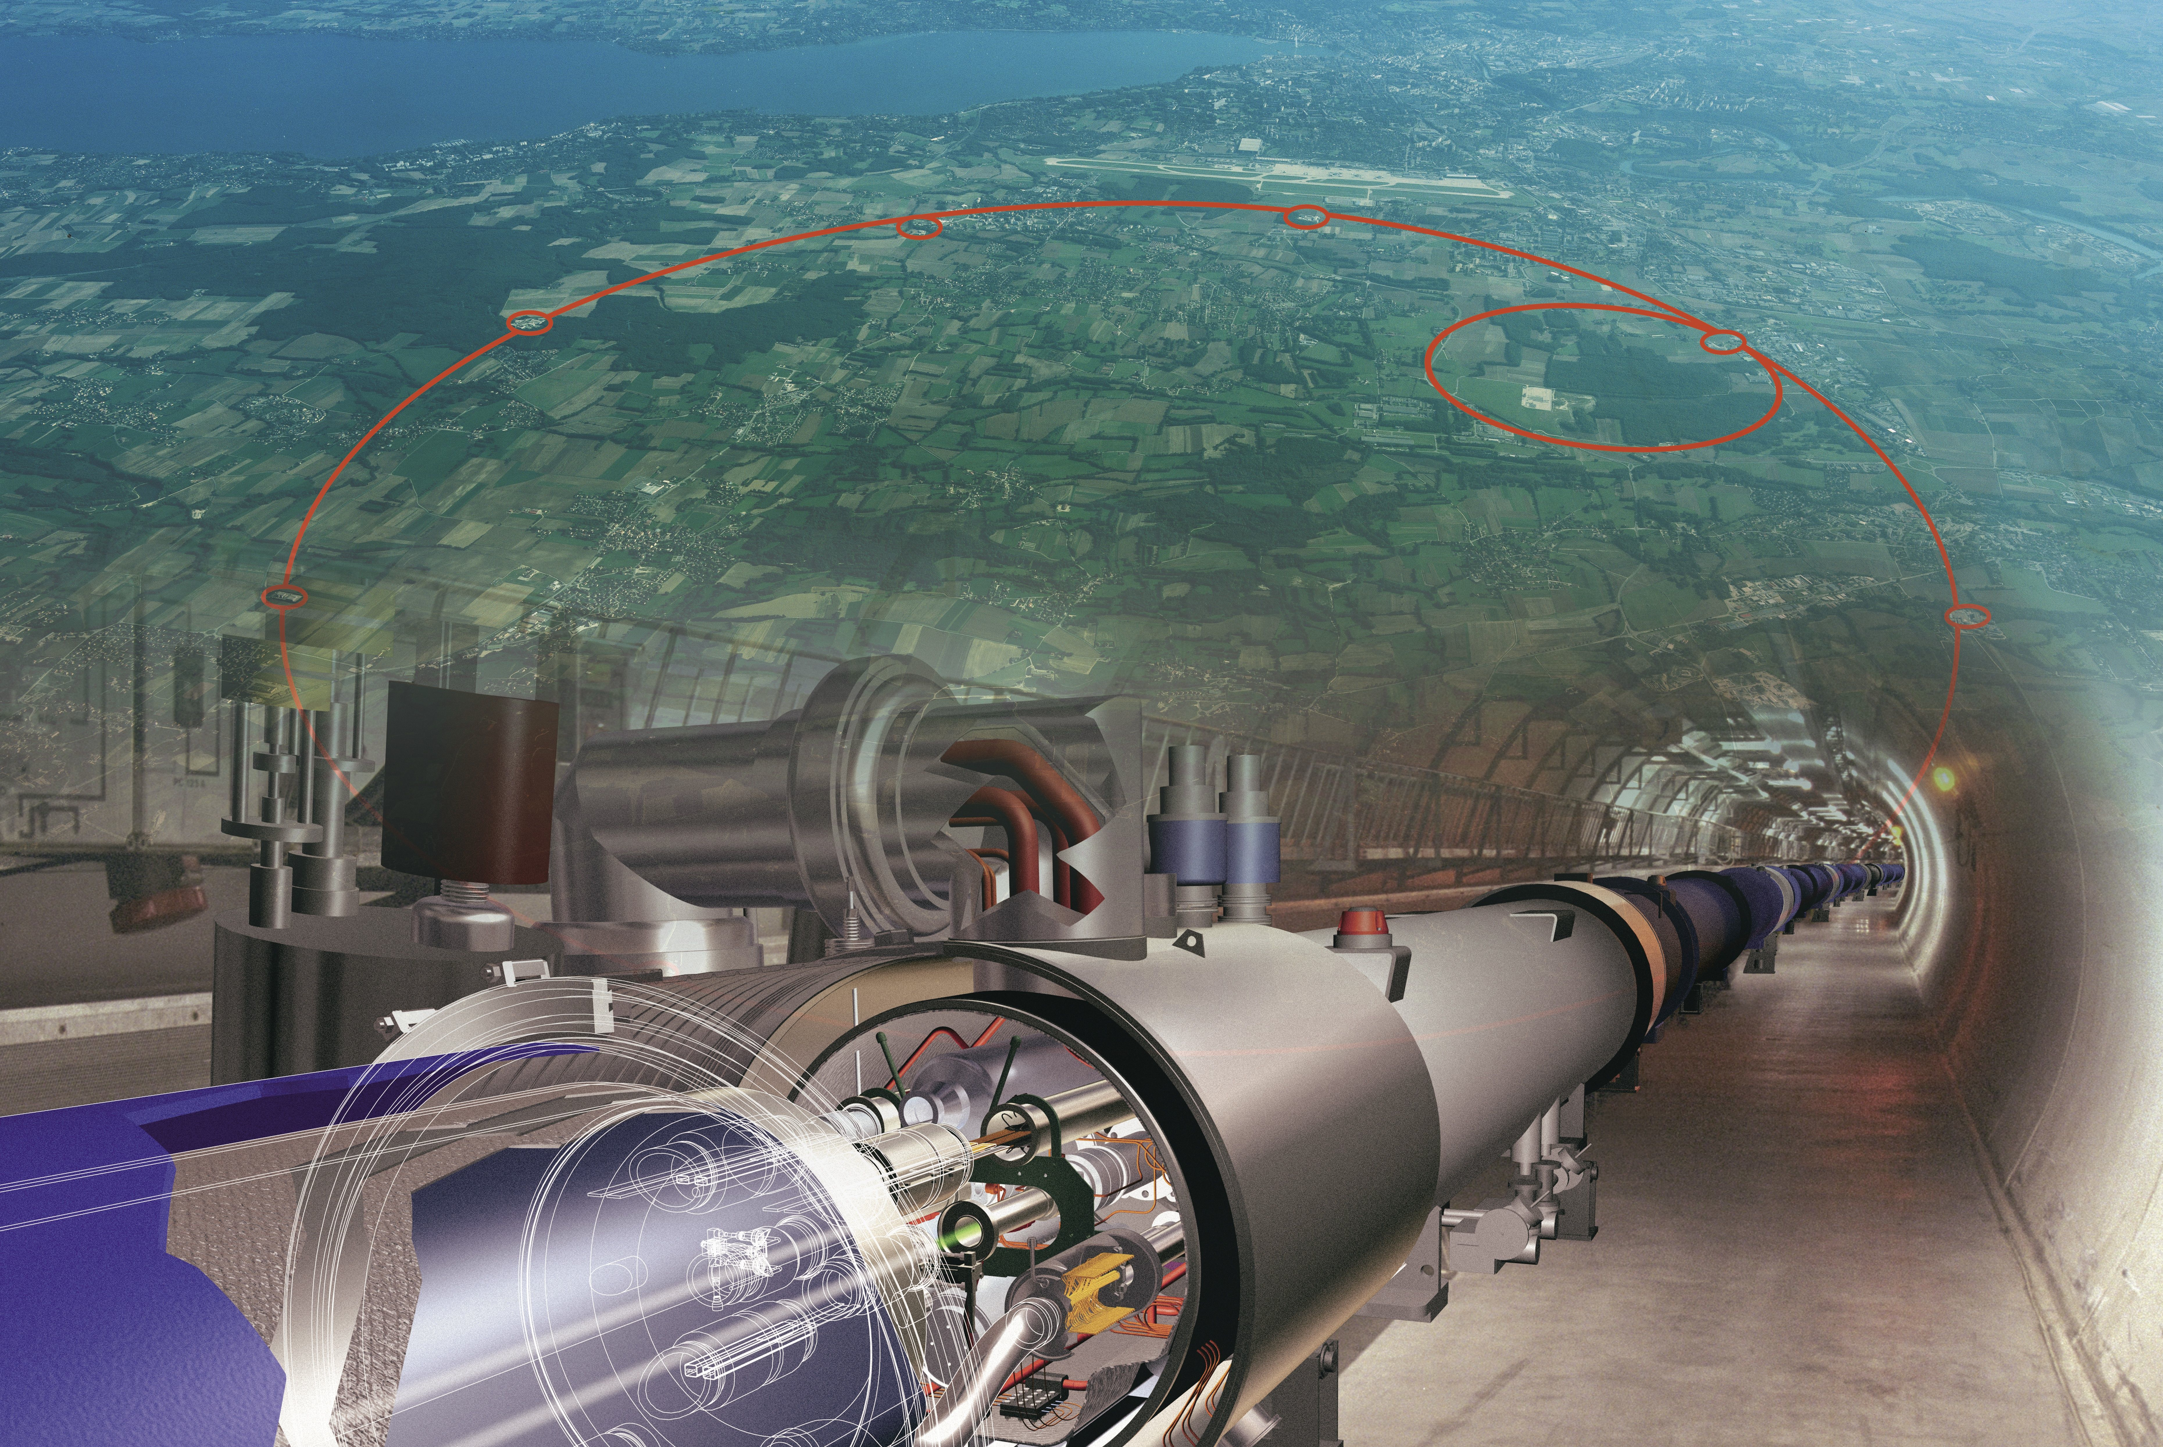
The Large Hadron Collider @ CERN
Colliding protons and heavy ions up to the highest energies

Slide 6
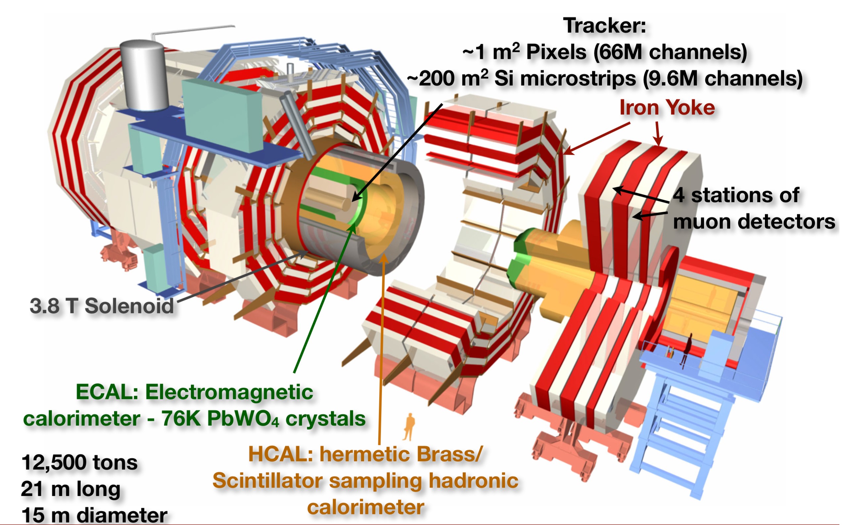
The CMS experiment

Slide 7
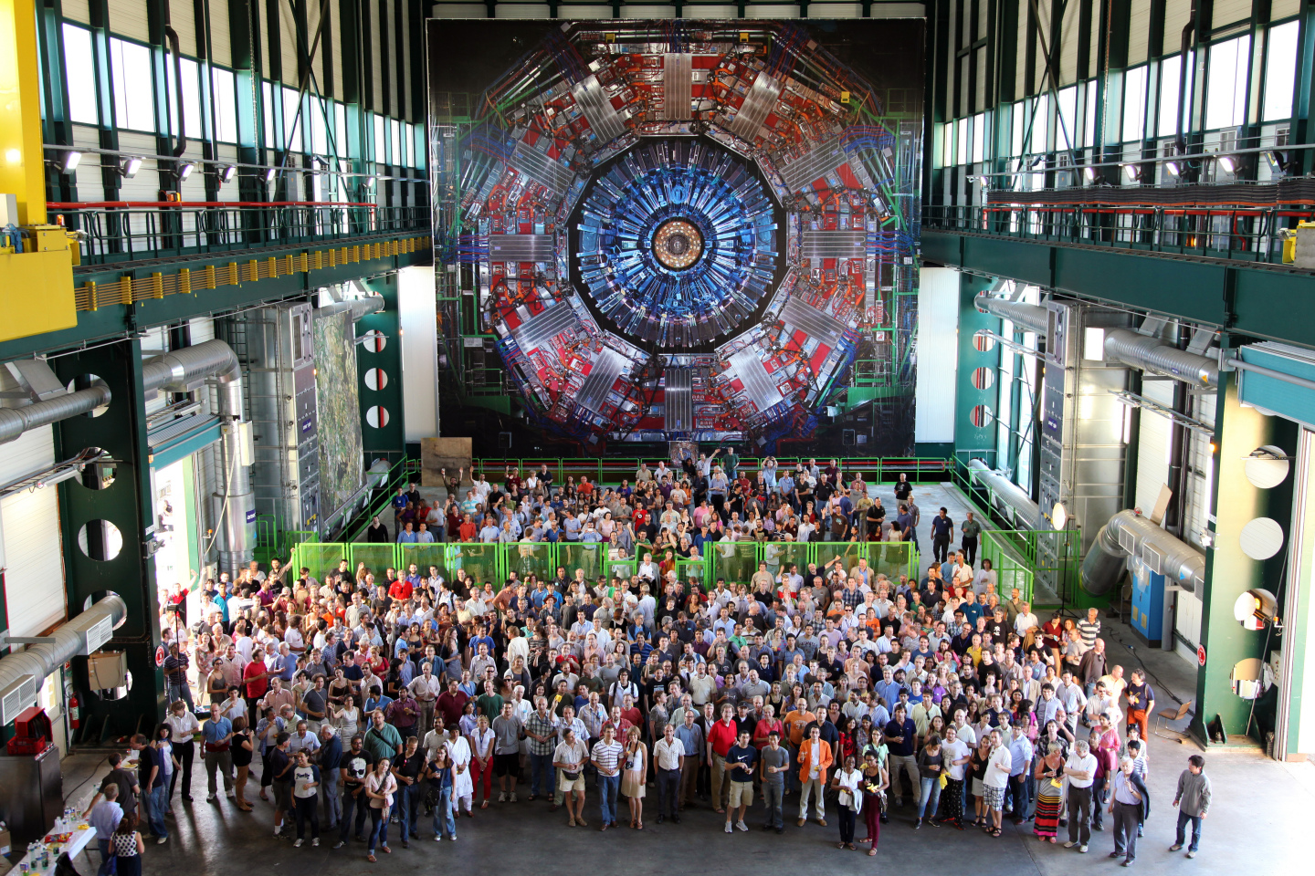
The CMS Collaboration
more than 200 institutions from 43 countries
Iran + Turkey in CMS is ~2.8% of the total CMS members.

Slide 8

The CMS Collaboration

Slide 9
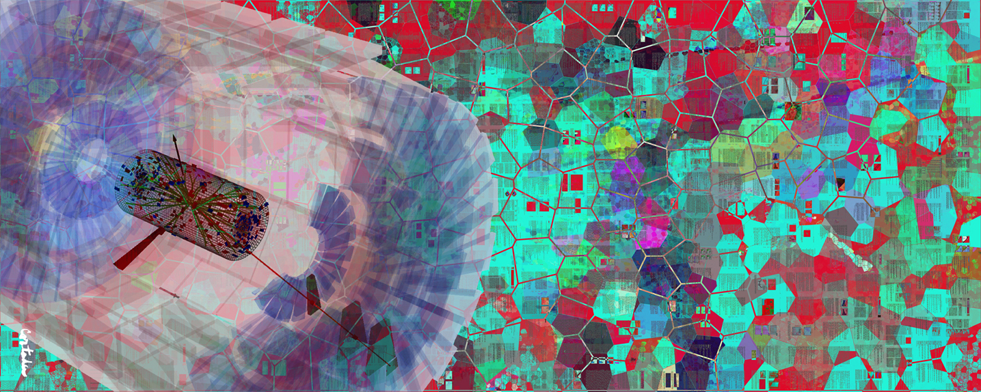
CMS-PHO-PUBLIC-2013-005-1
Run-1 results at 7 and 8 TeV
Xavier Cortada (with the participation of physicist Pete Markowitz), "In search of the Higgs boson: H -> WW", digital art, 2013.

Slide 10
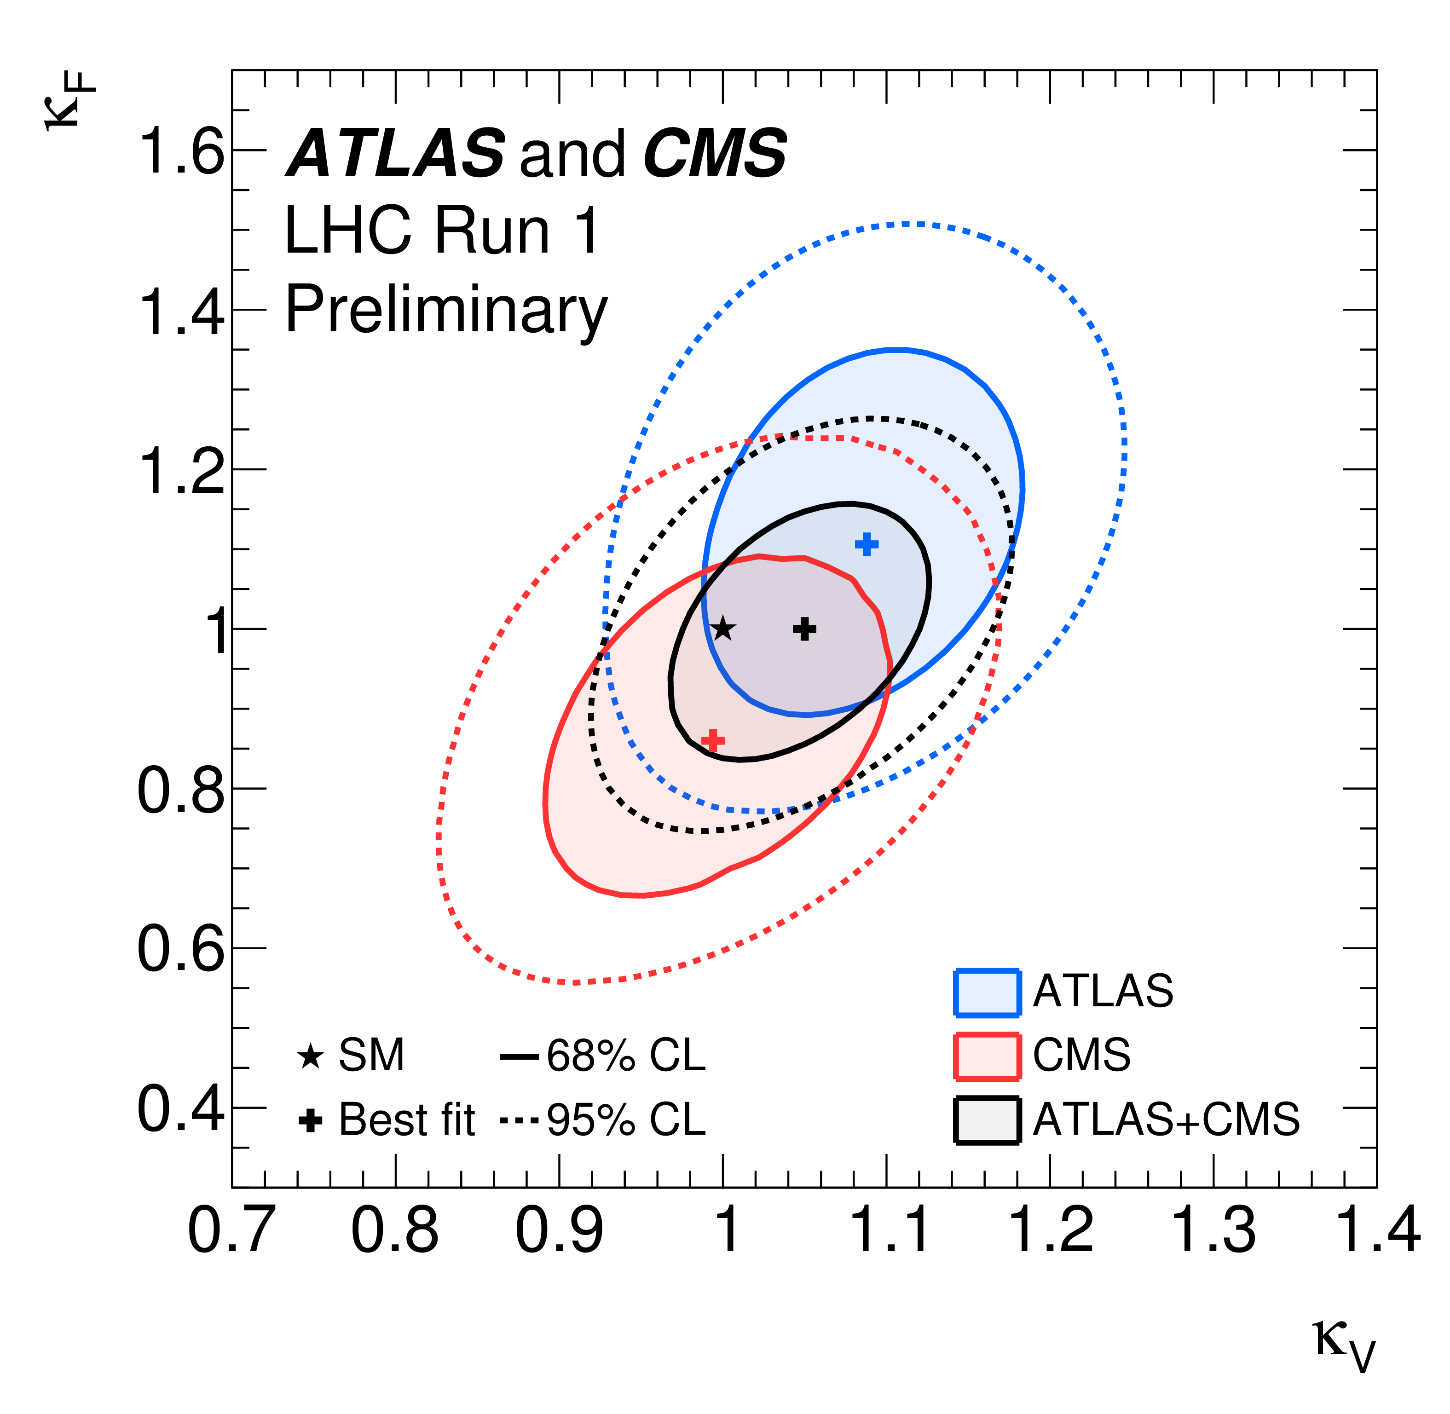
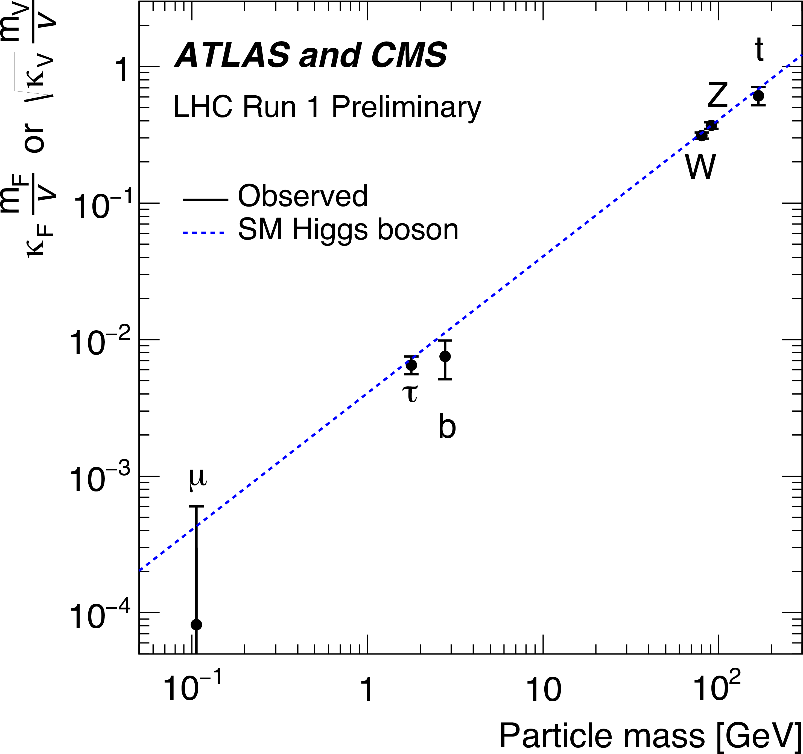
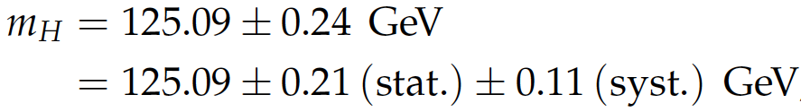
Discovery of a Higgs particle
ATLAS/CMS combination: SM like couplings within the current precision
The combined signal yield relative to the SM expectation is:
ATLAS-CONF-2015-044; CMS-PAS-HIG-15-002
ATLAS/CMS combination of the mass :
PRL 114 (2015) 191803

Slide 11
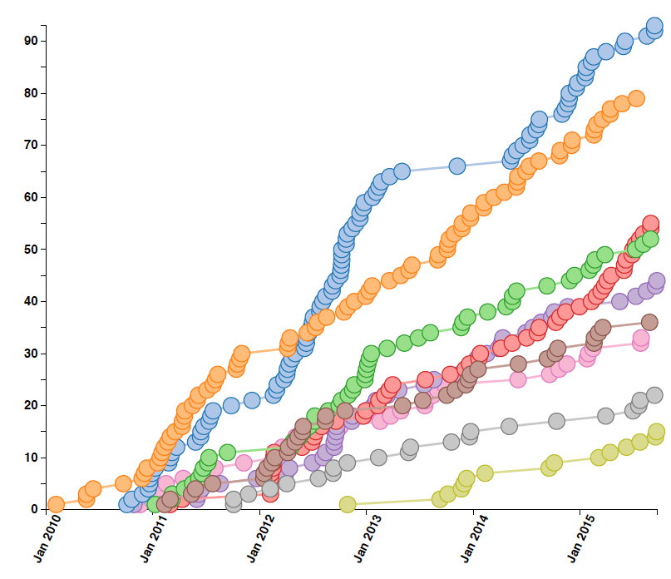
… more CMS Publications
exotica
428 physics papers submitted
+ 14 performance papers
+ 24 papers based on cosmic rays
+ many more in the pipeline
Standard Model
Higgs
Supersymmetry
Top quark physics
Heavy Ion physics
B physics
Forward physics
Beyond 2 Generations

Slide 12
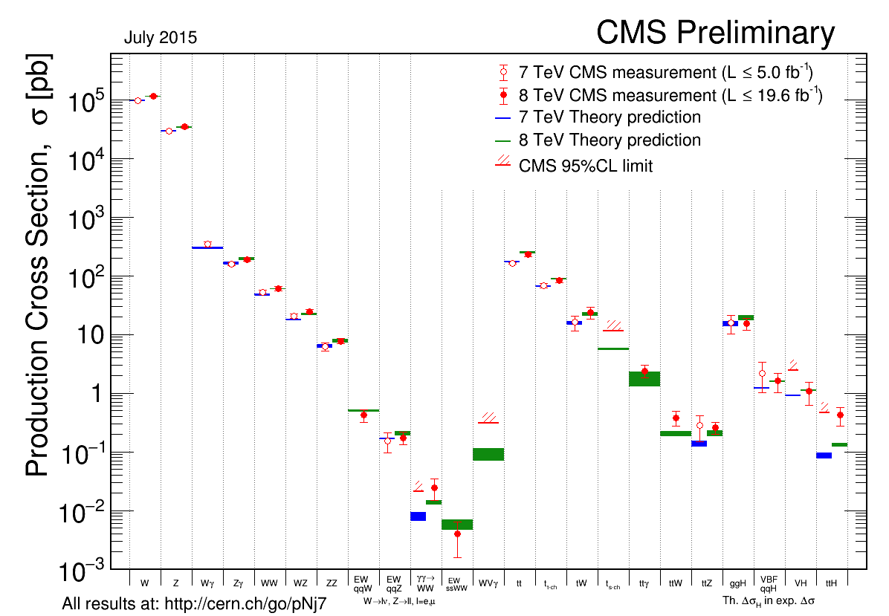
Cross-section measurements

Slide 13
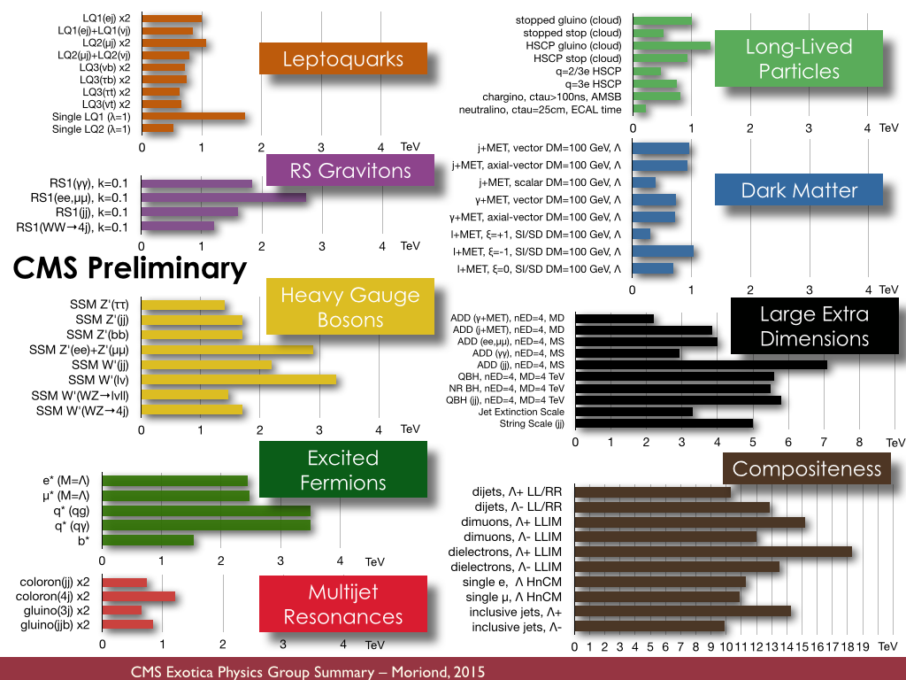
Searches for new physics

Slide 14
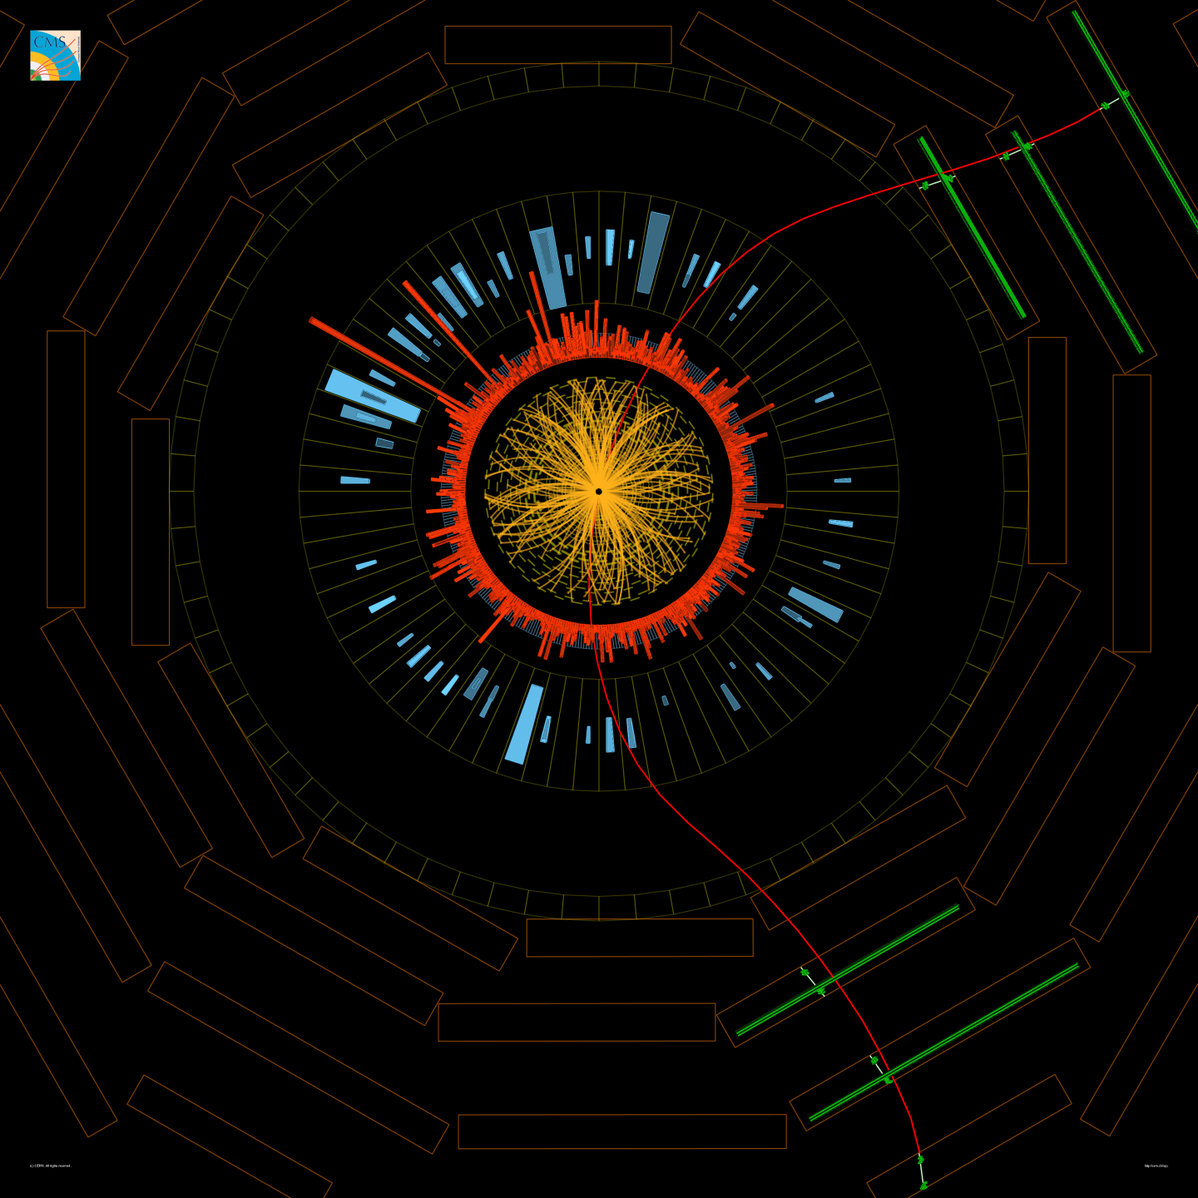
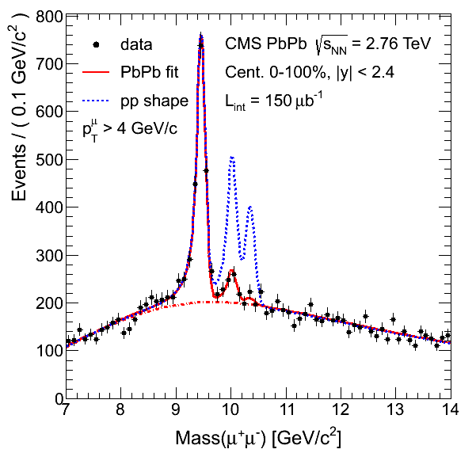
Heavy Ion physics with CMS
Understanding the properties of the quark-gluon plasma.
CMS observes melting of Upsilon (Y) particles in heavy-ion collisions.
PbPb collision
Y → μμ
PRL 109 (2012) 222301

Slide 15
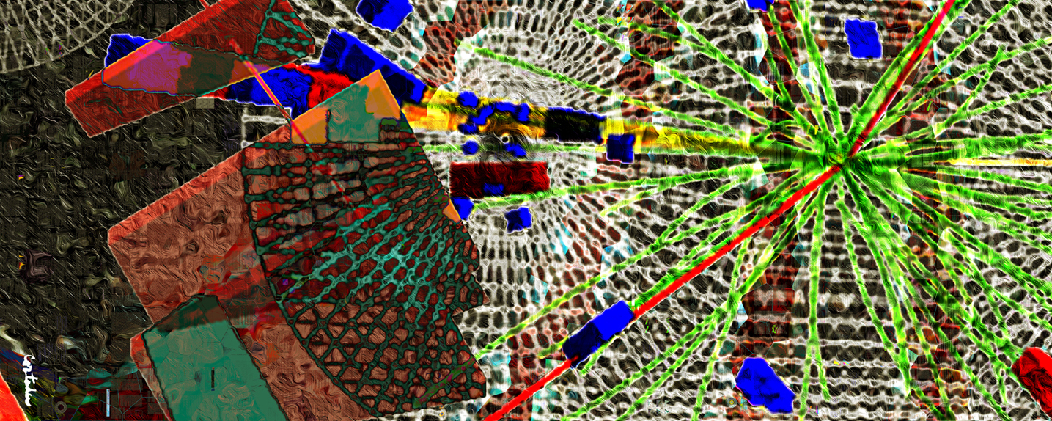
CMS-PHO-PUBLIC-2013-006-1
Towards Run-2: Long-shutdown 1
Xavier Cortada (with the participation of physicist Pete Markowitz), "In search of the Higgs boson: H -> gamma gamma", digital art, 2013.

Slide 16

LS1 program
Installation of new detector systems and extension of existing ones. Repair and maintenance after 3 years of Run-1 operation, and consolidation for the long-term future. CMS closed for physics on March 29th.
Preparations for the new “Stage-1” trigger system
New DAQ system
Extra CSC chambers
Extra RPC chambers
HF μTCA back-end electronics
Tracker cold (-10/15ºC)
New dry-gas injection system
New distributed analysis tools (CRAB3)
Data federation deployed (AAA)
Upgraded beam monitors
New Pixel Luminosity Telescope
New reconstruction software & miniAOD format & pile-up mitigation

Slide 17
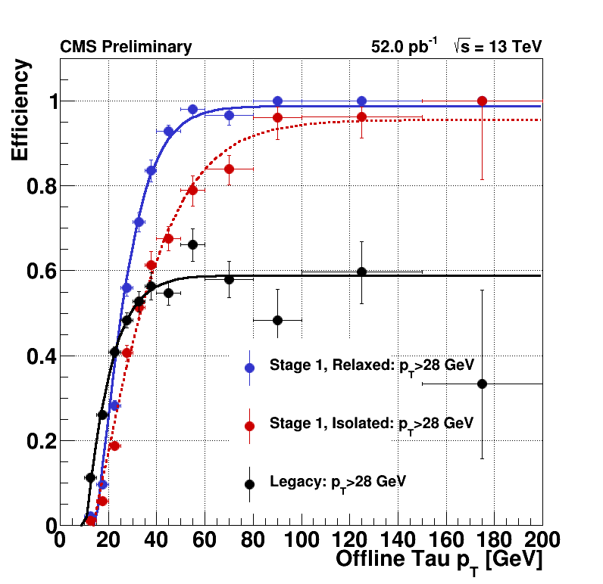
Evolution of the L1 trigger
At the start of the 25 ns Run switched to the “Stage 1” calorimeter trigger.
improved tau trigger and improved pile-up subtraction for jets, isolation variables and energy sums.
Full “Stage 2” trigger upgrade will be deployed in 2016 to operate on the full trigger-tower granularity.

Slide 18
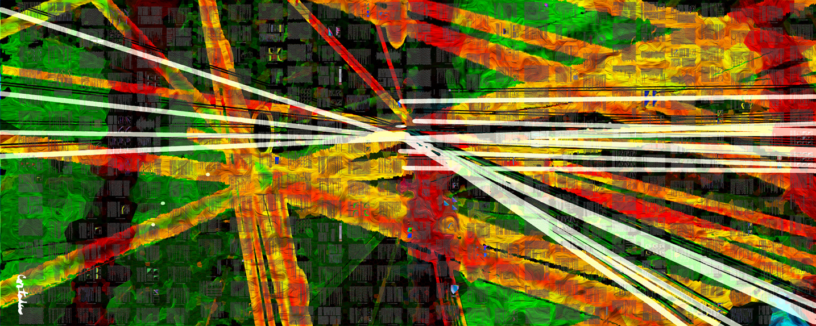
CMS-PHO-PUBLIC-2013-007-1
Run-2 at 13 TeV
General reference: http://cms-results.web.cern.ch/cms-results/public-results/publications/
Xavier Cortada (with the participation of physicist Pete Markowitz), "In search of the Higgs boson: H -> bottom bottom", digital art, 2013.

Slide 19
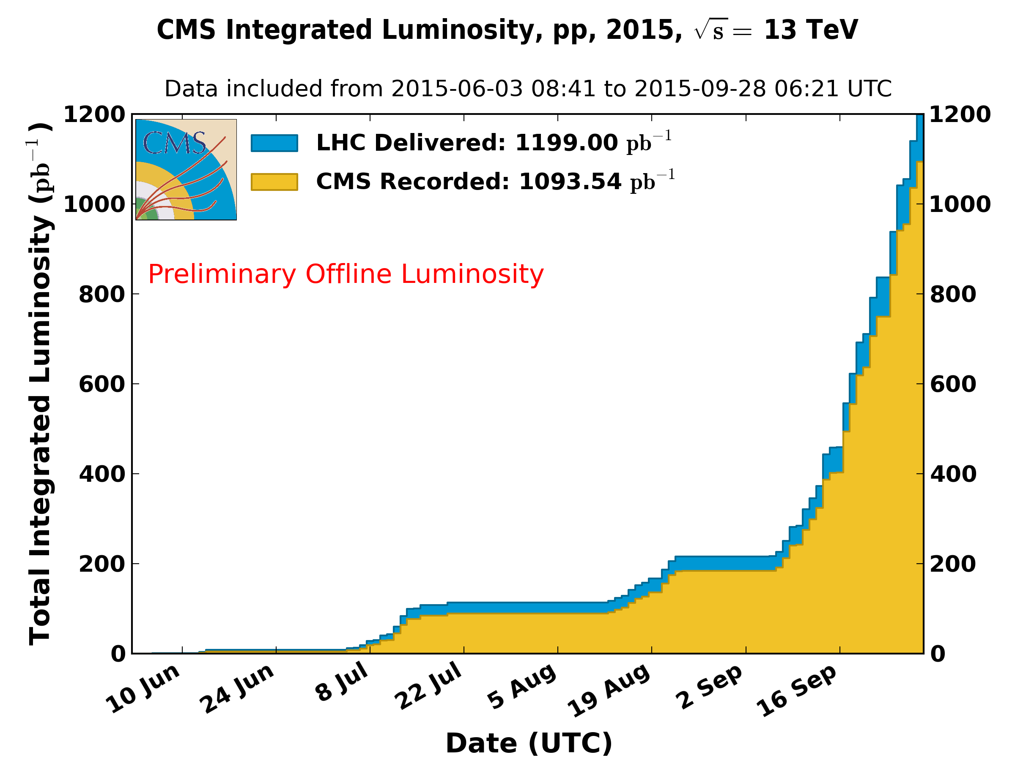
Data collected by CMS
https://twiki.cern.ch/twiki/bin/view/CMSPublic/LumiPublicResults
B = 0T: ~400 pb^{–1} delivered

Slide 20
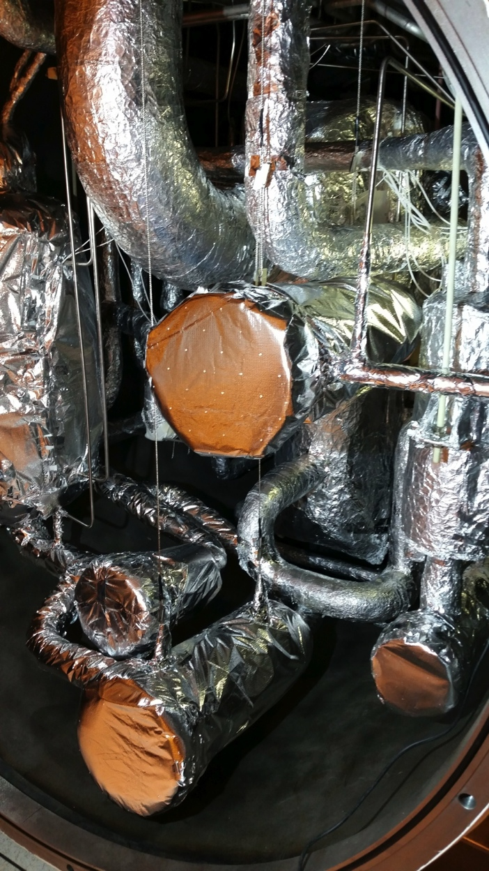
Cryogenic system for CMS magnet
The restart of the CMS magnet after LS1 was more complicated than anticipated due to problems with the cryogenic system in providing liquid Helium.
These problems are consistent with clogging effects due to contaminants in the “Cold box” that provides liquid Helium.
Currently the magnet can be operated, but the continuous up-time is still limited by the performance of the cryogenic system requiring more frequent maintenance than usual.
A comprehensive program to re-establish its nominal performance is being organized for the end-of-the-year technical stop.

Slide 21
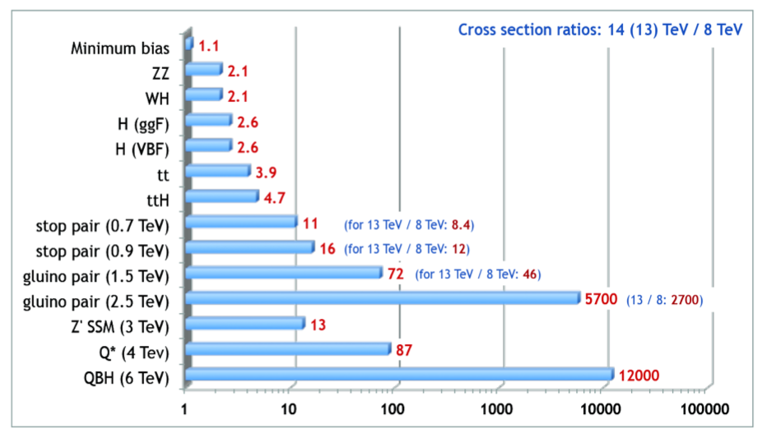
Cross-sections from 7/8 to 13 TeV
With relative small 13 TeV datasets we can reach discovery potential
For these models and with 1/fb at 13 TeV we start probing beyond the Run-1 reach.

Slide 22
Performance of the experiment
(fraction)

Slide 23
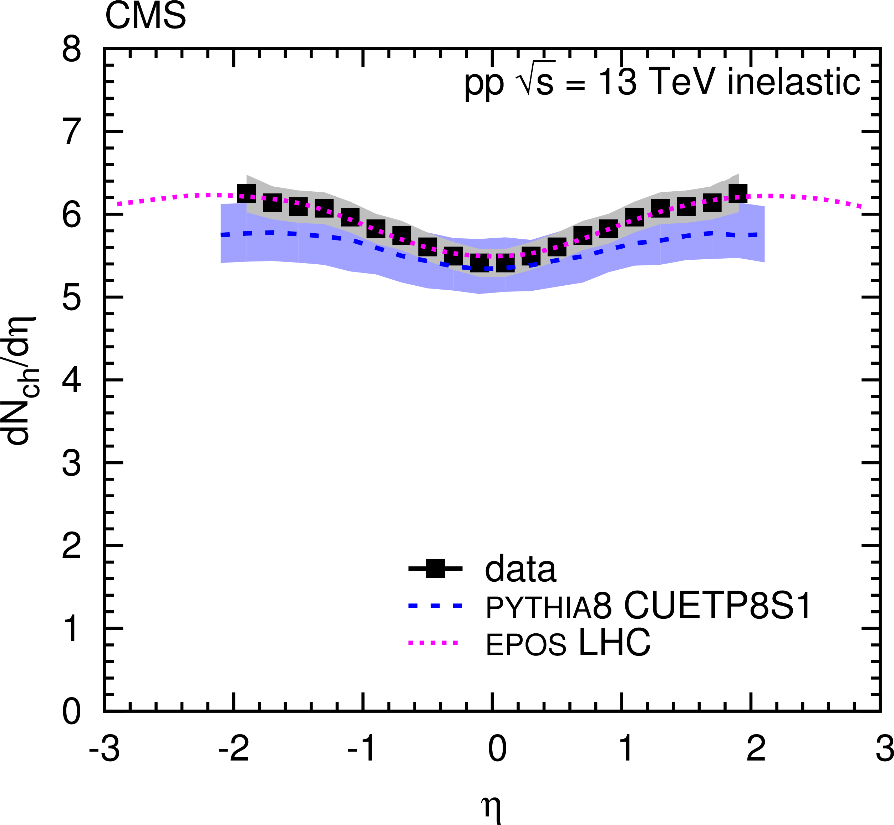
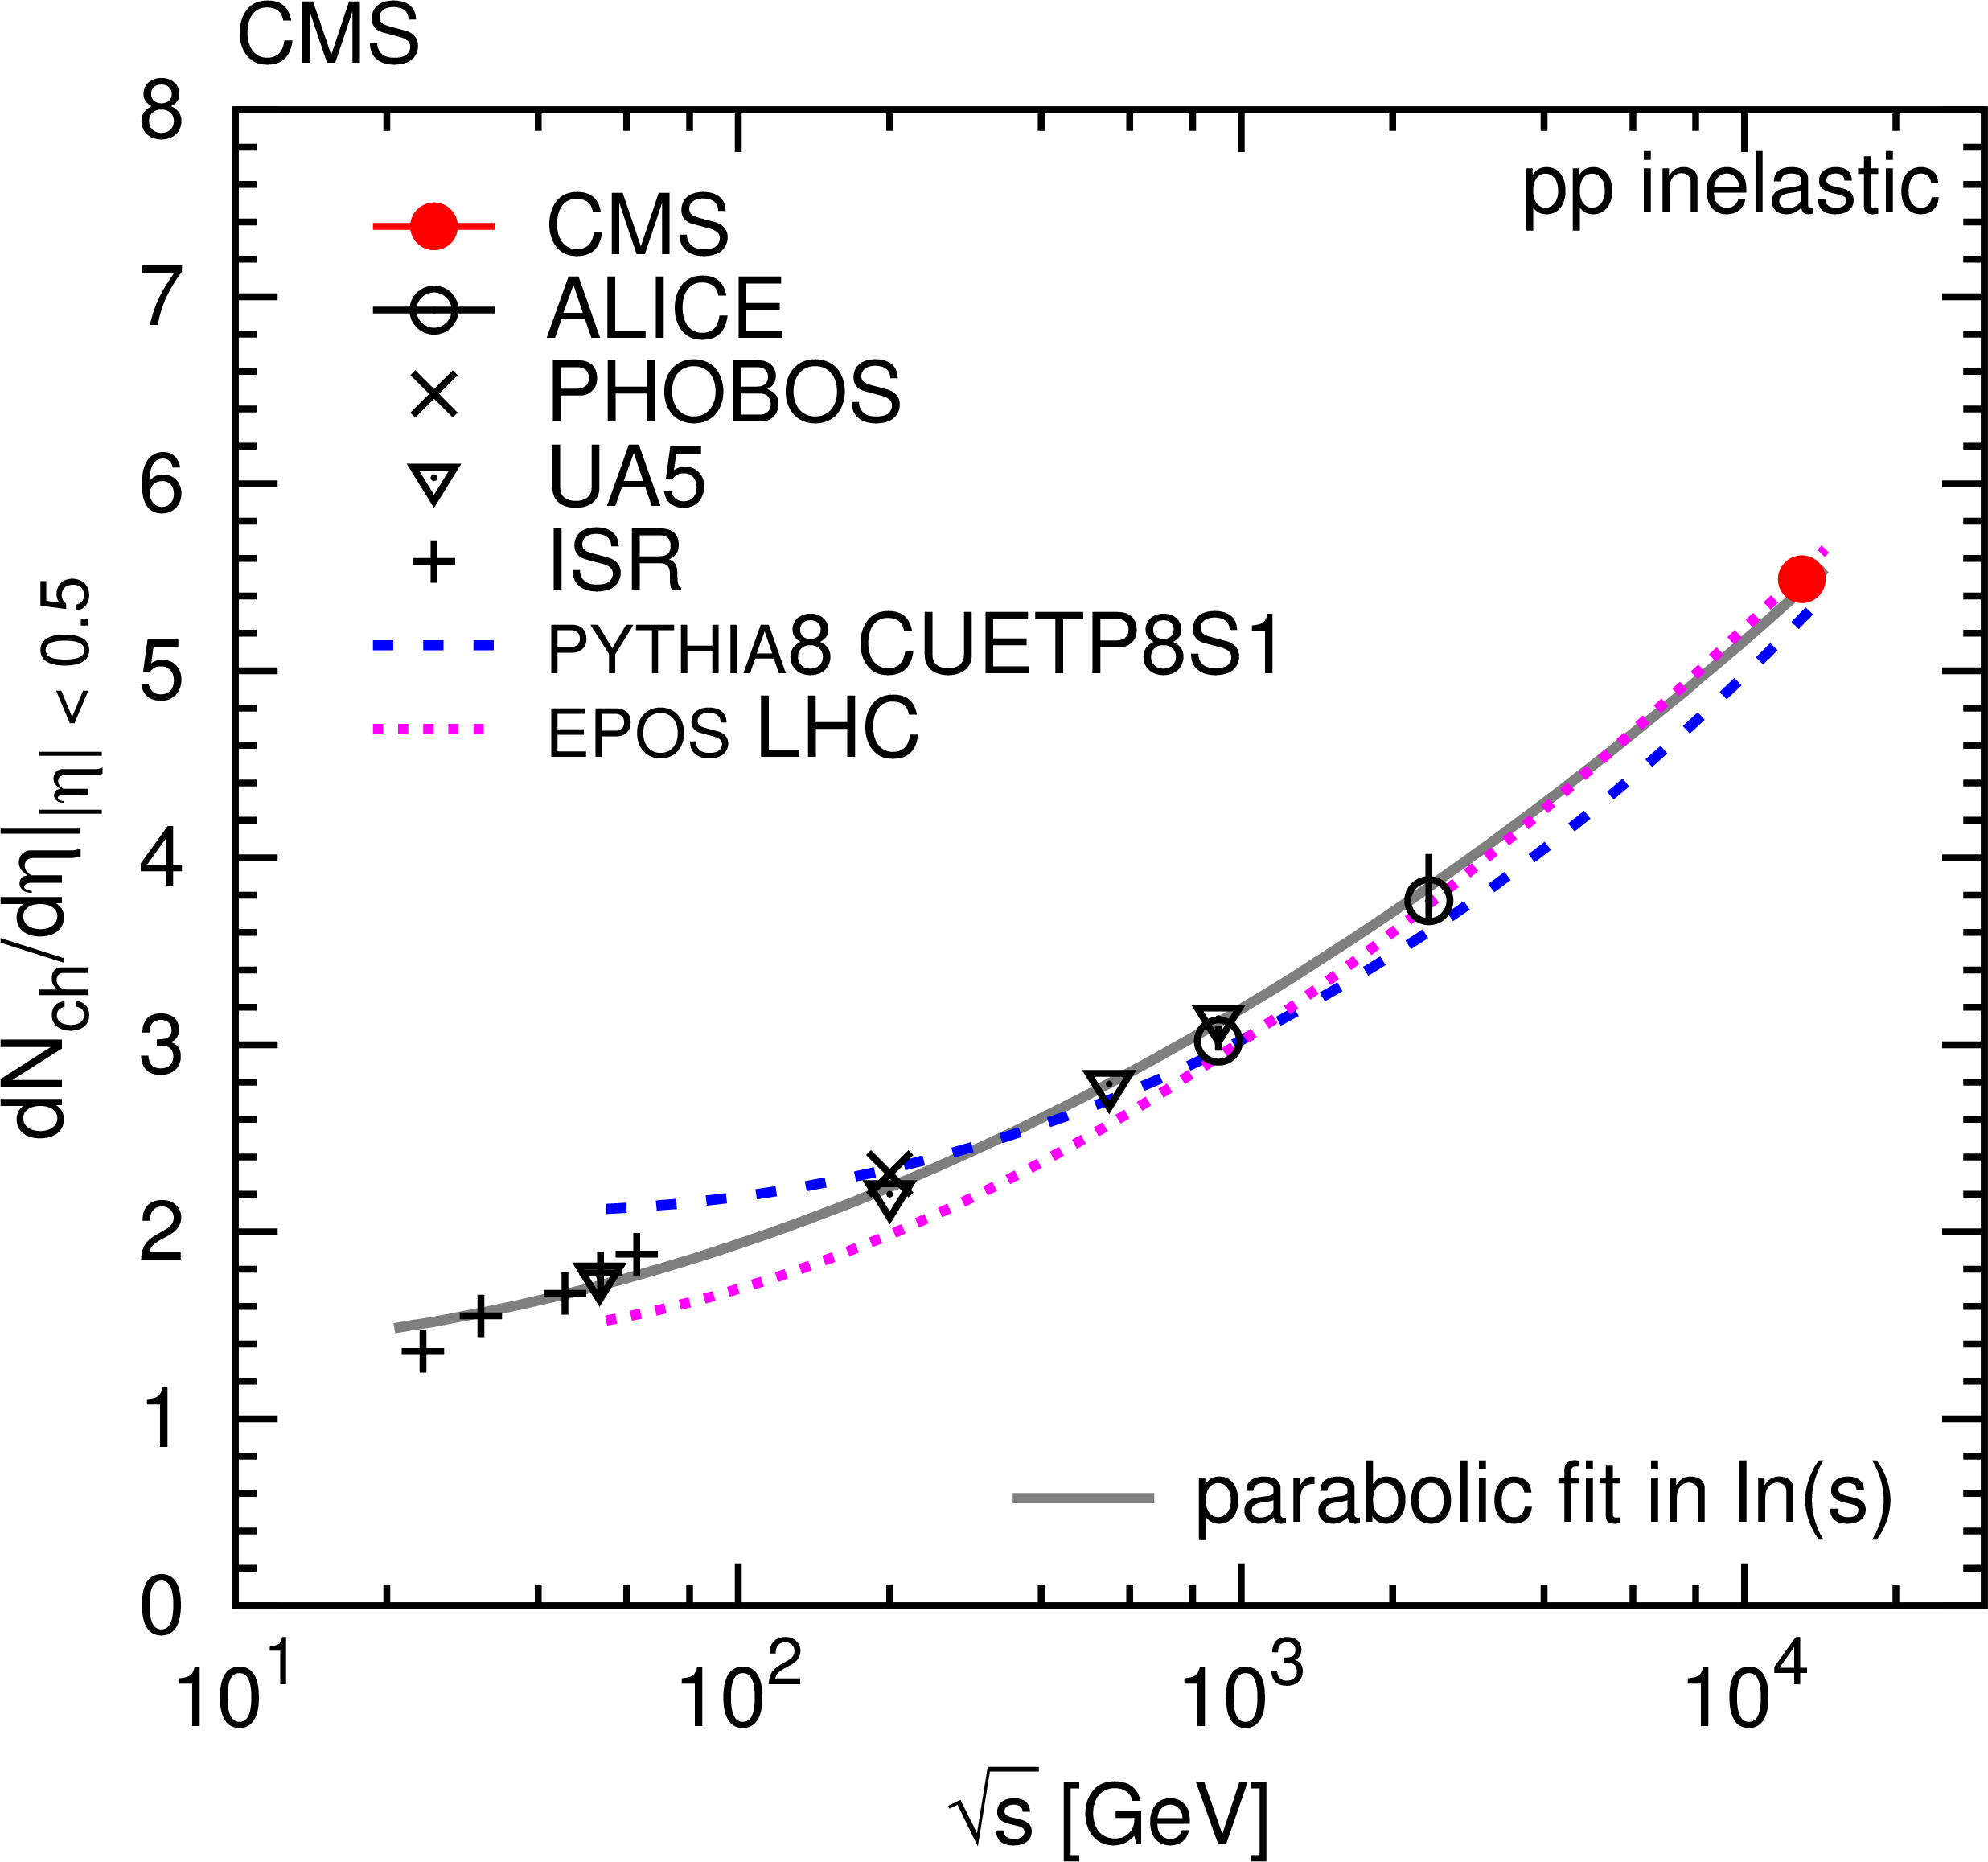
First physics publication at 13 TeV
Pseudorapidity distribution of charged hadrons in inelastic pp collisions at 13 TeV.
Using data collected with B=0T in CMS, and within the pixel detector acceptance (|η|<2), using methods with both hit pairs and reconstructed tracks.
|η|<0.5
These provide new constraints for the improvement of perturbative and non-perturbative QCD aspects implemented in hadronic event generators.
Submitted to Phys. Lett. B (arXiv:1507.05915)

Slide 24
Di-muon mass spectrum
Collected with various di-muon triggers, from inclusive di-muons triggers at high p_{T} and low-mass non-resonant di-muon triggers, to specialized triggers.
CERN-CMS-DP-2015-018

Slide 25
Di-muon mass spectrum
Collected with various di-muon triggers, from inclusive di-muons triggers at high p_{T} and low-mass non-resonant di-muon triggers, to specialized triggers.
next page:
zoom
CERN-CMS-DP-2015-018

Slide 26
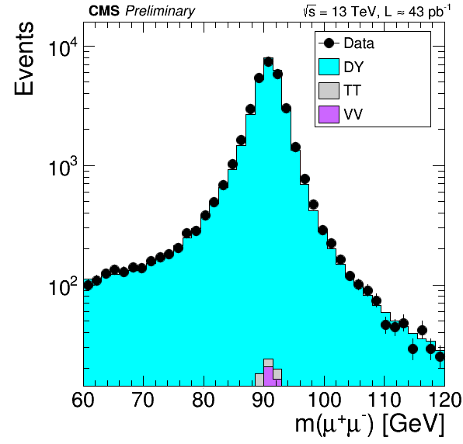
Di-muon mass spectrum
Very good agreement of our simulation with the collision data.
CERN-CMS-DP-2015-015

Slide 27
Di-muon mass spectrum: B-physics
Very nice (possible) B± → J/Ψ K± event
CERN-CMS-DP-2015-018

Slide 28
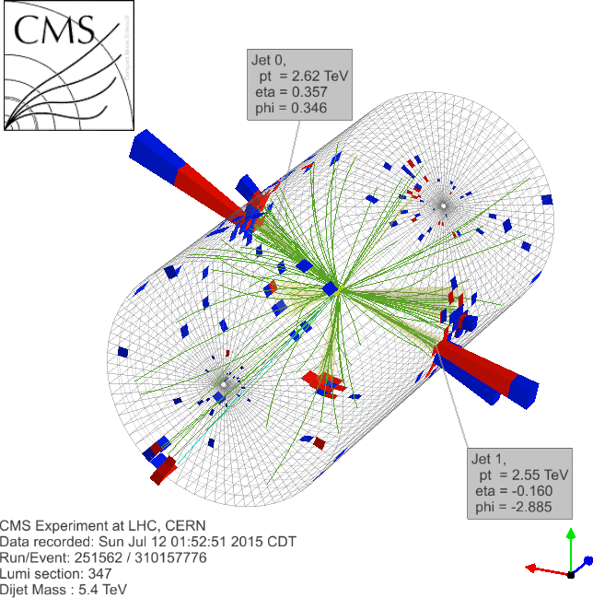
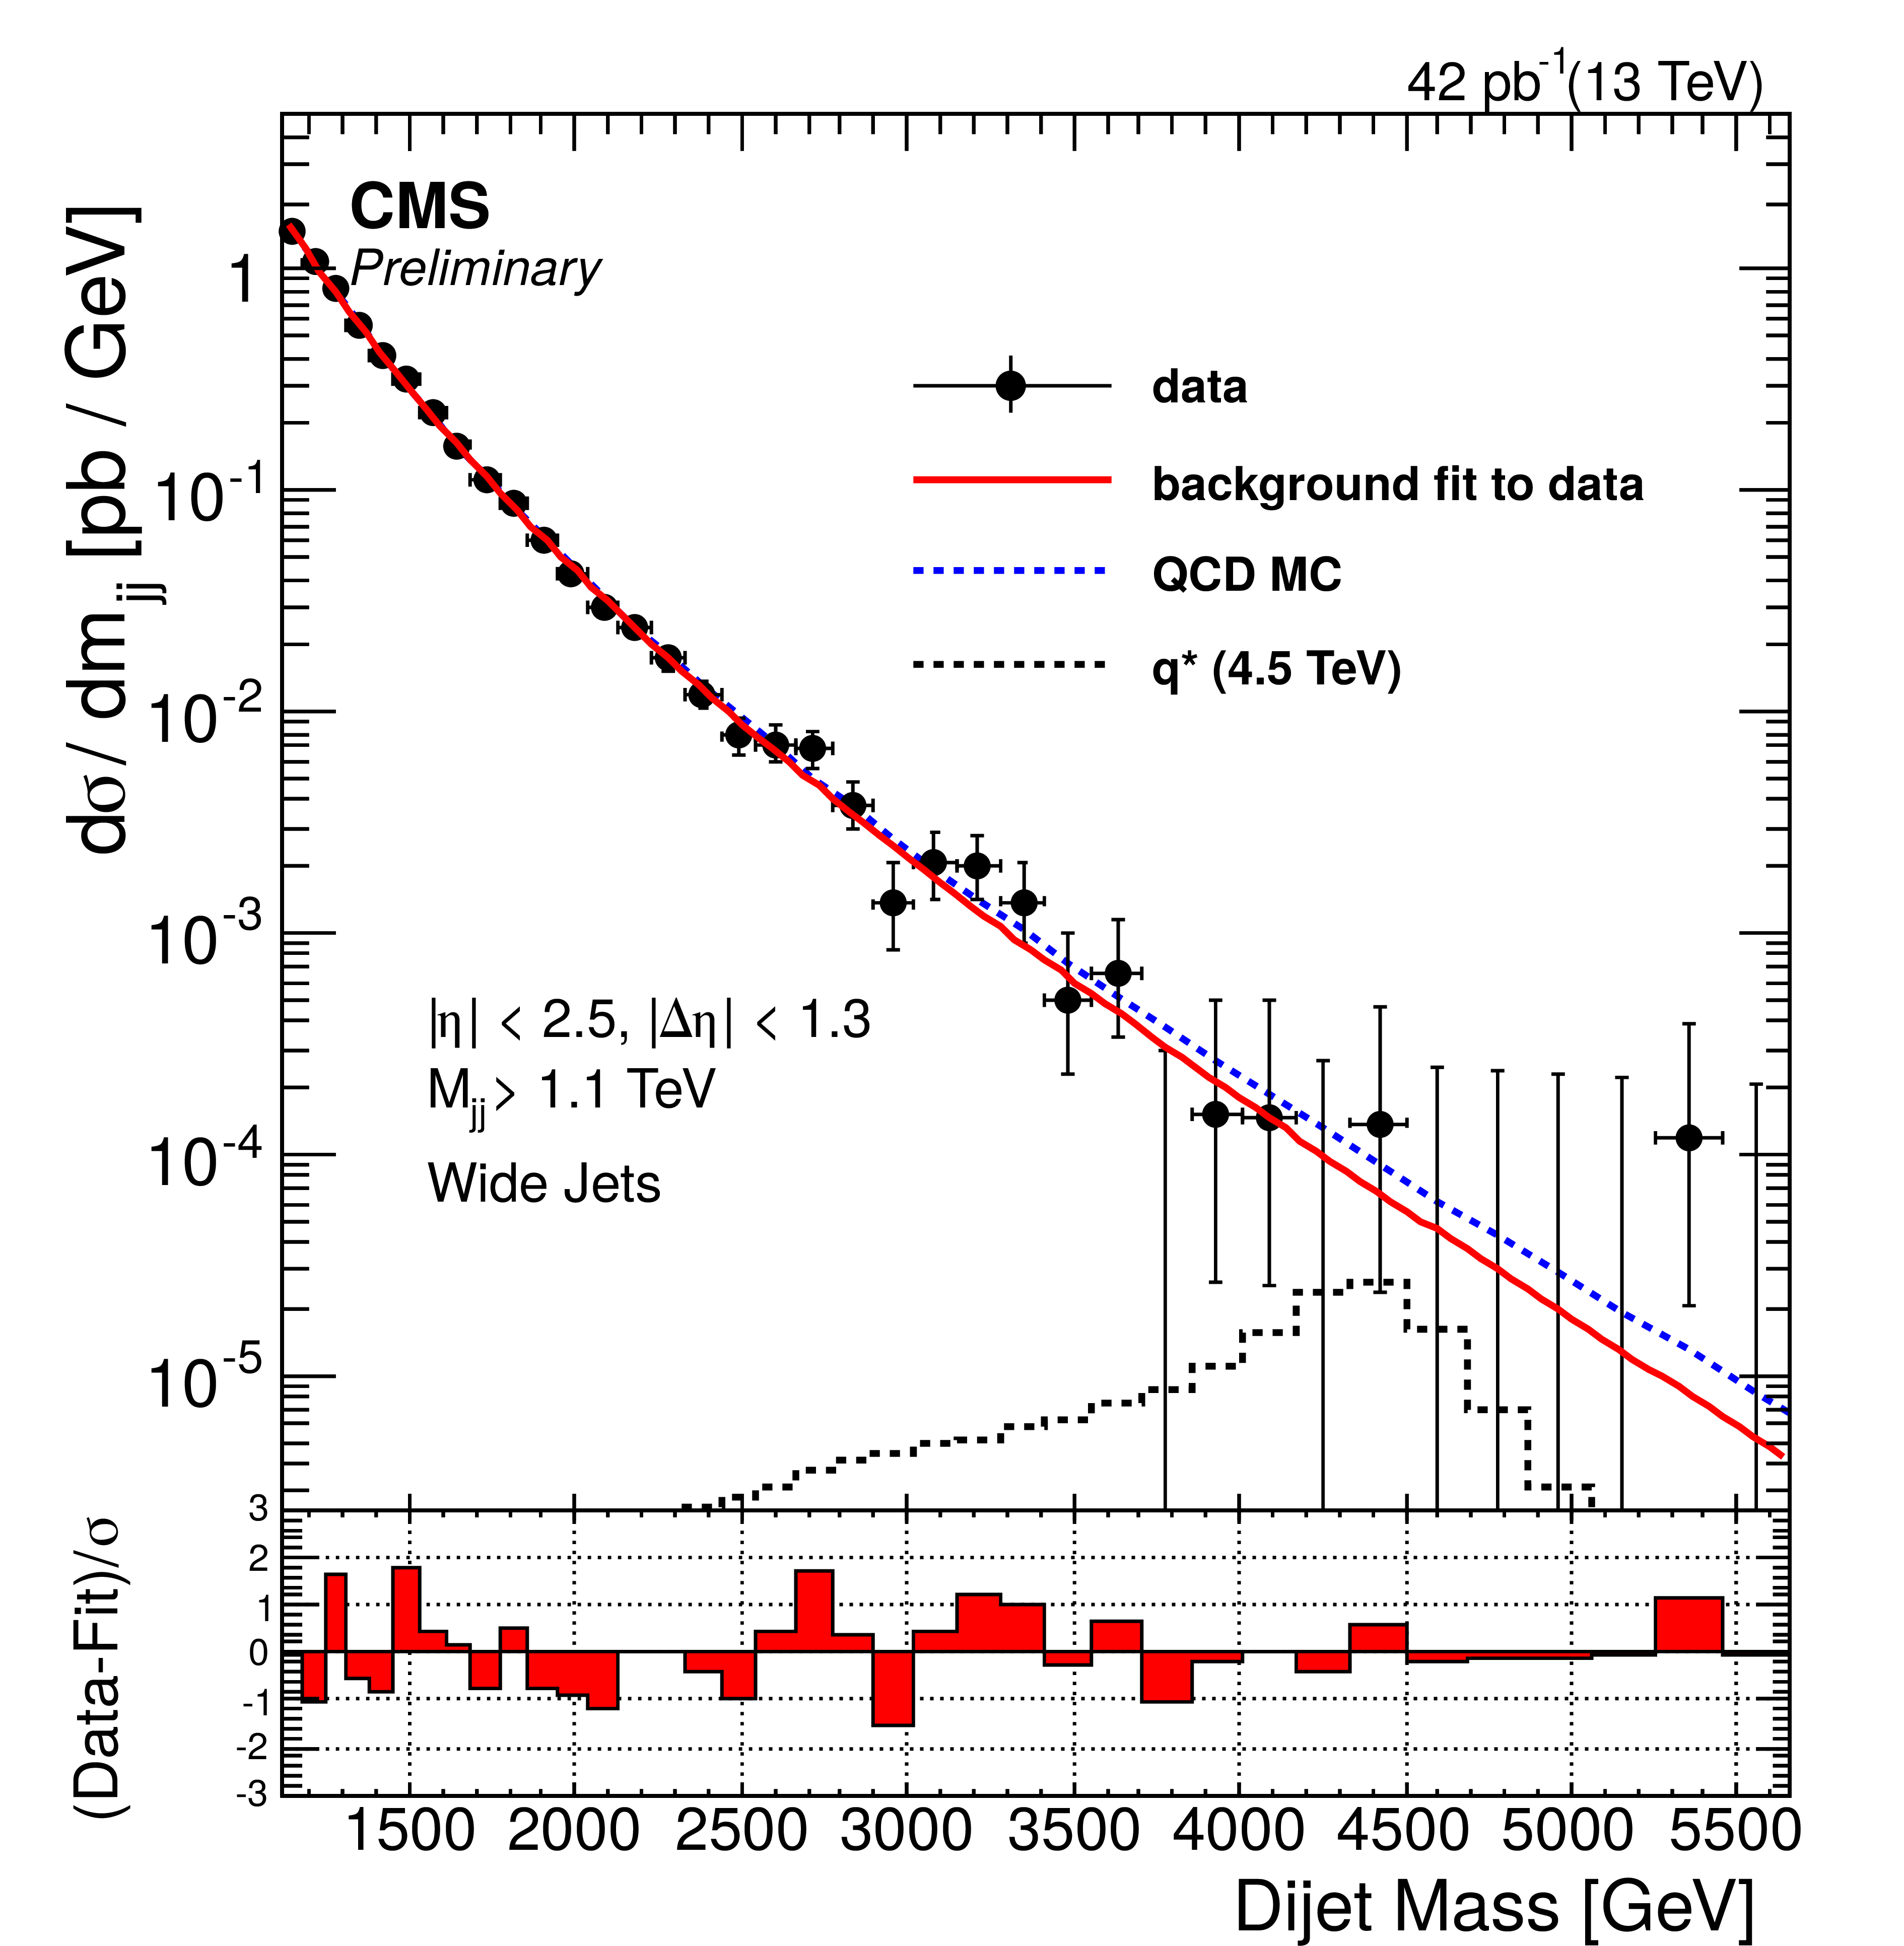
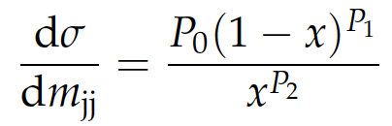

Di-jet mass spectrum
Search for narrow di-jet resonances, where the QCD prediction is normalized to data.
M(jj) = 5.4 TeV
Fit function:
CMS-PAS-EXO-15-001

Slide 29
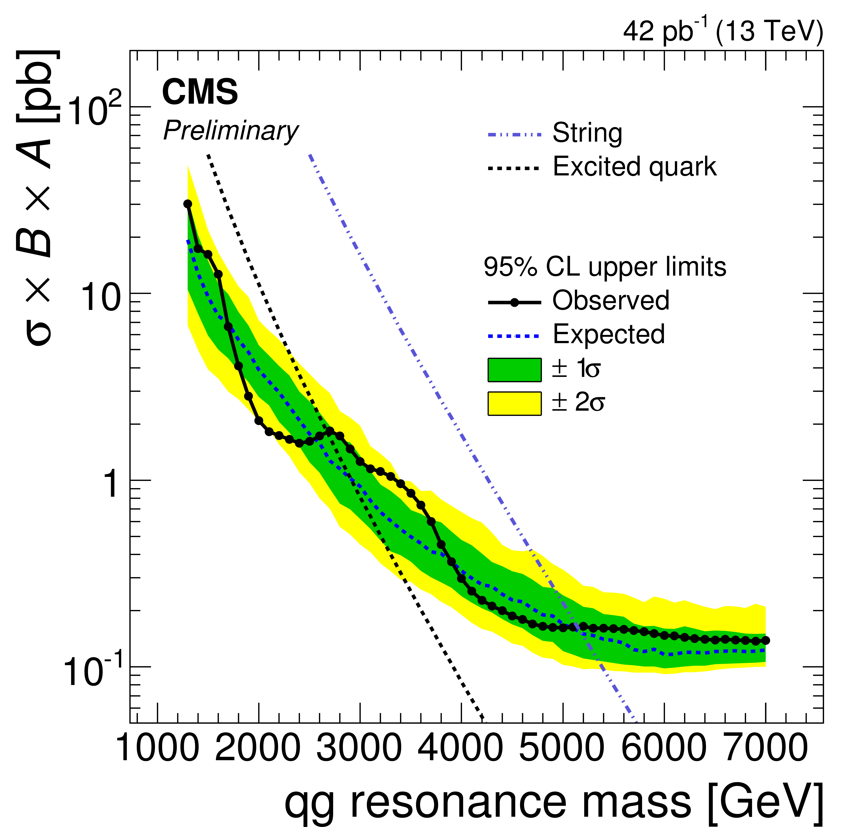
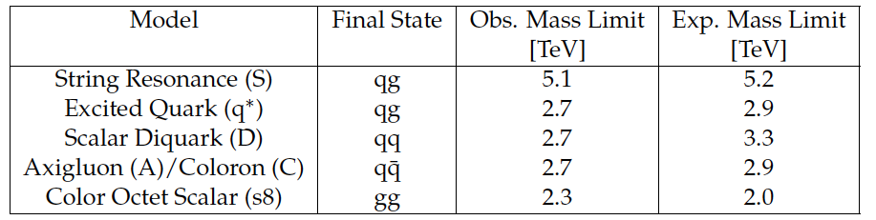
Di-jet mass spectrum
First searches with 13 TeV data that exceed the previous limits from Run-1 on new physics models.
CMS-PAS-EXO-15-001

Slide 30
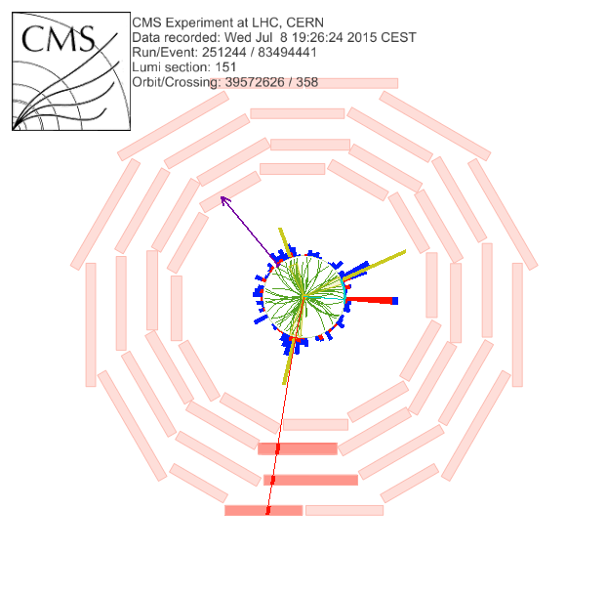
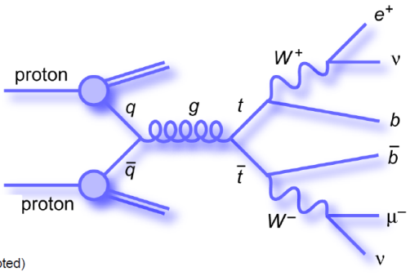
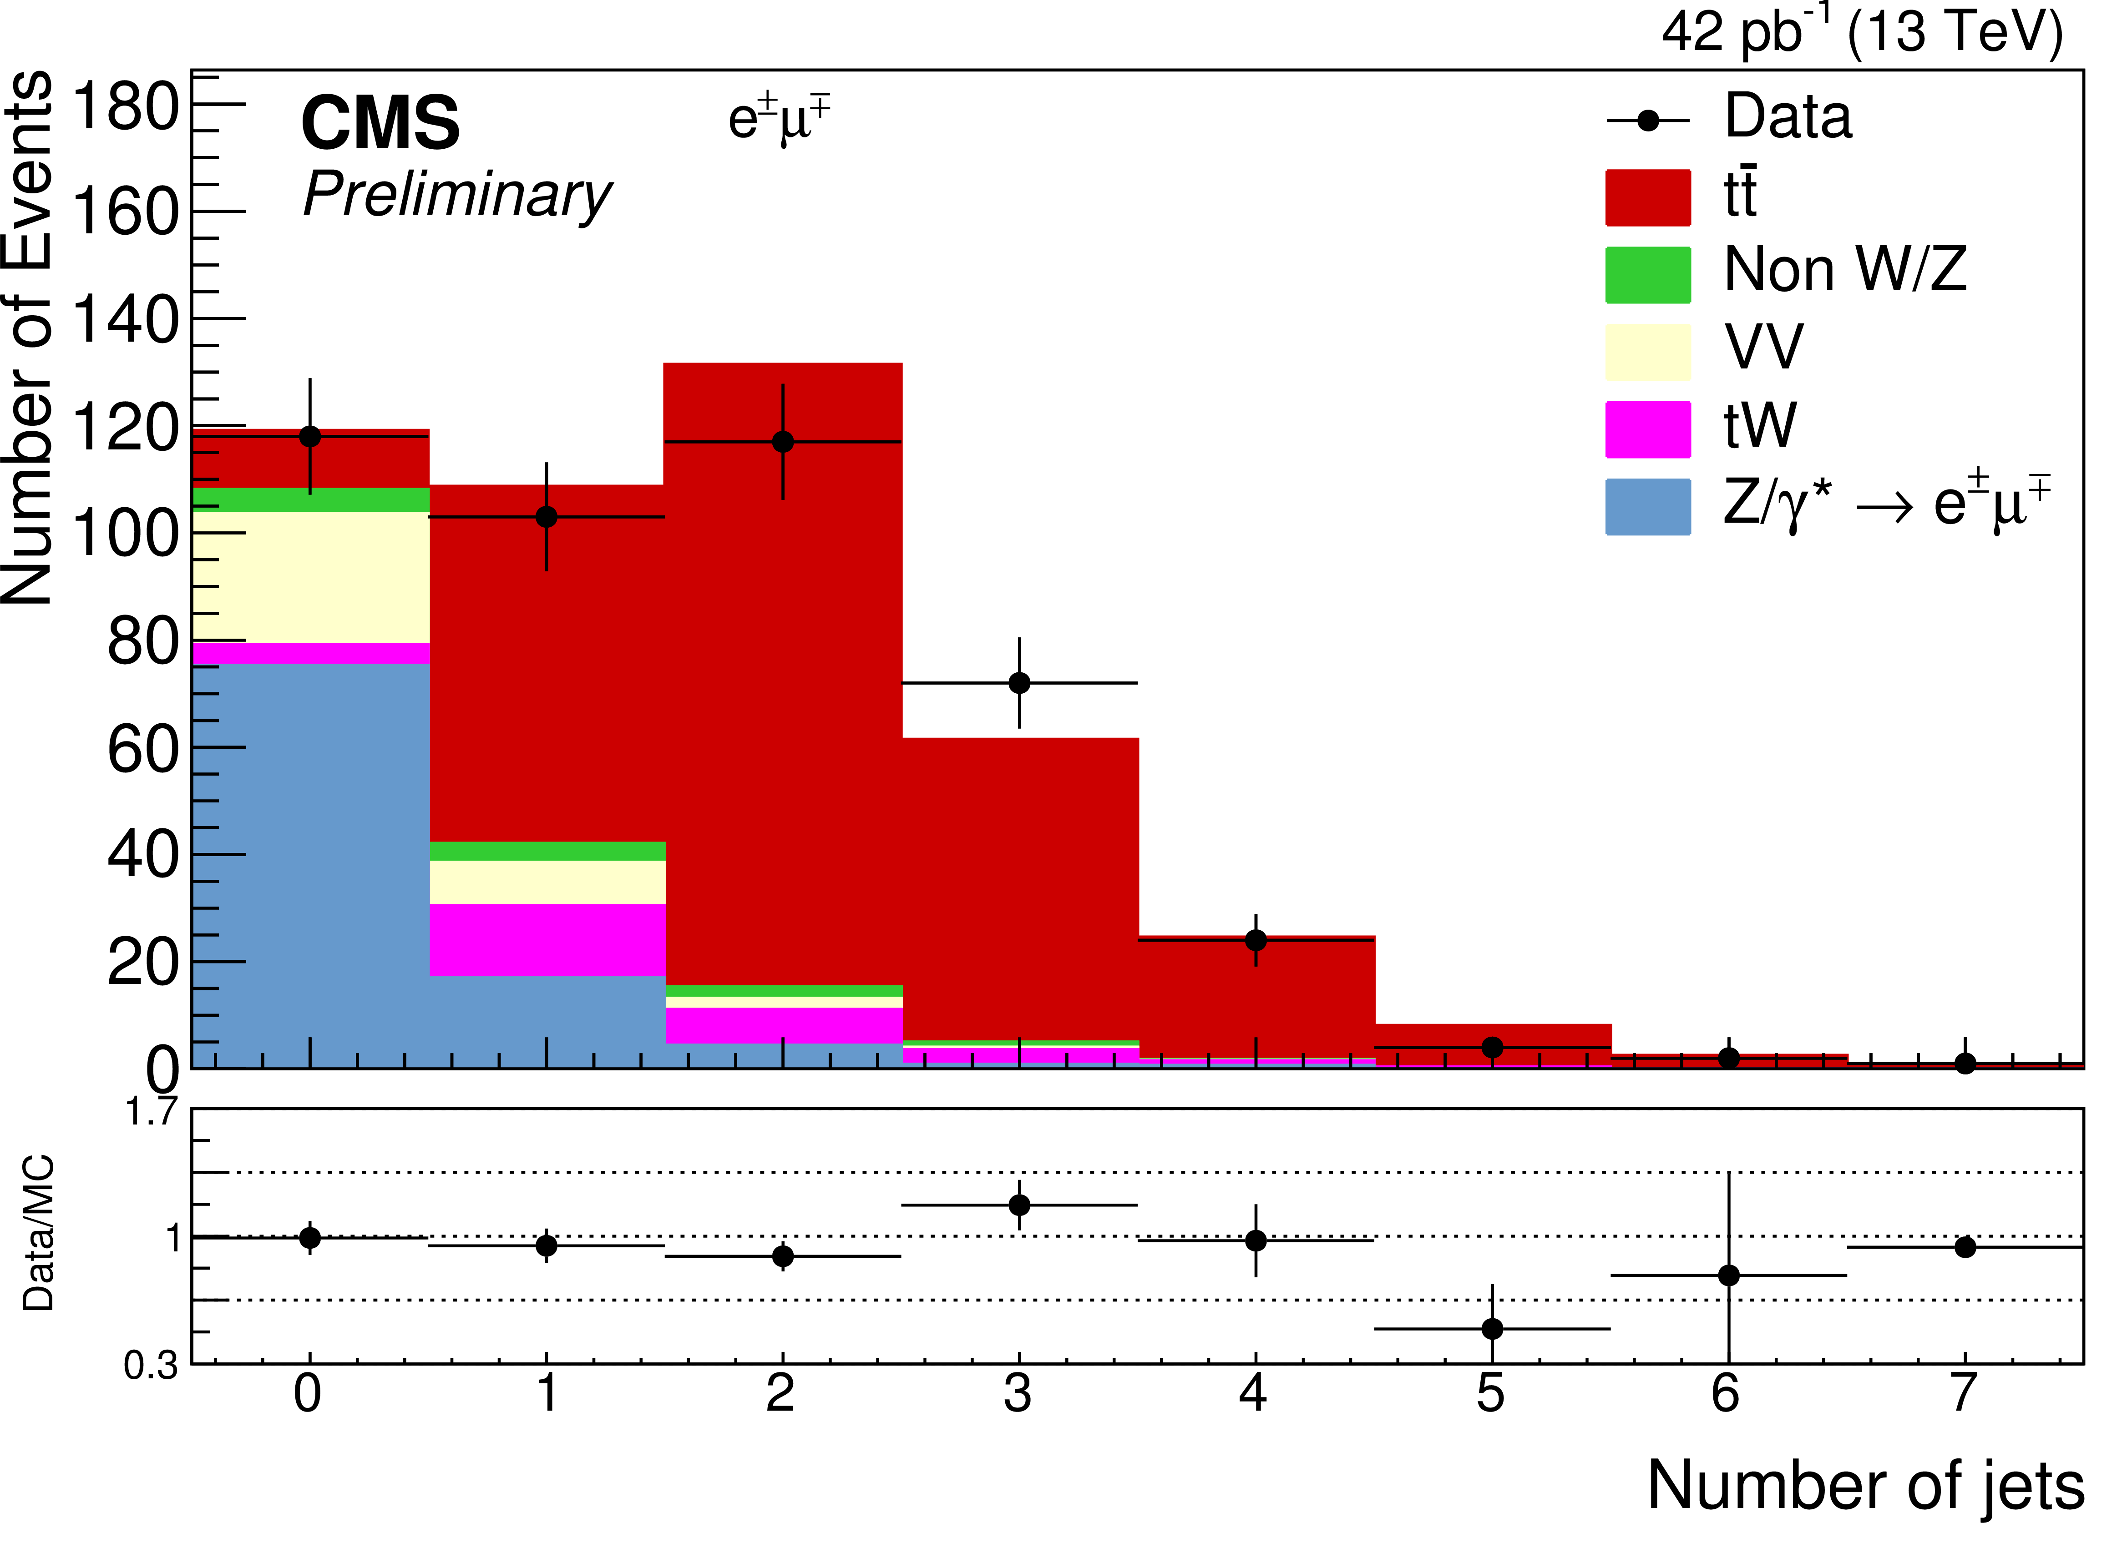

Top quark pair events
Di-lepton final state
(ee,eμ,μμ)
MET= 164.0 GeV
Jet
p_{T} = 81.6 GeV
Electron
p_{T} = 57.7
Jet p_{T} = 56.8 GeV
Muon p_{T} = 53.8 GeV
CMS-PAS-TOP-15-003; CMS-PAS-TOP-15-010

Slide 31
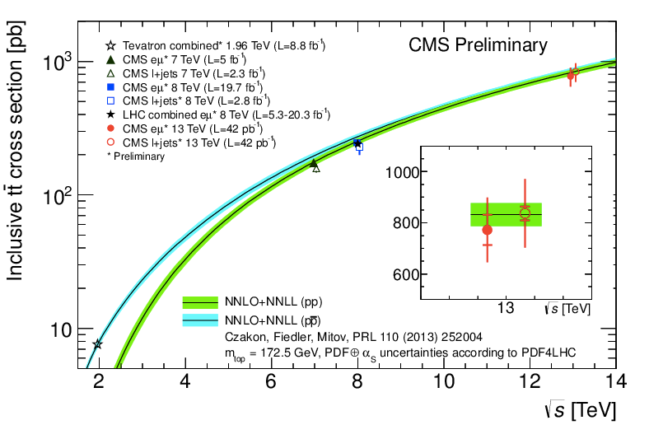
Top quark pair events
CMS-PAS-TOP-15-003; CMS-PAS-TOP-10-005

Slide 32
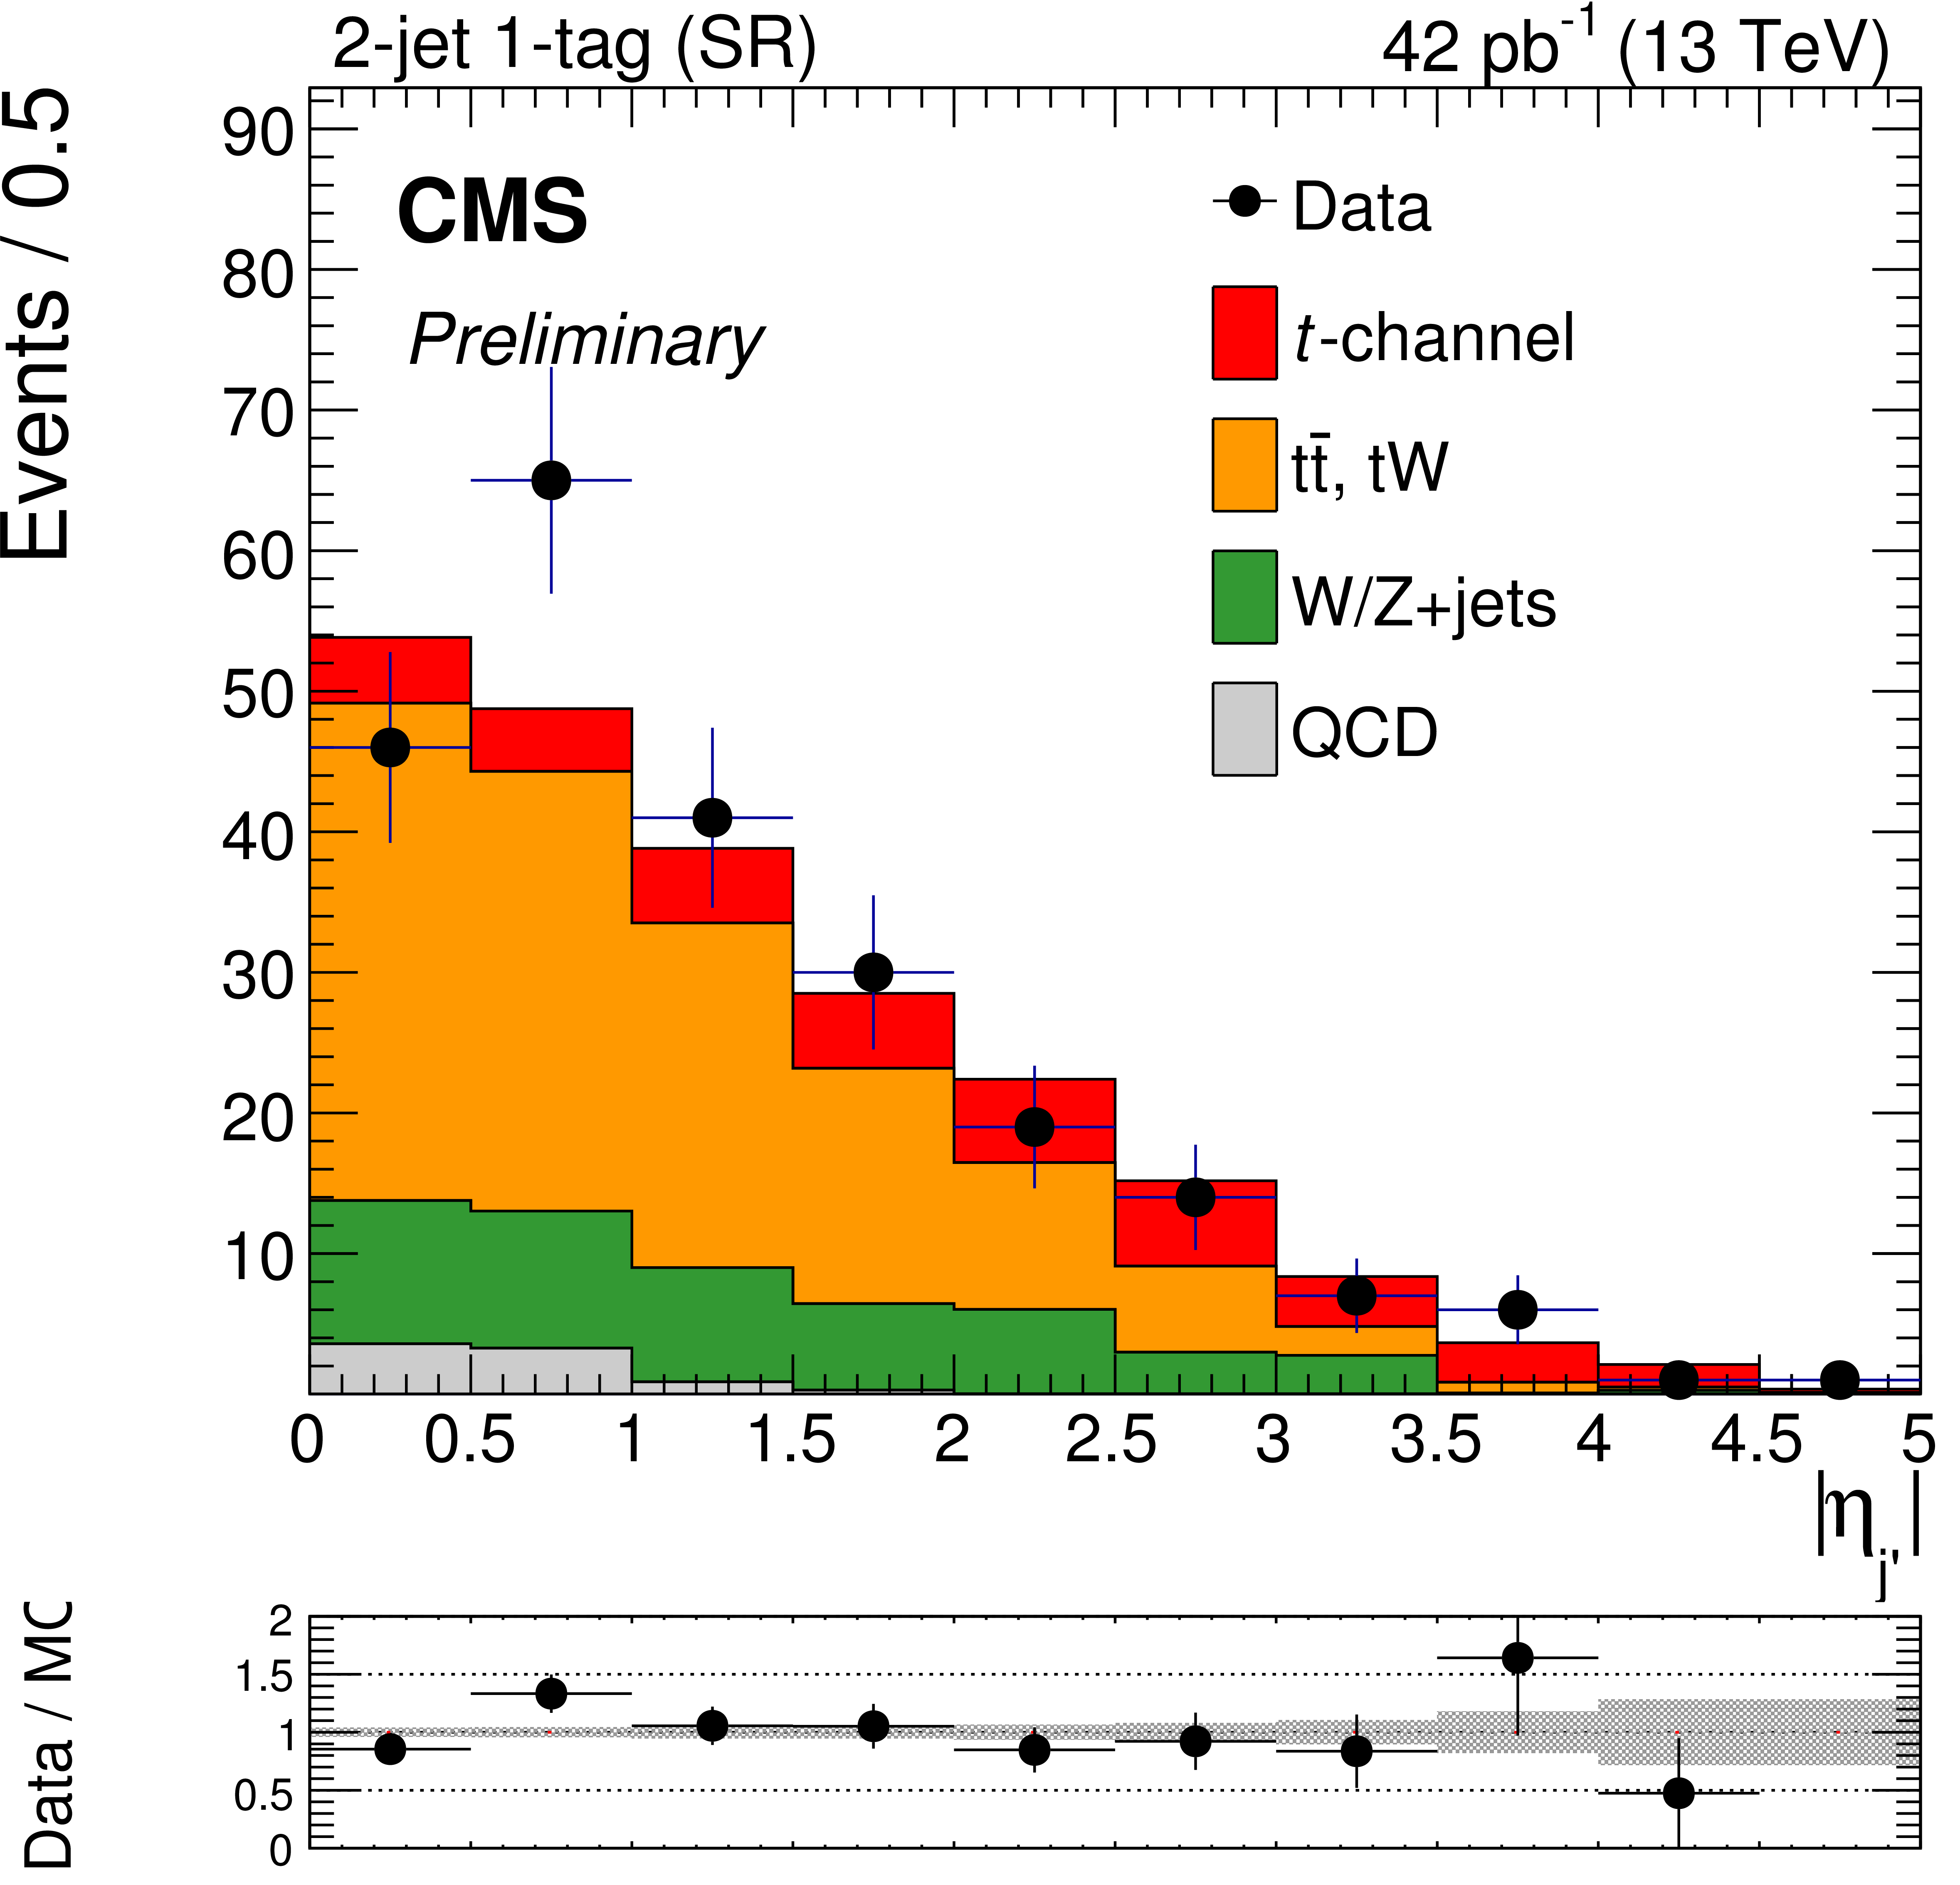
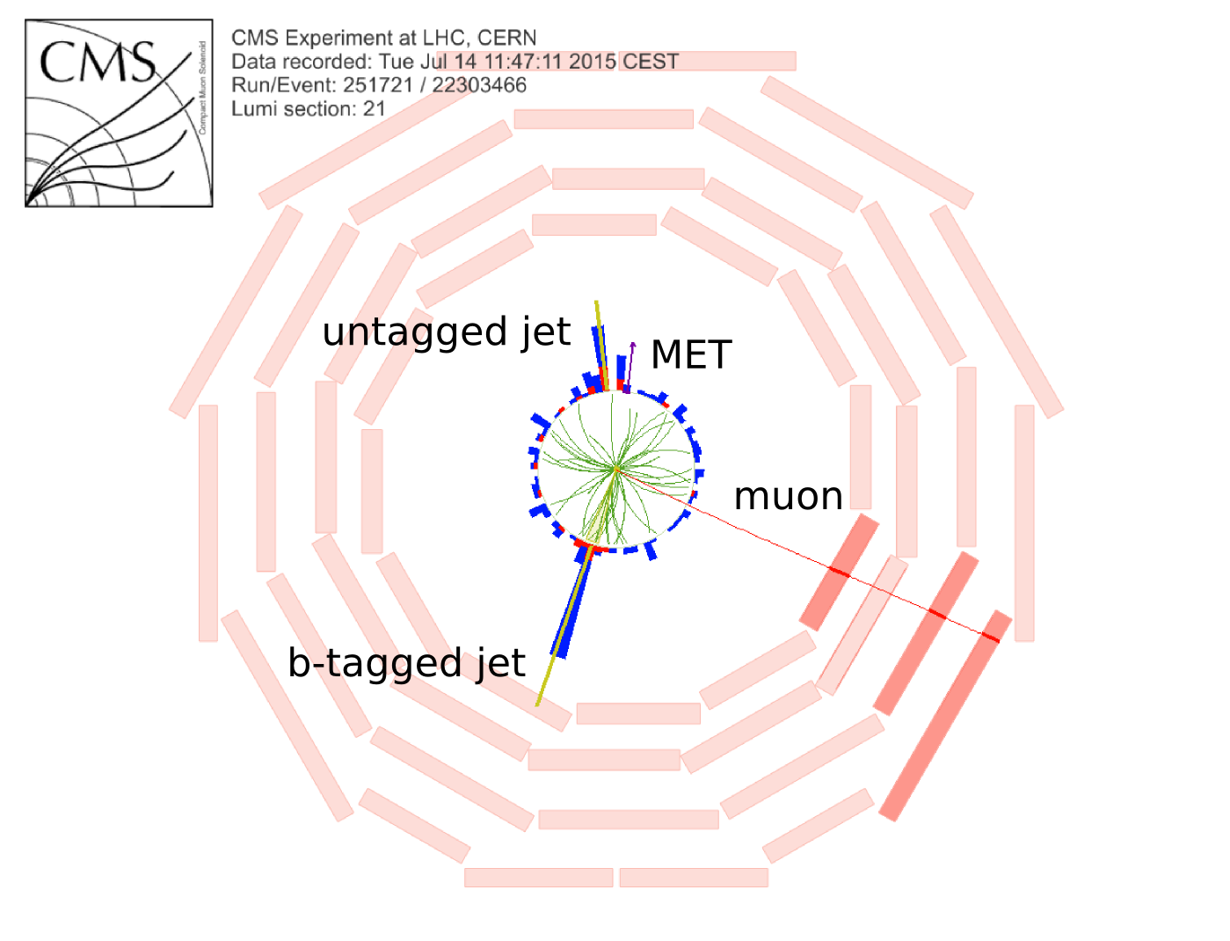
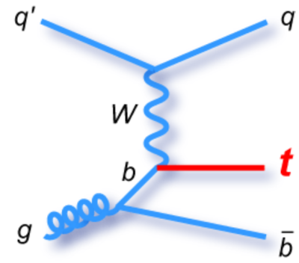
Single top quark events (t-channel)
pb
NLO HATHOR:
CMS-PAS-TOP-10-004

Slide 33
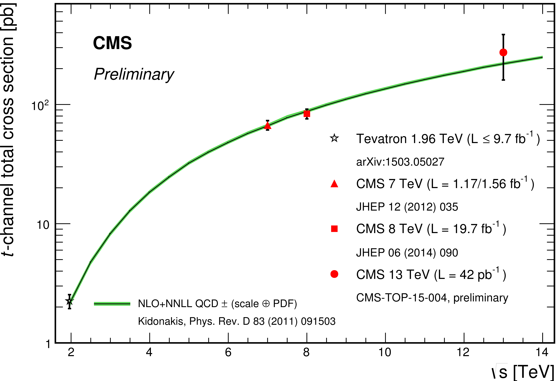
Single top quark events (t-channel)
CMS-PAS-TOP-10-004

Slide 34
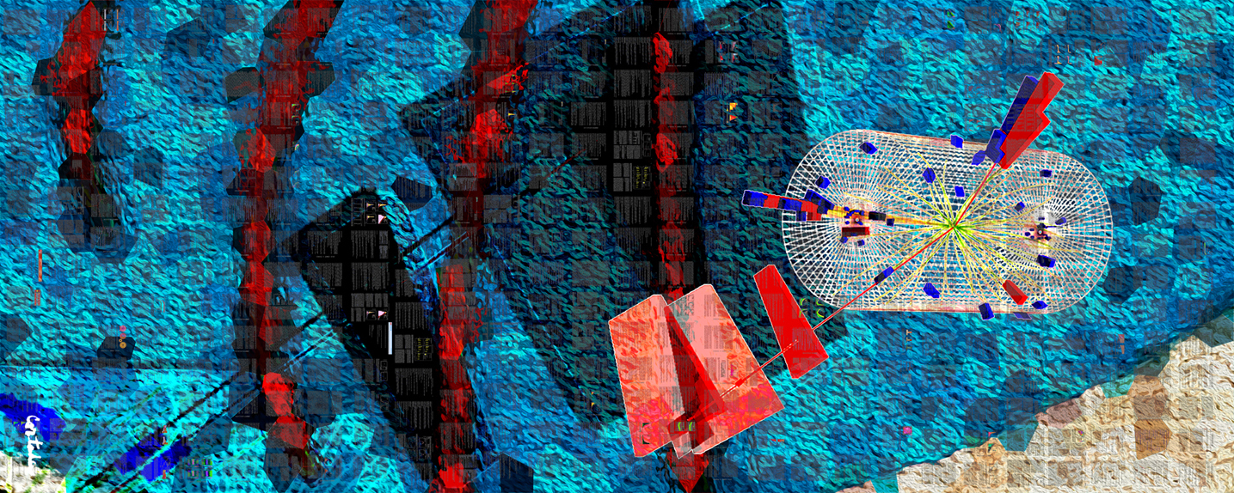
CMS-PHO-PUBLIC-2013-008-1
Spectacular events at 13 TeV
Xavier Cortada (with the participation of physicist Pete Markowitz), "In search of the Higgs boson: H -> tau tau", digital art, 2013.

Slide 35
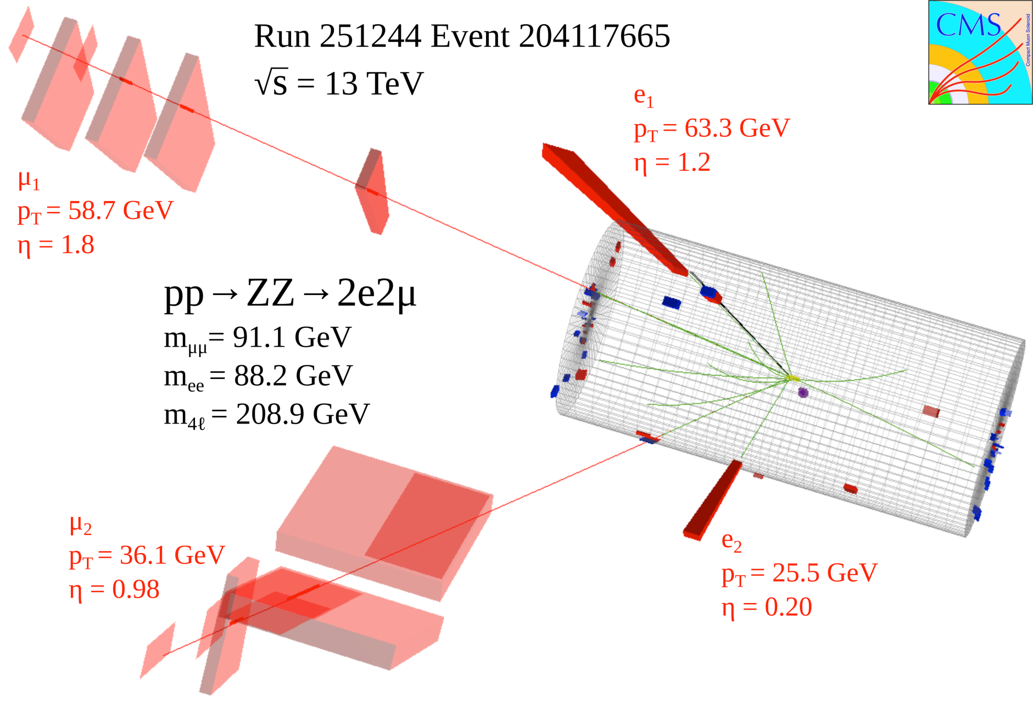
A very nice 4-lepton event
CERN-CMS-DP-2015-016

Slide 36
A very nice 4-lepton event: Higgs?
CERN-CMS-DP-2015-016

Slide 37
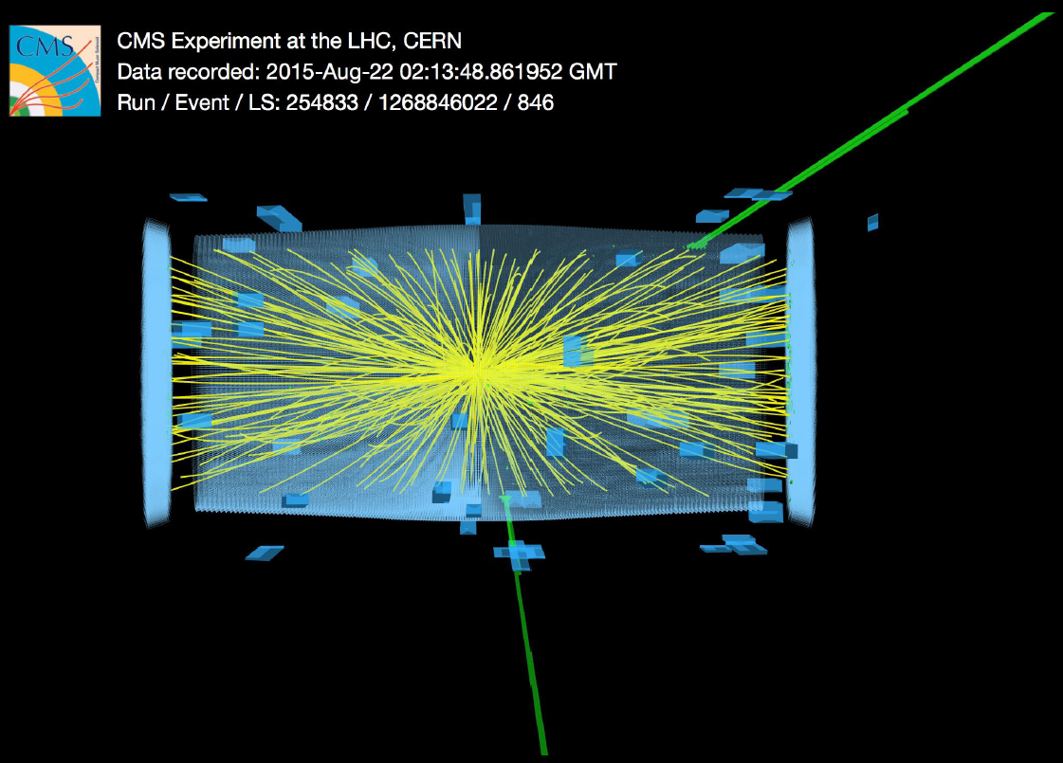
Initial searches for new physics
e⁺e⁻ final state
M(e⁺e⁻) = 2.9 TeV
CERN-CMS-DP-2015-039

Slide 38
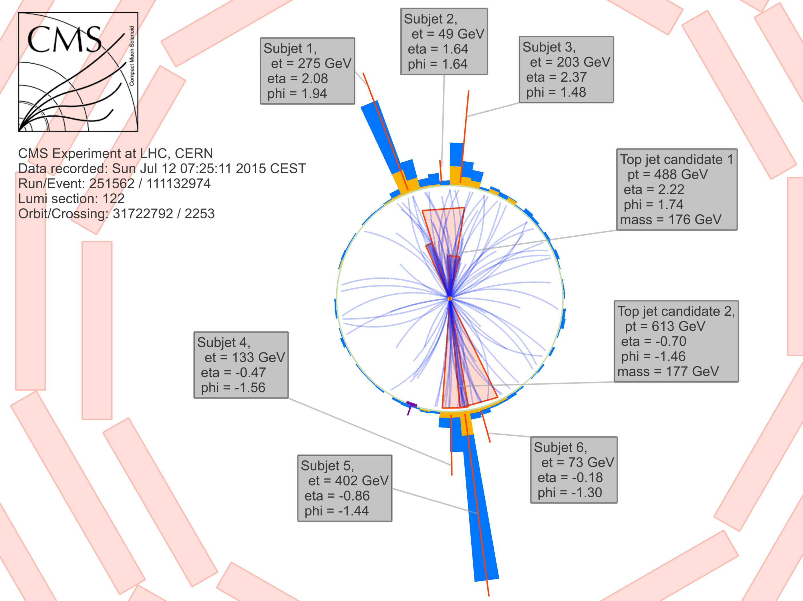
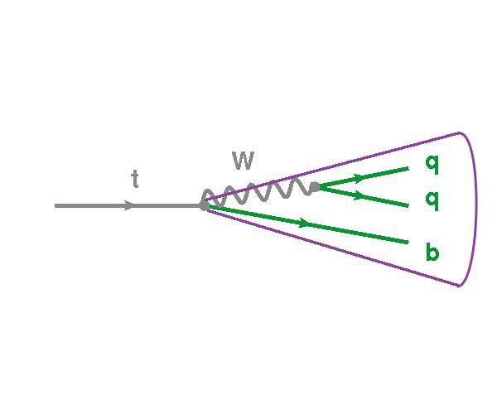
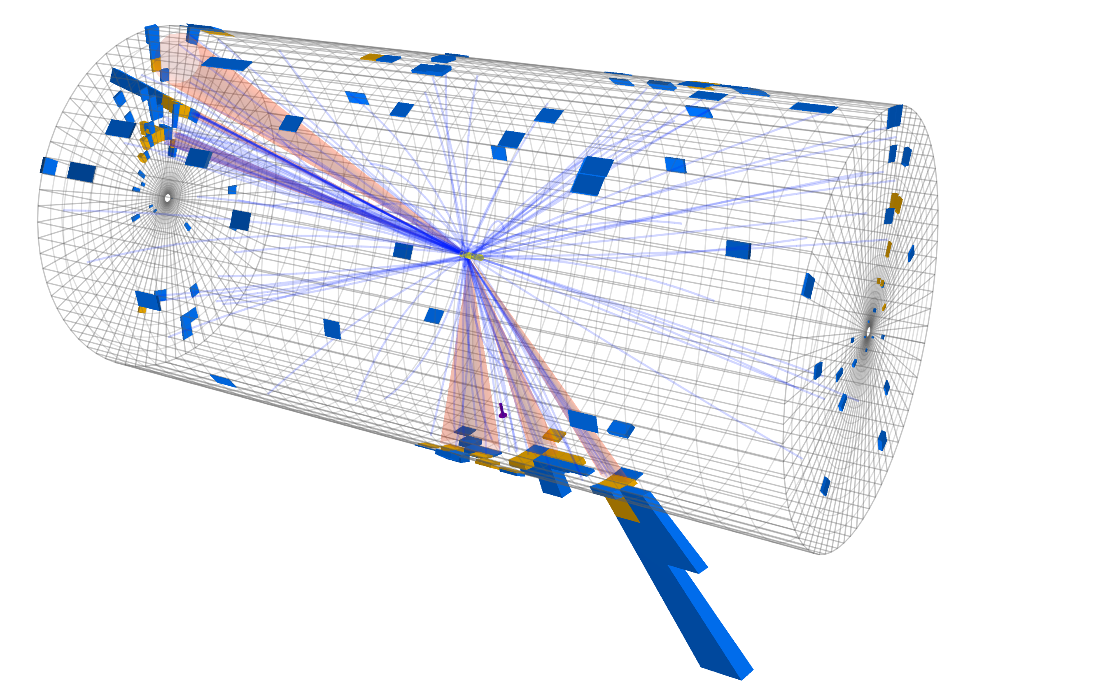
Initial searches for new physics
CERN-CMS-DP-2015-020
Two top-tagged objects
M(top-tagged 1) = 176 GeV
M(top-tagged 2) = 177 GeV
M(top-antitop) = 2.5 TeV

Slide 39
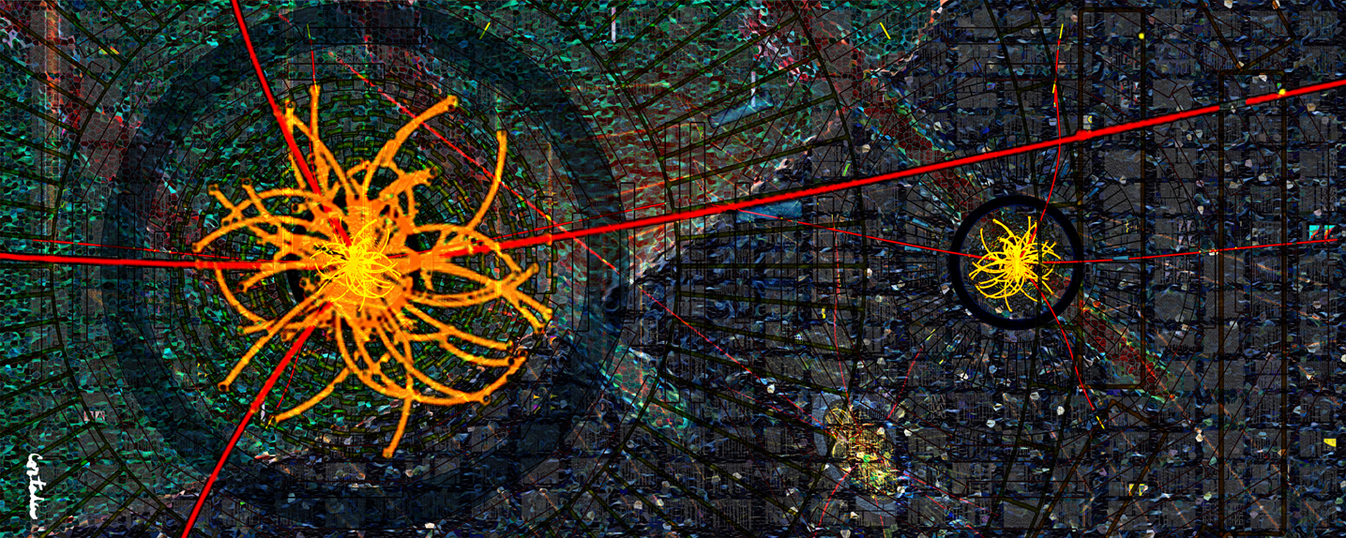
CMS-PHO-PUBLIC-2013-009-1
Towards HL-LHC
Xavier Cortada (with the participation of physicist Pete Markowitz), "In search of the Higgs boson: H -> ZZ", digital art, 2013.

Slide 40
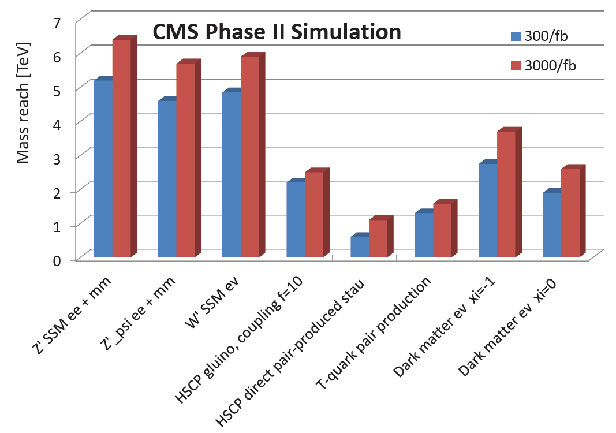
More luminosity at HL-LHC
All plots from CMS Phase-2 Technical Proposal CERN-LHCC-2015-010

Slide 41
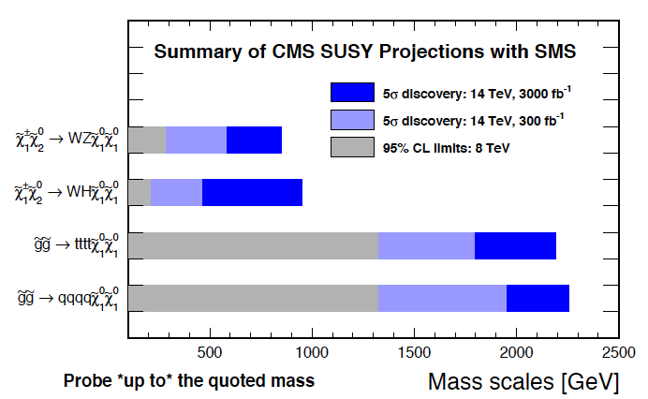
More luminosity at HL-LHC

Slide 42
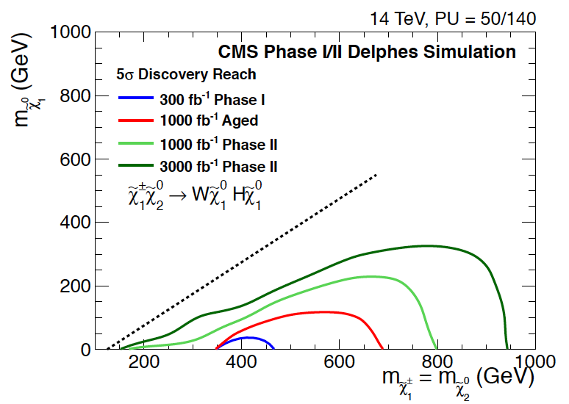
More luminosity at HL-LHC

Slide 43
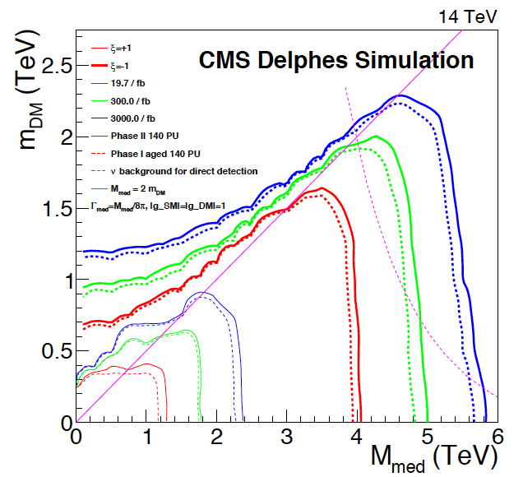
More luminosity at HL-LHC

Slide 44
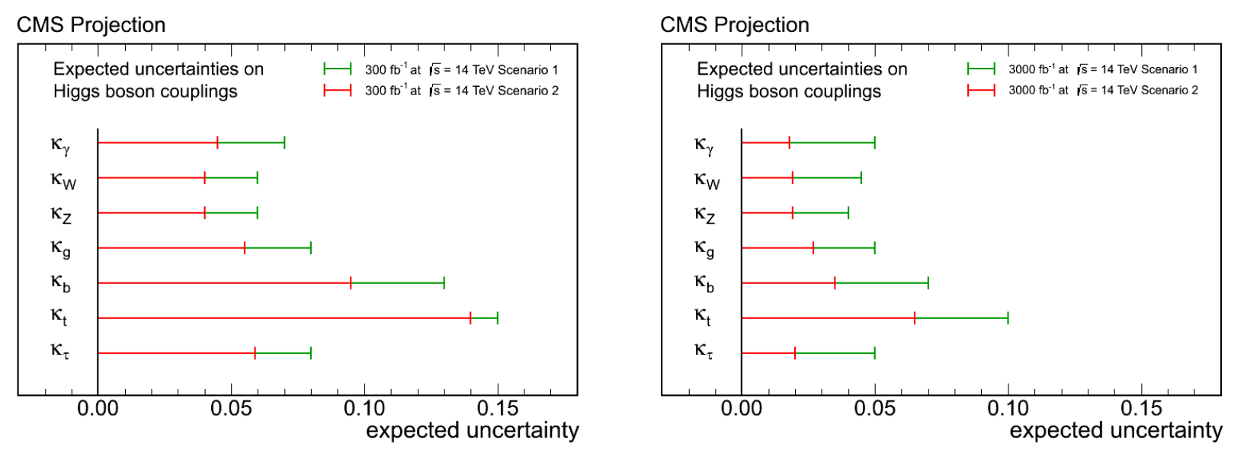
More luminosity at HL-LHC
From full LHC dataset to full HL-LHC dataset a factor of >2 improvement in Higgs boson SM coupling precision (scaled from current measurements and assuming same detector performances with the full 300-3000/fb).
300/fb
3000/fb
Two scenarios: (1) where systematic uncertainties do not scale with more integrated luminosity, and (2) where they do scale down with a factor of 2

Slide 45

HL-LHC schedule
Phase-1: more in the presentation of K. Borras
Phase-2: more in the presentation of D. Contardo
Phase-1 CMS Upgrades
Phase-2 CMS Upgrades
HL-LHC “baseline” peak luminosity 5 x 10³⁴ cm⁻² s⁻¹ (now ~1 x 10³⁴ cm⁻² s⁻¹ ) with an average number of collisions per bunch crossing (pileup PU) of 140
“Ultimate” peak luminosity is 7.5 x 10³⁴ cm⁻² s⁻¹ (i.e. 200 PU) potentially increasing integrated luminosity by 30%

Slide 46

HL-LHC: more luminosity
Top quark pair event with 140 PU events
CMS Phase-II (i.e. HL-LHC) upgrade goals
Maintain Phase-I detector performance, at 140 PU (baseline)
Enable operation at 200 PU (ultimate), with moderate performance degradation
Radiation tolerance 3000 fb⁻¹ margin up to 4000 fb⁻¹

Slide 47

More luminosity, i.e. more radiation

Slide 48

Upgrades for the CMS experiment
More in the presentation of D. Contardo

Slide 49
Status of the CMS experiment
    Excellent detector performance during Run-1
    >400 journal papers, including a major discovery
    Successful program during LS1 (2013-2014)
    Well prepared for 13 TeV collisions
    First 13 TeV results appear
    En-route for another long list of new physics insights
    Preparing for our future research at the HL-LHC

