Slide 1
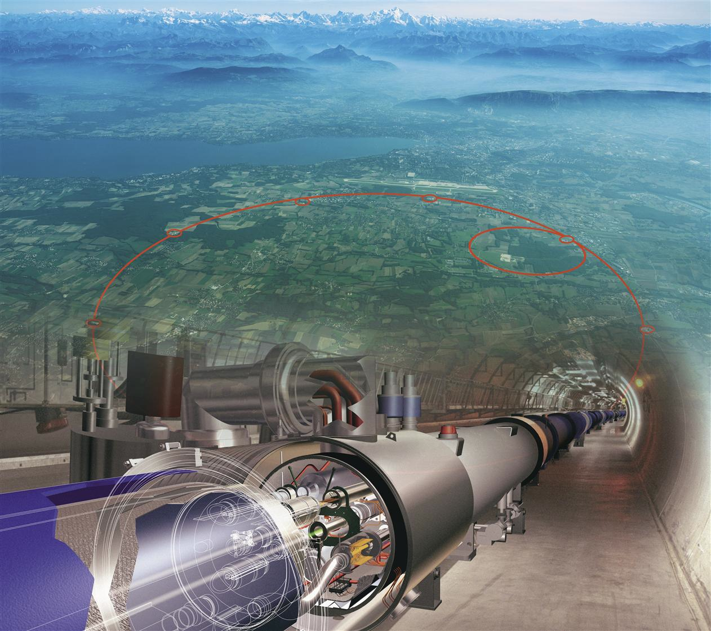
The CMS Experiment at the
Large Hadron collider at CERN

Slide 2
International collaboration including Flanders/Belgium
Three Flemish universities are involved in CMS, with directors/teamleaders:
Prof. Jorgen D’Hondt Vrije Universiteit Brussel – promoter
Prof. Pierre Van Mechelen Universiteit Antwerpen
Dr. Michael Tytgat Universiteit Gent
Taking into account newly granted projects at our universities and on the Belgian level (e.g. EoS) we expect a team size of 56 researchers in Flanders.
Including in total 7 faculty members (professor or equivalent).

Slide 3
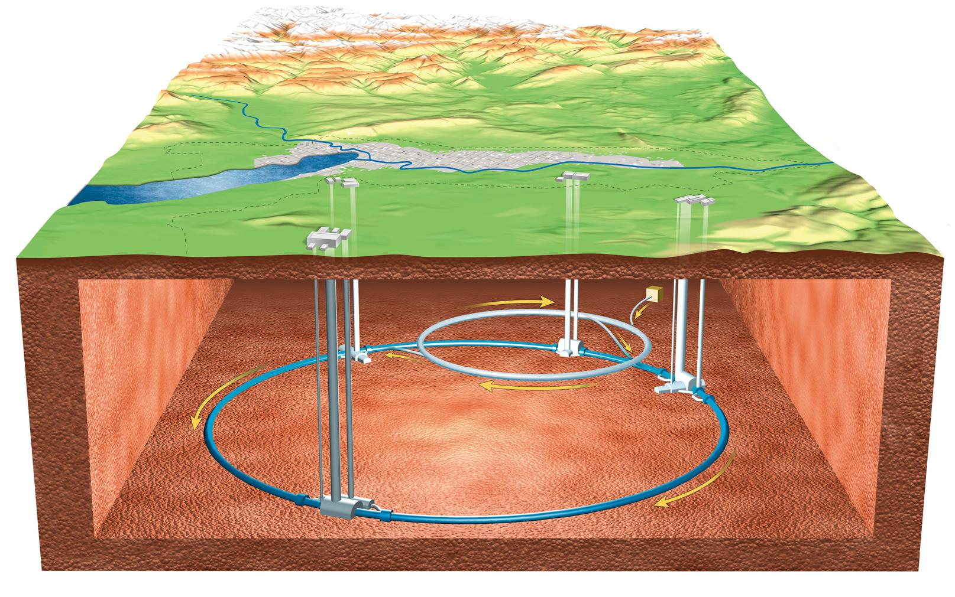
Particle Physics
Particle Colliders
universe
sun
Earth
human
~ 100 000 000 000 000 000 000 000 000 meter
~ 0.000 000 000 000 000 000 01 meter
Discover the fundamental constituents of matter, and understand how they interact among each other.
Develop dedicated instruments to measure the phenomena at the largest possible energies.
cells
atoms
quarks

Slide 4
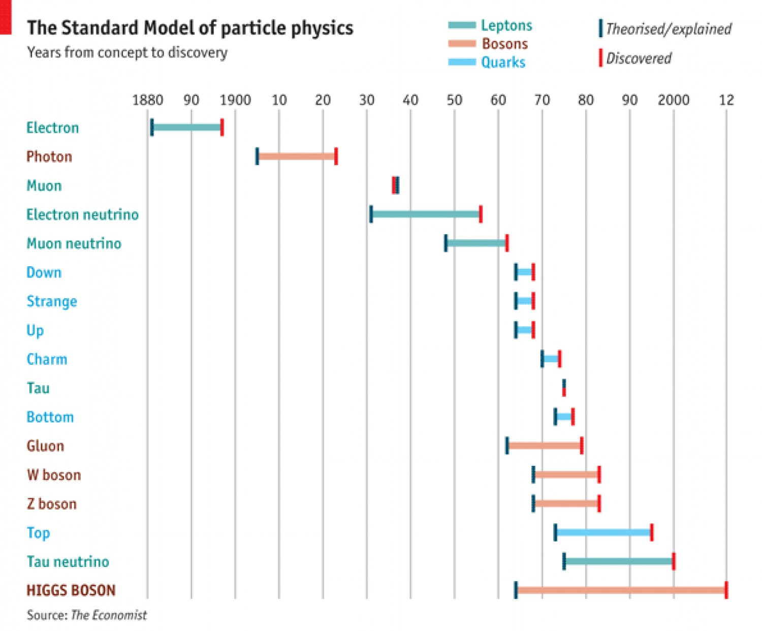
Particle Physics
The Standard Model of Particle Physics is a theory describing the structure of matter at its most fundamental level
The theory was established and precisely tested throughout the last century
The discovery of the Higgs particle (2012) opened several new questions and leaves many fundamental questions to be answered
the theory predicts that we might be living in only a semi-stable universe
the theory does not explain the vast amount of dark matter in the universe
the theory does not explain why we observe more matter compared to anti-matter
There must be a more profound structure yet to be discovered…
Source: The Economist, July 4th, 2012

Slide 5
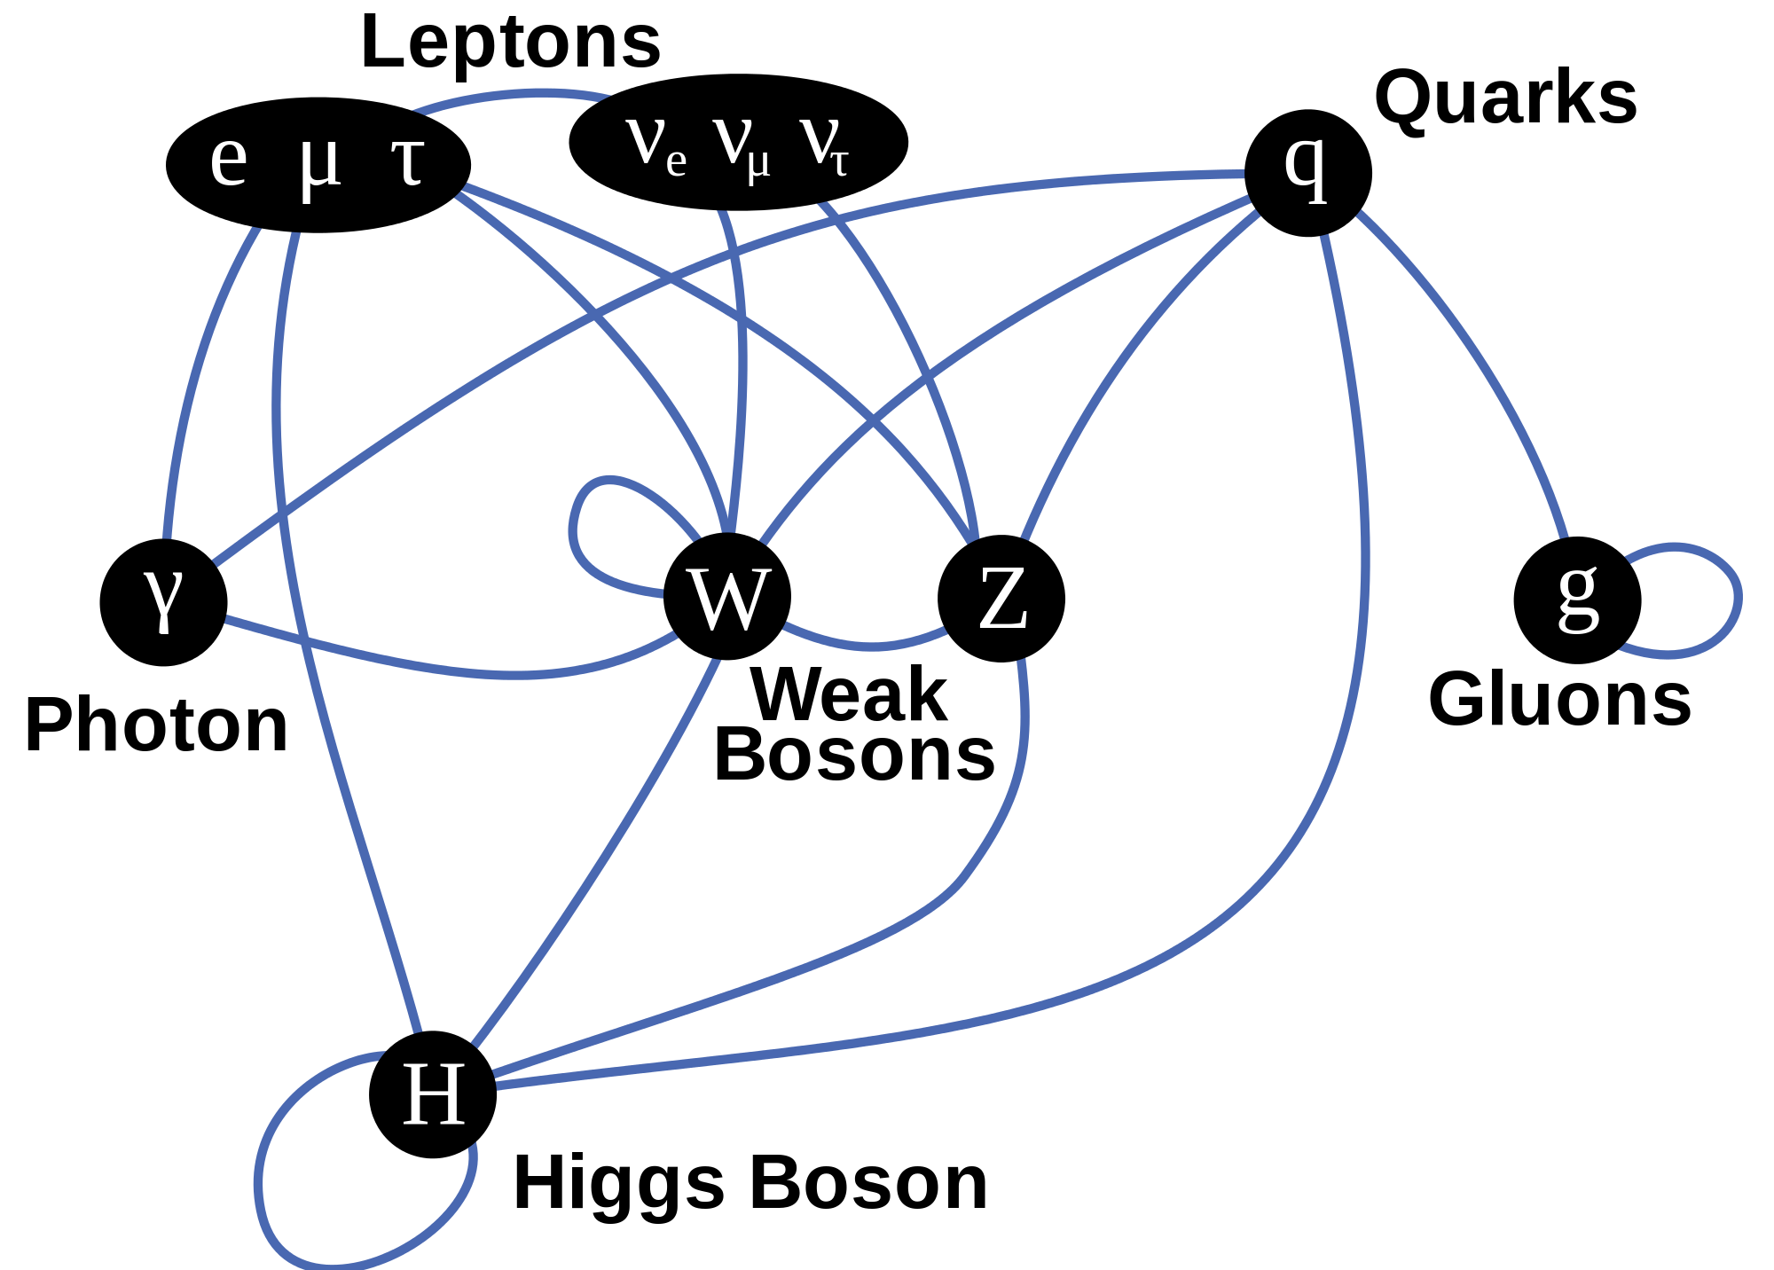
Particle Physics
the Higgs particle is confirmed in 2012 and its interactions with other particles are step by step being discovered
Higgs – Z boson (2012)
Higgs – W boson (2014)
Higgs – tau lepton (2016)
Higgs – top quark (2018)
Higgs – bottom quark (2018)
Higgs – muons, electrons, charm quark, self-coupling, etc. yet to come

Slide 6
Particle Physics
the Higgs particle is confirmed in 2012 and its interactions with other particles are step by step being discovered
Higgs – Z boson (2012)
Higgs – W boson (2014)
Higgs – tau lepton (2016)
Higgs – top quark (2018)
Higgs – bottom quark (2018)
Higgs – muons, electrons, charm quark, self-coupling, etc. yet to come
?

Slide 7
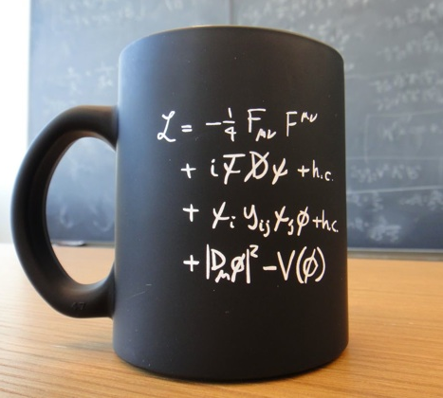
Particle Physics
free parameters of the theory are to be measured precisely
needed to calculate precise prediction that can be verified
need to zoom-in into matter to confront the predictions with experimental observations
the Large Hadron Collider at CERN is the unique laboratory for this exploration at the highest energies
compact version

Slide 8
The Large Hadron Collider @ CERN
1990-2000
designs and R&D
2000-2008
construction LHC
construction CMS
2009-2023 (LHC)
operational Phase-1
2026-2037 (HL-LHC)
Phase-2 of the program
A unique collider worldwide at the highest energies ever, and with a step-by-step increasing proton-proton collision rate from the LHC to the HL-LHC Phase.

Slide 9
The Large Hadron Collider @ CERN
1990-2000
designs and R&D
2000-2008
construction LHC
construction CMS
2009-2023 (LHC)
operational Phase-1
2026-2037 (HL-LHC)
Phase-2 of the program
The LHC/HL-LHC accelerator is co-financed through a sustained annual Belgian contribution (~28 MEUR/year) from the Federal government.

Slide 10
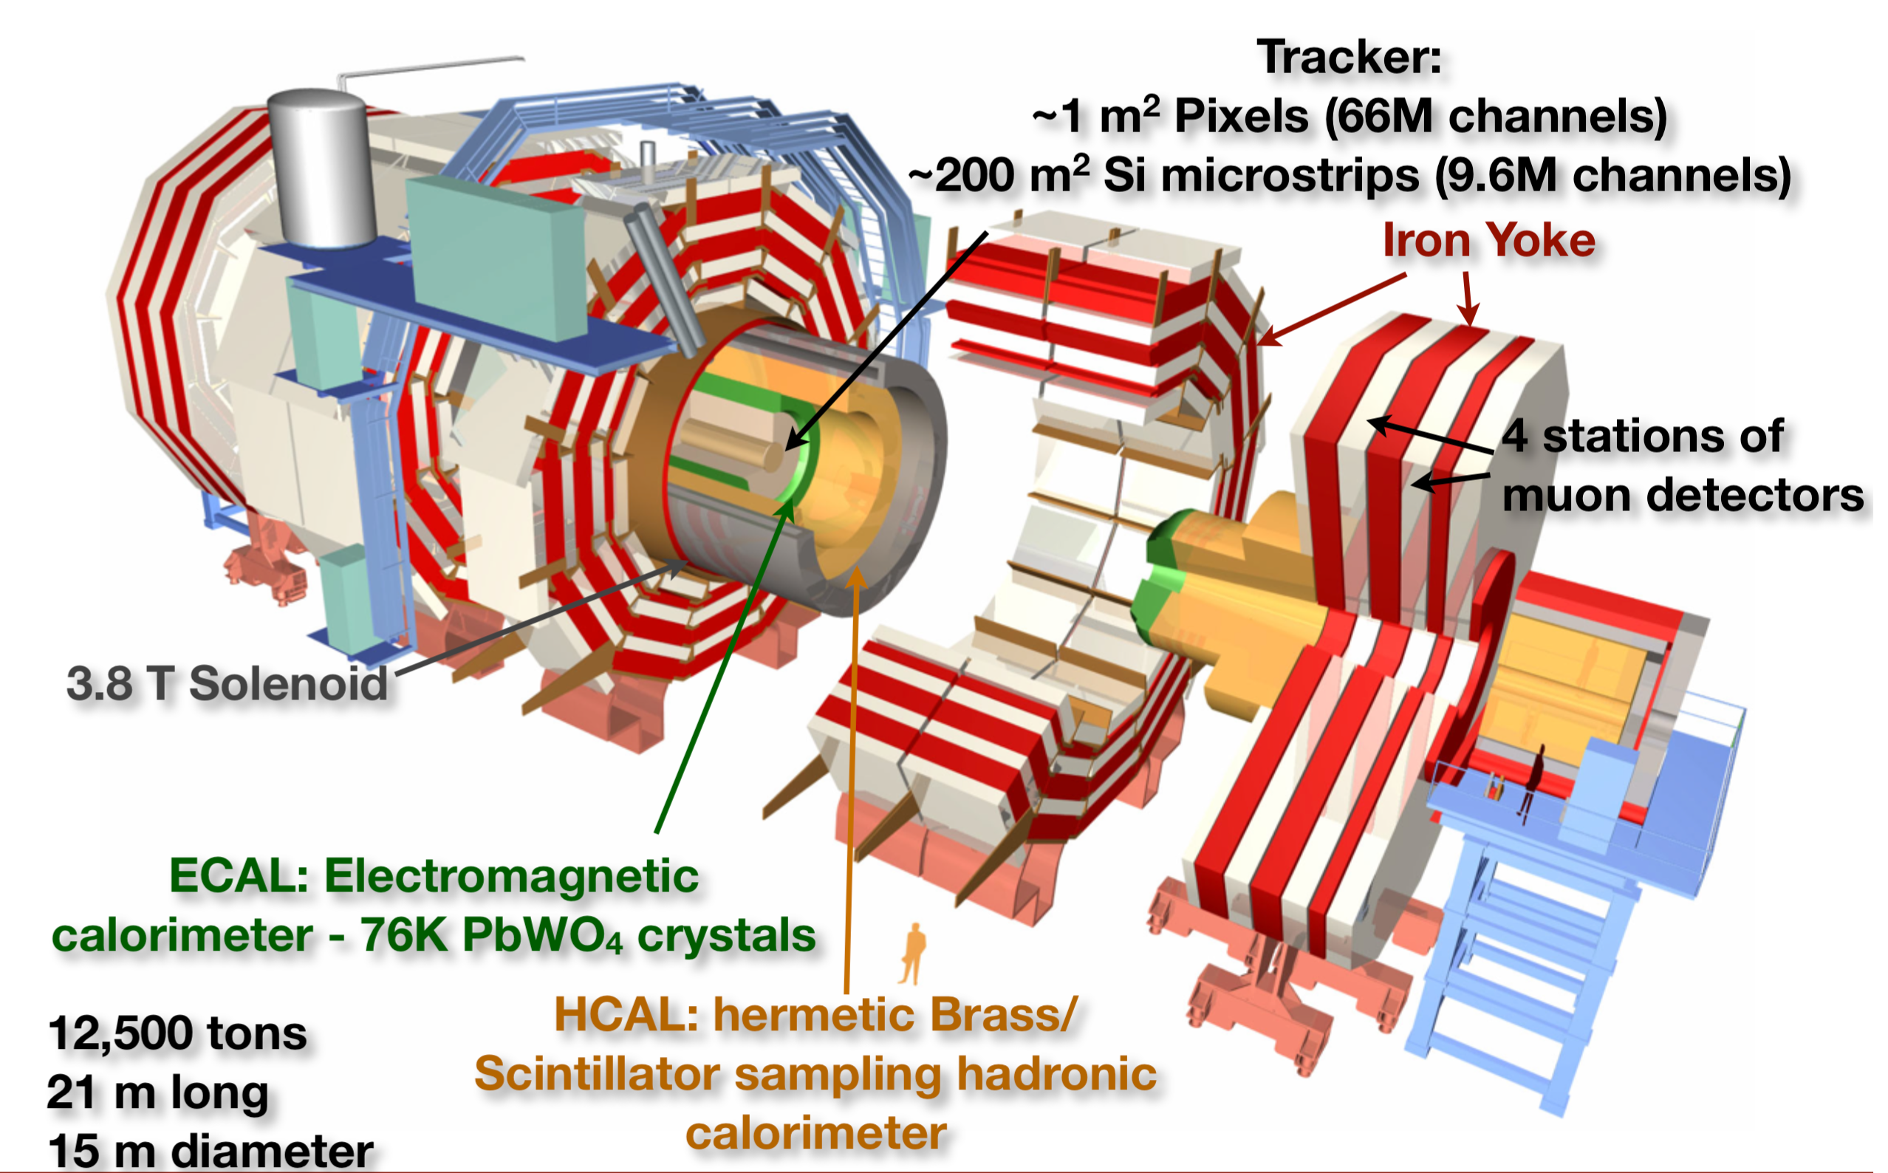
The CMS Collaboration and experiment
A worldwide collaboration established 25 years ago, and still growing
50 countries
~230 institutions
2885 scientists (incl. 922 PhD students)
1274 engineers & technicians
100 journal publications per year
Flanders = ~2% of the authors
51 PhDs graduated in our teams
27 PhD students ongoing
Several instruments have to be integrated and synchronized together to make the experiment a success. The responsibility to construct, commission, operate, maintain each instrument is typically connected to a consortium of institutions and formulated in Memoranda of Understanding (MoU) with funding agencies.

Slide 11
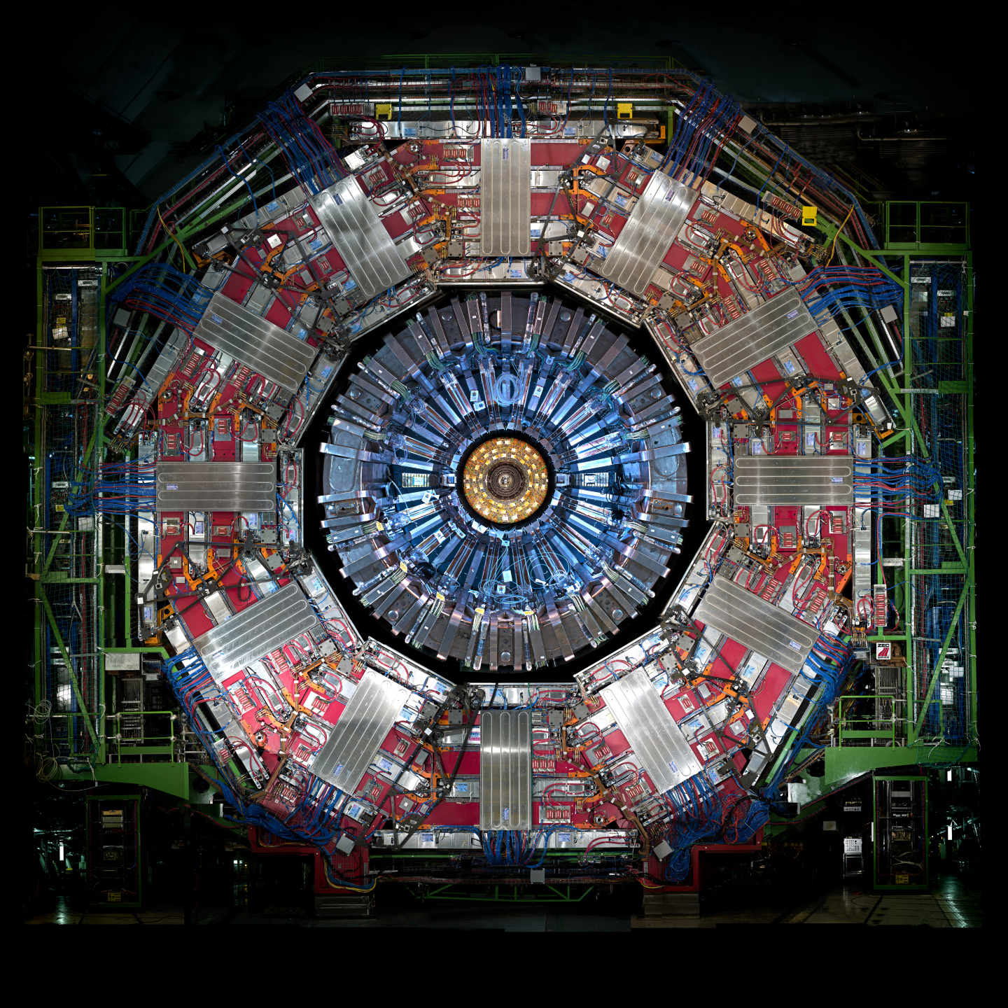
The CMS Collaboration and experiment
A worldwide collaboration established 25 years ago, and still growing
50 countries
~230 institutions
2885 scientists (incl. 922 PhD students)
1274 engineers & technicians
100 journal publications per year
Flanders = ~2% of the authors
51 PhDs graduated in our teams
27 PhD students ongoing
15m
The foreseen upgrade of the CMS detector by 2026 is co-financed through a Belgian contribution (~10 MEUR) obtained in the “Hercules programme”. Therefore no equipment investment is requested in this application.

Slide 12
IRI application: recurrent costs fixed in agreements
For the participation in the CMS experiment a funding agency signed a Memorandum of Understanding (MoU) to contribute:
in the annual Maintenance and Operation costs (M&O)
in the required computing resources (TIER-2)
in the operation of the experiment (collecting good data)
in the common cost to upgrade the experiment (Common Fund)
The CMS experiment operates within a flat budget year-after-year. For Flanders and for 2018 the required budget (and granted by the FWO) was calculated to be 1.15 MEUR.
For the years 2019-2022 we maintain this annual budget, modulo a small additional budget to cover the cost of technical personnel to construct the upgraded CMS detector, and the participation of the PI/co-PIs in the CMS Collaboration meetings.
The resulting budget is 1.32 MEUR per year (23.6 kEUR / year / researcher). Additional direct matching funds of around 0.55 MEUR per year, and the indirect leverage factor with similar contributions from institutions worldwide in the CMS Collaboration is around 50.

Slide 13
IRI application: annual costs
Maintenance and Operation costs (M&O): in agreement with the funding agencies involved (incl. FWO) this is fixed by the experiment to be 13 kEUR per year and PhD-titled researcher
Computing resources (TIER-2): in agreement with the funding agencies involved (incl. FWO) this is fixed in units of disk space and CPU power, and it reflects a total of 200 kEUR per year to plug in our local computing center into the worldwide LHC GRID network
Operation of the experiment (collecting good data): as researchers we need to deliver “services” to collect good data of 4 months per year per researchers (6 months for new researchers) typically at the detector for which we foresee a 60 kEUR travel budget per year and a cost of 60 kEUR to rent adequate apartments
Common cost to upgrade the experiment (Common Fund): in agreement with the funding agencies involved (incl. FWO) this is fixed by the experiment to cover the technical installation of the new CMS detector, spread over the years this results in 100 kEUR per year
Cost for the participation of PI/co-PIs in collaboration meetings (5x per year) of 24.5 kEUR per year, and cost of basic technical tools to support the construction of 22.5 kEUR per year

Slide 14
IRI application: annual costs and personnel
Maintenance and Operation costs (M&O): in agreement with the funding agencies involved (incl. FWO) this is fixed by the experiment to be 13 kEUR per year and PhD-titled researcher
Computing resources (TIER-2): in agreement with the funding agencies involved (incl. FWO) this is fixed in units of disk space and CPU power, and it reflects a total of 200 kEUR per year to plug in our local computing center into the worldwide LHC GRID network + 1.5 FTE techn
Operation of the experiment (collecting good data): as researchers we need to deliver “services” to collect good data of 4 months per year per researchers (6 months for new researchers) typically at the detector for which we foresee a 60 kEUR travel budget per year and a cost of 60 kEUR to rent adequate apartments + 3 FTE researchers (post-doc level)
Common cost to upgrade the experiment (Common Fund): in agreement with the funding agencies involved (incl. FWO) this is fixed by the experiment to cover the technical installation of the new CMS detector, spread over the years this results in 100 kEUR per year
Cost for the participation of PI/co-PIs in collaboration meetings (5x per year) of 24.5 kEUR per year, and cost of basic technical tools to support the construction of 22.5 kEUR per year
Technical personnel to support the construction of the new detector: 4.5 FTE techn

Slide 15
The unique national & international context of the project
The LHC/HL-LHC project is the top priority in the international vision for particle physics (conclusion from US and European strategy panels)
Since the start of the FWO Big Science funding programme the CMS experiment is by far the major project for particle physics in Flanders, and in Belgium
Although we are growing in size, the requested budget of 1.32 MEUR per year is a continuation of previously obtained budgets since about 10 years; and valorise the Belgian investment in CERN (~28 MEUR/year) and the Flemish/Belgian investment in the upgrade of the CMS detector (~10 MEUR)
The requested budget is the required cost to participate in the CMS experiment, it is the basis for several research projects funded through other programmes (e.g. FWO, EoS, university grants of excellence, etc.), e.g. 27 on-going PhD students
Our participation and this request is based on our strong international reputation and successes confirmed by the reviewers

Slide 16
The unique national & international context of the project
The LHC/HL-LHC project is the top priority in the international vision for particle physics (conclusion from US and European strategy panels)
Since the start of the FWO Big Science funding programme the CMS experiment is by far the major project for particle physics in Flanders, and in Belgium
Although we are growing in size, the requested budget of 1.32 MEUR per year is a continuation of previously obtained budgets since about 10 years; and valorise the Belgian investment in CERN (~28 MEUR/year) and the Flemish/Belgian investment in the upgrade of the CMS detector (~10 MEUR)
The requested budget is the required cost to participate in the CMS experiment, it is the basis for several research projects funded through other programmes (e.g. FWO, EoS, university grants of excellence, etc.), e.g. 27 on-going PhD students
Our participation and this request is based on our strong international reputation and successes confirmed by the reviewers
Thank you for your attention.

