Slide 1



End-of-the-Year Event
20 December 2021

Slide 2
Welcome
News from the directors
Introduction of newcomers
Some inspiration for a relaxing break!

Slide 3
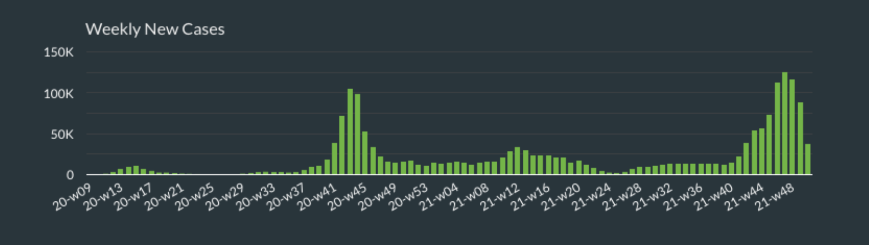
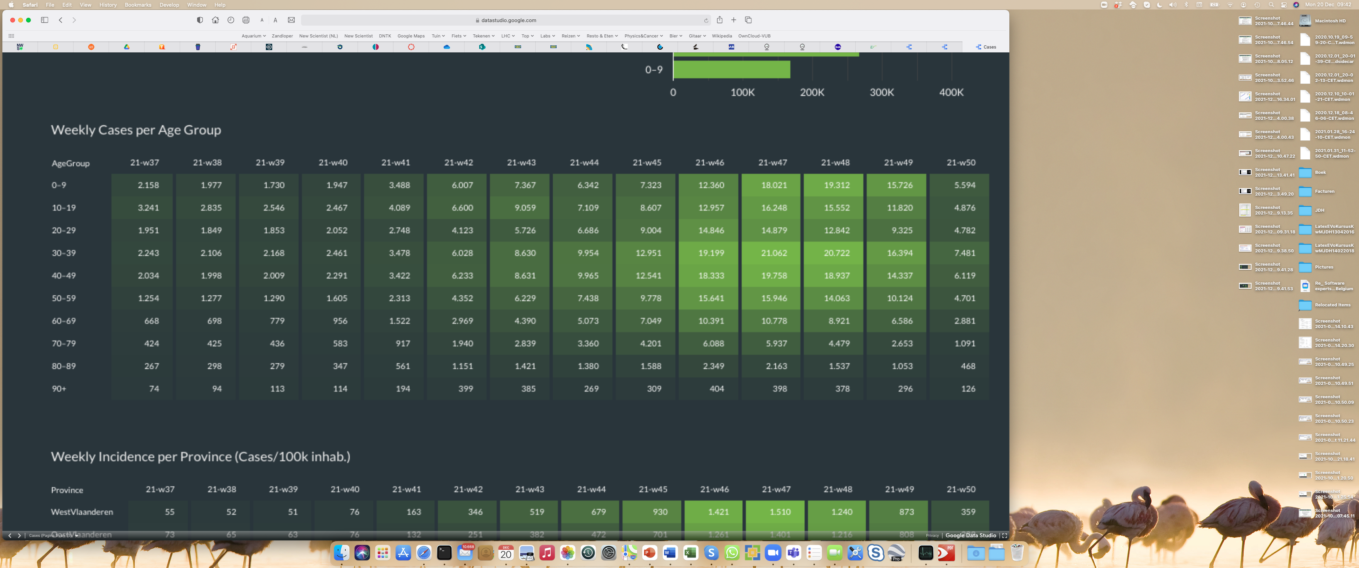
COVID-19 induced a worldwide pandemic and impacted our lives since about two years.
Vaccinations prevented the hospitals to be saturated.
The “booster” vaccination campaign is in full swing in Belgium with a target to deliver a dose to everyone within the next few months.
But, we are not out of the woods yet.
Information from Belgian government: https://www.info-coronavirus.be/en/
Sciensano numbers: https://www.sciensano.be/en

Slide 4
We have to continue to take care of each other!

Slide 5
United with cookies/tea/beer
Hopefully many of you have collected your small gift on behalf of the IIHE
May it serve you during the end-of-the-year break!

Slide 6
United with cookies/tea/beer
Hopefully many of you have collected your small gift on behalf of the IIHE
May it serve you during the end-of-the-year break!
Be aware that the first week of January the institute will be open, but this period will be considered by many as being part of
the end-of-the-year break.

Slide 7
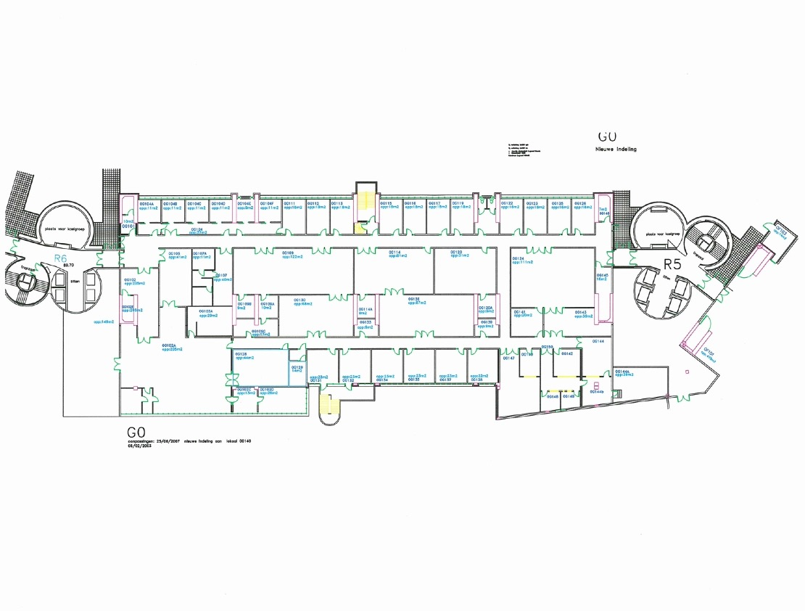
Renovations of the CMS centre and the Eurodemo rooms are done!
These rooms have been transformed into excellent meeting and lecture rooms.
IIHE level 0G
Eurodemo
CMS centre

Slide 8
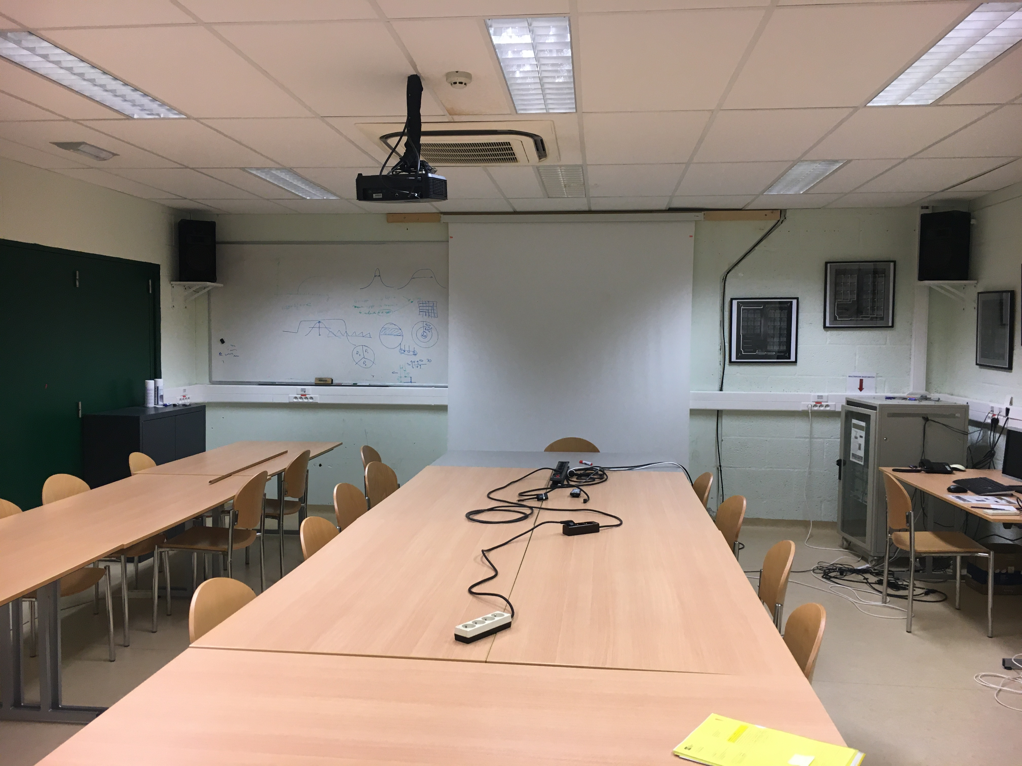
Renovations of the CMS centre and the Eurodemo rooms are done!
These rooms have been transformed into excellent meeting and lecture rooms.
CMS centre – previously

Slide 9
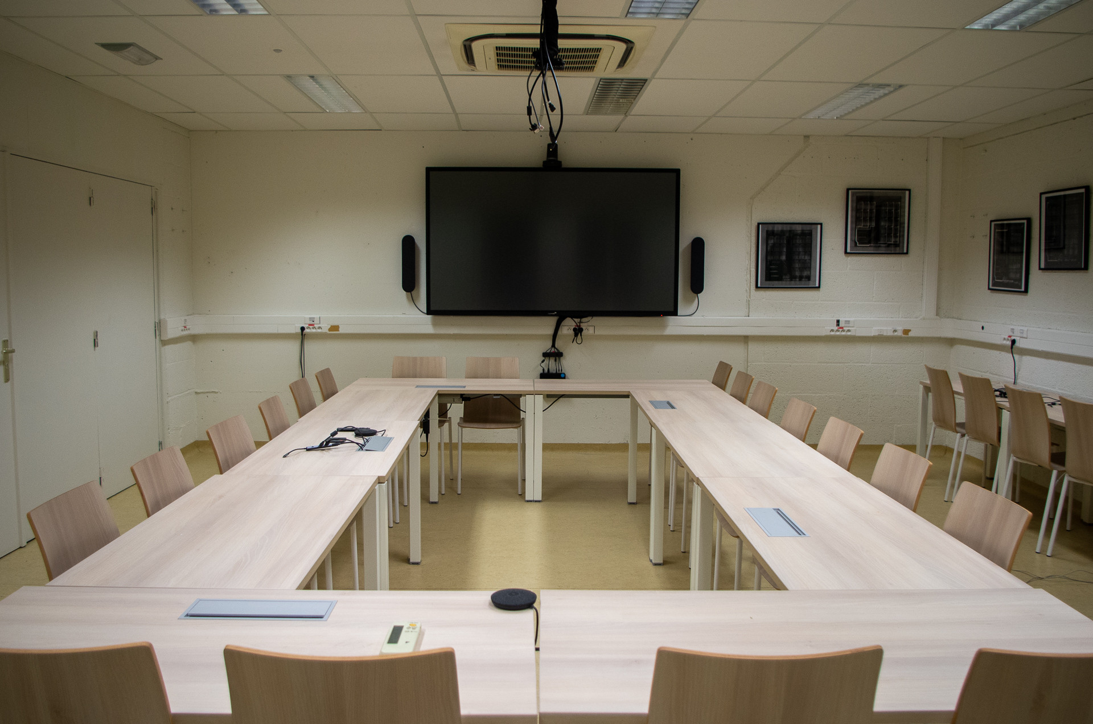
Renovations of the CMS centre and the Eurodemo rooms are done!
These rooms have been transformed into excellent meeting and lecture rooms.
CMS centre – today

Slide 10
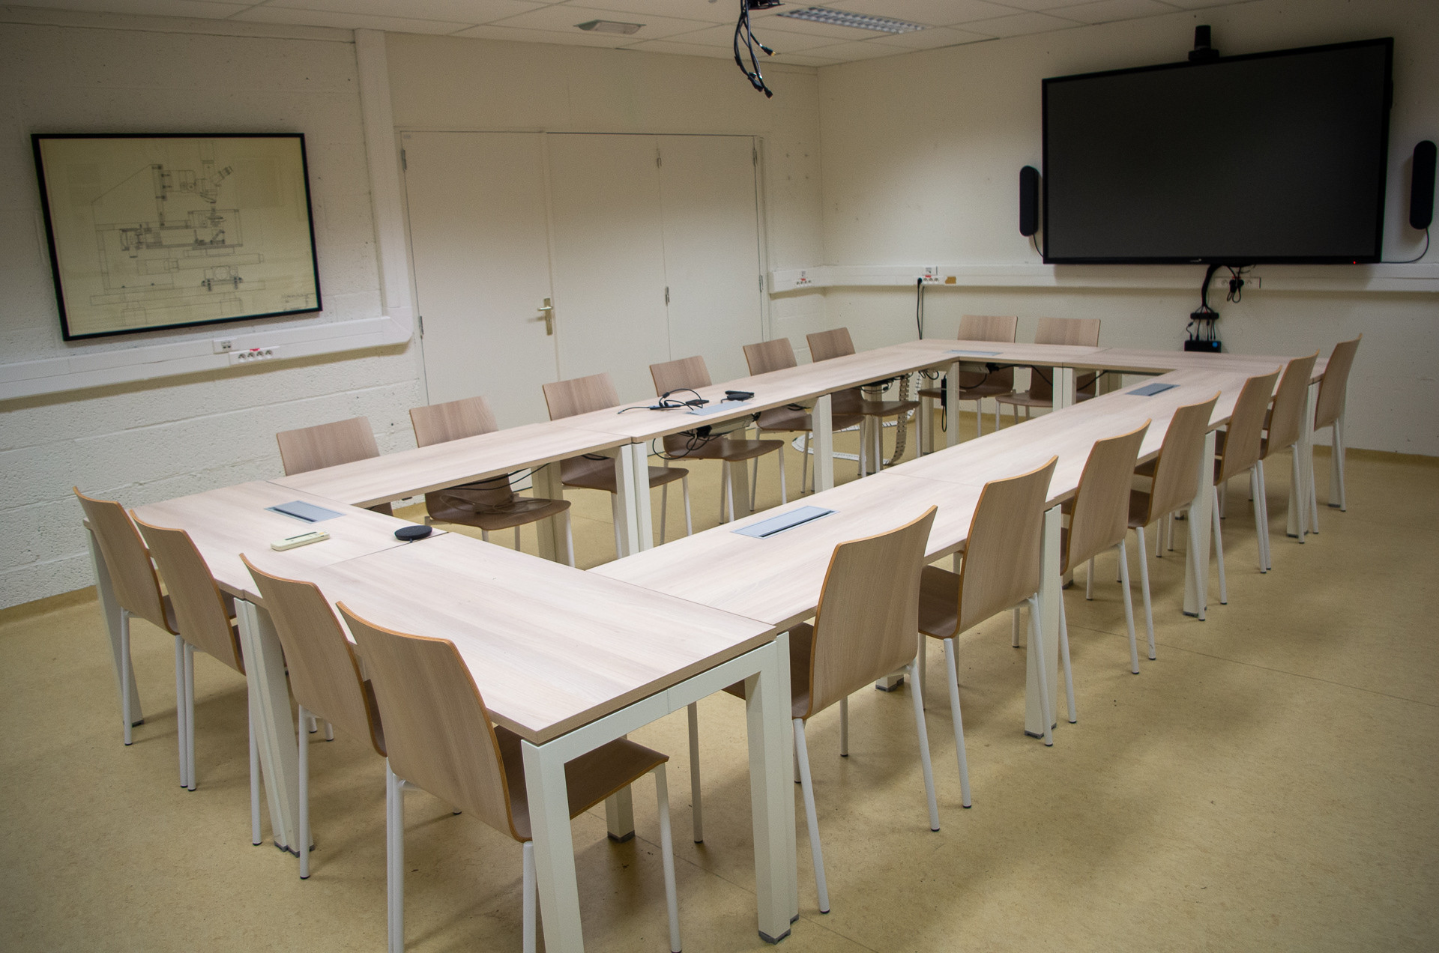
CMS centre – today
CMS centre – today
new furniture
build-in powerplugs
large e-screen
professional audio/video system

Slide 11
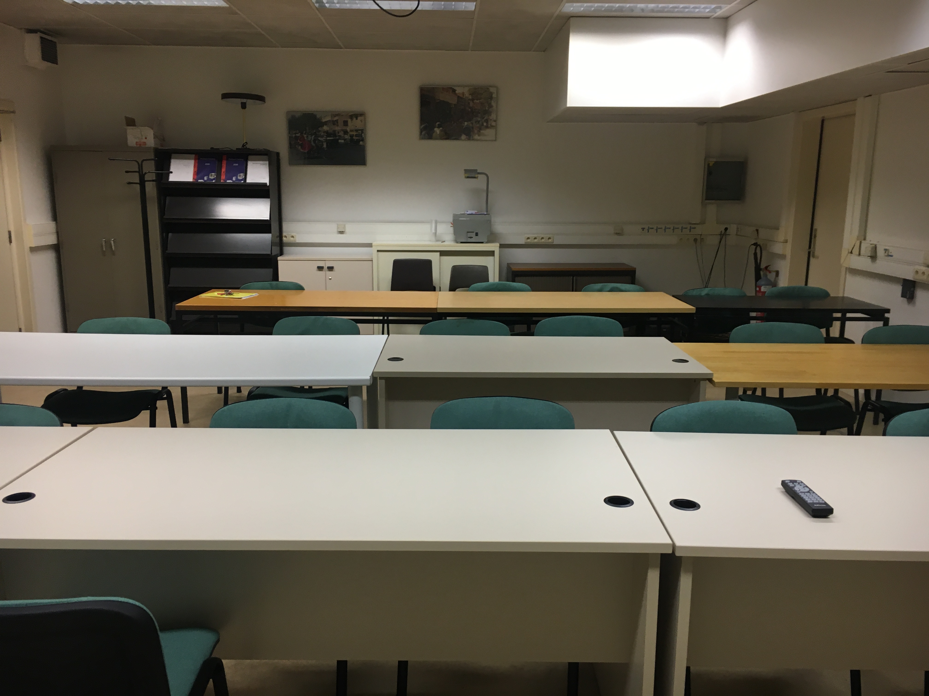
Renovations of the CMS centre and the Eurodemo rooms are done!
These rooms have been transformed into excellent meeting and lecture rooms.
Eurodemo – previously

Slide 12
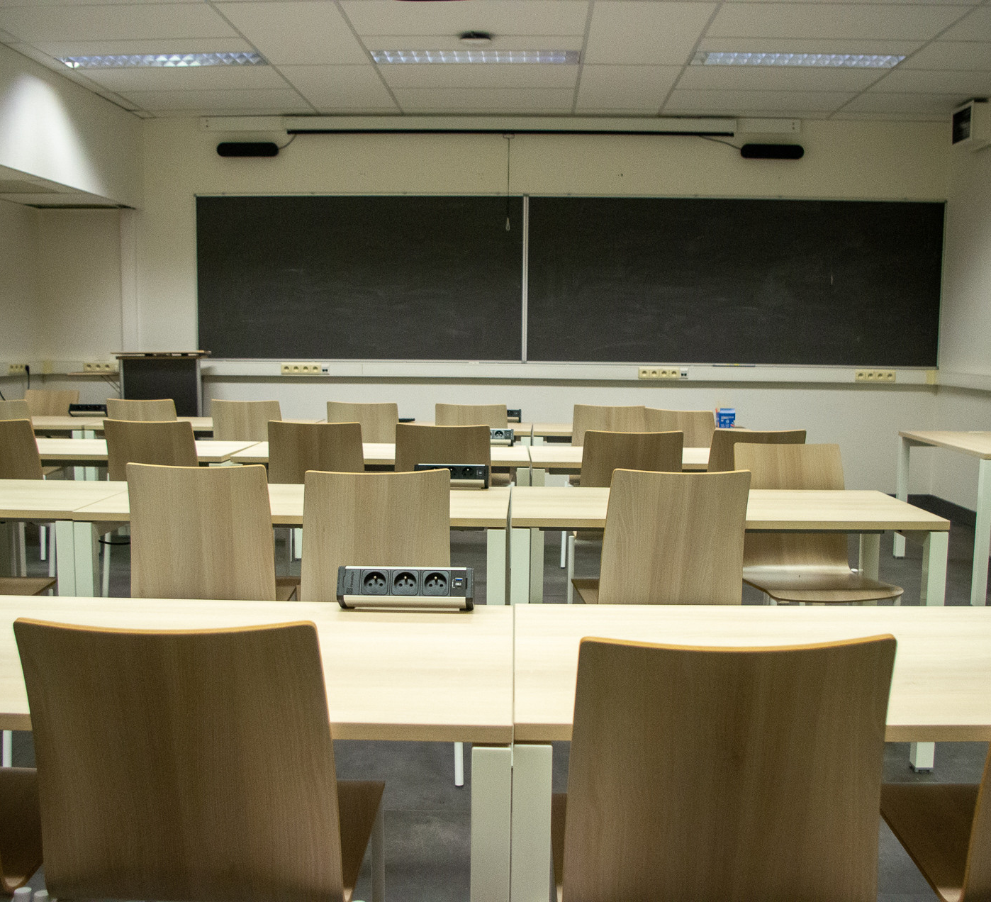
Renovations of the CMS centre and the Eurodemo rooms are done!
These rooms have been transformed into excellent meeting and lecture rooms.
Eurodemo – today

Slide 13
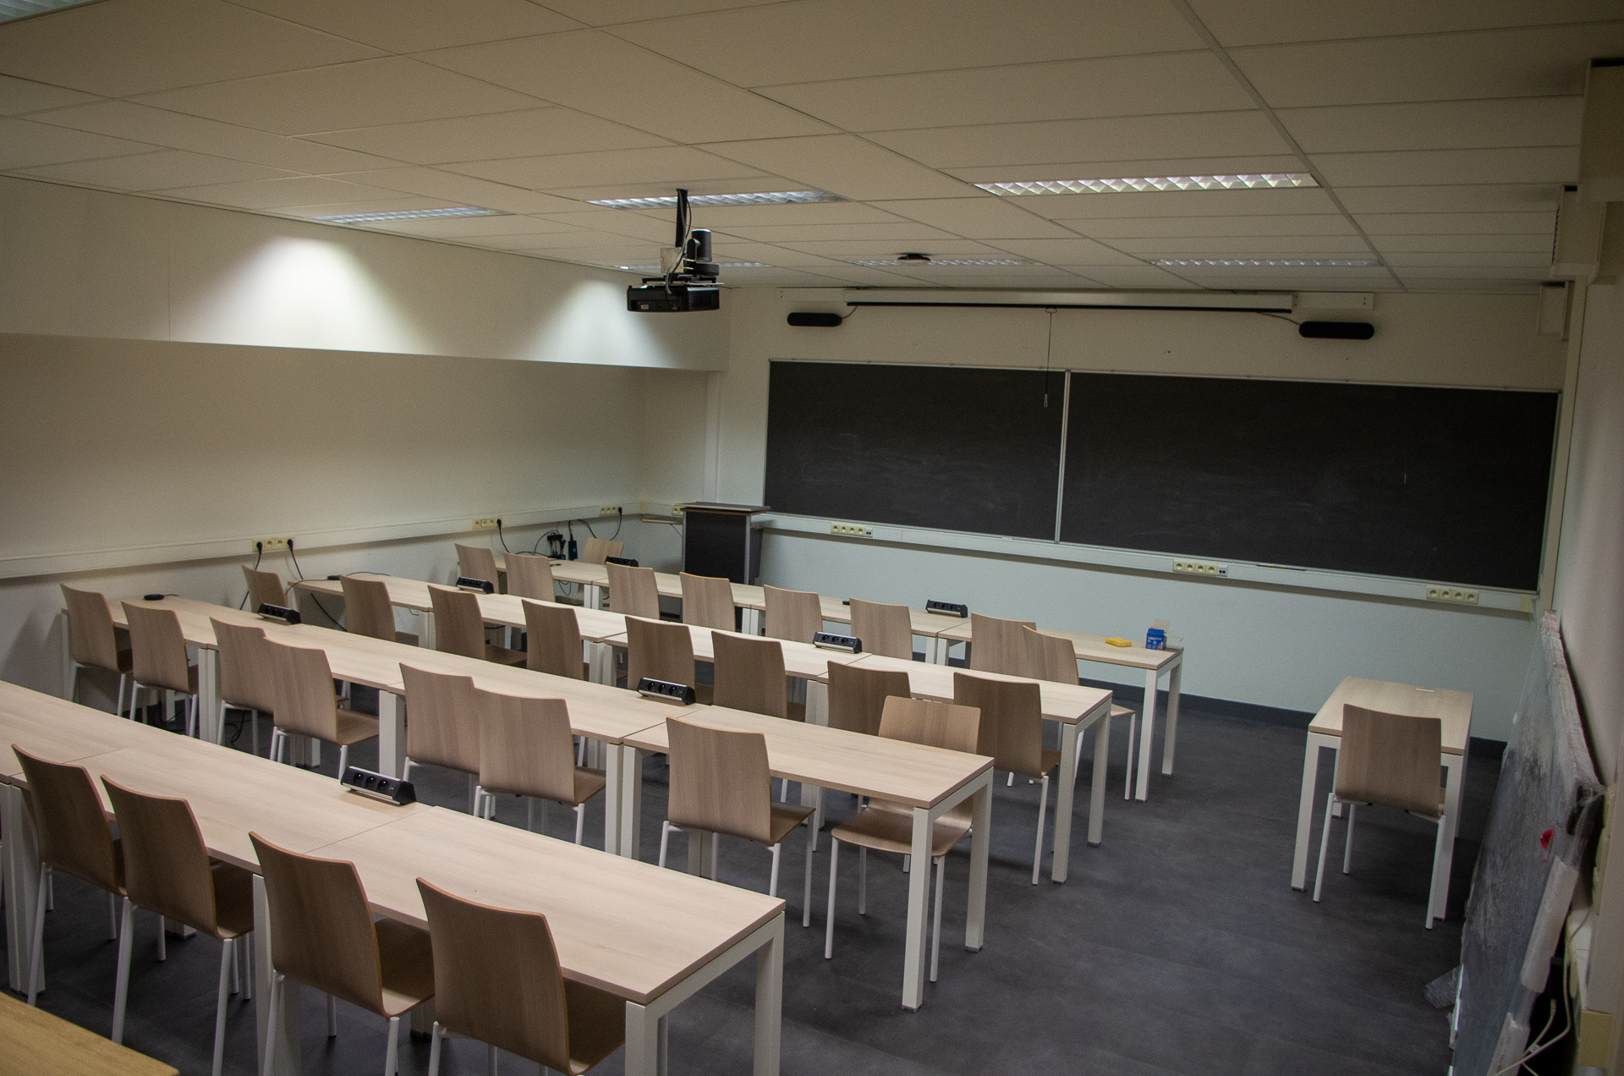
Eurodemo – today
new floor & ceiling
repainted
new furniture
teacher standing desk
build-on powerplugs
new black boards
professional audio/video system
wooden high-table (similar to social room)

Slide 14
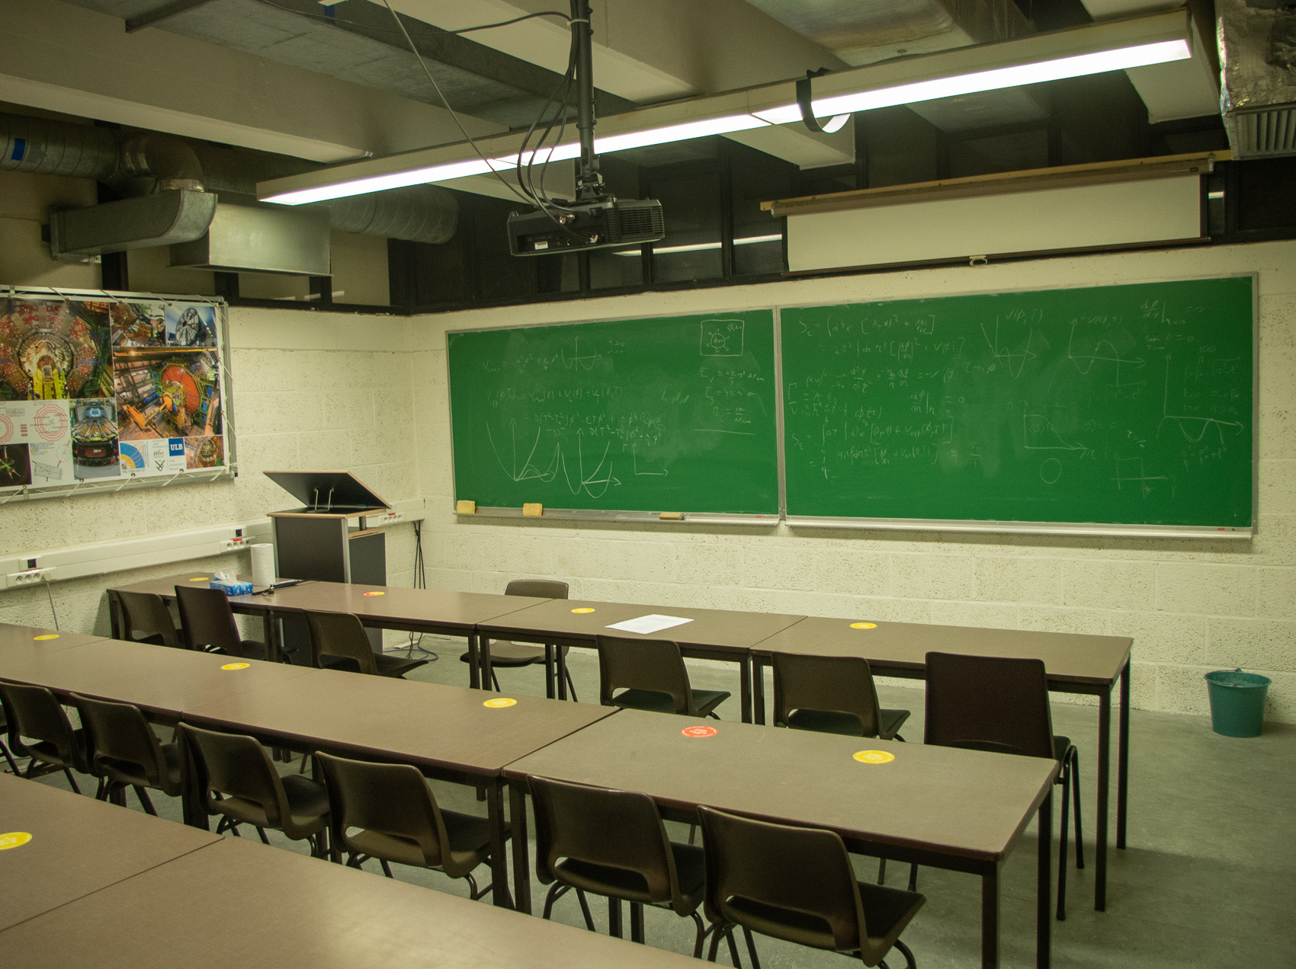
Additionally, the Jacques Lemonne and Jean Sacton rooms on the 1G level look much nicer today!
Jacques Lemonne room – today
teacher standing desk

Slide 15
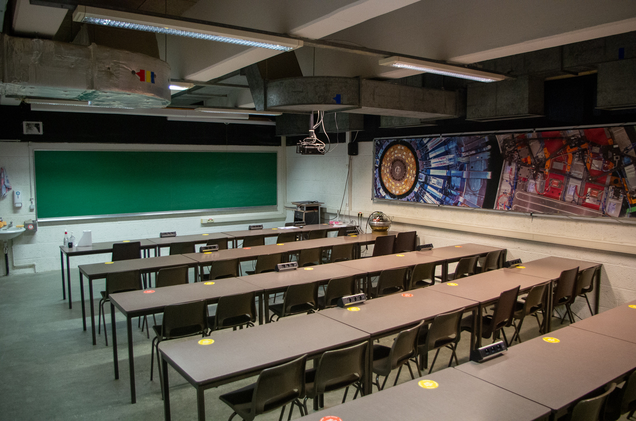
Additionally, the Jacques Lemonne and Jean Sacton rooms on the 1G level look much nicer today!
Jean Sacton room – today
teacher standing desk
build-on powerplugs

Slide 16
Renovations of the CMS centre and the Eurodemo rooms are done!
These rooms have been transformed into excellent meeting and lecture rooms.
The IIHE has a very long and succesful tradition in neutrino research with neutrinos both from beams and from the cosmos.
New names!
Neutrino Room
Eurodemo
CMS centre
Z Room
At the IIHE one of the first weak neutral current interactions was discovered in the analysis of bubble-chamber pictures of the Gargamelle experiment.

Slide 17
Renovations of the CMS centre and the Eurodemo rooms are done!
These rooms have been transformed into excellent meeting and lecture rooms.
The IIHE has a very long and succesful tradition in neutrino research with neutrinos both from beams and from the cosmos.
New names!
Neutrino Room
Eurodemo
Great thanks especially to
Adriano, Audrey, Olivier, Patrick, Sofie
CMS centre
Z Room
At the IIHE one of the first weak neutral current interactions was discovered in the analysis of bubble-chamber pictures of the Gargamelle experiment.

Slide 18


Important milestone in 2022
50

Slide 19
Our science

Slide 20
Slides Barbara

Slide 21
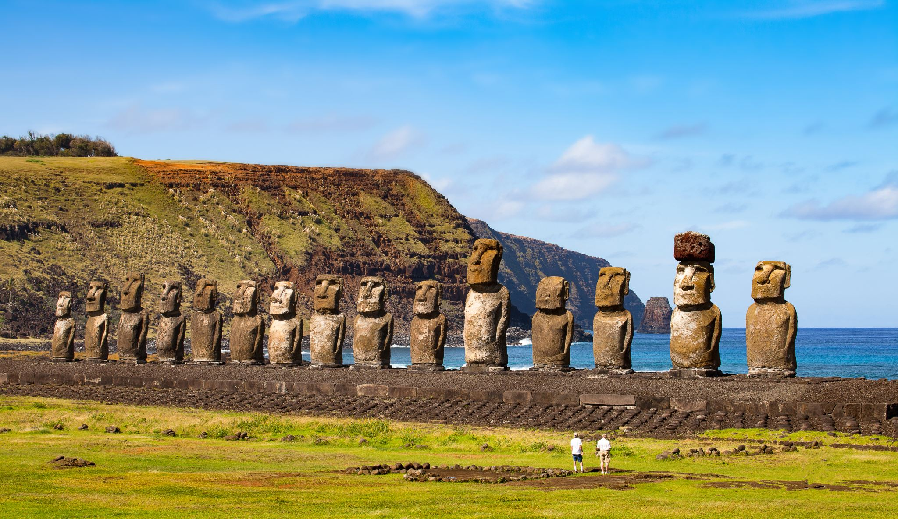
Many newcomers
We had many newcomers in 2021

Slide 22
Slides Barbara

Slide 23
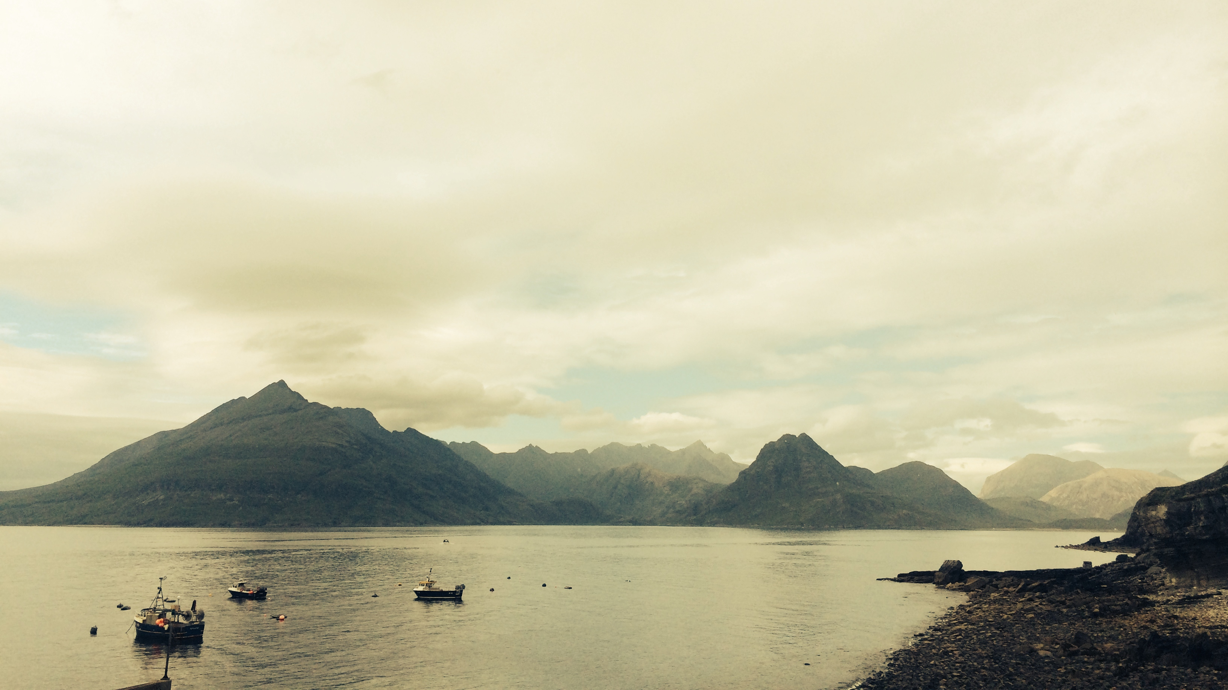
Inspiration for the End-of-the-Year break

Slide 24
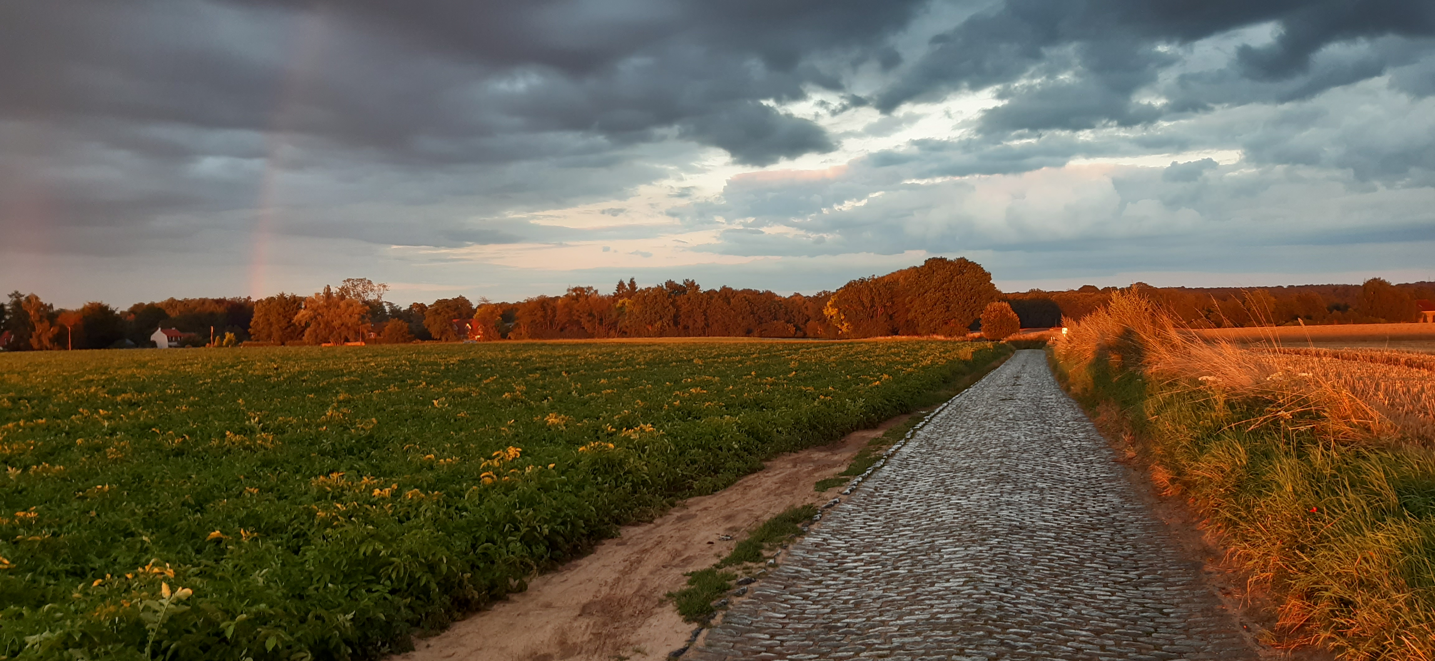
Krijn de Vries

Slide 25
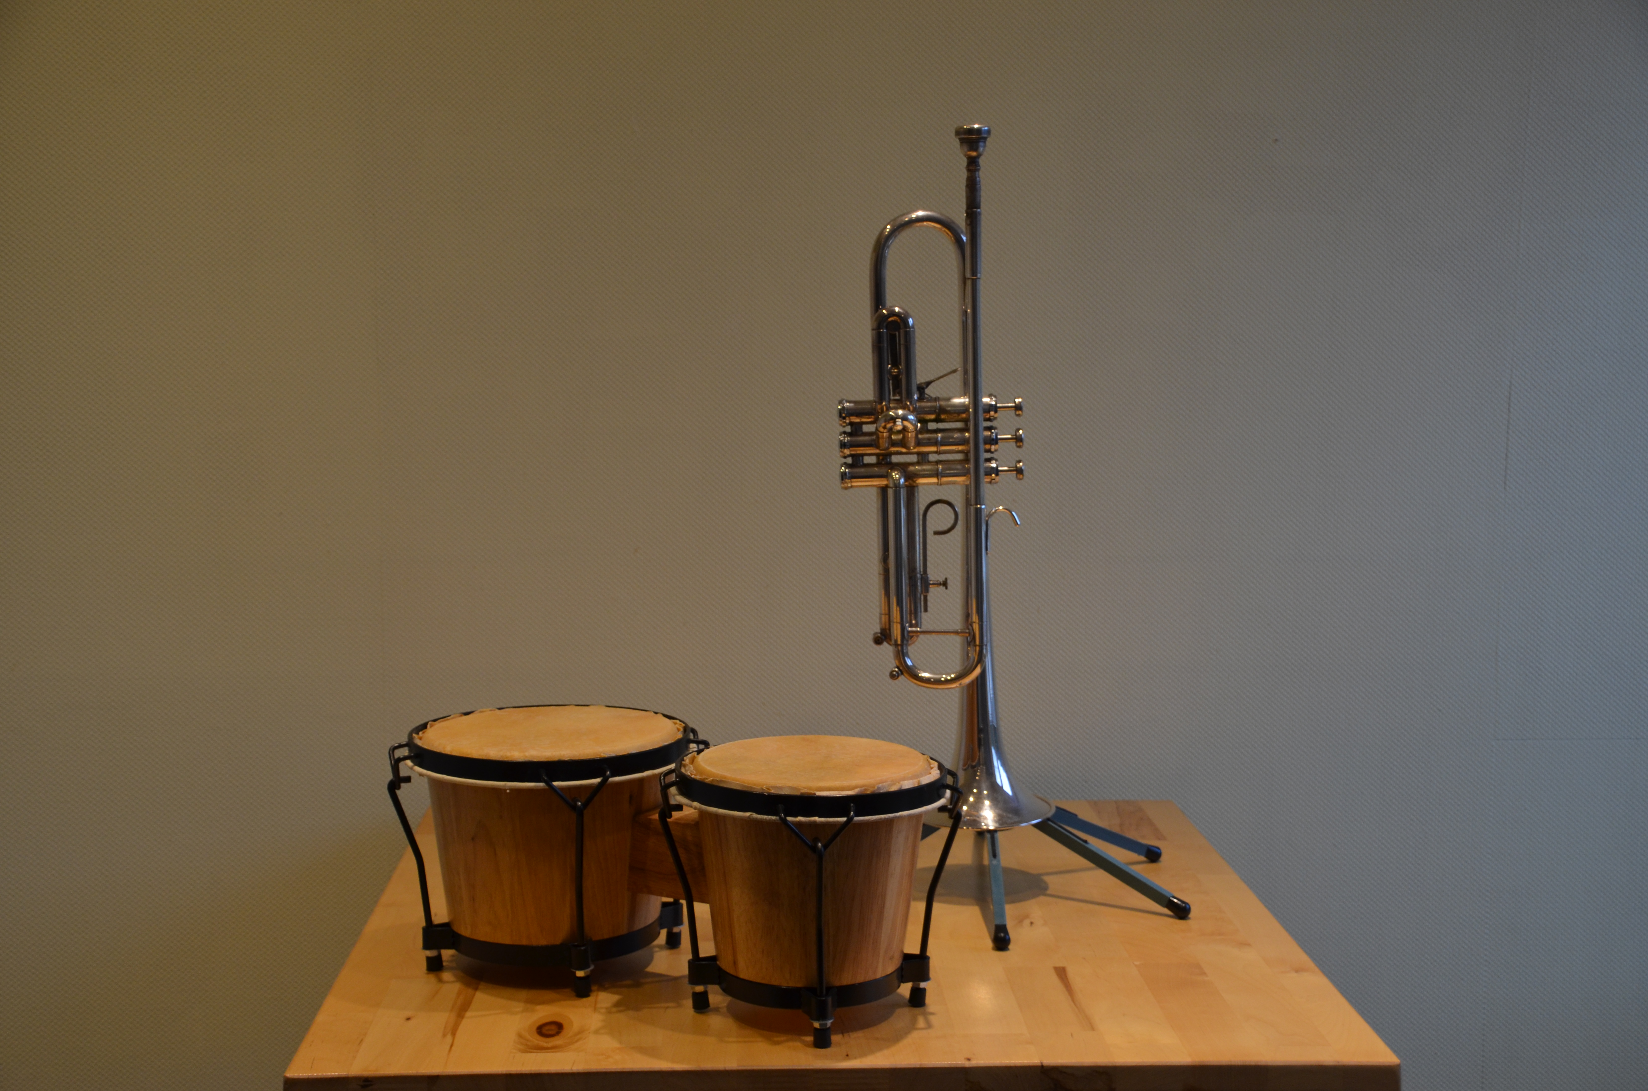
Nick van Eijndhoven

Slide 26
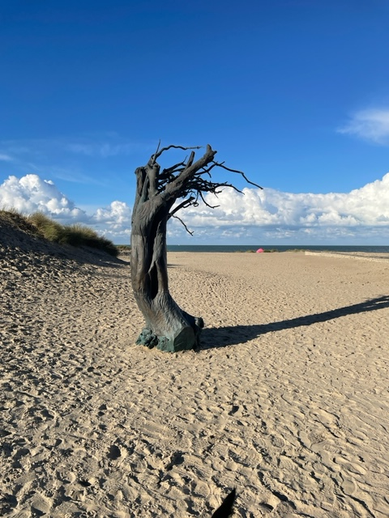
Sofie Van den Bussche

Slide 27
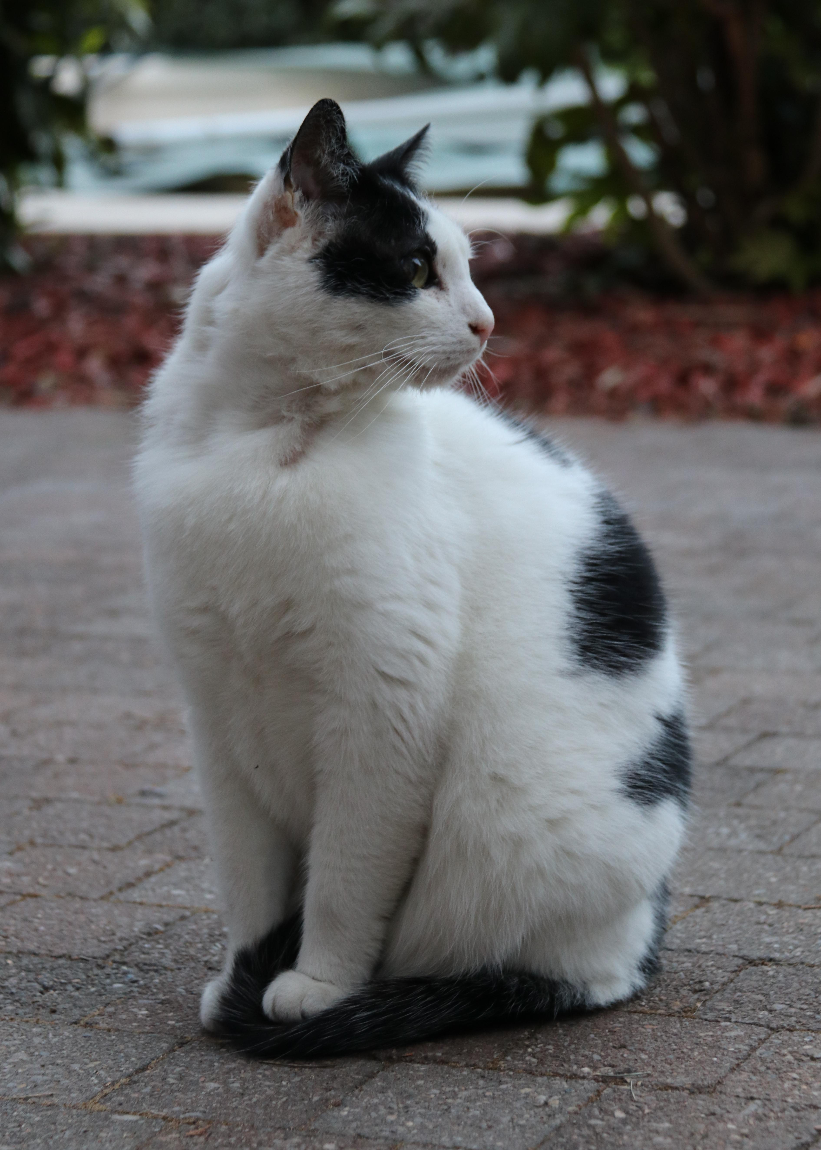
Martin Delcourt

Slide 28
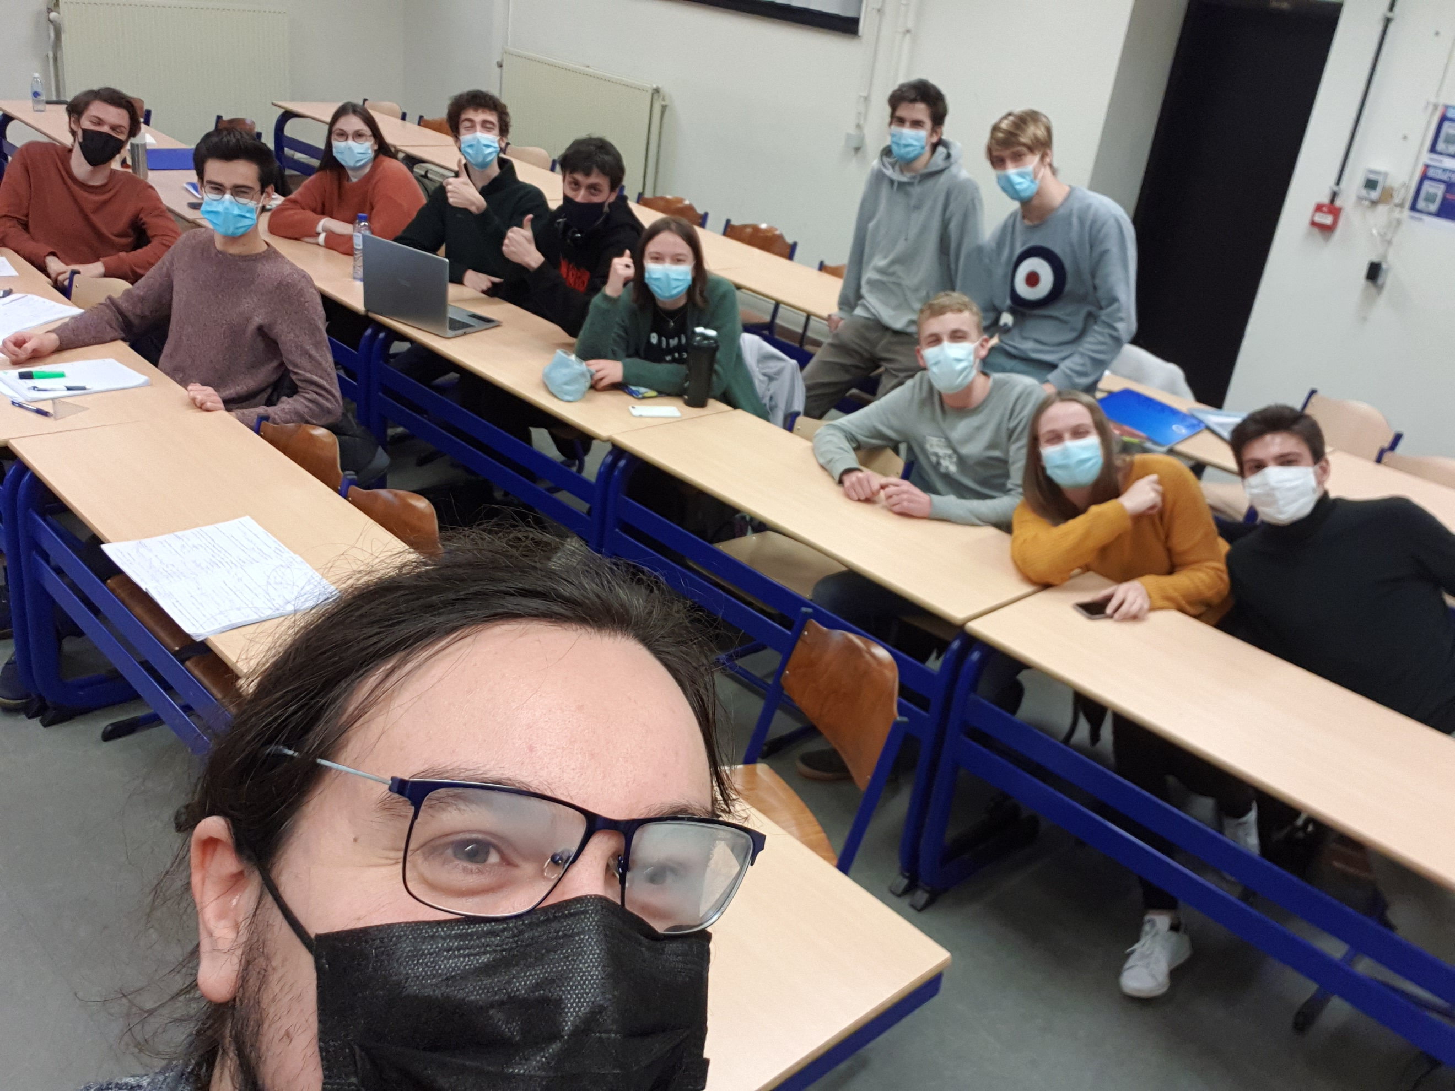
Dieder Van den Broeck

Slide 29
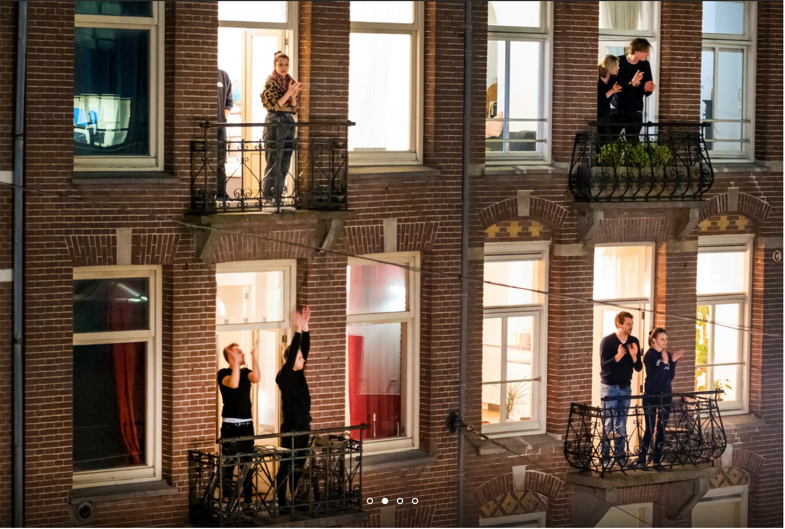
Annemie Morel

Slide 30
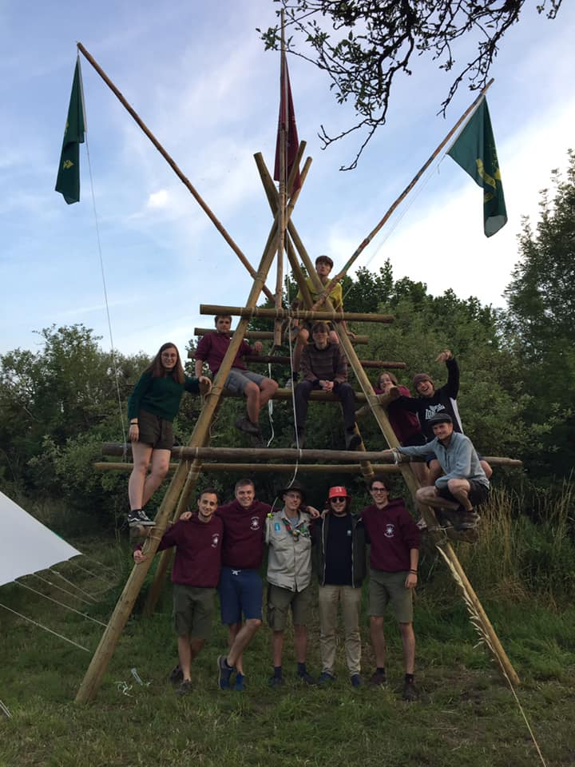
Mitja Desmet

Slide 31
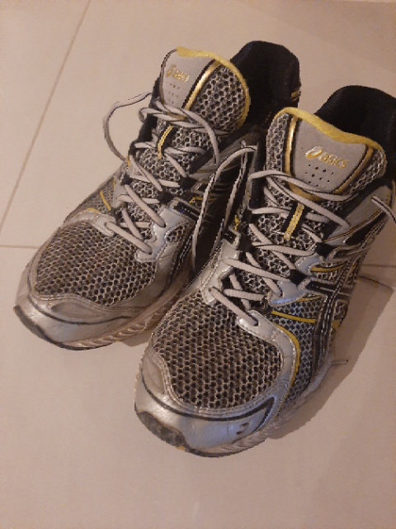
Steven Lowette

Slide 32
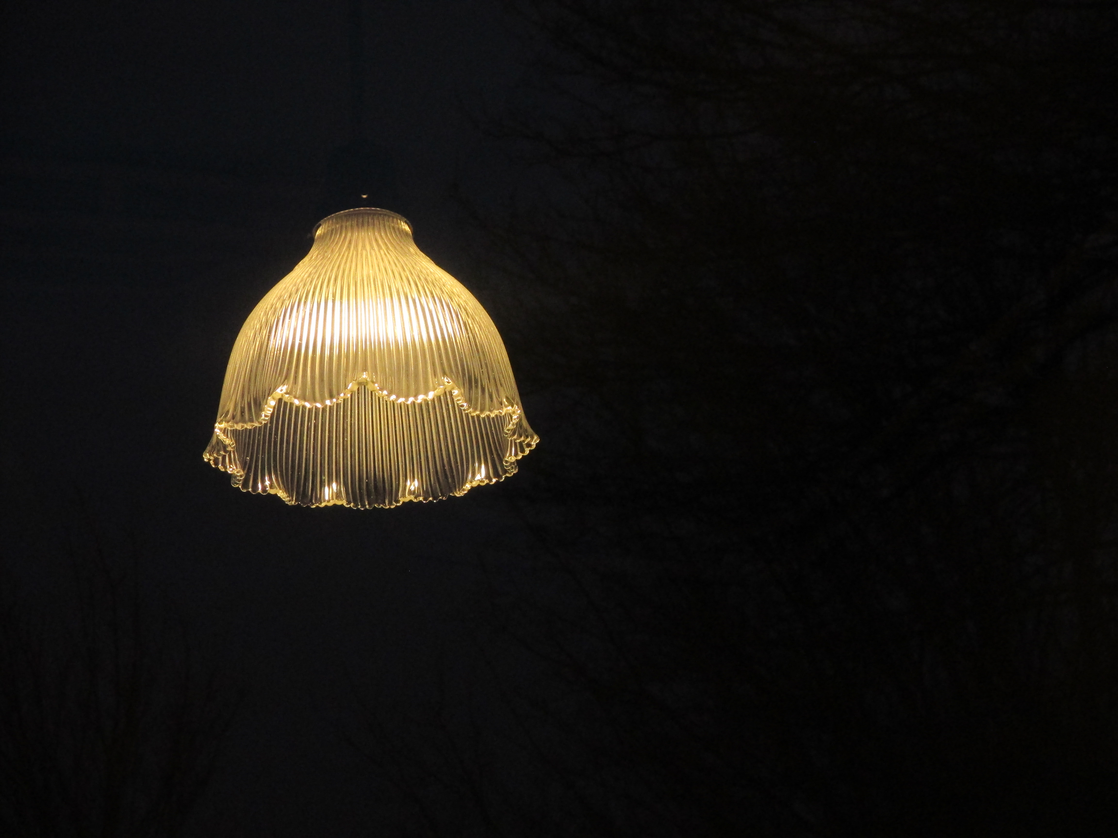
Yannick Allard

Slide 33
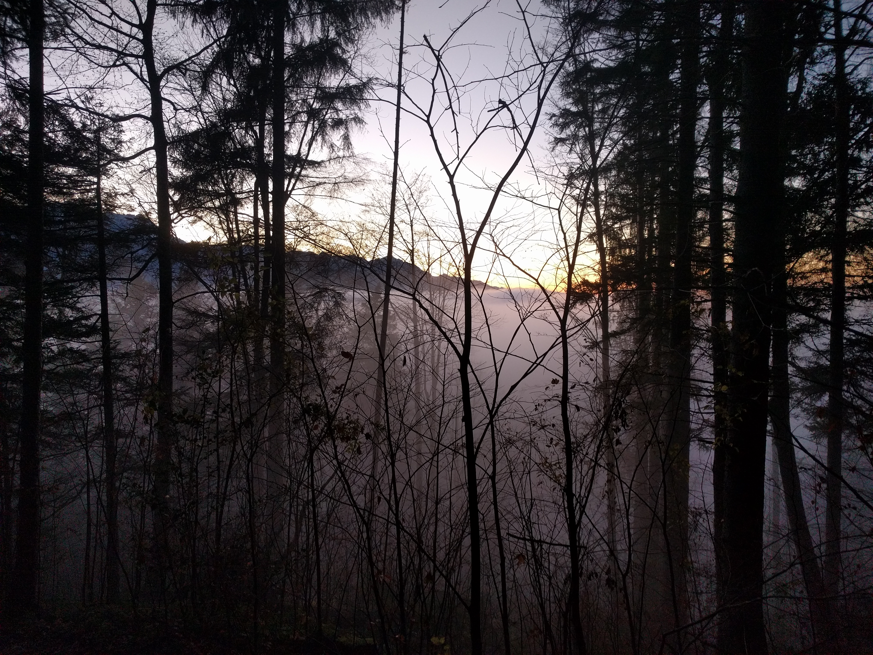
Eduardo Plorer

Slide 34
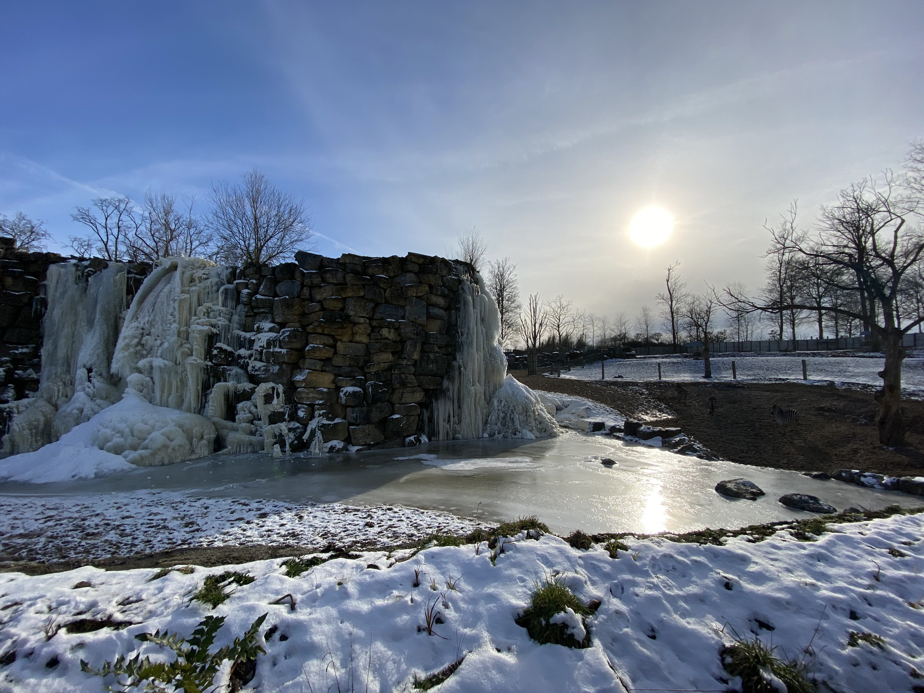
Yifan Yang

Slide 35
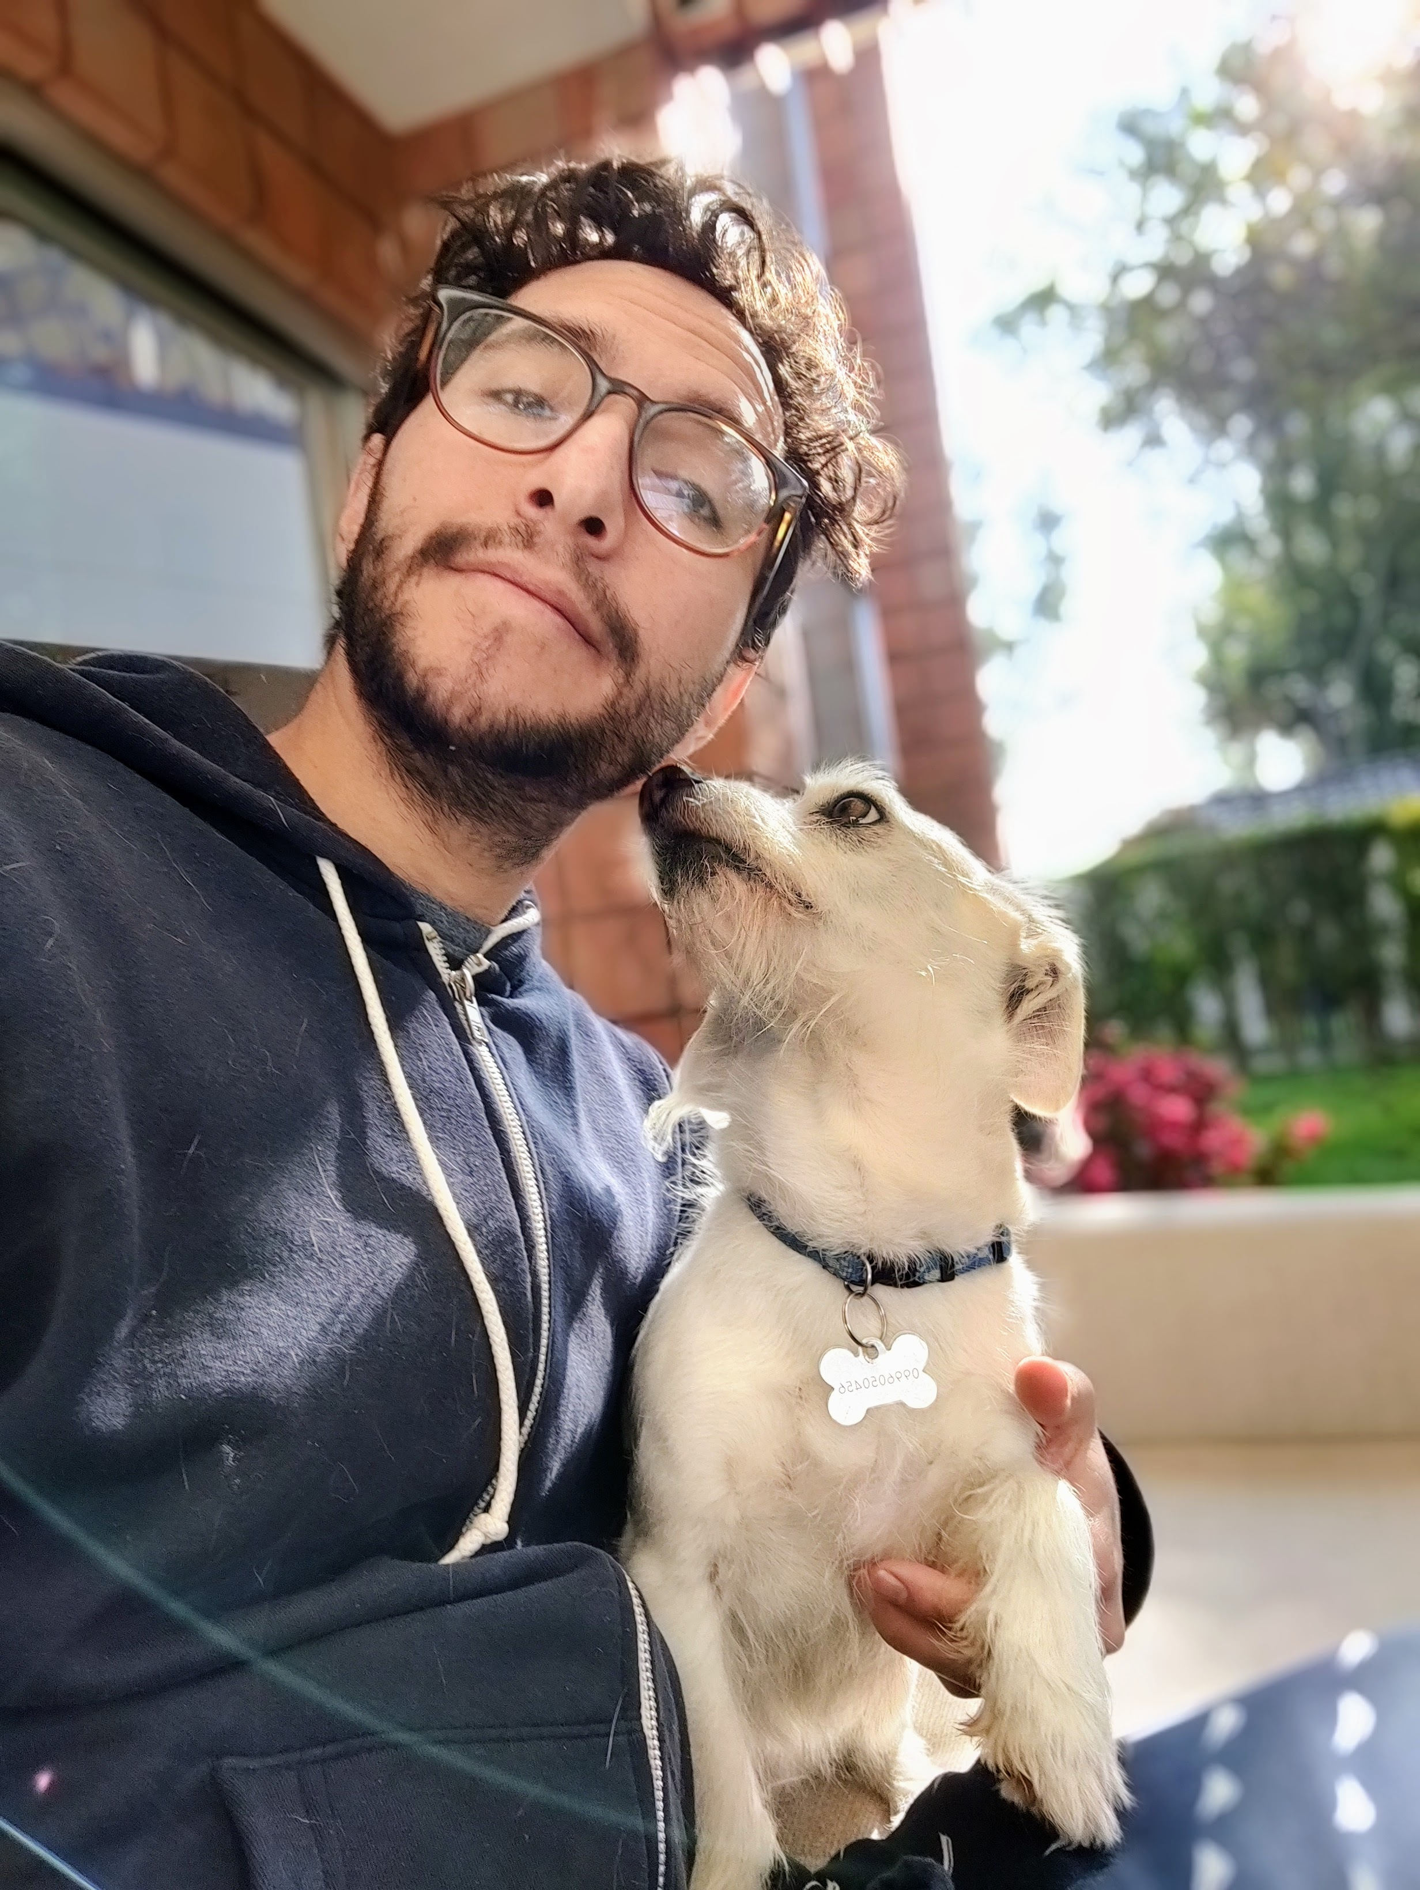
Santiago Paredes

Slide 36
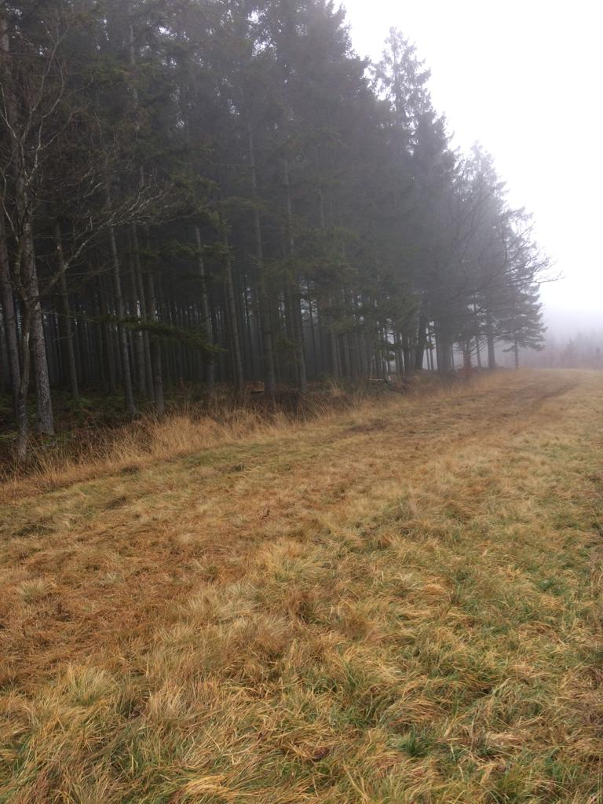
Patrick De Harenne

Slide 37
Barbara Clerbaux

Slide 38
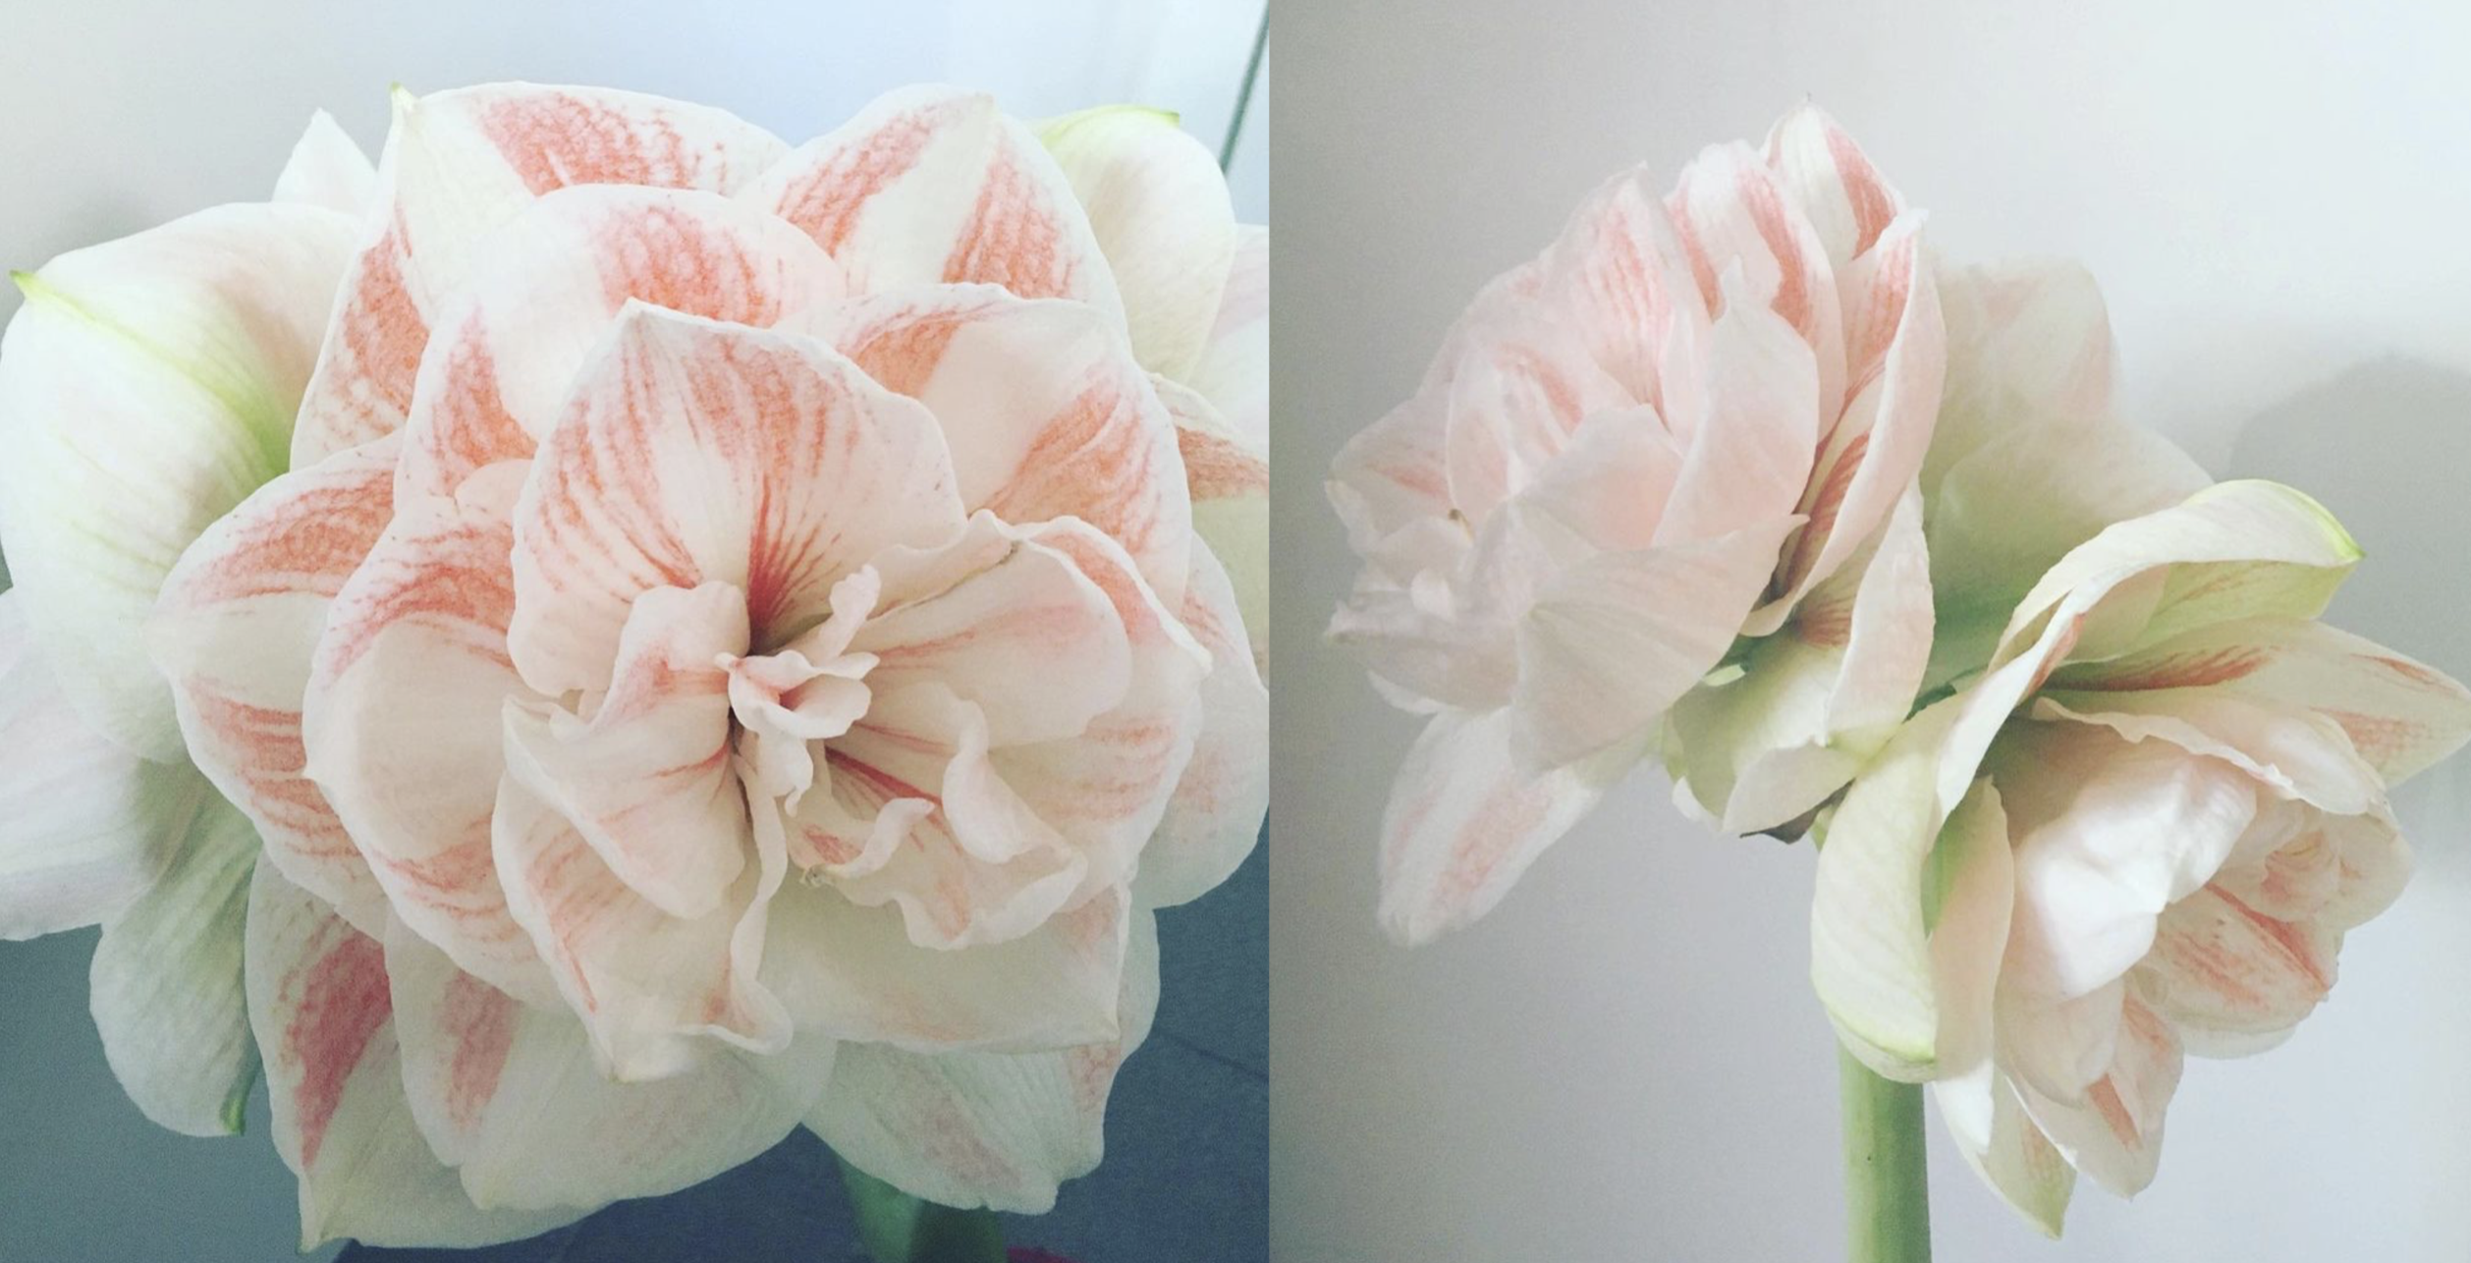
Inna Makarenko

Slide 39
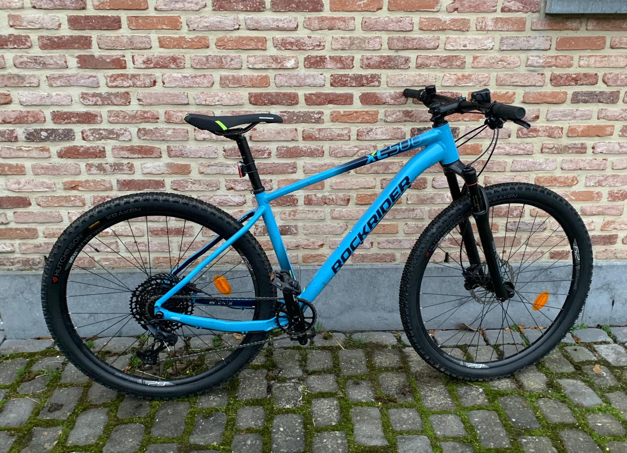
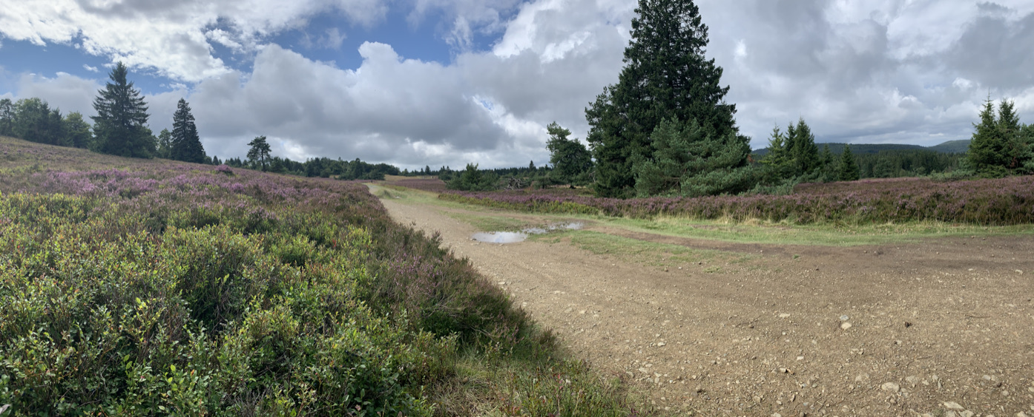
Jorgen D’Hondt

Slide 40

Thank you!
enjoy a well-deserved break and see you in 2022

