Slide 1



Future Collider Projects
Jorgen D’Hondt
Vrije Universiteit Brussel

Slide 2
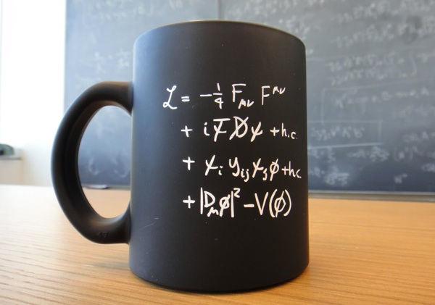
The quest for understanding particle physics
Wonderful description of fundamental interactions
  e.g. The Standard Models of Particle Physics and Cosmology together do not describe all our observations of the universe.
“Problems and Mysteries”
e.g. Abundance of dark matter?
Abundance of matter over antimatter?
Scale of things (EW hierarchy problem / strong CP problem)?
Pattern of fermion masses and mixings?
Dynamics of EW symmetry breaking?…
[Riccardo Rattazzi]
Picture from Flip Tanedo @ Quantum Dairies

Slide 3
The quest for understanding particle physics
Wonderful description of fundamental interactions
  e.g. The Standard Models of Particle Physics and Cosmology together do not describe all our observations of the universe.
“Problems and Mysteries”
e.g. Abundance of dark matter?
Abundance of matter over antimatter?
Scale of things (EW hierarchy problem / strong CP problem)?
Pattern of fermion masses and mixings?
Dynamics of EW symmetry breaking?…
[Riccardo Rattazzi]
Picture from Flip Tanedo @ Quantum Dairies
Important research in ph & th relates these to a portfolio of concrete observable phenomena at colliders and elsewhere
In many cases synergies emerge between astro(particle), cosmology, nuclear and particle physics

Slide 4
The quest for understanding particle physics
Wonderful description of fundamental interactions
  e.g. The Standard Models of Particle Physics and Cosmology together do not describe all our observations of the universe.
“Problems and Mysteries”
e.g. Abundance of dark matter?
Abundance of matter over antimatter?
Scale of things (EW hierarchy problem / strong CP problem)?
Pattern of fermion masses and mixings?
Dynamics of EW symmetry breaking?…
[Riccardo Rattazzi]
Picture from Flip Tanedo @ Quantum Dairies
Observations of new physics phenomena are expected
to unlock concrete ways to address these puzzling unknowns

Slide 5
Three frontiers on the collider route to BSM
Energy
Accelerator R&D – Vladimir Shiltsev
Detector R&D – Paula Collins
Computing and Software – James Catmore
Theory – Fabio Maltoni & Eric Kuflik
Intensity
Precision
(exp & th)
Extending these collider frontiers remains our prime route to
those BSM phenomena related to the most important open questions

Slide 6
Three frontiers on the collider route to BSM
Energy
Accelerator R&D – Vladimir Shiltsev
Detector R&D – Paula Collins
Computing and Software – James Catmore
Theory – Fabio Maltoni & Eric Kuflik
Intensity
Precision
(exp & th)
Extending these collider frontiers remains our prime route to unlock those BSM phenomena related to the most important open questions

Slide 7
Congratulations to SuperKEKB!
world record luminosity
2.4 10³⁴ cm⁻²s⁻¹ (June 2020)
(ultimate target 8 10³⁵ cm⁻²s⁻¹)
1st ever nano-beam scheme
e⁺e⁻ collider at the Y(4S)≈10.5GeV
B-Factory for the Belle II experiment
Y. Ohnishi
Note: SuperKEKB takes over the luminosity record from the LHC

Slide 8
Congratulations to SuperKEKB!
world record luminosity
2.4 10³⁴ cm⁻²s⁻¹ (June 2020)
(ultimate target 8 10³⁵ cm⁻²s⁻¹)
1st ever nano-beam scheme
e⁺e⁻ collider at the Y(4S)≈10.5GeV
B-Factory for the Belle II experiment
Ambition expressed to achieve 70% polarized e⁻ beams for precision measurements of EW parameters and via the running of sin²θ_{W} from Z⁰ to 10.5 GeV access to new physics
Michael Roney
Y. Ohnishi
Note: SuperKEKB takes over the luminosity record from the LHC

Slide 9
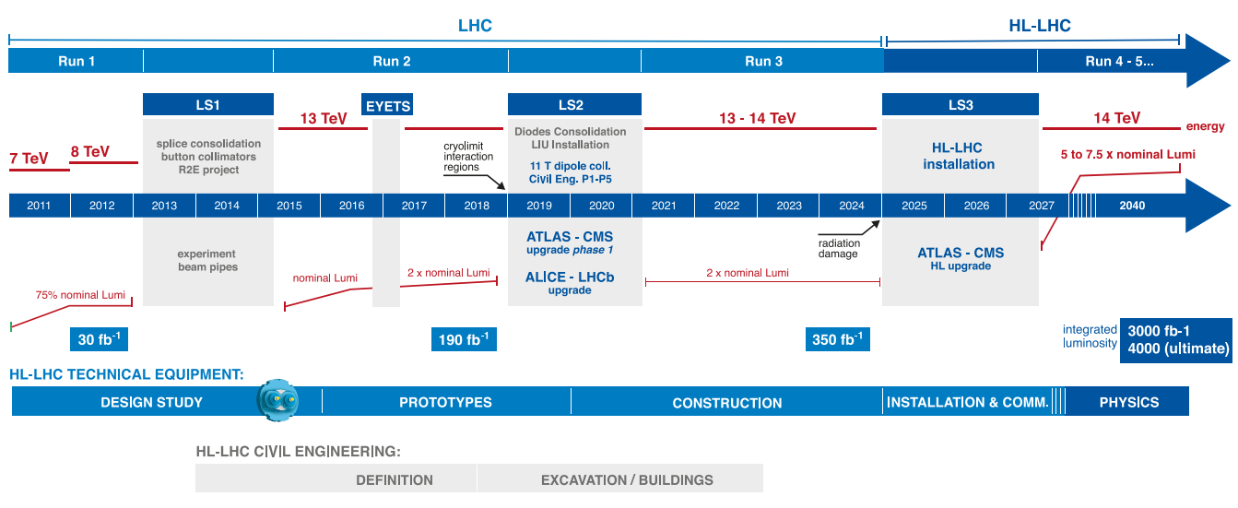
From the LHC to the High-Luminosity LHC @ CERN
ICHEP 2028
1st HL-LHC results
ICHEP 2012
H discovery
ICHEP 2020
Lukáš Malina

Slide 10
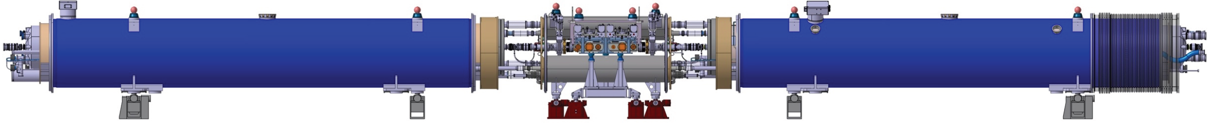
From the LHC to the High-Luminosity LHC @ CERN
excavation mostly done
successfully tested (US)
production ongoing
successfully tested at SPS (CERN)
ongoing tests on bench, some qualified (CERN)
60m system demonstrator
successful (CERN)
[CERN Courier]

Slide 11
From the LHC to the High-Luminosity LHC @ CERN
excavation mostly done
successfully tested (US)
production ongoing
successfully tested at SPS (CERN)
ongoing tests on bench, some qualified (CERN)
60m system demonstrator
successful (CERN)
[CERN Courier]

Slide 12
From the LHC to the High-Luminosity LHC @ CERN
Constraining the parameters of the unitary CKM matrix (not predicted by the SM) will provide an extremely precise test of the paradigm, and through loop corrections a powerful sensitivity to BSM physics (figure from LHCb only)
Expected improvement from LHC and Belle II (table)
In general, not limited by experimental or theoretical systematic uncertainties
Sensitivity to BSM up to 10³-10⁶ TeV assuming 𝒪(1) coupling strength, depending on flavour
Addressing significantly the flavour puzzle question
2018
[Physics case for an LHCb Upgrade II, https://arxiv.org/pdf/1808.08865.pdf]
LHC (23fb⁻¹)
[arXiv:1812.07638v2]
HL-LHC
(300fb⁻¹)

Slide 13
From the LHC to the High-Luminosity LHC @ CERN
The Higgs couplings are expected to improve significantly with the HL-LHC data
The estimate made in 2013 for κ_{t} was a precision of 7-10% with 3000fb⁻¹, while now a value better than 4% seems reachable (for the same integrated luminosity)
With only 6 years of experimental and theoretical innovations a factor of 2 improvement, and yet 20 years to go into the research program
Recent innovations in instrumentation, software, computing, analysis and theoretical reasoning unlocked several new avenues for research that were previously thought unreachable…
[Physics Briefing Book, http://cds.cern.ch/record/2691414]
The HL-LHC is an outstanding platform for innovations!

Slide 14
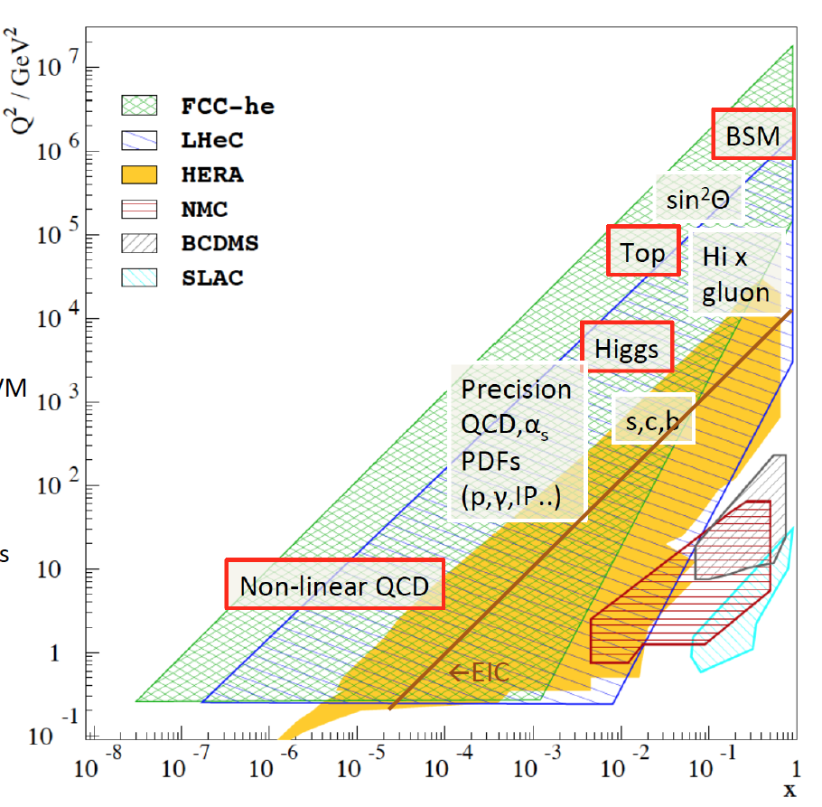
Empowering the HL-LHC program with the LHeC
LHeC (up to 60 GeV e⁻ from Energy Recovery Linac)
E_{cms} = 0.2 – 1.3 TeV, (Q²,x) range far beyond HERA
run with the HL-LHC (≳ Run5)
ERL R&D demonstrator at Orsay, PERLE
B.J. Holzer, U. Klein, G. Azuelos, H. Mäntysaari, D. Britzger, C. Gwenlan, …
up to 10x improvements of PDF/α_{s} syst. uncertainties in Higgs production cross sections at HL-LHC
[updated CDR submitted: https://arxiv.org/abs/2007.14491]

Slide 15
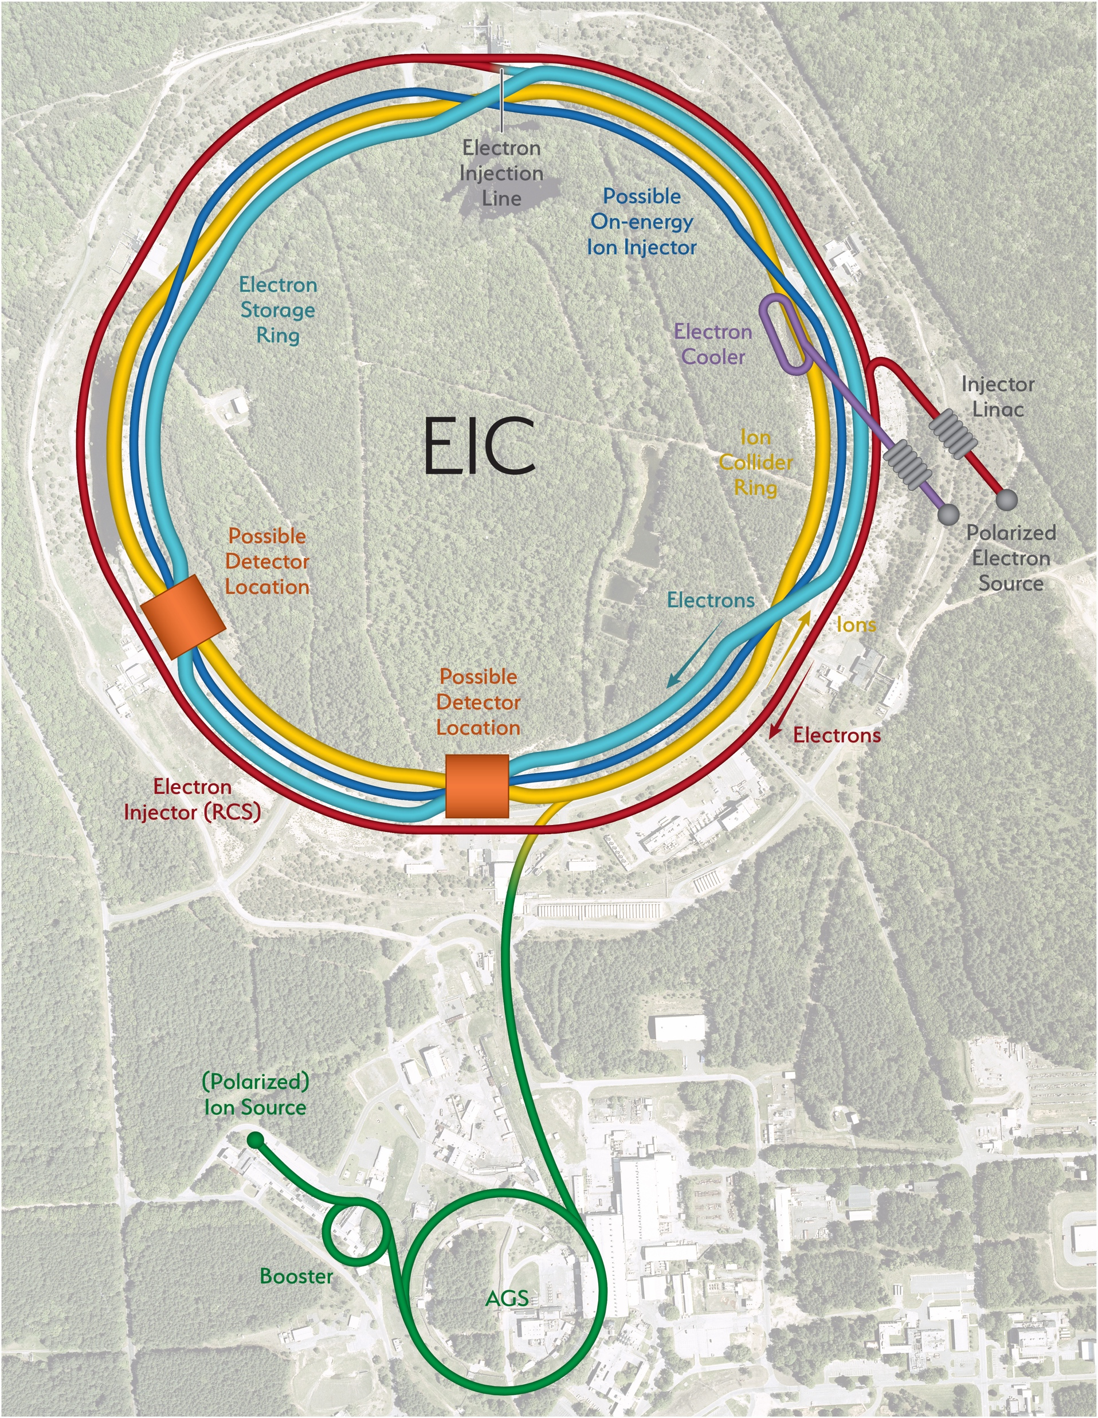
Electron-Ion Collider (EIC)
World’s 1st polarized e-p/light-ion & 1st eA collider
User Group >1000 members: http://eicug.org
The EIC can address three key questions.
How does the mass of the nucleon arise?
How does the spin of the nucleon arise?
What are the emergent properties of a dense system of gluons?
Towards a 3D partonic image of the proton
(spin-dependent transverse momentum distributions)
BNL (US)
beams from ∼2030
S. Joosten

Slide 16
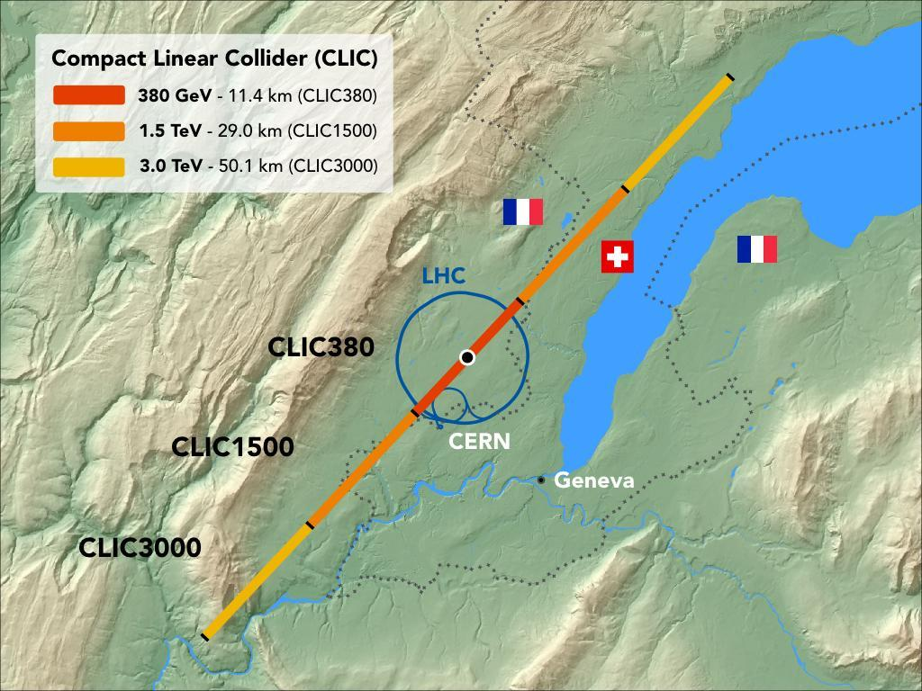
e⁺e⁻ Higgs Factories
P. Burrows, M. Weber, P. Roloff, …
D. d’Enterria, A. Blondel, P. Janot, …
4y @ M_{Z} (150ab⁻¹)
1-2y @ 2xM_{W} (10ab⁻¹)
3y @ 240 GeV (5ab⁻¹)
5y @ 2xm_{t} (1.5ab⁻¹)
8 years (1ab⁻¹)
𝒫(e⁻/e⁺) = ±80%/0%
circular
colliders
linear
colliders
CLIC@CERN [380 GeV]
FCC-ee@CERN [90-365 GeV]
ILC@Japan [250 GeV]
CEPC@China [90-240-(350) GeV]
11.5 years (2ab⁻¹)
𝒫(e⁻/e⁺) = ±80%/±30%
2y @ M_{Z} (16ab⁻¹)
1y @ 2xM_{W} (2.6ab⁻¹)
7y @ 240 GeV (5.6ab⁻¹)
J. List, M. Peskin, D. Jeans, G. Wilson, T. Núñez, …
J. Gao, M. Pandurovic, …

Slide 17
e⁺e⁻ Higgs Factories
2 IPs assumed for
circular colliders

Slide 18
e⁺e⁻ Higgs Factories
precision
frontier
circular
colliders
2 IPs assumed for
circular colliders
linear
colliders
energy
frontier
synchrotron radiation
for the same power, less luminosity at higher E_{cm}
(Energy Recovery Linac technology might mitigate this & allow to go to higher E_{cm})

Slide 19
e⁺e⁻ Higgs Factories
precision
frontier
circular
colliders
2 IPs assumed for
circular colliders
linear
colliders
energy
frontier
synchrotron radiation
for the same power, less luminosity at higher E_{cm}
(Energy Recovery Linac technology might mitigate this & allow to go to higher E_{cm})
Higgs
Top
Higgs Factories with complementarity
g_{HZZ} (250GeV) versus g_{HWW} (380GeV)
top quark physics
beam polarization for EW precision tests
(transverse polarization in circular e⁺e⁻ colliders only at lower E_{cm} while longitudinal polarization at linear colliders)

Slide 20
e⁺e⁻ Higgs Factories
precision
frontier
circular
colliders
2 IPs assumed for
circular colliders
linear
colliders
energy
frontier
synchrotron radiation
for the same power, less luminosity at higher E_{cm}
(Energy Recovery Linac technology might mitigate this & allow to go to higher E_{cm})
Higgs
Top
8.5 years (4ab⁻¹ @ 0.5 TeV)
8.5 years (8ab⁻¹ @ 1 TeV)
ILC
7 years (2.5ab⁻¹ @ 1.5 TeV)
8 years (5ab⁻¹ @ 3 TeV)
CLIC
Higgs Factories with complementarity
g_{HZZ} (250GeV) versus g_{HWW} (380GeV)
top quark physics
beam polarization for EW precision tests
(transverse polarization in circular e⁺e⁻ colliders only at lower E_{cm} while longitudinal polarization at linear colliders)

Slide 21
e⁺e⁻ Higgs Factories (incl. B/c/τ/EW/top factories)
Z
precision
frontier
circular
colliders
2 IPs assumed for
circular colliders
linear
colliders
energy
frontier
WW
synchrotron radiation
for the same power, less luminosity at higher E_{cm}
(Energy Recovery Linac technology might mitigate this & allow to go to higher E_{cm})
Higgs
Top
8.5 years (4ab⁻¹ @ 0.5 TeV)
8.5 years (8ab⁻¹ @ 1 TeV)
ILC
7 years (2.5ab⁻¹ @ 1.5 TeV)
8 years (5ab⁻¹ @ 3 TeV)
CLIC
Higgs Factories with complementarity
B/c/τ/EW Factories
g_{HZZ} (250GeV) versus g_{HWW} (380GeV)
top quark physics
beam polarization for EW precision tests
(transverse polarization in circular e⁺e⁻ colliders only at lower E_{cm} while longitudinal polarization at linear colliders)
per detector in e⁺e⁻ | # Z | # B | # τ | # charm | # WW
LEP | 4 x 10⁶ | 1 x 10⁶ | 3 x 10⁵ | 1 x 10⁶ | 2 x 10⁴
SuperKEKB | - | 10¹¹ | 10¹¹ | 10¹¹ | -
FCC-ee | 2.5 x 10¹² | 7.5 x 10¹¹ | 2 x 10¹¹ | 6 x 10¹¹ | 1.5 x 10⁸

Slide 22
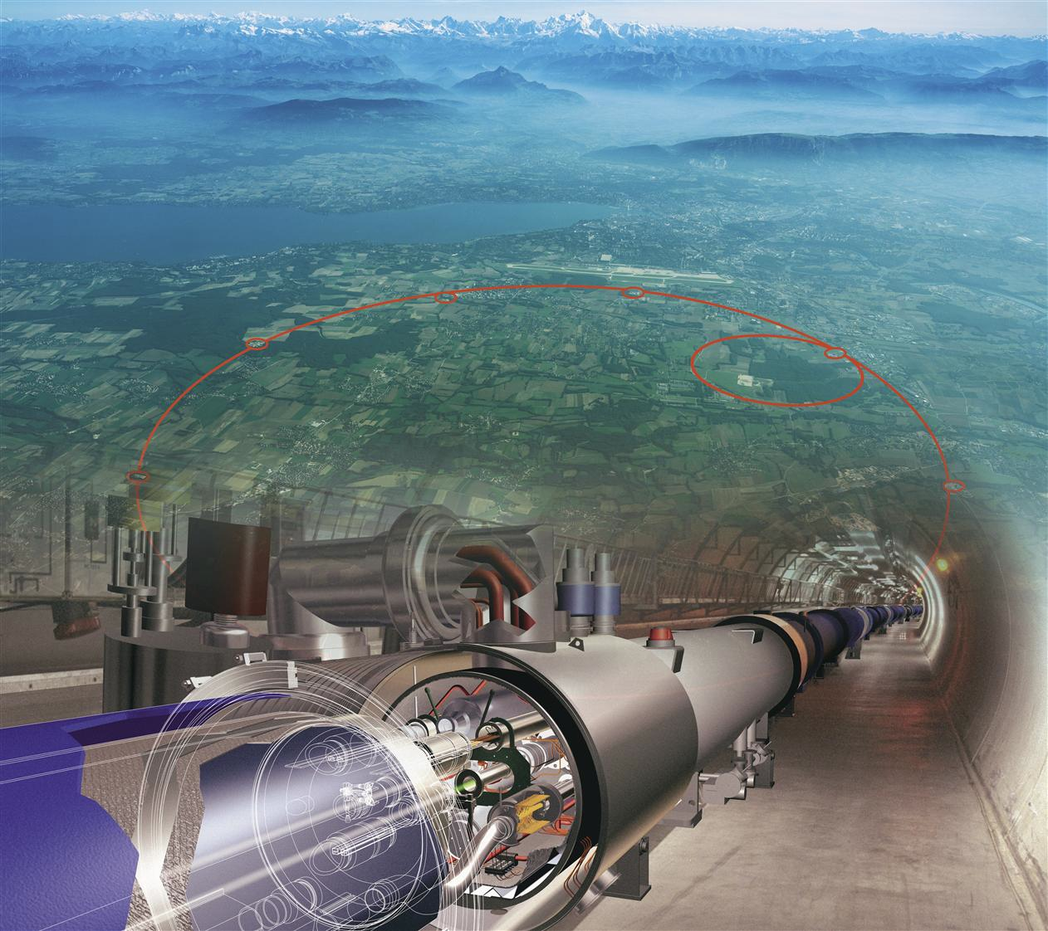
Energy frontier colliders – Hadron Colliders
Direct BSM searches at the highest energies
e.g. addressing the naturalness puzzle
M. Selvaggi, …
FCC-eh/hh@CERN [3.5/100 TeV]
25y @ hh 100 TeV (30ab⁻¹)
@ eh 3.5 TeV (2ab⁻¹)
HE-LHC@CERN [27 TeV]
20y @ 27 TeV (15ab⁻¹)
requires an upgrade of the CERN accelerator complex
Nb₃Sn
16T magnets
E
SppC@China [75-150 TeV]
Nb₃Sn
16T magnets
75 TeV (30ab⁻¹)
12-24T Fe-HTS magnets
numbers assume 2 IPs for each collider (only one for FCC-eh)

Slide 23
Towards an international muon collider design study
Suppressed synchrotron radiation wrt electrons
Luminosity can increase linearly with energy
For the production of heavy particle pairs 14 TeV lepton collisions are comparable to 100 TeV proton collisions
muon collider
benefits
D. Schulte
L. Sestini (Higgs), …
main challenge:
muon lifetime at rest
only 2.2 μs
international collaboration being formed towards
a design study for a 3 TeV and >10 TeV muon collider
(incl. exploring synergies with Higgs Factories & neutrino experiments)
http://muoncollider.web.cern.ch
MAP sheme
Additionally, an alternative LEMMA scheme with 45 GeV positrons that produce muon pairs

Slide 24
Principle collider avenues to seek new phenomena
Open questions relate to several physics phenomena that can be captures in 6 principle categories
(surely other sets could be used as well)
Physics themes of the Open Symposium of the European Strategy for Particle Physics in Granada

Slide 25
Searching for dark matter with colliders
The assumption of Thermal Equilibrium in the early Universe narrows the viable mass range
mediator
Standard Model
Physics themes of the Open Symposium of the European Strategy for Particle Physics in Granada

Slide 26
Searching for dark matter with colliders
Thermal WIMPs: simplified DM models with one DM particle and one mediator
(m_{χ}=1GeV)
quark-only interaction
lepton-only interaction
spin-1 Z’
Complementarity:
lepton
and
proton colliders

Slide 27
Searching for dark matter with colliders
Thermal WIMPs: simplified DM models with one DM particle and one mediator
(m_{χ}=1GeV)
BSM scalar
quark-only interaction
lepton-only interaction
spin-1 Z’
Complementarity:
lepton
and
proton colliders
Maximal overlap with direct & indirect detection sensitivity:
cosmological origin of DM
versus
nature of DM interactions

Slide 28
Addressing the naturalness puzzle with supersymmetry
jump one order of magnitude with proton colliders
Physics themes of the Open Symposium of the European Strategy for Particle Physics in Granada

Slide 29
Zooming into the Higgs sector with colliders
Sensitivity for deviations in effective Higgs couplings
(from a global EFT fit – dim-6 SM Effective Field Theory)
sensitivity at 68% for deviations
Results of the SMEFT fit projected in effective couplings:
Physics themes of the Open Symposium of the European Strategy for Particle Physics in Granada
[J. de Blas et al., JHEP 01 (2020) 139]

Slide 30
Zooming into the Higgs sector with colliders
Sensitivity for deviations in effective Higgs couplings
(from a global EFT fit – dim-6 SM Effective Field Theory)
sensitivity at 68% for deviations
Results of the SMEFT fit projected in effective couplings:
Physics themes of the Open Symposium of the European Strategy for Particle Physics in Granada
[J. de Blas et al., JHEP 01 (2020) 139]

Slide 31
Zooming into the Higgs sector with colliders
Sensitivity for deviations in effective Higgs couplings
(from a global EFT fit – dim-6 SM Effective Field Theory)
today
HL-LHC expectation (6000fb⁻¹)
HL-LHC ⊕ LHeC expectation
HL-LHC ⊕ e⁺e⁻ Higgs Factories (∼250 GeV)
HL-LHC ⊕ e⁺e⁻ Higgs Factories (∼250 GeV)
⊕ Energy Frontier
(ILC@1TeV, CLIC@3TeV, FCC-pp@100TeV)
The improvement is in the complementarity!
[J. de Blas et al., JHEP 01 (2020) 139]

Slide 32
Zooming into the Higgs sector with colliders
Complementarity between ee/eh/hh colliders – case for the FCC project
(Higgs coupling strength modifier parameters κ_{i} – assuming no BSM particles in Higgs boson decay)
(expected relative precision)
ALL COMBINED
only FCC-ee@240GeV
only FCC-hh
[J. de Blas et al., JHEP 01 (2020) 139]

Slide 33
Zooming into the Higgs sector with colliders
Complementarity between ee/eh/hh colliders – case for the FCC project
(Higgs coupling strength modifier parameters κ_{i} – assuming no BSM particles in Higgs boson decay)
(expected relative precision)
the coupling we looked at on the previous slide
ALL COMBINED
only FCC-ee@240GeV
only FCC-hh
[J. de Blas et al., JHEP 01 (2020) 139]

Slide 34
Zooming into the Higgs sector with colliders
Complementarity between e⁺e⁻ and proton colliders
(Higgs coupling strength modifier parameters κ_{i} – assuming no BSM particles in Higgs boson decay)
(expected relative precision)
the coupling we looked at on the previous slide
adding 365 GeV runs
adding FCC-ep
ALL COMBINED
only FCC-ee@240GeV
only FCC-hh
[J. de Blas et al., JHEP 01 (2020) 139]

Slide 35
Zooming into the Higgs sector with colliders
Complementarity between e⁺e⁻ and proton colliders
(Higgs coupling strength modifier parameters κ_{i} – assuming no BSM particles in Higgs boson decay)
(expected relative precision)
the coupling we looked at on the previous slide
complementarity between
e⁺e⁻ Higgs Factories
and
high-energy proton colliders
adding 365 GeV runs
adding FCC-ep
ALL COMBINED
only FCC-ee@240GeV
only FCC-hh
[J. de Blas et al., JHEP 01 (2020) 139]

Slide 36
Zooming into the Higgs sector with colliders
improvement factor adding
CEPC results additional to HL-LHC results
[J. de Blas et al., JHEP 01 (2020) 139]

Slide 37
Zooming into the Higgs sector with colliders
Comparable improvement from
HL-LHC to e⁺e⁻ Higgs Factories
[J. de Blas et al., JHEP 01 (2020) 139]

Slide 38
the coupling we looked at on the previous slides
Zooming into the Higgs sector with colliders
Comparable improvement from
HL-LHC to e⁺e⁻ Higgs Factories
Results from a global EFT fit for FCC-hh
with any of the four e⁺e⁻ Higgs Factories proposed
Differences at e⁺e⁻ colliders:
model independent total width Γ_{H} measured at
circular (1.1%@FCC-ee) and linear (2.2%@ILC250)
the combination of 250 GeV and >250 GeV e⁺e⁻ data is key
ILC @ 250+500 GeV would reach 1.1%
[J. de Blas et al., JHEP 01 (2020) 139]

Slide 39
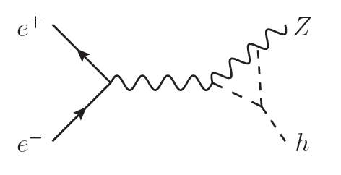
Zooming into the Higgs sector with colliders
The Higgs boson cubic self-coupling (κ₃)
di-Higgs
single-Higgs
Physics themes of the Open Symposium of the European Strategy for Particle Physics in Granada
[J. de Blas et al., JHEP 01 (2020) 139]

Slide 40
Zooming into the Higgs sector with colliders
The Higgs boson cubic self-coupling (κ₃)
di-Higgs
single-Higgs
complementarity between
lower-energy e⁺e⁻ colliders (single-H)
and
higher-energy e⁺e⁻ colliders or proton colliders (double-H)
Physics themes of the Open Symposium of the European Strategy for Particle Physics in Granada
[J. de Blas et al., JHEP 01 (2020) 139]

Slide 41
Principle collider avenues to seek new phenomena
High-energy colliders have a unique capability to address the most profound open questions in particle physics
Although with novel theoretical reasoning we are given several avenues where we could find new physics, we do not know where we will find new physics
This provides an argument, in a global context, for an inclusive collider programme exploiting complementary ee/eh/hh future colliders aiming for broad coverage
Physics themes of the Open Symposium of the European Strategy for Particle Physics in Granada
… strategy, next presentation …

Slide 42
The bold and the beautiful of colliders
With the HL-LHC and SuperKEKB the immediate future for particle physics colliders looks bright, and provides ample opportunities for innovative experimental and theoretical research to unlock physics that was initially thought to be out of reach at these colliders
Motivated by physics arguments, e⁺e⁻ Higgs Factories are technically ready to become operational in our medium-term future and with the ambition to integrate the concepts of B/c/τ, EW and top quark Factories in their research programs
Because together they address complementary open questions in particle physics, the above is to be complemented with a new energy frontier machine, potentially at a later stage, to unlock the physics potential of 100 TeV proton collisions

Slide 43
The bold and the beautiful of colliders
With the HL-LHC and SuperKEKB the immediate future for particle physics colliders looks bright, and provides ample opportunities for innovative experimental and theoretical research to unlock physics that was initially thought to be out of reach at these colliders
Motivated by physics arguments, e⁺e⁻ Higgs Factories are technically ready to become operational in our medium-term future and with the ambition to integrate the concepts of B/c/τ, EW and top quark Factories in their research programs
Because together they address complementary open questions in particle physics, the above is to be complemented with a new energy frontier machine, potentially at a later stage, to unlock the physics potential of 100 TeV proton collisions
In my view, we have a few years in front of us to join forces on a global scale
to organize together our concrete ambition for the colliders of the 21st century
… and if we do this together, it better be with a bold moonshot ambition

Slide 44
Thank you for your attention!
The bold and the beautiful of colliders
With the HL-LHC and SuperKEKB the immediate future for particle physics colliders looks bright, and provides ample opportunities for innovative experimental and theoretical research to unlock physics that was initially thought to be out of reach at these colliders
Motivated by physics arguments, e⁺e⁻ Higgs Factories are technically ready to become operational in our medium-term future and with the ambition to integrate the concepts of B/c/τ, EW and top quark Factories in their research programs
Because together they address complementary open questions in particle physics, the above is to be complemented with a new energy frontier machine, potentially at a later stage, to unlock the physics potential of 100 TeV proton collisions
In my view, we have a few years in front of us to join forces on a global scale
to organize together our concrete ambition for the colliders of the 21st century
… and if we do this together, it better be with a bold moonshot ambition

Slide 45
Break

Slide 46
Zooming into the Higgs sector with colliders
Comparable improvement from
HL-LHC to e⁺e⁻ Higgs Factories
Large improvement when adding FCC-hh
[J. de Blas et al., JHEP 01 (2020) 139]

Slide 47
Zooming into the Higgs sector with colliders
Comparable improvement from
HL-LHC to e⁺e⁻ Higgs Factories
Large improvement when adding FCC-hh
complementarity between
e⁺e⁻ Higgs Factories
and
high-energy proton colliders
[J. de Blas et al., JHEP 01 (2020) 139]

Slide 48
Zooming into the Higgs sector with colliders
Results from a global EFT fit for FCC-hh
with any of the four e⁺e⁻ Higgs Factories proposed
Differences: model independent total width Γ_{H} measured
at circular (1.1%@FCC-ee) and linear (2.2%@ILC250)
e⁺e⁻ colliders is different
ILC @ 500 GeV would reach 1.1%
(the combination of 250 GeV and >250 GeV e⁺e⁻ data is relevant)
[J. de Blas et al., JHEP 01 (2020) 139]

Slide 49
Zooming into the Higgs sector with colliders
Results from a global EFT fit for FCC-hh
with any of the four e⁺e⁻ Higgs Factories proposed
Differences: model independent total width Γ_{H} measured
at circular (1.1%@FCC-ee) and linear (2.2%@ILC250)
e⁺e⁻ colliders is different
K. Jacobs (ATLAS) & R. Carlin (CMS)
reminder: today’s uncertainty on κ_{μ} is ∼20-25%
%
%
%
%
ILC @ 500 GeV would reach 1.1%
(the combination of 250 GeV and >250 GeV e⁺e⁻ data is relevant)
[J. de Blas et al., JHEP 01 (2020) 139]

Slide 50
Empowering the HL-LHC program with the LHeC
LHeC (up to 60 GeV e⁻ from Energy Recovery Linac)
E_{cms} = 0.2 – 1.3 TeV, (Q²,x) range far beyond HERA
run with the HL-LHC (≳ Run5)
ERL R&D demonstrator at Orsay, PERLE
B.J. Holzer, U. Klein, G. Azuelos, H. Mäntysaari, D. Britzger, C. Gwenlan, …
EW/H/top range
EW/H/top range
pp 14 TeV
perturbative uncertainties
(to be addressed in future)
factor 5 to 10
[updated CDR submitted: https://arxiv.org/abs/2007.14491]

Slide 51
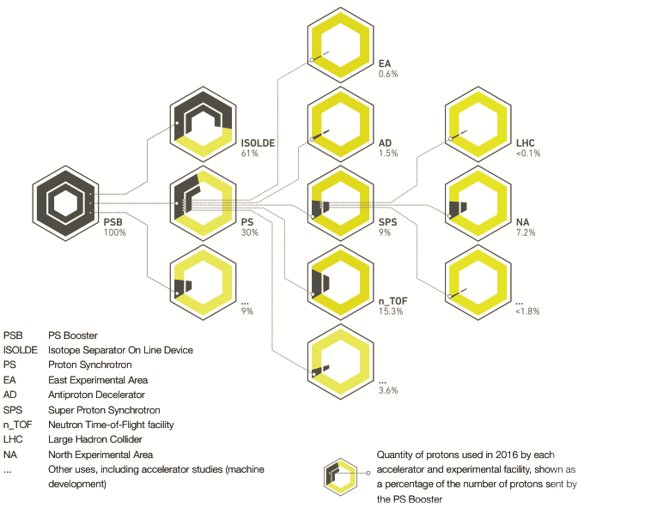
Colliding beams & physics beyond collider expt’s
The CERN accelerator complex and the LHC – protons from Booster only <0.1% to LHC

Slide 52
Colliding beams & physics beyond collider expt’s
The CERN accelerator complex and the LHC – protons from Booster only <0.1% to LHC
Beams for colliders unlock unique ways to address the open questions with a complementary methodology

Slide 53
From the LHC to the High-Luminosity LHC @ CERN
Recent innovations in instrumentation, software, computing, analysis techniques and theoretical reasoning unlocked several new avenues for physics research at the LHC that were previously thought unreachable… the HL-LHC platform is outstanding for innovations!
Example: search for Dark Photons (Z_{D}) decaying to a pair of muons in data from scouting triggers
[CMS Collab., CMS-PAS-EXO-19-018, in the CERN Courier, Dec 2019]

Slide 54
Principle collider avenues to seek new phenomena
Light-DM: particles below the EW scale in a hidden/dark sector interacting feebly with SM particles
Example: axion-like particles (a) as a pseudo-scalar mediator to a Dark sector with light DM particles
(related to ideas to address the strong CP problem)
e⁺e⁻ colliders with
e⁺e⁻→aγ (a→γγ)

Slide 55
The Future Collider landscape for particle physics
e⁺e⁻ colliders
SuperKEKB@10.5GeV
ILC@250GeV
CLIC@380GeV
FCC-ee@90-360GeV
CEPC@90-240GeV
ILC@>250GeV
CLIC@1.5-3TeV
proton colliders
LHC@14TeV
HL-LHC@14TeV
HE-LHC@27TeV
FCC-hh@100TeV
SppC@100TeV
muon collider
revived attention emerging
ep/eA colliders
EIC@up to 0.13TeV
LHeC@up to 1.3TeV
FCC-eh@up to 3.5TeV

Slide 56
The Future Collider landscape for particle physics
e⁺e⁻ colliders
SuperKEKB@10.5GeV
ILC@250GeV
CLIC@380GeV
FCC-ee@90-360GeV
CEPC@90-240GeV
ILC@>250GeV
CLIC@1.5-3TeV
proton colliders
LHC@14TeV
HL-LHC@14TeV
HE-LHC@27TeV
FCC-hh@100TeV
SppC@75-150TeV
muon collider
3 – 10+ TeV
ep/eA colliders
EIC@up to 0.13TeV
LHeC@up to 1.3TeV
FCC-eh@up to 3.5TeV

