Slide 1

High-Energy Physics
May 4th, 2017, Brussels
Coordinator:
  Jorgen D’Hondt
Group leaders:
  Stijn Buitink High-Energy Astrophysics
  Ben Craps Theoretical Physics
  Jorgen D’Hondt Particle Physics Experiments
  Nick van Eijndhoven Astro-Particle Physics – not available today

Slide 2

Objective – curiosity driven research
Observable universe
Visible with our eyes
~ 1.000.000.000.000.000.000.000.000.000 meter
~ 0.00000000000000000001 meter
Smallest particles

Slide 3
Objective – curiosity driven research
Standard Model of Cosmology
Gravity
Standard Model of Particle Physics
Quantum Field Theory
~ 1.000.000.000.000.000.000.000.000.000 meter
~ 0.00000000000000000001 meter
CMS @ CERN
SoLid @ Belgium
IceCube/ARA @ South Pole
LOFAR @ Netherlands
Auger @ Argentina

Slide 4
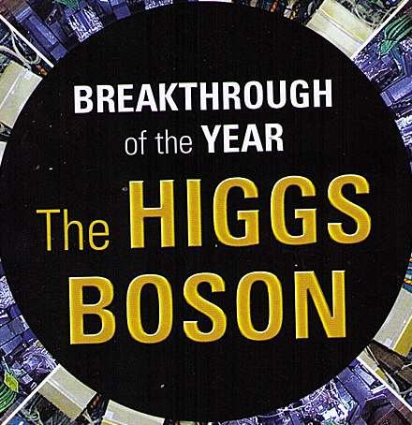
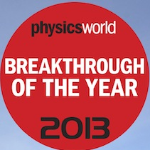
Objective – curiosity driven research
Standard Model of Cosmology
Gravity
Standard Model of Particle Physics
Quantum Field Theory
~ 1.000.000.000.000.000.000.000.000.000 meter
~ 0.00000000000000000001 meter
CMS @ CERN
SoLid @ Belgium
IceCube/ARA @ South Pole
LOFAR @ Netherlands
Auger @ Argentina
For a profound understanding of Nature, we need to understand the interplay between high-energy phenomena on the largest and the smallest scales
2012
2012

Slide 5
VUB-scale in Flanders
The VUB represents about 10% in the Flemish academic landscape, hence “covers” about 0.6M inhabitants
Strategic Research choices are to be made in order to excel on the international level
In this context HEP@VUB was established to have a major impact in reaching these scientific objectives

Slide 6
Research team – some numbers
8 professors
9 part-time professors
3 active emeriti
15 postdocs
24 PhD students
Since 2012:
±850 publications*
±55k citations (h-index 112)
16 PhD thesis
>14 awards for PD/students
Gender:
19% professors female
23% postdocs female
38% PhD students female
* many with 1000+ authors
1 Odysseus-I
2 Odysseus-II
(more selected but declined)
1 ERC Starting Grant
Leverage through FWO fellowships in Flanders:
37% of postdoc years
20% of PhD student years
i.e. 40% and 35% of those available in physics
(while VUB is 10% fair share in Flanders)
Over 5 years:
±16.5M Euro external funds
±2.7M Euro PhD/PD mandates
1.3M Euro from SRP
International:
less than 10% of our postdocs obtained PhD at VUB
20% of our PhD students obtained Master at VUB
20% obtained Master at another Belgian university
60% obtained their Master abroad
Many of our postdocs have obtained a permanent academic position

Slide 7
Research team – some numbers
8 professors
9 part-time professors
3 active emeriti
15 postdocs
24 PhD students
Since 2012:
±850 publications*
±55k citations (h-index 112)
16 PhD thesis
>14 awards for PD/students
Gender:
19% professors female
23% postdocs female
38% PhD students female
* many with 1000+ authors
1 Odysseus-I
2 Odysseus-II
(more selected but declined)
1 ERC Starting Grant
Leverage through FWO fellowships in Flanders:
37% of postdoc years
20% of PhD student years
i.e. 40% and 35% of those available in physics
(while VUB is 10% fair share in Flanders)
Over 5 years:
±16.5M Euro external funds
±2.7M Euro PhD/PD mandates
1.3M Euro from SRP
International:
less than 10% of our postdocs obtained PhD at VUB
20% of our PhD students obtained Master at VUB
20% obtained Master at another Belgian university
60% obtained their Master abroad
Many of our postdocs have obtained a permanent academic position

Slide 8
Research team – some numbers
8 professors
9 part-time professors
3 active emeriti
15 postdocs
24 PhD students
Since 2012:
±850 publications*
±55k citations (h-index 112)
16 PhD thesis
>14 awards for PD/students
Gender:
19% professors female
23% postdocs female
38% PhD students female
* many with 1000+ authors
1 Odysseus-I
2 Odysseus-II
(more selected but declined)
1 ERC Starting Grant
Leverage through FWO fellowships in Flanders:
37% of postdoc years
20% of PhD student years
i.e. 40% and 35% of those available in physics
(while VUB is 10% fair share in Flanders)
Over 5 years:
±16.5M Euro external funds
±2.7M Euro PhD/PD mandates
1.3M Euro from SRP
International:
less than 10% of our postdocs obtained PhD at VUB
20% of our PhD students obtained Master at VUB
20% obtained Master at another Belgian university
60% obtained their Master abroad
Many of our postdocs have obtained a permanent academic position

Slide 9
Research team – some numbers
8 professors
9 part-time professors
3 active emeriti
15 postdocs
24 PhD students
Since 2012:
±850 publications*
±55k citations (h-index 112)
16 PhD thesis
>14 awards for PD/students
Gender:
19% professors female
23% postdocs female
38% PhD students female
* many with 1000+ authors
1 Odysseus-I
2 Odysseus-II
(more selected but declined)
1 ERC Starting Grant
Leverage through FWO fellowships in Flanders:
37% of postdoc years
20% of PhD student years
i.e. 40% and 35% of those available in physics
(while VUB is 10% fair share in Flanders)
Over 5 years:
±16.5M Euro external funds
±2.7M Euro PhD/PD mandates
1.3M Euro from SRP
International:
less than 10% of our postdocs obtained PhD at VUB
20% of our PhD students obtained Master at VUB
20% obtained Master at another Belgian university
60% obtained their Master abroad
Many of our postdocs have obtained a permanent academic position

Slide 10
Research team – some numbers
8 professors
9 part-time professors
3 active emeriti
15 postdocs
24 PhD students
Since 2012:
±850 publications*
±55k citations (h-index 112)
16 PhD thesis
>14 awards for PD/students
Gender:
19% professors female
23% postdocs female
38% PhD students female
* many with 1000+ authors
1 Odysseus-I
2 Odysseus-II
(more selected but declined)
1 ERC Starting Grant
Leverage through FWO fellowships in Flanders:
37% of postdoc years
20% of PhD student years
i.e. 40% and 35% of those available in physics
(while VUB is 10% fair share in Flanders)
Over 5 years:
±16.5M Euro external funds
±2.7M Euro PhD/PD mandates
1.3M Euro from SRP
International:
less than 10% of our postdocs obtained PhD at VUB
20% of our PhD students obtained Master at VUB
20% obtained Master at another Belgian university
60% obtained their Master abroad
Many of our postdocs have obtained a permanent academic position

Slide 11
Research team – some numbers
8 professors
9 part-time professors
3 active emeriti
15 postdocs
24 PhD students
Since 2012:
±850 publications*
±55k citations (h-index 112)
16 PhD thesis
>14 awards for PD/students
Gender:
19% professors female
23% postdocs female
38% PhD students female
* many with 1000+ authors
1 Odysseus-I
2 Odysseus-II
(more selected but declined)
1 ERC Starting Grant
Leverage through FWO fellowships in Flanders:
37% of postdoc years
20% of PhD student years
i.e. 40% and 35% of those available in physics
(while VUB is 10% fair share in Flanders)
Over 5 years:
±16.5M Euro external funds
±2.7M Euro PhD/PD mandates
1.3M Euro from SRP
International:
less than 10% of our postdocs obtained PhD at VUB
20% of our PhD students obtained Master at VUB
20% obtained Master at another Belgian university
60% obtained their Master abroad
Many of our postdocs have obtained a permanent academic position

Slide 12
Research team – some numbers
8 professors
9 part-time professors
3 active emeriti
15 postdocs
24 PhD students
Since 2012:
±850 publications*
±55k citations (h-index 112)
16 PhD thesis
>14 awards for PD/students
Gender:
19% professors female
23% postdocs female
38% PhD students female
* many with 1000+ authors
1 Odysseus-I
2 Odysseus-II
(more selected but declined)
1 ERC Starting Grant
Leverage through FWO fellowships in Flanders:
37% of postdoc years
20% of PhD student years
i.e. 40% and 35% of those available in physics
(while VUB is 10% fair share in Flanders)
Over 5 years:
±16.5M Euro external funds
±2.7M Euro PhD/PD mandates
1.3M Euro from SRP
International:
less than 10% of our postdocs obtained PhD at VUB
20% of our PhD students obtained Master at VUB
20% obtained Master at another Belgian university
60% obtained their Master abroad
Many of our postdocs have obtained a permanent academic position

Slide 13
Research team – some numbers
8 professors
9 part-time professors
3 active emeriti
15 postdocs
24 PhD students
Since 2012:
±850 publications*
±55k citations (h-index 112)
16 PhD thesis
>14 awards for PD/students
Gender:
19% professors female
23% postdocs female
38% PhD students female
* many with 1000+ authors
1 Odysseus-I
2 Odysseus-II
(more selected but declined)
1 ERC Starting Grant
Leverage through FWO fellowships in Flanders:
37% of postdoc years
20% of PhD student years
i.e. 40% and 35% of those available in physics
(while VUB is 10% fair share in Flanders)
Over 5 years:
±16.5M Euro external funds
±2.7M Euro PhD/PD mandates
1.3M Euro from SRP
International:
less than 10% of our postdocs obtained PhD at VUB
20% of our PhD students obtained Master at VUB
20% obtained Master at another Belgian university
60% obtained their Master abroad
Many of our postdocs have obtained a permanent academic position

Slide 14
High-Energy Physics – organisation
HEP@VUB Coordinator: Prof. J. D’Hondt
Secretariat: M. Fabre and M. Goeman
Theoretical physics
Prof. B. Craps
Prof. A. Sevrin
Part-time:
Prof. V. Balasubramanian
Prof. O. Evnin
Prof. L. Lopez Honorez
Prof. D. Thompson
Particle physics experiments
Prof. F. Blekman
(Odysseus 2)
Prof. J. D’Hondt
Prof. S. Lowette
(Odysseus 2)
Part-time:
Prof. P. Van Mulders
Active emeriti:
Prof. S. Tavernier
Prof. W. Van Doninck
Astro-particle physics
Prof. N. van Eijndhoven
(Odysseus 1)
Part-time:
Prof. O. Scholten
Active emeriti:
Prof. C. De Clercq
High-energy astrophysics
Prof. S. Buitink
(ERC Starting Grant)
Part-time:
Prof. J. Blommaert
Prof. G. Gentile
Guest professor:
Prof. D. Vanbeveren
Phenomenology
Prof. A. Mariotti
Part-time:
Prof. K. Mawatari

Slide 15
High-Energy Physics – organisation
Theoretical physics
Prof. B. Craps
Prof. A. Sevrin
Part-time:
Prof. V. Balasubramanian
Prof. O. Evnin
Prof. L. Lopez Honorez
Prof. D. Thompson
Particle physics experiments
Prof. F. Blekman
(Odysseus 2)
Prof. J. D’Hondt
Prof. S. Lowette
(Odysseus 2)
Part-time:
Prof. P. Van Mulders
Active emeriti:
Prof. S. Tavernier
Prof. W. Van Doninck
Astro-particle physics
Prof. N. van Eijndhoven
(Odysseus 1)
Part-time:
Prof. O. Scholten
Active emeriti:
Prof. C. De Clercq
High-energy astrophysics
Prof. S. Buitink
(ERC Starting Grant)
Part-time:
Prof. J. Blommaert
Prof. G. Gentile
Guest professor:
Prof. D. Vanbeveren
Phenomenology
Prof. A. Mariotti
Part-time:
Prof. K. Mawatari
International Solvay Institutes

Slide 16
High-Energy Physics – organisation
Theoretical physics
Prof. B. Craps
Prof. A. Sevrin
Part-time:
Prof. V. Balasubramanian
Prof. O. Evnin
Prof. L. Lopez Honorez
Prof. D. Thompson
Particle physics experiments
Prof. F. Blekman
(Odysseus 2)
Prof. J. D’Hondt
Prof. S. Lowette
(Odysseus 2)
Part-time:
Prof. P. Van Mulders
Active emeriti:
Prof. S. Tavernier
Prof. W. Van Doninck
Astro-particle physics
Prof. N. van Eijndhoven
(Odysseus 1)
Part-time:
Prof. O. Scholten
Active emeriti:
Prof. C. De Clercq
High-energy astrophysics
Prof. S. Buitink
(ERC Starting Grant)
Part-time:
Prof. J. Blommaert
Prof. G. Gentile
Guest professor:
Prof. D. Vanbeveren
Phenomenology
Prof. A. Mariotti
Part-time:
Prof. K. Mawatari
Inter-university Institute for High Energies (IIHE), VUB+ULB

Slide 17
High-Energy Physics – experiments
Some experiments where we are involved in the construction, operation and exploitation.

Slide 18
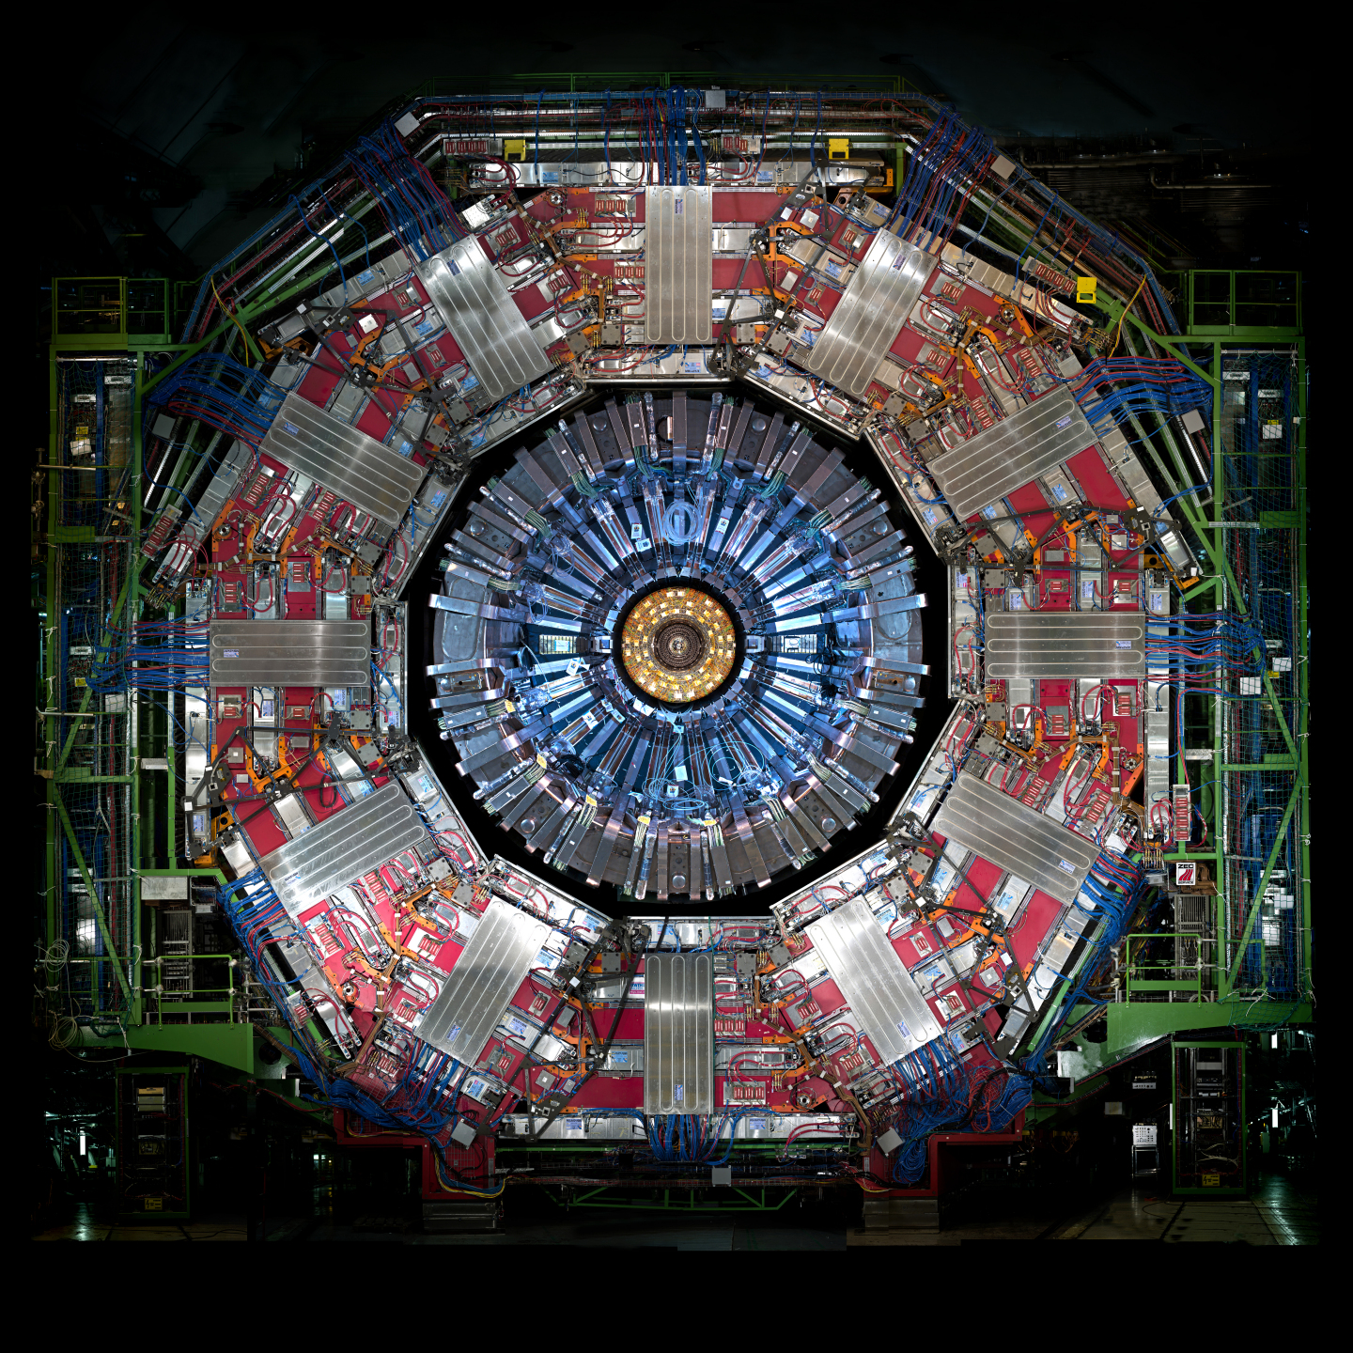

CMS experiment @ CERN
15m
2012
related to
Nobel Prize
in 2013

Slide 19
CMS experiment @ CERN
15m
To be replaced by 2026

Slide 20
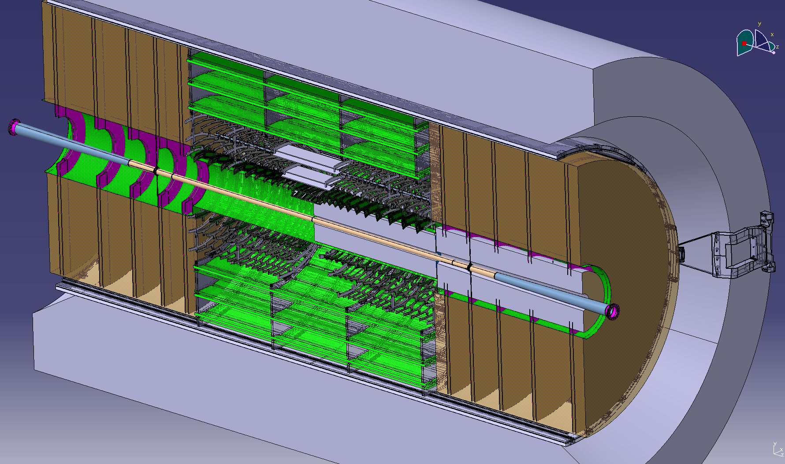
Construct new detector by 2026
Belgian project
± 6500 detector modules
2.5m
Jorgen D’Hondt is PI of this Belgian project with >10M Euro core budget secured, and >5M Euro human resources cost

Slide 21
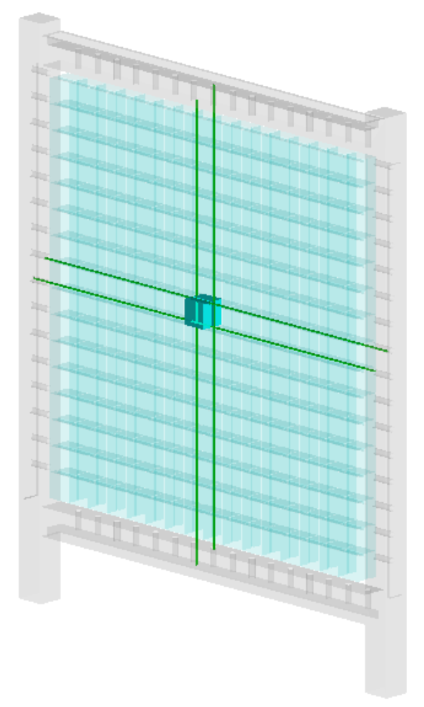
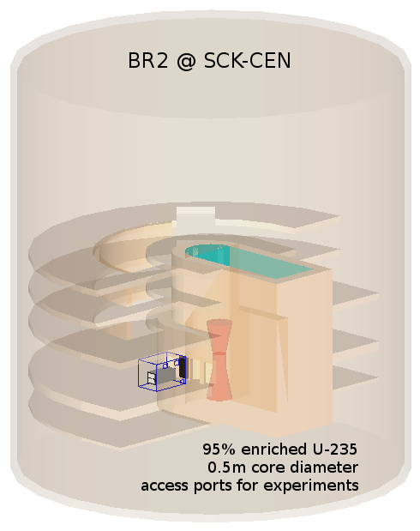
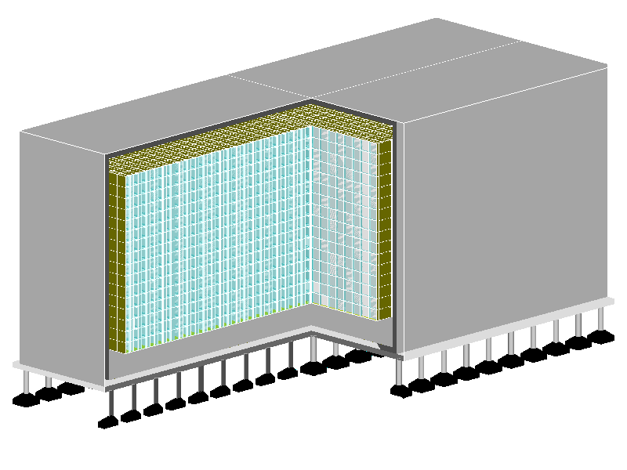
SoLid experiment @ BR2 reactor
12800 cubes
3200 readout fibers
Belgium
6 to 11m from reactor core
related to
Nobel Prize
in 2015
50 planes
1.5 ton

Slide 22
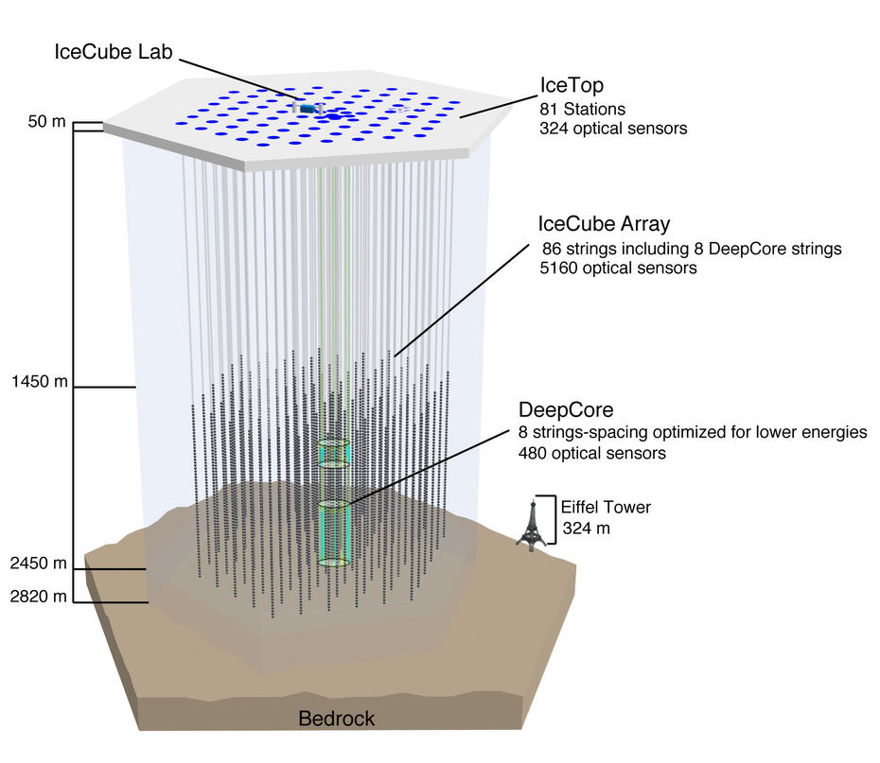
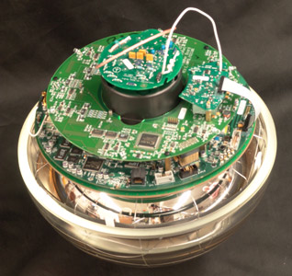
IceCube observatory @ South Pole

Slide 23
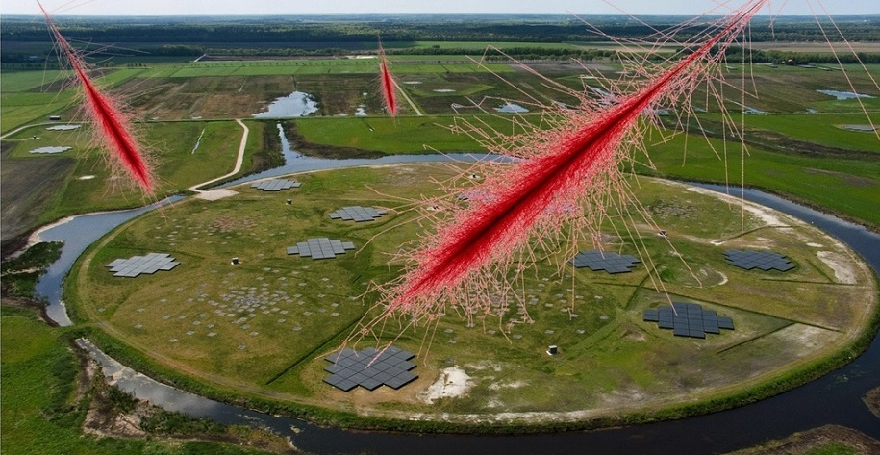
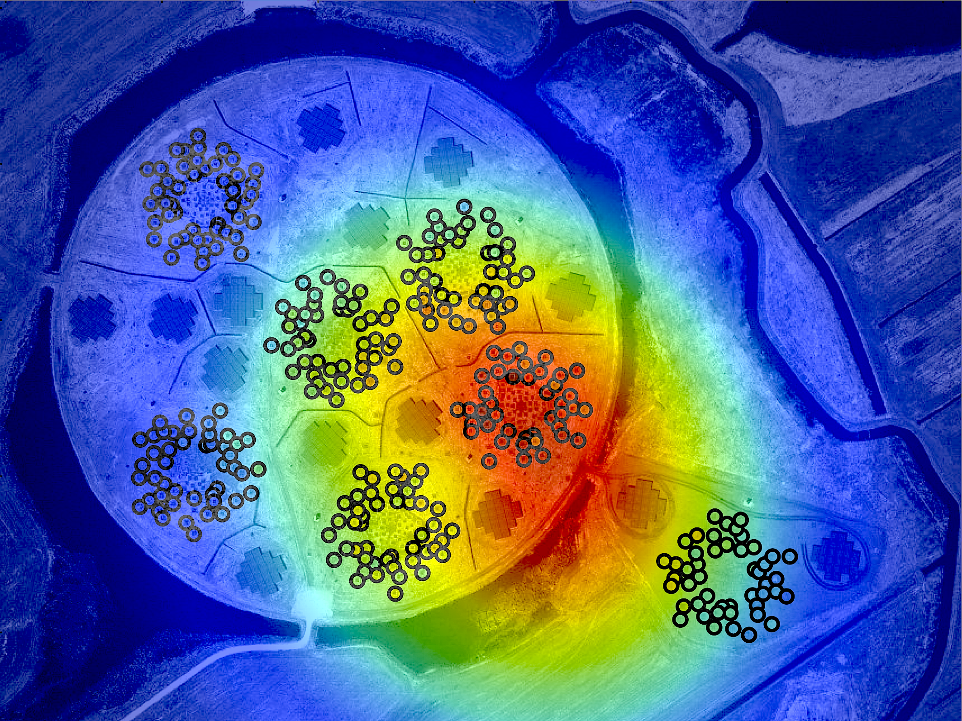

LOFAR observatory @ Netherlands
Low Frequency Array for novel radio astronomy in the 10-240 MHz range

Slide 24
High-Energy Physics – research
Theoretical physics
string theory
holography
cosmology
Particle physics experiments
high-energy colliders
neutrino physics
CMS experiment
SoLid experiment
Astro-particle physics
cosmic neutrinos
dark matter
multi-messenger observations
IceCube observatory
ARA observatory
Auger observatory
High-energy astrophysics
radio transients
binary evolution
LOFAR observatory
SKA observatory
Phenomenology
theoretical model building
relation between small and large scales
International mobility is very large and intrinsic to our field
Unique range of topics in Belgium, from large to small scales

Slide 25
High-Energy Physics – 2010
Theoretical physics
string theory
Prof. B. Craps
Prof. A. Sevrin
Particle physics
high-energy colliders
Prof. J. D’Hondt
Ending FWO positions:
Prof. R. Roosen
Prof. W. Van Doninck
Active emeriti:
Prof. S. Tavernier
Astro-particle physics
neutrino telescope
Prof. De Clercq

Slide 26
High-Energy Physics – new since 2010
Theoretical physics
string theory
holography
cosmology
Prof. B. Craps
Prof. A. Sevrin
Part-time:
Prof. V. Balasubramanian
Prof. O. Evnin
Prof. L. Lopez Honorez
Prof. D. Thompson
Particle physics experiments
high-energy colliders
neutrino physics
Prof. F. Blekman
(Odysseus 2)
Prof. J. D’Hondt
Prof. S. Lowette
(Odysseus 2)
Part-time:
Prof. P. Van Mulders
Active emeriti:
Prof. S. Tavernier
Prof. W. Van Doninck
Astro-particle physics
cosmic neutrinos
dark matter
multi-messenger observations
Prof. N. van Eijndhoven
(Odysseus 1)
Part-time:
Prof. O. Scholten
Active emeriti:
Prof. C. De Clercq
High-energy astrophysics
radio transients
binary evolution
Prof. S. Buitink
(ERC Starting Grant)
Part-time:
Prof. J. Blommaert
Prof. G. Gentile
Guest professor:
Prof. D. Vanbeveren
Phenomenology
Prof. A. Mariotti
Part-time:
Prof. K. Mawatari
Strong evolution since 2010 (i.e. strategic choices)
Enhanced connections and enlarged research portfolio

Slide 27
Some research highlights
Theoretical physics
Interpretation of new Planck satellite data for dark matter models
Thermalization properties of strongly coupled systems
Investigating whether anti-de Sitter spacetime is unstable
Particle physics experiments
Discovery of the Higgs particle (CMS)
Leading contributions in top quark physics measurements and searches (CMS)
Searches for dark matter and displaced supersymmetry (CMS)
Commissioning of a real-scale proto-type of the SoLid detector
Astro-particle physics
Discovery of cosmic high-energy neutrinos (IceCube)
Most stringent limits on Earth and Solar dark matter (IceCube)
Most stringent limit on cosmic ray flux from Gamma-Ray Bursts (IceCube)
Leading investigation for novel radio detection and radar reflection in ice (ARA)
High-energy astrophysics
Opened a unique radio observation window for the study of cosmic rays (LOFAR)
Mass composition of cosmic rays (LOFAR)
Phenomenology
41 publications & 16 preprints
2200 citations, h-index 21
Exploration of the Higgs sector & Higgs characterization
Important constraints on supersymmetry models
Unconventional supersymmetry phenomenology
Dark Matter simplified models

Slide 28
Important recognitions
Typically leading research on the national level
Leading functions in international collaborations with up to thousands of members, both in the coordination of physics research and in the management up to the highest level; example for CMS@CERN with >4400 members (numbers only available for Belgium)
    5.3% of PhD students
    6.6% of physics conveners
    ±3% funding from Belgium 8.3% of major conference talks
    33% of Best Thesis Awards
    1 out of 6 elected Collaboration Board chairs
Several invited Opening and/or Plenary talks at major conferences
Members in IUPAP C18 Mathematical Physics, Restricted European Committee for Future Accelerators (RECFA), Intern. Particle Physics Outreach Group (IPPOG), Eur. Physics Society board (EPS), Intern. Cosmic Ray Conferences board (ICRC), CERN Council (vice-president)
Several national and international awards and prizes (e.g. World Economic Forum, guest professors, Distinguished Researcher Fermilab LPC, etc.)

Slide 29
Future research opportunities
Theoretical physics
Holography (gauge/gravity duality): far-from-equilibrium aspects & role of quantum entanglement in the emerge of spacetime
String theory: geometric nature of spacetime & its dualities
Particle physics experiments
Interplay top quark and Higgs boson: full exploration of top Yukawa coupling
Interplay top quark and Dark Matter
SoLid oscillation analysis & background estimation
Construction of CMS Tracker Endcap: new 120 m² clean room
Astro-particle physics
Neutrinos from Gamma Ray Bursts & Active Galactic Nuclei
Neutrinos related to gravitational waves
Detection of GZK neutrinos (cosmic ray interactions with the CMB)
Feasibility IceCube-Gen2 upgrade
High-energy astrophysics
Signals from particle cascade on lunar surface & atmosphere
Mass composition of cosmic rays (galactic & extragalactic origin)
Search for extremely energetic particles from lunar surface (sensitive to physics beyond the SM)
Phenomenology
Research on the interplay between the large and the small scales
Large potential for breakthroughs in the interplay of our research
Enhanced by connecting our research through phenomenology

Slide 30
Essential research synergies
Phenomenology
Multi-messenger observations
Hierarchy problem
Theoretical physics
Particle physics experiments
Astro-particle physics
High-energy astrophysics
Theoretical physics
Particle physics experiments
Astro-particle physics
High-energy astrophysics
Recently installed a new social room to facilitate people to connect
Dark Matter
Sterile neutrinos

Slide 31
Essential research synergies
Phenomenology
Multi-messenger observations
Hierarchy problem
Theoretical physics
Particle physics experiments
Astro-particle physics
High-energy astrophysics
Theoretical physics
Particle physics experiments
Astro-particle physics
High-energy astrophysics
Recently installed a new social room to facilitate people to connect
Dark Matter
Sterile neutrinos

Slide 32
Essential research synergies
Phenomenology
Multi-messenger observations
Hierarchy problem
Theoretical physics
Particle physics experiments
Astro-particle physics
High-energy astrophysics
Theoretical physics
Particle physics experiments
Astro-particle physics
High-energy astrophysics
Recently installed a new social room to facilitate people to connect
Dark Matter
Sterile neutrinos

Slide 33
Essential research synergies
Phenomenology
Multi-messenger observations
Hierarchy problem
Theoretical physics
Particle physics experiments
Astro-particle physics
High-energy astrophysics
Theoretical physics
Particle physics experiments
Astro-particle physics
High-energy astrophysics
Recently installed a new social room to facilitate people to connect
Dark Matter
Sterile neutrinos

Slide 35
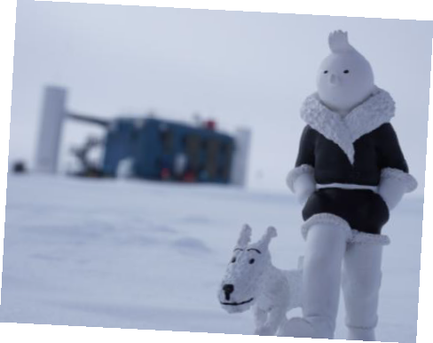

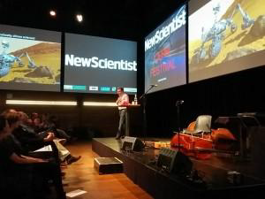
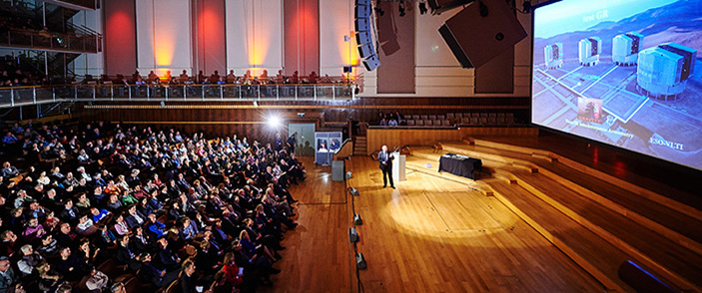
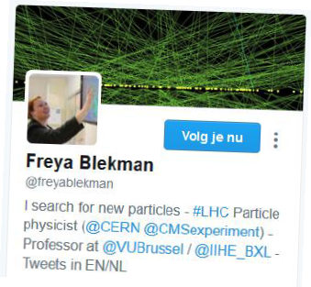
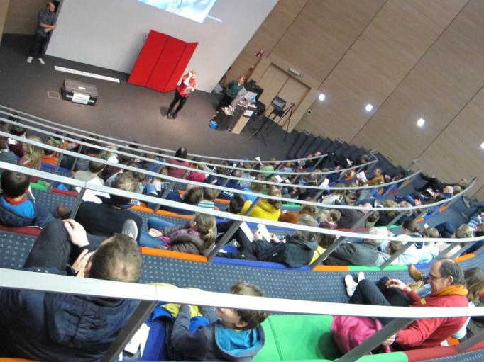

Research valorisation successes
Long list of appearances on television, radio and newspapers
“90 degrees South”
contest & event
Royal Academy Award 2013
for Science Communication
Jorgen D’Hondt
Participation to Bright Club Bxl
Kwantumrevolutie documentary
(selected for several festivals)
Regular Belgian VIP visits to CERN
Strong connections and appearances in New Scientist
Solvay Public Lectures
VUB annual Prize 2014
for Science Valorisation
(150k Euro)
Jorgen D’Hondt
Workshops for kids
Long list of public lectures
Royal Academy Award 2016
for Science Communication
Freya Blekman
International Masterclasses

Slide 36

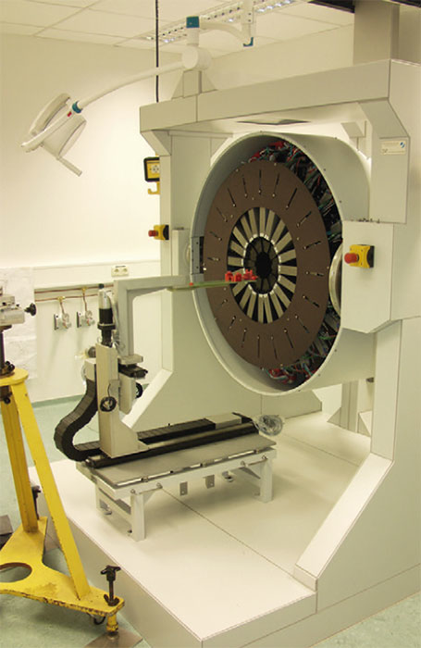
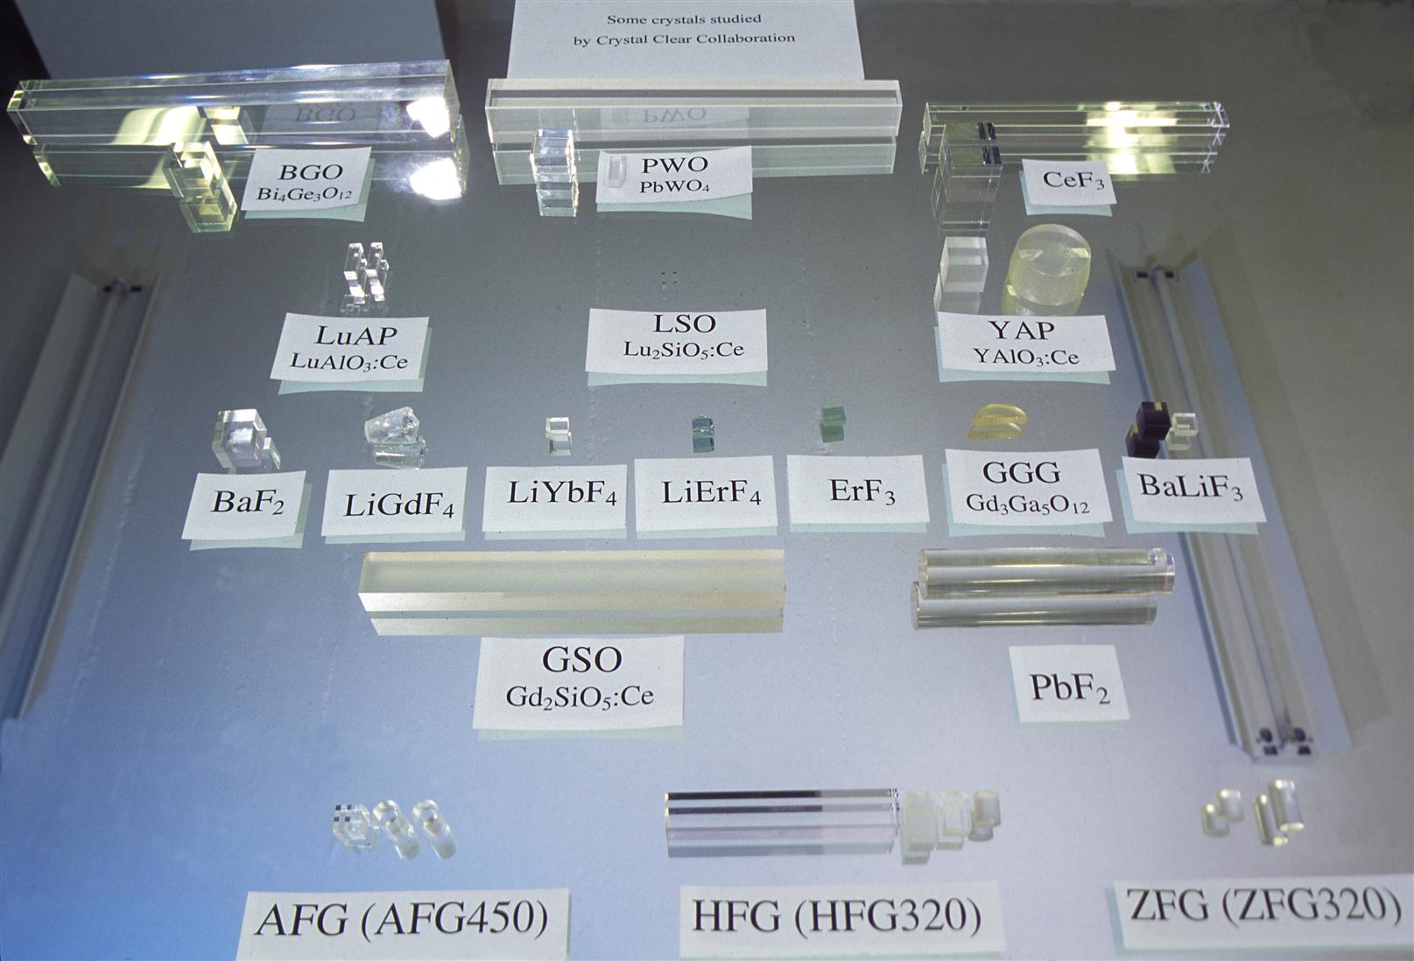
Research valorisation successes
International R&D collaboration on inorganic scintillators for novel detectors
Applications in high-energy physics, medical imaging and industry
S. Tavernier spokesperson (1995-2010)
Recent publications related to novel methods for PET and TOF-PET detectors

Slide 37
Research valorisation opportunities
Continue to participate in outreach programs & organize HEP@VUB Crosstalk Workshops
Focused outreach around each “HEP@VUB Crosstalk Workshop”:
      Use multi-media with short interviews and movies to highlight the specific high-energy physics topic
      Create work packages for teachers in schools (potentially STEM oriented)
      Create printable folders and posters
Explore opportunity for “SRP Crosstalk” workshops

Slide 38
Budget – investment to connect
One-day workshops with invited international experts focusing on contemporary topics on the interplay between our groups.
Bi-weekly invited seminars both topical as well as on the interplay between our groups.
 | Annual Budget
 | (kEuro)
Seminars (20) | 15
Crosstalk Workshops (3) | 15
Visitor program (10) | 15
Logistics, Outreach & Coordination | 30
Advisory Board | 2,5
Allocation per staff member (8) | 27.5 (x 8) = 220
 | 297.5
Short term visitors that help us making the bridge between groups.
Guido Tonelli (Pisa)
Dieter Lust (Munich)
Francis Halzen (Madison)
Professors need to work on joint projects to hire a PhD student or postdoc. Salary and bench-fee of PD or student is around 55k euro.
Unique funding program to explore connections in our research
Flexibility to act and react fast on novel scientific insights

Slide 39
Summary
HEP@VUB: investment to connect
Strong international recognition of our groups
Research groups are successful in funding requests
Need to explore the interplay of our research towards potential breakthroughs connecting the large and the small scales in our universe
Successful strategic hiring choices make us unique in Belgium and internationally very competitive to reach these objectives

