Slide 1
High-Energy Physics
May 3, 2022, Brussels (online)
Coordinator: in total 8 promotors
Jorgen D’Hondt
Group leaders of VUB research groups :
Stijn Buitink Astrophysics (AARG)
Ben Craps Theoretical Physics (TENA)
Jorgen D’Hondt Experimental High-Energy Physics (ELEM)
Alberto Mariotti Phenomenology (AARG+TENA+ELEM)
Other promotors:
Krijn de Vries, Steven Lowette, Alexandre Sevrin, Nick van Eijndhoven

Slide 2
High-Energy Physics (HEP): Curiosity driven research
observable
universe
8.8 10²⁶m
visible with
our own eyes
quarks
> 10⁻¹⁹m
~ 1˙000̇˙000˙000˙000˙000˙000˙000˙000˙000 meter
~ 0.000˙000˙000˙000˙000˙000˙01 meter
distance to
galactic center
distance
Earth-sun
distance light
travels in one year
biological cell
proton
neutron
farthest human object
from Earth (Voyager 1)
atoms

Slide 3
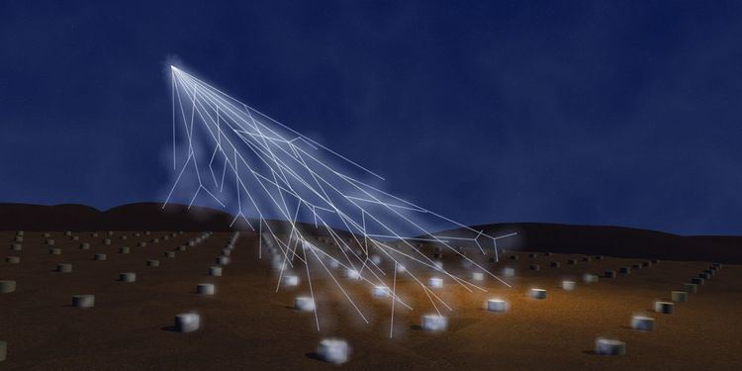
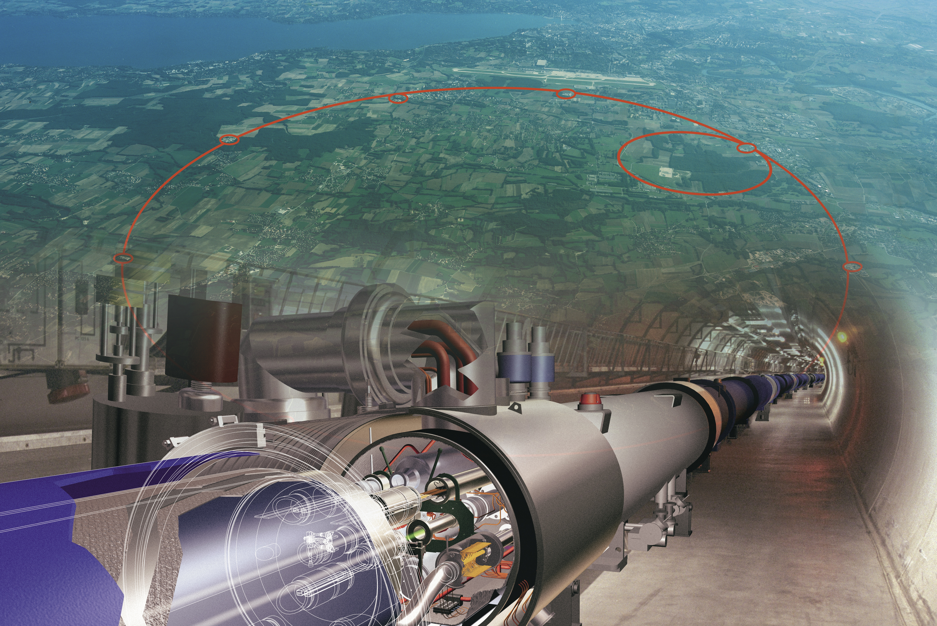
High-Energy Physics (HEP): Curiosity driven research
large surface/volume observatories
powerful accelerators
observable
universe
8.8 10²⁶m
visible with
our own eyes
quarks
> 10⁻¹⁹m
~ 1˙000̇˙000˙000˙000˙000˙000˙000˙000˙000 meter
~ 0.000˙000˙000˙000˙000˙000˙01 meter
distance to
galactic center
distance
Earth-sun
distance light
travels in one year
biological cell
proton
neutron
farthest human object
from Earth (Voyager 1)
atoms
General objective
Describe how nature behaves in this space and time

Slide 4
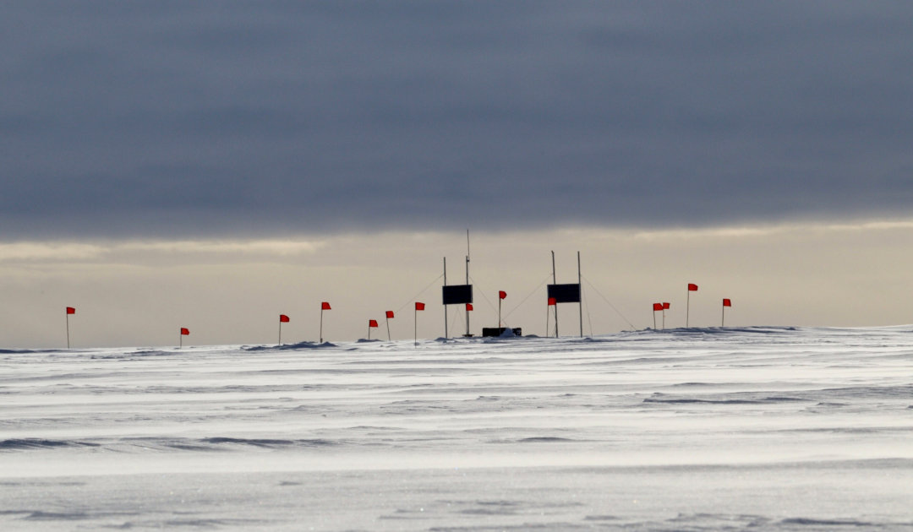
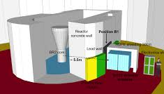
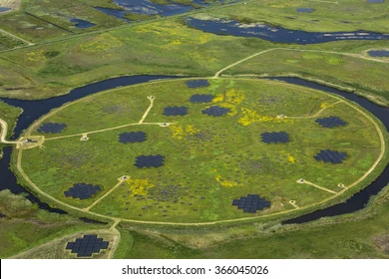
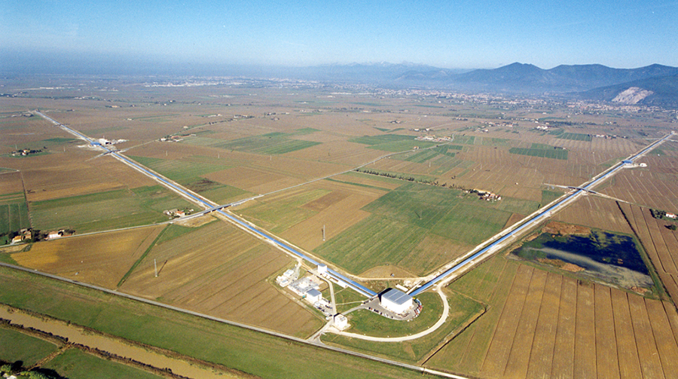
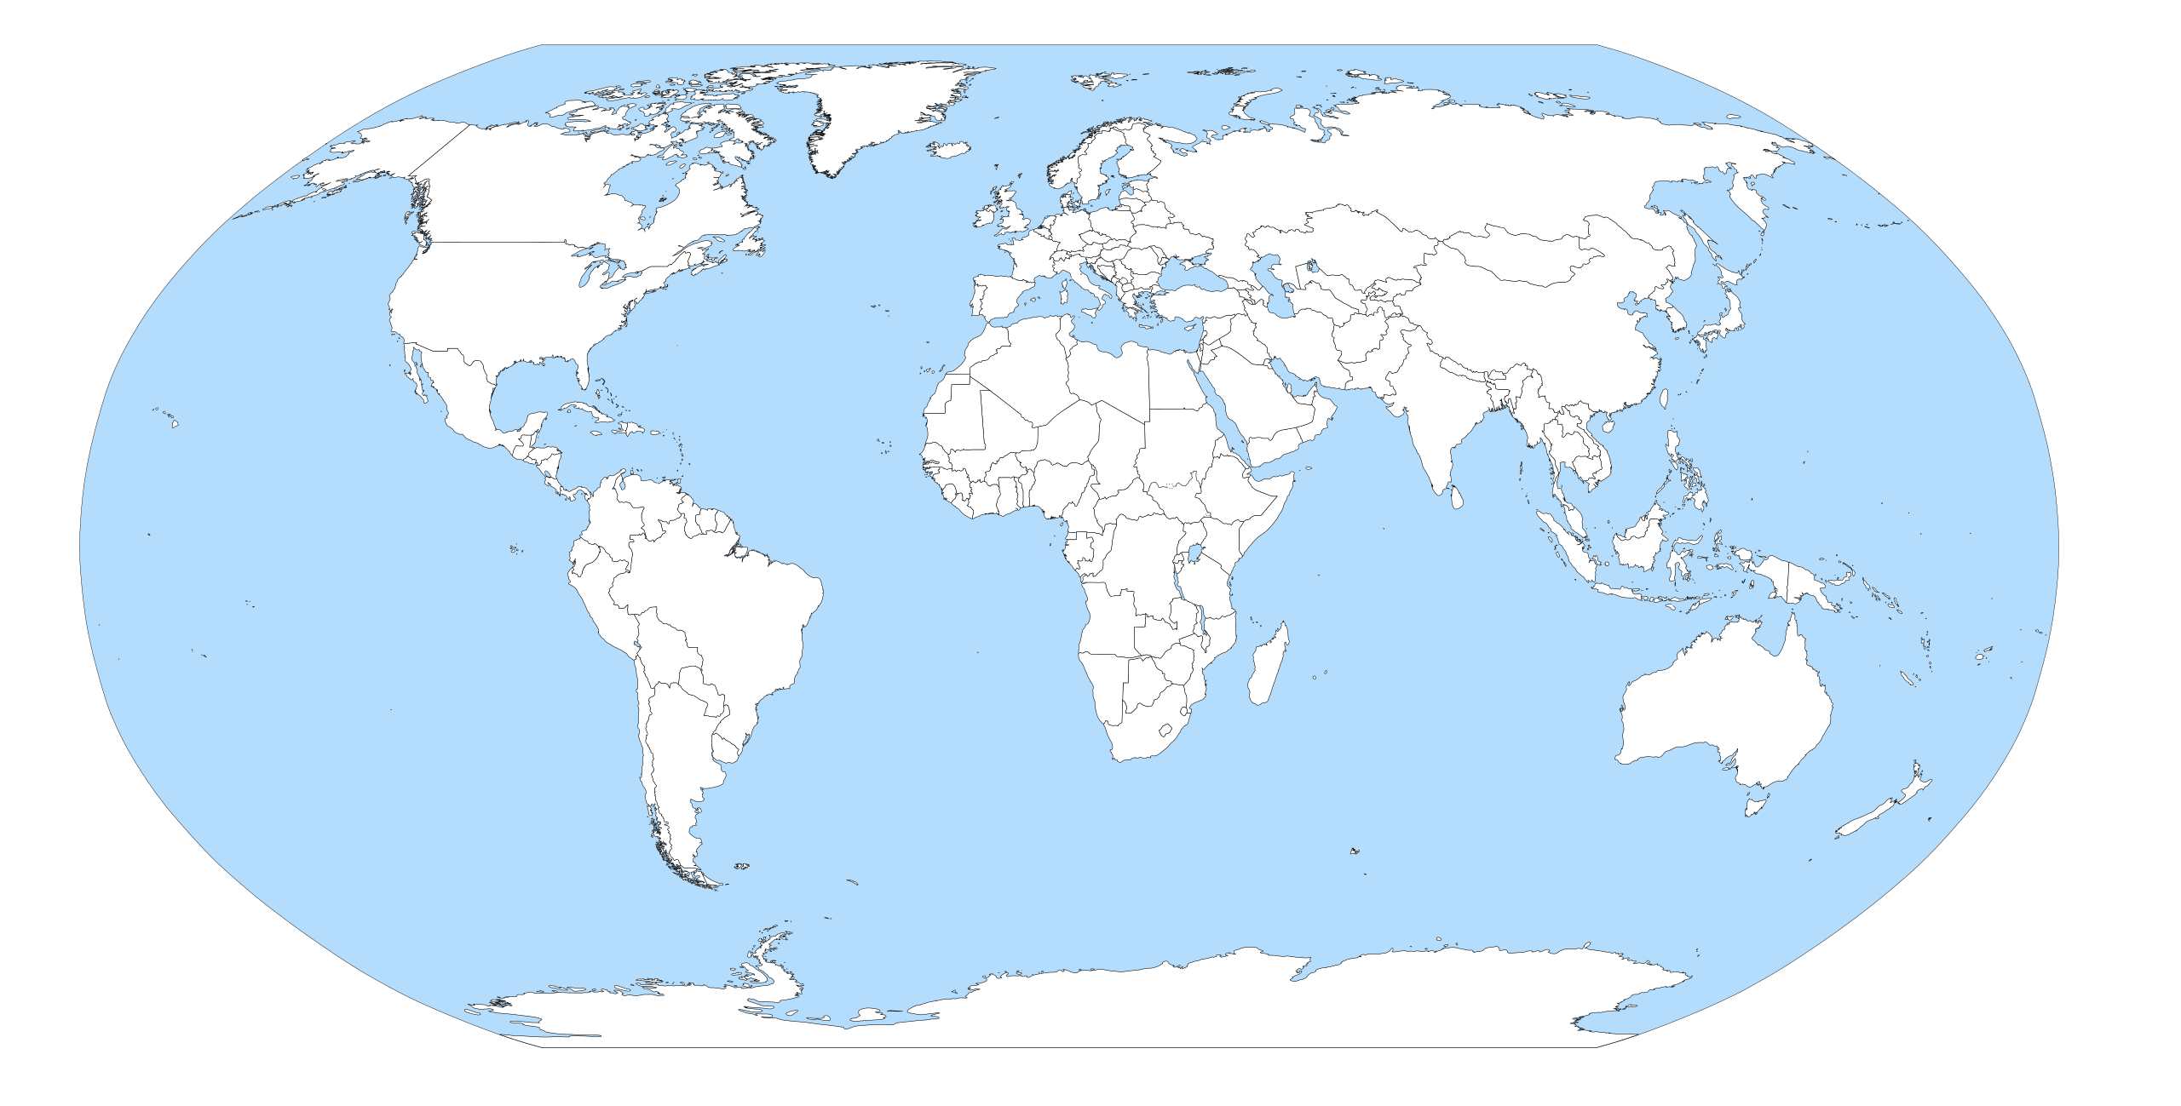
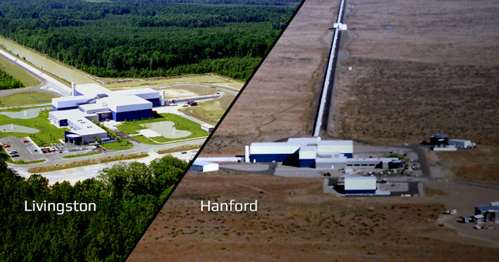
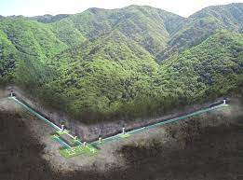
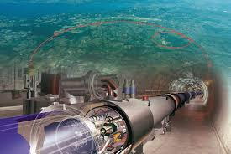
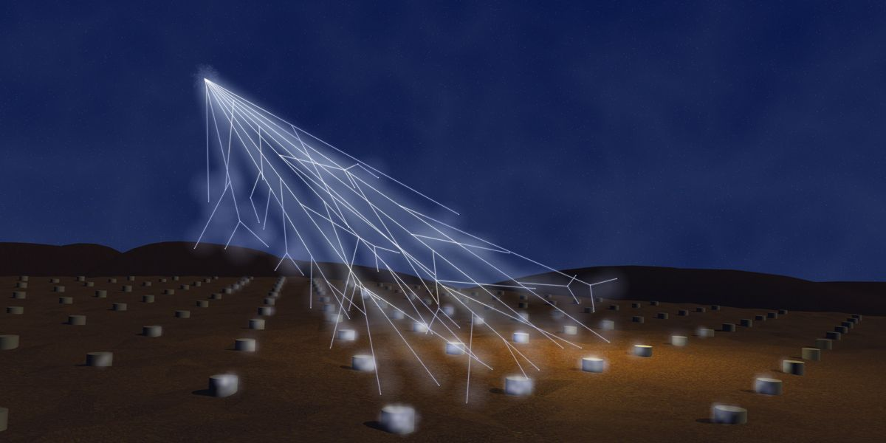
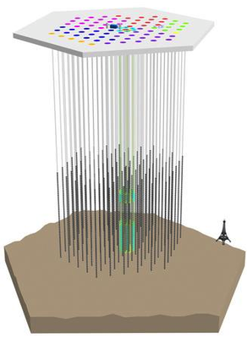
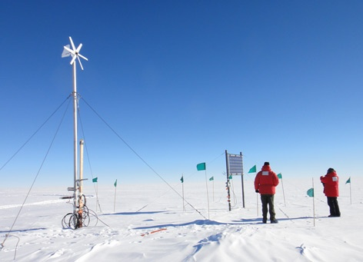
Radio Neutrino Observatory
Greenland
SoLid @ BR2
LOFAR Radio Telescope
LIGO/VIRGO/KAGRA
Gravitational Wave
Interferometers
CMS @ LHC
We are involved in a vast portfolio of running
research facilities
Pierre Auger
Cosmic Ray
Observatory
IceCube
Neutrino
Observatory
Askaryan
Radio
Array
Skaryan
Radio
Array

Slide 5
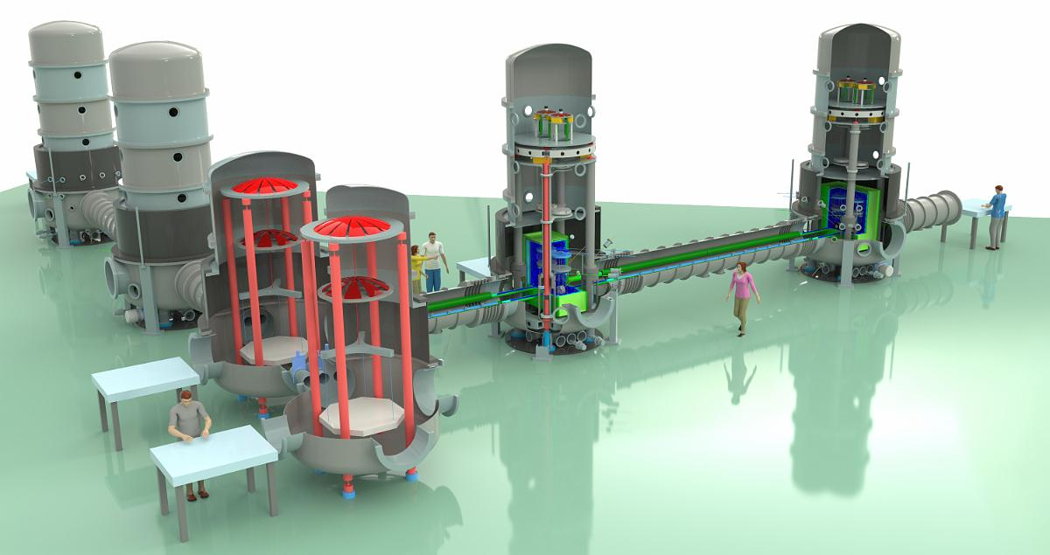
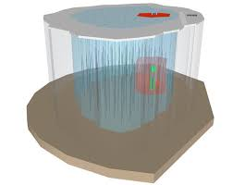
Radio Neutrino Observatory
Greenland
SoLid @ BR2
LOFAR Radio Telescope
LIGO/VIRGO/KAGRA
Gravitational Wave
Interferometers
CMS @ LHC
HL-LHC
… and we prepare for new ones
ETpathfinder
Pierre Auger
Cosmic Ray
Observatory
Gen2
IceCube
Neutrino
Observatory
Askaryan
Radio
Array

Slide 6
High-Energy Physics – pre-HEP@VUB
<2010
Theoretical physics
string theory
Prof. B. Craps
Prof. A. Sevrin
Particle physics experiments
high-energy colliders
Prof. J. D’Hondt
Ending FWO positions:
Prof. R. Roosen
Prof. W. Van Doninck
Active emeriti:
Prof. S. Tavernier
Astro-particle physics
neutrino telescope
Prof. De Clercq

Slide 7
High-Energy Physics – TODAY
Coordinator: Prof. J. D’Hondt
Secretariat: N. Hindrikx and S. Van den Bussche
Theoretical physics
string theory
holography
cosmology
gravitational waves
Prof. B. Craps
Prof. A. Sevrin
Part-time:
Prof. V. Balasubramanian
Prof. C. Blair
Prof. M. Sakellariadou
Prof. D. Thompson
Guest professor:
Prof. O. Evnin
Prof. L. Lopez Honorez
TENA
Particle physics experiments
high-energy colliders
neutrino physics
Prof. F. Blekman
(previous Odysseus 2)
Prof. J. D’Hondt
Prof. S. Lowette
(previous Odysseus 2)
Active emeriti:
Prof. S. Tavernier
ELEM
Astro-particle physics
cosmic neutrinos
dark matter
multi-messenger observations
Prof. K. de Vries
(ERC Starting Grant)
Prof. N. van Eijndhoven
(previous Odysseus 1)
Part-time:
Prof. K. Kotera
Active emeriti:
Prof. O. Scholten
ELEM
High-energy astrophysics
radio astronomy
cosmic rays
lightning
binary evolution
Prof. S. Buitink
(previous ERC Starting Grant)
Part-time:
Prof. J. Blommaert
Prof. T. Huege
Prof. K. Kolenberg
Guest professor:
Prof. D. Vanbeveren
Prof. J. Horandel
(ERC Advanced Grant)
AARG
Phenomenology
Prof. A. Mariotti
AARG – ELEM – TENA

Slide 8
High-Energy Physics – TODAY
Coordinator: Prof. J. D’Hondt
Secretariat: N. Hindrikx and S. Van den Bussche
Theoretical physics
string theory
holography
cosmology
gravitational waves
Prof. B. Craps
Prof. A. Sevrin
Part-time:
Prof. V. Balasubramanian
Prof. C. Blair
Prof. M. Sakellariadou
Prof. D. Thompson
Guest professor:
Prof. O. Evnin
Prof. L. Lopez Honorez
TENA
Particle physics experiments
high-energy colliders
neutrino physics
Prof. F. Blekman
(previous Odysseus 2)
Prof. J. D’Hondt
Prof. S. Lowette
(previous Odysseus 2)
Active emeriti:
Prof. S. Tavernier
ELEM
Astro-particle physics
cosmic neutrinos
dark matter
multi-messenger observations
Prof. K. de Vries
(ERC Starting Grant)
Prof. N. van Eijndhoven
(previous Odysseus 1)
Part-time:
Prof. K. Kotera
Active emeriti:
Prof. O. Scholten
ELEM
High-energy astrophysics
radio astronomy
cosmic rays
lightning
binary evolution
Prof. S. Buitink
(previous ERC Starting Grant)
Part-time:
Prof. J. Blommaert
Prof. T. Huege
Prof. K. Kolenberg
Guest professor:
Prof. D. Vanbeveren
Prof. J. Horandel
(ERC Advanced Grant)
AARG
News: two new vacancies for professors
Experimental high-energy physics
Theoretical high-energy physics
In total 24 professors in high-energy physics
to connect the large and small scales,
and experiment and theory
We are highly dependent on the SRP program
to provide a unique seed budget
Phenomenology
Prof. A. Mariotti
AARG – ELEM – TENA

Slide 9
VUB-scale in Flanders
As a university, the VUB represents about 10% in the Flemish academic landscape, hence “covers” about 0.6M inhabitants
Strategic research choices are to be made in order
to excel on the international level
HEP@VUB aims to create a prolific and inclusive environment for novel research to emerge and for the best researchers to thrive in seeking answers to these open questions in high-energy physics.
Such a consortium is unique in the Belgian context
and rare in the European context.

Slide 10
Some numbers
10 professors
14 part-time professors
or emeriti
17 postdocs
28 PhD students
Gender:
18% professors female
(after one left for another high-level position)
21% postdocs female
15% PhD students female
Since 2012:
>1330 publications*
>145k citations
h-index 176
>42 PhD thesis
* many with 1000+ authors
1 Odysseus-I (2M EUR)
2 Odysseus-II (2 x 750k EUR)
(more selected but declined)
2 ERC Starting Grant (2 x 1.5M EUR)
Through FWO in Flanders:
>1/3 of the resources in physics committee
(while VUB is only 1/10 fair share in Flanders)
Running & awarded since 2018:
>25M Euro external funds
11 FWO projects
13 FWO PhD grants
16 FWO postdoc grants
1.3M EUR from SRP program (~30k EUR/year/prof)
General leverage x20-25
International:
All (but two) our postdocs obtained
their PhD elsewhere
Most of our PhD students obtained
their Master abroad
Many of our postdocs have obtained a permanent academic position

Slide 11
International recognitions
Typically, leading research on the national level
Long list of invited Opening and Plenary talks at all major conferences in the field
Leadership at the international level, e.g.
J. D’Hondt: chair of the European Committee for Future Accelerators
S. Lowette: convenorship Exotica research team in CMS
N. van Eijndhoven: PI and chair Executive Board of RNO-Greenland
K. de Vries: scientific PI of the Radar Echo Telescope for Cosmic Rays
S. Buitink: PI of the LOFAR Cosmic Ray Key Science Program
Several national and international awards and prizes, e.g. World Economic Forum, valorisation prize, science communication, guest professors, Distinguished Researcher Fermilab LPC, thesis awards, etc.

Slide 12
Added value of the HEP@VUB budget
Instrumental and unique as seed budget
supporting initial explorations of unknown territories
external resources leverage on this initial investment
e.g. young researchers apply for individual FWO grants and promotors apply for FWO research projects based on the outcomes of the pilot investigations
our engagement in new projects would not have been possible without the initial exploration supported by the HEP@VUB budget
e.g. SoLid (2x FWO project), VIRGO/LIGO (1x iBOF), FCC (1x FWO project)
Strengthening our capacity to explore inter-disciplinary aspects
between the extremes in our high-energy physics research field
allows the promotors to enhance their horizon beyond the mono-disciplinary research
often results in opportunities for collaborations with external partners
e.g. over the last 5 years we have 19 joint-PhD students and 4 externally funded projects jointly with other institutions and involving mainly joint-PhD
Flexibility to act and react fast on novel scientific insights

Slide 13
Investment to connect
One-day workshops with invited international experts focusing on contemporary topics on the interplay between our groups.
Bi-weekly invited seminars both topical as well as on the interplay between our groups.
 | Annual Budget
 | (kEuro)
Seminars (20) | 15
Crosstalk Workshops (3) | 15
Visitor program (10) | 15
Logistics, Outreach & Coordination | 30
Advisory Board | 2,7
Allocation per staff member (8) | 27.5 (x 8) = 220
 | 297.7
Short term visitors that help us making the bridge between groups.
Guido Tonelli (Pisa)
Dieter Lust (Munich)
Francis Halzen (Madison)
Professors need to work on joint projects to hire a PhD student or postdoc. Salary and bench-fee of PD or student is around 55k euro.

Slide 14
Rebuttal
Elaborate more on the risk evaluation and measures
Several key risks were identified, and our measures described.
Enhance diversity in the research team
We have confirmed that we do not observe a passive role, but actively promote diversity in our organisation (incl. gender).
Provide more concrete work packages
We argued that HEP@VUB is a broad research programme and provided several mono- and interdisciplinary examples.

Slide 15
Summary
HEP@VUB: investment to connect
Strong international recognition of our groups
Research groups are successful in funding requests
Need to explore the interplay of our research towards potential breakthroughs connecting the large and the small scales in our universe
Successful strategic hiring choices make us unique in Belgium and internationally very competitive to reach these objectives

