Slide 1
High-Energy Physics
Proposal for a VUB research center
Prof. Ben Craps (Theoretical High-Energy Physics)
Prof. Jorgen D’Hondt (Particle Collider Physics)
Prof. Nick Van Eijndhoven (Astro-particle Physics)
Other staff members: Prof. Freya Blekman, Prof. Catherine De Clercq, Prof. Robert Roosen, Prof. Alexander Sevrin, Prof. Walter Van Doninck

Slide 2
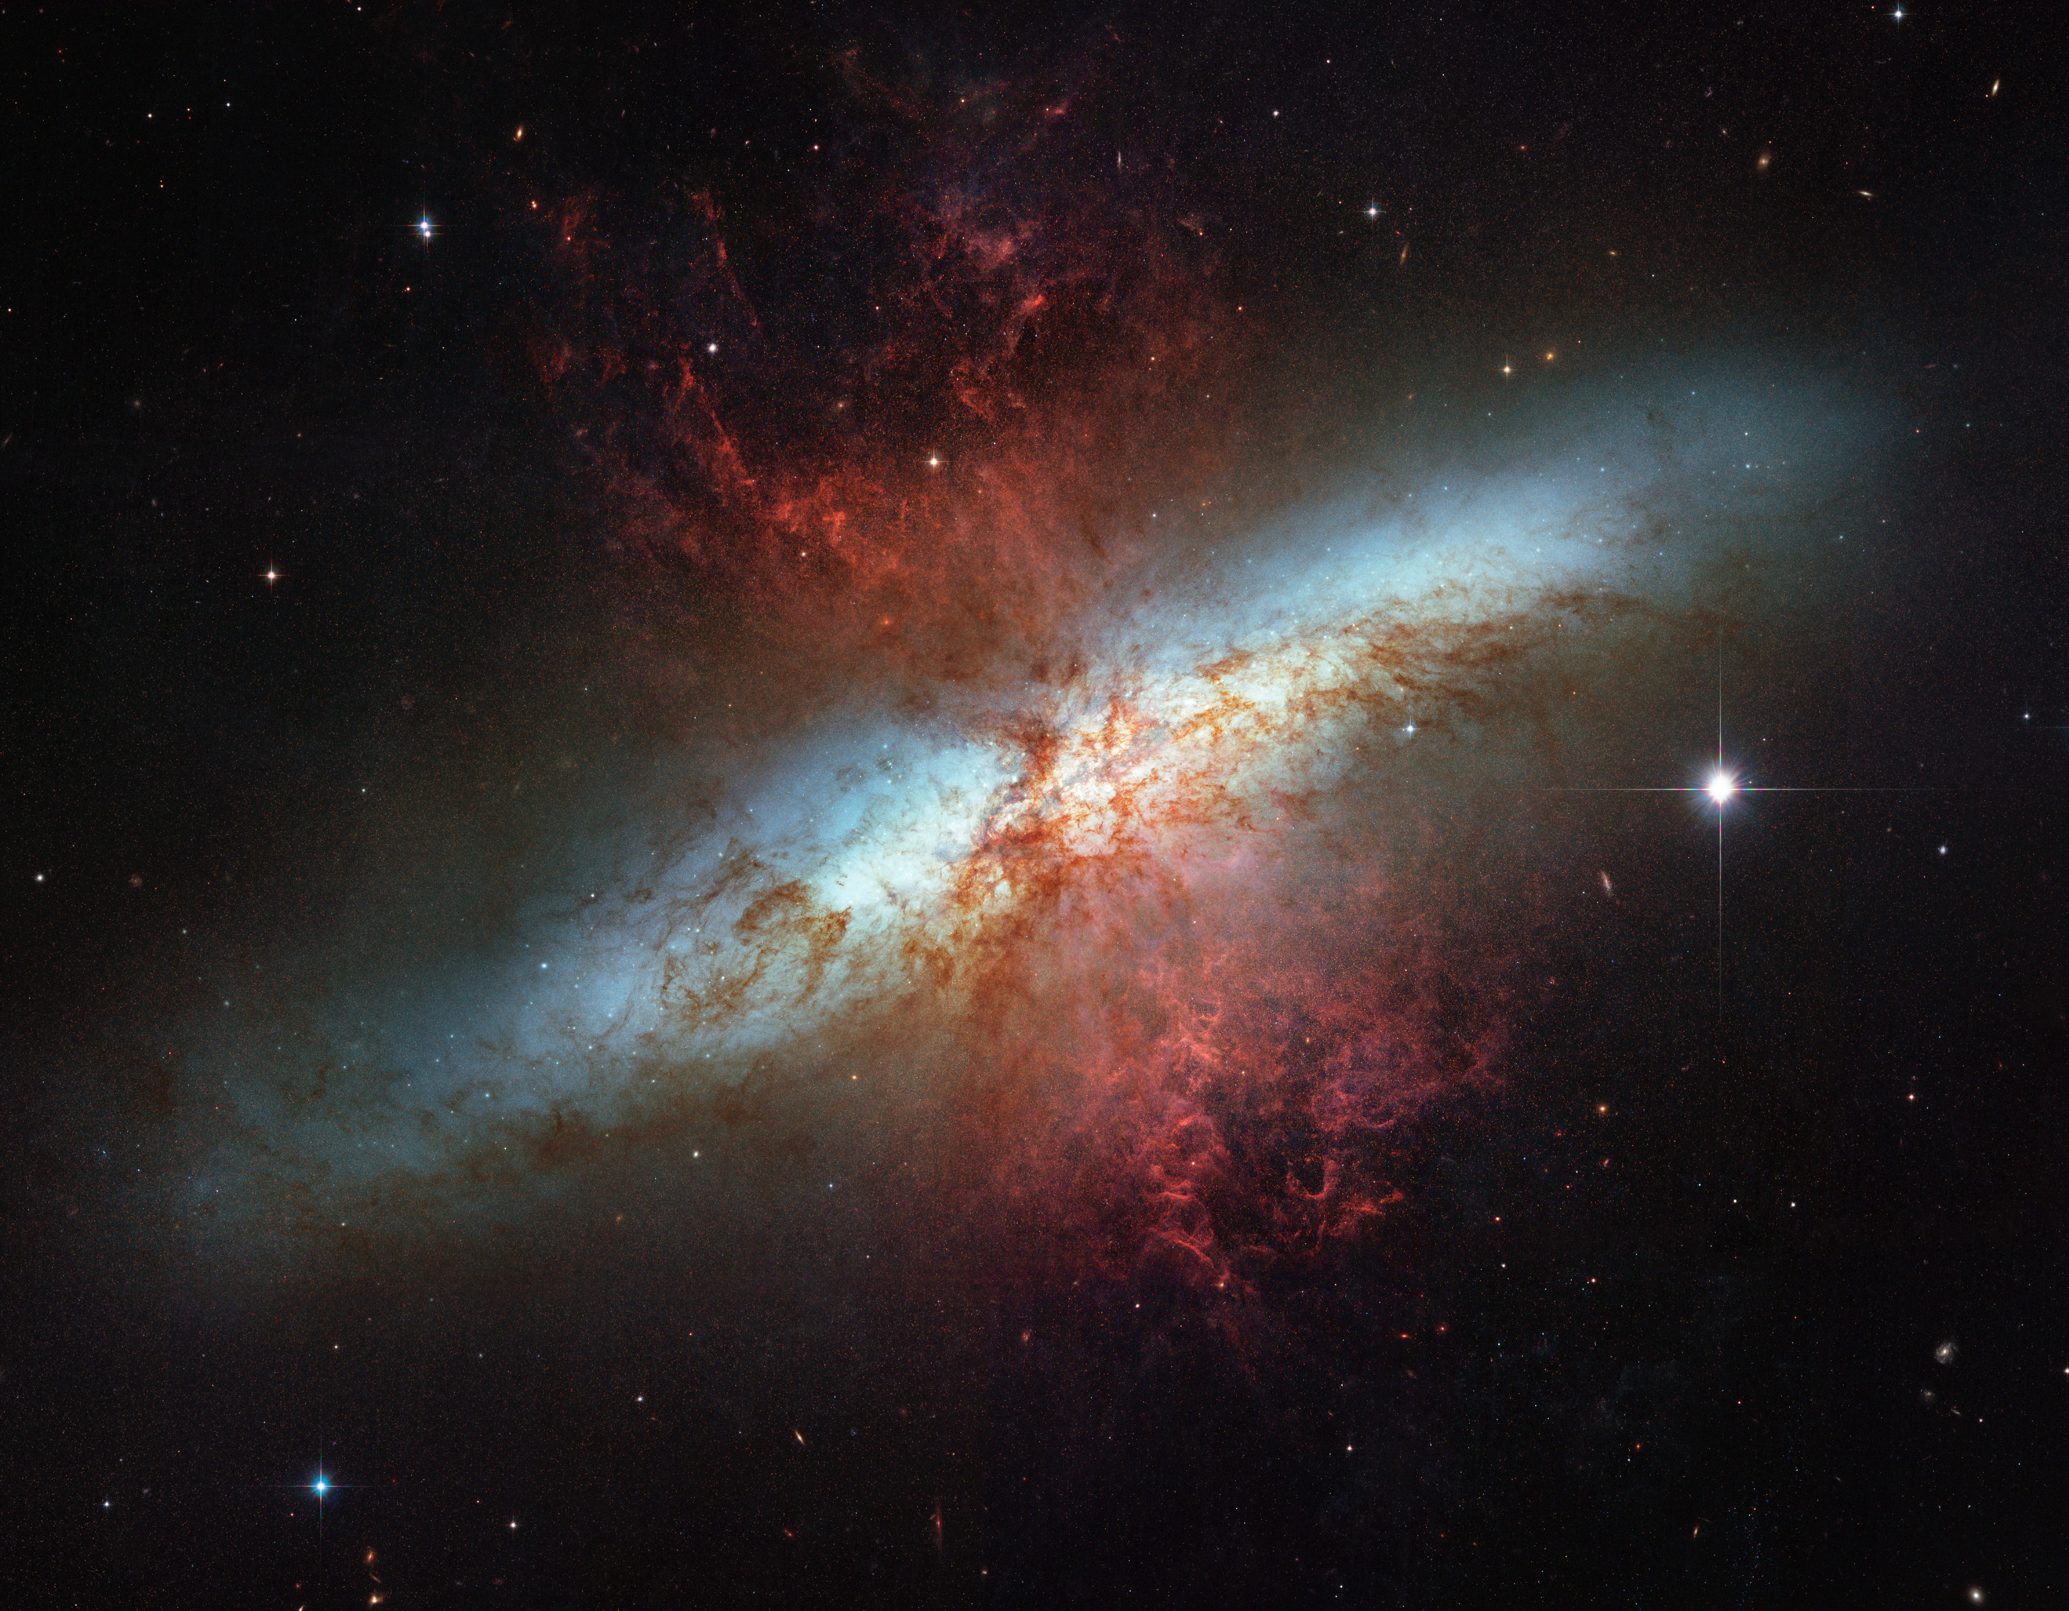
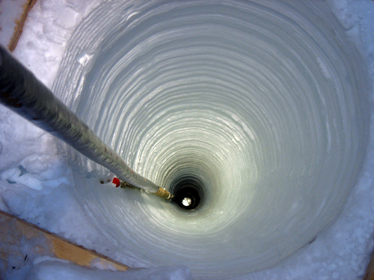
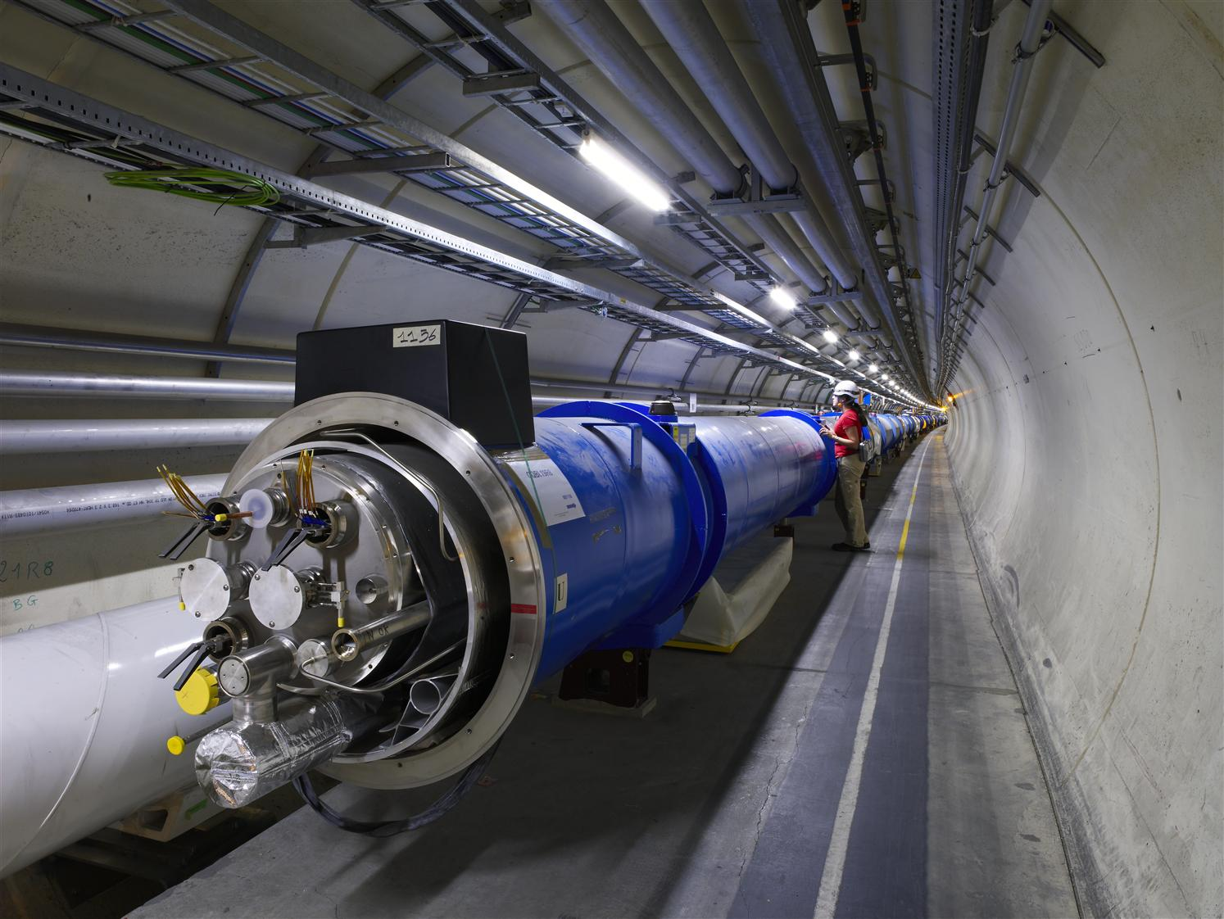
In our quest to identify the fundamental content and structure of the Universe many outstanding questions remain…
A booming research field with an enormous list of essential observations awaiting us in the next few years.
Strongly internationally embedded & recently a solid connection between theoretical and experimental high-energy physics.
The VUB has a leading role in HEP in Flanders and our teams are strategically deployed to contribute optimally in this field.

Slide 3
High-Energy Physics at the VUB – Research teams
experimental
Interuniversity Institute for High-Energies
(VUB + ULB)
(>50 scientists)
Collider Physics
(since 1972)
Astro-Particle Physics
(since 2000)
Phenomenology
(since 2010)
2 post-docs
2 PhD students
Theoretical High-Energy Physics
(since 1995)
Networks
IAP, CERN, DESY, Solvay, IceCube
VUB-ULB campus
~90 scientists in High-Energy Physics
largest HEP center in Belgium
Recent evaluation by 4 ref’s (IAP-VUB node) = 5/5

Slide 4
High-Energy Physics at the VUB – Research topics
CMS Week @ Brussels (2011)
Top Quark Conference (2010)
Collider Physics (Prof. Jorgen D’Hondt)
Construction and R&D of particle detectors (eg. leading role in the muon chambers of DELPHI, the Central Tracker of H1, the Silicon Tracker of CMS)
Largest data analysis Computing Centre (Brussels)
Key measurements and searches (2011 highlights @ LHC, eg. best limit on fourth generation quarks, most precise measurement top quark measurements,…)
New innovative directions: new physics phenomena connected to top quarks, Dark Matter searches in collisions
Many key positions within collider experiments, eg. first manager of the team of around 150 members working on research connected to the top quark, multiple coordinator positions
Leading role in Flanders since 40 years
4 professors
4 post-docs
6 PhD students
+ engineers/technicians/IT
Federal Government - CERN
FWO Big Science funding
Various FWO projects
Odysseus-II mandate
CMS Thesis Awards
Dr. S. Lowette (2007)
Dr. J Heyninck (2008)

Slide 5
High-Energy Physics at the VUB – Research topics
Astro-particle Physics (Prof. Nick Van Eijndhoven)
R&D on detector modules of Amanda/IceCube
Installation of detector modules on South Pole
Key measurements and searches with IceCube
Cosmic transients (leading γ-ray bursts research)
Dark Matter (one of the leading European centers)
Search for cosmic pointsources
Nature publication on γ-ray bursts with a strong world-wide press interest (April 2012)
New innovative research for GZK neutrinos with radio detection (ARA experiment), including participation in the R&D for timing and tracking
Many key positions within the IceCube experiment, leading analysis initiatives
Initiated astro-particle physics in Flanders
IceCube Week @ Brussels (2011)
2 professors
5 post-docs
3 PhD students
Various FWO projects
Odysseus-I mandate
Belgian Physics Society
D. Diederix (2010)
best Master thesis prize

Slide 6
High-Energy Physics at the VUB – Research topics
Theoretical High-Energy Physics (Prof. Ben Craps)
Geometric aspects of string theory & supersymmetry
Cosmological aspects of string theory
Generally highly successful in obtaining individual FWO grants for PhD students and post-docs
(anno 2012: 4 FWO-postdocs & 3 FWO-PhD-mandates)
Recently initiated theoretical research projects with a strong connection to phenomenology and observations
String theory techniques applied on the physics of Heavy Ion collisions
Supersymmetry breaking models
illustration on next slide
Both hot topics at the LHC at CERN.
Organized numerous Solvay Workshops
2 professors
5 post-docs
4 PhD students
(all post-docs & half of the PhD students internationally recruited)
FWO grant
7 individual FWO fellowships
Belgian Physics Society
W. Staessens (2008)
best Master thesis prize

Slide 7
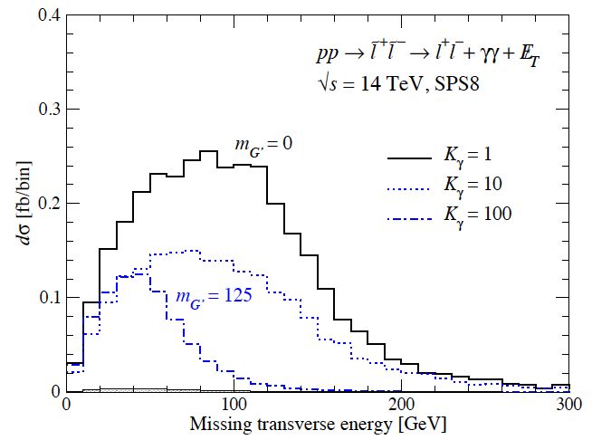
Illustration of the connection theory – pheno:
theory collaborator (ULB)
GOA pheno research team (VUB)
theory research team (VUB)
illustration in reply to one of the referees

Slide 8
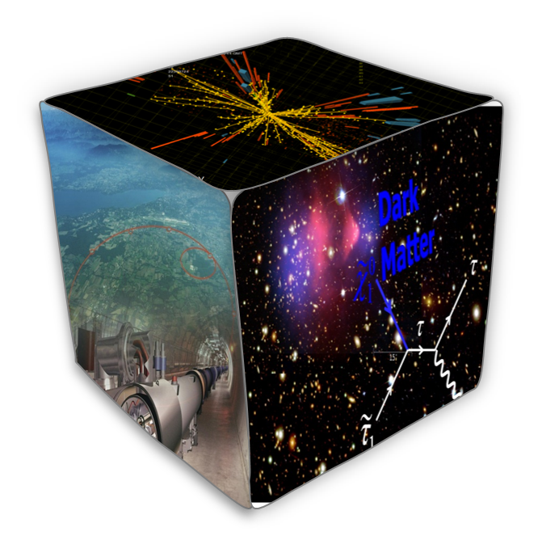
Example of collaboration: “Dark Matter”
Collider Physics
Astro-Particle Physics
particle
Dark Matter
particle
Dark Matter
detector
detector
particle
Dark Matter
particle
Dark Matter
Phenomenology
match empiric observations of fluxes with theoretical models
particle
Dark Matter
?
particle
Dark Matter
Theoretical HEP Physics
Other examples: Supersymmetry, Gamma Ray Burst, ...

Slide 9
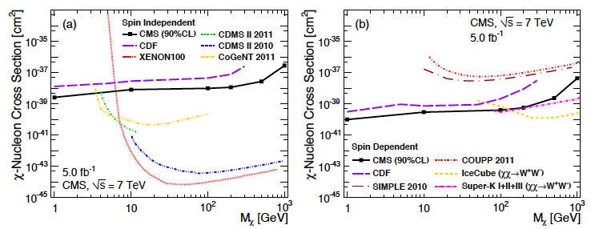
Recent results: “Dark Matter” (April 2012)
Collider research
Astro-particle research
Phenomenological work
Theoretical models

Slide 10
Outreach, Education and Valorisation
National coordinator within the IAP for Outreach (Prof. Alexander Sevrin)
Representing Belgium within the International Particle Physics Outreach Group (Prof. Jorgen D’Hondt)
Organizer of the Belgian Press Conference for the start of the LHC (Prof. Jorgen D’Hondt)
Outreach activities of the Solvay Institutes (Prof. Ben Craps & Prof. Alexander Sevrin)
About 40 media appearances in 4 years (written and audio-visual)
Experimental spin-offs developed in PET/PEM scanners and computing
Part of the organisation of the annual
Belgian-Dutch-German summer school for experimental high-energy physics
CERN Winter School on Supergravity, Strings and Gauge Theory
Amsterdam-Brussels-Paris school for theoretical high-energy physics

Slide 11
High-Energy Physics research center
experimental
Collider Physics
(since 1972)
Astro-Particle Physics
(since 2000)
Phenomenology
(since 2010)
consolidate & extend this research
Theoretical High-Energy Physics
(since 1995)
About 150 publications per year.
Timing perfectly aligned with international schedule of HEP.
Unique in Flanders;
Brussels center for HEP
Funding to consolidate the phenomenology research, with typically strong leverage.
Recent evaluation (IAP; VUB node) = 5/5

