Slide 1
Report from ECFA
(https://ecfa.web.cern.ch)
Jorgen D’Hondt (Jorgen.DHondt@cern.ch)
Council meeting, September 27-28th, 2018, CERN

Slide 2
Mandate ECFA
ECFA is advisory to CERN Management, CERN Council and its Committees, and to other organizations, national or international.
Long-range planning of European high-energy facilities adequate for the conduct of a valid high-energy research programme in the participating countries and matched to the size of this community and to the resources.
Duplication of similar accelerators should be avoided and international collaboration for the creation of these facilities should be encouraged if essential and efficient for attaining the purpose.
Equilibrium between the roles of international and national laboratories and university institutes in this research, and a close relation between research and education in high-energy physics and other fields.
Adequate conditions for research and a just and equitable sharing of facilities between physicists, irrespective of nationality and origin, as conducive to a successful collaborative effort.
slide from L. Evans – 25 years LHC symposium

Slide 3
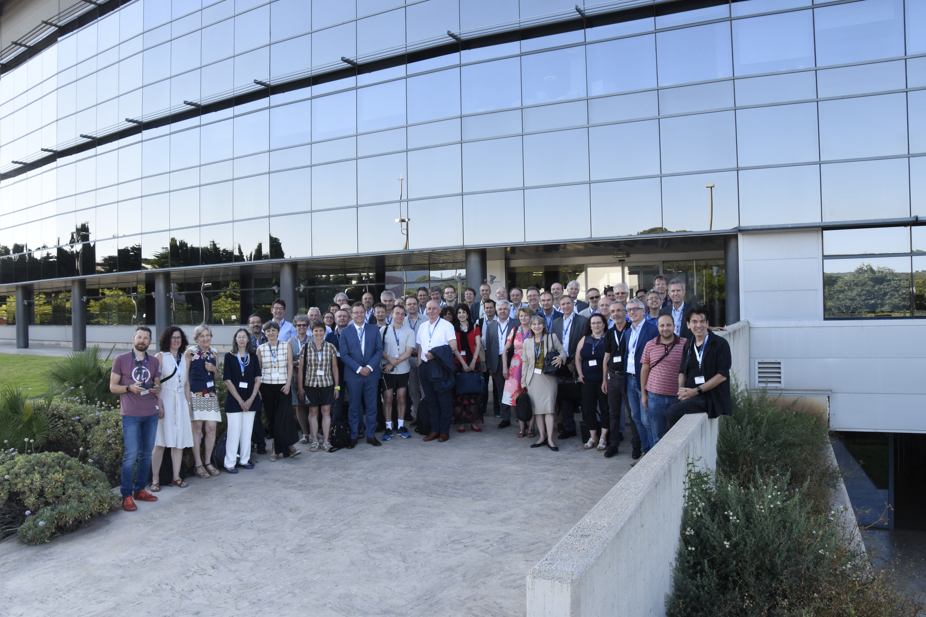
ECFA in some numbers
created in 1963
20 chairs since creation
Today:
27 countries + CERN
~110 members
Since 1976:
217 meetings
103rd Plenary meeting in Nov 2018
typically 6 RECFA meetings / year
typically 2 PECFA meetings / year
https://ecfa.web.cern.ch
Plenary ECFA at ALBA (Barcelona, Spain), 19-20 July 2018

Slide 4
PECFA and RECFA meetings
since Sept 2017
PECFA meeting at CERN, Nov 2017, https://indico.cern.ch/event/667672/
PECFA meeting at ALBA (Spain), July 2018, https://indico.cern.ch/event/730568/
Four RECFA visits: Turkey, Romania, Austria, Slovakia

Slide 5
ECFA decisions related to its organisation
Jorgen D’Hondt (VU Brussels, IIHE, Belgium) as ECFA chair for 2018-2020.
Carlos Lacasta (IFIC-Valencia, Spain) as ECFA Secretary for the remaining period of 2018-2020.
The ECFA Terms of Reference are updated with main changes:
the limitation of membership to European countries,
the provision of equal rights for CERN Associate Member States in the pre-stage to Membership, Associate Member States and Member States,
the concretisation of ECFA’s decision-making process (i.e. vote by RECFA, endorsement by PECFA),
the formalisation of the participation of the CERN Director for Research and Computing in RECFA meetings.
Cyprus, Slovenia, Turkey and Ukraine were endorsed as new members of ECFA, while Lithuania had also been invited to join ECFA.
ECFA endorsed the appointment of the NuPECC Chair as an Observer to ECFA, i.e. similar to the Observer status of the ApPEC Chair.

Slide 6
RECFA country visits 2018 & 2019
The following visits and meetings are foreseen in 2018
Romania (Bucharest), March 23-24, 2018
Austria (Vienna), April 6-7, 2018
Slovakia (Bratislava), May 18-19, 2018
ALBA (Barcelona), July 19-20, 2018 (including PECFA and RECFA meetings)
The Netherlands (Amsterdam), October 19-20, 2018
CERN, November 15-16, 2018 (including PECFA and RECFA meetings)
The following country visits in 2019:
Spring RECFA visits: Spain-Slovenia-Poland
Summer RECFA and PECFA: at the EPS-HEPP meeting in Ghent, Belgium
Fall RECFA visit: Cyprus
Fall RECFA and PECFA: CERN

Slide 7
RECFA visits to countries
Following the visits recommendations are formulated in letters from ECFA to the policy makers in the country are available on the ECFA website (https://ecfa.web.cern.ch/content/letters-member-states ). New since 2018 is that an executive summary complements the typical letter where we elaborate.

Slide 8
RECFA visit to Turkey – October 2017
(https://indico.cern.ch/event/671732/ )
The committee was impressed by the extensive and excellent educational network with a large body of academics and graduate students.
The focus of the high-energy physics community in Turkey is on the LHC experiments. The Turkish particle physics community is somewhat fragmented, with 80 doctorate-level physicists distributed among 40 institutes spread over a wide geographical area. Despite this challenge, they manage to collaborate successfully on experiments by forming thematic clusters between institutes. However, the investment made in the experimental programme is currently not at a level appropriate for a country with the resources and aspirations of Turkey, in particular given the investment that is now being made at CERN through its status as an Associate Member State.
The Committee is impressed by the number of university groups and the wide spectrum of detector and accelerator R&D activities carried out by Turkish scientists both within the country and abroad. The Committee believes that these valuable technical skills need to be maintained and could be extended.
The Committee appreciates the progress in the field of computing infrastructure in the country, however the resources channeled towards GRID computing and similar technologies used by big science are limited. A country like Turkey with big investments in scientific infrastructure could get more return by investing in these technologies.
In recent years, a very active programme for schools and school teachers has been developed, initiated by Turkish physicists based at CERN through non-Turkish institutes, even without central support from funding agencies. The Committee stresses the importance of these activities to ensure the future of the country in the field of science and technology.
In conclusion, the Committee strongly recommends closer interactions between the Turkish funding agencies and the particle physics research community to optimise the scientific and technological return of Turkey’s Associate Member State status at CERN.

Slide 9
RECFA visit to Turkey – October 2017
(https://indico.cern.ch/event/671732/ )
The committee was impressed by the extensive and excellent educational network with a large body of academics and graduate students.
The focus of the high-energy physics community in Turkey is on the LHC experiments. The Turkish particle physics community is somewhat fragmented, with 80 doctorate-level physicists distributed among 40 institutes spread over a wide geographical area. Despite this challenge, they manage to collaborate successfully on experiments by forming thematic clusters between institutes. However, the investment made in the experimental programme is currently not at a level appropriate for a country with the resources and aspirations of Turkey, in particular given the investment that is now being made at CERN through its status as an Associate Member State.
The Committee is impressed by the number of university groups and the wide spectrum of detector and accelerator R&D activities carried out by Turkish scientists both within the country and abroad. The Committee believes that these valuable technical skills need to be maintained and could be extended.
The Committee appreciates the progress in the field of computing infrastructure in the country, however the resources channeled towards GRID computing and similar technologies used by big science are limited. A country like Turkey with big investments in scientific infrastructure could get more return by investing in these technologies.
In recent years, a very active programme for schools and school teachers has been developed, initiated by Turkish physicists based at CERN through non-Turkish institutes, even without central support from funding agencies. The Committee stresses the importance of these activities to ensure the future of the country in the field of science and technology.
In conclusion, the Committee strongly recommends closer interactions between the Turkish funding agencies and the particle physics research community to optimise the scientific and technological return of Turkey’s Associate Member State status at CERN.

Slide 10
RECFA visit to Turkey – October 2017
(https://indico.cern.ch/event/671732/ )
The committee was impressed by the extensive and excellent educational network with a large body of academics and graduate students.
The focus of the high-energy physics community in Turkey is on the LHC experiments. The Turkish particle physics community is somewhat fragmented, with 80 doctorate-level physicists distributed among 40 institutes spread over a wide geographical area. Despite this challenge, they manage to collaborate successfully on experiments by forming thematic clusters between institutes. However, the investment made in the experimental programme is currently not at a level appropriate for a country with the resources and aspirations of Turkey, in particular given the investment that is now being made at CERN through its status as an Associate Member State.
The Committee is impressed by the number of university groups and the wide spectrum of detector and accelerator R&D activities carried out by Turkish scientists both within the country and abroad. The Committee believes that these valuable technical skills need to be maintained and could be extended.
The Committee appreciates the progress in the field of computing infrastructure in the country, however the resources channeled towards GRID computing and similar technologies used by big science are limited. A country like Turkey with big investments in scientific infrastructure could get more return by investing in these technologies.
In recent years, a very active programme for schools and school teachers has been developed, initiated by Turkish physicists based at CERN through non-Turkish institutes, even without central support from funding agencies. The Committee stresses the importance of these activities to ensure the future of the country in the field of science and technology.
In conclusion, the Committee strongly recommends closer interactions between the Turkish funding agencies and the particle physics research community to optimise the scientific and technological return of Turkey’s Associate Member State status at CERN.

Slide 11
RECFA visit to Turkey – October 2017
(https://indico.cern.ch/event/671732/ )
The committee was impressed by the extensive and excellent educational network with a large body of academics and graduate students.
The focus of the high-energy physics community in Turkey is on the LHC experiments. The Turkish particle physics community is somewhat fragmented, with 80 doctorate-level physicists distributed among 40 institutes spread over a wide geographical area. Despite this challenge, they manage to collaborate successfully on experiments by forming thematic clusters between institutes. However, the investment made in the experimental programme is currently not at a level appropriate for a country with the resources and aspirations of Turkey, in particular given the investment that is now being made at CERN through its status as an Associate Member State.
The Committee is impressed by the number of university groups and the wide spectrum of detector and accelerator R&D activities carried out by Turkish scientists both within the country and abroad. The Committee believes that these valuable technical skills need to be maintained and could be extended.
The Committee appreciates the progress in the field of computing infrastructure in the country, however the resources channeled towards GRID computing and similar technologies used by big science are limited. A country like Turkey with big investments in scientific infrastructure could get more return by investing in these technologies.
In recent years, a very active programme for schools and school teachers has been developed, initiated by Turkish physicists based at CERN through non-Turkish institutes, even without central support from funding agencies. The Committee stresses the importance of these activities to ensure the future of the country in the field of science and technology.
In conclusion, the Committee strongly recommends closer interactions between the Turkish funding agencies and the particle physics research community to optimise the scientific and technological return of Turkey’s Associate Member State status at CERN.

Slide 12
RECFA visit to Romania – March 2018
(http://www.nipne.ro/indico/conferenceDisplay.py?ovw=True&confId=358 )

Slide 13
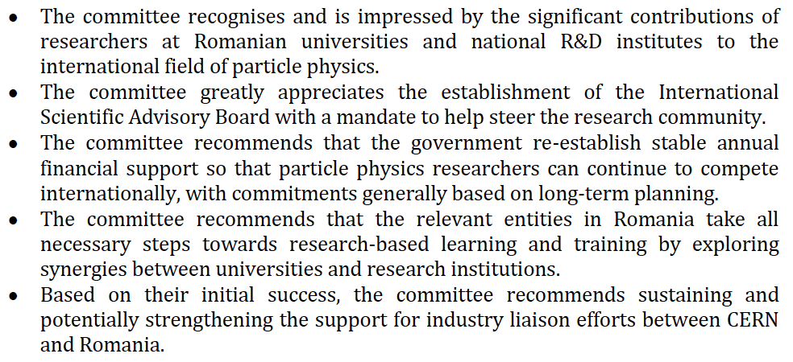
RECFA visit to Romania – executive summary

Slide 14
RECFA visit to Romania – executive summary

Slide 15
RECFA visit to Romania – executive summary

Slide 16
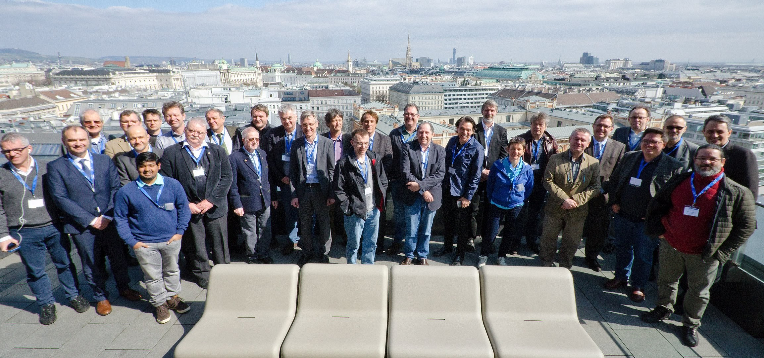
RECFA visit to Austria – April 2018
(https://indico.cern.ch/event/689498/overview )

Slide 17
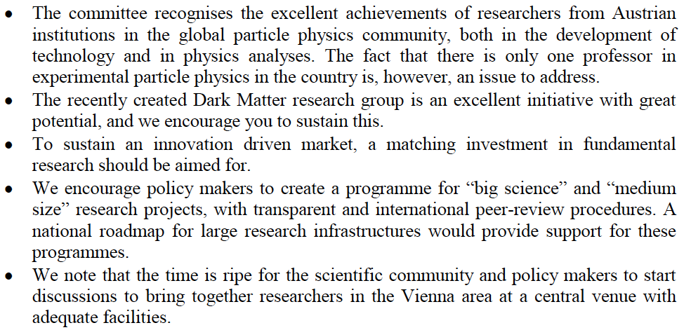
RECFA visit to Austria – executive summary

Slide 18
RECFA visit to Austria – executive summary

Slide 19
RECFA visit to Austria – executive summary

Slide 20
RECFA visit to Slovakia – May 2018 – executive summary
(https://indico.cern.ch/event/711794/ )
The committee confirms that the Slovak research community is making adequate use of the opportunities provided by CERN, notably through its participation in several experiments.
In this context, the time is ripe to confirm Slovak core investments in the upgrade of the ATLAS experiment, in particular.
The committee encourages the creation of additional funding programmes based on scientific excellence to support researchers in their pursuit of innovative ambitions.
The committee recommends initiating a dialogue between funding bodies and researchers to establish an adequate and sustainable level of technical and computing personnel to support the research.
The successes of the industry liaison and outreach efforts are to be applauded and the committee advises Slovakia to explore ways of using these accomplishments to strengthen science education as a whole in Slovakia.
The committee feels that the Slovak particle physics community should become more international and suggests that postdoctoral mobility programmes be created as an avenue to tenured positions.

Slide 21
RECFA visit to Slovakia – May 2018 – executive summary
(https://indico.cern.ch/event/711794/ )
The committee confirms that the Slovak research community is making adequate use of the opportunities provided by CERN, notably through its participation in several experiments.
In this context, the time is ripe to confirm Slovak core investments in the upgrade of the ATLAS experiment, in particular.
The committee encourages the creation of additional funding programmes based on scientific excellence to support researchers in their pursuit of innovative ambitions.
The committee recommends initiating a dialogue between funding bodies and researchers to establish an adequate and sustainable level of technical and computing personnel to support the research.
The successes of the industry liaison and outreach efforts are to be applauded and the committee advises Slovakia to explore ways of using these accomplishments to strengthen science education as a whole in Slovakia.
The committee feels that the Slovak particle physics community should become more international and suggests that postdoctoral mobility programmes be created as an avenue to tenured positions.

Slide 22
RECFA visit to Slovakia – May 2018 – executive summary
(https://indico.cern.ch/event/711794/ )
The committee confirms that the Slovak research community is making adequate use of the opportunities provided by CERN, notably through its participation in several experiments.
In this context, the time is ripe to confirm Slovak core investments in the upgrade of the ATLAS experiment, in particular.
The committee encourages the creation of additional funding programmes based on scientific excellence to support researchers in their pursuit of innovative ambitions.
The committee recommends initiating a dialogue between funding bodies and researchers to establish an adequate and sustainable level of technical and computing personnel to support the research.
The successes of the industry liaison and outreach efforts are to be applauded and the committee advises Slovakia to explore ways of using these accomplishments to strengthen science education as a whole in Slovakia.
The committee feels that the Slovak particle physics community should become more international and suggests that postdoctoral mobility programmes be created as an avenue to tenured positions.

Slide 23
ECFA Working Groups

Slide 24
ApPEC-ECFA Working Group on Detector R&D
“A committee to review detector development efforts for future projects”
https://cds.cern.ch/record/2235340/files/Statement%20R&D298.pdf
The mandate of the Detector R&D panel (ECFA/16/298, June 2016), some extracts:
The ECFA Detector Panel is aimed at providing advice on detector development efforts for projects in their preliminary and preparatory phases. It receives R&D proposals on request by research communities, laboratories, institutions, individual authors and bodies such as science funding agencies. It appoints experts charged to evaluate them and make recommendations.
It helps to create coherence of global detector R&D efforts by encouraging synergies between different activities and advising funding agencies on request.
It is primarily concerned with large projects, related to accelerator and non-accelerator experiments in the fields of particle and astroparticle physics, involving several institutions and requiring significant resources. It is in particular intended for the review of projects that do not undergo an existing review process elsewhere.
The Panel has only a reviewing and advisory role. It does not assume any coordination of the R&D programs, nor does it take part in any science policy decisions.

Slide 25
ApPEC-ECFA Working Group on Detector R&D
The current composition of the panel (contact: ecfa-dp@desy.de ):
Phil Allport
Ariella Cattai
Silvia Dalla Torre
Doris Eckstein
Els Koffeman (chairperson)
Lucie Linssen
Laurent Serin
Arno Straessner

Slide 26
ApPEC-ECFA Working Group on Detector R&D – survey
As part of the process to inform the upcoming update of the European Strategy for Particle Physics, the ECFA Detector Panel (https://ecfa-dp.desy.de/ ) advertised as widely as possible the brief questionnaire at https://www.surveymonkey.com/r/DetectorsRD .
The survey will contribute to assessing the deployment and strength of R&D activities in astro-particle, neutrino, nuclear and particle physics in Europe. It will also aim to elucidate opportunities created by current and emerging technologies and the potential for greater synergies between R&D activities.

Slide 27
Working group on Software Skills
(Alexander Read, Eilam Gross, Kati Lassila-Perini, Tadeusz Lesiak, ECFA chair and secretary)
Developing optimal data analysis techniques for particle physics experiments is vital to our community, as is continuous dialogue between software experts and analysers.
Worldwide, several initiatives are under way to study this topic, resulting in, for example, the HEP Software Foundation’s white paper (https://arxiv.org/pdf/1712.06982.pdf ).
Based on an initial view of the potential future opportunities and challenges relating to analysis tools, the ECFA working group will ascertain how the particle physics community can best prepare itself and how well we are currently preparing.
The working group will collect a census of HEP software professionals, either with a software engineering degree (or equivalent) or with expert experience in the field. This information might also be relevant to the strategic discussions in the context of the update of the European Strategy for Particle Physics.

Slide 28
Working group on Recognition of Individual Achievements
in Large Collaborations
(Antonio Zoccoli, Dave Milstead, Peter Schleper, Roger Forty, Stan Bentvelsen, ECFA chair and secretary)
ECFA acknowledges the importance of correctly recognising individual achievements and affirms the challenges therein when dealing with scientific collaborations of between one hundred and many thousands of researchers.
Recently, a working group has been created within the role and responsibility of ECFA to verify the current status of the recognition of individual achievements in large collaborations, with the aim of providing recommendations as input for the update of the European Strategy for Particle Physics.
At its meeting at ALBA, PECFA heard the outcomes of a survey of the leaders of 29 CERN-based or CERN-recognised experiments in particle, nuclear, astroparticle and astro- physics. Encouragingly, the leaders of these collaborations declared our efforts to be highly appreciated, timely and welcome. Therefore, we are convinced that the community is open-minded, ready for a profound dialogue on the topic and receptive to recommendations.
Yesterday we launched a community-wide survey to verify the current status of the recognition of individual achievements (the survey is linked to the ECFA website: https://ecfa.web.cern.ch ).

Slide 29
Plenary ECFA meeting at CERN (Nov 15-16, 2018, Main Auditorium)
(organising group: Guy Wormser, Lenny Rivkin, Roger Forty, Tadeusz Lesiak, ECFA chair and secretary)
https://indico.cern.ch/event/759130/overview
The auditorium will be open for the community.
The presentations will be webcast and the recordings shared with the community.

Slide 30
Relations between ECFA and NuPECC
(NuPECC, Nuclear Physics European Collaboration Committee, http://www.nupecc.org )
(ApPEC, Astroparticle Physics European Consortium, http://www.appec.org )
ECFA approved the NuPECC chair to become Observer to RECFA (similar to ApPEC).
The NuPECC chair (or deputy) participated in our previous RECFA country visits and meetings, and this is considered a clear added value.
Similarly the ECFA chair becomes Observer to NuPECC, and participated already in the NuPECC meeting in Oslo on June 15-16, 2018.

Slide 31
ApPEC-ECFA-NuPECC – Diversity Charter
(ApPEC: Francesca Moglia, Teresa Montaruli; ECFA: Patricia Conde Muino, Stewart Boogert; NuPECC: Jens Jorgen Gaardhøje, Nasser Kalantar, Jochen Wambach)
Diversity is an important aspect for all organisations, also in the scientific organisations and collaborations of our community.
Diversity charters can help in promoting diversity actions in a coherent way across a community. For example inviting the scientific collaborations and/or laboratories within our field to sign such a charter.
Signing a diversity charter would commit the signatory entity to engage in a typically long-term process of actively encouraging diversity within the structures of the collaboration/laboratory.
A joint working group among ApPEC-ECFA-NuPECC is created to explore this avenue.

Slide 32
ApPEC-ECFA-NuPECC – Joint Seminar
(ApPEC: Antonio Masiero, Berrie Giebels, Stan Bentvelsen; ECFA: Carlos Lacasta, Jorgen D’Hondt; NuPECC: Eberhard Widmann, Marek Lewitowicz)
NuPECC and ApPEC have many elements in common with ECFA, i.e. scientifically, technically and in the organisation of our research.
Organising a joint ApPEC-ECFA-NuPECC seminar every three years might be a wishful option, very similar to the triennial ICFA seminars with a focus on particle physics.
To overview the scientific and technical achievement and upcoming challenges, as well as potential synergies, and the organisational, outreach and valorisation aspects.
A joint working group among ApPEC-ECFA-NuPECC is created to explore this avenue.

Slide 33
News from ICFA, especially on the ILC project

Slide 34
Report from ICFA
International Committee for Future Accelerators (http://icfa.fnal.gov )
Current members:
G. Taylor (Chair, Australia)
P. Bhat (Secretary, USA) J. D’Hondt, F. Gianotti, J. Mnich (previous chair) (CERN Member States) N. Lockyer, D. MacFarlane, N. Hadley (USA) I. Koop, V. Petrov (Russia) Y. Wang (China) T. Mori, M. Yamauchi (Japan) M. Roney (Canada)
E. Álvarez, V. Matveev, P.A. Naik (Other Countries)
H. Schellman, Chair of the IUPAP Commission on Particles and Fields (ex officio)

Slide 35
Report from ICFA
International Committee for Future Accelerators (http://icfa.fnal.gov )
Current panels:
ICFA Instrumentation Innovation and Development Panel (Chair — Ariella Cattai, CERN)
ICFA Beam Dynamics Panel (Chair — Yong Ho Chin, KEK)
ICFA Panel on Advanced and Novel Accelerators (Chair — Brigitte Cros, Paris)
ICFA Standing Committee on Interregional Connectivity (Chair — Harvey Newman, Caltech)
ICFA Study Group on Data Preservation in High Energy Physics (Chair – Cristinel Diaconu, CPPM, Marseille)
Linear Collider Board (Chair – Tatsuya Nakada, EPFL, Lausanne)
ICFA Panel on Sustainable Accelerators and Colliders (Chair — Mike Seidel, PSI)

Slide 36
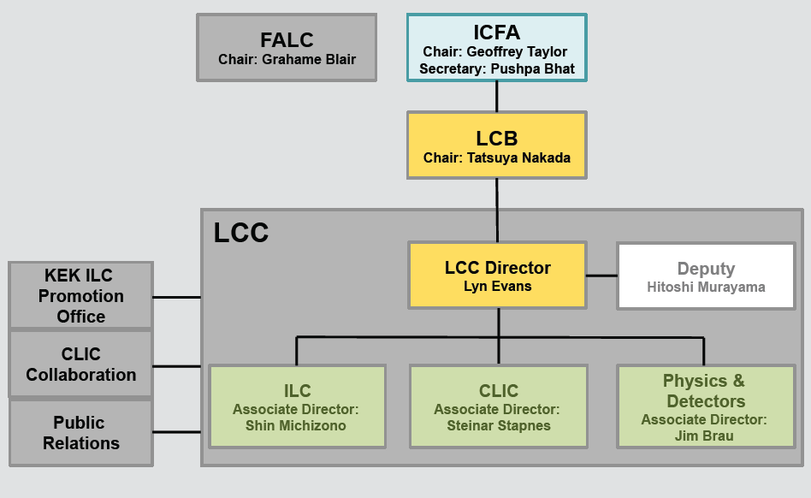
Report from ICFA/LCB (82nd meeting on July 8, 2018, Seoul/ICHEP, Korea)
International Committee for Future Accelerators (http://icfa.fnal.gov )
Joined meeting with the Linear Collider Board (LCB, http://icfa.fnal.gov/panels/linear-collider-board/ )
To promote the construction of an electron-positron linear collider and its detectors as a world-wide collaborative project, and to assume responsibility for the science, technology, outreach and organization in pursuit of the linear collider project
http://icfa.fnal.gov/wp-content/uploads/LCB-Mandate-2016.pdf
Linear Collider Collaboration

Slide 37
Procedure deployed in Japan towards ILC250 support
Meanwhile the political process continues, including for example visits of Japanese Diet members to Germany and France (and vice versa), and to the USA.
Japanese scientists and government understood that a statement is expected by the end of 2018 in order for the ILC to be considered in the update of the European Strategy for Particle Physics.
http://icfa.fnal.gov/wp-content/uploads/MEXT_AdvPanel_Report_July2018.pdf
English version of the report
Working groups:
(*)TDR validation
(*)Particle and Nuclear Physics
Human Resources
Organisation/Management
June 19
MEXT-ILC Advisory Panel
(meeting on July 4)
Decision by MEXT
(by Autumn 2018)
(*) reactivated for ILC250 proposal
Opinion of
Science Council of Japan (SCJ)

Slide 38
On the political front in Japan (July 5, meeting with PM Abe)
Satoru Yamashita, Uni. of Tokyo

Slide 39
Linear Collider community beyond a Japanese statement
The concluding statement later this year from the Japanese government on the ILC project will be a milestone for the particle physics community on the global scale.
The LCB/ICFA meeting foreseen on March 7-9, 2019, in Tokyo, will be an opportunity to digest the Japanese statement towards formulating an ICFA conclusion.
Taking into account these elements, it was agreed at our recent LCB/ICFA meeting that the Linear Collider community (ILC+CLIC) should meet to verify its opportunities; and this prior to the Open Symposium of the European Strategy process.
Intention: a 2-day meeting will be organised in March/April 2019 nearby CERN (e.g. Lausanne, Aix-les-Baines, etc.) to facilitate this gathering of the Linear Collider community.

Slide 40
ECFA communication

Slide 41
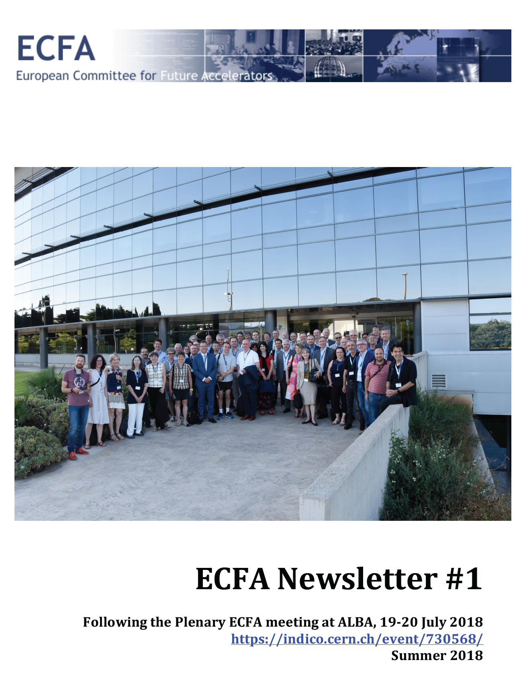
ECFA Newsletter #1
available on the ECFA website: https://ecfa.web.cern.ch
Facilitate ECFA members to inform their communities with a brief and comprehensive ECFA newsletter
It summarizes the Plenary ECFA meeting and include relevant announcements
Is available only digitally as a PDF document
Aim to have this available shortly after each PECFA meeting, hence twice per year (i.e. a Summer and a Winter edition)

Slide 42
ECFA Newsletter #1
available on the ECFA website: https://ecfa.web.cern.ch
On behalf of ECFA we sincerely thank the CERN Council secretariat and the CERN Minutes and Translation service teams for their continuous support

Slide 43
ECFA Newsletter #1
available on the ECFA website: https://ecfa.web.cern.ch
On behalf of ECFA we sincerely thank the CERN Council secretariat and the CERN Minutes and Translation service teams for their continuous support
THANK YOU FOR YOUR ATTENTION

