Slide 1
Mid-term report Belgium
ECFA meeting at DESY, July 2014
Belgian ECFA members:
Eduardo Cortina Gil (UC Louvain)
Jorgen D’Hondt (VU Brussel)
Nick Van Remortel (U Antwerpen)

Slide 2
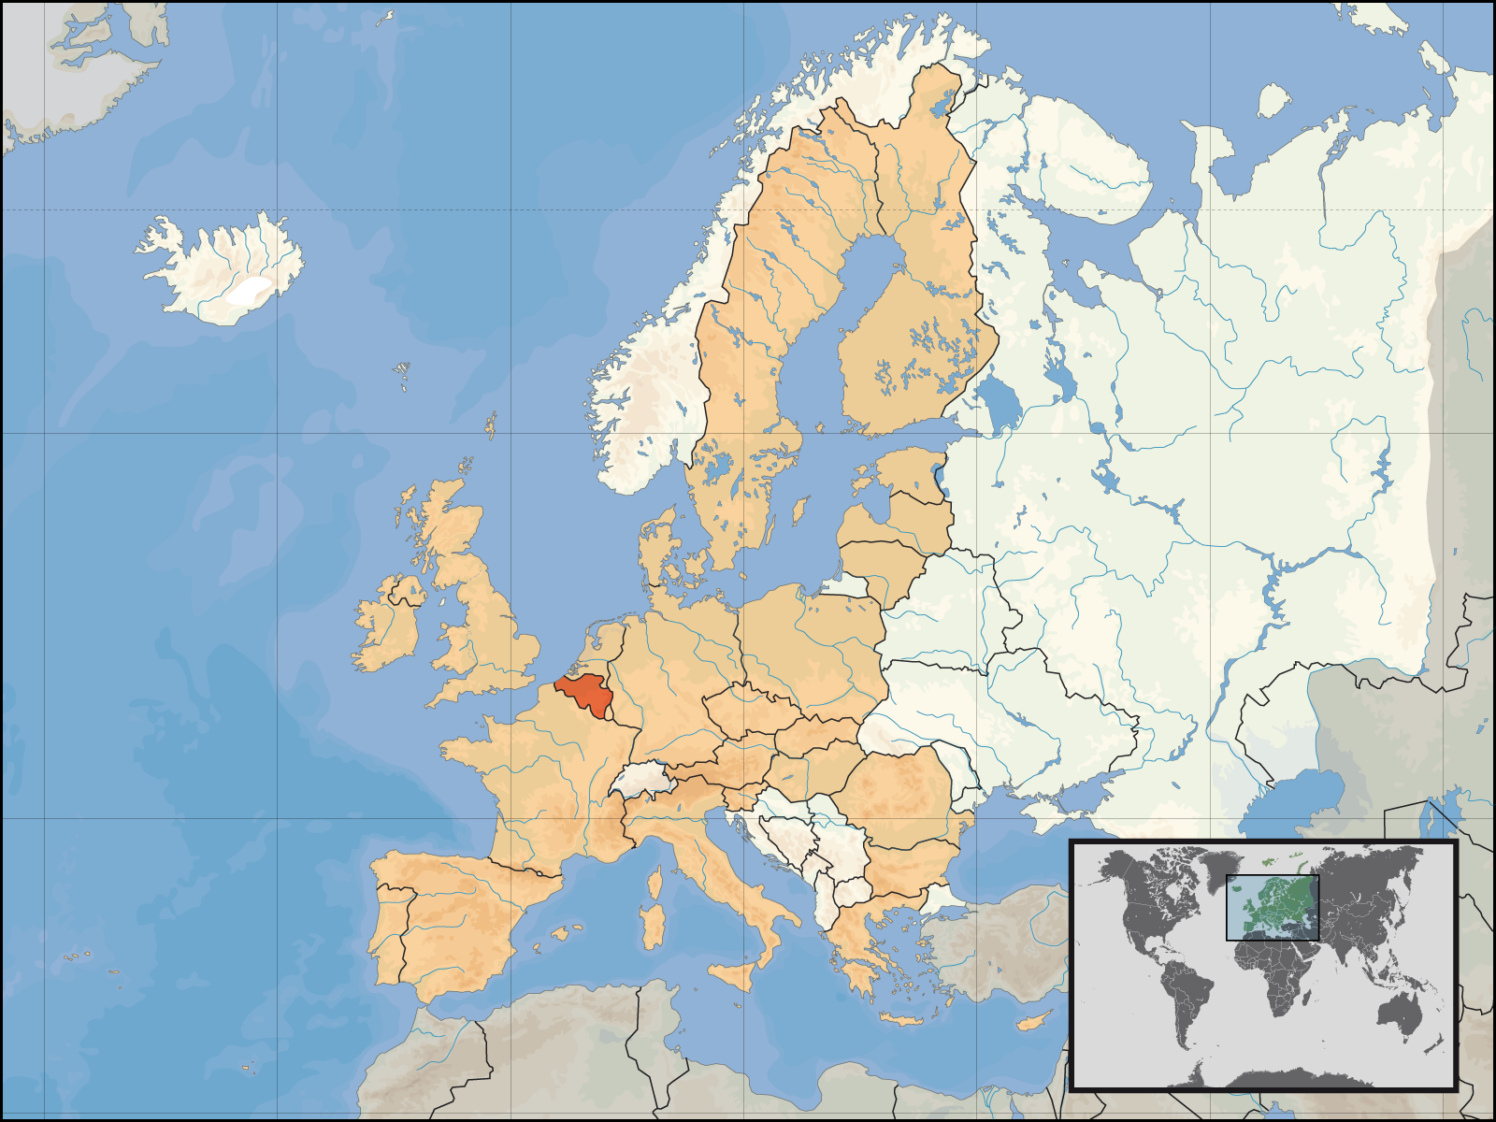

Slide 3
Belgium (www.belgium.be)
11,1 million inhabitants (anno 2013)
30528 km² (maximum distance between two points 280 km)
Languages: Dutch, French, German
GDP: 314 billions of EUR & 6.5% to education
6 governments, 589 municipalities
Highest point: 694m
One football team

Slide 4
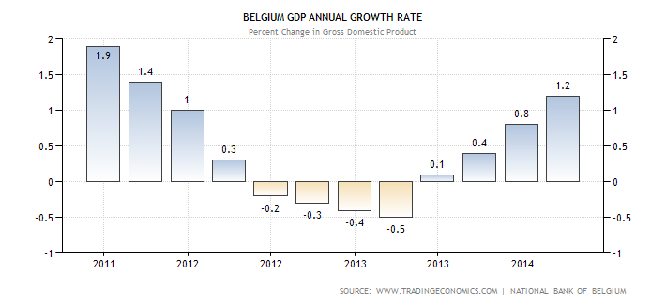
GDP Annual Growth Rate

Slide 5
Science & Development fraction of GDP
Percentage of GDP
Belgium
World
EU
Source: World Bank

Slide 6
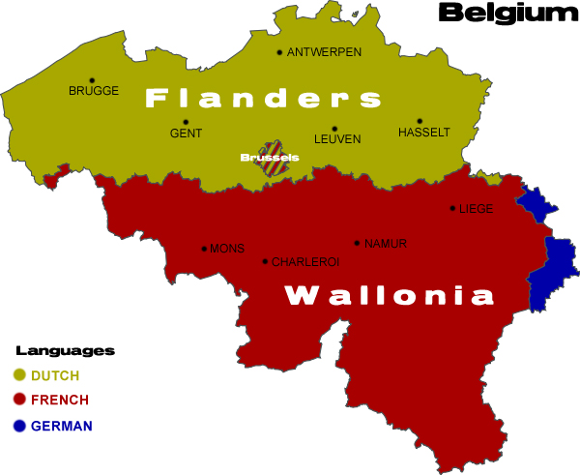
Governments in Belgium
Federal state with regions (Flanders, Wallonia, Brussels-capital) and communities (Flemish, French, German speaking)
Regions deal with infrastructure
Communities with matters related to people and culture (incl. teaching and research)
Tendency: more responsibilities from the Federal government towards the regions

Slide 7
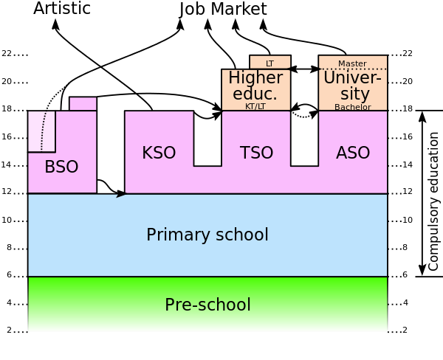
Education
Annual registration at universities 500-850 EUR
3 years for Bachelor degree, 1 or 2 years for Master
Overall ~2% increase in students every year
Strong increase in number of PhD students due to financing system with budget allocation relative to number of graduating PhD’s

Slide 8
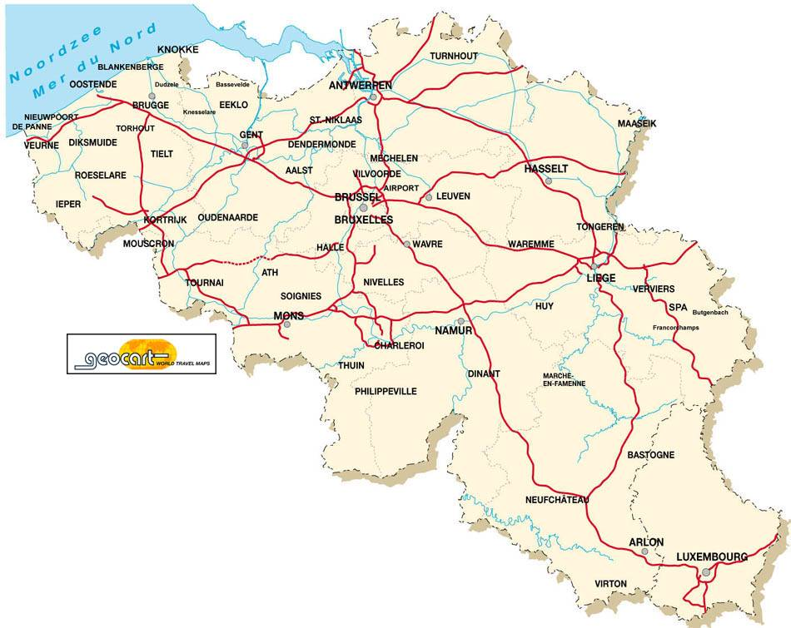
Universities for ECFA
In total 14 universities (of which 7 appear on a top-200 list): from them 8 relevant for ECFA physics
Universiteit Gent
Vrije Universiteit Brussel
Universiteit Antwerpen
Universite de Mons
Universite Catholique de Louvain
Universite Libre de Bruxelles
Universite de Liege
Katholieke Universiteit Leuven

Slide 9
Research groups for ECFA
Theory HEP
Experiment HEP
Astroparticles
U.Antwerpen T+E
U.Gent T+E+A
V.U.Brussel T+E+A
K.U.Leuven T+ISOLDE
IIHE (ULB-VUB)
U.L.Bruxelles T+E+A
U.Liège T
U.C.Louvain T+E
U.Mons T+E+A
CP3
U.Namur T
associated
Research groups for ECFA

Slide 10
Past/Present experiments
Past contribution: DELPHI, H1, OPERA
Present*: CMS, IceCube, ISOLDE, GANIL/SPIRAL2, HIE-ISOLDE, PSI UCN, CALICE, RD57, Telescope Array, SoLid, Planck, ARA, NA62,…
Key contributions in CMS:
  Detectors: Tracker, Muons (RPC and GEM), CASTOR
  Objects: Jets, b-tagging, tracking, tau’s, e/gamma, muons
  Analyses: H-boson, SUSY, Top, Exotica, B2G, Forward, SM
  Two TIER-2’s
The disappearance of spin-off activities is still a worry
* More diversity was stimulated during the RECFA visit of 2010.

Slide 11
Human resources
Average:
#PhD’s since 2010 (incl 2010) = 76 (i.e. 17/year)
On average between 4 and 4,5 years to complete the PhD
#post-doc-years since 2010 (incl 2010) = 306 (i.e. 68/year)
Snapshot January 1st, 2014:
#engineers = 10
#technicians = 12,5
#logistics/administration = 9
#IT persons = 7
Still a decreasing trend since RECFA visit to Belgium in 2010

Slide 12
Human resources
Snapshot January 1st, 2014:
 |  | #professor-level | # post-docs | #PhD students
accelerator based | NA62 | 1 | 1 | 3
 | CMS | 15,6 | 38,9 | 41
 | ISOLDE | 6 | 11 | 13
 | dosimetry | 0,2 | - | 2
neutrino/astro-particle | IceCube | 2,9 | 3,9 | 12
 | SoLid | 1 | 0,2 | -
 | ARA | 0,5 | 1 | 1
 | VLT | 0,2 | - | -
Pheno |  | 3 | 11 | 7
Theory |  | 20,2 | 35 | 38
Total |  | 50,6 | 102 | 119
Many younger people
RECFA visit to Belgium 2010: 108 FTE in theory and 105 FTE in experiment
Mid-term report 2007: 89 FTE in theory and 87 FTE in experiment
Situation in 1995: 53 FTE in theory and 74 FTE in experiment

Slide 13
Financial resources – FWO
Flemish part
Funding for fundamental research in Flanders
PhD and post-docs mandates (competitive)
No permanent research staff, but absorbed by universities as research professor mandates
Projects (very competitive)
Big Science program (selective): CMS & ISOLDE
including ~4,9 M EUR competitive personal grants (ERC-like) to setup new teams

Slide 14
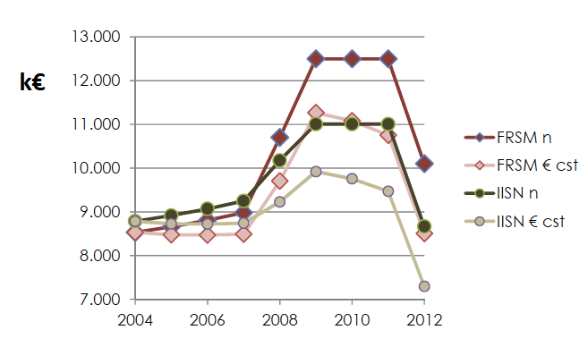
Financial resources – FNRS
French part
IISN (Institut Interuniversitaire des Sciences Nucleaires)
Important budget cuts last years (success rate for project application is reduced from ~45% to ~23%)
The creation of a Big Science program for sustainable research at large infrastructures becomes very relevant
Source: conseil d’administration FNRS du 21 mai 2012

Slide 15
Financial resources – others
University funding is competitive and selective, but we tend to be successful to obtain some (personal, scholarships, research professor mandates, project grants, concerted projects)
EU COST, ERC, fellowships
Hercules fund (Flanders) for local equipment
International Solvay Institutes (for theory)

Slide 16
Financial resources – IUAP
Funded by the federal government
IUAP on Fundamental Interactions: a nation wide HEP collaboration between experiment and theory
  5,8 M EUR budget for 2007-2011 mainly to hire post-docs and PhD students
  was successfully extended for 2013-2017 (5,1 M EUR)
IUAP on BRIX (the Belgian Research Initiative on eXotic nuclei for atomic, nuclear and astrophysics studies)
  2,6 M EUR budget (2007-2011) and 3,1 M EUR (2012-2017)
Beyond 2017 this responsibility will be in the hands of the regional governments

Slide 17
Some recent key positions in the field
Vice-president of “CERN Council”
Deputy spokesperson of CMS
Chairperson of “CMS Collaboration Board”
Chairperson of “CERN HIE Isolde Steering Committee”
One member of CERN’s SPC
MINIBALL Collaboration spokesperson
Spokesperson of Crystal Clear Collaboration
Several conveners of Physics groups in CMS and IceCube

Slide 18
Nobel Prize – Francois Englert

Slide 19
Conclusion
Per million inhabitants in Belgium (11M) we have:
  10,9 PhD students in ECFA-like physics
  9,3 post-docs in ECFA-like physics
  4,5 professors in ECFA-like physics
  0,1 alive Nobel Prize winners in High-Energy Physics
In order to follow the European Strategy for Particle Physics, it is important to create and secure funding for Big Science programs in both the Flemish and French region

Slide 20
Extra’s
Diagrams of education system (ref. OECD)

