Slide 1
“Physics with Top Quarks in CMS”
(highlights of >200 pages notes!)
Top Physics, SUSY, Exotica
Staff
Freya Blekman
Jorgen D’Hondt
Catherine Vander Velde
Post-docs
Rebeca Gonzalez Suarez
James Keaveney (from Jan 2012)
Petra Van Mulders
Pre-docs
Stijn Blyweert
Thierry Caebergs
Gregory Hammad (PhD Aug 2011)
Nadjieh Jafari (PhD Nov 2011)
Alexis Kalogeropoulos
Joris Maes (PhD Nov 2010)
Michael Maes
Annik Olbrechts
Petra Van Mulders
Gerrit Van Onsem
Ilaria Villella
Maryam Zeinali (PhD Nov 2011)

Slide 2
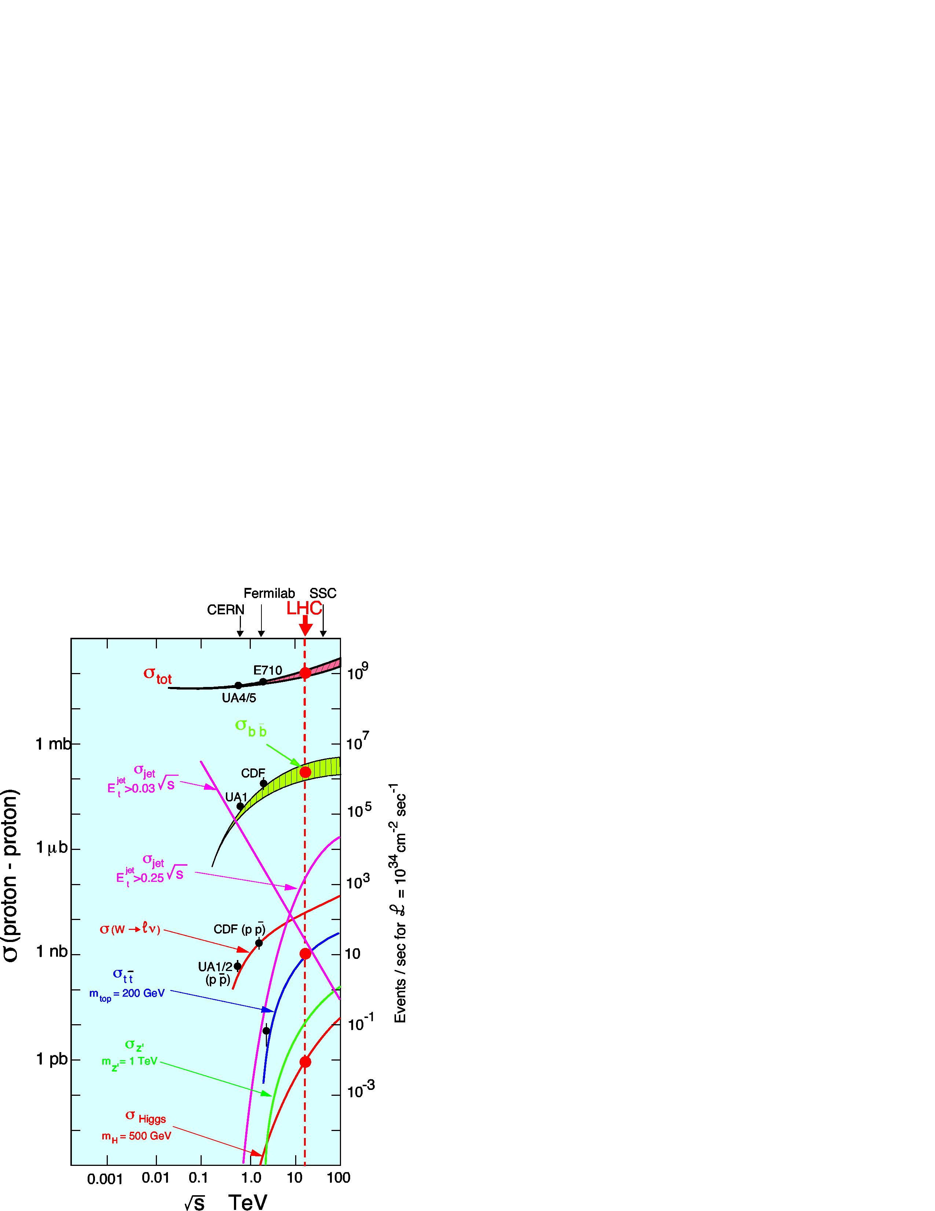
Top quark Topologies at the LHC
The first complex topology to be observed at the LHC with divers reconstructed objects and extremely rich in physics, both about key questions in the Standard Model and in the search for new phenomena.
σ(tt) @ 7 TeV ≈ 150 pb (NLO)
N_{tt}(2011) with 5000pb⁻¹ ≈ 750k
tt → W(lv/qq)bWb(lv/qq)
BR(fully hadronic) = 4/9
BR(semi leptonic) = 4/9 → 333k events (e/μ/τ)
BR(di-leptonic) = 1/9
Efficiency for muon/electron channel ~ 20%
~22k events in 2010 (e/μ)
IIHE Top Quark Group
Annual Meeting IIHE

Slide 3
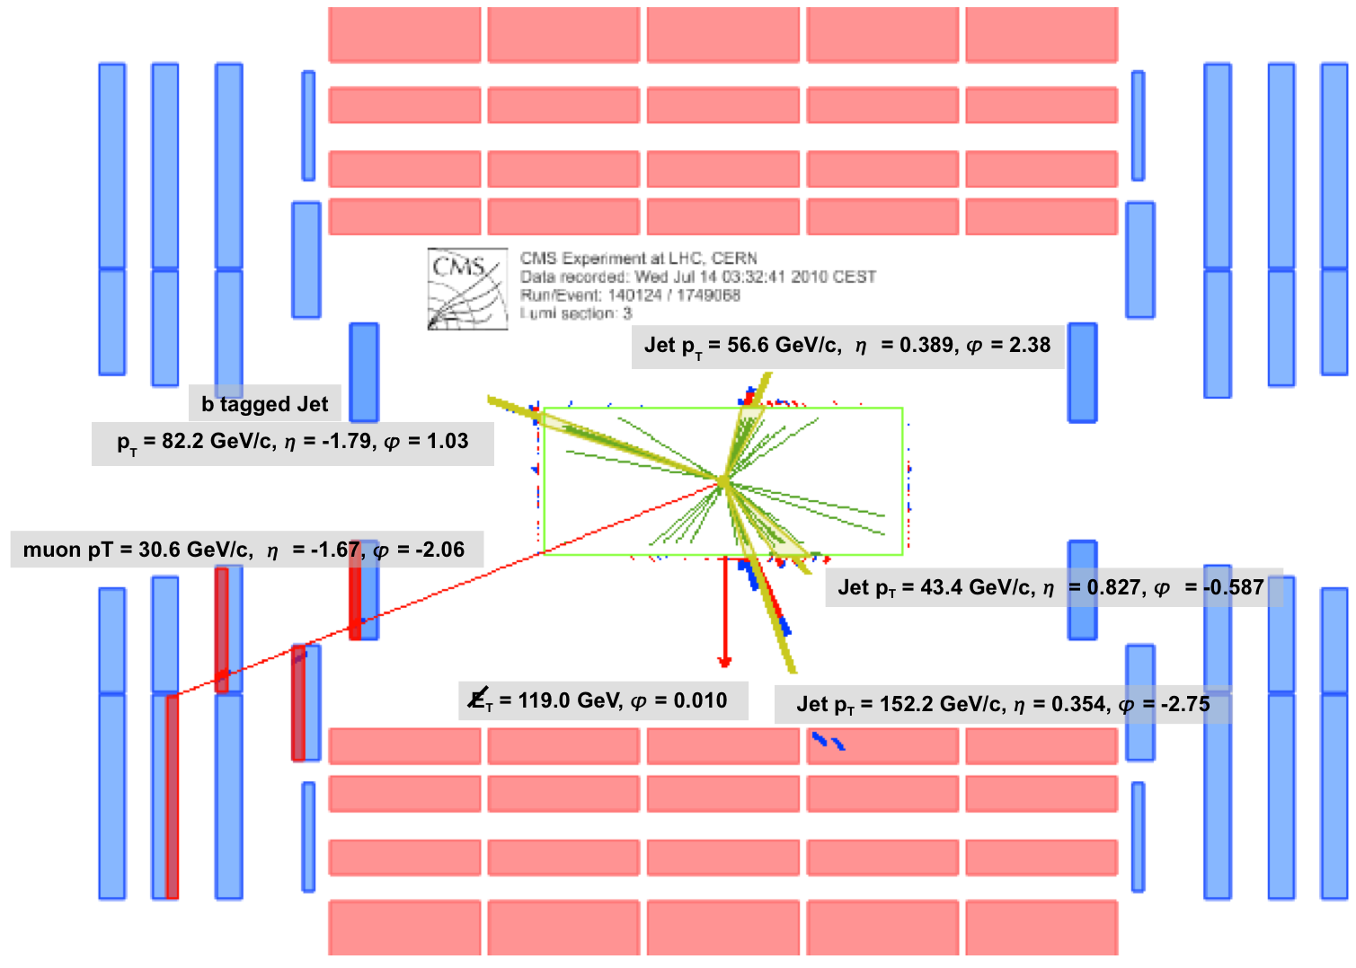
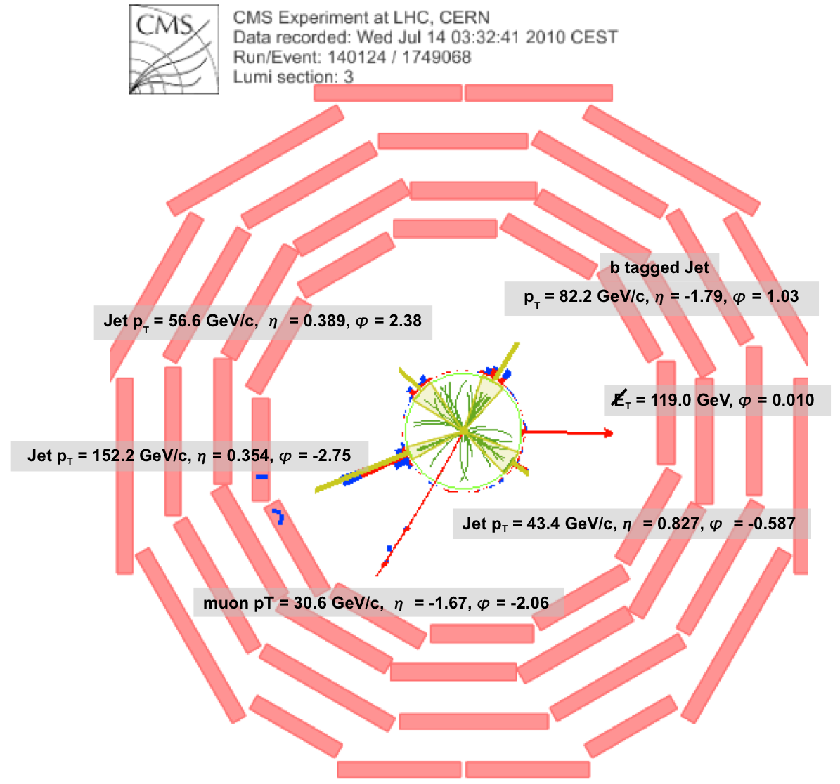
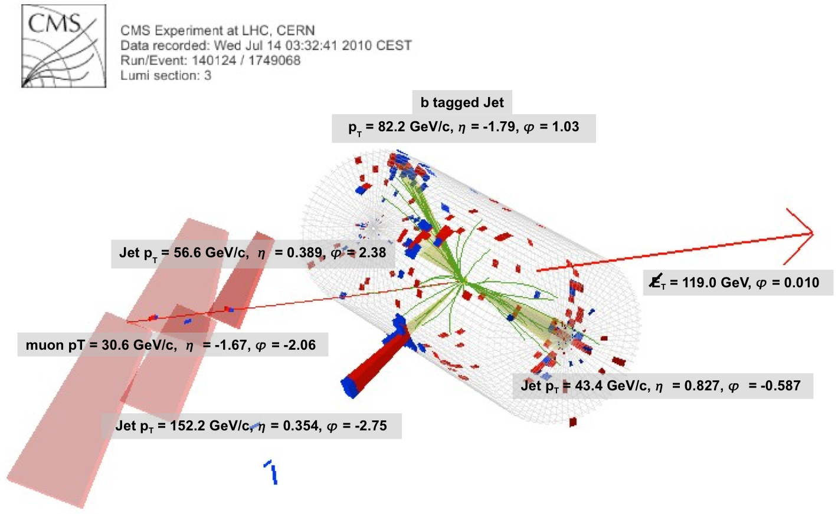
Candidate events observed
IIHE Top Quark Group
Annual Meeting IIHE

Slide 4
Deal with many reconstruction aspects prior to perform measurements or searches involving top quarks.
IIHE Top Quark Group
Annual Meeting IIHE

Slide 5
Recent physics results from our IIHE group
Measurement of the difference in top and anti-top quark mass (Stijn)
Measurement of the top quark pair cross section (Michael)
Measurement of the btagging efficiency using top quark events (Michael, Nadjieh)
Study of the tW single-top channel (Rebeca, Freya)
Search for fourth generation quarks in t’ pair events (Gerrit)
Inclusive search for fourth generation quarks (Petra, Gerrit)
Measurement of the W helicity in top quark decays (Annik)
Measurement of the jet energy scale in top quark pair events (Maryam)
Search for supersymmetry phenomena in top quark like events (Alexis)
Study of the W and QCD backgrounds in top quark event selections (Gregory)
Study of spin correlations in top quark pair events (Ilaria)
2 published journal papers already with our results
many results shown at major conferences
some results in the CERN Courier
plots and numbers illustrate the work in progress
IIHE Top Quark Group
Annual Meeting IIHE

Slide 6
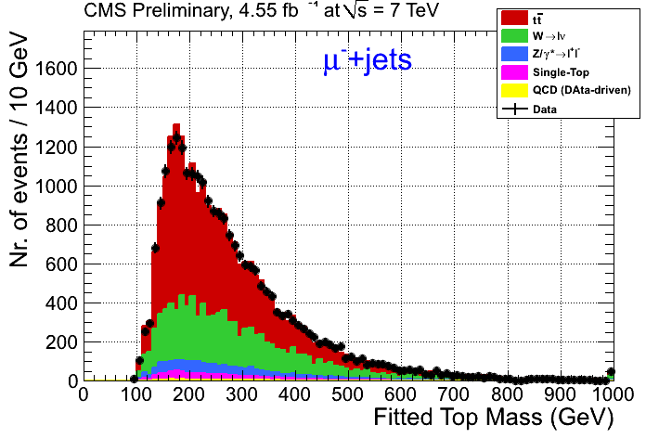
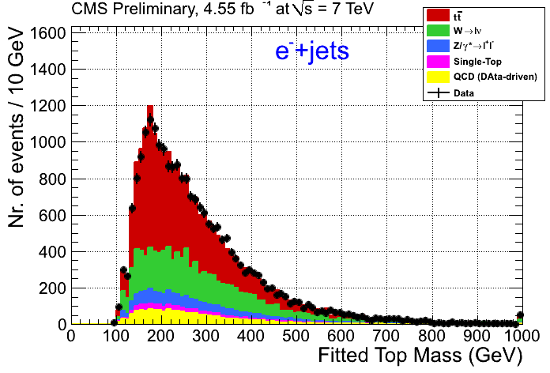
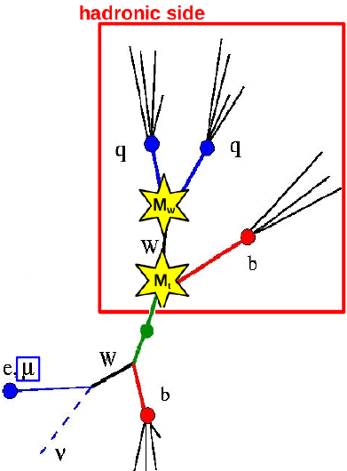
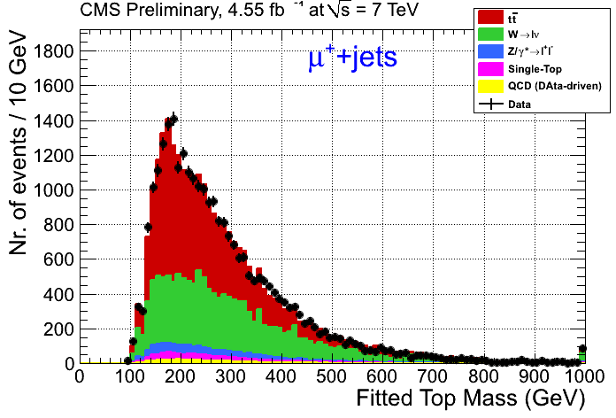
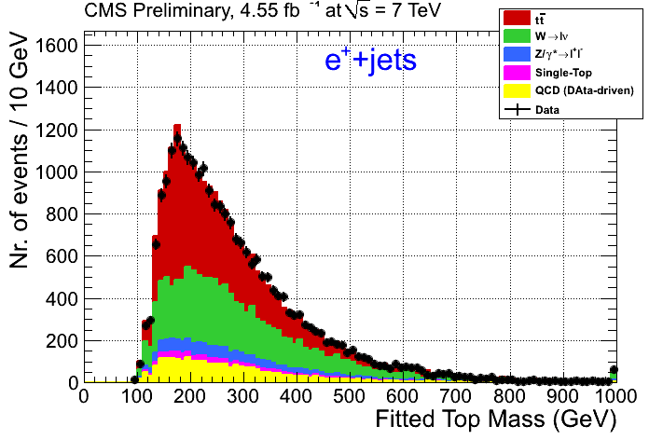
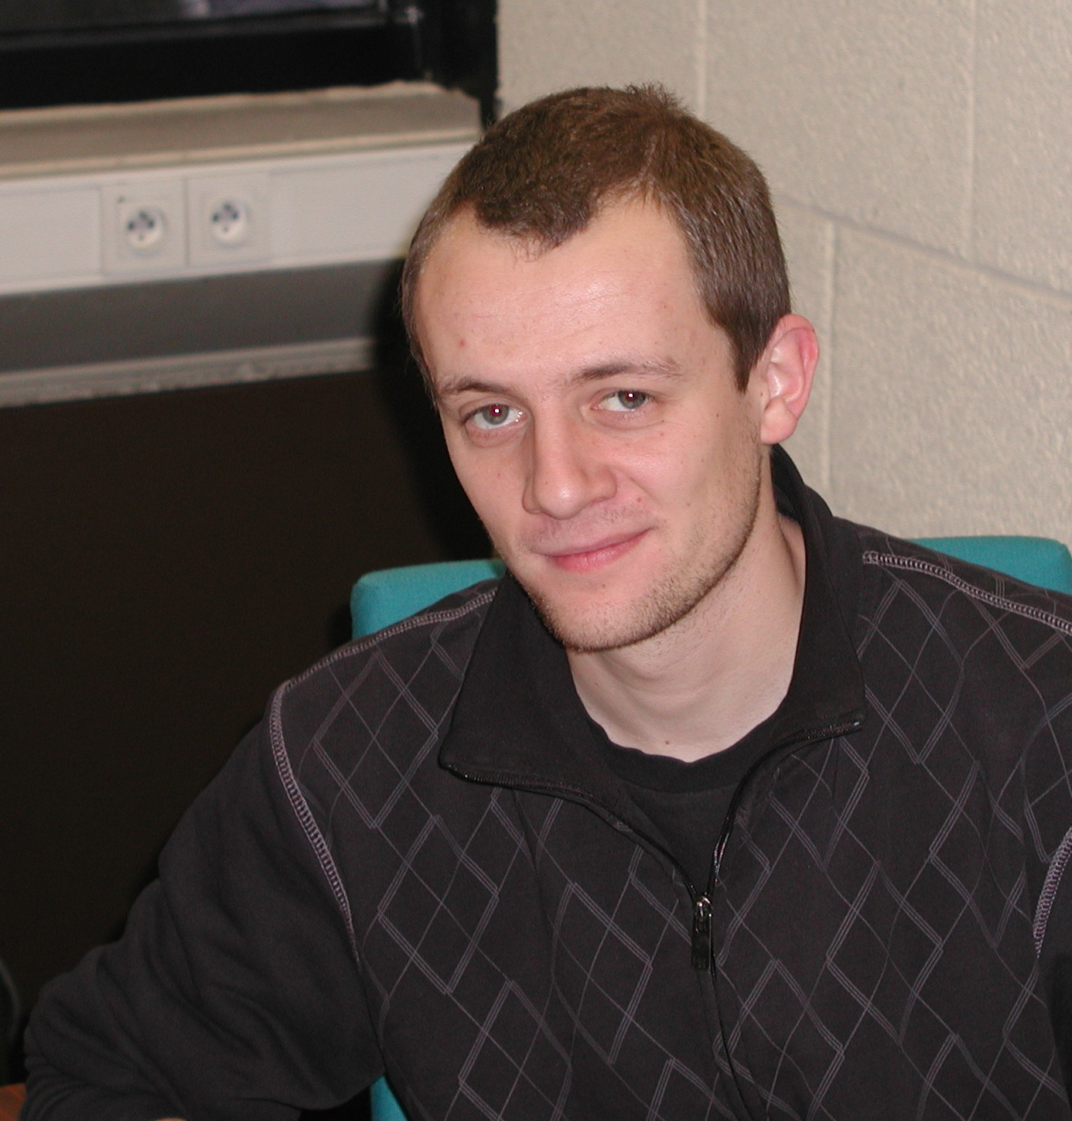
Measurement of the difference in top and anti-top quark mass
Most precise measurement in the world!
Testing the CPT symmetry.
Δm_{t} = 0.00 ± 0.46 (stat) ± 0.47 (syst)
IIHE Top Quark Group
Annual Meeting IIHE

Slide 7
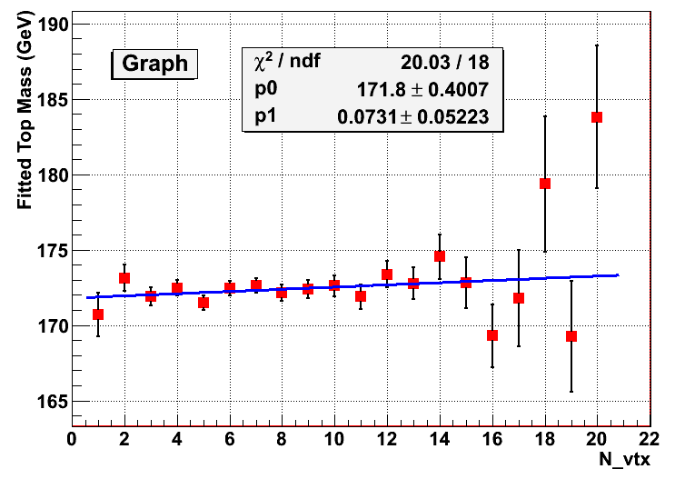
Measurement of the difference in top and anti-top quark mass
Most precise measurement in the world!
Testing the CPT symmetry.
Effect of pile-up collisions seems very small!
Δm_{t} = 0.00 ± 0.46 (stat) ± 0.47 (syst)
IIHE Top Quark Group
Annual Meeting IIHE

Slide 8
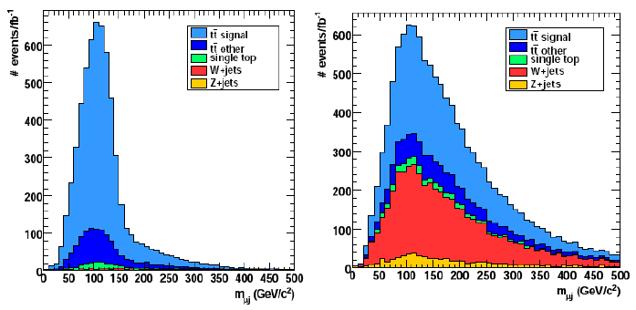
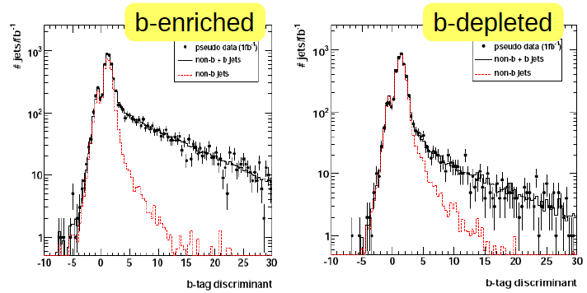
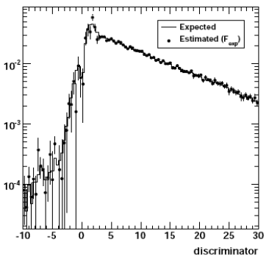
Top Quark events as a calibration tool: b-tagging performance
Construct the mass of the {lepton + b-jet from (t→Wb→lvb)} system, m_{lb}.
m_{lb}
true b-quark jets
non b-quark jets
N_{no-sel}
b-tag var
- F .
=
N_{sel}
b-tag efficiency
ε_{b} = N_{sel}/(N_{sel}+N_{no-sel})
from a control sample in data
IIHE Top Quark Group
Annual Meeting IIHE

Slide 9
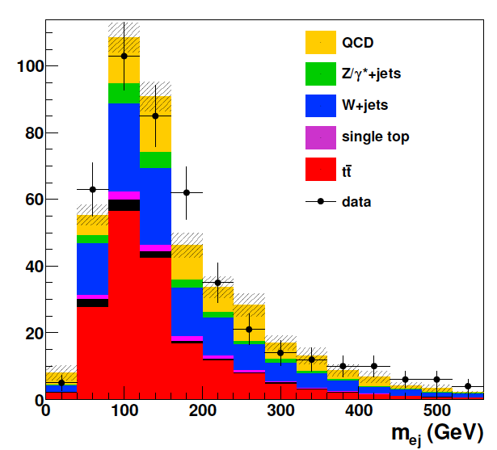
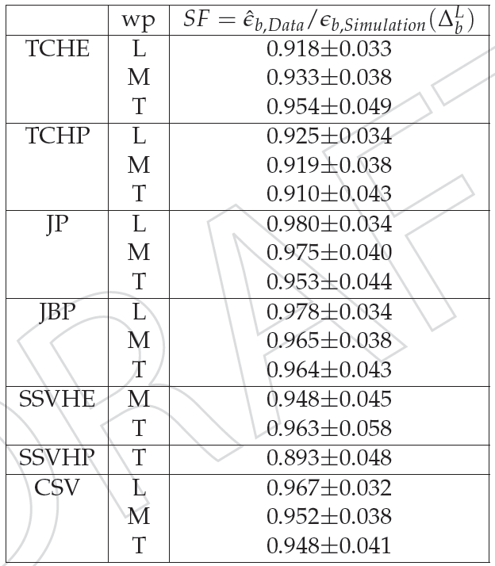
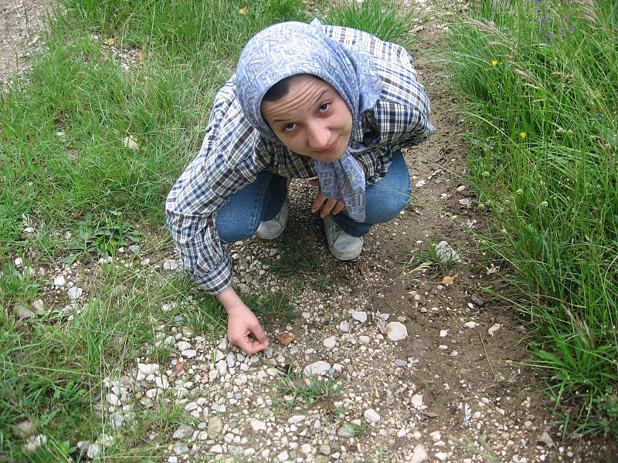
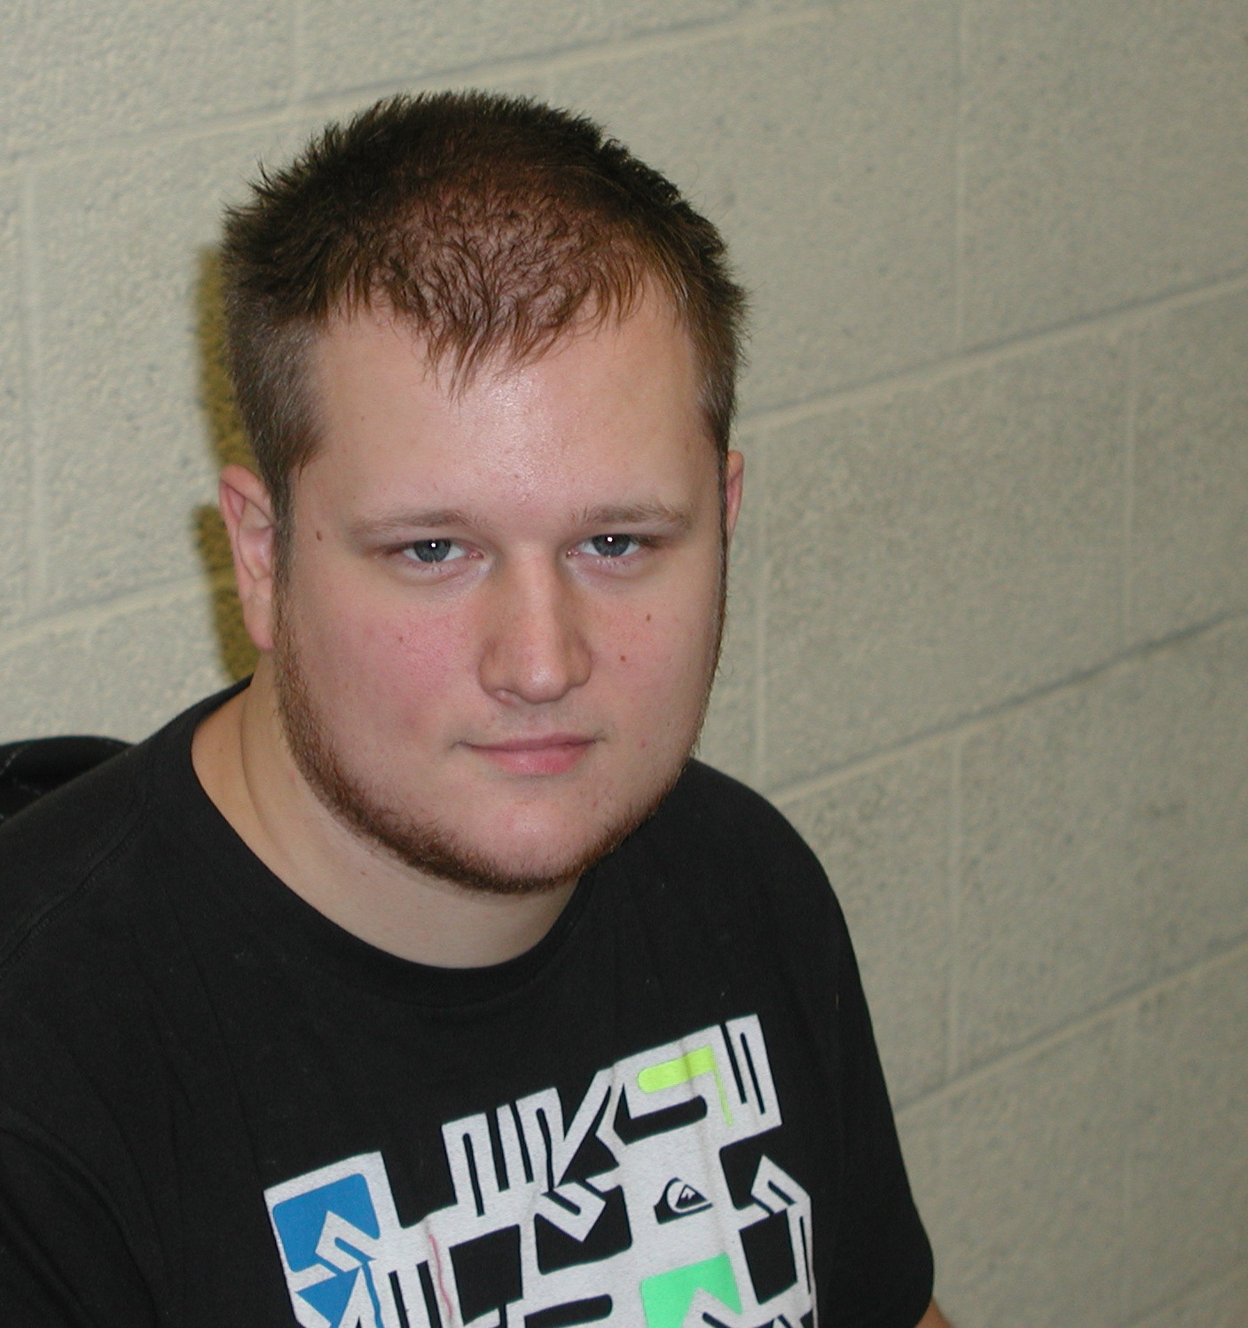
B-tagging efficiency from top quark events
In 2010 with few data, we reached a 30% precision, hence a prove of principle.
2010
In 2011 results for all btaggers and ~4% precision
IIHE Top Quark Group
Annual Meeting IIHE

Slide 10
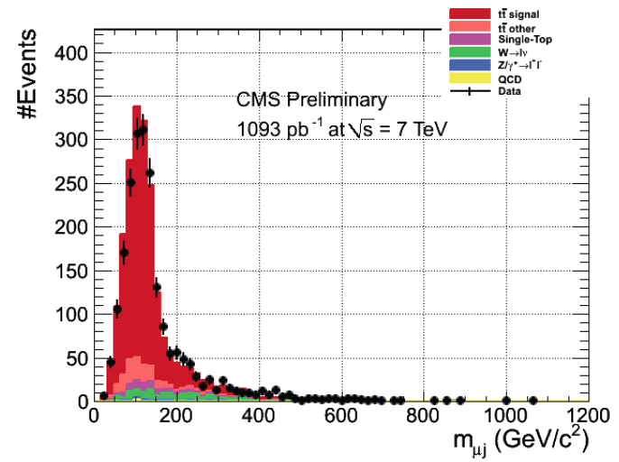
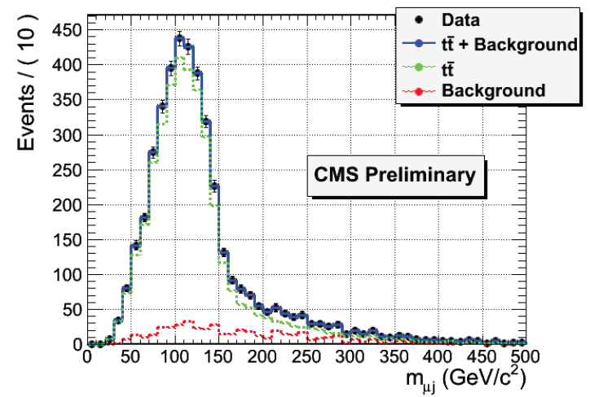
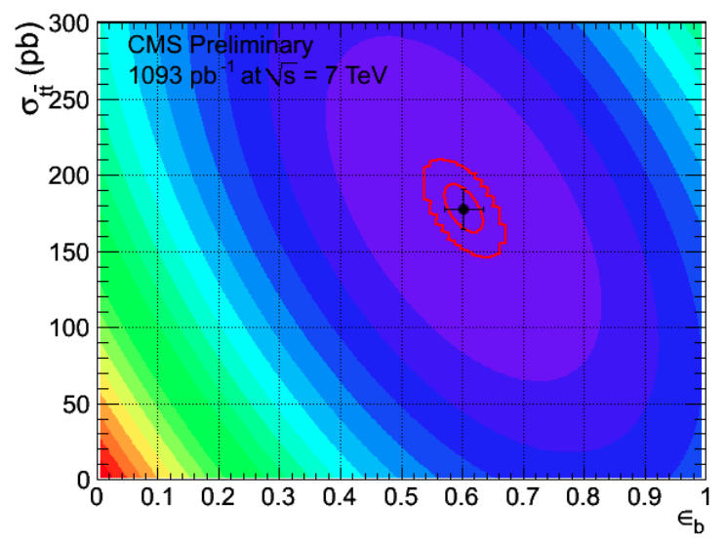
Measurement of the top quark pair cross section
template fit
Combined cross section and b-tag efficiency measurement with novel data-driven techniques.
Best poster prize during the CMS week in Brussels!
σ_{ttbar} = 152.3 +- 9.9 pb (stat) +- 43.1 pb (sys)
overestimated
probably more like 15 pb
theory = 157 pb
IIHE Top Quark Group
Annual Meeting IIHE

Slide 11
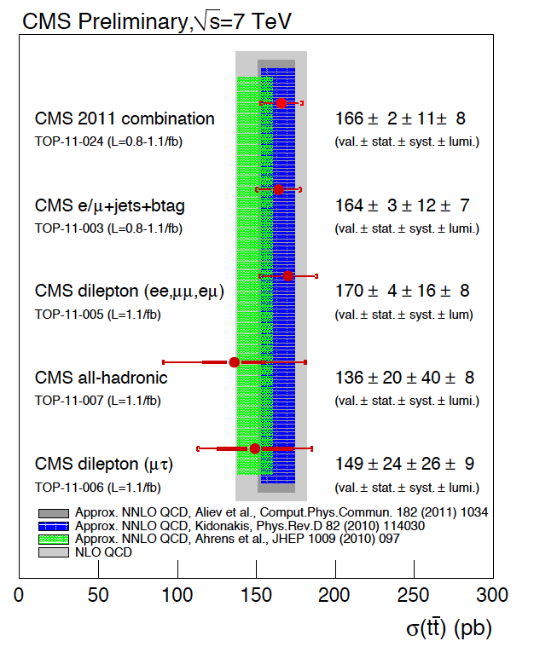
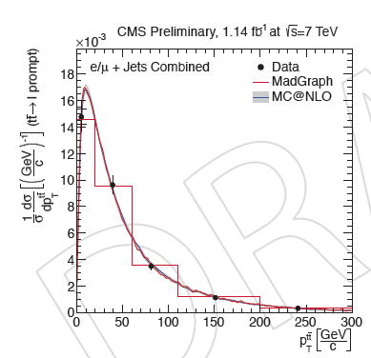
Combination of the measurements of the top quark pair cross section
Experimental precision better than that of the theoretical predictions !
Time to start measuring differential cross sections…
IIHE Top Quark Group
Annual Meeting IIHE

Slide 12
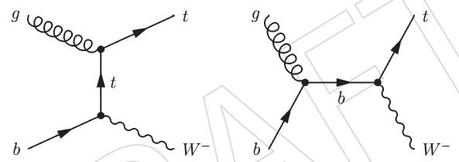
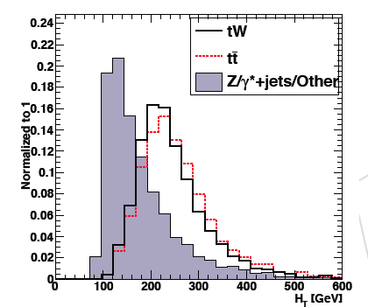
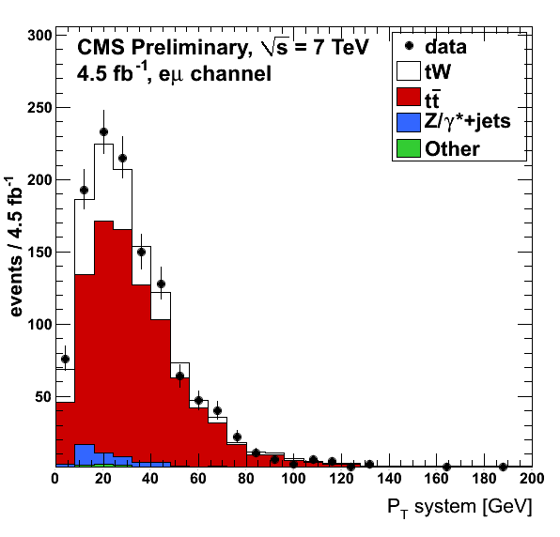
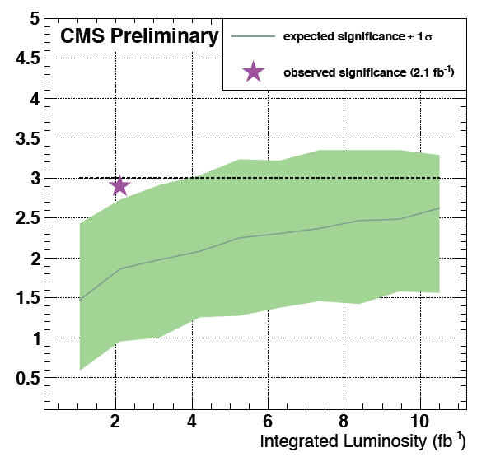
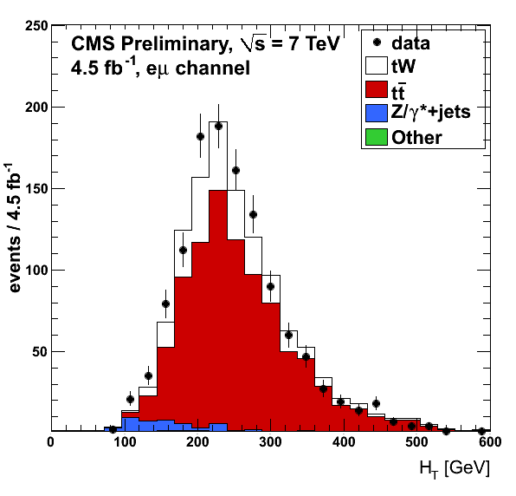
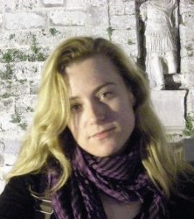

Study of the single-top tW channel
Soon we hope to be able to claim the first observation and study of the single-top tW channel.
Enhancing signal with multi-variate analysis techniques.
Sensitive to anomalous couplings and a direct measurement of |V_{tb}|.
Expected significance
IIHE Top Quark Group
Annual Meeting IIHE

Slide 13
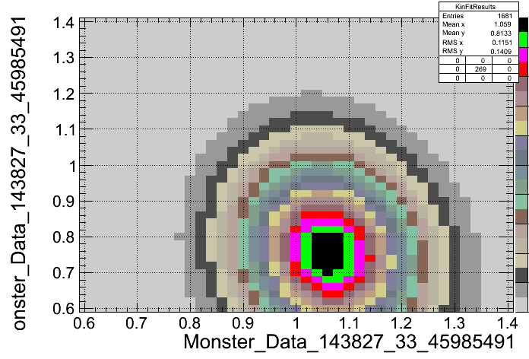
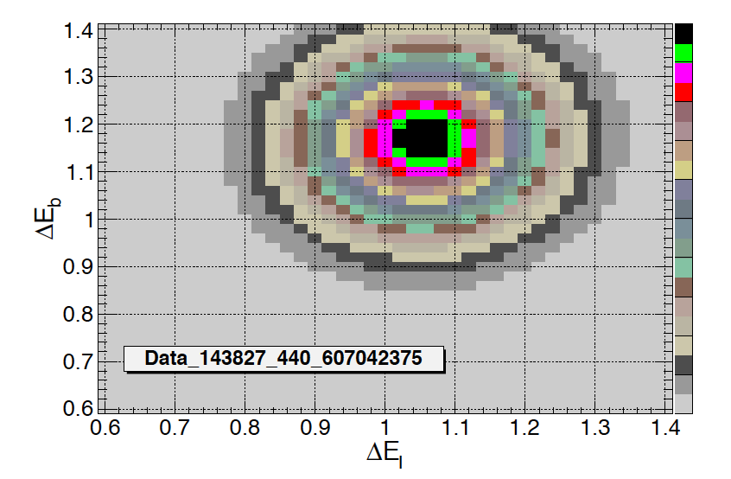
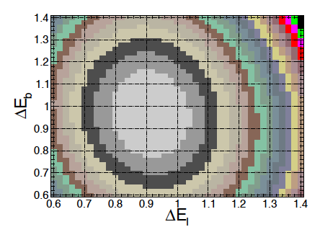
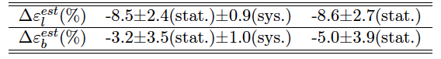
Top Quark events as a calibration tool: Jet Energy Scale
Apply a kinematic fit χ²(m_{W},m_{top}) for each choice of ΔE_{light} and ΔE_{b}.
Some clever cuts to remove ~80% outlying events (keeping ~80% of the good ones).
all events
data
2010
Σ
1 event
χ²(m_{W},m_{top})
=
ΔE_{b} (rel. corr.)
events
ΔE_{b} (rel. corr.)
ΔE_{b} (rel. corr.)
ΔE_{b} (rel. corr.)
ΔE_{b} (rel. corr.)
Maryam Zeinali
ΔE_{light} (rel. corr.)
Electron channel
ΔE_{light} (rel. corr.)
simulation
data
IIHE Top Quark Group
Annual Meeting IIHE

Slide 14
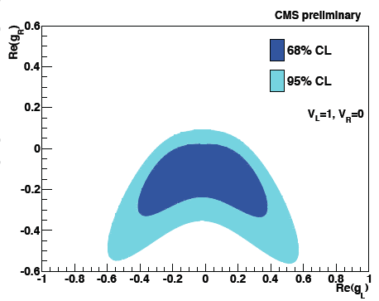
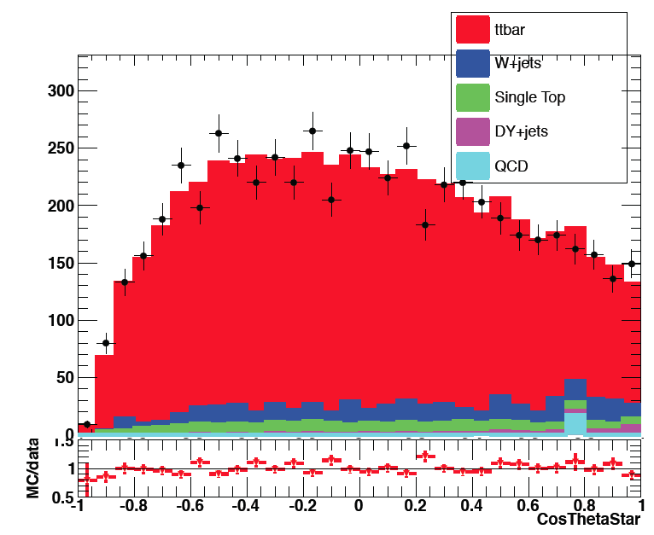

W helicity measurement
Decay properties of the top quark interpreted
in the helicity parameters space (f₀,f₋,f₊)
Fit the angular distribution (c=cosθ∗)
Important optimization study taking into
account both the statistical and systematical
uncertainty.
F_{L} = 0.33 ± 0.03 (stat) ± 0.02 (syst)
F₀ = 0.58 ± 0.04 (stat) ± 0.05 (syst)
F_{R} = 0.09 ± 0.03 (stat) ± 0.07 (syst)
2011 data (A)
Ready to search for anomalous couplings.
Also part of a master thesis this year!
IIHE Top Quark Group
Annual Meeting IIHE

Slide 15
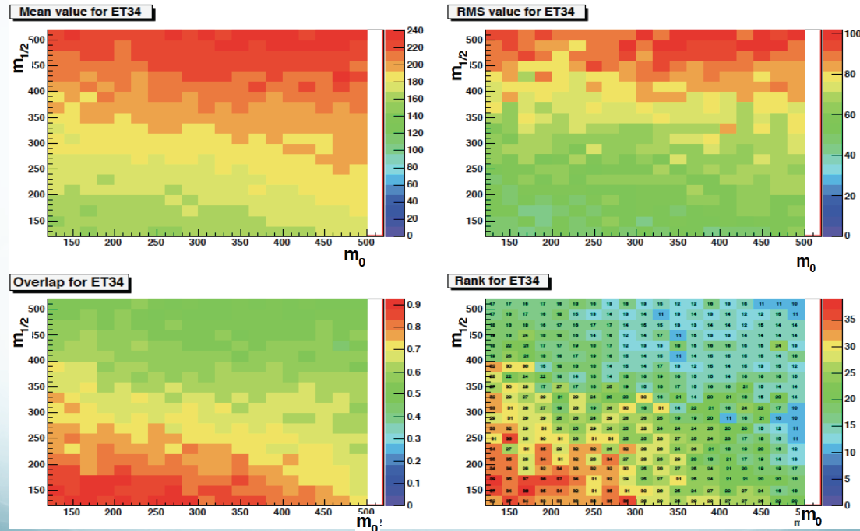
Top@SUSY
Searching for SUSY in top topologies
Apply a top-identifier in the final state (using the W and top masses and
btagging) and search for supersymmetric phenomena, eg. stop-like searches.
Optimize the choice of variables for each mSUGRA point (m_{1/2},m₀).
Different pheno in each region.
Perform a test between only SM and SM+mSUGRA.
Obtain the probability to potentially exclude the mSUGRA point.
IIHE Top Quark Group
Annual Meeting IIHE

Slide 16
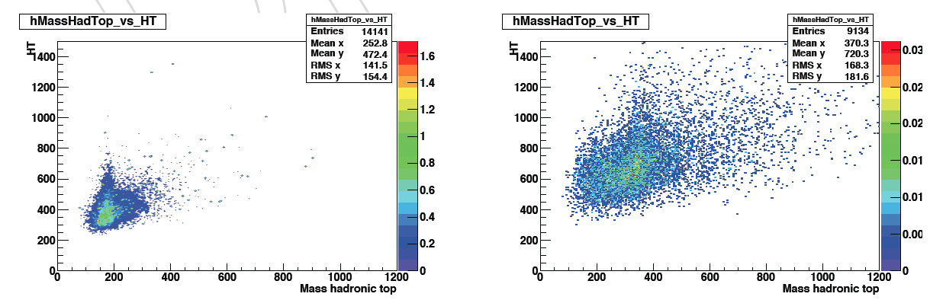
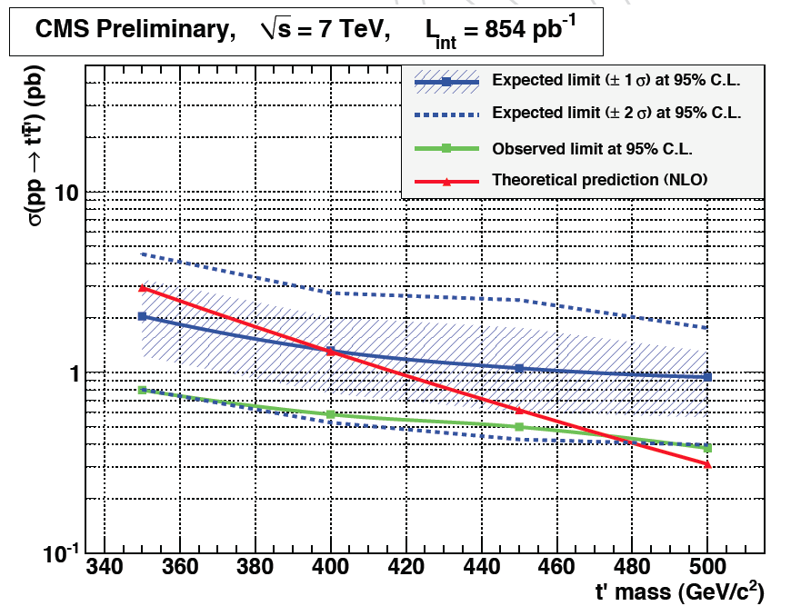
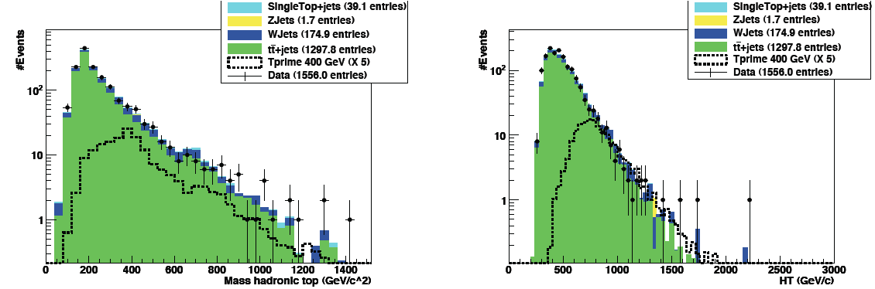

Top@Exotica
Fourth generation search as t’t’ events
summer result
t’t’
signal
ttbar
background
Systematics are fitted with nuisance parameters
excluded part
signal
IIHE Top Quark Group
Annual Meeting IIHE

Slide 17
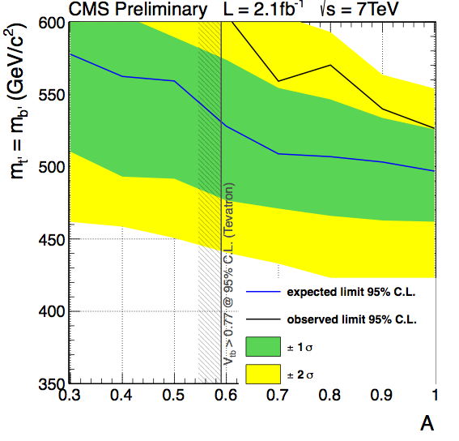

Top@Exotica
Inclusive fourth generation search
Studying coherently t’ pair, b’ pair and single-t’, single-b’ production; systematics with detailed nuisance parameters. World most stringent limit on fourth generation t’ mass.
m_{t'} = m_{b'} < 526 (497) GeV/c² observed (expected) @ 95% CL
Examples of studied topologies
coupling parameter
Gerrit joins this inclusive effort to extend it
IIHE Top Quark Group
Annual Meeting IIHE

Slide 18
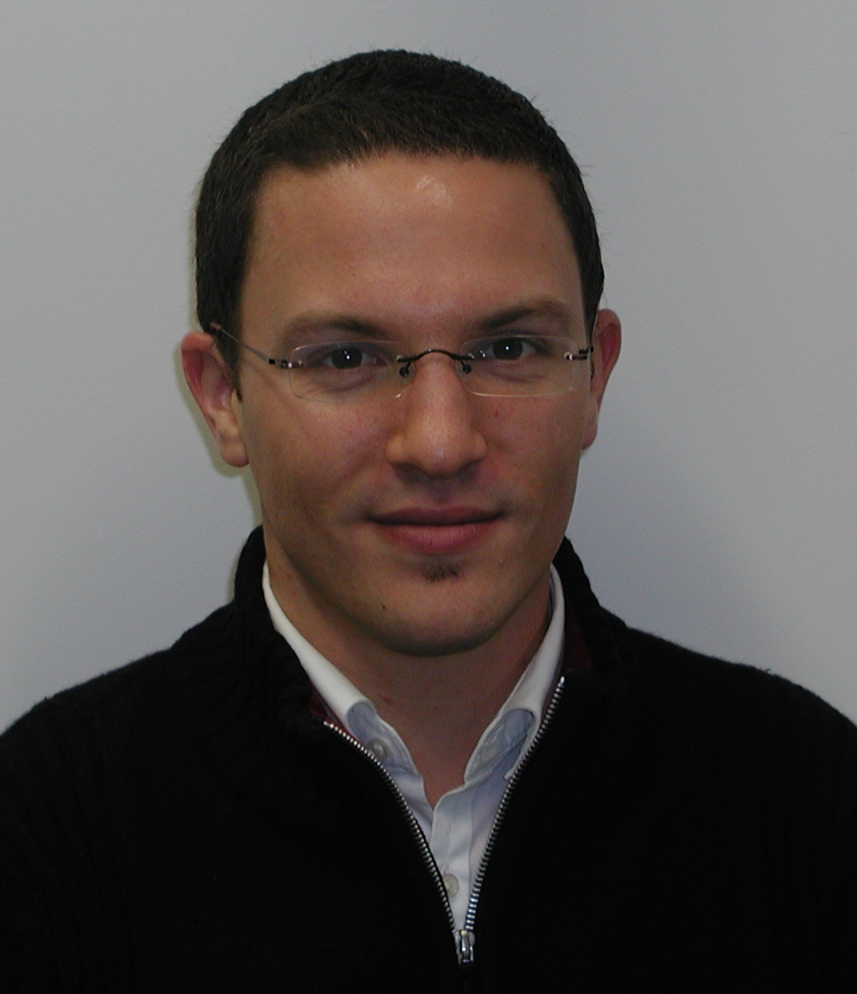
PhD’s defended in 2011
Gregory Hammad – ULB (Aug 2011)
Data-driven estimation of the multi-jet & V+jets production for top
quark pair production with in-situ b-tagging and mis-tagging
measurement
Maryam Zeinali – VUB (Nov 2011)
Measurement of the jet energy scale corrections using top quark events
Nadjieh Jafari – VUB (Nov 2011)
Measurement of the btagging efficiency using top quark events
Previously within our group:
Joris Maes (2010), Petra Van Mulders (2010), Jan Heyninck (2008) & Steven Lowette (2007)
IIHE Top Quark Group
Annual Meeting IIHE

Slide 19
Regular Top@Brussels meetings - Well connected to Pheno at the IIHE and UCL
Tomorrow !!
IIHE Top Quark Group
Annual Meeting IIHE

