Slide 1
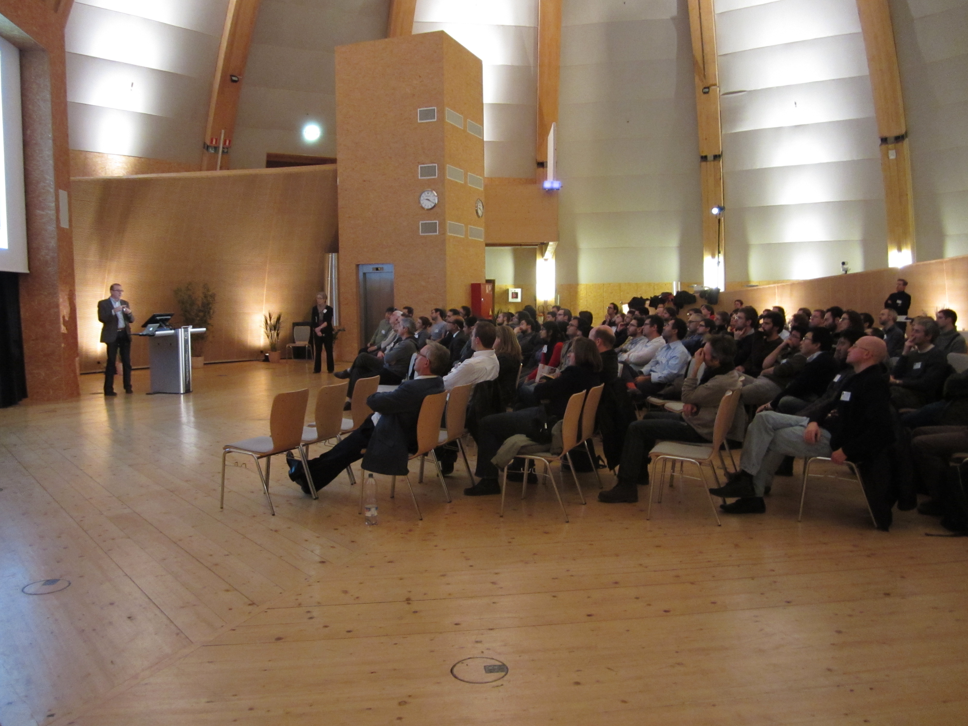
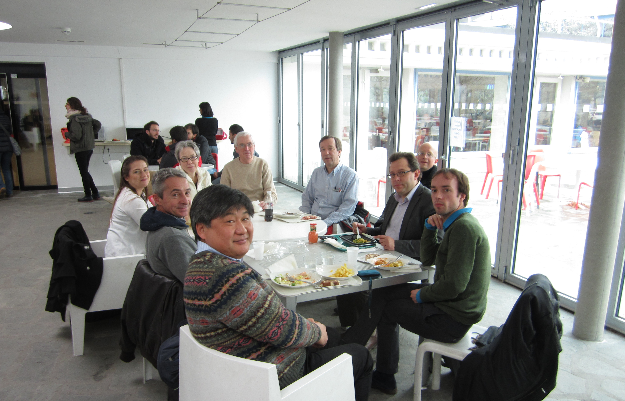
Post-event meeting/lunch
with Career Committee
Career Event in the Globe
Networking between students/postdocs & CMS-alumni and large international companies
Presentations from CMS-alumni & companies
December 9th 2013
About 150 participants

