Slide 1
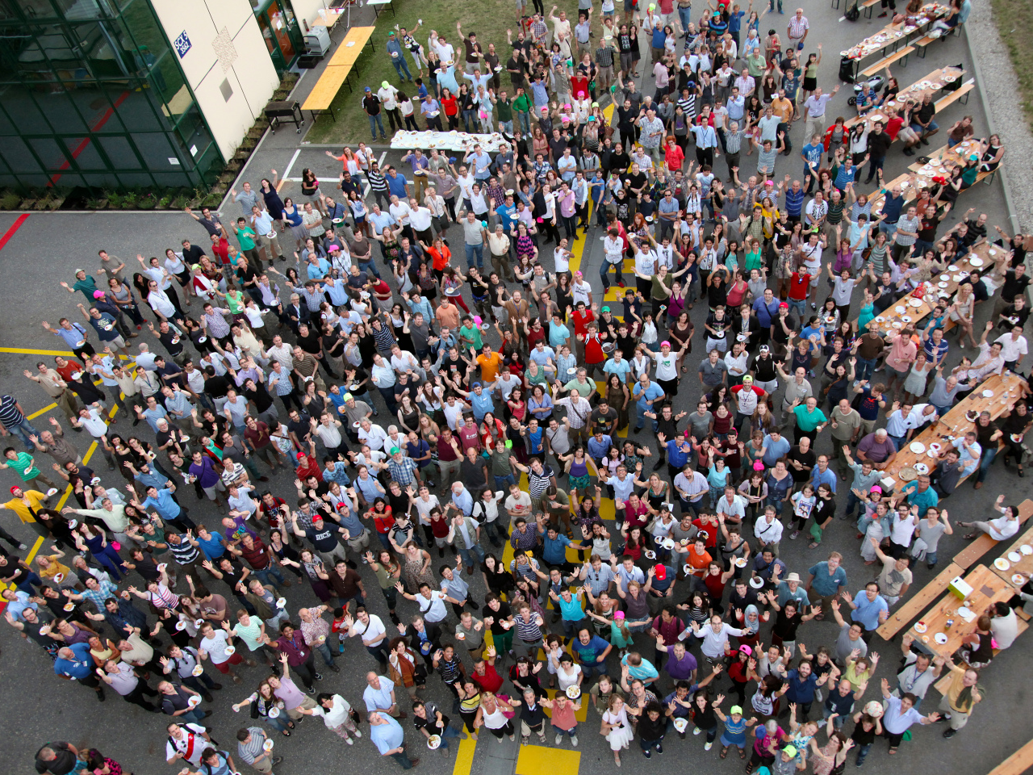
CMS
Collaboration Board
Opening Plenary – CMS Physics Week
October 13-17th, 2014

Slide 2
Some important events this week
CB Chat
Event in the Globe
Plenary Physics
CB meeting (CB98)
Wedn all day
Friday 13:30-16:30
Meetings with an interest for CB members
Wednesday from 18:00
Focus of the Week
Run-1 end-game
Industry Award and Career Event
Informal discussion of CB matters
Monday 18:00-23:00
Thursday all day
Focus the meeting
Friday all morning
Run-2 preparation
TP preparation
Agenda: https://indico.cern.ch/event/342994/other-view?view=standard

Slide 3
Today: Industry Awards & Career Event
Industry Award Event
18:00-19:15 Industry Awards
Career Event
19:15-19:45 Aperitif and snacks
19:45-21:30 Presentations by CMS Alumni in Industry
(Google, EPO, Jaguar Land Rover, Intel, AHL)
21:30-21:50 Drinks
21:50-22:30 Round table discussion with CMS Alumni
22:30-23:00 Networking with Alumni
Registration at : https://indico.cern.ch/event/330005/overview

Slide 4
Topics for CB98 (Oct 17th, 2014)
Vote
IIT
RM statement
Resource Manager is finalizing the in-take meetings
Vote on new institution
Quorum of 1/3
Proxy
Please assign a proxy when you cannot be present !
Madras, India
At least 50% “yes”
CB98 agenda: https://indico.cern.ch/event/343866/

Slide 5
Topics for CB98 (Oct 17th, 2014)
Associate Institute (to take note)
Synchronization of membership CB committees (up for approval)
Starting dates for all CB committees: 1st of Sept or 1st of March
From CB Chair team
Wish from Electron National Research Institute to be removed (St.Petersburg, Russia)
First discussions on the following topics
Towards a policy for publishing the numerical aspects of figures and plots in CMS papers
Aligned with other management/coordination positions in CMS
Aligned with typical academic semesters
Transition: extend the mandates of the current members
Towards a proposal for long-term proxy assignments
See CB newsletter (via email on October 3rd)

Slide 6
Topics for CB98 (Oct 17th, 2014)
Proposal
Mumbai, India
Presentation
Decision
By Tariq Aziz during the CB meeting
During the CB meeting on October 17th, by vote or consensus
CMS Week outside CERN 2016
From the Indian community in CMS
Sept or Dec 2016
At TIFR (Tata Institute for Fundamental Research)
Link to their proposal: https://indico.cern.ch/event/343866/

Slide 7
Topics for CB98 (Oct 17th, 2014)
Written reports, no oral reports
Dedicated topics
Please contact us when you want to discuss a specific item during this or a future CB meeting
CB committees
Added to the CB meetings agenda
Some highlights
The call for CMS Achievement Awards went out to the Project Managers and Coordinators (deadline December 1st)
First Open Access data release in High-Energy Physics delayed to end of October (cfr. report attached to CB98 indico page)
Projects: Tracker, ECAL, HCAL, Muons, TriDas, BRIL, CT-PPS (i.e. the CMS members of CT-PPS)
Coordination areas: Run, Trigger, Computing, Offline, PPD, Upgrade

Slide 8
Update of SCOAP3
Sponsoring Consortium for Open Access Publishing in Particle Physics
Currently contributing countries
Austria, Belgium, Canada, CERN, China, Czech Republic, Denmark, Finland, France, Germany (3x), Greece, Hungary, IAEA, Italy, Japan, JINR (representing 12 countries), Korea, Norway, Portugal, Slovak Republic, South Africa, Sweden, Switzerland, Netherlands, Turkey, United Kingdom (2x), United States (2x, 200 partners)
Arrangements in progress with
Mexico, Poland, Spain
In the United States only missing
Notre Dame, Puerto Rico
Currently not yet participating countries
Russia, Brazil, India, Iran, Taiwan, Ireland, Croatia, Bulgaria, Colombia, Cyprus, New Zealand, Serbia, Egypt, Pakistan
Link to SCOAP3 website: http://scoap3.org
Presentation of Gigi Rolandi: https://indico.cern.ch/event/303903/session/0/contribution/21/material/slides/0.pdf

Slide 9
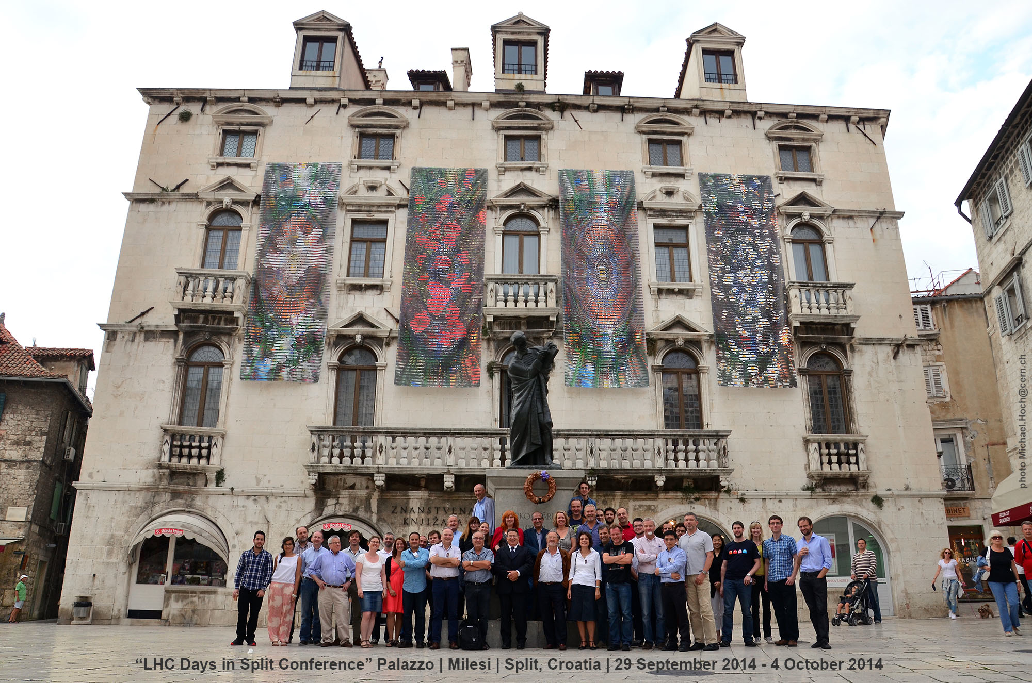
News from Michael Hoch
Physics Days in Split
art@CMS
Permanent link to art@CMS report: http://mhoch.web.cern.ch/mhoch/Art@CMS/Art@CMSporjects2014.pdf

Slide 10
Topics for CB98 (Oct 17th, 2014)
2015 CMS Calendar
Forward Calorimeter
Management/coordination
New CSC deputy
From Spokespersons team
Proposal to shift the dates of the first CMS Physics and Upgrade week (23-27 Febr)
Updated planning following the LHCC report
New position: Deputy Trigger PM to follow the upgrade beyond the TP
For approval
For approval
Proposal Endcap Calorimetry review panel
Chaired by Ph. Bloch
EPR pledges 2014
Please fill your pledges by tomorrow
CB98 agenda: https://indico.cern.ch/event/343866/

Slide 11
Topics for CB98 (Oct 17th, 2014)
Please contact us timely for AOB items

Slide 12
CB Chat (Wedn 18:00 at “Pas Perdu”)
For a drink
… and Belgian beers
All welcome

Slide 13
CB Chat (Wedn 18:00 at “Pas Perdu”)

Slide 14
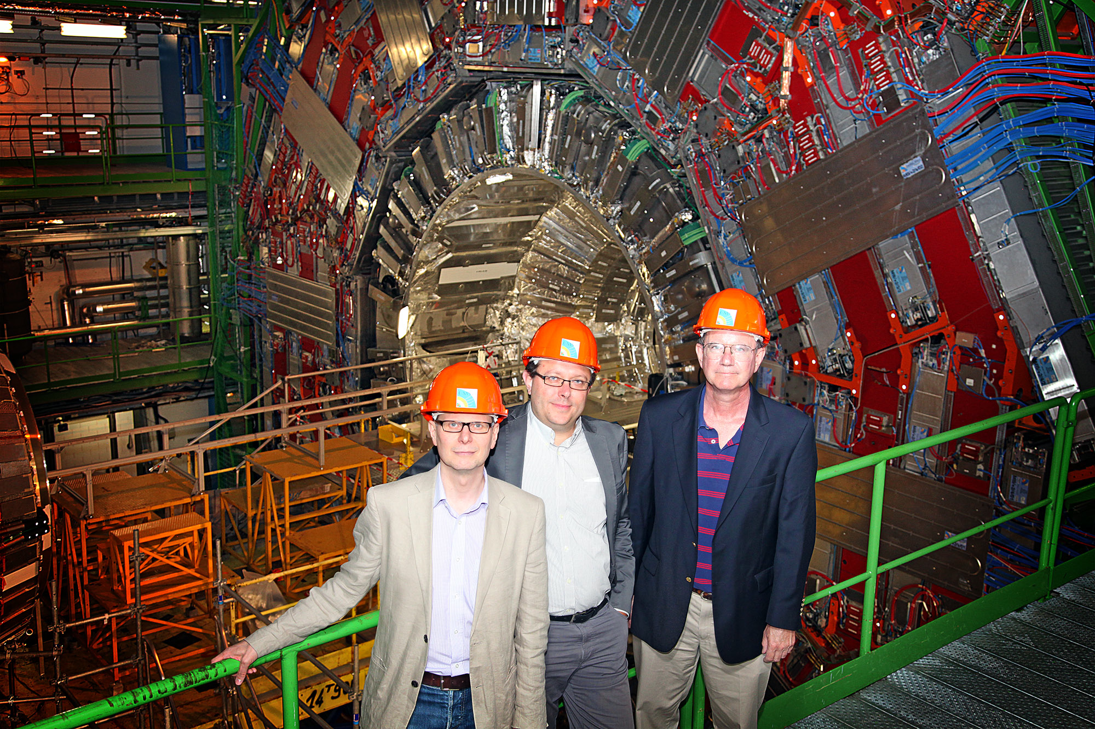
Collaboration Board Chair team
July 1st 2014 until August 31st, 2017
Chairperson
Jorgen D’Hondt
Secretary
Nick Hadley
Deputy Chairperson
Günther Dissertori
main office: 42-3-031
cms-cbchairteam@cern.ch

