Slide 1
Extensions of the Standard Model
(part 2)
Prof. Jorgen D’Hondt
Vrije Universiteit Brussel
Inter-university Institute for High Energies
Content:
The Higgs sector of the Standard Model and extensions
Theoretical constraints on the Higgs boson mass
Searching for the Higgs boson
The hierarchy problem in the Standard Model
Introduction to the phenomenology of Supersymmetry
http://w3.iihe.ac.be/~jdhondt/Website/BeyondTheStandardModel.html

Slide 2
Extensions of the Standard Model
(part 2)
Prof. Jorgen D’Hondt
Vrije Universiteit Brussel
Inter-university Institute for High Energies
Lecture 1
Important note: whenever we note “Higgs boson” (or mechanism), we mean the well-known Brout-Englert-Higgs boson or mechanism.
http://w3.iihe.ac.be/~jdhondt/Website/BeyondTheStandardModel.html

Slide 3
How far can we stretch our theory?
Prof. Jorgen D’Hondt
Vrije Universiteit Brussel
Inter-university Institute for High Energies
Content:
Short reminder of the spontaneous ElectroWeak symmetry breaking
One missing piece: the mass of the Brout-Englert-Higgs scalar
Theoretical constraints on the Higgs boson mass
  Pertubativity or unitarity constraint
  Triviality bound and stability bound
  Fine-tuning
Methods can be applied to models beyond the Standard Model
What about more then one Higgs doublet…
http://w3.iihe.ac.be/~jdhondt/Website/BeyondTheStandardModel.html

Slide 4
Spontaneously broken QED theory
Let us illustrate the “Higgs” mechanism with a massive U(1) theory before going to the symmetry group SU(2)_{L} x U(1)_{Y}. The Lagrangian of QED is:
This is invariant under the U(1) gauge transformation
Now we wish to give the photon a mass by adding the term
Which breaks the initial U(1) gauge symmetry. Hence need to invoke a mechanism which introduces a mass without breaking the symmetry.

Slide 5
Spontaneously broken QED theory
Introduce a complex scalar field as
with the potential V defined as which is symmetric under the transformation
We can choose a parametrization as
where both fields and are real fields.
The potential becomes
where the Higgs self-coupling term should be positive (λ>0) to get a potential bound from below. When a non-zero vacuum expectation value is obtained.
-

Slide 6
Spontaneously broken QED theory
Therefore we can normalize the field as .
We can choose the unitary gauge transformation
and then becomes real-valued everywhere. The kinetic term in the Lagrangian becomes
The Lagrangian can be expanded around its minimum by introducing a degree of freedom h (a new field). The potential becomes
with and and
+
+
+

Slide 7
Spontaneously broken QED theory
The kinetic term becomes
and with this becomes
where the first term provides a mass to the photon ,
the second term gives the interaction strength of the coupling A-A-h, the third term the interaction strength of the coupling A-A-h-h
In the new potential term also cubic terms appear which break the reflexion symmetry .
This U(1) example is the most trivial example of a spontaneous broken symmetry.

Slide 8
Spontaneously broken SU(2)xU(1) theory
The bosonic part of the Lagrangian is
with a doublet field consisting out of two complex scalar fields or components
We need at least 3 massive gauge bosons, hence need at least 2 complex fields (cfr. Goldstone theorem).
with the Pauli matrices and the structure constants of the SU(2)_{L} group.

Slide 9
Spontaneously broken SU(2)xU(1) theory
The B_{μ} field corresponds to the generator Y of the U(1)_{Y} group and the three fields to the generators of the SU(2)_{L} group.
When μ²<0 the vacuum expectation value of is non-zero.
The VEV will carry the hypercharge and the weak charge into the vacuum, but the electric charge remains unbroken, hence
and we break SU(2)_{L}xU(1)_{Y} to U(1)_{Q} with only one generator.
Expending the terms in the Lagrangian around the minimum of the potential gives

Slide 10
Spontaneously broken SU(2)xU(1) theory
We obtain
and define the following fields
which we can transform into expressions for
and put this in the above equation for and isolate the Higgs boson interaction terms

Slide 11
Spontaneously broken SU(2)xU(1) theory
…
with
where it is convenient to define the Weinberg mixing angle θ_{W}
and therefore

Slide 12
Spontaneously broken SU(2)xU(1) theory
From experiment we know
Hence we obtain
And for the couplings between V=W/Z bosons and the Higgs boson
We observe that the Higgs sector in the Standard Model is completely determined from the mass of the Higgs boson.

Slide 13
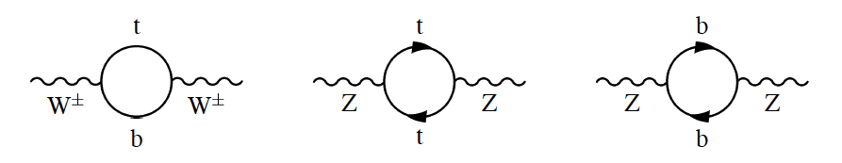
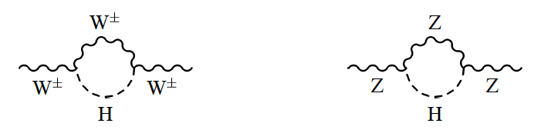
Experimental constraints on the Higgs boson mass
Radiative corrections on the propagators of bosons in the theory
References:
  “A combination of preliminary Electroweak Measurements and Constraints on the Standard Model”, hep-ex/0612034 (and recent updates)
  “Precision Electroweak measurements on the Z boson resonance”, hep-ex/0509008

Slide 14
The free parameters in the fit
The Standard Model gives a unified description of Electro-Magnetic & Weak interactions, hence the weak coupling is related to the EM coupling → only 2 coupling constants remain independent
    α : EM interactions (fine structure constant)
    α_{s} : strong interactions
Among the fermion masses only the top quark mass plays an important role (all others are well enough determined and can be assumed fixed) as they have m_{f} << m_{Z} and do not influence the observations at high energies significant: m_{t}
Among the boson masses the Z boson mass (m_{Z}) is very well measured while the W boson mass not that presice. The free parameter m_{W} has been replaced by G_{F}, hence m_{W} becomes a quantity derived from the SM relations or the EW fit.
The Higgs boson mass (m_{H}).
  → the free parameters are α_{s}(m_{Z}²), α(m_{Z}²), m_{Z}, m_{t}, m_{H}, G_{F}

Slide 15
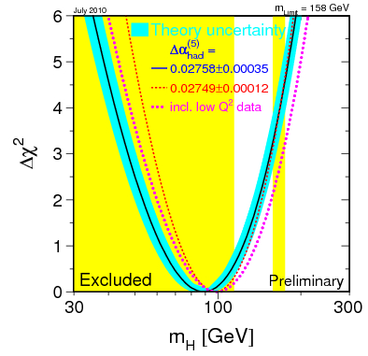
The ElectroWeak fit: the result
Given these parameters we can obtain indirect measurements of the observables measured directly by
LEP, SLC, Tevatron.
These predictions go through
radiative corrections calculated
to some precision
→ blueband in the plot
(eg. 2-loop fermionic and bosonic
corrections for the calculation of m_{W})
On each of the input parameters
there is some uncertainty, hence we
derive a confidence interval where
the observed quantity should have
its value give the SM relations
→ reflected in the Δχ²(m_{H})
Five relevant input parameters of the Standard Model relations
  α_{s}(m_{Z}²), α(m_{Z}²), m_{Z}, m_{t}, m_{H}, G_{F}

Slide 16
Theoretical constraints on the Higgs boson mass
Aim:
  Get a feeling how one can test if a theory is consistent
  How far can we stretch the EW theory until it does not make sense anymore?
  Example for the yet unobserved Higgs sector in the Standard Model, but techniques can be applied elsewhere
Content:
  Perturbativity & unitarity
  The triviality bound
  The vacuum stability bound
  The fine tuning constraints

Slide 17
Perturbative constraint & unitarity
The scattering of vector bosons at high energies is divergent due to their longitudinal polarization. Take V = W or Z traveling in the z-direction with 3-momentum magnitude k.
with
The three polarization vectors are (resp. right handed, left handed and longitudinal):
which satisfy (a,b = +, - , L)

Slide 18
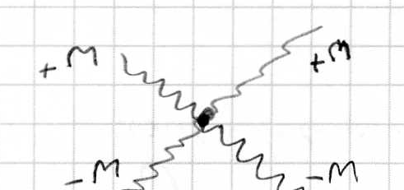
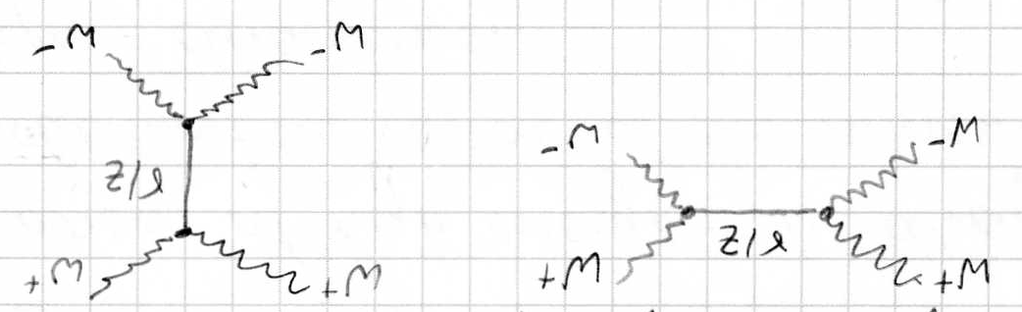
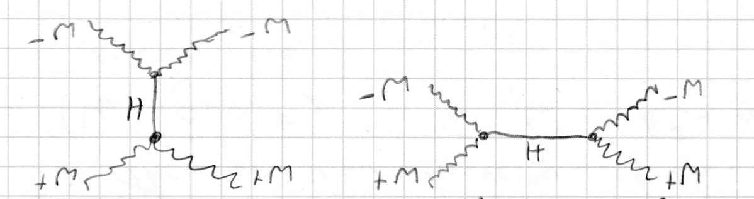
Perturbative constraint & unitarity
When E_{k} >> m_{V} the longitudinal polarization is divergent. Diagrams with external vector bosons have divergent cross sections. Consider the process
(i) Four point interaction
(ii) Gauge exchange of photon/Z in the s- and t-channel
(iii) Higgs exchange in the s- and t-channel

Slide 19
Perturbative constraint & unitarity
The amplitude can be written as (S.Weinberg, Vol.1, sec 3.7)
s = Mandelstam variable (square sum of initial momenta)
From computations we learn that (when )
Perfect cancellation between the diagrams. But the amplitude remains proportional to the Higgs boson mass. If the Higgs boson mass is too large the theory becomes strongly interacting and we cannot perform expansions versus λ.

Slide 20
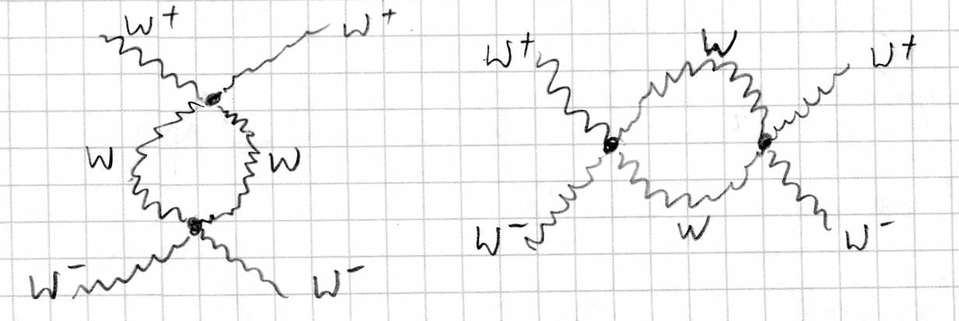
Perturbative constraint & unitarity
At the loop level the process
has an amplitude of
The one-loop amplitude becomes equal to the tree-level amplitude when λ ~ 32π², hence the Electro-Weak theory should break down when m_{h} > 6 TeV.
More rigorous via partial wave analysis: m_{h} < 870 GeV
When taking also the WW→ZZ process into account: m_{h} < 710 GeV

Slide 21
The triviality bound
The couplings should remain finite at all energy scales Q.
Via the renormalization group equations we can evolve the couplings to higher scales Q.
For large Higgs boson masses the term λ² dominates and after integration one obtains Landau pole or a limit on the value of Q for which the theory is still valid.

Slide 22
The vacuum stability bound
When the Higgs boson mass is light the term -6y_{t}⁴ will dominate:
hence for higher scales Q the value of λ could become negative, hence the vacuum instable (V<0). With the constraint λ(Q)>0 for all values of Q we obtain a lower limit on the Higgs boson mass. After integrating the part of the RGE which is λ independent from Q₀ to Q we obtain:
Hence a lower limit for the Higgs boson mass for a given Q scale to keep the vacuum stable (without the presence of new physics phenomena beyond the Standard Model).
The full calculations at higher order (more loops) is done.

Slide 23
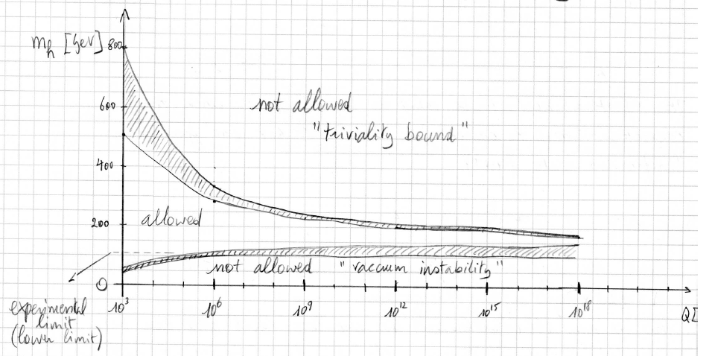
All together: theoretical bounds on the Higgs boson mass
If the Higgs boson is to be found at 60 GeV then this means the vacuum is instable in the absence of new physics. Only when the mass is between 130-180 GeV the vacuum can remain stable up to the Planck scale.

Slide 24
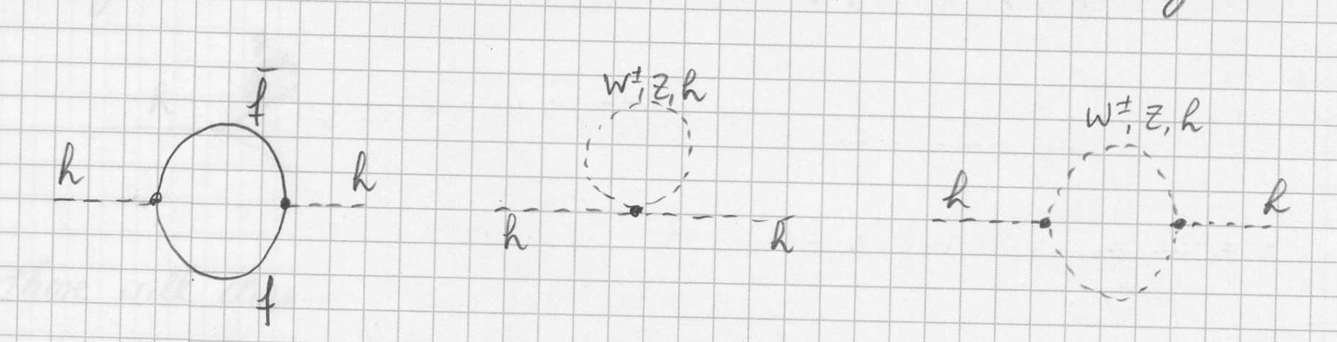
The fine-tuning constraint
The radiative corrections to the Higgs boson mass induce a fine tuning problem. At one loop
The integral can be cut-off at a momentum scale Λ
hence to cancel this we need m_{h}² ~ (320 GeV)²
To cancel the radiative terms up to the GUT scale Λ ~ 10¹⁶ GeV we need to cancel up to 32 digits after the comma.

Slide 25
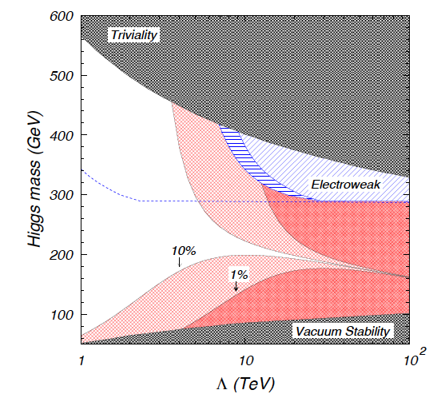
The fine-tuning constraint
Requesting up to 10% (or 1%) fine-tuning the allowed range for the validity of the Standard Model is reduced.

Slide 26
The fine-tuning constraint
Requesting up to 10% (or 1%) fine-tuning the allowed range for the validity of the Standard Model is reduced.
… why should there be only one Higgs doublet ?

Slide 27
Two Higgs Doublet Models (2HDM)
In the Standard Model we have introduced only one complex Higgs doublet resulting into one physical Higgs boson field and masses for 3 vector bosons. There is however no experimental reason why we cannot have more then one Higgs doublet.
Let us introduce two complex Higgs doublet fields φ₁ and φ₂.
The most general Higgs potential V which spontaneously breaks SU(2)_{L}xU(1)_{Y} into U(1)_{EM} is
where the λ_{i} values are real and the φ_{i}’s are the Higgs fields with a minimum of the potential appearing at

Slide 28
Two Higgs Doublet Models (2HDM)
When there is no CP violation in the Higgs sector, which we will force. The last two terms can be combined when λ₅=λ₆ into
where the e^{iξ} term can be rotated away by redefining one of the φ fields.
We develop the two doublets around the minimum of the potential. For this we parameterize the fields as
where η_{i} is the CP-even part and χ_{i} the CP-odd part. We put these fields in the potential and the mass terms appear.

Slide 29
Two Higgs Doublet Models (2HDM)
This results in the following relevant terms, grouped according to the CP-even, CP-odd and charged Higgs sectors:
where these squared-mass terms can be obtained from
with

Slide 30
Two Higgs Doublet Models (2HDM)
The physical eigenstates of the Higgs fields are obtained from a mixing between these fields
With a rotation of the eigenstates the squared-mass matrices can be diagonalized and the masses of the physical eigenstates can be determined. Express the potential in terms of the real fields.
For the CP-odd Higgs (mixing angle β with tanβ=v₂/v₁)
For the CP-even Higgs (mixing angle α)
For the charged Higgs (mixing angle β)
3 Goldstone bosons to give masses to W and Z bosons

Slide 31
Two Higgs Doublet Models (2HDM)
These relations depend on the values of λ and the mixing angles, hence they can be inverted to write the λ values as a functions of the masses and mixing angles.
These will fully define the potential. Hence this non-CP violating 2HDM Higgs sector has 6 free parameters:
The fermions can couple to these two Higgs doublet field in different ways:
  Type-I 2HDM: the field φ₂ couples couples to both the up- and down-type fermions
  Type-II 2HDM: the field φ₁ generates the masses for the down-type fermions, while the field φ₂ generates the masses for the up-type quarks (this is the basis of the Higgs sector in the MSSM)
The couplings between the fermions and the neutral Higgs bosons are defined from the mixing angles α and β.

Slide 32
Lecture summary
Reminder of the mechanism of spontaneous symmetry breaking
Applied on the EW symmetry of SU(2)xU(1)
The yet to be observed Higgs sector of the Standard Model depends only on one parameter, the mass of the Higgs boson
Diverse arguments can be invoked to put theoretically constraints on the Higgs boson mass (m_{H} < 1 TeV)
For the theory to be valid up to the Planck scale, the allowed range of the Higgs boson mass is very limited (m_{H} ~ 130-180 GeV)
When you do not “believe” that Nature has fine-tuned the parameters of the model, the allowed range is even vanishing or new physics has to appear at scale below Λ ~ 10-100 TeV
Maybe one Higgs doublet is not enough…
2-Higgs Doublet Models are the basis of supersymmetric models
We have walked through the techniques needed to calculate the mass spectrum of the Higgs sector in a general 2HDM

