Slide 1
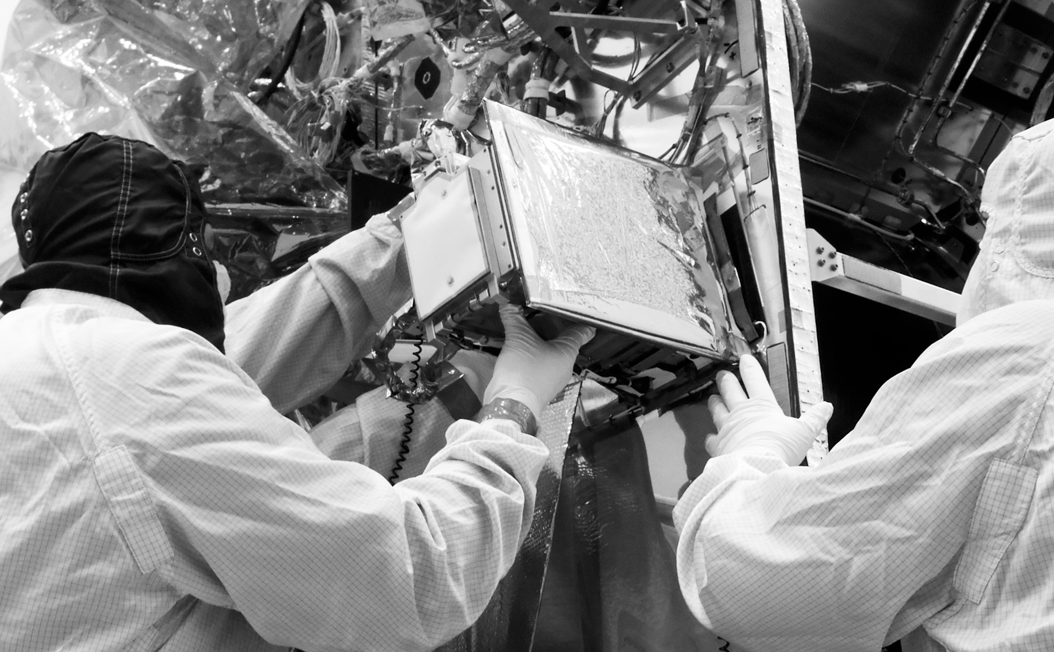
From Past To Present… And Back
Jorgen D’Hondt - Anaïs Tondeur

Slide 2
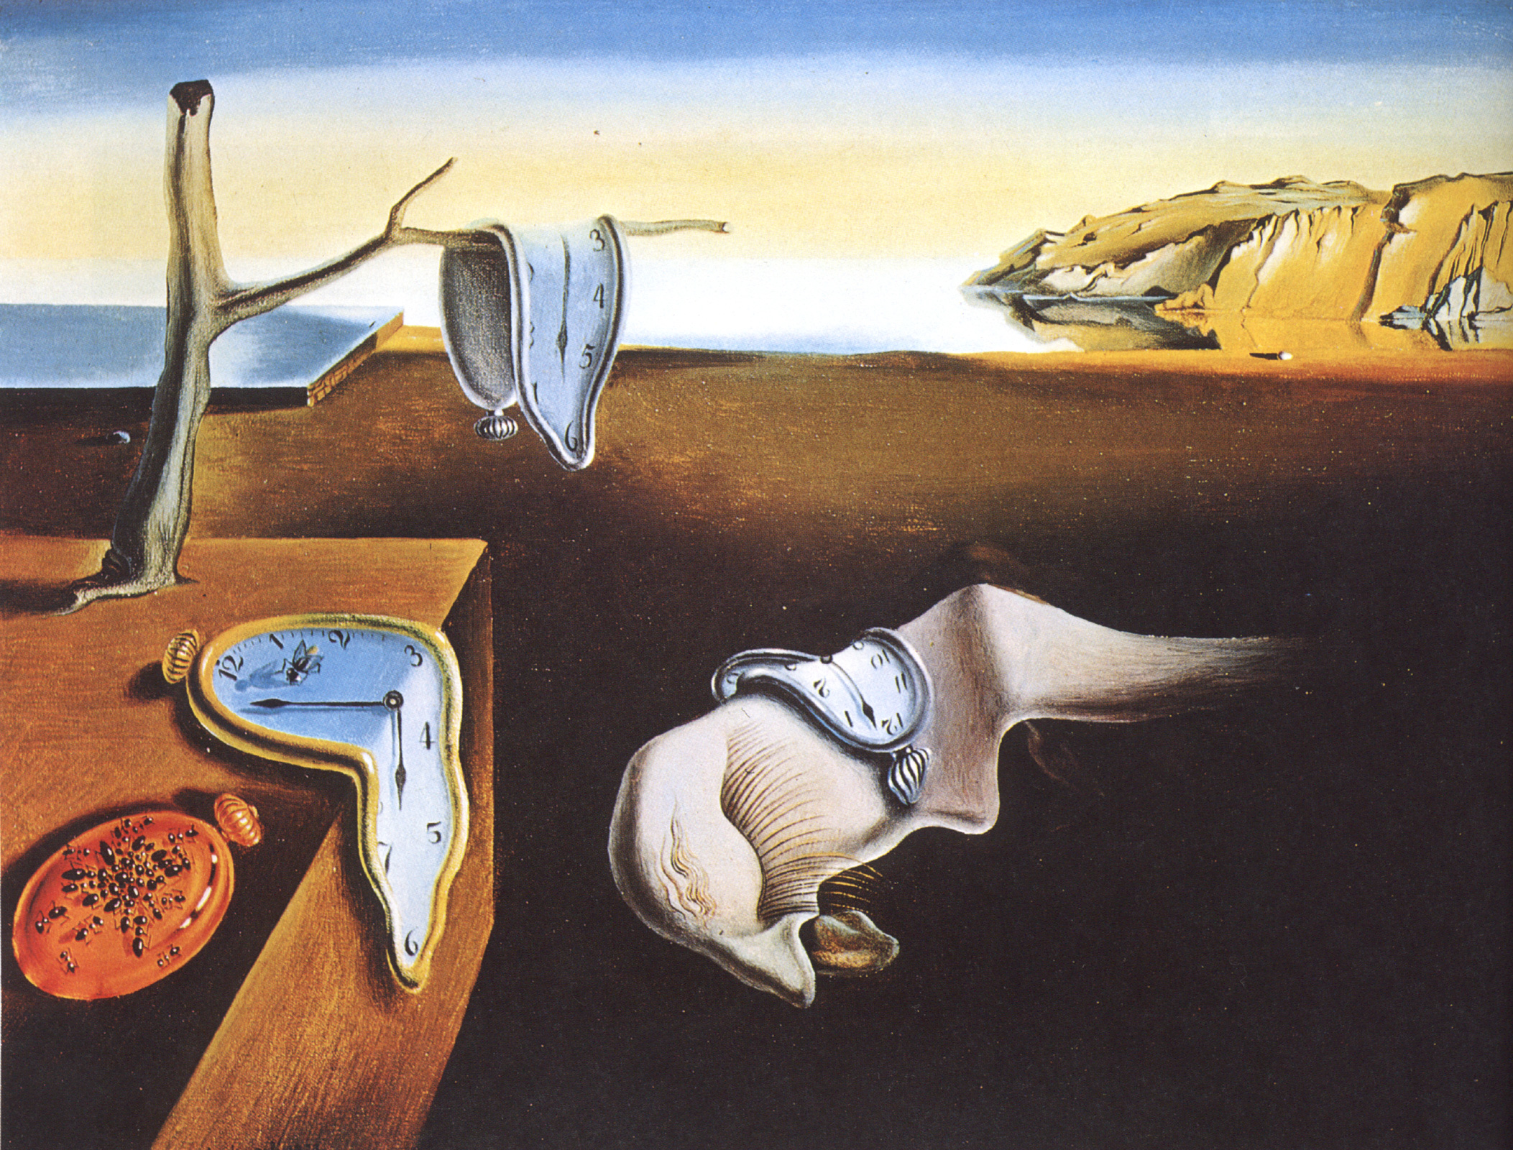
The physicist: What is time ?
Is time something real or invented by human?
The Persistence of Memory, 1931, S. Dali

Slide 3
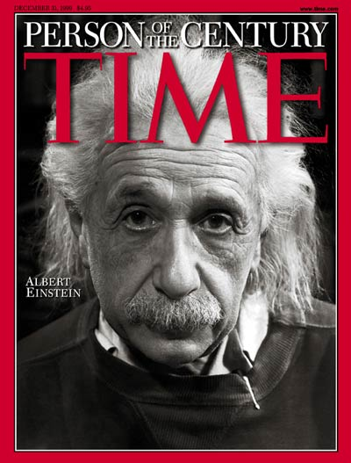
The physicist: Time after Einstein ?
Invented “relativity” to describe how objects move around in space and time
I measure that your time is relatively slower if your speed relative to me is close to the speed of light
Life on Earth
Life in a rocket at
85% of the light speed
Time Magazine, Dec 1999; Cover Credit: PHILIPPE HALSMAN

Slide 4
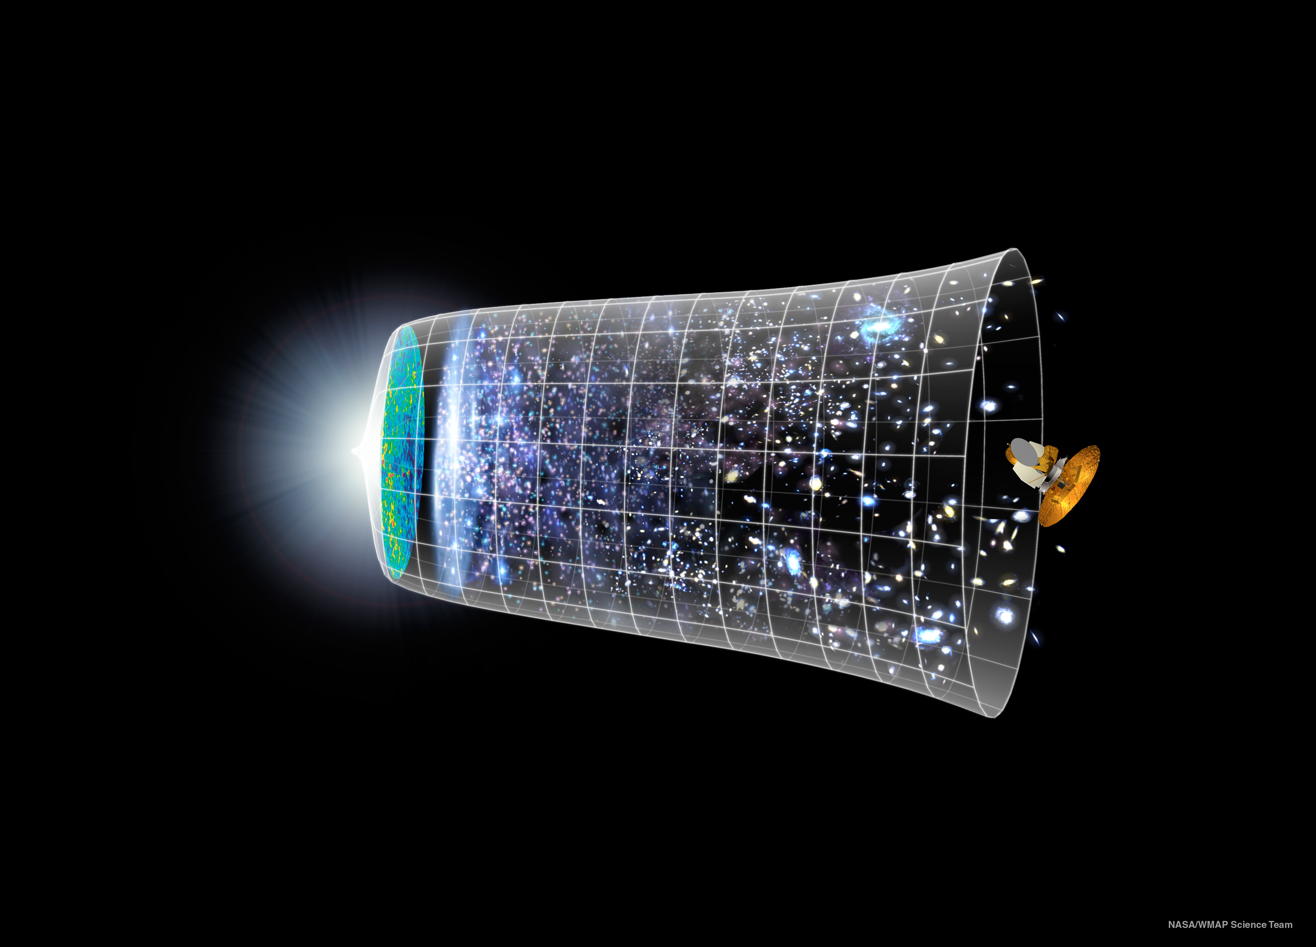
Space and time were created together
Particle physics research, the first fraction of a second
NASA/WMAP Science Team

Slide 5
The physicist: Scale of things ?
Observable universe
Visible with our eyes
Smallest particles
~ 1.000.000.000.000.000.000.000.000.000
~ 0.00000000000000000001 meter
Distance to galactic center
Distance light travels in one year
Size of an H₂O molecule
Farthest human object from Earth (Voyager 1)
Distance a human can walk in one year (and we typically drive per year)
Thickness growth of a tree each year
Different “perception” of time while exploring

Slide 6
The physicist: Scale of Time ?
Age of the universe
Humanity measures time with instruments
Smallest time unit
(Planck unit)
1 second
14.000.000.000
0.000000000000000000000000000000000000000000000000001 years
Lifetime of lightning
Lifetime of a star
Lifetime of a mayfly
Time needed to switch on your light
Lifetime of a radio-active atom (U²³⁵)
Human lifetime
Period of ice-ages
Timescales beyond the human perception

Slide 7
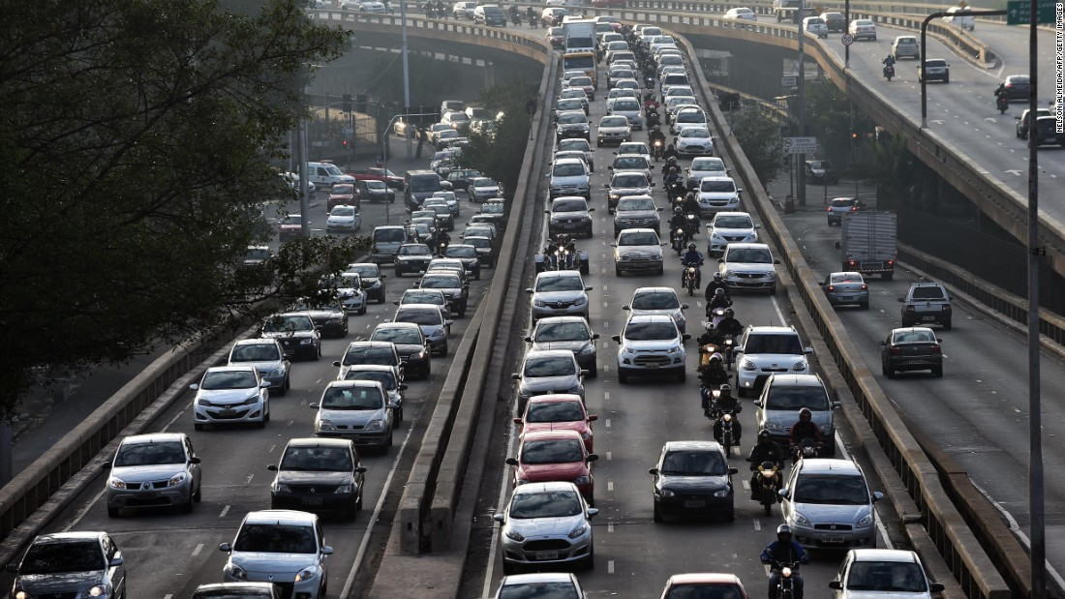
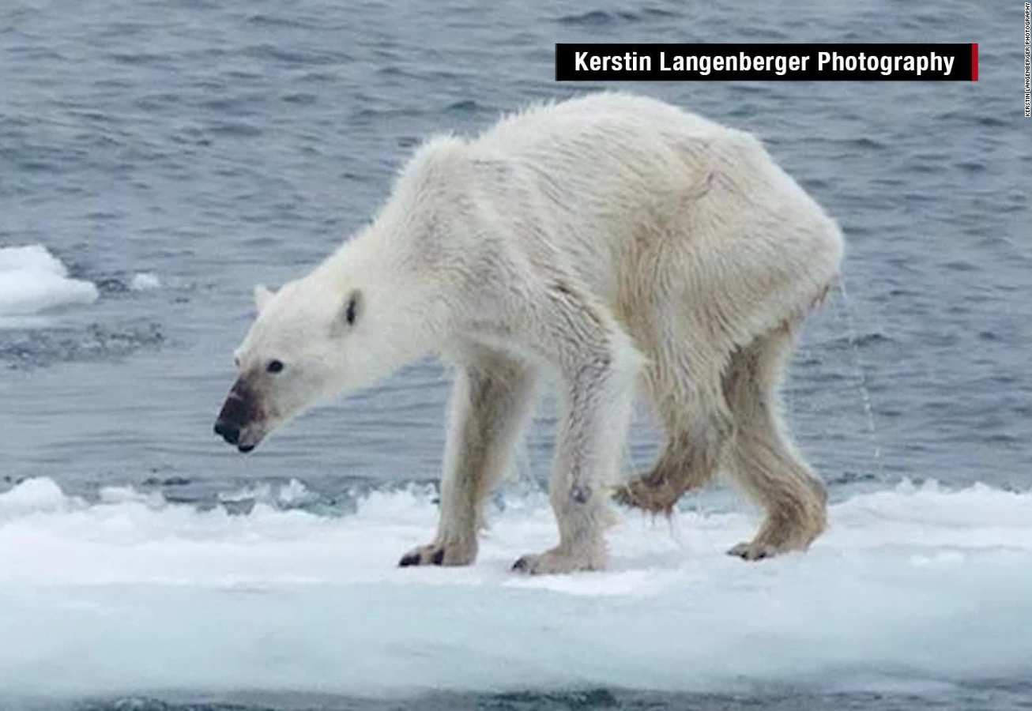
Evolution with Time
Some aspects have a slow impact, some a fast growing impact
The connection between past and present might become even debatable (by some)
CNN

Slide 8
Evolution with Time
Some aspects have a slow impact, some a fast growing impact
Discovering the connection sometimes requires a scientific revolution

Slide 9
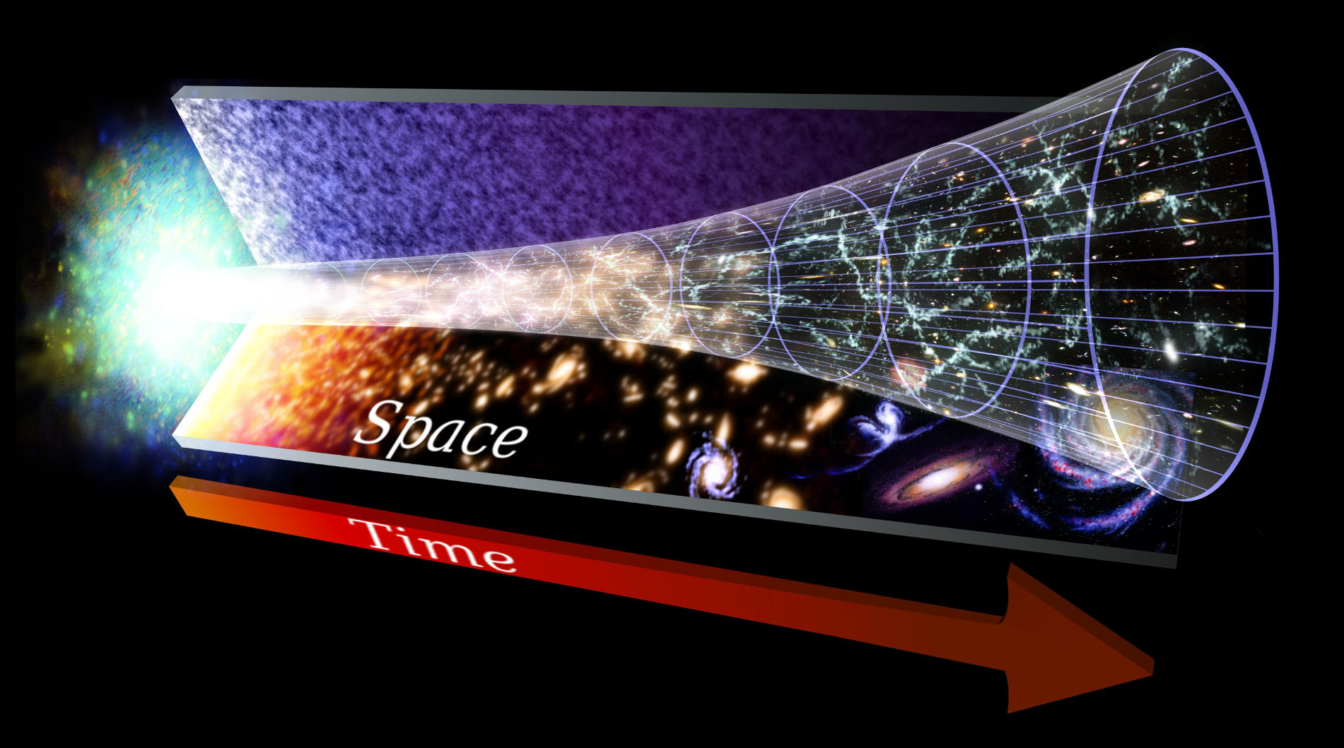
Evolution with Time
And sometimes it is very challenging to make the
connection between past and present
Credit: NASA, Goddard Space Flight Center

Slide 10
The Large Hadron Collider at CERN creates particle interactions similar to those 0,000000000001 seconds after the Big Bang
Credit: CERN

Slide 11
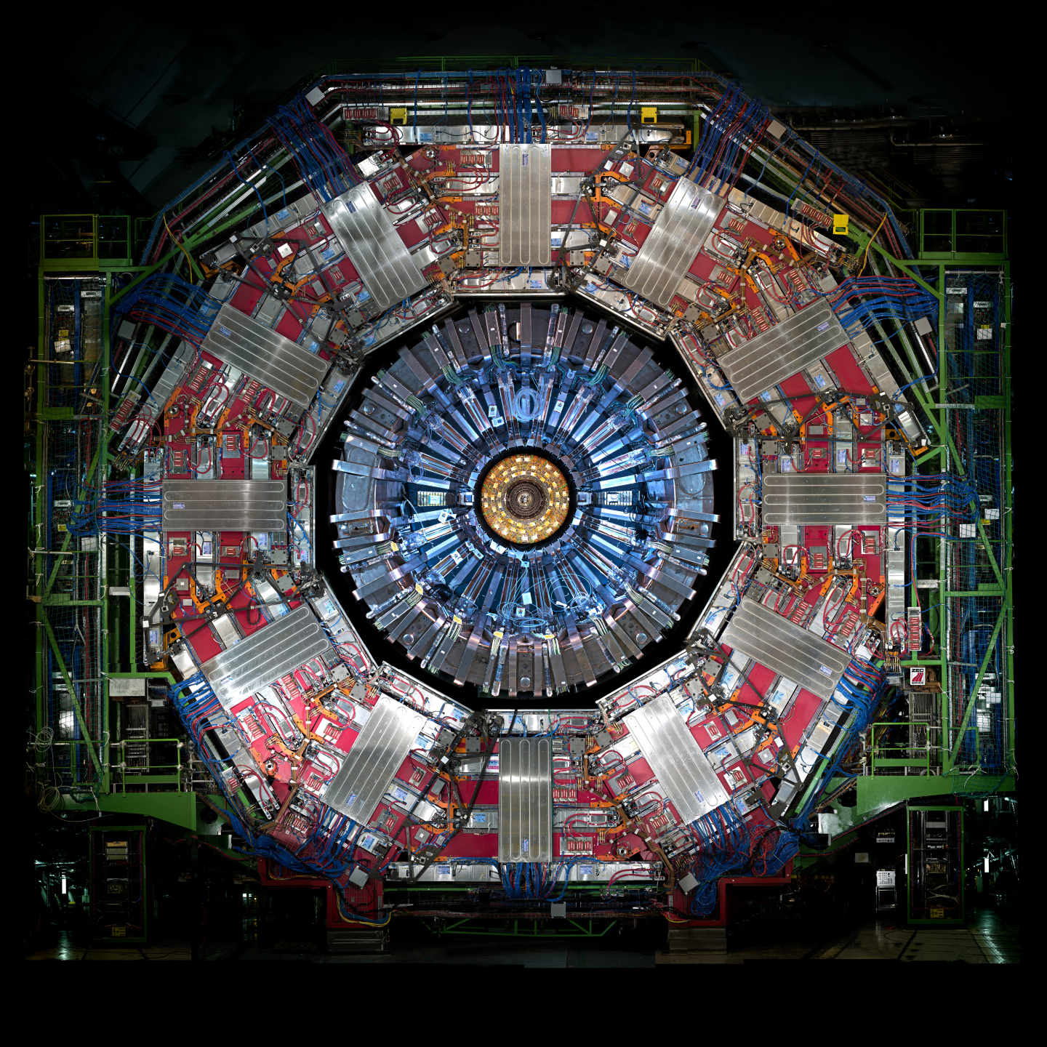
15m

Slide 12
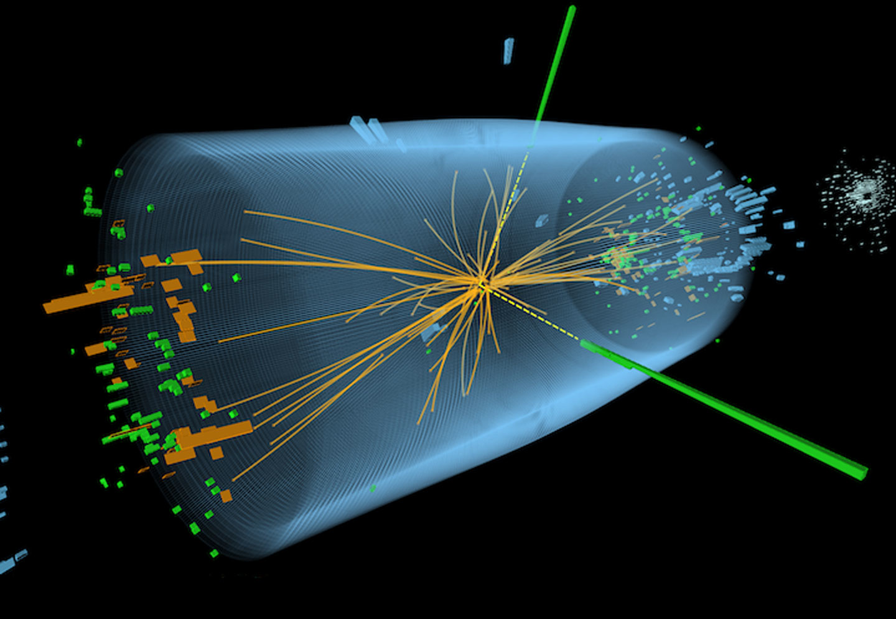
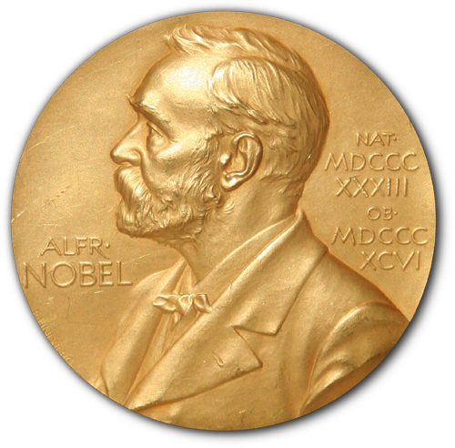
In these high-energy collisions we discovered the Higgs particle (in 2012)
related to
Nobel Prize
in 2013
2012

Slide 13
From Past to Present… and Back!
Big Bang
Today
Credit: NASA, Goddard Space Flight Center
Unraveling the story of our universe

