Slide 1
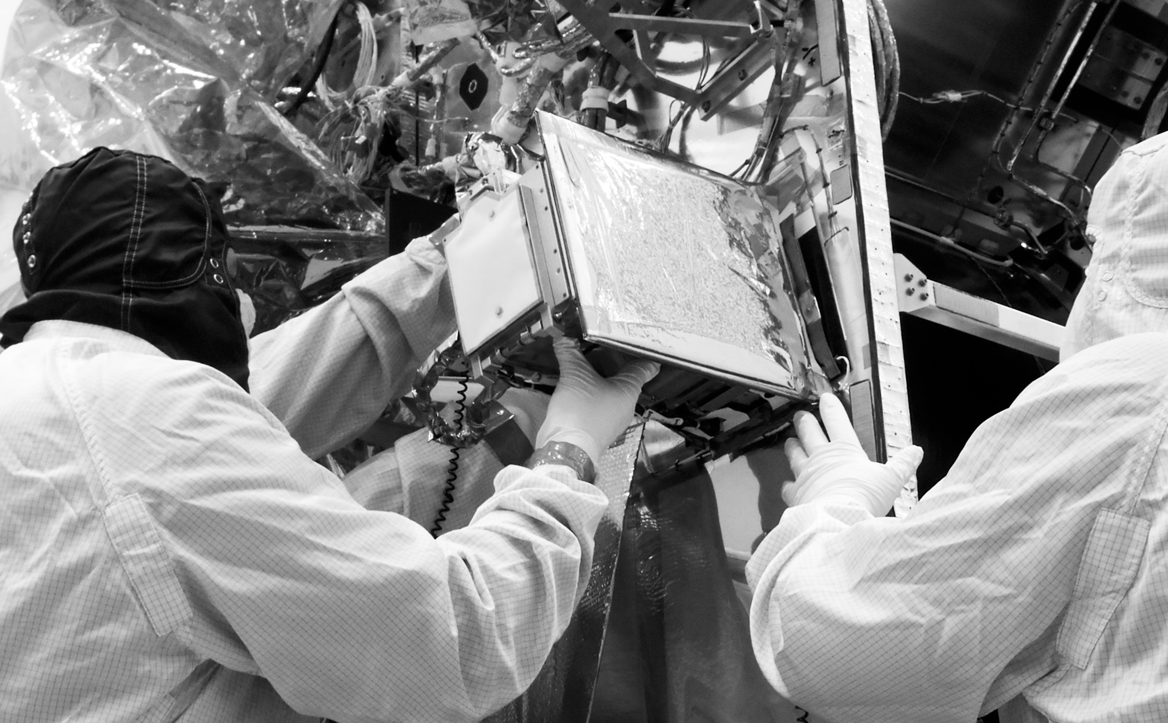
From Past To Present… And Back
Jorgen D’Hondt - Anaïs Tondeur
Notes:
Ainsi, par sa forme à la fois organique et minérale, la galalithe renvoie en miroir au
rôle des vers de terre,
qui par digestion assemblent particules de roches et de végétaux pour générer le véritable sol.
Cette performance affirme
le lien nourricier réciproque qui nous unit au sol.
L’allaitement est une période où le corps nutritif s’affirme.
Un être nourrit un autre être.
Fluide qui transmet la vie, le lait maternel passera dans le sol, pour s’offrir en retour au milieu de vie souterrain qui permet et supporte notre existence.
Je me demande si au fond nous n’avons pas besoin de retrouver un rapport sensible au monde
ce qui nous est arrivé serait de l'ordre d'une brutale mutation écologique,
qui a interrompu la symbiose entre nos sens et le monde.

Slide 2
Part 1
Jorgen: Time from a physicist point of view

Slide 3
The physicist: What is time ?
(I admit, it is closely related to philosophy)
Is time something real or invented by human?

Slide 4
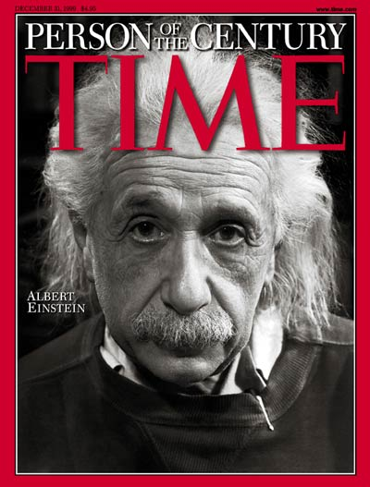
The physicist: Time after Einstein ?
Invented “relativity” to describe how objects move around in space and time
You experience time relatively slower if you travel close to the speed of light
Life on Earth
Life in a rocket at
85% of the light speed
Time Magazine, Dec 1999; Cover Credit: PHILIPPE HALSMAN

Slide 5
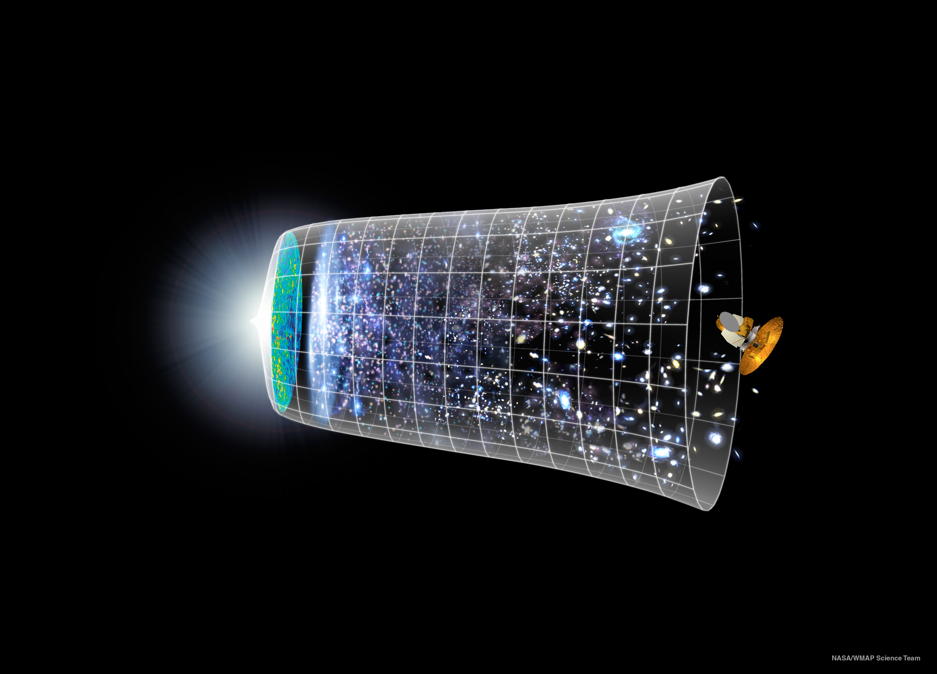
Space and time were created together
Particle physics research, the first fraction of a second
NASA/WMAP Science Team

Slide 6
The physicist: Scale of things ?
Observable universe
Visible with our eyes
Smallest particles
~ 1.000.000.000.000.000.000.000.000.000
~ 0.00000000000000000001 meter
Distance to galactic center
Distance light travels in one year
Size of an H₂O molecule
Farthest human object from Earth (Voyager 1)
Distance a human can walk in one year (and we drive typically per year)
Thickness growth of a tree each year
All things “perceive” time differently

Slide 7
The physicist: Scale of Time ?
Age of the universe
Humanity measures time with instruments
Smallest time unit
(Planck unit)
1 second
14.000.000.000
0.000000000000000000000000000000000000000000000000001 years
Lifetime of lightning
Lifetime of a star
Lifetime of a mayfly
Time needed to switch on your light
Lifetime of a radio-active atom (U²³⁵)
Human lifetime
Lifetime of a memory
Period of ice-ages
Timescales beyond the human perception

Slide 8
Part 2
Anais
Potentially:
I.55
A Dream To Space

Slide 9
Part 3
Jorgen: Evolution with time, and connect past and present

Slide 10
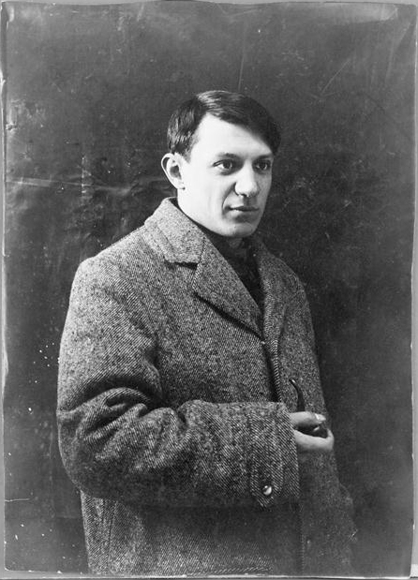
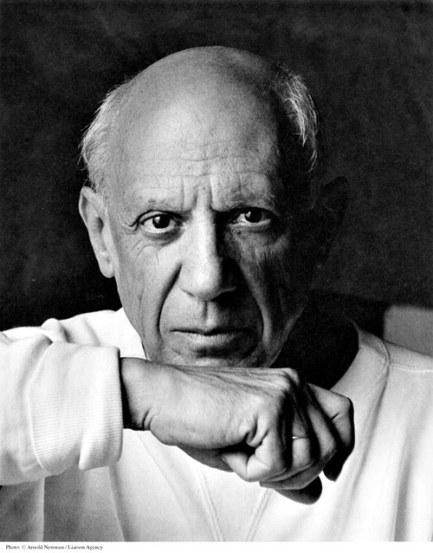
Evolution with Time
Some aspects have a slow impact, some a fast growing impact
Here the connection between two moments in time is easy

Slide 11
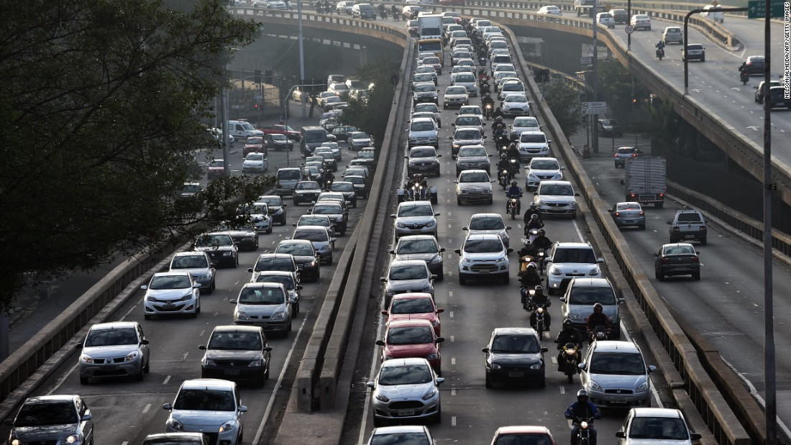
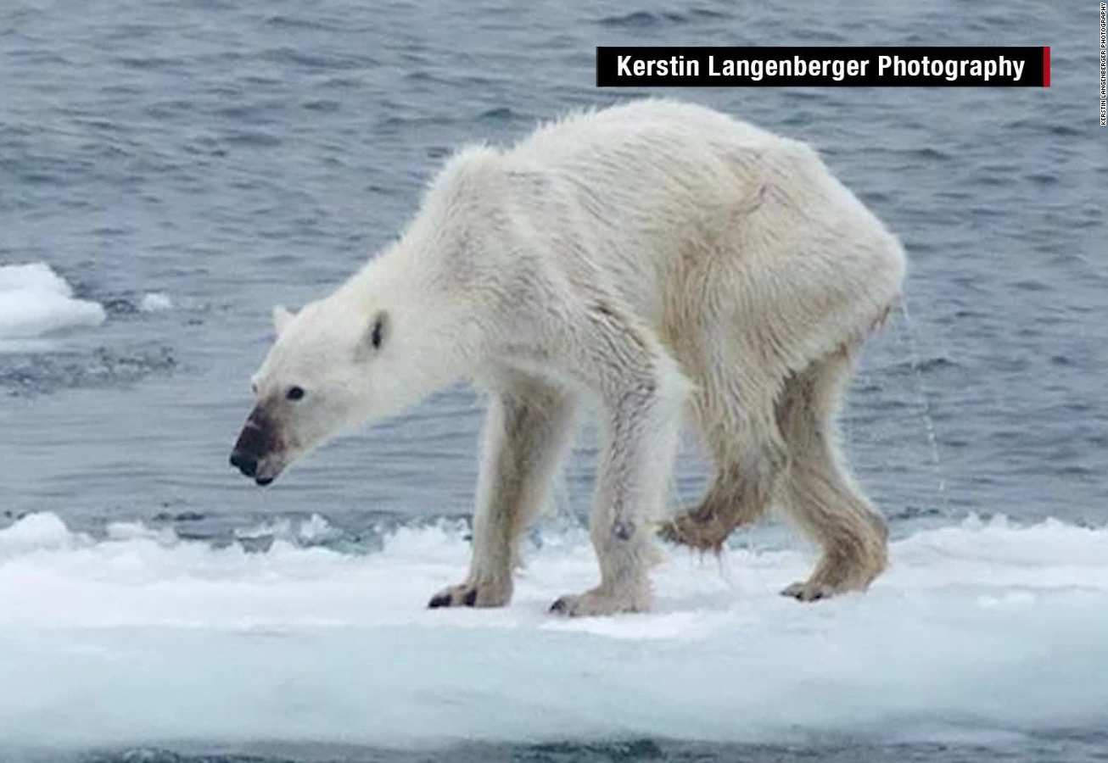
Evolution with Time
Some aspects have a slow impact, some a fast growing impact
The connection between past and present might become even debatable (by some)
CNN

Slide 12
Evolution with Time
Some aspects have a slow impact, some a fast growing impact
Discovering the connection sometimes requires a scientific revolution

Slide 13
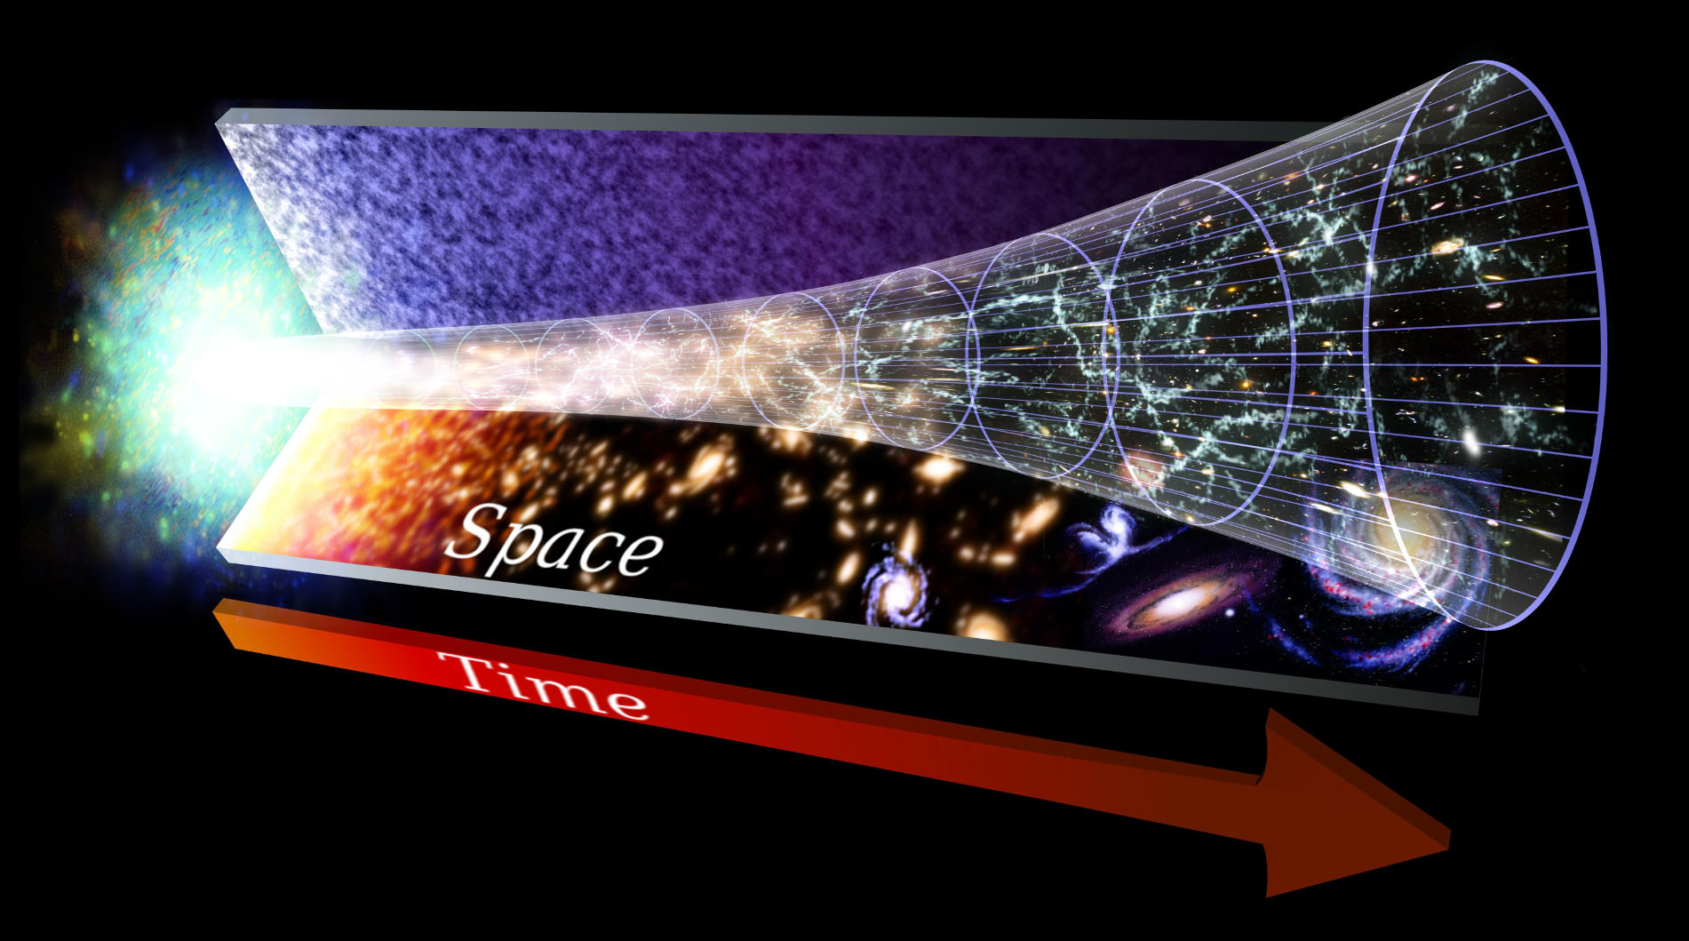
Evolution with Time
And sometimes it is very challenging to make the
connection between past and present
Credit: NASA, Goddard Space Flight Center

Slide 14
The Large Hadron Collider at CERN creates particle interactions similar to those 0,000000000001 seconds after the Big Bang
Credit: CERN

Slide 15
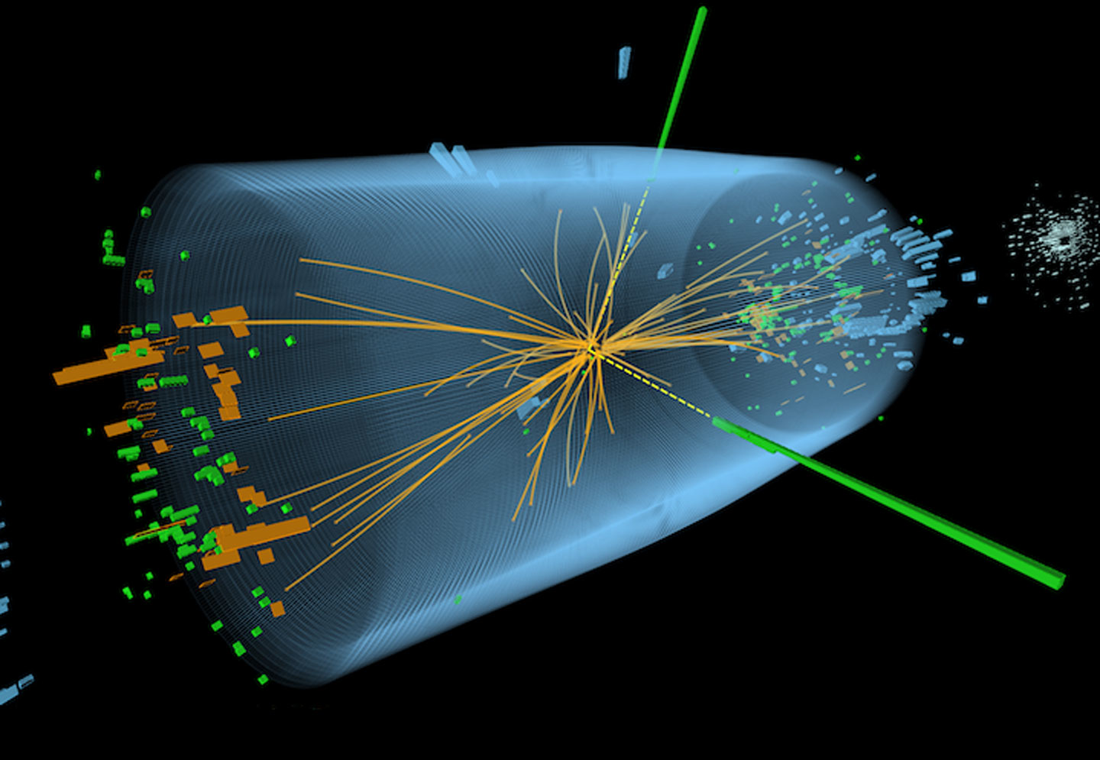
In these high-energy collisions we discovered the Higgs particle (in 2012)

Slide 16
From Past to Present… and Back!
Big Bang
Today
Credit: NASA, Goddard Space Flight Center
Unraveling the story of our universe

Slide 17
Part 4
Anais: Every evolution has its story and the human impact
Potentially:
The Eophone’s Whistle
A particular matter
La Fabbrica dei Terremotti

Slide 18
Conclude
What if the same evolution can be told with different stories?

