Slide 1
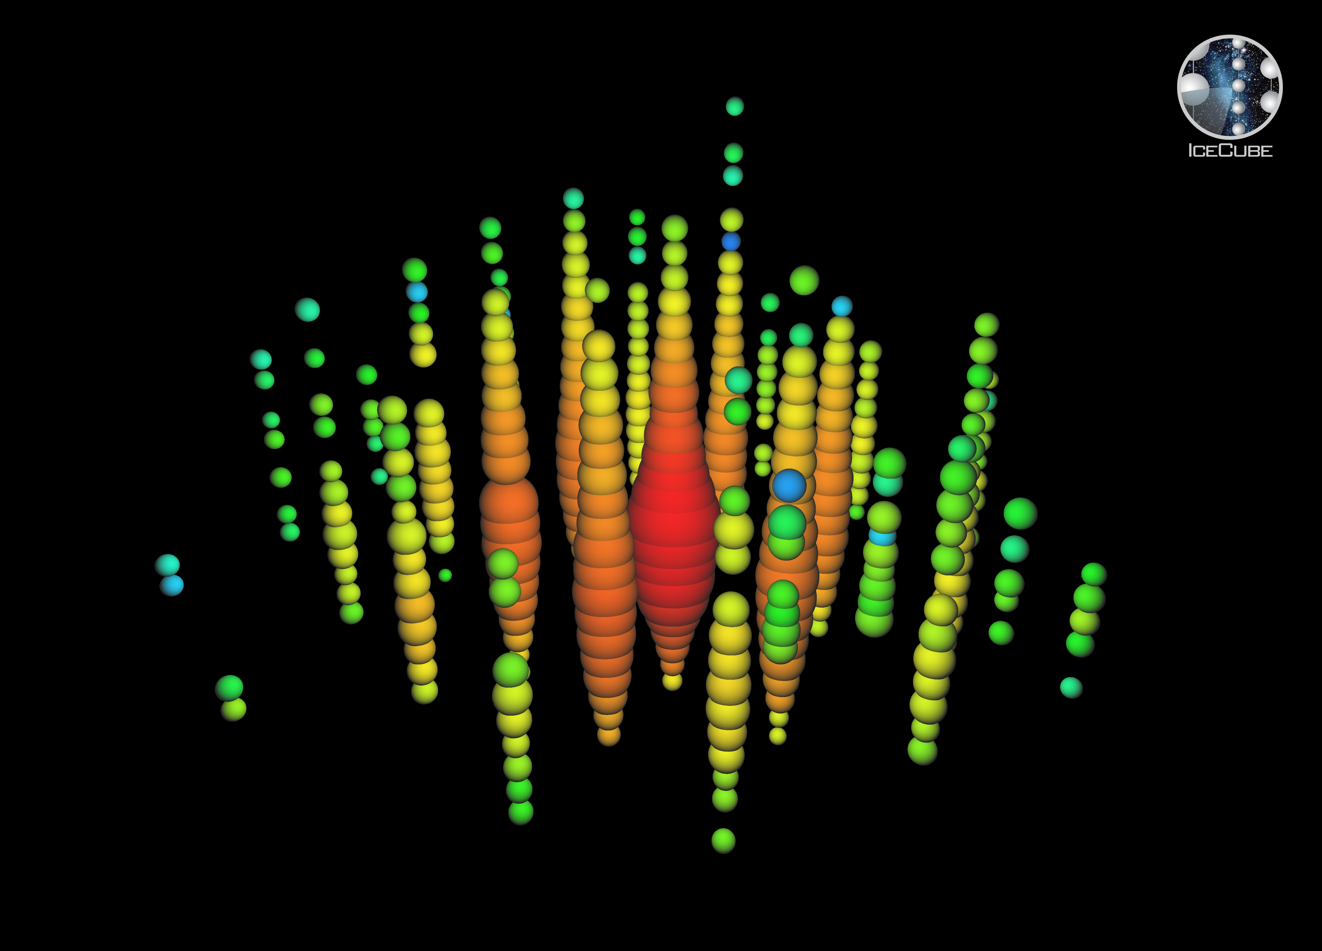
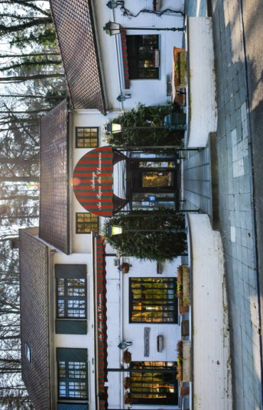
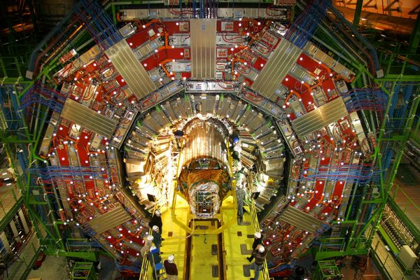
Topics:
CMS @ LHC
IceCube @ South Pole
Neutrino projects
R&D future exp’s
Phenomenology
Computing
Inter-university Institute for
High Energies
Annual meeting
22 November 2017
website: http://w3.iihe.ac.be
Au repos des Chasseurs, Av. Charle-Albert 11, 1170 Watermael-Boitsfort
http://au-repos-des-chasseurs.be/en/

