Slide 1
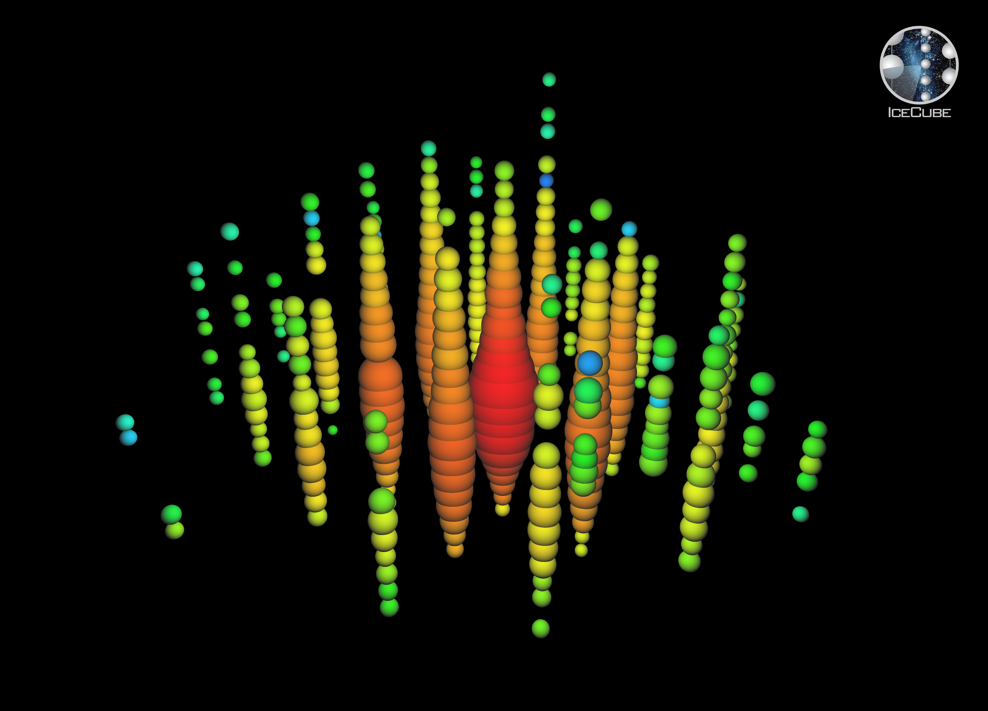
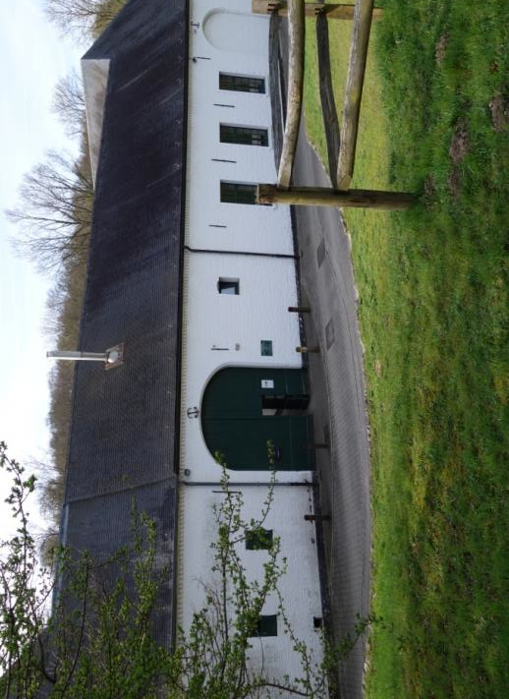
Topics:
CMS @ LHC
IceCube @ South Pole
Neutrino projects
R&D future exp’s
Phenomenology
Computing
Inter-university Institute for
High Energies
Annual meeting
19 October 2016
website: http://w3.iihe.ac.be
Bosmuseum Groenendaal, Duboislaan 2, 1560 Hoeilaart
http://www.natuurlocaties.be/vergaderen-en-events/bosmuseum-groenendaal

