Slide 1
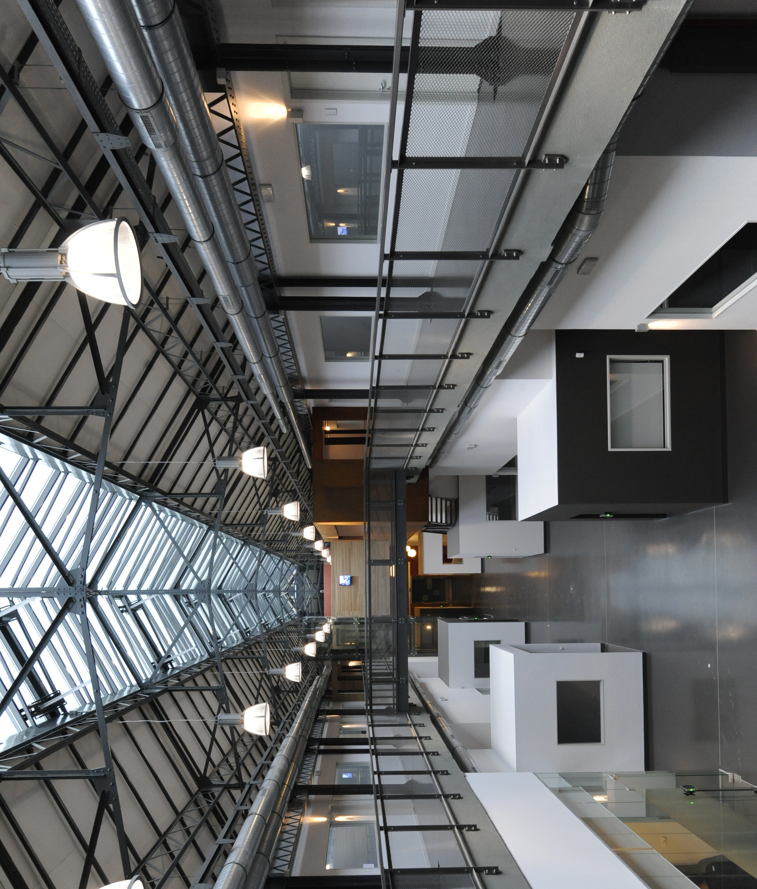
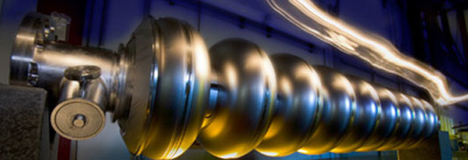
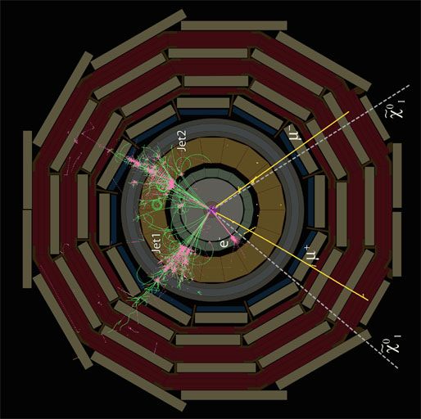
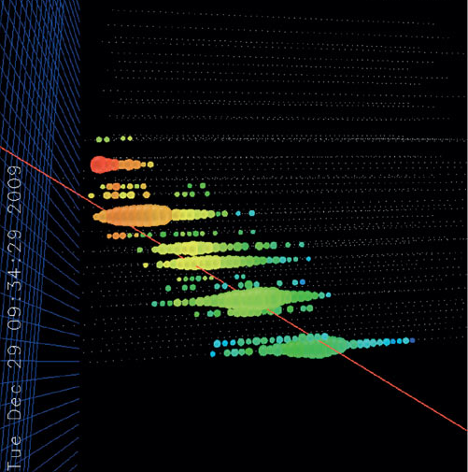
Topics:
CMS @ LHC
IceCube @ South Pole
ARA project
H1/VFPS at HERA
OPERA
R&D future exp’s
Phenomenology
Computing
Inter-university Institute for
High Energies
Annual meeting
9 November 2012
website: http://w3.iihe.ac.be
Business & Technology INCUBATOR, Site Arsenaal Brussels, www.icabrussel.be

