Slide 1
Experimental Techniques in Particle Physics
Prof. J. D’Hondt
Vrije Universiteit Brussel
jodhondt@vub.ac.be
Tel: 02-6293483
Office: Campus Oefenplein – 0G117

Slide 2
Content
Overview of a contemporary collider experiment
General timeline of a collision experiment (eg. LHC)
Overview of the structure of all systems in a detector
First layer of triggers to reduce the data stream to tape
Data Acquisition system & High Level triggers
Reconstruction aspects of tracks
Identification of specific objects (eg. b-tagging)
General analysis techniques to select the signal processes
Advanced statistical tools for measurements
An example analysis of how it all comes together…
It should take about 3 sessions of about 4 hours on average to cover the course. This will be complemented with a reading exercise with a written report by the students (this is part of the exam).
I
II
III

Slide 3
The first part
General concepts of triggering and DAQ
Introduction to high energy physics (HEP) – short!
  Theory evolution & experiments evolution (accelerators)
  Evolution of particle detectors (rate of particles produced in collisions)
General timeline of a collision experiment (eg. LHC)
  From the design concepts to the final paper
  Introduction to the Large Hadron Collider at CERN
Overview of the structure of all systems in a detector
  Complexity of a particle detector (eg. Compact Muon Solenoid)
  General layout of a Trigger & Data Acquisition (DAQ) system
First trigger layer to reduce the data stream to tape
  Hardware based trigger setups & performance
Data Acquisition system & High Level Triggers
  Read-out of the detector & event building
  Final trigger level algorithms

Slide 4
Introduction to HEP
The basic goal of the field of High Energy Physics is to reveal the fundamental particles in Nature and the interactions among them.
It aims to construct a formal theory which allows to predict the outcome of interactions via pertubative calculations (matching general relativity and quantum mechanics in a quantum field theoretical approach).
The domain covers a wide range of experiments of which some have a close connection to the fields of astronomy and cosmology. Due to the complexity of most particle detectors and accelerators the domain is a driving force for technology.

Slide 5
Evolution of the theory
Today we know the Standard Model as a solid theory of particle physics putting the Electro-Weak and Strong force within one framework in a Quantum Field Theory.
This model (which is basically a theory) has been the result of many experimental observations over the last ~50 years at for example fixed target experiments and collider experiments.
To validate the Standard Model we aim to observe phenomena at always higher energy densities and we aim to measure its parameters as precise as possible.
To achieve this we need accelerators which are as powerful as possible and detectors which can measure as precise as possible, hence driven the technology on different sides.
One of the open questions we have today is the apparent dominating Dark Matter in the Universe for which the Standard Model particles cannot give an answer.

Slide 6
Timeline of a HEP experiment
The idea of a new laboratory is motivated by the need to investigate yet unexplored domains either in energy, in rate, in flavour, in exposure time, etc.
Usually theory motivates that new phenomena are to be discovered in this new domain or that the measurement of specific phenomena will give us much more insight in the current theories
Physics results
Physics motivation
Exploitation of experiment
Design of accelerator
Commissioning
Design of particle detectors
Construction

Slide 7
Evolution of the experiments
In general new particles and phenomena are being discovered or measured at particle accelerators.
In general several types of collision experiments exist:
  Fix target experiments (eg. discovery of the quarks – proposed by J.Björken – within the proton/neutron at SLAC in 1969)
  Synchrotron experiments with colliding lepton beams (eg. LEP where electrons and positrons collided 1989-2000)
  Synchrotron experiments with colliding hadron-lepton beams (eg. HERA where electrons and protons collided 1993-2007)
  Synchrotron experiments with colliding hadron-hadron beams (eg. Tevatron at Fermilab & LHC where protons will be collided 2009-?)
  Linear colliders where leptons are colliding (eg. SLC where electrons and positrons collided 1989-1998)
Usually it takes a sequence of several experiments to reach the goal of testing the Standard Model or other theories profoundly.

Slide 8
Generalities of accelerators
The main parameters of an accelerator are (those relevant for this course):
  the maximum beam energy & the dipole field for circular accelerators
  the luminosity
  the time between collisions
  the bunch length
  particles per bunch & number of bunches per ring
The luminosity (hence the event rate) at colliders has increased by large factors.
  Rate = σ L
  σ - cross-section (units of cm² or barn=10²⁴cm²), probability that an interaction will occur. If this were a game of darts, the larger the area of the dart board the more likely you will get the dart on the board.
  L - luminosity (units of cm⁻²s⁻¹ or barn⁻¹ sec⁻¹), cross sectional density of the beams. The more particles per beam or the more compact (transverse) the higher the luminosity. For colliding beam, goes as the product of the two beam currents.

Slide 9
Evolution of these parameters
 | LEP2 (ee) | HERA (ep) | Tevatron (p-antip) | LHC (pp)
Beam energy (GeV) | ~100 | ~30 (e) ~920 (p) | ~980 | ~7000
Dipole field (Tesla) | 0.135 | 0.274 (e) 5 (p) | 4.4 | 8.3
Luminosity (10³⁰cm⁻²s⁻¹) | 100 | 75 | 171 | 10000
Time between collisions (ns) | 22000 | 96 | 396 | 25
Bunch length (cm) | 1.0 | 0.83 (e) 8.5 (p) | 50 | 7.55
Particles per bunch (10¹⁰) | 45 | 3 (e) 7 (p) | 24 (p) 6 (antip) | 11.5
# bunches | 4 | 189 (e) 180 (p) | 36 | 2808

Slide 10
Evolution of accelerator types
Hadron colliders can go higher in energy with the same technology compared to lepton colliders. This is due to the energy loss in synchrotron radiation when charged particles curve (hence electromagnetic radiation generated by the acceleration of ultra-relativistic charged particles through magnetic fields)
  energy loss per turn: ΔE ~ E⁴/(r m⁴)
  E is the energy of a particle with mass m which described a circle with radius r
  the mass of a proton is 2000 times larger than that of an electron.
Hadron colliders can reach higher energies with the same electric RF fields compared to leptons, hadron colliders are therefore used to explore a new energy regime but lepton colliders are used to perform precise measurements.
SPS (discovery W/Z bosons) → LEP (measurement W/Z bosons)
LHC (discovery of SUSY ?) → ILC (measurement of SUSY ?)

Slide 11
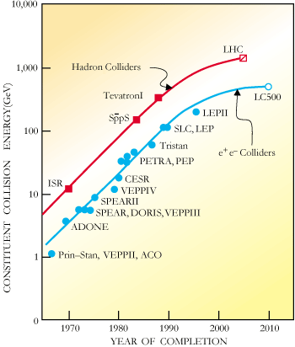
Evolution of accelerator types
Hadron colliders reach higher beam energies compared to lepton colliders, but the partons within the hadrons which collide have only a fraction of the beam energy. The leptons carry the full beam energy.
Strong progress over the last decades in accelerator performance, but slowed down recently due to the scale of the projects and no real revolution in the technology which is being applied.

Slide 12
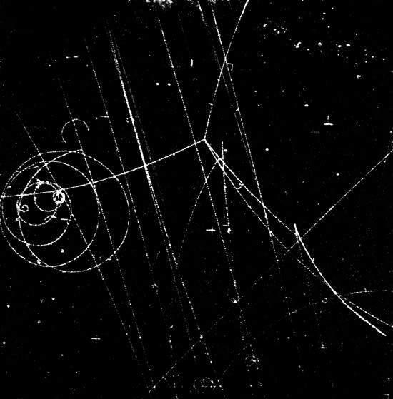
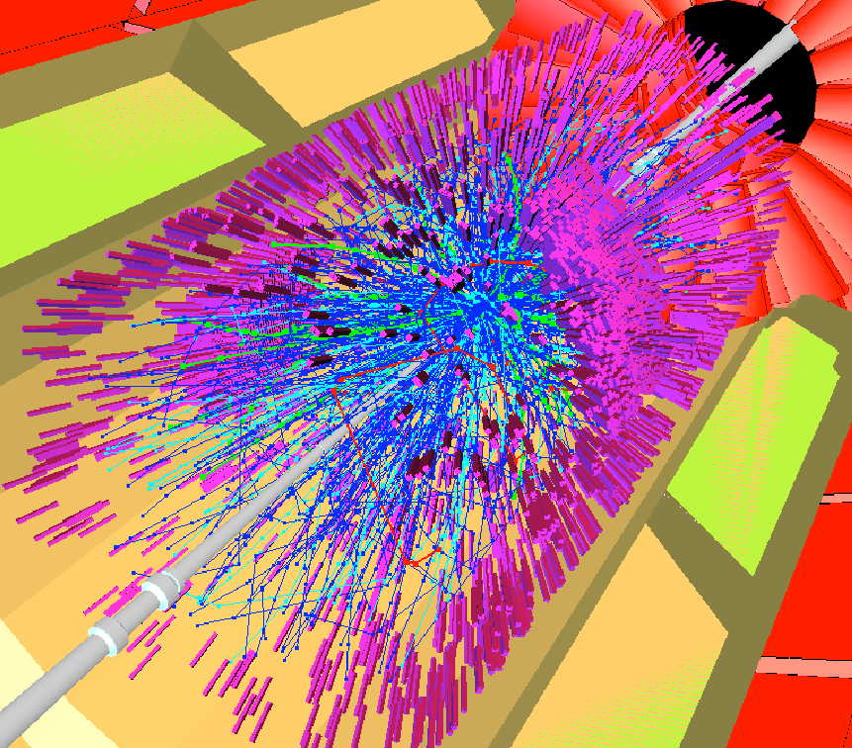
Evolution of the detectors
Particle detectors have been evolving from simple devices with few channels to very complex multi-layer systems with several millions of read-out channels.
  the data acquisition (DAQ) systems have evolved accordingly
  the main reason for this evolution is the ever increasing particle rate in the final state of the collisions we provoke in the laboratory
  together with the usually custom detector electronics
More events to be looked at in less time and also more complex events, give stronger requirements on the read-out and trigger systems of our detectors.

Slide 13
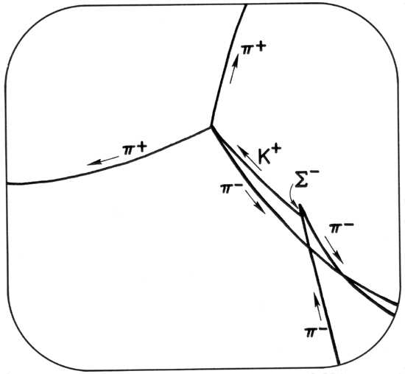
Event rate at early experiments
Bubble Chambers, Cloud Chambers, etc. (4π)
  DAQ was a stereo photograph!
  Effectively no Trigger:
    Each expansion was photographed based on the accelerator cycle
    The High level trigger was human (scanners).
  Slow repetition rate.
    Only most common processes were observed.
  Some of the high repetition experiments (>40 Hz) had some attempt at triggering.
Emulsions still used in some neutrino experiments (eg CHORUS, DONUT).

Slide 14
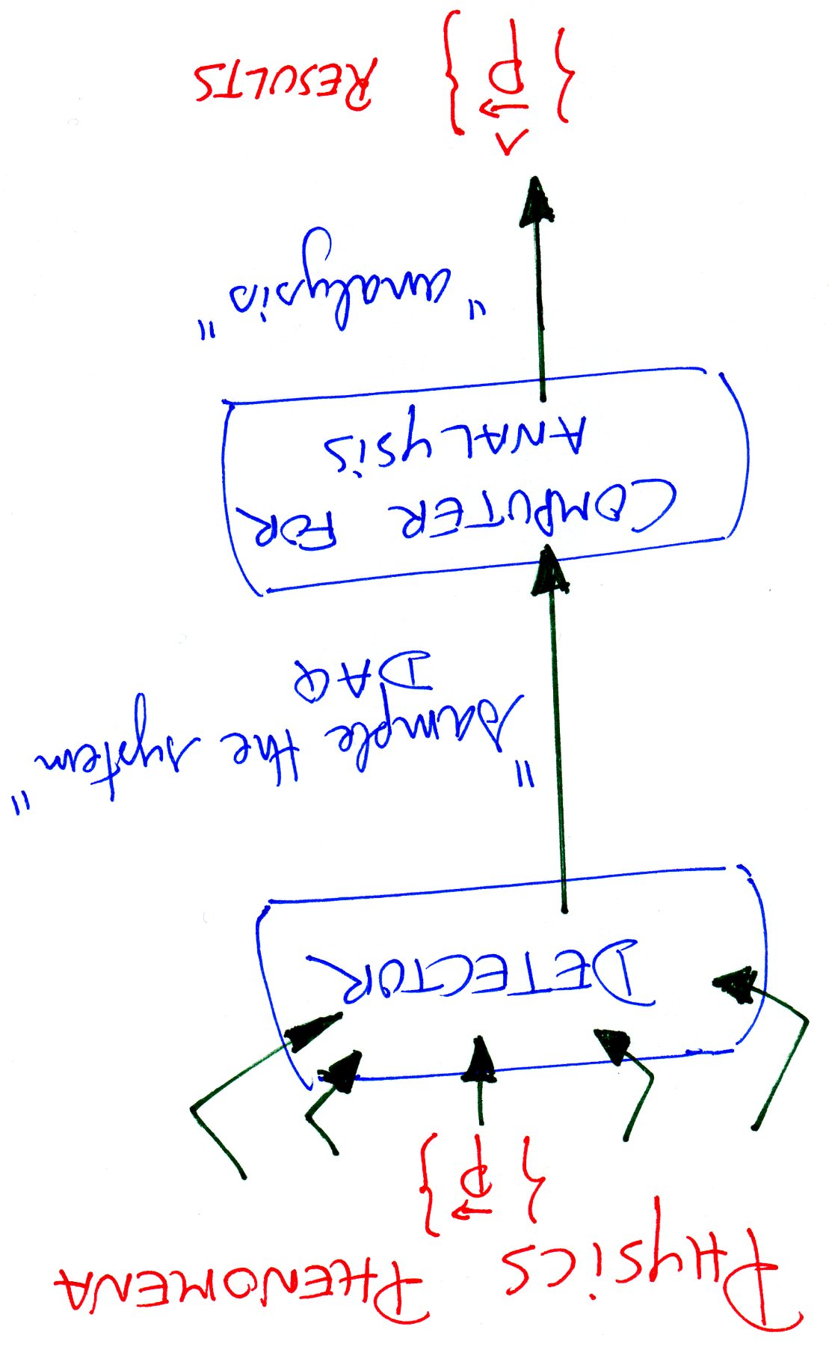
Data Acquisition
Data acquisition systems in general obtain information of a physical property, usually multi-dimensional, from the signals of detectors. Hence the system contains electronic components which can convert specific measured parameters into an electrical signal. The acquired data is hereafter stored on a disk for further analysis by a computer. The DAQ hardware are electronic devices which provide an interface between the signal and the computer.
In the language of HEP experiments, the DAQ system collects the signals of the millions of detector channels and allows the trigger system to analyze the data stored.

Slide 15
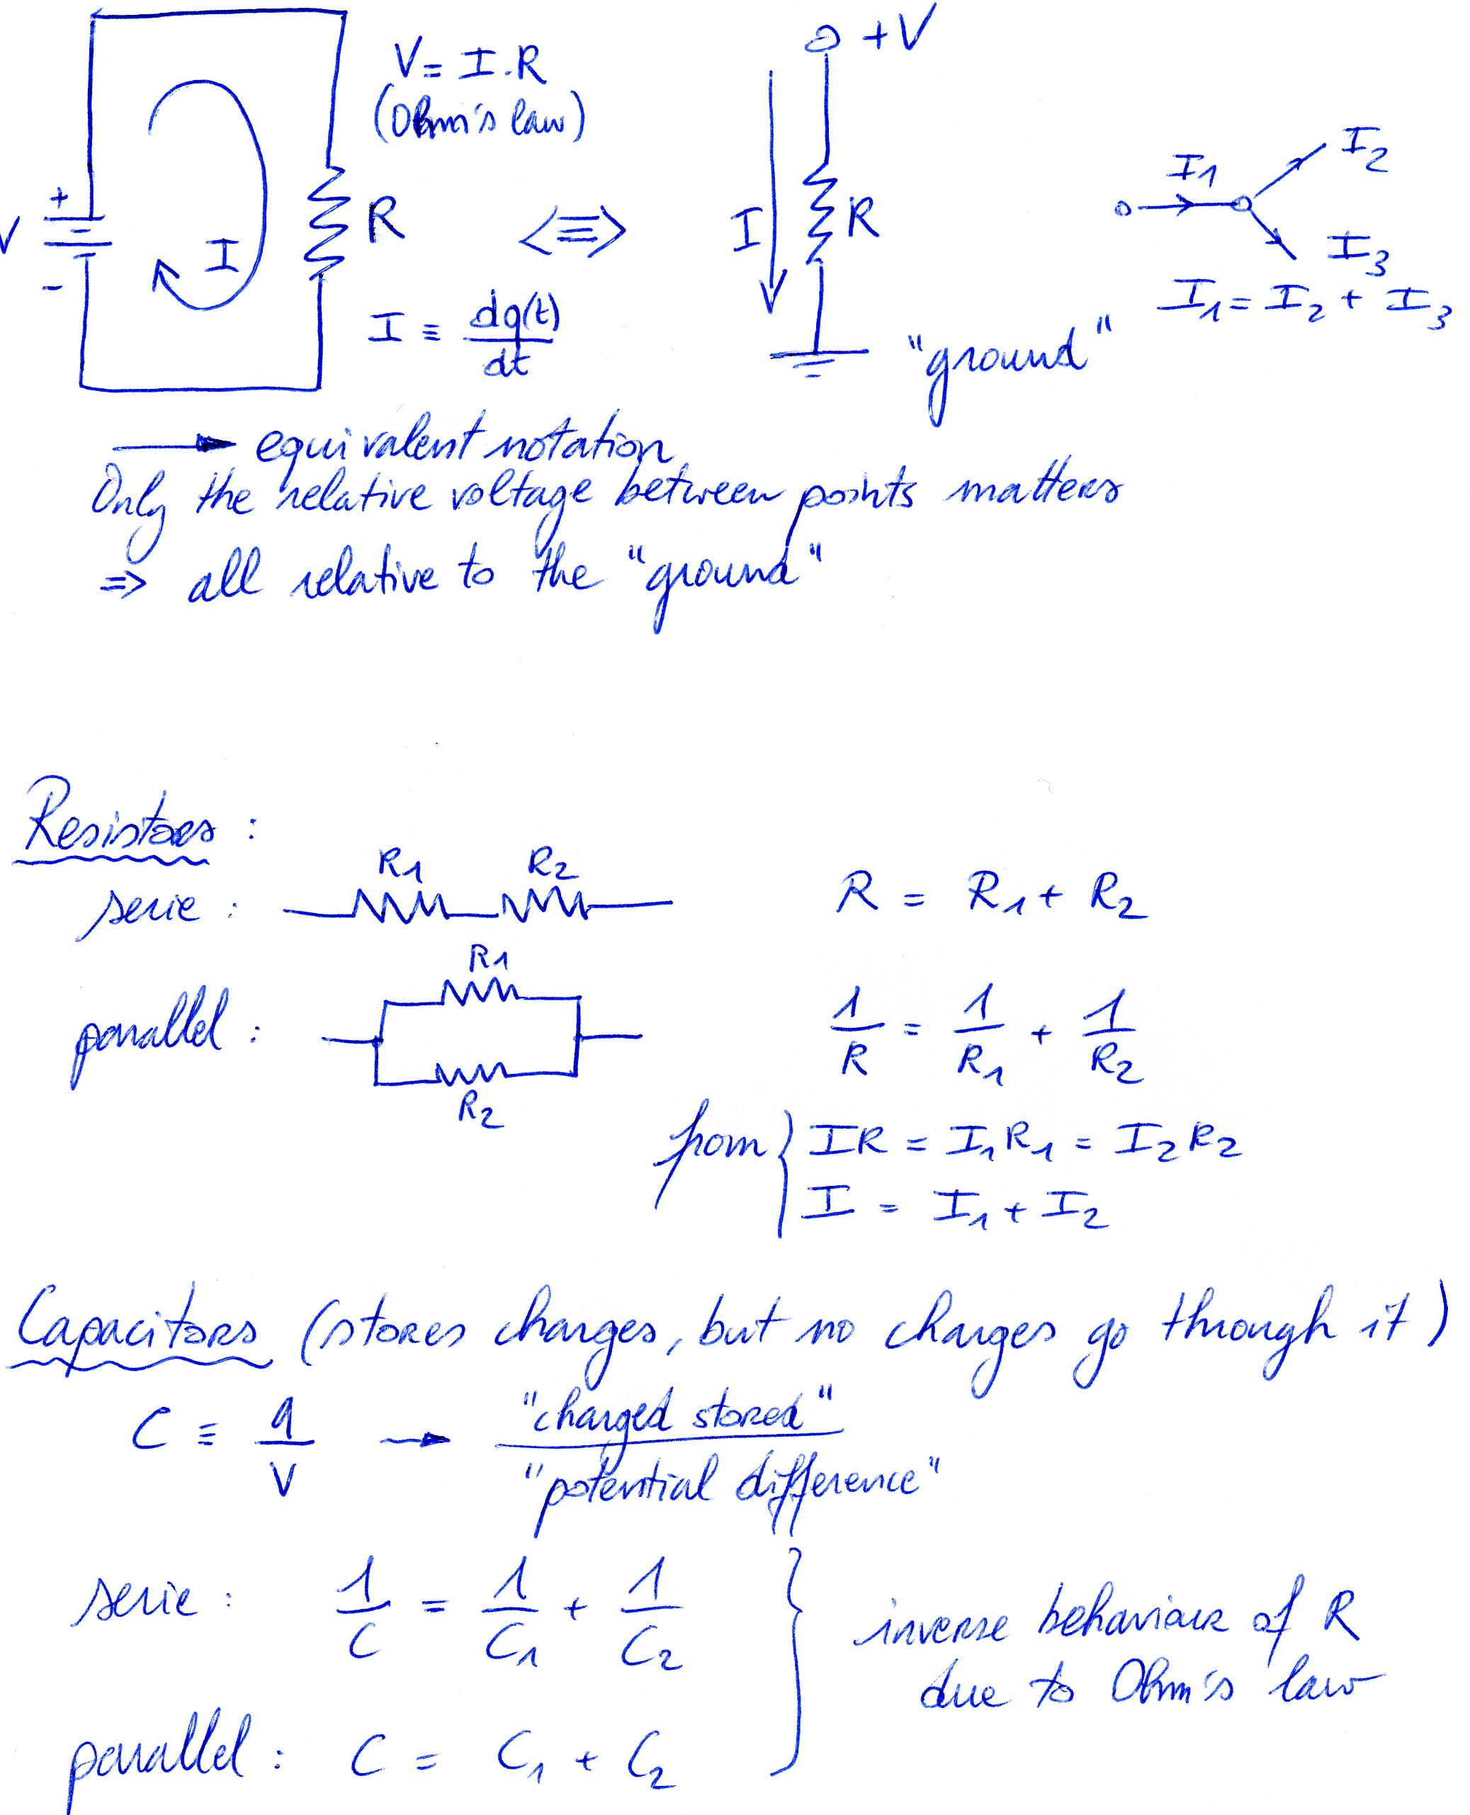
Electronic signals (reminder)
The signal is in most cases a short voltage pulse… how does this looks like?
First some basics:

Slide 16
Electronic signals (reminder)

Slide 17
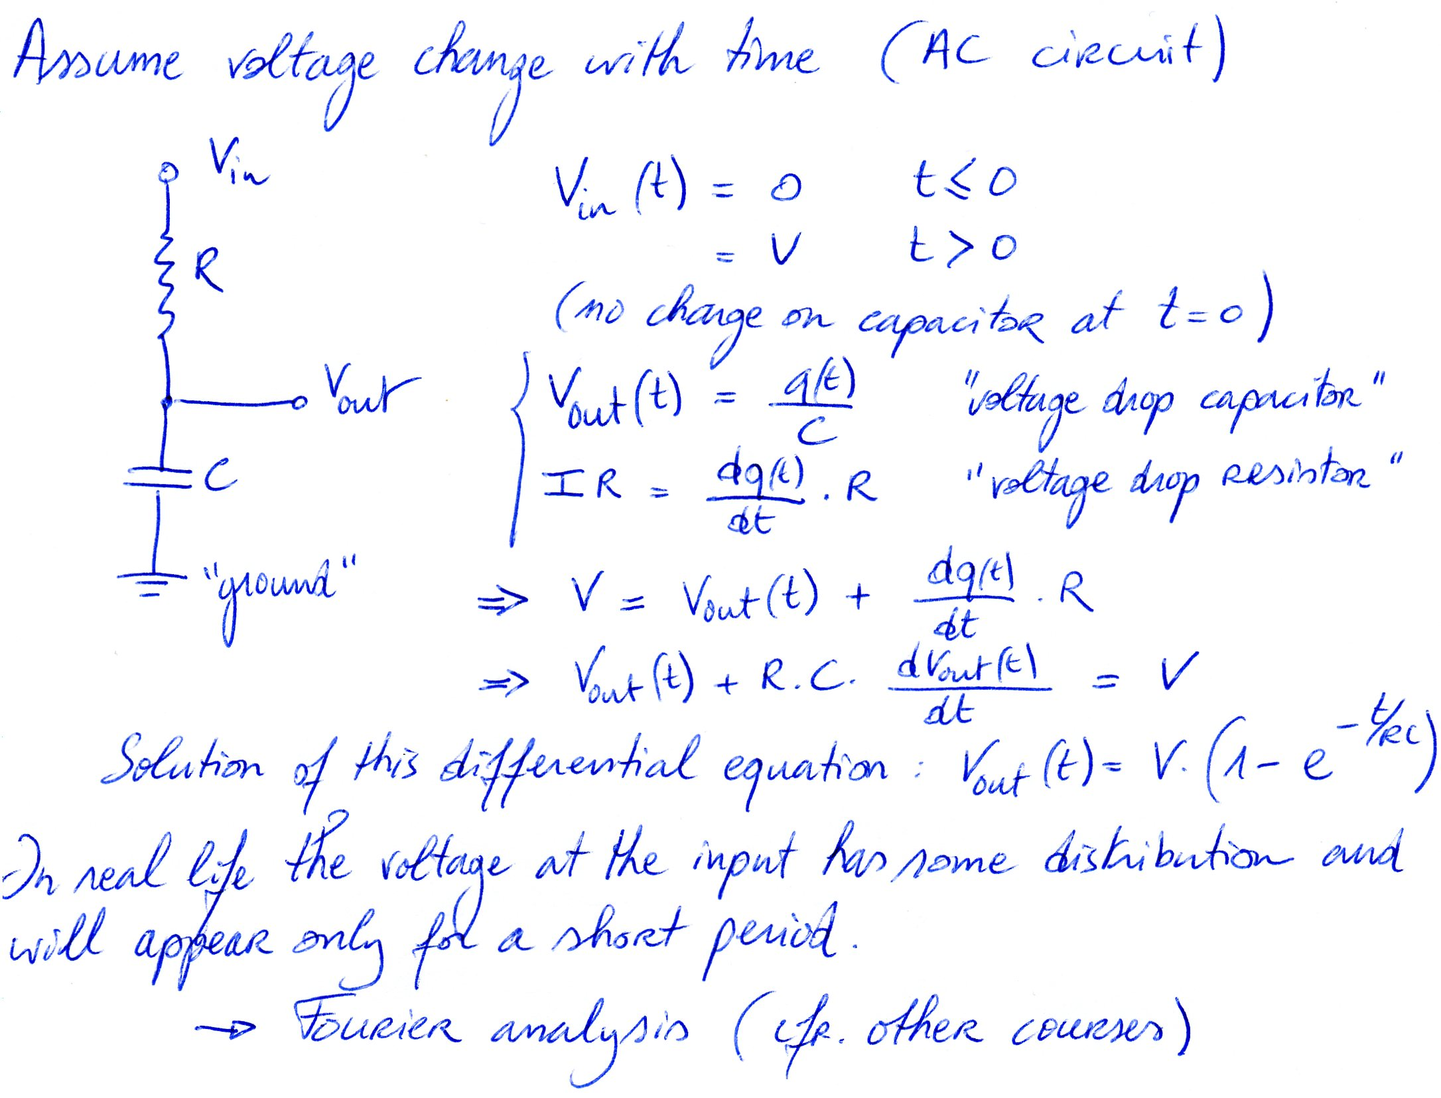
Electronic signals (reminder)

Slide 18
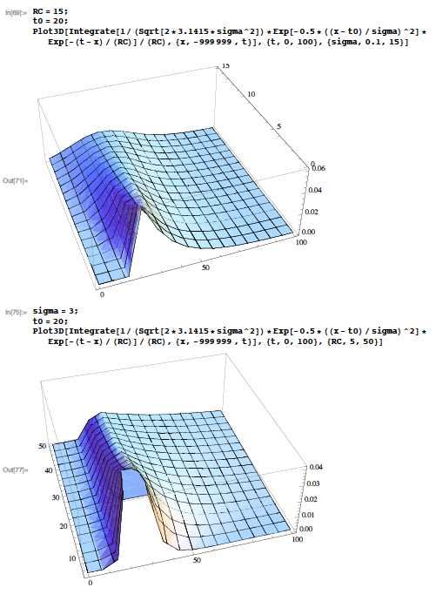
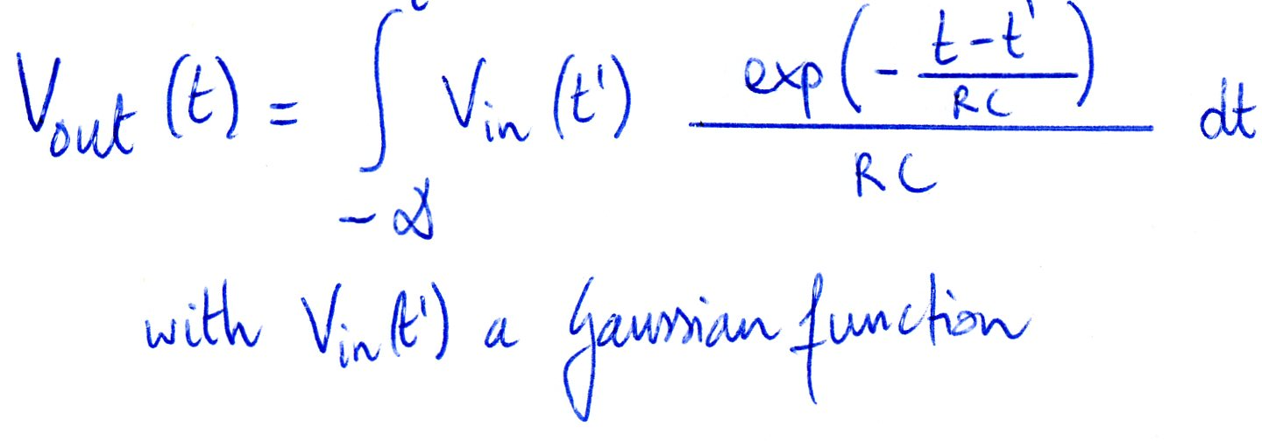
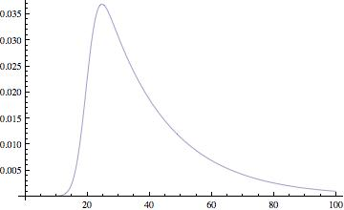
Electronics
V_{out}(t)
The signal appears as a peak in the time-dependent voltage evolution:
sigma
time
V_{out}(t)
V_{out}(t)
t₀=20
R*C
time
time

Slide 19
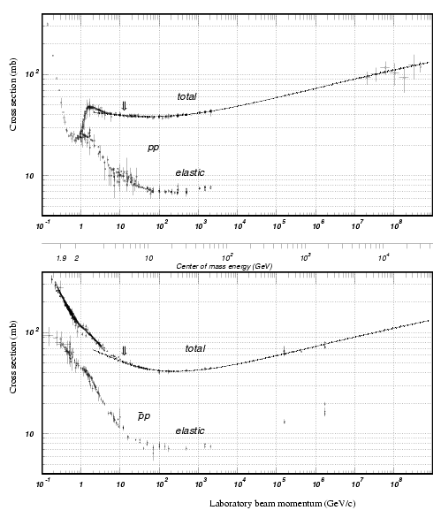
Cross section & event rate
proton-proton
The cross section of specific processes is changing when going to higher energies.
The total cross section in hadron collisions is increasing according to the measurements made (extrapolation to higher energies).
Together with the luminosity increase this results in a higher event rate R=L σ, hence important technical challenges for the design of the experiments.
Cross Section (mb)
proton-antiproton

Slide 20
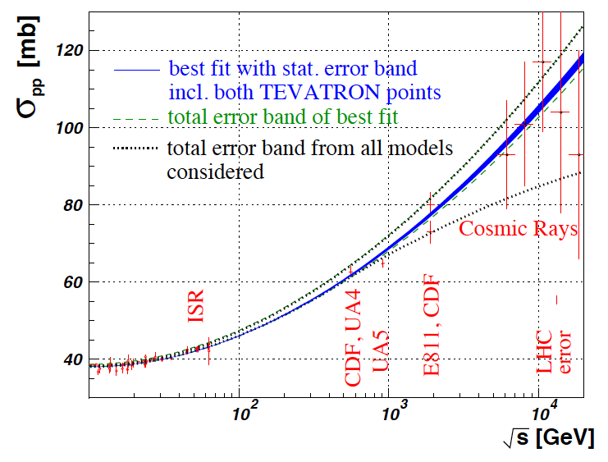
Cross section & event rate
The total cross section at the LHC (14 TeV) ranges between 90 and 130 mb
JINST 3 S08007 (2008)

Slide 21
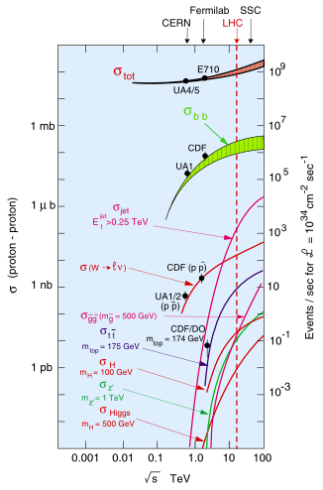
Cross section & event rate
In general the cross sections of Standard Model processes is increasing when going to higher centre of mass energies.
The processes of interest to be discovered (Higgs bosons, SUSY, etc.) have much lower cross sections compared to the Standard model processes, but as they require the creation of particles at higher mass scales they usually increase more rapidly compared to Standard Model processes with the centre of mass energy.
References for LHC & experiments:
http://www.iop.org/EJ/journal/-page=extra.lhc/jinst

Slide 22
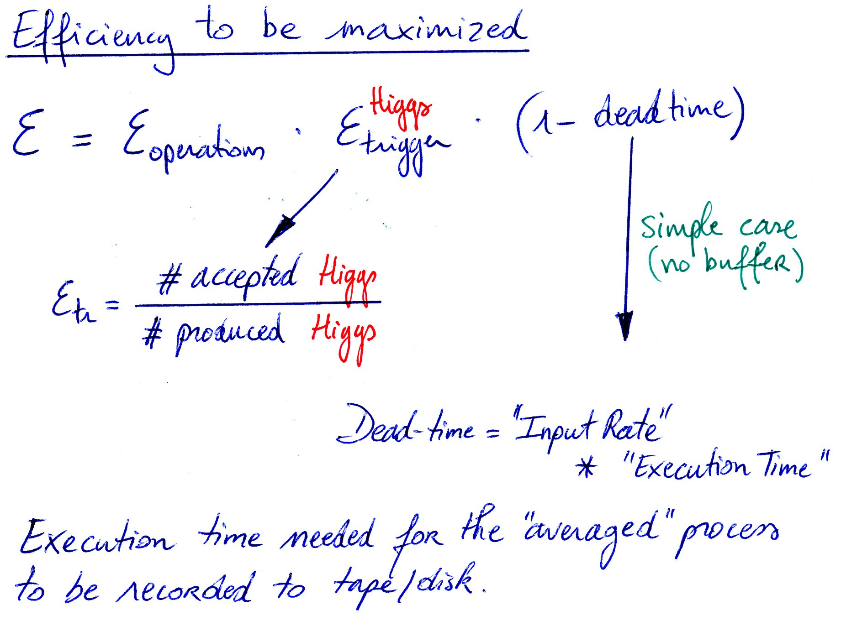
Goal of the trigger setup
Buffering incoming data reduces dead-time, more buffering less dead time
  If <Incoming Rate> is larger than 1/<Execution Time>, dead no matter what!
Minimizing dead-time helps all processes
  1% of machine time * 1 year = exploitation time lost (=money lost)
Goal of Trigger and DAQ systems is to store the maximize amount of data for the desired process with minimal cost (=time)
Relevant efficiency is for events that will be useful for later analysis
Low rate process (eg. Higgs production at Tevatron or LHC), try to accept them all in the trigger, hence maximize their selection efficiency.
Dead-time induced do to fluctuations when rate into a stage of trigger (or read-out) approaches the rate it can handle.

Slide 23
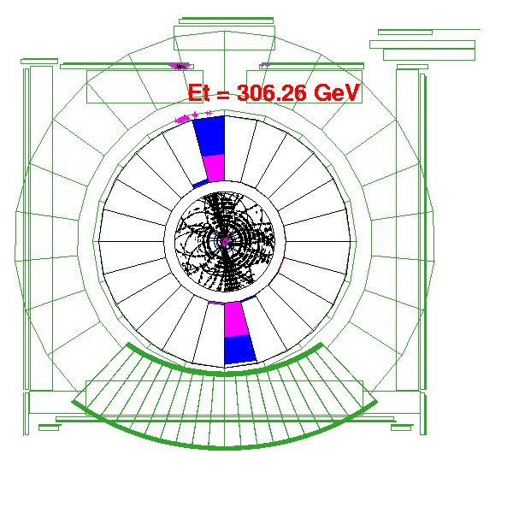

Trigger on what?
Accept specific decays modes
  high P_{T} leptons from W, Z, top, W/Z+Higgs QCD: High Et jets
  B_{s}/ψ ➔ μμ , medium p_{T} leptons for B physics
Reject:
  lower P_{T} objects (QCD)
Select on object/event kinematics:
  E_{T} of Calor Tower (cluster) or missing E_{T}
  muon P_{T} (+ track P_{T})
  track P_{T} (+ impact parameter/detached vertex)

Slide 24
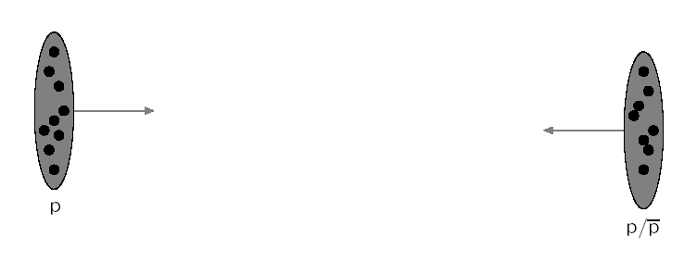
Hadron collisions
What do you expect to see in the detector?
The incoming particles are contained into bunches of for example 10¹¹ hadrons (eg. protons). The proton is a bag full of partons which have probability densities depending on Björken-x (longitudinal momentum fraction) and the Q² (momentum transfer), hence the partons collide with each other, not the full hadron.
Warning: simplified schematic view which is not to scale

Slide 25
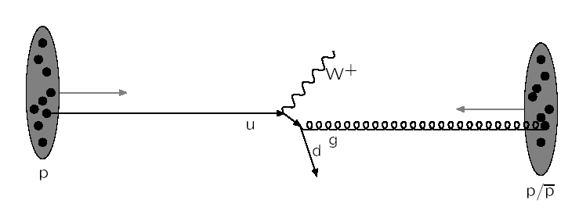
Hadron collisions
What do you expect to see in the detector?
The partons (being quarks or gluons) interact reflecting the hard subprocess described by matrix elements obtained from quantum field theory calculations (Feynman diagrams).

Slide 26

Hadron collisions
What do you expect to see in the detector?
The heavy resonances decay, for example the W boson with a mass around 80 GeV. This is still correlated with the hard subprocess and is usually calculated with the same tools.

Slide 27
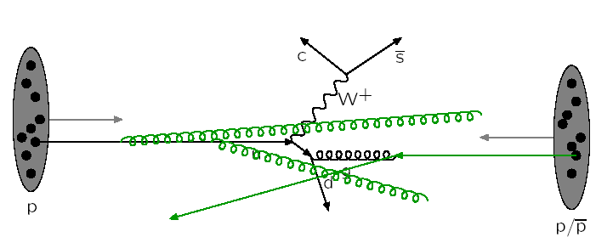
Hadron collisions
What do you expect to see in the detector?
The partons could radiate coloured particles before interacting with each other, this is called initial state radiation (=space-like parton showers).

Slide 28
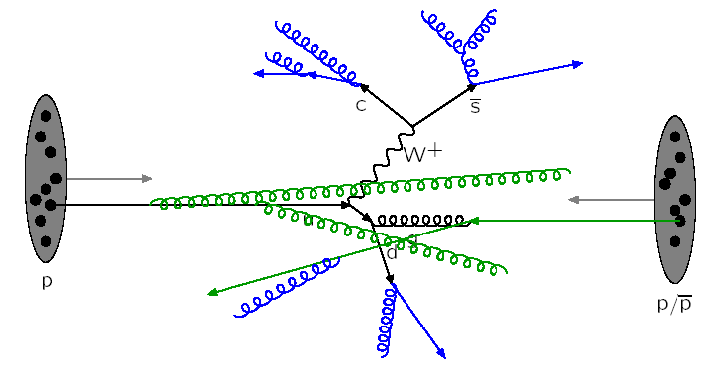
Hadron collisions
The partons could radiate coloured particles after interacting with each other, this is called final state radiation (=time-like parton showers).

Slide 29
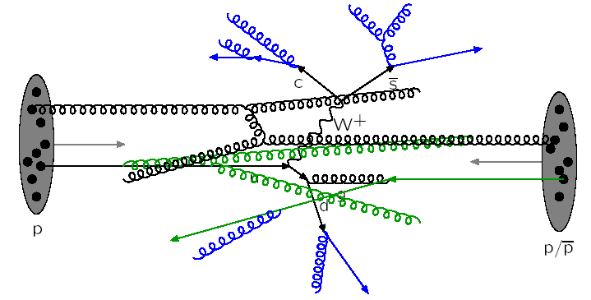
Hadron collisions
The hadrons consist out of several partons, hence there can be more than one parton-parton interaction. We speak about multi-parton interactions.

Slide 30
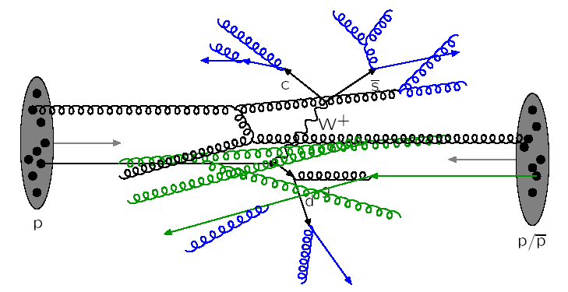
Hadron collisions
And in these extra parton-parton interactions there can also be initial and final state radiation of extra partons. More blue and green lines…

Slide 31
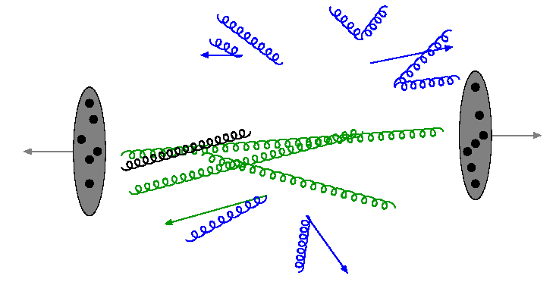
Hadron collisions
After the collision of course we do not “see” the internal lines, we only “see” the outgoing partons and the beam remnants.

Slide 32
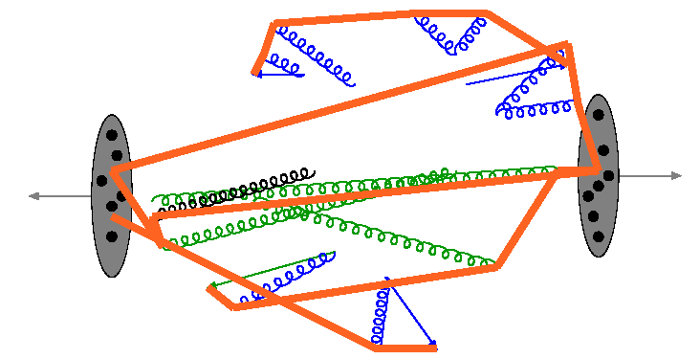
Hadron collisions
All partons are connected by colour confinement strings (colour field between partons as you have an electromagnetic field between charged particles).

Slide 33
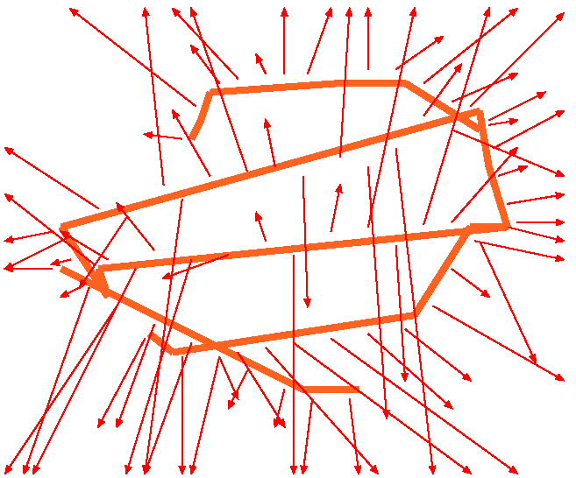
Hadron collisions
The strings will fragment to produce in general hadrons, hence colour-neutral particles.

Slide 34
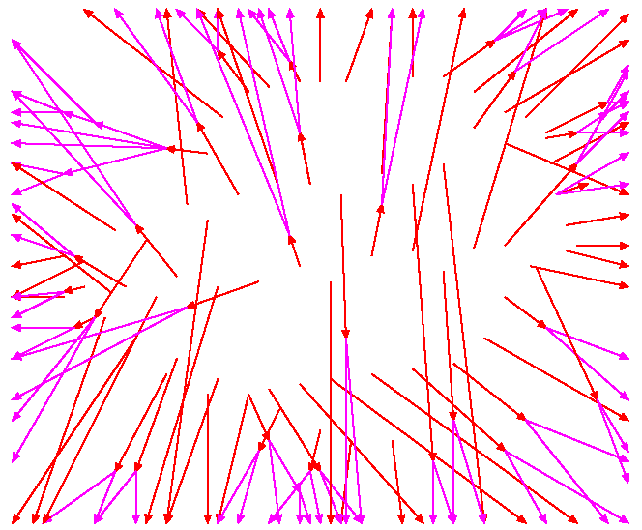
Hadron collisions
A lot of hadrons are not stable and will decay further into stable particles which we will observe in our detectors.

Slide 35
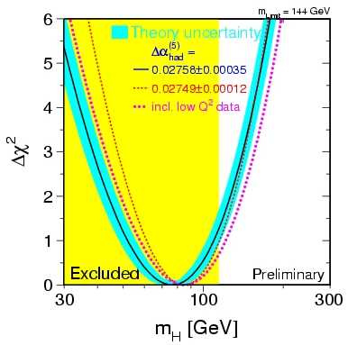
The Large Hadron Collider (LHC)
The next in line accelerator is the Large Hadron Collider at CERN which collides protons up to centre of masses of 7-14 TeV
Several theory based motivations are driving the design of both the accelerator and the particle detectors
  Search for the Higgs boson motivated by the spontaneous symmetry breaking mechanism [Brout, Englert, Higgs] and the divergences of cross section of the WW→ZZ scattering process
  Or alternative models explaining the origin of mass
  The search for particles able to solve the Dark Matter problem in the Universe, eg. by introducing Supersymmetry in our theories
  Try to incorporate gravity into the Standard Model
  Many exotics …
The accelerator started in 2009

Slide 36
The timeline of the project
The history of this accelerator is long:
  1982: first studies for the LHC project
  1983: Z0 & W boson discovered at the SPS proton anti-proton collider
  1989: start of LEP operation (Z boson factory)
  1994: approval of the LHC by the CERN Council
  1996: final decision to start the LHC construction
  1996: LEP operation to produce W boson pairs (W boson factory)
  2000: last year of LEP operation above 100 GeV beam energy
  2002: LEP equipment removed
  2003: start of the LHC installation
  2005: start of LHC hardware commissioning
  2008: LHC commissioning with beam (and incident with magnets)
  2009: start of the accelerator at 900 and 2360 GeV
  2010: run at 7 TeV

Slide 37
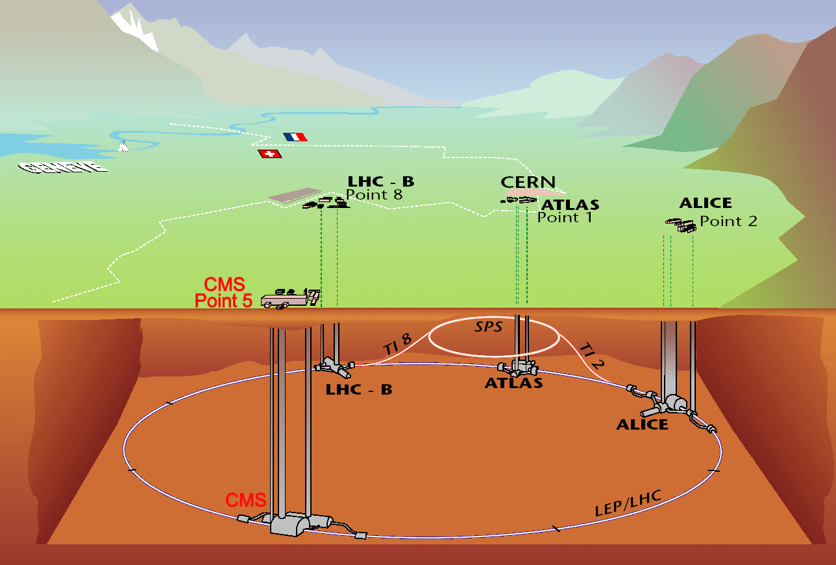
Large Hadron Collider basics
Colliding protons at the LHC
√s = 7-14 TeV
circumference ~26.7km
tunnel diameter 3.8m
depth 70-140m
From the first workshop in 1984 to 2009, it toke 25 years to get to this laboratory

Slide 38
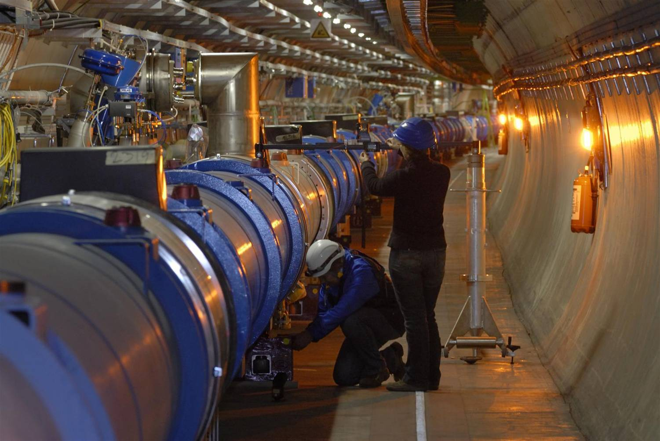
Laboratory is operational!
... new era for physics !

Slide 39
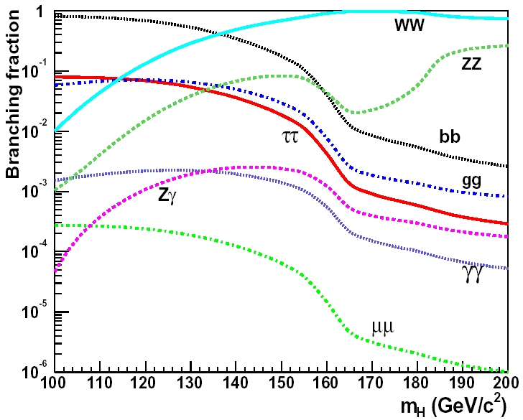
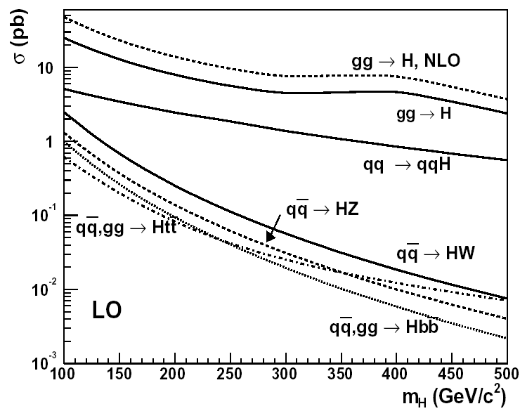
Higgs boson production at LHC
How does the Higgs boson shows itself: several production and decay possibilities
Would like to have 20-30 Higgs boson events per year at the highest masses (lowest cross section)
Hence need 10³⁴ cm⁻²s⁻¹ of luminosity and ~2800 bunches in the 27km long accelerator
decay branching ratios
production cross-section

Slide 40
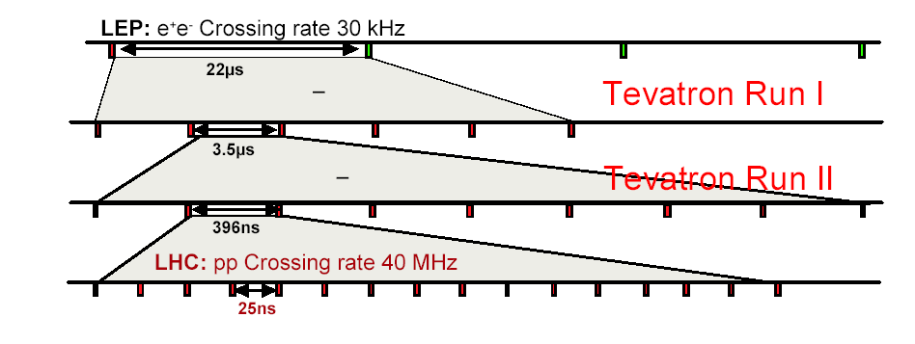
Beam crossings evolution
Also empty bunch spaces are needed in order to be able to dump the proton beam properly
Therefore need ~3600 bunch spaces (= 25 ns)
25 ns = 27 km / (c . 3600)

Slide 41
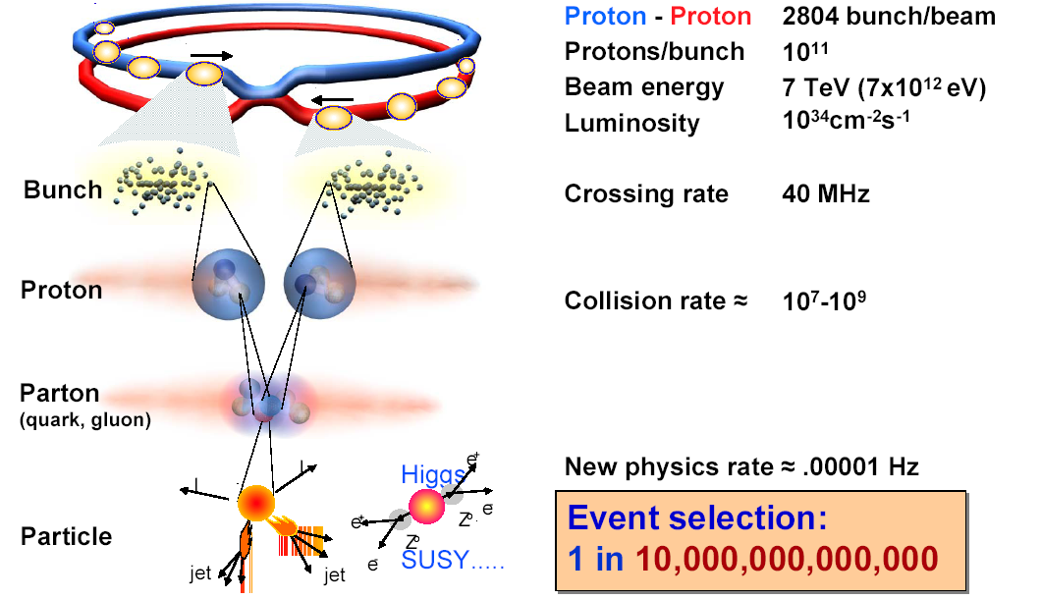
The Large Hadron Collider (LHC)

Slide 42
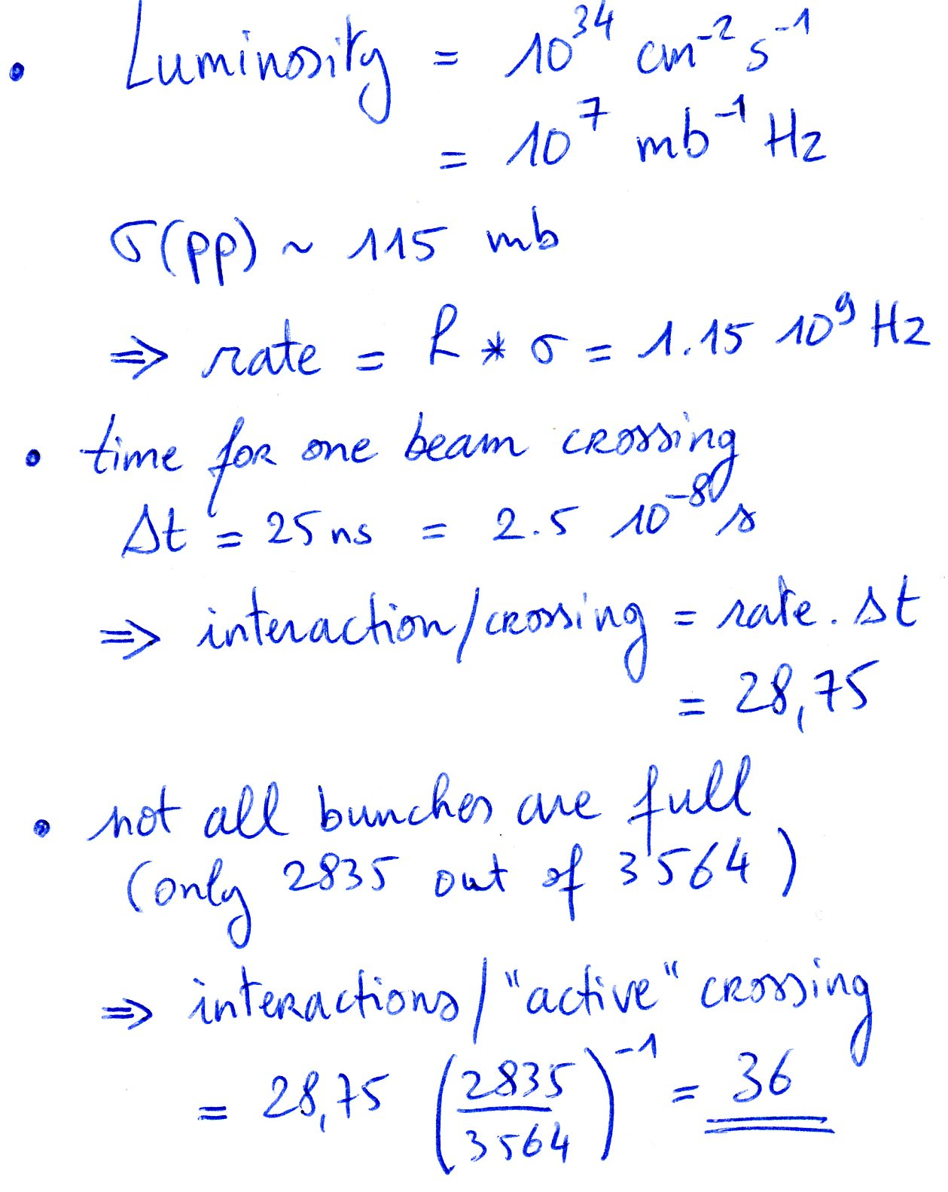
Cross section and minimum bias: in-time pile-up
How many interactions per beam crossing ?
Therefore a Higgs boson process (pp->HX) comes together with ~36 minimum bias events

Slide 43
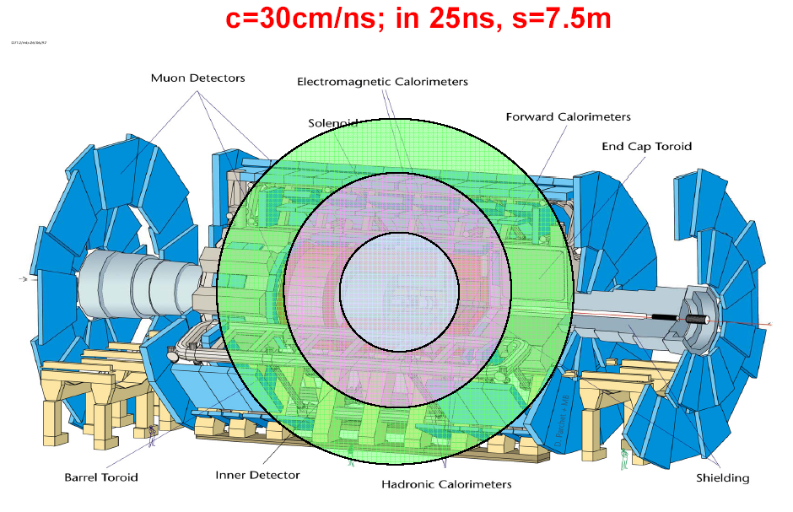
Time-of-flight of signal: out-of-time pile-up

Slide 44
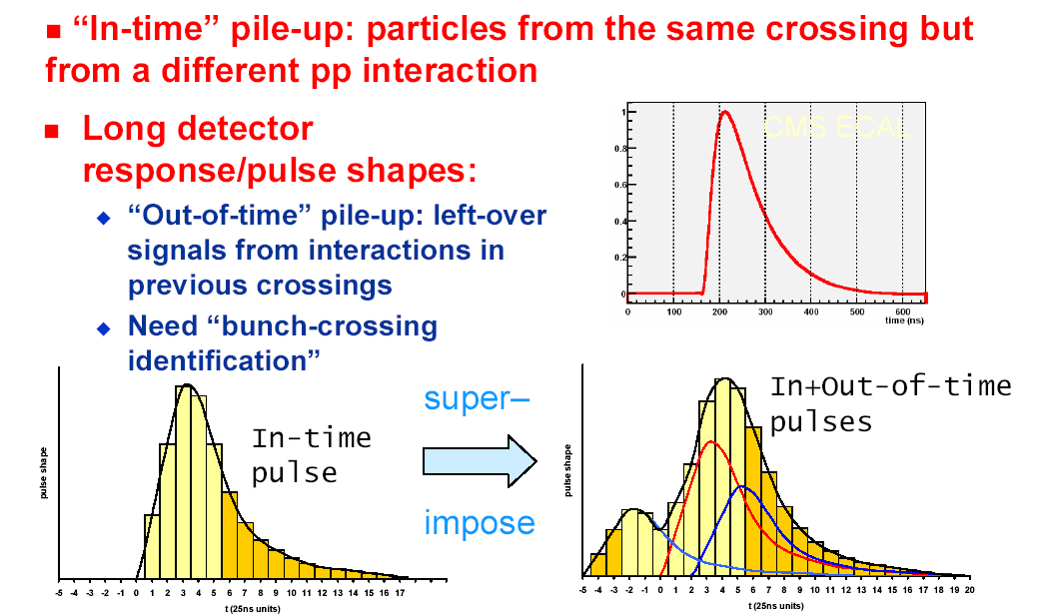
Superimposed pile-up collisions

Slide 45
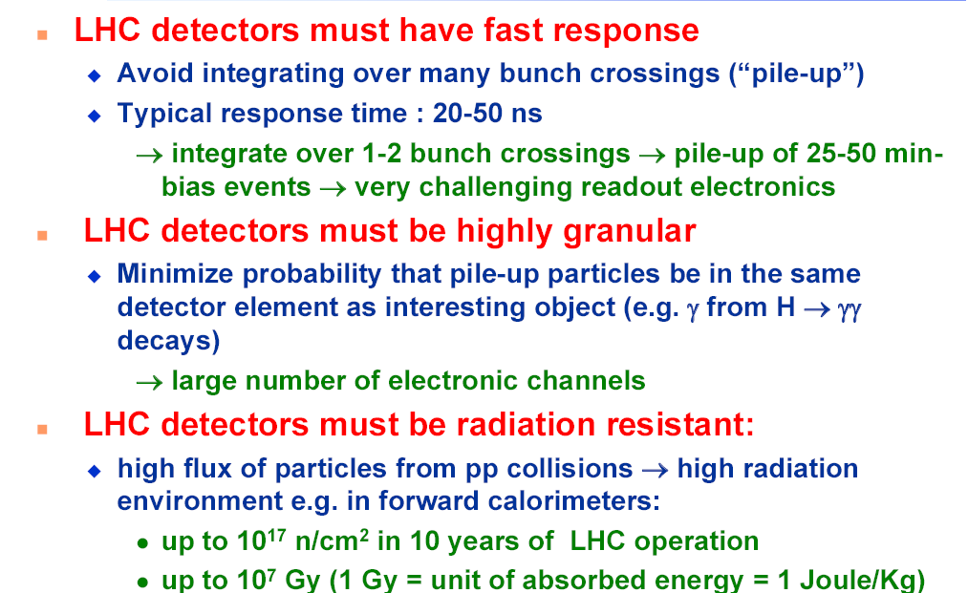
Impact on detector design

Slide 46
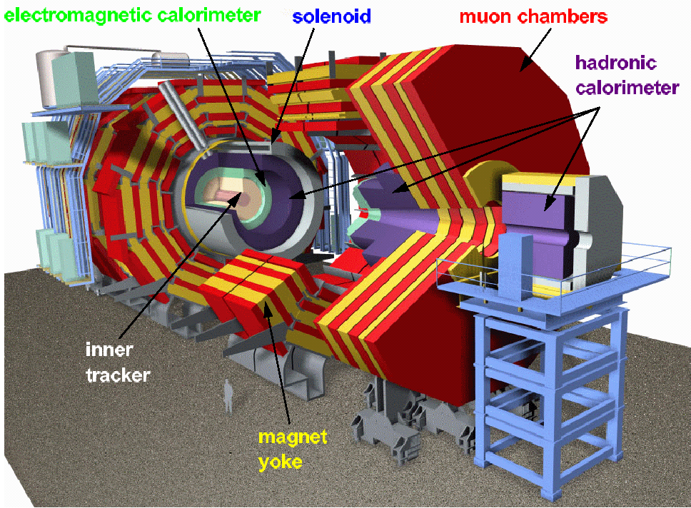
The Compact Muon Solenoid
One of the main particle detectors which will collect the outcome of the proton collisions at the LHC is the CMS detector.
A multi-purpose detector with millions of read-out channels and electronics at sampling frequencies of 40MHz similar to the collision rate.

Slide 47
SUPERCONDUCTING
HCAL
ECAL
COIL (4T B field)
Δp_{T}/p_{T}~1%@100GeV
Plastic scintillator/brass
sandwich
Scintillating
PbWO4 crystals
~76k crystals
IRON YOKE
TRACKER
Silicon Microstrips
Pixels
~220m² of Si
MUON
ENDCAPS
MUON BARREL
Drift Tube
Resistive Plate
Cathode Strip Chambers (CSC )
Chambers ( DT )
Chambers ( RPC )
Resistive Plate Chambers (RPC)

Slide 48
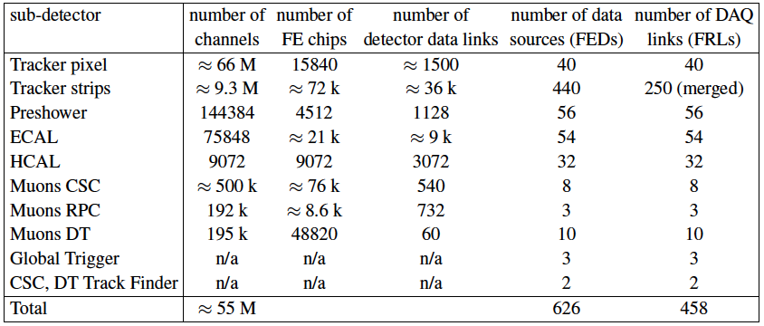
Enormous amount of data sources
77 M
Each data source will deliver on average ~2kByte per pp collision.

Slide 49
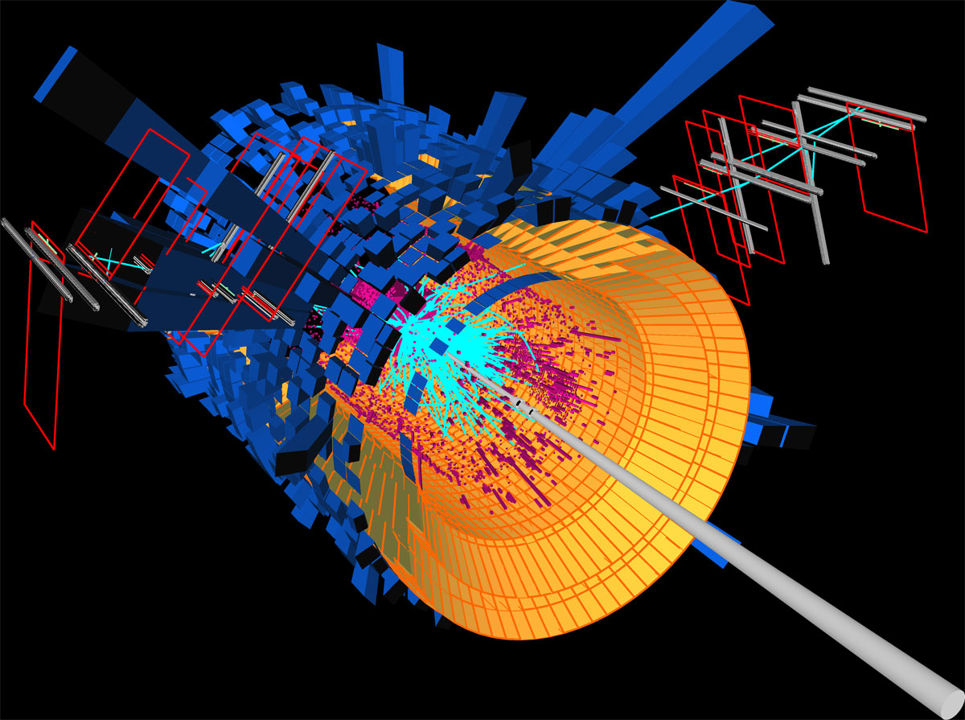
Example of a final state event
Event size ~ 1 MByte

Slide 50
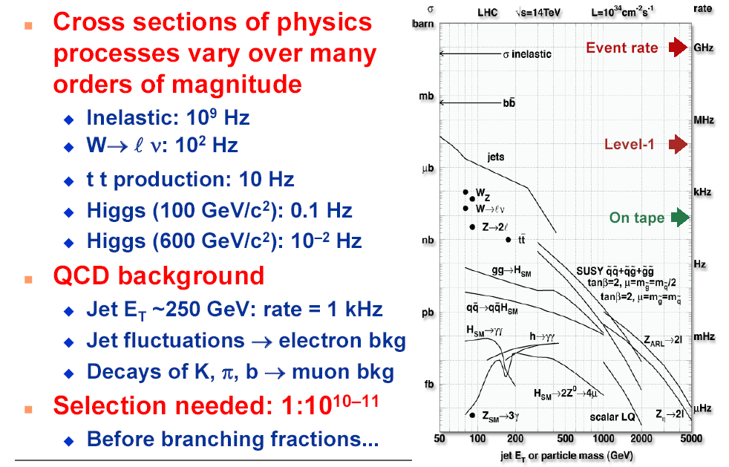
Selectivity of the physics signals

Slide 51
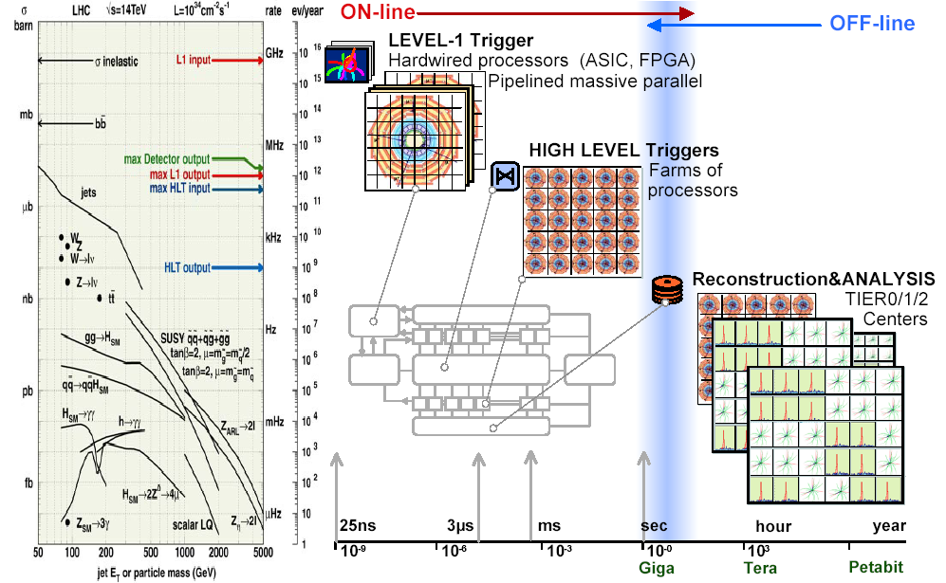
Physics selection at the LHC

Slide 52
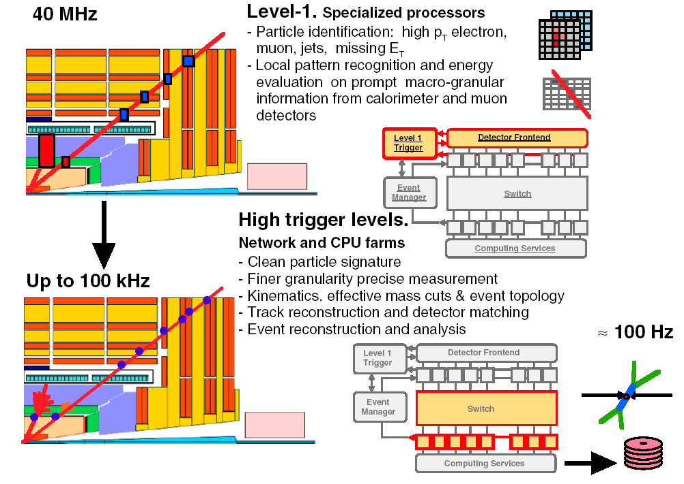
Physics selection at the LHC

Slide 53
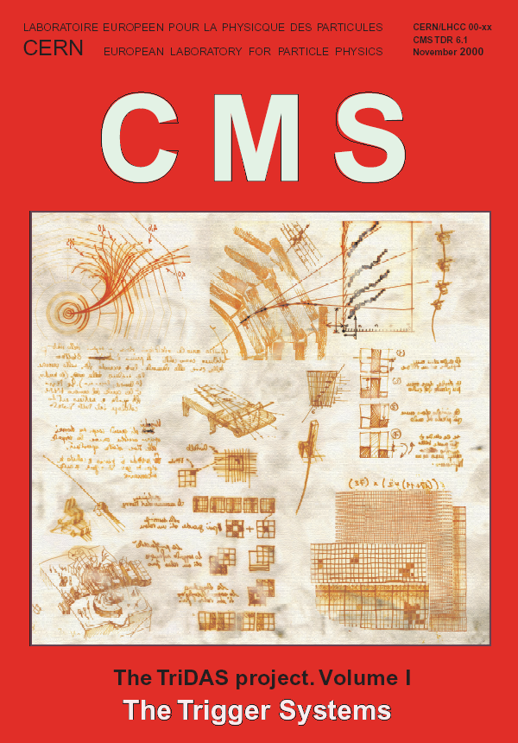
Reference for Level-1 in CMS
Public manuscript written in 2000 and contains lots of information on the Level-1 Trigger of the CMS experiment. Almost 600 pages. Can be found at
http://cms.cern.ch/iCMS/jsp/page.jsp?mode=cms&action=url&urlkey=CMS_TDRS

Slide 54
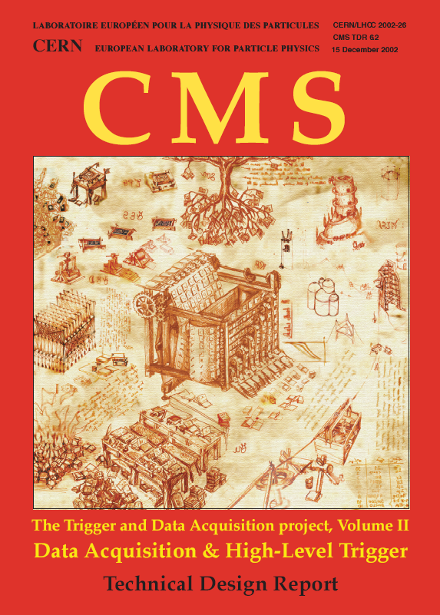
Reference for HLT in CMS
Public manuscript written in 2002 and contains lots of information on the High Level Trigger of the CMS experiment. Almost 500 pages. Can be found at
http://cms.cern.ch/iCMS/jsp/page.jsp?mode=cms&action=url&urlkey=CMS_TDRS

Slide 55
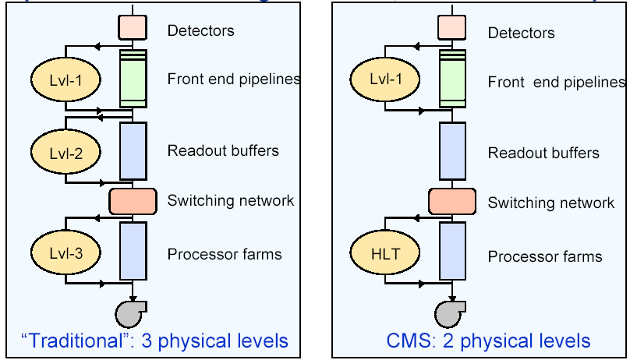
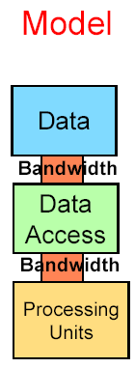
Trigger structures
First L1 reduction from 40MHz to 10⁵Hz (cfr 10²Hz final rate to tape/disk) is always there, followed by 1 or 2 extra steps.
40MHz
40MHz
hardware
10⁵Hz
3.2μs/event
10⁵Hz
10³Hz
10⁵Hz
10Gb/s
software
1000Gb/s
10²Hz
10²Hz
~2000PCs
40ms/event
one event=
one processor

Slide 56
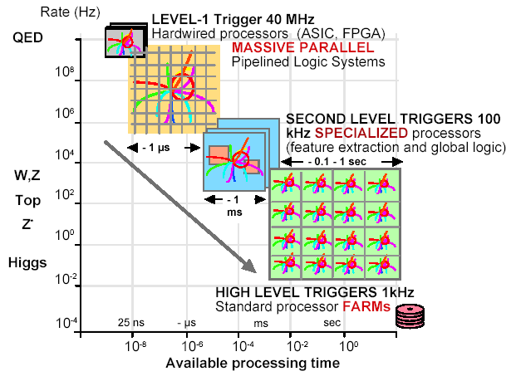
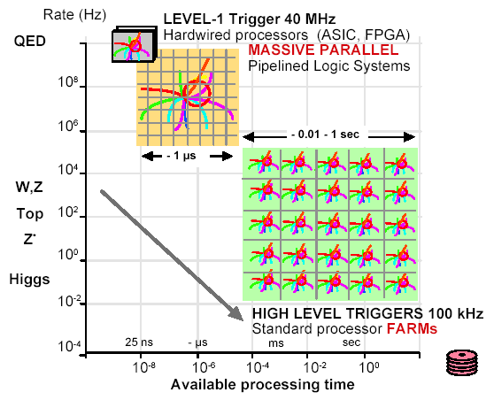
Trigger structures
3-step approach
Control logistics
Specialized processors
2-step approach
Bandwidth important
Commercial processors

Slide 57
Data flow in the CMS experiment
Tier 0
50 TeraFlops
To regional centers
10 Gbit/s
To regional centers
Remote
Remote
control rooms
control rooms
Controls:
1 Gbit/s
High Level Trigger
10 TeraFlops
Events Data:
10 Gbit/s
Controls:
Controls:
1 Gbit/s
1 Gbit/s
Raw Data:
2000 Gbit/s

Slide 58
The Level-1 trigger

Slide 59
The Level-1 trigger
The Level-1 trigger algorithms have to analyze every bunch crossing
To get a quasi-deadtime-free operation, pipelines (or electronic buffers) are installed at the detectors to cover the 3.2 μs time needed for the trigger decision
The decision is based on algorithms which are calculated by specific processors (=hardware)

Slide 60
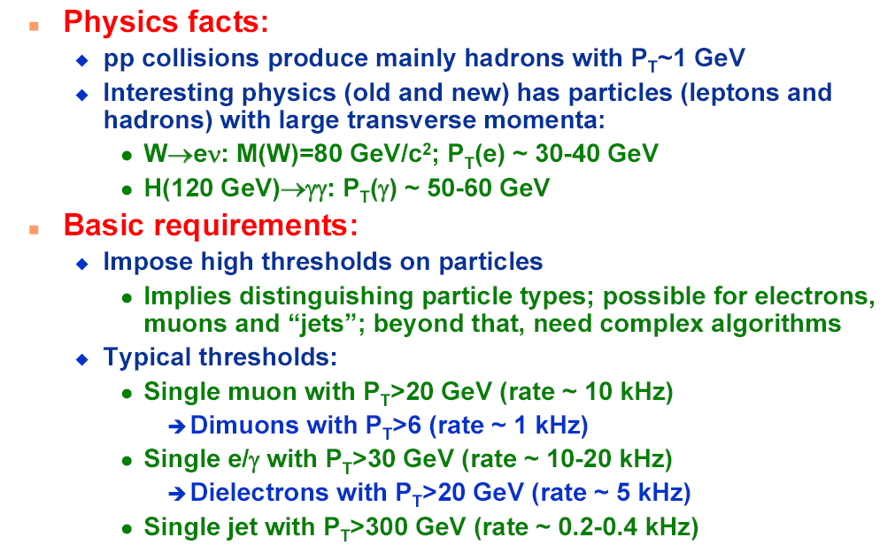
Level-1 trigger algorithms

Slide 61
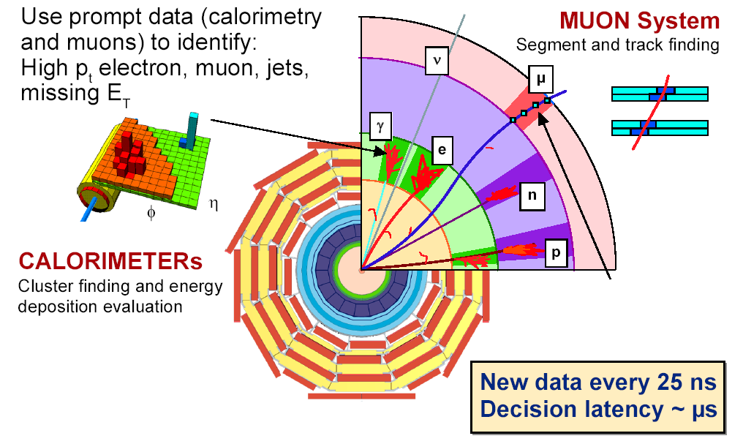
Signatures in the detector(s)

Slide 62

Signatures in the detector(s)

Slide 63

Level-1 trigger decision loop

Slide 64

Level-1 is hardware

Slide 65

The path of the signal...

Slide 66

Detector readout: front-end

Slide 67

Calorimeter system in CMS
The electro-magnetic calorimeter (ECAL) will help in the reconstruction of electrons and photons. It consist out of ~77k lead-tungstate crystals equipped with avalanche photodiodes in the barrel or vacuum phototriodes in the endcap.

Slide 68

Calorimeter system in CMS
The hadron calorimeter (HCAL) is important for the detection of hadronic jets from quarks, gluons or new particles, and also for the measurement of the missing energy resulting from a neutrino or a new very weakly interacting particle. These are sampling calorimeters of copper absorber plates interleaved with thick scintillator sheets.

Slide 69

Level-1 Calorimeter trigger

Slide 70

Level-1 Calorimeter trigger
The efficiency of triggering an event with a reconstructed electron of a given transverse momentum is important (trigger object not necessary the offline object as then we have more time to reconstruct all pieces in the detector).
To select the signal events (eg. Higgs bosons) among all proton collisions we apply cuts on the transverse momentum of the objects. High mass resonances produce on average objects like electrons with larger transverse momenta.
But we need to make sure that if we need electrons above p_{T}=25GeV/c that we get them on disk after triggering.

Slide 71

Level-1 Jet and τ trigger

Slide 72

Level-1 Jet and τ trigger
Similar efficiencies for τ and jets as for electrons. The resolution of these objects is however worse, hence the less sharp turn-on curve.

Slide 73

Muon system in CMS
The muon system consists out of several complementary techniques for example to suppress the amount of “ghost” muons.
Tracking algorithms are developed to construct the path of the muon candidate.
The RPCs or Resistive Plate Chambers are dedicated to the trigger system due to their good time resolution to check the bunch crossing time. They are complemented with the high resolution provided by the DT and CSC.
Hence we have two trigger subsystems which deliver independent information to the Global Muon Trigger.

Slide 74

Level-1 muon trigger
Similar efficiency function for muons as for electrons
For the muon Level-1 trigger several sub-detectors are combined to reduce the “ghost” muon candidates which are also triggering the system.
At a threshold at pT>25GeV/c a “ghost” rate of 0.07% and an efficiency for real muons of 90% is reached by taking the “AND” logic of the three sub-detectors (in |η|<2.4).

Slide 75

Level-1 trigger rates
The overall rate of online selected events is dropping fast with increasing thresholds. Need to tune the thresholds in order to fill the complete bandwidth of 100kHz with useful data events.

Slide 76
Level-1 trigger rates
Same challenges as at the Tevatron but higher energies, much higher luminosity & more interactions/crossing
Cut on E_{T} and p_{T} to discriminate against QCD backgrounds
  Higher E_{T} cuts than Tevatron needed
  More boost & don’t loose efficiency
Examples of unprescaled high p_{T} trigger thresholds and rates:
CDF Rates for 2x10³²cm⁻² s⁻¹, scaled from 3x10³¹ cm⁻² s⁻¹
LHC rates for 10³⁴ cm⁻² s⁻¹, from N. Ellis, LECC Workshop 2002 at Colmar

Slide 77

Global Level-1 trigger (CMS)
The decision is based on the algorithm calculations and on the readiness of the sub-detectors and the DAQ system, which is determined by the Trigger Control System (TCS).
Level-1 Trigger Objects used for the decision:
Jets: 4 central, 4 forward, 4 tau-tagged & multiplicities
Electrons: 4 isolated, 4 non-isolated
4 muons
Missing E_{T} and total E_{T}

Slide 78


Level-1 is hardware
This selection requires hardware very near to the detector, hence new technologies or evolving technologies when we go to larger interaction rates (ASICs for radiation tolerant on-detector electronics and FPGAs which are more flexible, and communication technologies).
ASIC: Application-Specific Integrated Circuits
FPGA: Field-Programmable Gate Arrays
Zeus Calorimeter Trigger:
16 9U Crates
CDF L1&L2 Calorimeter Triggers: 12 9U Crates

Slide 79




Level-1 is hardware
ZEUS
CDF
They look all the same, but use different techniques and serve different purposes
CLEO III
BaBar

Slide 80

Trigger and DAQ trends
Detectors become more and more complex, hence more and more read-out channels. Hence the event size in #byte is increasing demanding for larger bandwidths.
The luminosity of the accelerators is increasing as we search for more and more rare processes. Hence the Level-1 rate in Hz is increasing demanding for faster processors.

Slide 81
Level-1 summary
First step in the online selection of the collision events to be saved on disk, based on hardware deployed very near to the detector.
Large challenges for the LHC which deals with very high interaction rates (40MHz) and the detectors with a huge amount of read-out channels.
Pipelined system for 3μs to decide on the event, therefore uses only part of the detector information (calorimeter & muon systems). Remember most of the time is spend on the transportation of the signal through cables.
Reduce the rate from 40MHz to about 100kHz.
Complex process to optimize the use of the bandwidth (which is limited) to the next trigger step. Tuning of threshold requirements for each stream (eg. 1 electron, 1 electron isolated, 2 muons, 3 jets, …) results in a “trigger table” of the experiment. One should take into account the cross sections of the signal processes to be observed or discovered versus the rate of the background processes or the detector background consisting out of “fake” objects (eg. “ghost” muons).

Slide 82

DAQ system

Slide 83
The “Event Builder”
The main task of the DAQ system is to read the data corresponding to each event selected by the Level-1 trigger out of the detector Front-End Drivers (= the readout electronics specific to each type of detector). Beyond that to concentrate this into one data structure, called the physical “event”, and to forward this event to the filter farm for the final High Level decision if the event is to be written on disk or not for permanent storage. This complex system is called the “Event Builder”.
The main parameters of this system is dictated by the physics program of the experiment
  maximum Level-1 trigger rate of 100kHz
  maximum rate after the High-Level Trigger of 100Hz
  average event size of 1MB (dictated by the occupancy of the CMS detector channels)
This is implemented in several stages.

Slide 84

Main view of the DAQ system
40MHz
100kHz
1TB/s
100Hz

Slide 85

Data flow in proton collisions

Slide 86

Main view of the DAQ system
From fragments of the event in different read-out systems, to full events.

Slide 87

Main view of the DAQ system
The factorization of the DAQ functions into four tasks facilitates the design. Deep buffers allow to match the widely different operating rates of the elements at each stage.
  Detector read-out (fragments)
  Event building (switch network)
  Selection stage (High Level Trigger or HLT)
  Analysis/storage stage (computing services)
For example the FED delivers at a rate of 100kHz (every 10μs), but it takes the event building stage 1MB/2Gb/s=4ms to read the complete event.

Slide 88


Scalability of the DAQ system
The DAQ system is duplicated 8 times for which the deployment is staged (=flexibility). They are connected with a 8x8 switch network (FED Builder), hence for each event in the system there are 8 potential destinations as far as the Front-End information is concerned.
Basically one extra layer of switches allows to increase the DAQ performance when duplicating the full system which can come whenever the physics program requires.
input changes in size from FED to FED and from event to event

Slide 89

FED Builder specifications
The main functions of the FED Builder are:
  transport the fragments from the underground area to the surface
  assemble event fragments of variable size from some ~700 FEDs into 64 super-fragments of roughly equal size (16kB each)
  these super-fragments are given one of the 64 Readout Unit Builders in a particular DAQ slice
2kB output
(average!)
2kB x 100kHz
= 200MB/s
I/O switches
(average!)
has an output buffer to select the correct output port for each event
put associate trigger info in the correct Readout Unit Builder

Slide 90

Main view of the DAQ system
Close-up illustration between the FED and the Readout Units :
The size of the fragments of the event which are being formed is increasing (FED fragments of 2kB to super-fragments of 16kB on average).
The amount of links is being reduced.

Slide 91

Readout Unit Builder
Via a network of switches the event is built from the fragments deliver from the Front-End electronics of the detectors. At a rate of 12.5kHz (= 100kHz / 8 DAQ slices) and a mean event size of 16kB from 64 RUs = 1MB, the total sustained throughput of the switch fabric should be about 200MB/s (including event-by-event fluctuations).

Slide 92

High-Level Trigger

Slide 93

High-Level Trigger

Slide 94
HLT table
With each object or multi-object topology an HLT stream is defined based on software loaded on a multi-processor PC farm.
The tuning of the bandwidth to be allocated to which HLT stream is guided by the physics program of the experiment (eg. Higgs boson, SUSY, ... but also calibration issues).
It is important to check the trigger efficiency of the signal processes of interest and to adapt the trigger thresholds accordingly. Most of the new physics phenomena of interest are created at larger mass scales and therefore give objects at large transverse momenta.
At this point we use all relevant information in the event and the level of complexity of the HLT algorithms define the scale of the computing farm.
Next course on reconstruction tools.
Referentie:
http://arxiv.org/ftp/hep-ex/papers/0512/0512077.pdf

Slide 95

HLT table for low luminosity

Slide 96

High-Level Trigger
The amount of time needed to select the HLT object and the rate of these events after Level-1 trigger. This gives an estimate on how much computers are needed in the HLT farm for 15.1kHz of Level-1 trigger rate (calculations are of course evolving with the evolution of the computer processors). Today it results in about 2000 CPU’s for the start up of the LHC.

Slide 97

Summary of first part

Slide 98

Summary of first part
A modern particle physics detector has millions of readout channels and therefore hundreds of Front-End Driver. On top of this the event rate is very high.
Hence large amount of data has to be processed in a very short time.
Only a small fraction of the events can be stored on disk, hence very quick a decision has to be made on a complex multi-channel event.
The online data reduction is performed in several steps: electronics very close to the detector (Level-1 Trigger), a large bandwidth transfer system to built the event (DAQ system) and a more complex layer (High-Level Trigger)

Slide 99

Summary of first part
From signals in the FED’s to an event in my ROOT file…
The DAQ of such experiments is very complex and requires specific electronics and a multi-layer approach to built the events
The ideas can be applied for other experiments, but the implementation is specific for each (sub-)detector

Slide 100

Summary of first part

Slide 101

End
of
Part I

